Slide 1
Purdue Process Safety & Assurance Center (P2SAC)
- Pharmaceuticals -
Ray A. Mentzer
Professor of Engineering Practice
Associate Director, P2SAC
Charles D. Davidson School of Chemical Engineering Purdue University
May 10, 2022

Slide 3
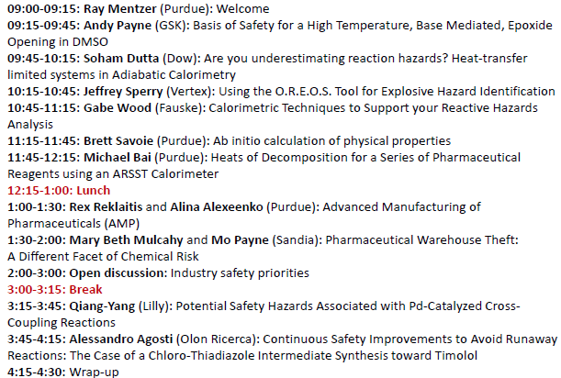
Process Safety in the Pharmaceutical Industry – May 10

Slide 4
May 2022 Conference Registration
Sponsors
ACC – Am Chem Council
AcuTech
AMGEN
Chevron
Corteva
CountryMark
Dow
Endress+Hauser
ExxonMobil
Fauske & Associates
GSK
Honeywell
Kenexis
Lilly
Marsh Risk
Phillips 66
Pfizer
SABIC
3M
Guests
Abbvie
ACS
ADAMA Agr Solutions
Air Products
Alliant Insurance Serv
AstraZeneca
AXA XL Insurance
BASF
BMS
CatSci Ltd
CCPS
CDC - NIOSH
Cenovus Lima Refin
Cook
Corden Pharma CO*
Cummins
DS*
DNV
Dr Reddy’s*
Evonik
ExecuPharma*
Exponent
Gilead
Grace*
Huntsman
Intact Insurance
ioMosaic
Johnson Matthey
JMJ*
LCCI – India
Langan Eng & Env*
Liberty Mutual Ins*
Northwestern Univ*
Olon Ricerca BioSc
PI Industries
Process Haz Mgmt Services*
Process Safety Core Consulting, LLC*
Promega Corp
Queen Mary U, London*
Sandia Nat’l Labs*
Smith Burgess
Snapdragon Chem
Syngenta Crop Protection
Tate & Lyle
Terminus Data Sci*
Thermal Haz Tech
Transpek Industry Ltd*
Univ of Wisc*
Vertex
Worley*
*denotes 1st meeting
On-going dialog with other Depts:
ABE, CHEM, IE, IPPH & ME

Slide 5
Growing P2SAC Research at all Academic Levels

Slide 6
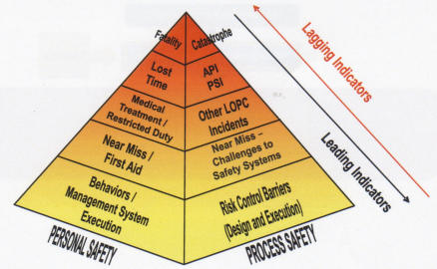
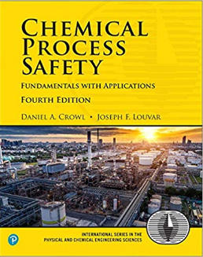
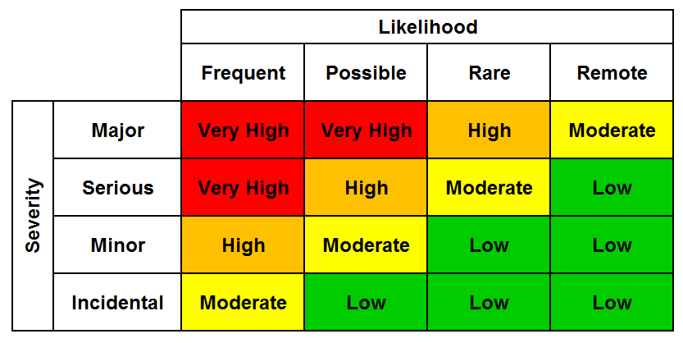
Chemical Process Safety - Core Class
Process Safety Metrics
Personnel vs. Process Safety
& Metrics
Applicable regulations: OSHA
PSM, EPA RMP, etc
Source Term Modeling
Toxicants & Industrial Hygiene
Toxic/Flammable Gas Release
Dispersion Modeling
Fire & Explosion Protection
Chemical Reactivity
Relief System Design
Hazards Identification (HAZOP, ..)
Risk Assessment (Matrix, QRA, ..)
Accident Investigations, CSB videos …
LOPA Frequencies
Typical 4x4 Risk Matrix
HAZOP

Slide 7
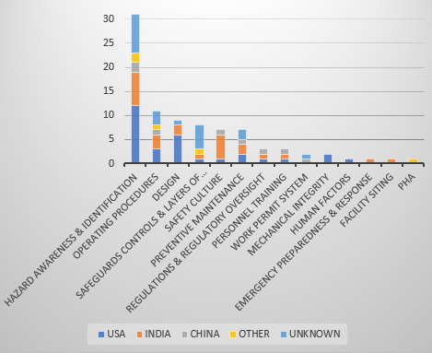
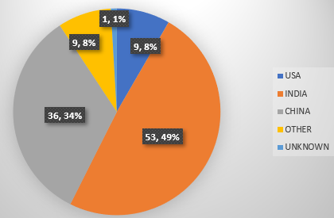
Global Process Safety Incidents in the Pharmaceutical Industry – PMP / UG
Analyzed 73 process safety incidents; 108 fatalities between 1985-2019
Identified and summarized trends between the number of incidents, number of fatalities, location, and contributing factors
Highest reported fatalities occurred in 2018 & 2019, 26 & 16, respectively
83% of fatalities occurred in China and India
Explosions associated with 71% of incidents, resulting in 89% of fatalities
Published: J Loss Prevention in Process Industries, 68, Nov (2020)
Number of Fatalities and Corresponding %
Number of Incidents vs. Contributing Factors

Slide 8
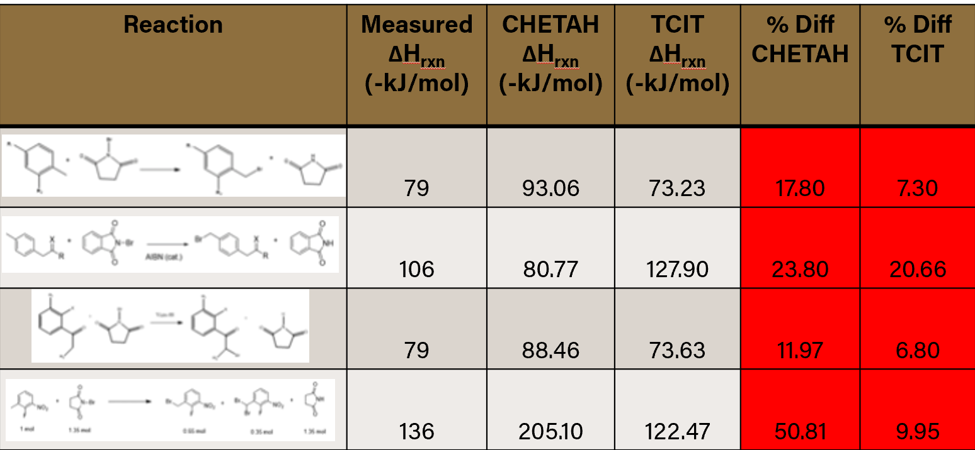
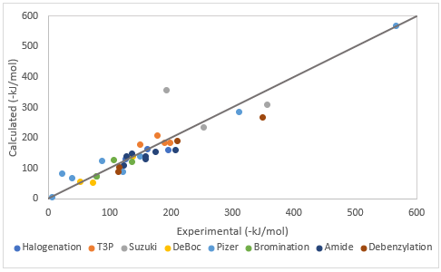
Predicting Heats of Reactions Common In Pharma Industry – UG / PMP
Research project used known reaction data from pharmaceutical companies, including Amgen, Corteva, GSK, JM, Lilly, Merck, and Vertex to compare to predictions of
CHETAH – widely used, licensed by ASTM since 1974, based on Benson groups
TCIT – novel Purdue methodology, combines quantum chemistry & G4 data
Programs calculate the heat of reaction when given the molecular structures
Study included: amide coupling, debenzylation, bromination, BOC deprotection, Suzuki coupling, T3P, and halogenation reactions
Example bromination reactions shown below, with TCIT parity plot on lower right
CONCLUSIONS: TCIT calculations generally within 20% with few exceptions; generally reasonable approximations with CHETAH but limited by substitutions; neither method can currently handle ionic and free-radical groups
Finalizing paper for publication

Slide 9
Benefits from Joining P2SAC
Direct engagement in suggesting & selecting process safety research projects at all levels – PhD, PMP and UG.
Priority in serving as mentor for process safety related Professional Masters Project of your choice.
Attendance at biannual meetings to review research progress and learn from outside expert presentations.
Sharing among companies of process safety learnings and challenges.
Contact with students as they develop process safety expertise and enhance the science.

Slide 10
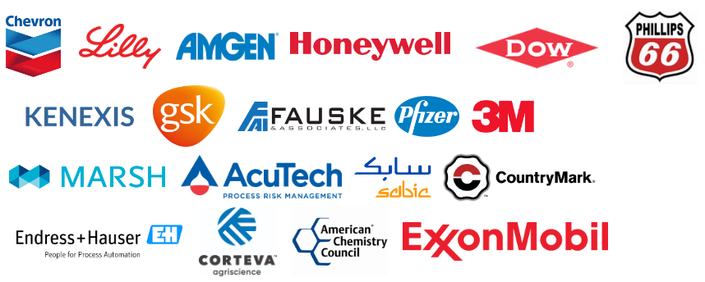
P2SAC Sponsors

