Slide 1
LOPA and Quantitative Bowtie Analysis Recognizing both Preventive and Mitigative Safeguards

Slide 2
Presenter
Jim McGlone
Technical Consultant and Chief Marketing Officer
Co-author of Security PHA Review for Consequence-based Cybersecurity
USN nuclear reactor operator and electronic technician on submarines
Nuclear Physics and Computer Technology undergraduate degrees, MBA international business
Rockwell Automation, Tridium (Honeywell), Ultra Electronics

Slide 3
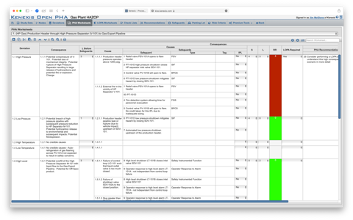
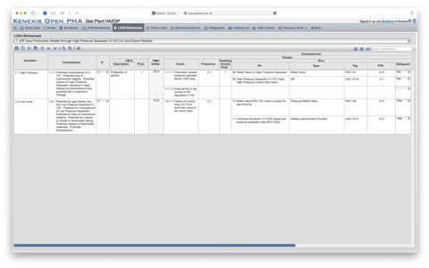
Risk Analysis Progression
In the beginning, there was HAZOP…
LOPA extended HAZOP through quantification of frequency
Better resolution and analysis than qualitative only
Allowed performance-based design processes such as IEC/ISA 61511
“Worksheet” presentation and highly numerical nature loses visual thinkers
Bowtie diagrams separately developed as method for visualizing risk scenarios
Primarily used for important high-consequence scenarios
Communicate risk to a variety of stakeholders
Example from Open PHA showing a HAZOP on top and a LOPA on bottom

Slide 4
Overview
Layer of Protection Analysis (LOPA) is ubiquitous in process hazard analysis (PHA) and safeguard design
LOPA suffers from limitations
One cause, one consequence
Multiple causes required to aggregate risk (critical for SIS design)
Multiple consequences required to design consequence mitigation measures
Unified Hazard Assessment developed to combine disparate risk analysis techniques
Quantitative Bowtie Analysis extends LOPA and addresses shortcomings
Unified Hazard Assessment
PHA was initially “check the box” – minimum compliance and minimum cost
Value found in PHA information, expanded to other purposes
LOPA – for SIS safety integrity levels
Hazard Registers – tracking and understanding of significant hazard scenarios
Bowtie diagrams – visualization of hazard scenarios
Maximizing usefulness of data developed during PHA will require changes in data structure and practices

Slide 5
Typical Bowtie Diagram
CAUSE(S)
PREVENTIVE
Event
MITIGATIVE
CONSEQUENCE(S)
Example from Kenexis Bowtie

Slide 6
Extended Bowtie Diagram for Degradation
CAUSE
PREVENTATIVE
DEGRADATION
Example from Kenexis Bowtie

Slide 7
Early LOPA – One Cause - One Consequence
Example from an early LOPA book published by the AICHE

Slide 8
Early LOPA in “Spreadsheet” Format
CAT = CONSEQUENCE CATEGORY
S = SEVERITY
TMEL = TARGET MAXIMUM EVENT LIKELIHOOD
IPL = INDEPENDENT PROTECTION LAYER
PFD = PROBABILITY OF FAILURE ON DEMAND
MEL = MITIGATED EVENT LIKELIHOOD
RFF = RISK REDUCITON FACTOR
Example from Open PHA showing a LOPA worksheet

Slide 9
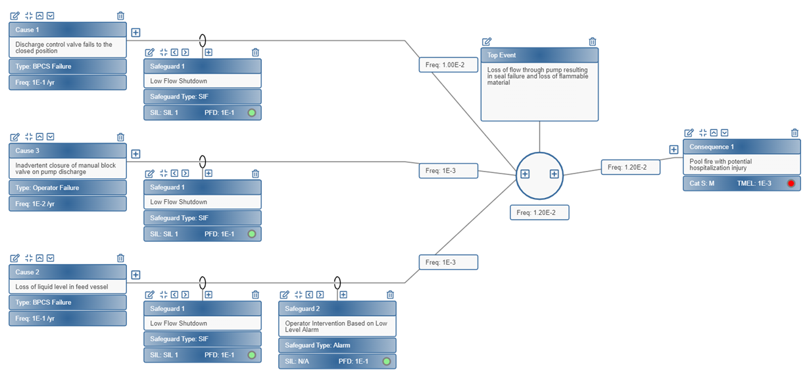
Mathematical Underpinning of LOPA
Frequencies and Probability are combined based on logic
Logical ‘AND’ – Probability Multiplication
Relation between initiating event and independent protection layers
Logical ‘OR’ – Probability Addition
Relation between multiple initiating events
Example from Kenexis Bowtie

Slide 10
LOPA with Multiple Causes
Example from Open PHA showing LOPA with multiple Causes

Slide 11
LOPA with Multiple Causes Converted to Quantitative Bowtie
Example from Kenexis Bowtie

Slide 12
Handling Conditional Modifiers - One Consequence
Example from Kenexis Bowtie

Slide 13
Multiple Consequences – Conditional Modifiers
Example from Kenexis Bowtie

Slide 14
Handling Mitigative Safeguards Traditionally
Mitigative safeguards reduce but do not prevent consequence
Options
Ignore safeguard – no credit taken
Ignore consequence if safeguard is effective (residual consequence)
Assumes that mitigative safeguard never fails
Kludge together multiple LOPA scenarios, one for each consequence

Slide 15
Quantitative Bowtie of Tank Dike Example
Examples from Kenexis Bowtie

Slide 16
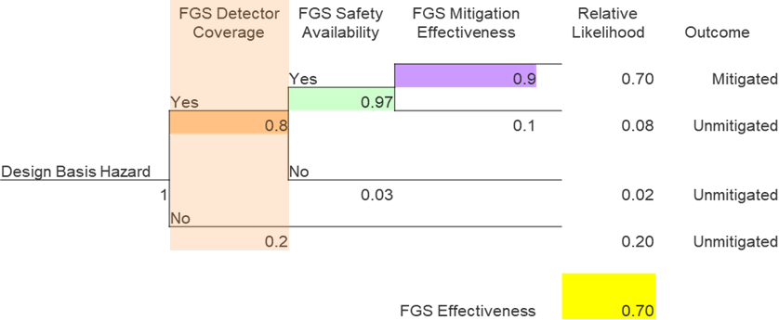
Analysis of Fire and Gas Detection
Mitigative Safeguard, ineffectiveness can stem from
Probability of failure on demand of equipment
Detection Coverage
Mitigation Effectiveness
Example from ISA TR 84.00.07-2018 Guidance On The Evaluation Of Fire, Combustible Gas, And Toxic Gas System Effectiveness

Slide 17
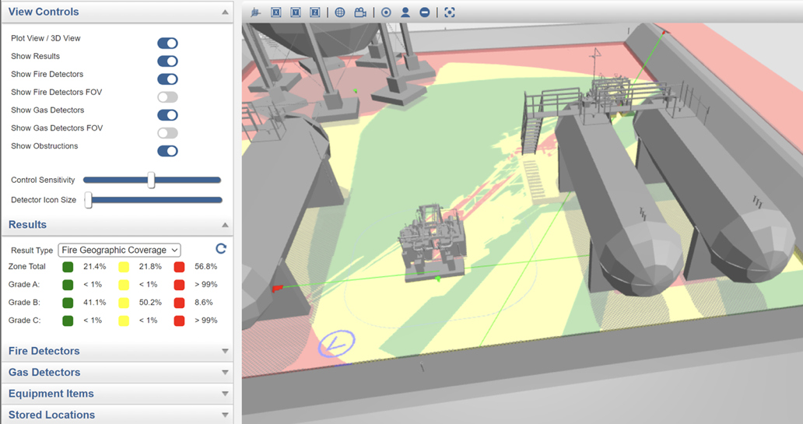
Calculation of Fire Detection Coverage
Example from Kenexis Effigy – fire & gas mapping software

Slide 18
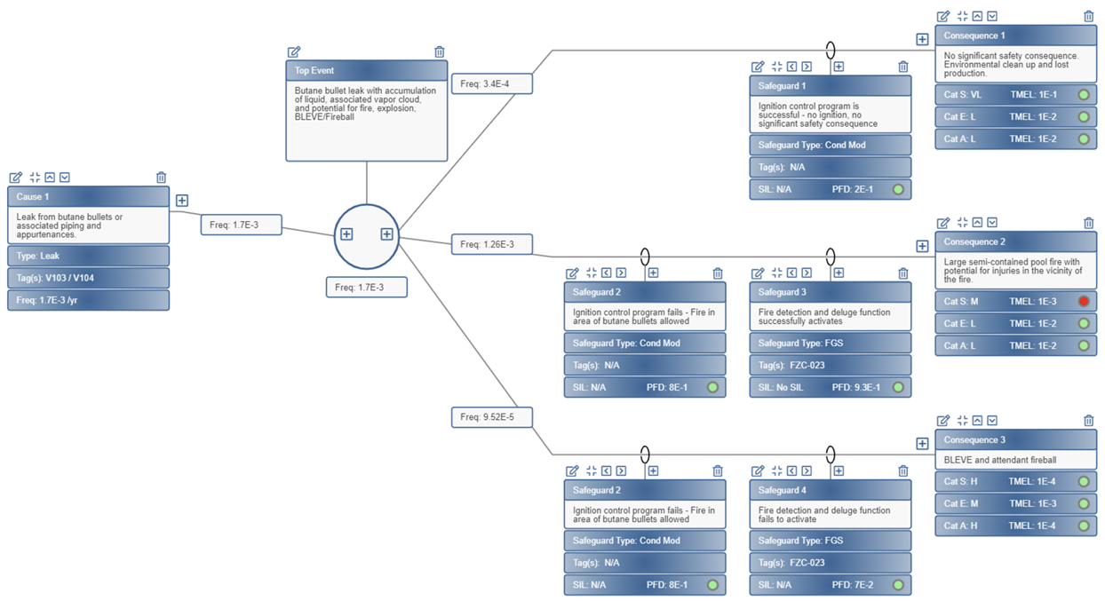
Quantitative Bowtie of Fire Detection/Deluge
Example from Kenexis Bowtie

Slide 19
Conclusions
LOPA is ubiquitous and will continue to be used
Dump LOPA data to Bowtie using UHA to extend to meet the full range of required applications and use cases
Quantitative bowtie encompasses all current LOPA capabilities and expands to include multiple consequence outcomes
Quantitative bowtie allows for elegant assessment of effectiveness of mitigative safeguards
Quantitative bowtie provides a broader and more visual representation of risk scenarios

