Slide 1
Heats of Decomposition for a series of pharmaceutical reagents using an arsst calorimeter
Michael Bai
Mentored by PhD Candidate Bonn Cao and Professor Ray Mentzer
Notes:
Title Slide: Introduce myself, Bonn, and Professor Mentzer, and then the name of the project.

Slide 2
Agenda
Project Description
Background
Procedure and Safety
Results
Methodology and Analysis
Conclusion and Recommendations
Future Work
Notes:
Outline/TableofContents (TOC) of presentation.

Slide 3
Partnership with Industry
Data Collection, Collaboration and Providing Chemical Samples
Notes:
Companies that provided support. GSK provided ARC data for TBHP, Lilly provided some of the tested materials, and Fauske provided not only the calorimeter but also help in calculations, data checking, and troubleshooting. It'll be something like
"And before I begin, I'd like to thank these companies – Fauske & Associates, GSK, and Lilly – for making this research possible" or something along those lines.

Slide 4
Project Description
Purpose
Chemical property data is important for a variety of purposes
Knowing how certain chemicals behave can influence safe handling procedures
Heat of decomposition can be used to estimate the risk of runaway decomposition
Objective
Determine the heats of decomposition for several pharmaceutical reagents
Identify which of these chemicals may pose potential safety risks based on this information
Compare data to existing literature values to evaluate the accuracy of the ARSST measurements
Notes:
Quick descriptor of the background info/purpose of the project, and its objective.
"The main purpose of this project is to gain more data regarding the heats of reaction – or in this case, the heats of decomposition of these pharmaceutical reagents. The heat of reaction is an indication of the amount of energy when a chemical undergoes a reaction – in this case, a decomposition reaction. This heat of decomposition can be used to estimate the risk of a chemical experiencing a runaway thermal reaction – an exothermic reaction can lead to such a scenario. This project is designed to determine these heats of decomposition, as well as to

Slide 5
Background
Heat of Reaction
A relative measure of the amount of energy in the form of heat that is released or absorbed by a chemical reaction
When examining a decomposition reaction, is known as "Heat of Decomposition"
Correctly determining this value gives information on how dangerous that chemical is during decomposition
More exothermic = greater potential hazard
An exothermic decomposition can be an indicator of potential thermal runaway: a dangerous uncontrolled reaction where a decomposition releases a large amount of energy in a short time due to a self-sustaining decomposition reaction
Notes:
First, some background regarding this project. The properties of a substance are vital in understanding how it behaves, reacts, and what it is capable of. The heat of reaction is one such property, and represents the change in energy a reaction can cause per gram of reagent. In this case, the reactions being studied are decomposition reactions for pharmaceutical reagents. The more exothermic these decompositions are, the more energy they release, and the more dangerous they can be. In certain cases, a decomposition reaction may become a runway decomposition – a dangerous type of self-sustaining reaction that can release a large amount of energy very quickly, usually in the form of a fire or an explosion. As such, using calorimetry to determine these properties beforehand – so that risks may be evaluated and safety measures put in place – is vital.

Slide 6
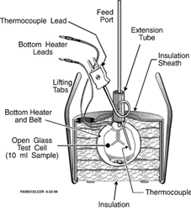
Apparatus
Advanced Reactive System Screening Tool
A type of calorimeter, developed by Fauske & Associates
Has a low thermal inertia (phi factor) of about 1.05 (1)
Relatively short testing time
Useful for initial screening
Has mixing
Figure 1: ARSST internal test cell assembly (2)
Notes:
The system used in this project is the Advanced Reactive System Screening Tool, or ARSST. It is a type of calorimeter, developed by Fauske & Associates. Like all calorimeters, the ARSST system detects changes in internal heat in the form of changes in both temperature and pressure. Its advantages are its low thermal inertia compared to other calorimeters – which allows it to more closely mimic an adiabatic system – and its relatively short testing time of only a few hours – compared to the few days other calorimeter types may require. This makes it ideal for a project such as this, wherein initial screening data is required for several chemicals.

Slide 7
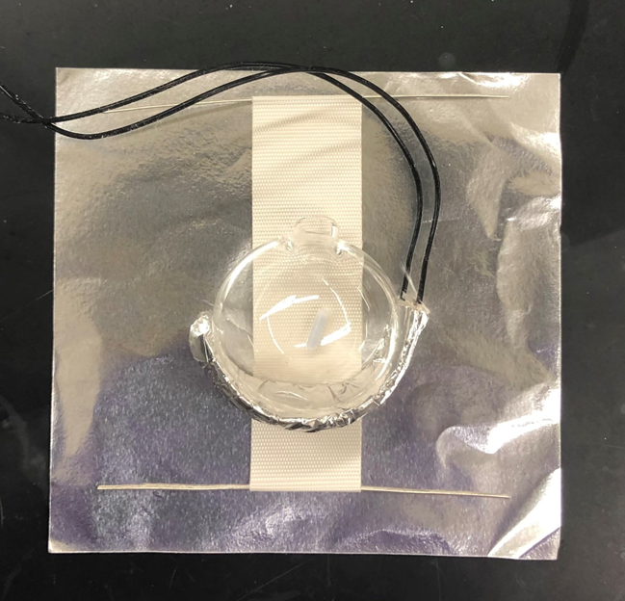
Procedure - 1
ARSST Operation
Pre-set Heating Polynomial controls heating rate
2 °C/min, 300 psig
Test bulb is assembled, loaded with a sample, and placed inside the calorimeter insulation
Thermocouple sensors are attached, wires connected, and vessel sealed and pressurized with nitrogen
ARSST is activated from attached computer
Calorimeter is typically left to run for a few hours
Upon return, data is collected, and cleanup
procedures begin
Notes:
Operation of the ARSST is relatively simple. First, a heating cell assembly must be constructed. This starts with a glass sample bulb, which is wrapped in a heating jacket, insulation jacket, and aluminum foil – in that order – as depicted in this picture here. A small magnetic stir bar is then inserted into the cell, and the components are wrapped around it. Care must be taken when doing this, as the cells are very fragile. After this, the wrapped cell is placed inside a layer of cotton insulation, and is then loaded inside its metal assembly into the calorimeter vessel itself. After this, the heating wires are connected, the thermocouple probe is attached to the test cell neck, and the vessel is sealed - using vacuum grease to ensure an airtight seal. After this, pressurization occurs – in this case to about 300 psig. The test is started from the ARSST box and the computer after the stir plate below the ARSST vessel and the heater switch on the ARSST box is activated. To ensure functionality, the system can be watched for about a minute or so, to ensure that the temperature increases and that all parameters are within acceptable values.

Slide 8
Procedure - 2
ARSST Cleanup
During cleanup, the vessel is depressurized, and the tested chemical sample is disposed of.
Acetone, Millipore water, and methanol can be used to remove solid residue from inside the test cell before disposal.
The test cell must be disposed with glass waste.
For DMSO or other hazardous chemical cleanup, special safety procedures are required.
Any expendable consumable components are disposed of properly.
The vessel is cleaned, all component functionality is checked, and the system is stored safely.

Slide 9
Chemical Abbreviations
DCP: Bis(1-methyl-1-phenylethyl) peroxide, Bis(α,α-dimethylbenzyl) peroxide, dicumyl peroxide,
TBHP: 1,1-Dimethylethyl hydroperoxide, tert-butylhydrogen peroxide
HATU: 1-[Bis(dimethylamino)methylene]-1H-1,2,3-triazolo[4,5-b]pyridinium 3-oxid hexafluorophosphate
HBTU: (2-(1H-benzotriazol-1-yl)-1,1,3,3-tetramethyluronium hexafluorophosphate
HCTU: 2-(6-Chloro-1-H-benzotriazole-1-yl)-1,1,3,3-tetramethylaminium hexafluorophosphate
PyBOP: Benzotriazole-1-yl-oxy-tris-pyrrolidino-phosphonium hexafluorophosphate
TBTU: 2-(1H-Benzotriazole-1-yl)-1,1,3,3-tetramethylaminium tetrafluoroborate
DMSO: Dimethyl Sulfoxide
DMS: Dimethyl Sulfide
TEMPO: (2,2,6,6-Tetramethylpiperidin-1-yl)oxyl
PyOXIM: [Ethyl cyano(hydroxyimino)acetato-O²]tri-1-pyrrolidinylphosphonium hexafluorophosphate
5-Amino: 5-amino-3,4-dimethylisoxazole
Notes:
These are just some of the abbreviations I'll be using – primarily in graphs and tables – for the various chemicals used in this project. Those chemicals listed below in red are those which will be mentioned later in this presentation, but which did not produce analyzable results.

Slide 10
Safety, Health, and Hazard Considerations - 1
Safety and Health Risks
Standard PPE is required
Lab Coat
Eye Protection
Disposable Gloves
Before testing, always check all component resistances for functionality
Make sure the system is properly grounded before testing
Always check Safety Data Sheets (SDS) for all tested chemicals
Beware toxicity, chemical incompatibilities and high-energy reactions
System is designed with a rupture disc, and with auto-shutoff parameters
Notes:
Of course, safety is a priority when performing any sort of scientific procedure. Standard PPE is required when using the ARSST: lab coat, eye protection – like lab goggles – and disposable gloves are all standard. All components should be checked for potential damage or shorts before testing, and any suspect components should be replaced whenever possible. Proper grounding should also be confirmed before starting a test. Last but certainly not least, the MSDS' should always be thoroughly examined and studied prior to any chemical test, to avoid potentially hazardous reactions, substances, products, or chemical incompatibilities.

Slide 11
Safety, Health, and Hazard Considerations - 2
Dimethyl Sulfoxide Decomposition
Dimethyl Sulfoxide (DMSO) was a primary solvent used in this project.
In the presence of acids, Dimethyl Sulfoxide reacts to form formaldehyde.
Decomposes to form methanethiol, also known as methyl mercaptan.
DMSO also releases and contains Dimethyl Sulfide (DMS), which has an unpleasant smell and as such is easily detectable.
To neutralize any potential hazardous chemicals, a solution of 10% by wt. Sodium Hydroxide in Water and Epoleon Deodorizer was used.
After testing, the gases within the calorimeter were slowly bubbled through this solution with a fritted disc.
A nitrogen flush should be done after depressurization, using a small amount of nitrogen to cycle and remove the potentially hazardous gases within the calorimeter.
A respirator is required for these procedures, as well as during cleanup after a test involving DMSO.
Notes:
One of the primary solvents used in this project was Dimethyl Sulfoxide, or DMSO. The usage of this solvent required additional safety procedures, such as the introduction of a gas purge and nitrogen flush step. The reason for this is the dangerous chemicals that DMSO can decompose into – namely, methyl mercaptan, formaldehyde when reacting with an acid, and dimethyl sulfide. Methyl mercaptan and formaldehyde are toxic, and dimethyl sulfide (also known as DMS) – while not as dangerous as the previously mentioned substances – has a pungent odor, is unpleasant, and should not be inhaled freely – any chemical can be dangerous in a sufficient quantity. To start, a respirator is needed when exposure to these chemicals is a possibility. When depressurizing the vessel after a test involving DMSO, the nitrogen and other gases contained within the vessel should be bubbled through a fritted disc into a solution of 10% by weight Sodium Hydroxide in water and Epoleon deodorizer. The sodium hydroxide will neutralize the methyl mercaptan and formaldehyde, while the Epoleon deodorizer will neutralize the unpleasant odor of the DMS.

Slide 12
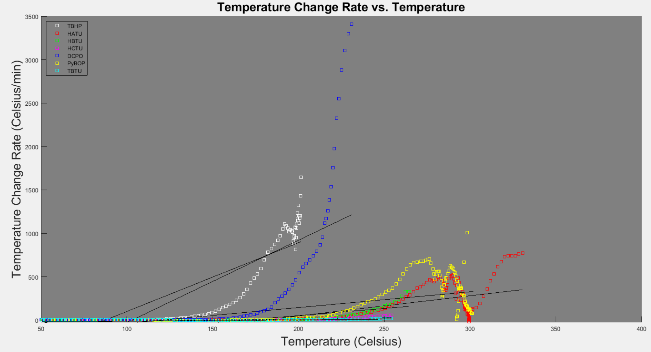
Results - 1
Onset Time and Temperature Determination
Notes:
This graph instead shows the rates of temperature change over time for each of the test. This data has been truncated as well: this time, to remove a large portion of the initial region of heating- represented by these flat-ish regions here. These fluctuations are the result of electrical noise within the data, which as can be seen is sometimes present – and sometimes not. In each data set, the colored region represents the totality of the temperature rate change data. These black regions are the regions examined to determine the onset temperature region, and these dotted lines are the linear fits used to ultimately calculate the time of onset temperature – which can then be used to find the onset temperature itself.

Slide 13
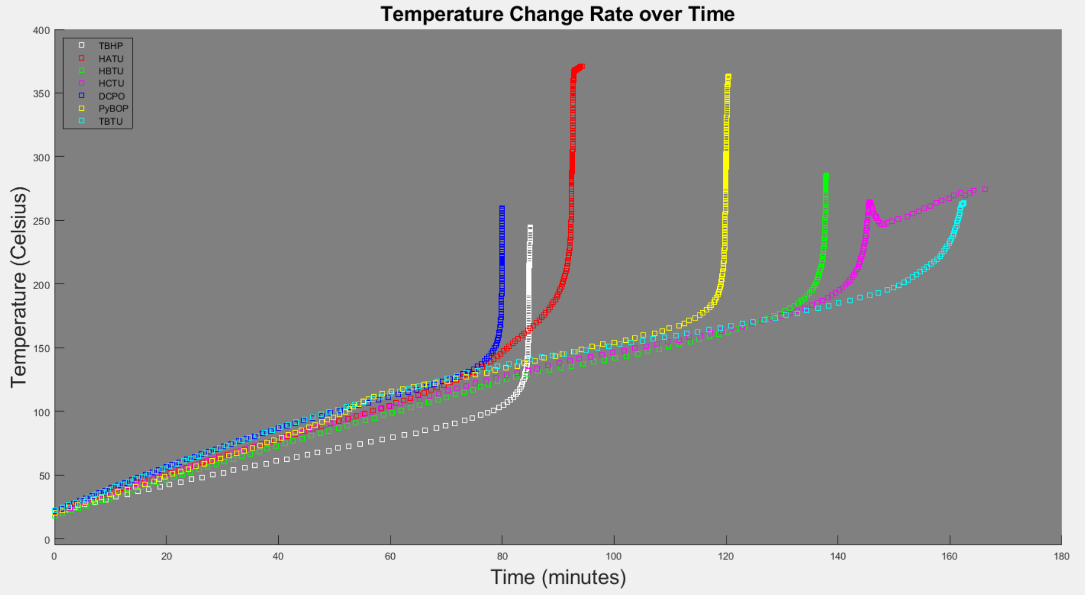
Results - 2
ARSST Temperature Data
Notes:
Now, onto the results. This graph shows the temperature data collected from the calorimeter itself. More specifically, these are the regions of interested analyzed – the cooling data produced after each test is not very useful, and as such can safely be ignored. The major points of interest are the initial temperature spikes shown here. These spikes indicate an exothermic reaction, with the steepness of each spike indicating the speed at which the decomposition occurred. Most of these chemicals follow a similar pattern, with two visible exceptions: HCTU and TBTU. TBTU has a much less aggressive slope – indicating a slower and thus less immediately energetic decomposition. HCTU shows an intiial spike, comparable to that of HBTU to its left in the green, but also shows continued heating after this spike. This may be indicative of a two-stage decomposition reaction, wherein the decomposition of the intermediate products continued to release energy into the system.

Slide 14
Results - 3
Heat of Reaction, Onset Temperature, and Adiabatic Temperature Change
Chemical Sample | Phi Factor ϕ | T_{Onset} (°C) | T_{Max} (°C) | Adiabatic Temperature Change (°C) | Heat of Reaction (J/g)
HATU | 1.069 | 179.8 | 371 | 191.2 | -1510.6
HBTU | 1.094 | 169.3 | 285.2 | 115.9 | -1096.2
HCTU | 1.099 | 150.1 | 274.3 | 124.2 | -844.8
DCP | 1.102 | 103.2 | 259.3 | 156 | -516.9
TBHP | 1.103 | 87.6 | 244.4 | 156.9 | -297.1
PyBOP | 1.062 | 154.6 | 363.2 | 208.6 | -1452
TBTU | 1.098 | 184.6 | 263.8 | 79.2 | -1284
Notes:
So these are the determined results from this project. This includes the maximum temperatures each sample reached, the onset temperature that the decompositions began at, as well as the total adiabatic temperature changes and the final heats of reaction in joules per gram. The previous temperature spikes all demonstrate that these reactions were exothermic, and this supported by the negative values for each of these heats of reaction – indicating that energy was released by the decomposition reactions.

Slide 15
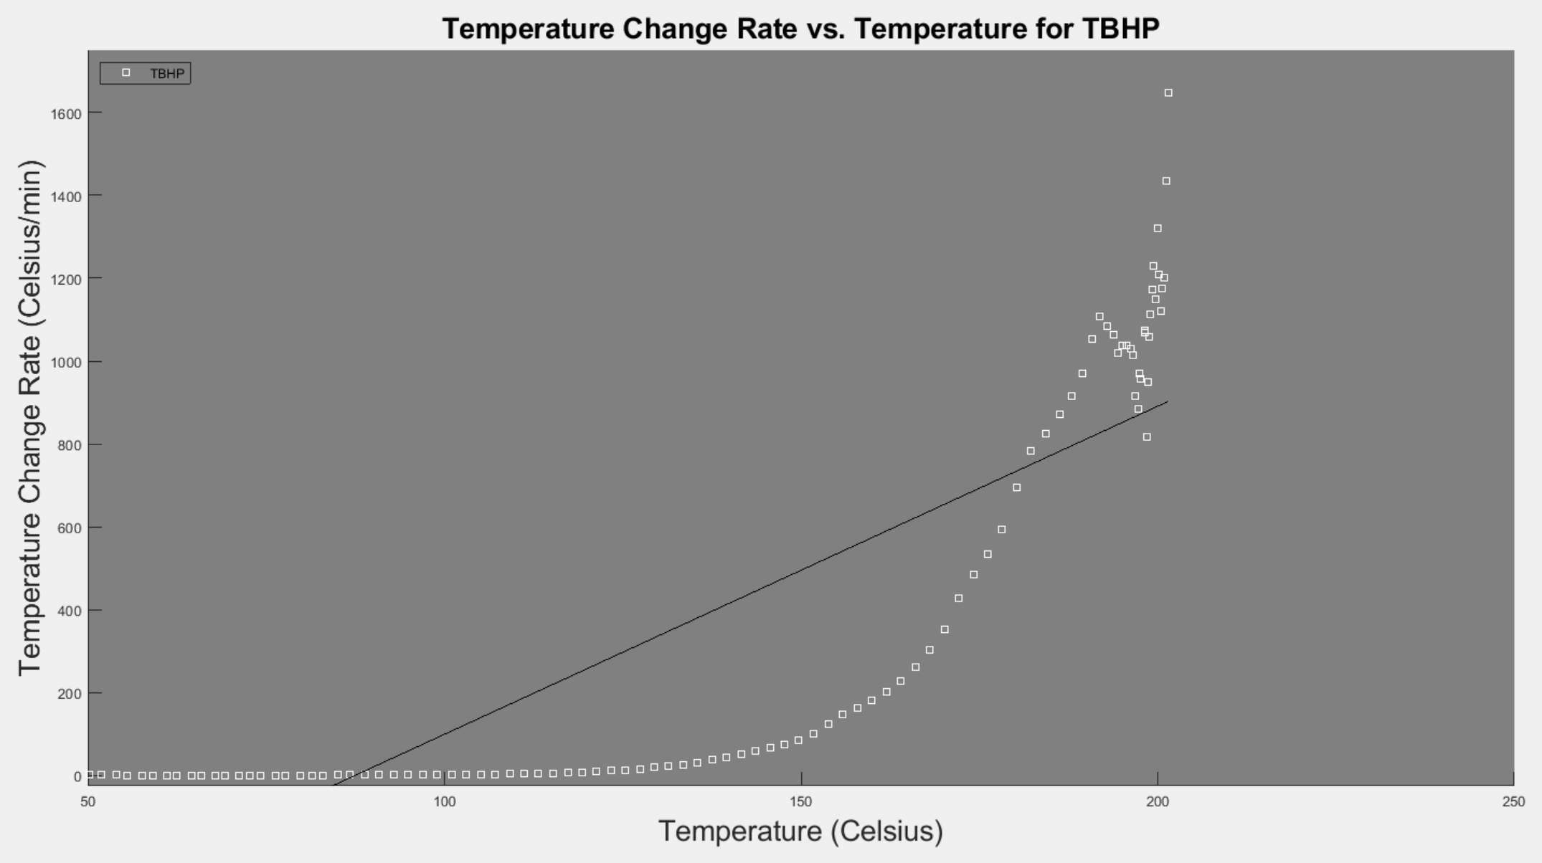
Methodology - 1
Finding Onset Temperature and Adiabatic Temperature Change (ATR)
Linear Fit between Max Temperature Change and Initial Temperature Change Rate gives Onset Temperature
Adiabatic Temperature change formula is as follows:
Notes:
In order to find the onset temperature, the linear fits previously described were used. This is an example graph of the previous data, this time showing only the data for tert-butylhydrogen peroxide, or TBHP. This white region represents the totality of the data, while the black solid region here is the region examined to find the onset time. This is found using a linear fit between the maximum rate of temperature change – at the top here – and fitting it to the average value of the external temperature change, which is also the initial heating rate of the sample prior to decomposition. That's this fluctuating region here, with those fluctuations being due to electrical noise. This variation is controlled for by taking the change in temperature between the 20th and the first points, as well as the change in time between those points and using this information to find the average rate of temperature change. This intersection here is the time of decomposition onset, which can be used alongside a linear interpolation to find the temperature of the decomposition onset.

Slide 16
Methodology - 2
Calculating the Heat of Reaction (3)
Phi factor: Thermal inertia; a measure of how well the system approximates an adiabatic system
Xo: Conversion at onset (assumed to be 0, as decomposition does not occur before onset)
Cps: Heat capacity of the sample, found using CHETAH
(ΔTAB): Adiabatic temperature rise
ΔHR: Heat of Reaction
Notes:
Using the adiabatic temperature change previously found, the heat of reaction for the decomposition reaction of the substance can be found. This starts with the determination of the thermal inertia of the system, represented here by the phi factor. This approximates how well this system mimics a perfectly adiabatic system, with a value closer to 1 being more adiabatic. The heat capacity was provided using the CHETAH tool for estimating heat capacities of substances. Within this test, the heat capacity for HBTU was also used for HATU ,HCTU, TBTU, and PyBOP due to their similar structures. These allow for the determination of the heat of reaction of the tested substance.

Slide 17
Comparison to Existing Literature Data
Reagents of Interest | ARSST Heats of Decomposition (J/g) | DSC Heats of Decomposition (J/g) | % Difference from Literature Values (Heat of Decomposition)
HATU | -1510.6 | -1131 | 33.6
HBTU | -1096.2 | -1032 | 6.2
HCTU | -844.8 | -845 | .02
PyBOP | -1452 | -1020 | 42.4
TBTU | -1284 | -1206 | 6.5
Comparison of Heats of Decomposition and Onset Temperatures between ARSST and DSC Analyses by Sperry (4)
 | ARSST | ARC | % Difference from Literature Values
T_{Onset} (°C) | 87.6 | 90.05 | 2.8
Comparison of Onset Temperature of 70% TBHP in Water between ARSST and ARC Tests (5)
 | ARSST | ARSST Simulation | % Difference from Literature Values
T_{Onset} (°C) | 103.2 | 106.45 | 3.0
T_{Max} (°C) | 259.3 | 176.85 | 46.6
Heat of Decomposition (J/g) | -516.9 | -1075 | 51.9
Comparison of Heats of Decomposition of 40% DCP in Ethylbenzene between ARSST and ARSST Simulation (6)
Notes:
Comparisons were carried out between the determined values and existing literature values. When compared to the values found in a presentation titled "Inherently Safer Process Design: Assessing the Thermal Stability of Common Peptide Coupling Reagents," the onset temperatures and heats of decomposition show some difference. However, the values are in general relatively similar, with the most extreme difference in heat of decomposition being in TBTU – with a difference of about 500 j/g.
Another source of comparison was provided by Mr. Roy Flanagan of GlaxoSmithKline, as he provided onset temperature comparison data gathered via an Accelerating Rate Calorimeter, or ARC system. The determiend onset temperatures for these substances turned out to be very similar.
Lastly, a comparison was made between the decompsition of Dicumyl Peroxide (DCP) in ethylbenzene and a simulation of such a decomposition in an Arsst by Marco et al. As can be seen, the tested sample reached a much higher maximum temperature, but the heats of decomposition were relatively similar.

Slide 18
Chemicals and Trials
Chemical Name | Number of Trials | Reasons for Retrials
PyBOP | 2 | Sample failed to reach onset temperature
TBTU | 3 | Sample failed to dissolve: Incorrect Solvent Sample failed to reach onset temperature
TEMPO | 2 | Solid sample failed to remain in contact with thermocouple Sample failed to reach onset temperature
PyOXIM | 2 | Sample failed to dissolve: Incorrect Solvent Sample failed to reach onset temperature
5-Amino | 5 | Sample failed repeatedly to reach onset temperature Excessive solvent vaporization
Notes:
One of the key things to note is that these values were not found using simply one trial per chemical. In fact, several chemicals required multiple trials to produce results, and some never did. This is due to a variety of external factors, with some of them listed here. It took several tries to get PyBOP and TBTU to decompose, though unfortunately due to time constraints and repeated issues, I was unable to gain relevant test data for either TEMPO or PyOXIM.

Slide 19
Conclusions and Recommendations
All tested samples show exothermic decomposition
Most energetic samples (HATU, HBTU, PyBOP) are most at risk for runaway decomposition
Some similarity to literature heat of decomposition values implies some consistency, though further comparison and tests are required
Onset temperatures are affected by system parameters: inconclusive
Average difference: 21.4%
Due to risk of runaway reaction or exothermic decomposition, care must be taken when handling these chemicals
Isolated storage and careful temperature regulation
Removal of potential ignition sources
Notes:
In closing, the tested chemicals all turned out to exhibit exothermic tendencies. The most exothermic substances – as can be told by the magnitudes of their heats of reaction – were HATU, HBTU, TBHP, and PyBOP. When compared to literature values, the determined values from this study were somewhat accurate – with differences ranging in the . This implies that the ARSST is capable of producing results similar to those produced by other forms of calorimetry. With regards to the exothermic nature of these substances, care must be taken to avoid potential runaway decomposition and the risks such an event present. This includes methods such as isolated storage and temperature regulation, so as to avoid unexpected decomposition of these substances. Another basic safety procedure that applies to this – and all – substances is limiting and removing any unnecessary potential ignition sources, so as to prevent the required energy from starting a runaway decomposition reaction.

Slide 20
Future Work/Next Steps
Additional tests should be carried out to ensure the accuracy and validity of the determined values
Alternate calorimetry methods – ARC, DSC
Alternate solvents
Additional chemical tests
Alternate pressures and heating polynomials/ARSST settings
Further study should also be conducted into the products of the decomposition reactions studied, to determine their potential toxicity and decomposition product compositions
Notes:
In the future, additional tests can be performed to ensure the accuray and validity of these determined values. This could be done via alternative calorimetry methods – such as through the use of the ARC, or through Differential Scanning Calorimetry – better known as DSC – as well as with solvents other than DMSO. Other chemical samples can of course be run, to determine their heats of reaction, and of course alternate settings or heating polynomials on the ARSST itself can be used to check these reactions again. Further studies could and should also be carried out to examine the biproducts of these decompositions, to determine their toxicity and the composition of these products.

Slide 21
Acknowledgements
A special thanks to those who helped to make this project possible:
Graduate Mentor
Bonn Cao
Research Advisor
Professor Ray Mentzer
Help with running the ARSST and examining ARSST data
Miss Elizabeth Raines of Fauske & Associates
Help with running and maintaining the ARSST:
Gabe Wood of Fauske & Associates
Providing multiple tested reagents
Han Xia of Eli Lilly and Company
Providing comparison data for TBHP from an ARC:
Roy Flanagan of GlaxoSmithKline
Notes:
I'd like to make a special thanks to everyone who helped to make this project possible. This includes my Graduate Mentor Bonn Cao, and my Research Advisor Professor Ray Mentzer. I'd also like to thank Miss Elizabeth Raines of Fauske & Associates for her help in understanding the ARSST data and learning how to run the ARSST, as well as Mr. Gabe Wood – I think he's over there – with his help in learning how to maintain and running the ARSST, as well as for his help in fixing the ARSST. Lastly, I'd like to thank Mr. Roy Flanagan of GlaxoSmithKline for providing comparison data for TBHP from an Accelerating Rate Calorimeter, as well as Dr. Han Xia of Eli Lilly and Company for providing several of the chemical samples tested during this project.

Slide 22
References
Crowl, D. A.; Louvar, J. F. In Chemical Process Safety: Fundamentals with Applications; Pearson: Boston, 2019; pp 349.
Burelbach, J. P. Advanced Reactive System Screening Tool (ARSST).
Raines, E. Calculating Heat of Reaction from Adiabatic Calorimetry Data... https://www.fauske.com/blog/calculating-heat-of-reaction-from-adiabatic-calorimetry-data (accessed Apr 5, 2022).
Sperry, J. B. Inherently Safer Process Design: Assessing the Thermal Stability of Common Peptide Coupling Reagents, 2016.
Flanagan, R. RE: Purdue - ARSST Measurements on Pharma Reagents, 2021.
Marco, E.; Cuartielles, S.; Peña, J. A.; Santamaria, J. Simulation of the Decomposition of Di-Cumyl Peroxide in an ARSST Unit. Thermochimica Acta 2000, 362 (1-2), 49–58.
Notes:
These are just the references used for this project.

Slide 23
Thank You
Questions?
Notes:
I thank you for your time and attention. Are there any questions?

