Slide 1
ECE 264 Fall 2020 Advanced C Programming
Yung-Hsiang Lu
Purdue University

Slide 2
Recursion 01

Slide 3
Common Misunderstanding
Wrong: Slow, Useless, Difficult to understand, Use too much memory, For exams only
Truth: Recursion is slow, useless, difficult to understand, inefficient, …., really bad, if you do not understand it.
Many books do not explain recursion well.
If you understand recursion and use it properly, it can be fast and efficient.

Slide 4
Where Recursion is Used?
Sorting (almost everywhere, such as quick sort)
Strategy games (chess, go)
Optimization
…
Recursion is one of many tools. Recursion is good for solving some problems.

Slide 5
Recursion is natural
You have parents. Your parents have their parents. They have their parents. This is recursion.
You are younger than your parents. Your parents are younger than your grandparents. Different generations are different.
If you have no child, the recursion stops at you. If you have a child (or several children) and no grandchild, recursion stops at your child (or children).
Three essential components of recursion: recurring patterns, changes, and stop condition.

Slide 6
Please call your parents and tell them that they are part of recursion. Also thank them for supporting you to study at Purdue. Please tell them that you love them very much.

Slide 7
Recursion in Quick Sort
R1
 |  |  | R1
< R1
> R1
transitivity: if a > b and b > c, then a > c
R2
 |  |  |  |  |  |  | R2
< R2
> R2

Slide 8
Recursion in Binary Search (sorted data)
 |  |  |  |  |  |  | v1
< v1
> v1
 |  |  | v2
< v2
> v2

Slide 9
Recursion in Board Games
current state
different states after one move

Slide 10
3 Essential Components in Recursion
Stop condition (or conditions), also call terminating conditions: when nothing needs to be done.
Changes.
Recurring pattern.

Slide 11
Recursion good for “branches”
current state
different states after one move

Slide 12
Branch in Quick Sort (sorted data)
 |  |  | R1
< R1
> R1
 |  |  |  |  |  |  | R2
< R2
> R2
 |  |  | R3
< R3
> R3

Slide 13
Select Balls
If you have an unlimited supply for red and blue balls, how many ways can you select n balls?
Orders matter: Red – Blue is different from Blue – Red.
second ball
first ball
B
B
R
2^{n} options
B
R
R

Slide 14
You have an unlimited supply for red and blue balls. Two adjacent balls cannot be both Red. How many ways can you select n balls? Orders matter.
second ball
B
first ball
B
R
B
R
B
R
B
B
R

Slide 15
First Approach: list answers
one ball: two solutions: R or B
two balls: three solutions: RB, BR, or BB
three balls: five solutions: RBR, RBB, BRB, BBR, BBB

Slide 16
Divide the problem
If the first ball is B, the second can be R or B.
If the first ball is R, the second must be B.
B
B
R
B
R
B
R
B
B
R

Slide 17
Divide the problem
If the first ball is B, the second can be R or B.
If the first ball is R, the second must be B.
Suppose f(n) means the number of options to select n balls.
f(1) = 2 because there are two options to select 1 ball.
f(2) = 3 because there are three options to select 2 balls.
When n is larger, we shrink the problem slightly by selecting only one ball.

Slide 18
Shrink the problem by one ball
To select n balls, select one ball only.
If B is selected, there is no restriction of the next ball.
If the selected ball is B, the next can be R or B. The problem becomes selecting n-1 balls.
If the selected ball is R, the next must be B. . The problem becomes selecting n-2 balls.
Suppose f(n) means the number of options to select n balls.
$$f\left(n\right)= \left\{\begin{aligned}f(n−1) \\ f(n−2)\end{aligned}\right.$$
first ball is B
first ball is R

Slide 19
Addition or Multiplication?
$$f\left(n\right)= \left\{\begin{aligned}f(n−1) \\ f(n−2)\end{aligned}\right.$$
f(n) = f(n-1) + f(n-2) or
f(n) = f(n-1) × f(n-2)
first ball is B
first ball is R

Slide 20
Addition or Multiplication?
$$f\left(n\right)= \left\{\begin{aligned}f(n−1) \\ f(n−2)\end{aligned}\right.$$
f(n) = f(n-1) + f(n-2) or
f(n) = f(n-1) × f(n-2)
if the two are either A or B, then add
if the two are independent, then multiply
first ball is B
first ball is R

Slide 21
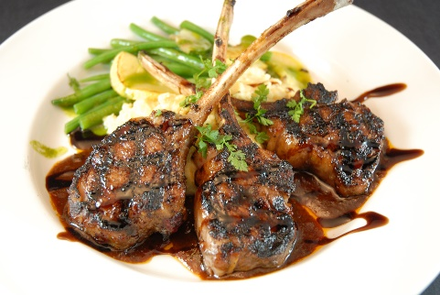
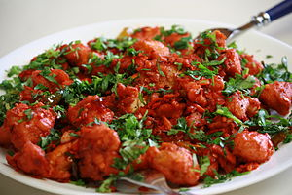
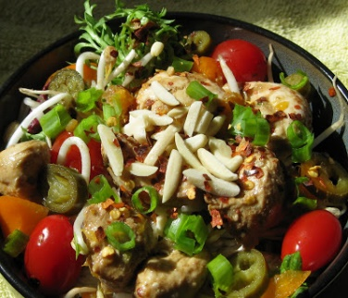
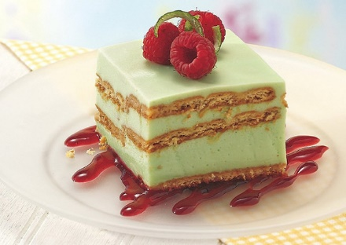
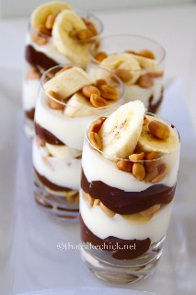
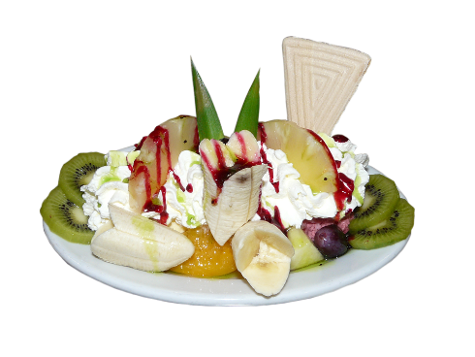
Order meal in a restaurant
If a restaurant offers 4 options of beef, 3 options of chicken, 4 options of fish, and 5 options of salad, how much options do you have? 4 + 3 + 4 + 5 = 16
If there are three options of dessert, how many ways can you order meal + dessert? 16 × 3 = 48.

Slide 22
Addition or Multiplication?
$$f\left(n\right)= \left\{\begin{aligned}f(n−1) \\ f(n−2)\end{aligned}\right.$$
f(n) = f(n-1) + f(n-2) or
f(n) = f(n-1) × f(n-2)
if the two are either A or B, then add
if the two are independent, then multiply
first ball is B
first ball is R

Slide 23
Shrink the problem by one ball
f(1) = 2 and f(2) = 3: stop condition: when n is 1 or 2
f(n) = f(n - 1) + f(n - 2)
f(n - 1) = f(n - 2) + f(n - 3)
f(n - 2) = f(n - 3) + f(n - 4)
f(n - 3) = f(n - 4) + f(n - 5)
…
change: n becomes smaller and smaller
recurring pattern

