Slide 1
ECE 264 Fall 2020
Advanced C Programming
Yung-Hsiang Lu
Purdue University

Slide 2
Structure 02 and Heap Memory

Slide 3
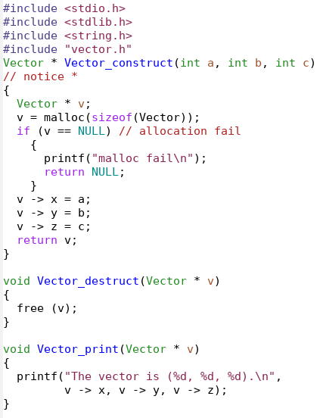
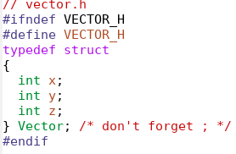

Slide 4
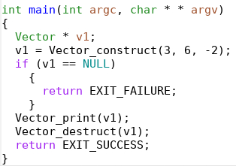
Frame | Symbol | Address | Value
main | v1 | 100 | U

Slide 5
Frame | Symbol | Address | Value
Vector_construct | c | 308 | -2
 | b | 304 | 6
 | a | 300 | 3
 | value address A100
 | return location
main | v1 | 100 | U

Slide 6
Frame | Symbol | Address | Value
Vector_construct | v | 312 | U
 | c | 308 | -2
 | b | 304 | 6
 | a | 300 | 3
 | value address A100
 | return location
main | v1 | 100 | U

Slide 7
Heap Memory
Symbol | Address | Value
v -> z | 10008 | U
v -> y | 10004 | U
v -> x | 10000 | U
Stack Memory
Frame | Symbol | Address | Value
Vector_construct | v | 312 | A10000
 | c | 308 | -2
 | b | 304 | 6
 | a | 300 | 3
 | value address A100
 | return location
main | v1 | 100 | U

Slide 8
Heap Memory
Symbol | Address | Value
v -> z | 10008 | -2
v -> y | 10004 | 6
v -> x | 10000 | 3
Stack Memory
Frame | Symbol | Address | Value
Vector_construct | v | 312 | A10000
 | c | 308 | -2
 | b | 304 | 6
 | a | 300 | 3
 | value address A100
 | return location
main | v1 | 100 | U

Slide 9
Heap Memory
Symbol | Address | Value
v -> z | 10008 | -2
v -> y | 10004 | 6
v -> x | 10000 | 3
Stack Memory
Frame | Symbol | Address | Value
Vector_construct | v | 312 | A10000
 | c | 308 | -2
 | b | 304 | 6
 | a | 300 | 3
 | value address A100
 | return location
main | v1 | 100 | A10000

Slide 10
Heap Memory
Symbol | Address | Value
v1 -> z | 10008 | -2
v1 -> y | 10004 | 6
v1 -> x | 10000 | 3
Frame | Symbol | Address | Value
main | v1 | 100 | A10000

Slide 11
Heap Memory
Symbol | Address | Value
v -> z | 10008 | -2
v -> y | 10004 | 6
v -> x | 10000 | 3
Frame | Symbol | Address | Value
main | v1 | 100 | A10000

Slide 12
Heap Memory
Symbol | Address | Value
v -> z | 10008 | -2
v -> y | 10004 | 6
v -> x | 10000 | 3
Frame | Symbol | Address | Value
main | v1 | 100 | A10000
free does not change v1’s value
v1’s value is not NULL

Slide 13
Vector * p = NULL;
p = malloc(sizeof(Vector));
p -> x = 264; // ok
free (p);
if (p == NULL) // will be false
…
p -> x = 2020; // segmentation fault
free does not change p’s value
p’s value is not NULL

Slide 14
Vector * p = NULL;
p = malloc(sizeof(Vector));
p -> x = 264; // ok
free (& p);
Will this set p’s value to NULL?
No
p is a local variable on stack memory
& p is an address in stack memory

Slide 15
Segmentation Fault
Computer memory is divided into units called segments.
Each program is given some segments.
Segmentation fault: a program intends to access (read from or write to) memory that does not belong to this program.
Operating systems stop the program.
To prevent segmentation fault:
  malloc before using
  do not use after free
  do not free twice

Slide 16
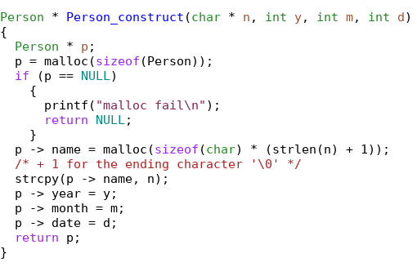
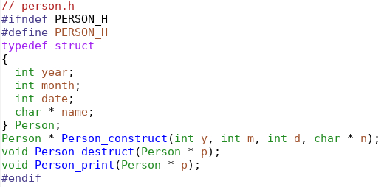
notice the order

Slide 17
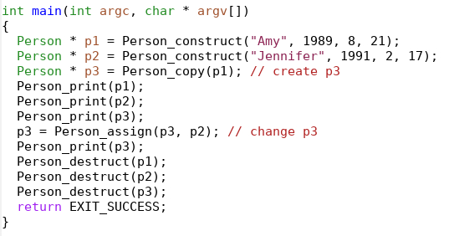
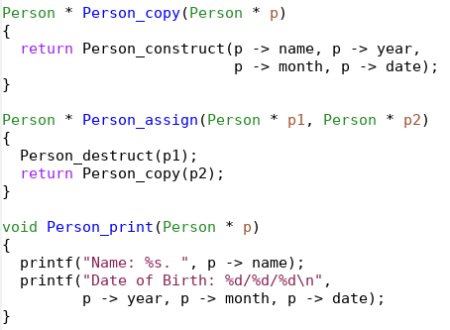

Slide 18
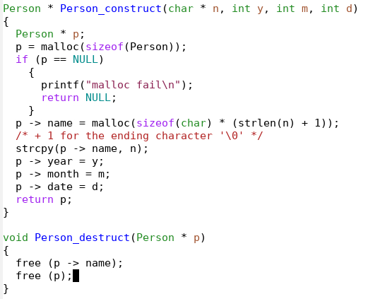
malloc earlier will be free later

Slide 19
malloc p before
malloc p -> name
free p -> name before
free p

Slide 20
shallow vs deep copy
If a structure has one or several pointers, be very careful about assignment.
Person * p1 = Person_construct("Amy", 1989, 8, 21);
Person * p2 = Person_construct("Jennifer", 1991, 2, 17);
Person * p3 = Person_copy(p1); // create p3
Person * p4 = p1;
p3 = Person_assign(p3, p2); // change p3
// different from p3 = p2?

Slide 21
Person * p1 = Person_construct("Amy", 1989, 8, 21);
Frame | Symbol | Address | Value
main | p1 | 100 | U

Slide 22
Person * p1 = Person_construct("Amy", 1989, 8, 21);
Frame | Symbol | Address | Value
construct | n[3] | 223 | \0
 | n[2] | 222 | y
 | n[1] | 221 | m
 | n[0] | 220 | A
 | d | 216 | 21
 | m | 212 | 8
 | y | 208 | 1989
 | n | 200 | A220
 | value address |  | A100
 | return location
main | p1 | 100 | U

Slide 23
Person * p1 = Person_construct("Amy", 1989, 8, 21);
Frame | Symbol | Address | Value
construct | p | 224 | U
 | n[3] | 223 | \0
 | n[2] | 222 | y
 | n[1] | 221 | m
 | n[0] | 220 | A
 | d | 216 | 21
 | m | 212 | 8
 | y | 208 | 1989
 | n | 200 | A220
 | value address |  | A100
 | return location
main | p1 | 100 | U

Slide 24
Stack Memory
Frame | Symbol | Address | Value
construct | p | 224 | A10000
 | n[3] | 223 | \0
 | n[2] | 222 | y
 | n[1] | 221 | m
 | n[0] | 220 | A
 | d | 216 | 21
 | m | 212 | 8
 | y | 208 | 1989
 | n | 200 | A220
 | value address |  | A100
 | return location
main | p1 | 100 | U
Person * p1 = Person_construct("Amy", 1989, 8, 21);
Heap Memory
Symbol | Address | Value
p->name | 10012
p->date | 10008
p->month | 10004
p->year | 10000

Slide 25
Person * p1 = Person_construct("Amy", 1989, 8, 21);
Heap Memory
Symbol | Address | Value
p->name[3] | 25003
p->name[2] | 25002
p->name[1] | 25001
p->name[0] | 25000
p->name | 10012 | A25000
p->date | 10008
p->month | 10004
p->year | 10000

Slide 26
Stack Memory
Frame | Symbol |  | Address | Value
construct | p |  | 224 | A10000
 | n[3] |  | 223 | \0
 | n[2] |  | 222 | y
 | n[1] |  | 221 | m
 | n[0] |  | 220 | A
 | d |  | 216 | 21
 | m |  | 212 | 8
 | y |  | 208 | 1989
 | n |  | 200 | A220
 | value address |  |  | A100
 | return location
main | p1 | 100 |  | U
Person * p1 = Person_construct("Amy", 1989, 8, 21);
Heap Memory
Symbol | Address | Value
p->name[3] | 25003 | \0
p->name[2] | 25002 | y
p->name[1] | 25001 | m
p->name[0] | 25000 | A
p->name | 10012 | A25000
p->date | 10008
p->month | 10004
p->year | 10000

Slide 27
Stack Memory
Frame | Symbol |  | Address | Value
construct | p |  | 224 | A10000
 | n[3] |  | 223 | \0
 | n[2] |  | 222 | y
 | n[1] |  | 221 | m
 | n[0] |  | 220 | A
 | d |  | 216 | 21
 | m |  | 212 | 8
 | y |  | 208 | 1989
 | n |  | 200 | A220
 | value address |  |  | A100
 | return location
main | p1 | 100 |  | U
Person * p1 = Person_construct("Amy", 1989, 8, 21);
Heap Memory
Symbol | Address | Value
p->name[3] | 25003 | \0
p->name[2] | 25002 | y
p->name[1] | 25001 | m
p->name[0] | 25000 | A
p->name | 10012 | A25000
p->date | 10008 | 21
p->month | 10004 | 8
p->year | 10000 | 1989

Slide 28
Stack Memory
Frame | Symbol |  | Address | Value
construct | p |  | 224 | A10000
 | n[3] |  | 223 | \0
 | n[2] |  | 222 | y
 | n[1] |  | 221 | m
 | n[0] |  | 220 | A
 | d |  | 216 | 21
 | m |  | 212 | 8
 | y |  | 208 | 1989
 | n |  | 200 | A220
 | value address |  |  | A100
 | return location
main | p1 | 100 |  | A10000
Person * p1 = Person_construct("Amy", 1989, 8, 21);
Heap Memory
Symbol | Address | Value
p->name[3] | 25003 | \0
p->name[2] | 25002 | y
p->name[1] | 25001 | m
p->name[0] | 25000 | A
p->name | 10012 | A25000
p->date | 10008 | 21
p->month | 10004 | 8
p->year | 10000 | 1989

Slide 29
Stack Memory
Frame | Symbol |  | Address | Value
construct | p |  | 224 | A10000
 | n[3] |  | 223 | \0
 | n[2] |  | 222 | y
 | n[1] |  | 221 | m
 | n[0] |  | 220 | A
 | d |  | 216 | 21
 | m |  | 212 | 8
 | y |  | 208 | 1989
 | n |  | 200 | A220
 | value address |  |  | A100
 | return location
main | p1 | 100 |  | A10000
Person * p1 = Person_construct("Amy", 1989, 8, 21);
Heap Memory
Symbol | Address | Value
p->name[3] | 25003 | \0
p->name[2] | 25002 | y
p->name[1] | 25001 | m
p->name[0] | 25000 | A
p->name | 10012 | A25000
p->date | 10008 | 21
p->month | 10004 | 8
p->year | 10000 | 1989

Slide 30
Heap Memory
Symbol | Address | Value
p1->name[3] | 25003 | \0
p1->name[2] | 25002 | y
p1->name[1] | 25001 | m
p1->name[0] | 25000 | A
p1->name | 10012 | A25000
p1->date | 10008 | 21
p1->month | 10004 | 8
p1->year | 10000 | 1989
Person * p3 = Person_copy(p1);
Heap Memory
Symbol | Address | Value
p3->name[3] | 45003 | \0
p3->name[2] | 45002 | y
p3->name[1] | 45001 | m
p3->name[0] | 45000 | A
p3->name | 20012 | A45000
p3->date | 20008 | 21
p3->month | 20004 | 8
p3->year | 20000 | 1989
Stack Memory
Frame | Symbol |  | Address | Value
main | p3 | 108 |  | A20000
 | p1 | 100 |  | A10000

Slide 31
Stack Memory
Frame | Symbol |  | Address | Value
main | p4 | 108 |  | A10000
 | p1 | 100 |  | A10000
Person * p4 = p1;
Heap Memory
Symbol | Address | Value
p->name[3] | 25003 | \0
p->name[2] | 25002 | y
p->name[1] | 25001 | m
p->name[0] | 25000 | A
p->name | 10012 | A25000
p->date | 10008 | 21
p->month | 10004 | 8
p->year | 10000 | 1989
p1 and p4 point to the same heap memory
Changing p1 -> year changes p4 -> year

Slide 32
Heap Memory
Symbol | Address | Value
p1->name[3] | 25003 | \0
p1->name[2] | 25002 | y
p1->name[1] | 25001 | m
p1->name[0] | 25000 | A
p1->name | 10012 | A25000
p1->date | 10008 | 21
p1->month | 10004 | 8
p1->year | 10000 | 1989
Person * p3 = Person_copy(p1);
Person * p4 = p1;
p3 = p4; // lose memory
Heap Memory
Symbol | Address | Value
p3->name[3] | 45003 | \0
p3->name[2] | 45002 | y
p3->name[1] | 45001 | m
p3->name[0] | 45000 | A
p3->name | 20012 | A45000
p3->date | 20008 | 21
p3->month | 20004 | 8
p3->year | 20000 | 1989
Stack Memory
Frame | Symbol |  | Address | Value
main | p4 | 116 |  | A10000
 | p3 | 108 |  | A20000
 | p1 | 100 |  | A10000

Slide 33
Heap Memory
Symbol | Address | Value
p1->name[3] | 25003 | \0
p1->name[2] | 25002 | y
p1->name[1] | 25001 | m
p1->name[0] | 25000 | A
p1->name | 10012 | A25000
p1->date | 10008 | 21
p1->month | 10004 | 8
p1->year | 10000 | 1989
Person * p3 = Person_copy(p1);
Person * p4 = p1;
p3 = p4; // lose memory
Heap Memory
Symbol | Address | Value
p3->name[3] | 45003 | \0
p3->name[2] | 45002 | y
p3->name[1] | 45001 | m
p3->name[0] | 45000 | A
p3->name | 20012 | A45000
p3->date | 20008 | 21
p3->month | 20004 | 8
p3->year | 20000 | 1989
lost
Stack Memory
Frame | Symbol |  | Address | Value
main | p4 | 116 |  | A10000
 | p3 | 108 |  | A10000
 | p1 | 100 |  | A10000

Slide 34
Person p1; // no *
p1.year = 2001; // . not ->
p1.month = 3;
p1.date = 9;
p1.name = strdup(“Amy”);
Person p2 = p1;
Heap Memory
Symbol | Address | Value
p1.name[3] | 25003 | \0
p1.name[2] | 25002 | y
p1.name[1] | 25001 | m
p1.name[0] | 25000 | A
Stack Memory
Symbol | Address | Value
p1.name | 112 | A25000
p1.date | 108 | 9
p1.month | 104 | 3
p1.year | 100 | 2001

Slide 35
Person p1;
p1.year = 2001;
p1.month = 3;
p1.date = 9;
p1.name = strdup(“Amy”);
Person p2 = p1; // no *
Stack Memory
Symbol | Address | Value
p2.name | 132 | A25000
p2.date | 128 | 9
p2.month | 124 | 3
p2.year | 120 | 2001
p1.name | 112 | A25000
p1.date | 108 | 9
p1.month | 104 | 3
p1.year | 100 | 2001
Heap Memory
Symbol | Address | Value
p1.name[3] | 25003 | \0
p1.name[2] | 25002 | y
p1.name[1] | 25001 | m
p1.name[0] | 25000 | A

Slide 36
Shallow vs Deep Copy
If a structure has one (or more) pointer, be very careful.
Assignment (such as p2 = p1; ) copies attribute by attribute.
If an attribute is a pointer, two pointers refer to the same address (shallow copy).
Shallow copy: changing p2.name[0] also changes p1.name[0]
Deep copy: allocate memory so that they occupy different heap memory space

Slide 37
Shallow Copy | Deep Copy
point to the same heap memory | point to different heap memory
save memory space | use more memory
changing one changes the other (s) | changing one does not affect the other (s)
can be used when sharing is desired | can be used when sharing is not preferred
use case: address of employees | use case: address of children
Conclusion: Both are useful. You need to know which one to choose.
“Copy-on-write”: beyond the scope of ECE 264.

