Slide 1
ECE 264 Fall 2020 Advanced C Programming
Yung-Hsiang Lu
Purdue University

Slide 2
Homework 06 Count Occurrences of a Word
an article (in a file)
+ a word
count (a number)

Slide 3
Understand C Strings
C has no “string” data type.
C uses “array of characters + \0” as a string
Each element can store a value between 0 and 255
Conversion between numbers and characters based on ASCII
E | C | E |  | P | U | R | D | U | E | \0
Don’t Care
(after \0)
2 | 6 | 4 |  | C | \0 | DC | DC | DC | DC | DC
C |  | P | R | O | G | R | \n |  | \0 | DC

Slide 4
String Functions

Slide 5
String Functions
pay attention to the order

Slide 6
C array is always a pointer
char * arr1;
arr1 = malloc(sizeof(char) * 20);
// arr1 stores the address of the first element
strcpy(arr1, “Purdue ECE”);
char arr2[20];
// arr2 is equivalent to & arr2[0],
// i.e., address of the first element
// cannot free (arr2)
free (arr1);
Double quotation
automatically add ‘\0’

Slide 7
A pointer may not be an array
char ch = ‘A’;
char * p;
p = & ch; // a pointer, but there is no array

Slide 8
strcpy, not overlap
char s[20];
strcpy(s, “ECE Purdue”);
char * src = & s[0];
char * dest = & s[8];

Slide 9
char s[20];
strcpy(s, “ECE Purdue”);
char * src = & s[0];
char * dest = & s[8];
symbol | s[0] |  |  |  |  |  |  |  | s[8] |  |  |  |  |  |  |  |  |  |  | s[19] | src | dest
address | 100 |  |  |  |  |  |  |  | 108 |  |  |  |  |  |  |  |  |  |  | 119 | 120 | 128
value | E | C | E |  | P | u | r | d | u | e | \0 |  |  |  |  |  |  |  |  |  | A100 | A108

Slide 10
char s[20];
strcpy(s, “ECE Purdue”);
char * src = & s[0];
char * dest = & s[8];
strcpy(dest, src);
symbol | s[0] |  |  |  |  |  |  |  | s[8] |  |  |  |  |  |  |  |  |  |  | s[19] | src | dest
address | 100 |  |  |  |  |  |  |  | 108 |  |  |  |  |  |  |  |  |  |  | 119 | 120 | 128
value | E | C | E |  | P | u | r | d | u | e | \0 |  |  |  |  |  |  |  |  |  | A100 | A108
 |  |  |  |  |  |  |  |  | E | C | E

Slide 11
String Functions

Slide 12
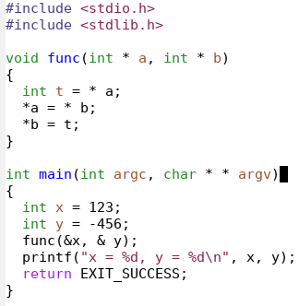
const in argument

Slide 13
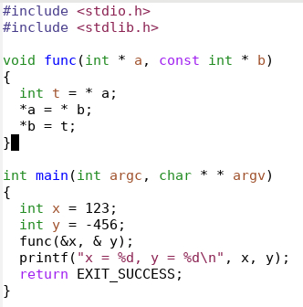

Slide 14
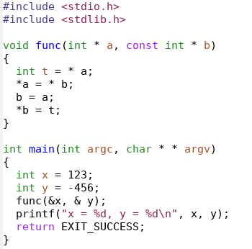
this is ok
this is not allowed (cannot use the LHS rule)

Slide 15
Frame | Symbol | Address | Value
func | t | 212 | 123
 | b | 208 | A104
 | a | 200 | A100
main | y | 104 | -456
 | x | 100 | 123

Slide 16
Frame | Symbol | Address | Value
func | t | 212 | 123
 | b | 208 | A104
 | a | 200 | A100
main | y | 104 | -456
 | x | 100 | 123
-456

Slide 17
Frame | Symbol | Address | Value
func | t | 212 | 123
 | b | 208 | A100
 | a | 200 | A100
main | y | 104 | -456
 | x | 100 | -456

Slide 18
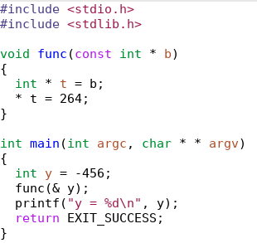

Slide 19
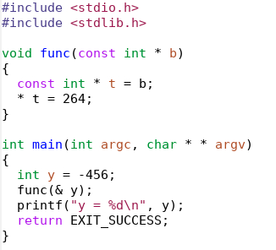

Slide 22
‘\0’ in string
The array must have space to store this special character
strelen does not count it
char * mystrdup(const char * src)
{
char * p = malloc(sizeof(char) * (strlen(src) + 1));
strcpy(p, src);
return p;
}
without + 1,
program behavior undefined
for ‘\0’

Slide 23
strstr
Symbol | Address | Value
p | 222 | U
t | 214 | A200
 | 213 | \0
 | 212 | E
 | 211 | C
 | 210 | E
 | 209 | C
 | 208 | E
 | 207 | C
 | 206 | E
 | 205 | C
 | 204 | E
 | 203
t[2] | 202 | E
t[1] | 201 | C
t[0] | 200 | P
char *t = “PCE ECECECECE”;
// How many ECE does t have?
// Does “ECECE” count as one or two?
char * p;
p = strstr(t, “ECE”);

Slide 24
strstr
Symbol | Address | Value
p | 222 | A204
t | 214 | A200
 | 213 | \0
 | 212 | E
 | 211 | C
 | 210 | E
 | 209 | C
 | 208 | E
 | 207 | C
 | 206 | E
 | 205 | C
 | 204 | E
 | 203
t[2] | 202 | E
t[1] | 201 | C
t[0] | 200 | P
char *t = “PCE ECECECECE”;
// How many ECE does t have?
// Does “ECECE” count as one or two?
char * p;
p = strstr(t, “ECE”);

Slide 25
strstr
Symbol | Address | Value
p | 222 | A204
t | 214 | A200
 | 213 | \0
 | 212 | E
 | 211 | C
 | 210 | E
 | 209 | C
 | 208 | E
 | 207 | C
 | 206 | E
 | 205 | C
 | 204 | E
 | 203
t[2] | 202 | E
t[1] | 201 | C
t[0] | 200 | P
char *t = “PCE ECECECECE”;
// How many ECE does t have?
// Does “ECECE” count as one or two?
char * p;
p = strstr(t, “ECE”);
p = strstr(t, “ECE”); // p is 204

Slide 26
strstr
Symbol | Address | Value
p | 222 | A204
t | 214 | A200
 | 213 | \0
 | 212 | E
 | 211 | C
 | 210 | E
 | 209 | C
 | 208 | E
 | 207 | C
 | 206 | E
 | 205 | C
 | 204 | E
 | 203
t[2] | 202 | E
t[1] | 201 | C
t[0] | 200 | P
char *t = “PCE ECECECECE”;
// How many ECE does t have?
// Does “ECECE” count as one or two?
char * p;
p = strstr(t, “ECE”);
p = strstr(p, “ECE”); // p is 204

Slide 27
strstr
Symbol | Address | Value
p | 222 | A205
t | 214 | A200
 | 213 | \0
 | 212 | E
 | 211 | C
 | 210 | E
 | 209 | C
 | 208 | E
 | 207 | C
 | 206 | E
 | 205 | C
 | 204 | E
 | 203
t[2] | 202 | E
t[1] | 201 | C
t[0] | 200 | P
char *t = “PCE ECECECECE”;
// How many ECE does t have?
// Does “ECECE” count as one or two?
char * p;
p = strstr(t, “ECE”);
p ++;

Slide 28
strstr
Symbol | Address | Value
q | 230 | A205
p | 222 | A206
t | 214 | A200
 | 213 | \0
 | 212 | E
 | 211 | C
 | 210 | E
 | 209 | C
 | 208 | E
 | 207 | C
 | 206 | E
 | 205 | C
 | 204 | E
 | 203
t[2] | 202 | E
t[1] | 201 | C
t[0] | 200 | P
char *t = “PCE ECECECECE”;
// How many ECE does t have?
// Does “ECECE” count as one or two?
char * p;
p = strstr(t, “ECE”);
p ++;
char * q = p;

Slide 29
strstr
Symbol | Address | Value
q | 230 | A205
p | 222 | A206
t | 214 | A200
 | 213 | \0
 | 212 | E
 | 211 | C
 | 210 | E
 | 209 | C
 | 208 | E
 | 207 | C
 | 206 | E
 | 205 | C
 | 204 | E
 | 203
t[2] | 202 | E
t[1] | 201 | C
t[0] | 200 | P
char *t = “PCE ECECECECE”;
// How many ECE does t have?
// Does “ECECE” count as one or two?
char * p;
p = strstr(t, “ECE”);
p ++;
char * q = p;
p = strstr(q, “ECE”); // not t

Slide 30
Symbol | Address | Value
q | 230 | A207
p | 222 | A207
t | 214 | A207
 | 213 | \0
 | 212 | E
 | 211 | C
 | 210 | E
 | 209 | C
 | 208 | E
 | 207 | C
 | 206 | E
 | 205 | C
 | 204 | E
 | 203
t[2] | 202 | E
t[1] | 201 | C
t[0] | 200 | P
char *t = “PCE ECECECECE”;
// How many ECE does t have?
// Does “ECECE” count as one or two?
char * p;
p = strstr(t, “ECE”);
p ++;
char * q = p;
p = strstr(q, “ECE”); // not t
p ++;
q = p;

Slide 31
Symbol | Address | Value
q | 230 | A207
p | 222 | A208
t | 214 | A200
 | 213 | \0
 | 212 | E
 | 211 | C
 | 210 | E
 | 209 | C
 | 208 | E
 | 207 | C
 | 206 | E
 | 205 | C
 | 204 | E
 | 203
t[2] | 202 | E
t[1] | 201 | C
t[0] | 200 | P
char *t = “PCE ECECECECE”;
// How many ECE does t have?
// Does “ECECE” count as one or two?
char * p;
p = strstr(t, “ECE”);
p ++;
char * q = p;
p = strstr(q, “ECE”); // not t
p ++;
q = p;
p = strstr(q, “ECE”);

Slide 32
Symbol | Address | Value
p | 222 | A204
t | 214 | A200
 | 213 | \0
 | 212 | E
 | 211 | C
 | 210 | E
 | 209 | C
 | 208 | E
 | 207 | C
 | 206 | E
 | 205 | C
 | 204 | E
 | 203
t[2] | 202 | E
t[1] | 201 | C
t[0] | 200 | P
char *t = “PCE ECECECECE”;
// How many ECE does t have?
// Does “ECECE” count as one or two?
char * p;
p = strstr(t, “ECE”);

Slide 33
Symbol | Address | Value
p | 222 | A207
t | 214 | A200
 | 213 | \0
 | 212 | E
 | 211 | C
 | 210 | E
 | 209 | C
 | 208 | E
 | 207 | C
 | 206 | E
 | 205 | C
 | 204 | E
 | 203
t[2] | 202 | E
t[1] | 201 | C
t[0] | 200 | P
char *t = “PCE ECECECECE”;
// How many ECE does t have?
// Does “ECECE” count as one or two?
char * p;
p = strstr(t, “ECE”);
p += strlen(“ECE”);

Slide 34
Symbol | Address | Value
q | 230 | A207
p | 222 | A207
t | 214 | A200
 | 213 | \0
 | 212 | E
 | 211 | C
 | 210 | E
 | 209 | C
 | 208 | E
 | 207 | C
 | 206 | E
 | 205 | C
 | 204 | E
 | 203
t[2] | 202 | E
t[1] | 201 | C
t[0] | 200 | P
char *t = “PCE ECECECECE”;
// How many ECE does t have?
// Does “ECECE” count as one or two?
char * p;
p = strstr(t, “ECE”);
p += strlen(“ECE”);
char * q = p;

Slide 35
Symbol | Address | Value
q | 230 | A207
p | 222 | A208
t | 214 | A200
 | 213 | \0
 | 212 | E
 | 211 | C
 | 210 | E
 | 209 | C
 | 208 | E
 | 207 | C
 | 206 | E
 | 205 | C
 | 204 | E
 | 203
t[2] | 202 | E
t[1] | 201 | C
t[0] | 200 | P
char *t = “PCE ECECECECE”;
// How many ECE does t have?
// Does “ECECE” count as one or two?
char * p;
p = strstr(t, “ECE”);
p += strlen(“ECE”);
char * q = p;
p = strstr(q, “ECE”);

Slide 36
Symbol | Address | Value
q | 230 | A207
p | 222 | A208
t | 214 | A200
 | 213 | \0
 | 212 | E
 | 211 | C
 | 210 | E
 | 209 | C
 | 208 | E
 | 207 | C
 | 206 | E
 | 205 | C
 | 204 | E
 | 203
t[2] | 202 | E
t[1] | 201 | C
t[0] | 200 | P
char *t = “PCE ECECECECE”;
char * p;
p = strstr(t, “ECE”);
p += strlen(“ECE”);
char * q = p;
p = strstr(q, “ECE”);
// How many ECE does t have?
// Does “ECECE” count as one or two?
// p += strlen(“ECE”) count as one
// p ++ count as two

