Slide 1
ECE 264 Fall 2020 Advanced C Programming
Yung-Hsiang Lu
Purdue University

Slide 2
Heap Memory 03

Slide 3
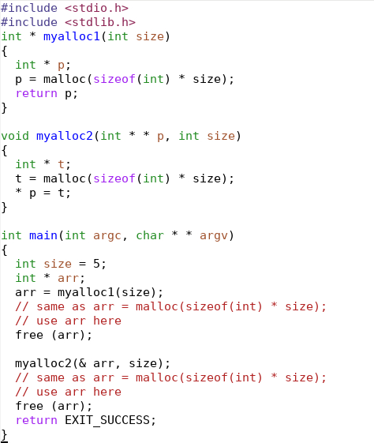
Different ways to allocate memory

Slide 4
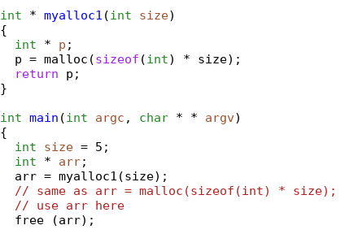
Stack Memory
Frame | Symbol | Address | Value
main | arr | 104 | U
 | size | 100 | 5

Slide 5
Stack Memory
Frame | Symbol | Address | Value
myalloc1 | p | 204 | U
 | size | 200 | 5
 | Value Address 104
 | Return Location
main | arr | 104 | U
 | size | 100 | 5

Slide 6
Heap Memory
Symbol | Address | Value
arr[4] | 2016 | U
arr[3] | 2012 | U
arr[2] | 2008 | U
arr[1] | 2004 | U
arr[0] | 2000 | U
Stack Memory
Frame | Symbol | Address | Value
myalloc1 | p | 204 | A2000
 | size | 200 | 5
 | Value Address 104
 | Return Location
main | arr | 104 | U
 | size | 100 | 5

Slide 7
Heap Memory
Symbol | Address | Value
arr[4] | 2016 | U
arr[3] | 2012 | U
arr[2] | 2008 | U
arr[1] | 2004 | U
arr[0] | 2000 | U
Stack Memory
Frame | Symbol | Address | Value
myalloc1 | p | 204 | A2000
 | size | 200 | 5
 | Value Address 104
 | Return Location
main | arr | 104 | A2000
 | size | 100 | 5

Slide 8
Heap Memory
Symbol | Address | Value
arr[4] | 2016 | U
arr[3] | 2012 | U
arr[2] | 2008 | U
arr[1] | 2004 | U
arr[0] | 2000 | U
Stack Memory
Frame | Symbol | Address | Value
main | arr | 104 | A2000
 | size | 100 | 5

Slide 9
Heap Memory
Symbol | Address | Value
Stack Memory
Frame | Symbol | Address | Value
main | arr | 104 | A2000
 | size | 100 | 5
Remember to call free even though
malloc is not called in the same function

Slide 10
To modify the value in another frame of the stack, pass the address.

Slide 11
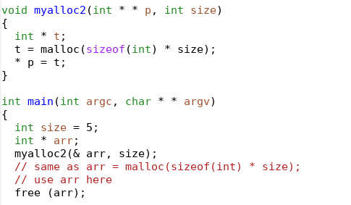
Notice * *
Notice &
Stack Memory
Frame | Symbol | Address | Value
main | arr | 104 | U
 | size | 100 | 5

Slide 12
Stack Memory
Frame | Symbol | Address | Value
myalloc2 | t | 212 | U
 | p | 204 | A104
 | size | 200 | 5
 | Return Location
main | arr | 104 | U
 | size | 100 | 5

Slide 13
Heap Memory
Symbol | Address | Value
arr[4] | 2016 | U
arr[3] | 2012 | U
arr[2] | 2008 | U
arr[1] | 2004 | U
arr[0] | 2000 | U
Stack Memory
Frame | Symbol | Address | Value
myalloc2 | t | 212 | A2000
 | p | 204 | A104
 | size | 200 | 5
 | Return Location
main | arr | 104 | U
 | size | 100 | 5

Slide 14
Heap Memory
Symbol | Address | Value
arr[4] | 2016 | U
arr[3] | 2012 | U
arr[2] | 2008 | U
arr[1] | 2004 | U
arr[0] | 2000 | U
Notice *
Stack Memory
Frame | Symbol | Address | Value
myalloc2 | t | 212 | A2000
 | p | 204 | A104
 | size | 200 | 5
 | Return Location
main | arr | 104 | U
 | size | 100 | 5
1
2
3

Slide 15
Heap Memory
Symbol | Address | Value
arr[4] | 2016 | U
arr[3] | 2012 | U
arr[2] | 2008 | U
arr[1] | 2004 | U
arr[0] | 2000 | U
Stack Memory
Frame | Symbol | Address | Value
myalloc2 | t | 212 | A2000
 | p | 204 | A104
 | size | 200 | 5
 | Return Location
main | arr | 104 | A2000
 | size | 100 | 5

Slide 16
Heap Memory
Symbol | Address | Value
arr[4] | 2016 | U
arr[3] | 2012 | U
arr[2] | 2008 | U
arr[1] | 2004 | U
arr[0] | 2000 | U
Stack Memory
Frame | Symbol | Address | Value
main | arr | 104 | A2000
 | size | 100 | 5

Slide 17
Common Mistake

Slide 18
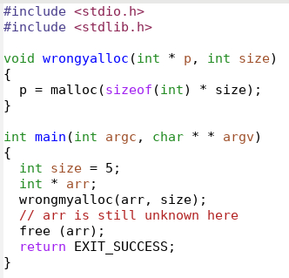
Stack Memory
Frame | Symbol | Address | Value
main | arr | 104 | U
 | size | 100 | 5

Slide 19
Stack Memory
Frame | Symbol | Address | Value
main | arr | 104 | U
 | size | 100 | 5

Slide 20
Heap Memory
Symbol | Address | Value
Stack Memory
Frame | Symbol | Address | Value
myalloc2 | p | 204 | U
 | size | 200 | 5
 | Return Location
main | arr | 104 | U
 | size | 100 | 5

Slide 21
Heap Memory
Symbol | Address | Value
arr[4] | 2016 | U
arr[3] | 2012 | U
arr[2] | 2008 | U
arr[1] | 2004 | U
arr[0] | 2000 | U
Stack Memory
Frame | Symbol | Address | Value
myalloc2 | p | 204 | A2000
 | size | 200 | 5
 | Return Location
main | arr | 104 | U
 | size | 100 | 5

Slide 22
Heap Memory
Symbol | Address | Value
arr[4] | 2016 | U
arr[3] | 2012 | U
arr[2] | 2008 | U
arr[1] | 2004 | U
arr[0] | 2000 | U
Stack Memory
Frame | Symbol | Address | Value
main | arr | 104 | U
 | size | 100 | 5

