Slide 1
ECE 264 Fall 2020 Advanced C Programming
Yung-Hsiang Lu
Purdue University

Slide 2
Memory and Pointer 01

Slide 3
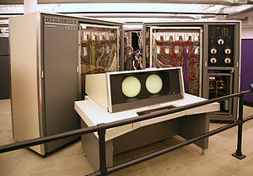
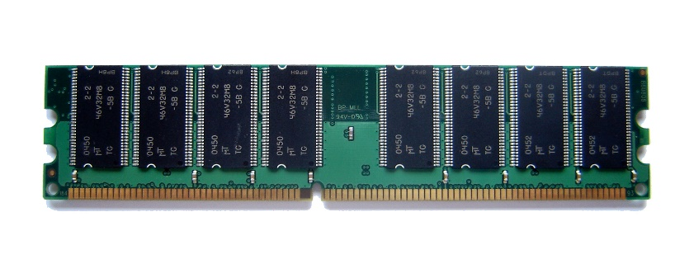
Computer Memory
First “supercomputer” CDC 6600, up to 982kB memory, $19M
HTC 10 evo, 32 GB memory (more than 32,000 more), $199

Slide 4
Review

Slide 5
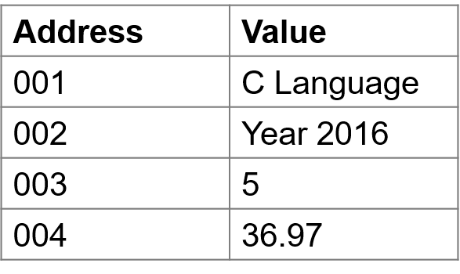
Memory organized as address-value
Smith
Taylor
Johnson

Slide 6
For Humans
Frame | Symbol | Address | Value
f3 | z | 106 | 3.2
 | y | 105 | 7
 | VA | 104 | 102
 | RL | 103 | line 5
f1 | a | 102
 | x | 101
 | RL | 100 | line ?
RL: return location
VA: value address
1 | void f1(int x)
2 | {
3 | int a;
4 | a = f3(7, 3.2);
5 | ...
6 | ...
7 | }
8 | int f3(int y, double z)
9 | {
10 | ...
11 | return ...

Slide 7
A function can see only its frame
Frame | Symbol | Address | Value
f3 | z | 106 | 3.2
 | y | 105 | 7
 | VA | 104 | 102
 | RL | 103 | line 5
f1 | a | 102
 | x | 101
 | RL | 100 | line ?
RL: return location
VA: value address
1 | void f1(int x)
2 | {
3 | int a;
4 | a = f3(7, 3.2);
5 | ...
6 | ...
7 | }
8 | int f3(int y, double z)
9 | {
10 | a = 5;
11 | return ...
error

Slide 8
Frame | Symbol | Address | Value
f3 | z | 106 | 3.2
 | a | 105 | 7
 | VA | 104 | 102
 | RL | 103 | line 5
f1 | a | 102
 | x | 101
 | RL | 100 | line ?
RL: return location
VA: value address
1 | void f1(int x)
2 | {
3 | int a;
4 | a = f3(7, 3.2);
5 | ...
6 | ...
7 | }
8 | int f3(int a, double z)
9 | {
10 | ...
11 | return ...
invisible
to f3
rename

Slide 9
swap function
Attempt 1 (wrong)
int a = 5;
int b = 7;
a = swap(a, b);
// both a and b are 7
int swap (int x, int y)
{
return y;
}
int a = 5;
int b = 7;
swap(a, b);
// a should be 7 here
// b should be 5 here

Slide 10
swap function
Attempt 2 (wrong)
int a = 5;
int b = 7;
swap(a, b);
// a and b unchanged
void swap (int a, int b)
{
int t = a;
a = b;
b = t;
}
int a = 5;
int b = 7;
swap(a, b);
// a should be 7 here
// b should be 5 here

Slide 11
Attempt 2 (wrong)
int a = 5;
int b = 7;
swap(a, b);
// a and b unchanged
…
void swap (int a, int b)
{
int t = a;
a = b;
b = t;
}
Frame | Symbol | Address | Value
 | a | 101 | 5
 | b | 100 | 7
RL: return location
VA: value address

Slide 12
Attempt 2 (wrong)
int a = 5;
int b = 7;
swap(a, b);
// a and b unchanged
…
void swap (int a, int b)
{
int t = a;
a = b;
b = t;
}
Frame | Symbol | Address | Value
swap | t | 106 | 5
 | b | 105 | 7
 | a | 104 | 5
 | RL | 103 | line 4
 | a | 101 | 5
 | b | 100 | 7
RL: return location
VA: value address

Slide 13
Attempt 2 (wrong)
int a = 5;
int b = 7;
swap(a, b);
// a and b unchanged
…
void swap (int a, int b)
{
int t = a;
a = b;
b = t;
}
Frame | Symbol | Address | Value
swap | t | 106 | 5
 | b | 105 | 7
 | a | 104 | 5
 | RL | 103 | line 4
 | a | 101 | 5
 | b | 100 | 7
RL: return location
VA: value address
7

Slide 14
Attempt 2 (wrong)
int a = 5;
int b = 7;
swap(a, b);
// a and b unchanged
…
void swap (int a, int b)
{
int t = a;
a = b;
b = t;
}
Frame | Symbol | Address | Value
swap | t | 106 | 5
 | b | 105 | 7
 | a | 104 | 7
 | RL | 103 | line 4
 | a | 101 | 5
 | b | 100 | 7
RL: return location
VA: value address
5

Slide 15
Attempt 2 (wrong)
int a = 5;
int b = 7;
swap(a, b);
// a and b unchanged
…
void swap (int a, int b)
{
int t = a;
a = b;
b = t;
}
Frame | Symbol | Address | Value
swap | t | 106 | 5
 | b | 105 | 5
 | a | 104 | 7
 | RL | 103 | line 4
 | a | 101 | 5
 | b | 100 | 7
RL: return location
VA: value address

Slide 16
Attempt 2 (wrong)
int a = 5;
int b = 7;
swap(a, b);
// a and b unchanged
…
void swap (int a, int b)
{
int t = a;
a = b;
b = t;
}
Frame | Symbol | Address | Value
swap | t | 106 | 5
 | b | 105 | 5
 | a | 104 | 7
 | RL | 103 | line 4
 | a | 101 | 5
 | b | 100 | 7
RL: return location
VA: value address

Slide 17
Attempt 2 (wrong)
int a = 5;
int b = 7;
swap(a, b);
// a and b unchanged
…
void swap (int a, int b)
{
int t = a;
a = b;
b = t;
}
Frame | Symbol | Address | Value
swap | t | 106 | 5
 | b | 105 | 5
 | a | 104 | 7
 | RL | 103 | line 4
 | a | 101 | 5
 | b | 100 | 7
RL: return location
VA: value address

Slide 18
Attempt 2 (wrong)
int a = 5;
int b = 7;
swap(a, b);
// a and b unchanged
…
void swap (int x, int y)
{
int t = x;
x = y;
y = t;
}
Frame | Symbol | Address | Value
swap | t | 106 | 5
 | y | 105 | 5
 | x | 104 | 7
 | RL | 103 | line 4
 | a | 101 | 5
 | b | 100 | 7
RL: return location
VA: value address

