Slide 1
ECE 264 Fall 2020 Advanced C Programming
Yung-Hsiang Lu
Purdue University

Slide 2
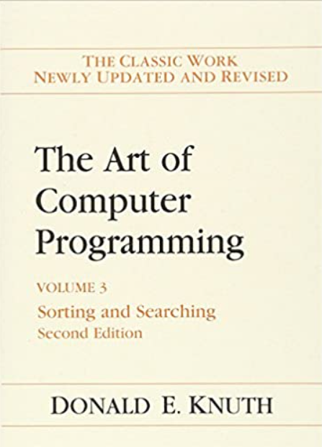
Homework 2 Selection Sort

Slide 3
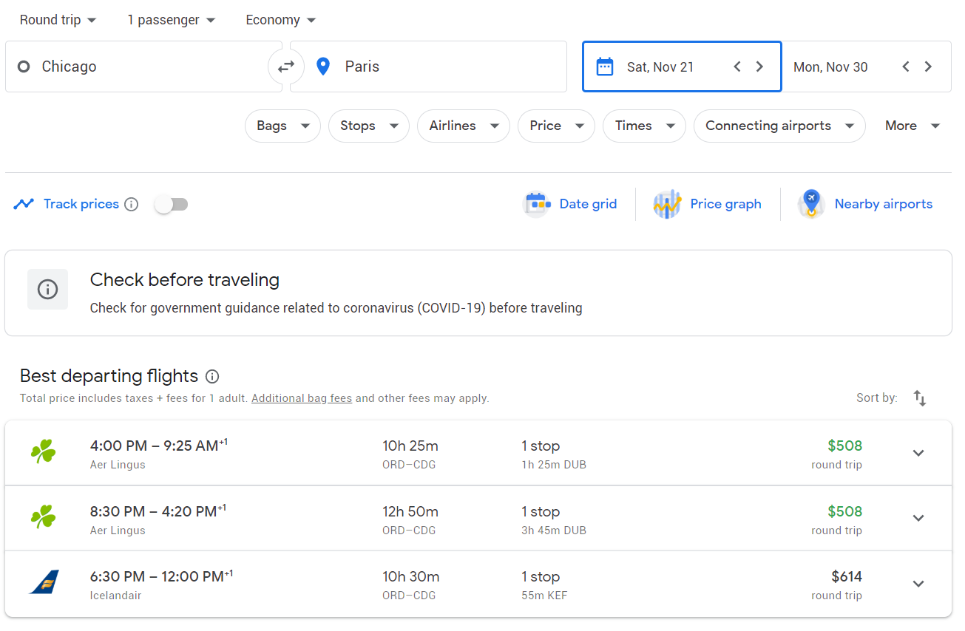
Where sorting is used?

Slide 6
Selection Sort
5 | 3 | 7 | 8 | 1 | 4 | 6 | 2 | 9
Find the smallest value
5 | 3 | 7 | 8 | 1 | 4 | 6 | 2 | 9
Swap with the first value
1 | 3 | 7 | 8 | 5 | 4 | 6 | 2 | 9
Will not touch the first value any more
1 | 3 | 7 | 8 | 5 | 4 | 6 | 2 | 9

Slide 7
Selection Sort
1 | 3 | 7 | 8 | 5 | 4 | 6 | 2 | 9
Find the smallest value
1 | 3 | 7 | 8 | 5 | 4 | 6 | 2 | 9
Swap with the first value
1 | 2 | 7 | 8 | 5 | 4 | 6 | 3 | 9
Will not touch the first two values any more
1 | 2 | 7 | 8 | 5 | 4 | 6 | 3 | 9

Slide 8
Selection Sort
1 | 2 | 7 | 8 | 5 | 4 | 6 | 3 | 9
Find the smallest value
1 | 2 | 7 | 8 | 5 | 4 | 6 | 3 | 9
Swap with the first value
1 | 2 | 3 | 8 | 5 | 4 | 6 | 7 | 9
Will not touch the first three values any more
1 | 2 | 3 | 8 | 5 | 4 | 6 | 7 | 9

Slide 9
Selection Sort
Two levels of iterations:
Outer: from the first element to the second last element
Inner: from one after the outside to the last element
Select the smallest value
If the smallest value is different from the outside value, swap
If there are n elements, at most n swaps
The number of comparisons is ≈ (n – 1) x (n – 1) /2 ≈ n²

Slide 10
Bubble Sort? Many students love bubble sort. Nobody can explain the reason.
Knuth: “the bubble sort seems to have nothing to recommend it, except a catchy name and the fact that it leads to some interesting theoretical problems”
If you agree with Knuth, you can forget bubble sort.

Slide 11
an array of integers
size of the array (# elements)
main.c

Slide 12
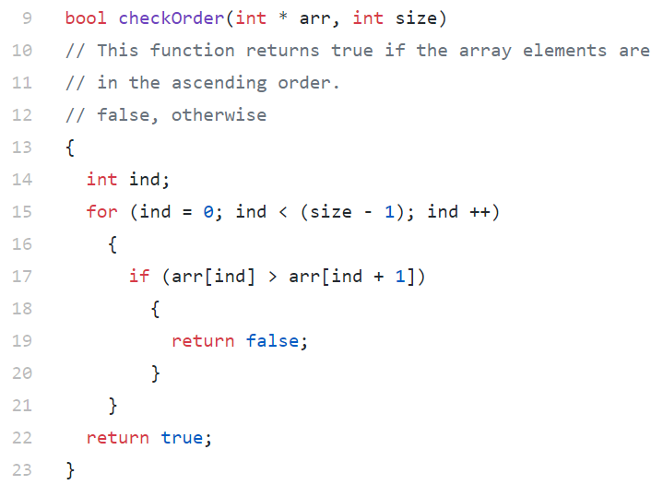
Check whether
elements are sorted

Slide 13
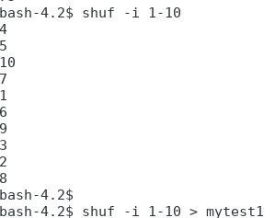
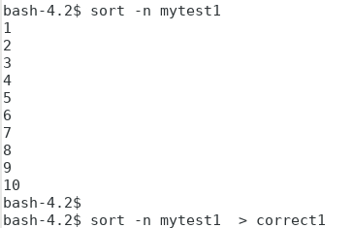
create correct answer
save the output
to a file
treat the content
as numbers
create test cases
save the output
to a file

Slide 14
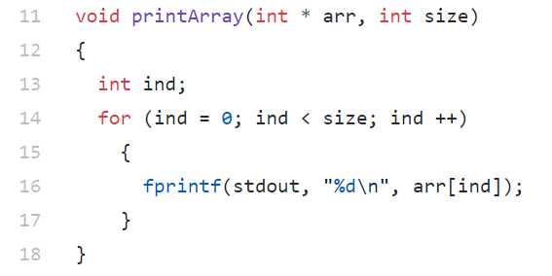
main.c

Slide 15
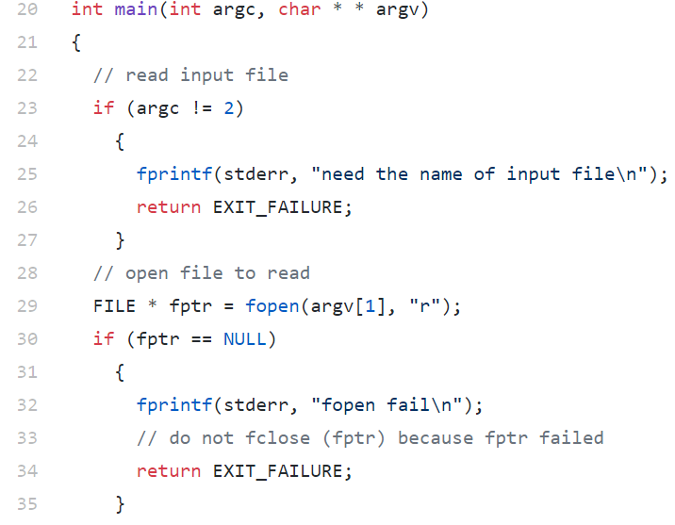
before using argv[1],
necessary to check
whether argc is at least two
main.c

Slide 16
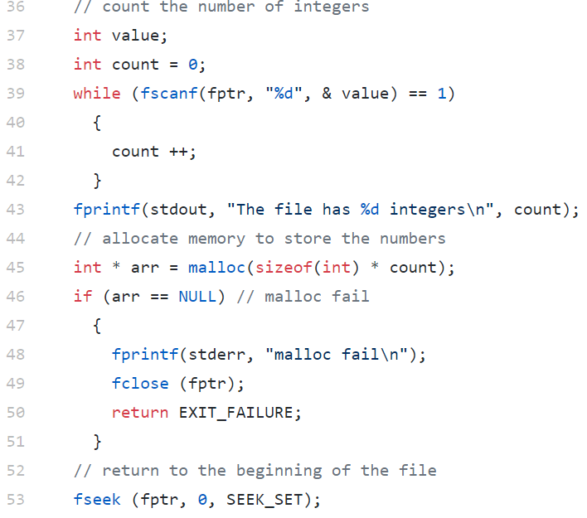
read one integer
main.c

Slide 17
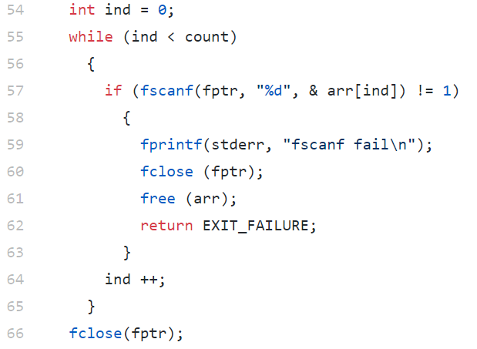
main.c

Slide 18
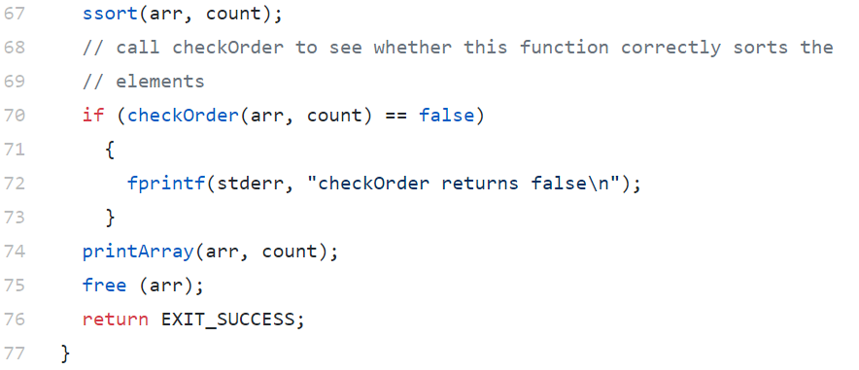
release memory created by malloc
main.c

Slide 19
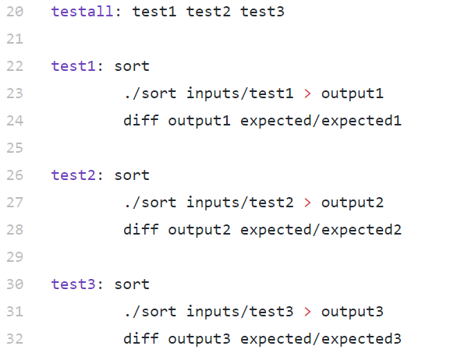
make testall: run all three test cases
Makefile

Slide 20
make testfor: run all three test cases
Makefile

Slide 21
How to test code (and not)?

Slide 22
Separate “Product” from “Development” code
Product Code | Development Code
Create products | Internal use
Polished | Experimental
Only necessary for product | May include additional for instrumentation
No assert | May use assert in testing
No debugging message | May include debugging messages
homework submission
1:5 rule: for each line of product code,
write 5 lines of development code

Slide 23
How to test your code correctly?
Product Code
X = A function your write
ssort
Development Code
Prepare data for testing X
call X with the proper data
check results
print debugging messages
(use assert here if you wish)
main

Slide 24
How to test your code incorrectly? (mix product code and testing code)
X = A function your write (Product Code)
{
….
necessary code
check results
debugging messages
assert
….
}

