Slide 1
ECE 264 Fall 2020 Advanced C Programming
Yung-Hsiang Lu
Purdue University

Slide 2
Makefile 2

Slide 3
Makefile
Define symbols for gcc warnings and select code sections
Keep track of which .c files have been changed
compile all changed .c files to generate .o files
link .o files to create executable

Slide 4
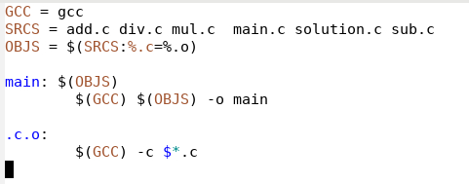

Slide 7
target: dependence

Slide 8
replace .c in SRCS by .o to create OBJS
add.o div.o mul.o main.o solution.o sub.o

Slide 9
create .o file by gcc –c .c file

Slide 11
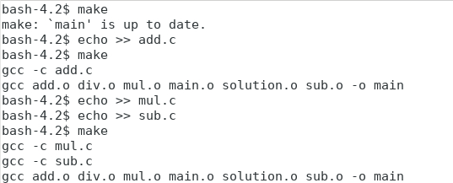

Slide 14
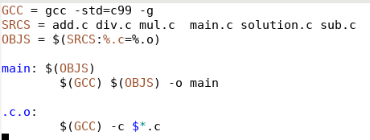
remove all object files

Slide 15
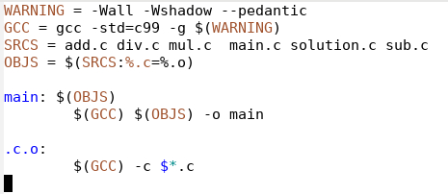
add warnings

Slide 16
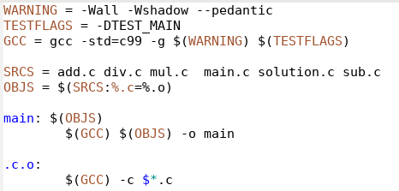
conditional compilation

Slide 17
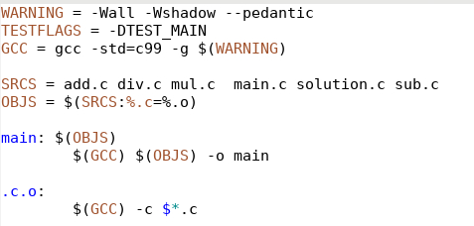
TESTFLAGS is not used

