Slide 1
ECE 264 Fall 2020 Advanced C Programming
Yung-Hsiang Lu
Purdue University

Slide 2
Before You Learn Programming Some ideas are worth thinking

Slide 3
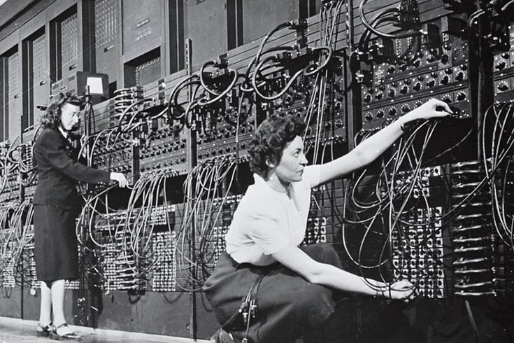
Computers were developed for military applications

Slide 4
Computers are not very smart
Computers were invented and improved in the second world war and the cold war.
Computers cannot guess your mind.
Computers do exactly what you ask them to do, nothing more and nothing less.
Computers cannot tolerate "small" mistakes because they do not know what you want them to do.

Slide 5
The “real world” has zero tolerance
of mistakes.

Slide 6
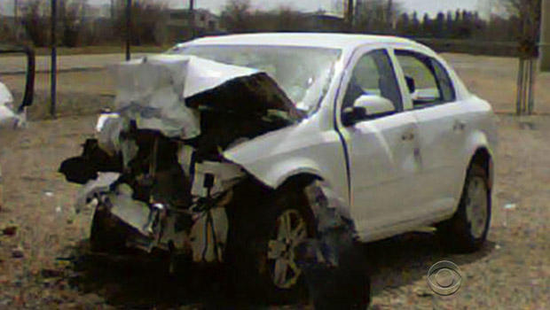
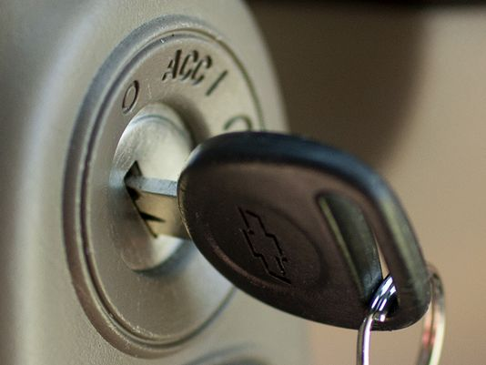
GM Ignition Problem
GM recalled 30 million vehicles. About 150 deaths are linked to the problem. This is 0.000005% failure rate.
Do you think 99.999995% success rate is sufficient?

Slide 7
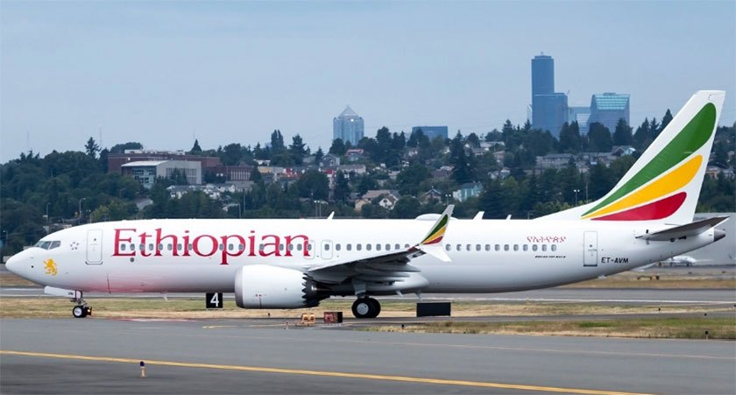
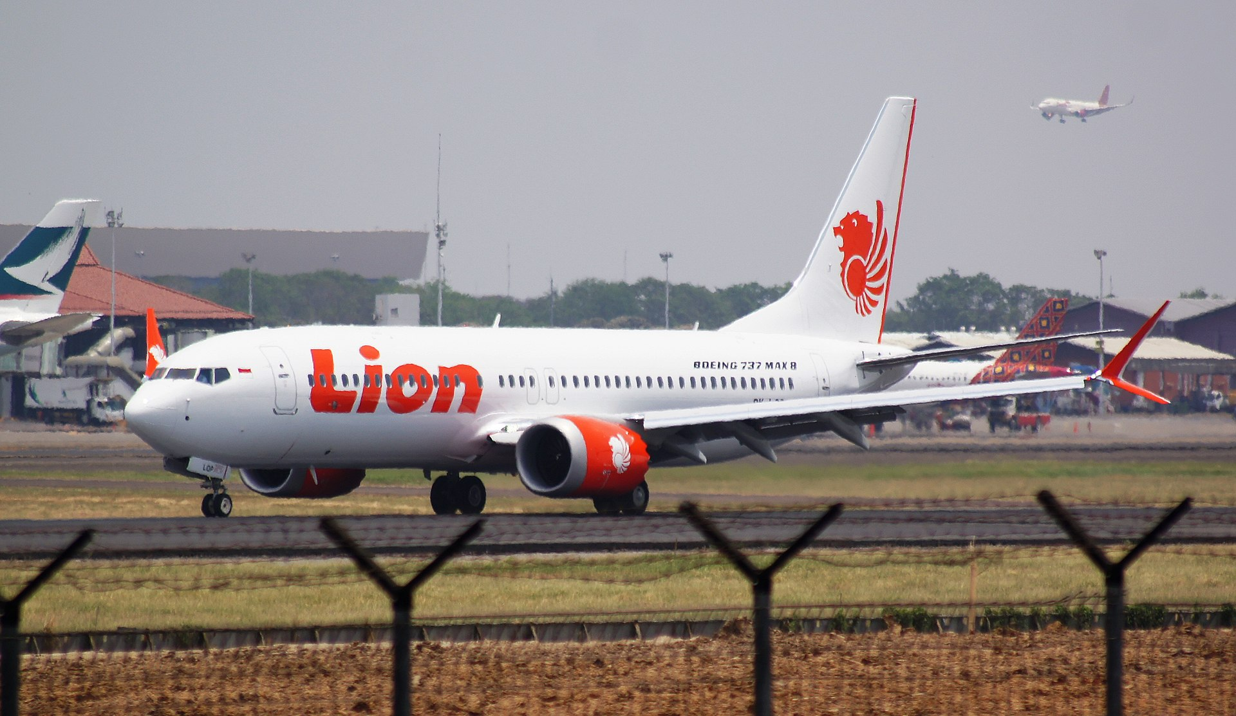
Boeing Grounded 737 Max after two Crashes
Before grounding, 387 aircrafts, 8,600 weekly flights

Slide 8
99.999999% success
Ladies and gentlemen, this is your captain speaking. We are delighted to inform you that we have flown more than 10,000 km and landed safely. Our plane is now parked only 10 meters away from the jet bridge. We have accomplished 99.9999% of the distance. For the remaining 0.0001%, please jump over the 10 meters to the gate.
Thank you for flying with us. Please come again.

Slide 9
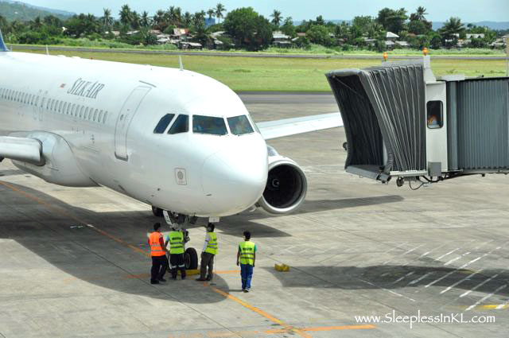
10 meters

Slide 10
1994 Intel Processor Recall
Intel recalled Pentium processors
Byte magazine estimated erroneous results in 1 out of 9 billion cases
Another estimate was 0.00061% error
Would you demand that Intel replace the faulty processor?

Slide 11
Is 99.9999% Success Acceptable?
Try to convince your customers
Good Luck You would need it

Slide 12
There is no “partial credit” in the real world.
This class will give partial credits to
encourage learning.

Slide 13
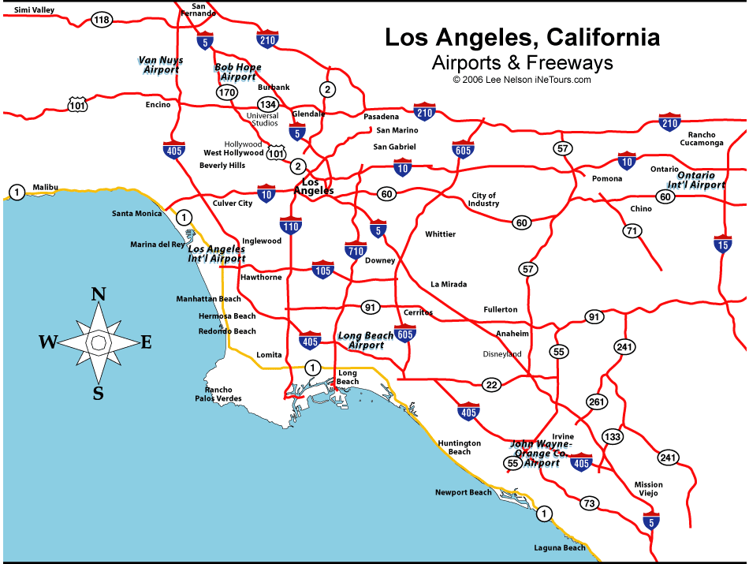
If you live in Pasadena California and you want to go to Boston Massachusetts, what would you do?

Slide 14
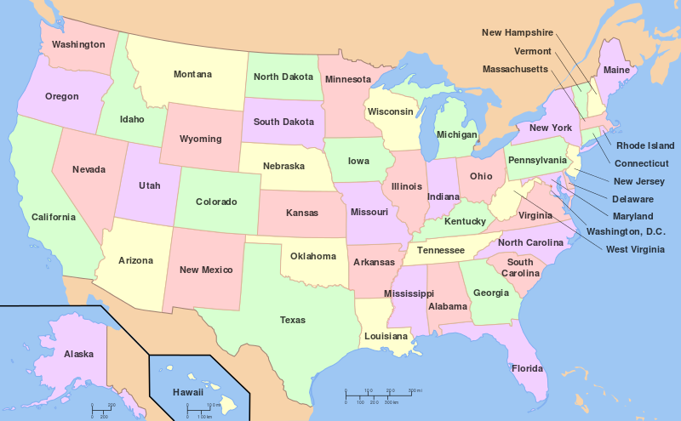

Slide 15
Options
Boston is east of Pasadena. You can start driving east.
You can start walking east.
You can drive west to the Los Angeles Airport and take a flight.
Which would you choose? Why?

Slide 16
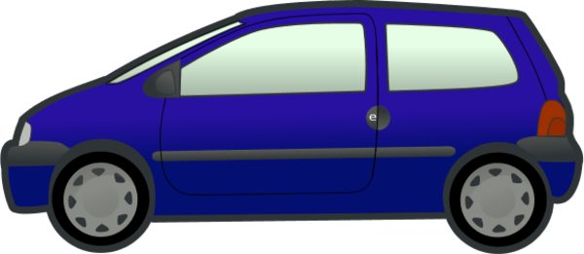

Slide 17
The shortest route may need a detour
If you choose 1 (driving) or 2 (walking), you will be closer to Boston after one or two hours. If you choose 3 (flying), you are going in the wrong direction (west) and you will spend time through the security check and waiting for boarding.
However, you will arrive in Boston a few hours later. If you choose 1 or 2, you will spend several days or many weeks.
Sometimes, the shortest route needs a detour. In the computer world, you often need to spend time learning good tools, then you can save time.

Slide 18
"Solve a Problem" vs. "Fix a Solution"
Imagine that your roof leaks and it is raining. You take a bucket to catch water but it has a hole.
What are you going to do when it is no longer raining?
Fix the roof so that it does not leak?
Or buy a new bucket so that it can catch water?
The first is to solve a problem. The second is to fix a solution.

Slide 19
Welcome to Computer Programming
It is challenging and you will enjoy it.

