Slide 1
ECE 264 Fall 2020 Advanced C Programming
Yung-Hsiang Lu
Purdue University

Slide 2
Homework 01: gcc

Slide 3
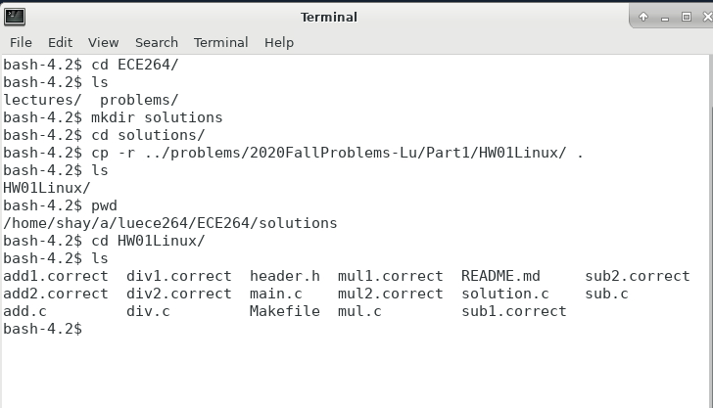
cp -r copies files inside an entire

Slide 4
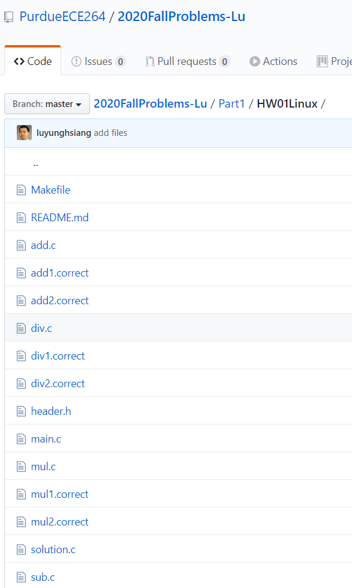
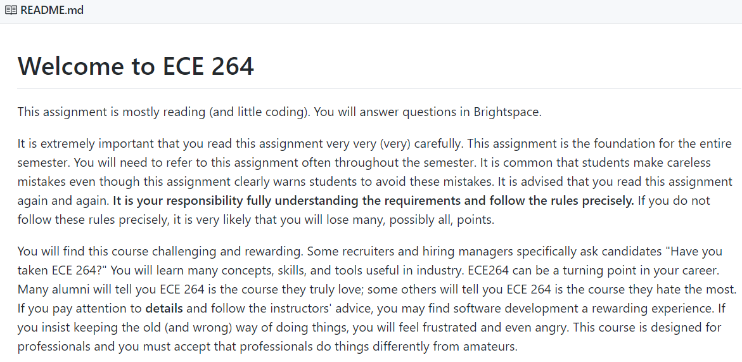
https://github.com/PurdueECE264/2020FallProblems-Lu/tree/master/Part1/HW01Linux

Slide 5
gcc compiler
Convert text file (human readable) to executable file (machine)
Detect likely mistakes if you ask gcc to do that
gcc -std=c99 -g -Wall -Wshadow -pedantic -Wvla –Werror
-std=c99: using the C standard announced in 1999
-g : enabling debugging
-Wall : enable warning messages
-Wshadow : detecting shadow variables
-pedantic : restricting standard C
-Wvla : detecting variable length array
-Werror : treating warnings as errors

Slide 6
create an alias for gcc

Slide 7
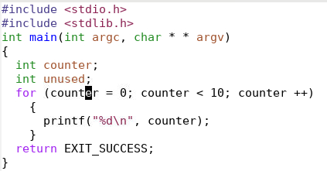
Warning: unused variable
Compiler warnings are your “first-line of defense” detecting erroneous code.
Unused variables are likely caused by mistyping.

Slide 8
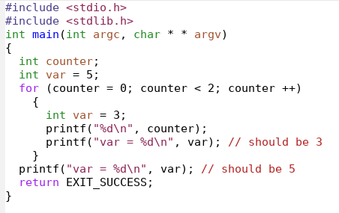
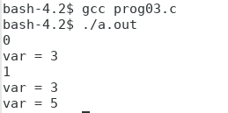
Shadow Variables
without gcc
warning
with gcc warning

Slide 9
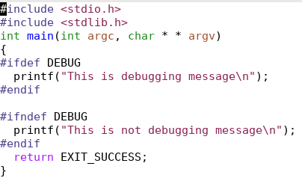
conditional compilation
Notice the difference
ifdef and
ifndef (with n)

