Slide 1
ECE 264 Fall 2020 Advanced C Programming
Yung-Hsiang Lu
Purdue University

Slide 2
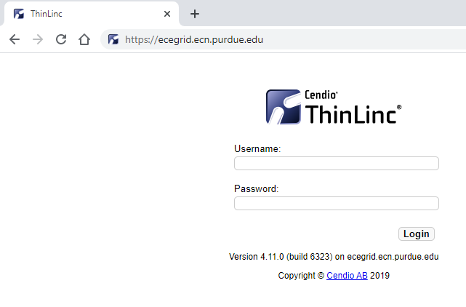

Slide 3
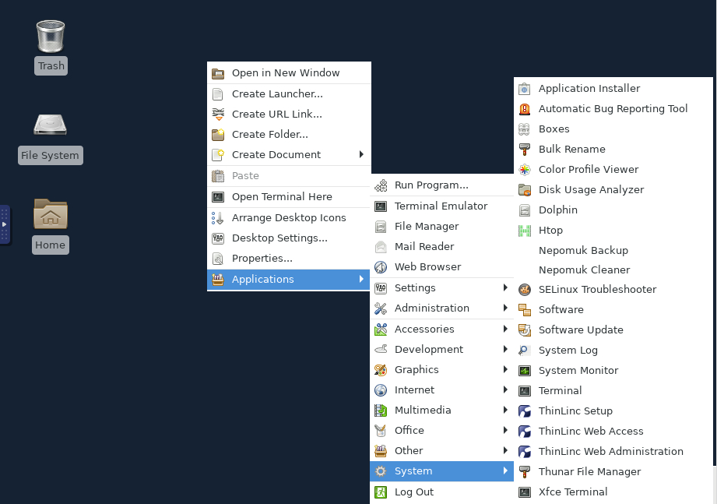

Slide 4
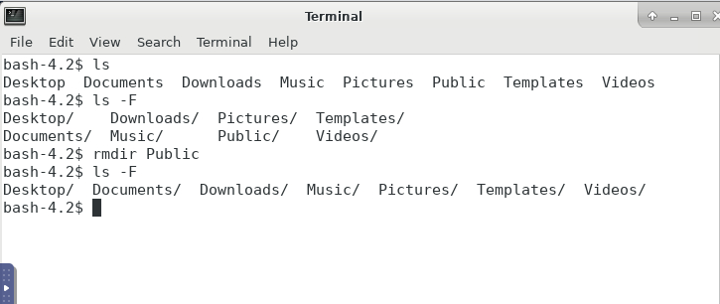
The Public directory has been removed.
rm: remove a file
rmdir: remove a directory

Slide 5
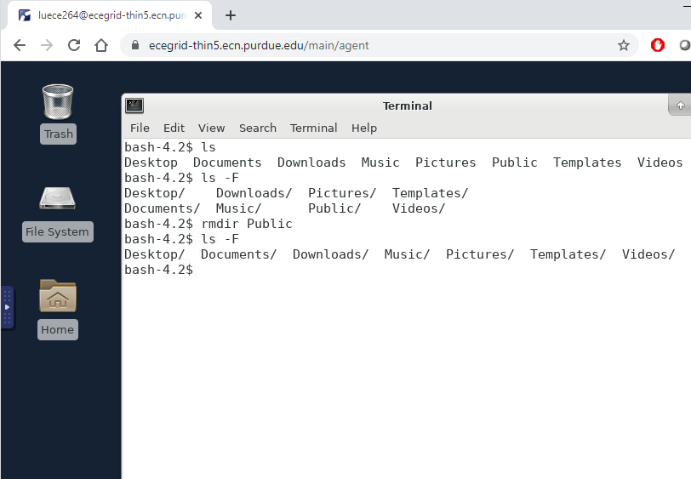

Slide 6
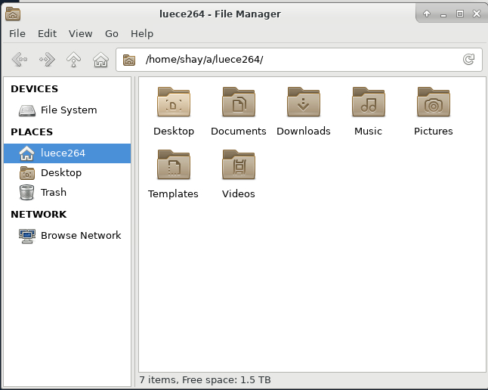

Slide 8
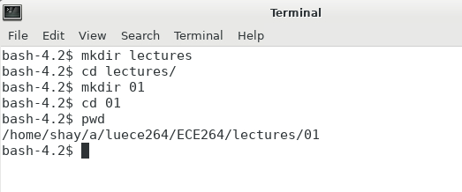

Slide 10
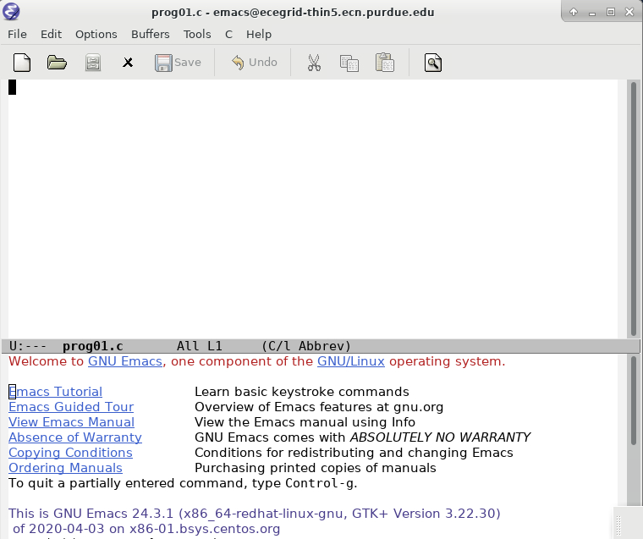

Slide 11
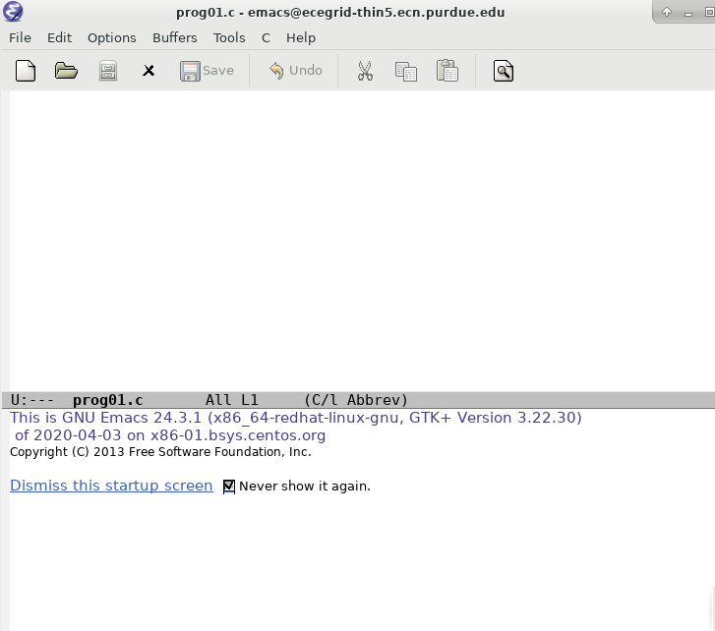

Slide 12
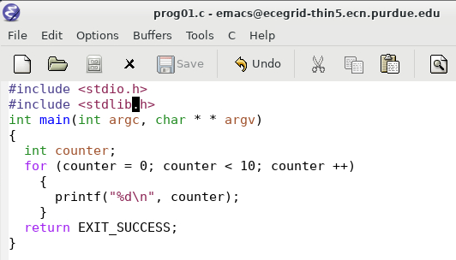

Slide 13
C Programs has three formats
Compilation + Linking
ECE 264 uses gcc
These formats allow the same programs (text format) to run on different types of machines.
Text Format
Human Readable
Executable Format
Machine Readable
Compilation
Object Format
Machine Readable
Linking
gcc -c
gcc

Slide 14
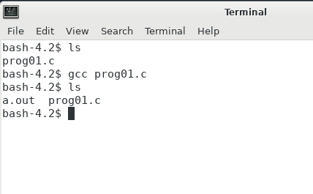

Slide 15
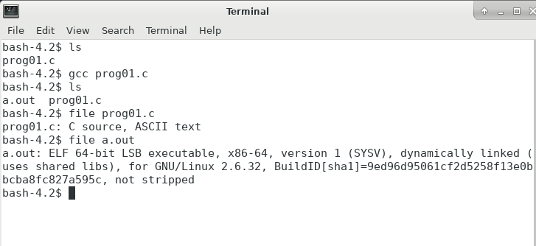

Slide 16
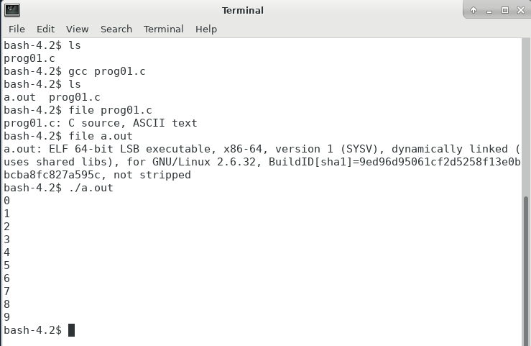
./ ensures that you are running
the program in this directory

Slide 17
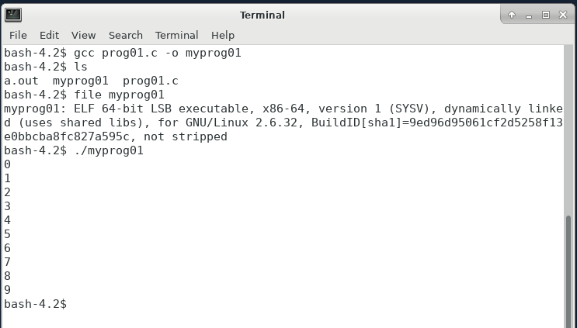
-o (lower case) specifies the
name of the executable

Slide 18
-o (lower case) specifies the
name of the executable
Caution:
Do not call your executable “test”. Test is a Linux command.
Do not put your text file after -o. Doing so erases your text file.

