Slide 1
Linux Commands
Yung-Hsiang Lu
Purdue University

Slide 2
Topics
head and tail
pipe (revisited)
sort
sed
awk
Linux user manual

Slide 3
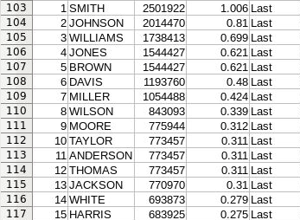
Popular First and Last Names

Slide 4
head: print the first 10 lines

Slide 5
tail: print the last 10 lines

Slide 6
head -n: first n lines

Slide 7
tail -n: last n lines

Slide 8
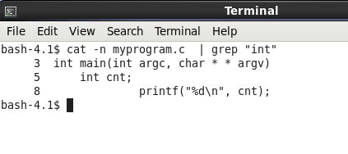
pipe (|): output as input of next

Slide 9
sort -n: sort as numbers

Slide 10
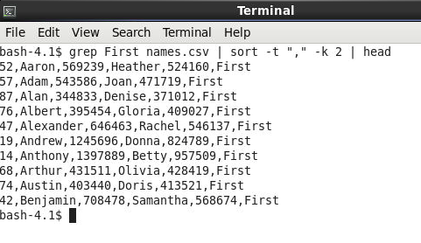
sort -k c: sort by the c's column

Slide 11
sed: substitute a letter

Slide 12
sed: substitute a word

Slide 13
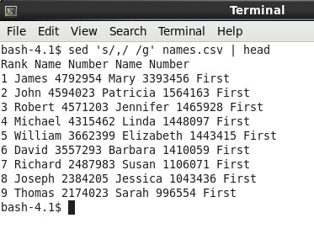
awk: keep a column

Slide 14
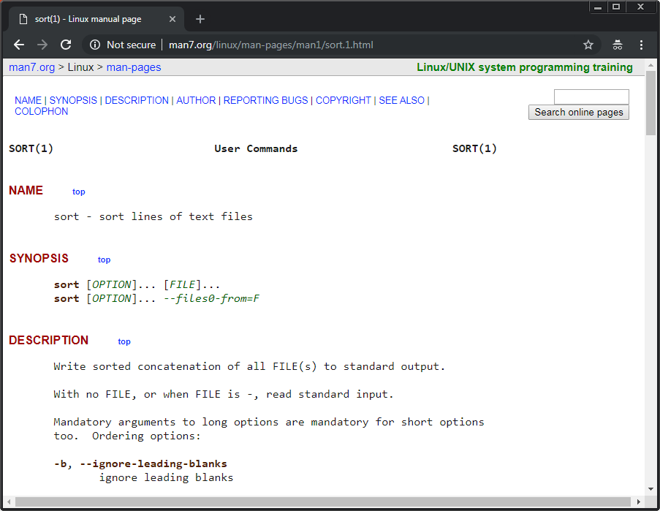

Slide 15
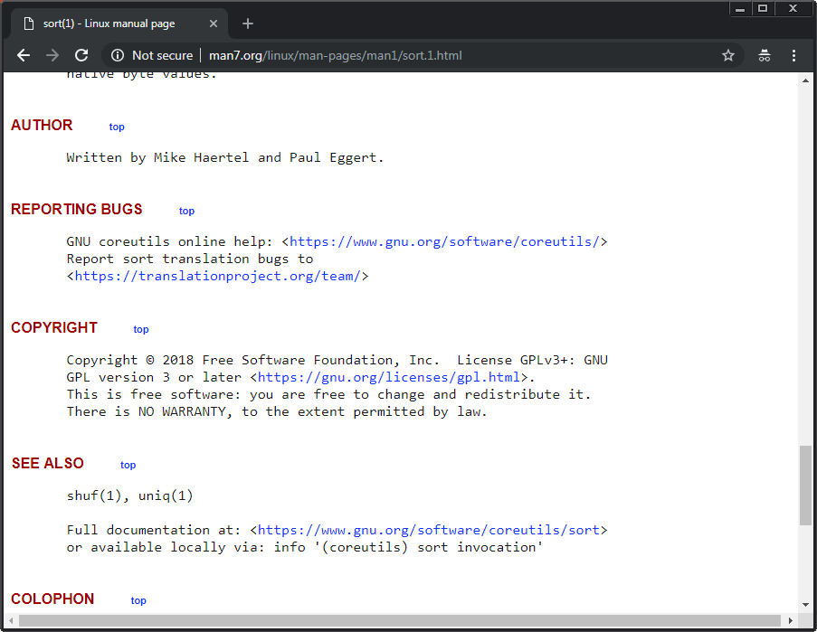

Slide 16
Enjoy Linux

