Slide 1
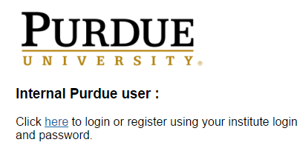
iLab Accounts
If you have not done so already, you must register for an iLab account to use any iLab-controlled instruments and equipment
To create an account, go to https://purdue.ilabsolutions.com/ and login with your Purdue Career Account

Slide 2
iLab Accounts
After you have created an account, your advising professor(s) will have to assign billing account(s) to your profile by either:
  Directly approving the account access themselves through iLab
  Providing your name and the billing account(s) to the ARMS business office for approval

Slide 3
Using iLab
iLab is a browser-based software that can be accessed from any device connected to the internet
In iLab, you must reserve a time from the Core Facility schedule
Once reserved, you need to enable/disable the instrument from the Core's Kiosk page in iLab
You cannot turn on an instrument in the Kiosk without a reservation
Your iLab user account must have at least one faculty-approved billing account active to reserve and use instruments

Slide 4
Using iLab
To schedule a session on one of the MSE instruments, go to the following Core Facility link(s) from any internet browser
  Quanta, Talos: https://purdue.ilabsolutions.com/equipment/show/305244?tab=schedule
  MSE Characterization and Prep (MSE): https://purdue.ilabsolutions.com/sc/4221/school-of-materials-preparation-and-characterization-recharge-center/?tab=equipment
  Soft Materials Lab (SMC): https://purdue.ilabsolutions.com/sc/4224/soft-materials-characterization-laboratory-smc/?tab=equipment

Slide 5

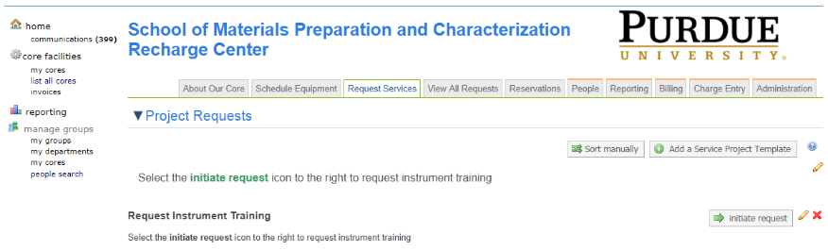
Request Training in iLab
From the MSE or SMC cores on the previous slide:
  Go to the Request Services tab
  Select

Slide 6
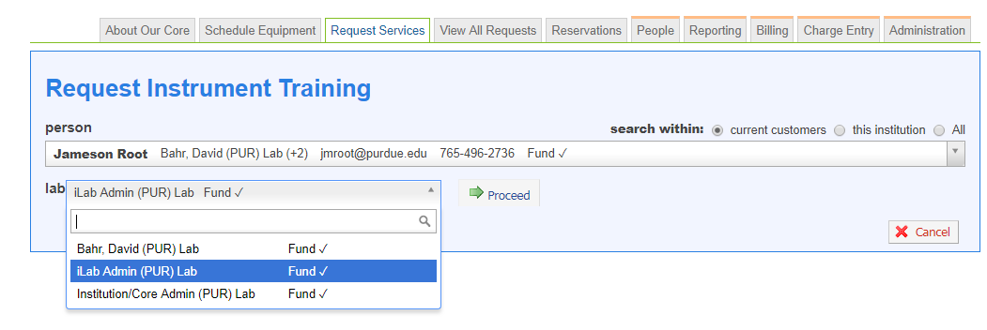
Request Training in iLab
Type in your name into the Customer field
Select which Lab group you want to make the request with
Select Proceed

Slide 7
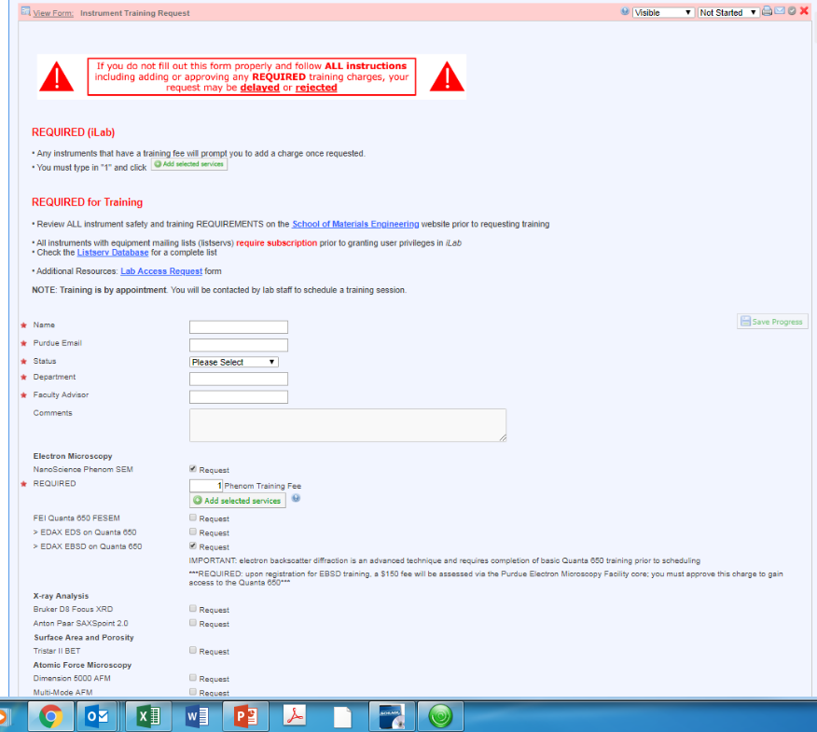

Training
Fill out the Instrument Training Request, noting all requirements (both in the form and instrument-specific, which are published on the MSE website)
Certain instruments, when requested, will display a prompt to add a training charge ( ) and additional requirements
Make sure you Submit The Request

Slide 8
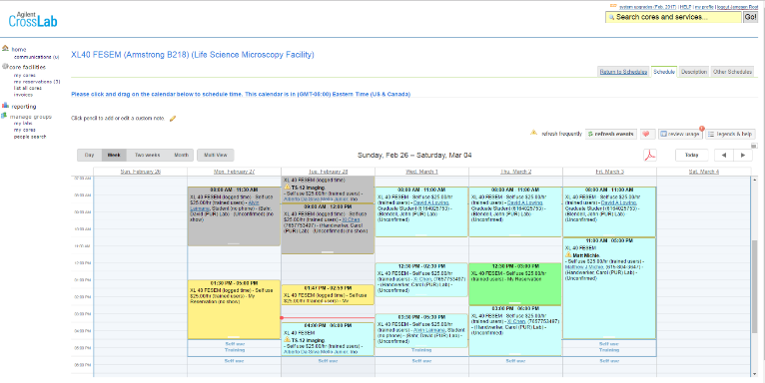
Scheduling in iLab
L-click and drag on the calendar to select the desired reservation time (15- up to 60-min increments depending on the tool)
You can reserve time up to 14 days in advance

Slide 9
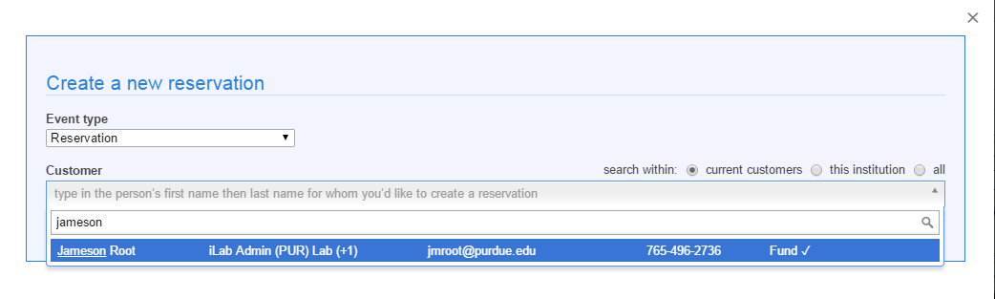
Scheduling in iLab
Use the Reservation Event type
Type in your name into the Customer field
Select which Lab group you want to make the reservation within
Select Account String… from the dropdown menu in Payment Information
Save Reservation

Slide 10
iLab Kiosk
To start/finish a session, you must go to the iLab Kiosk page for the Core Facility (listed below); there is a link at the top of the scheduling page for users to directly navigate to the kiosk. Or, directly go to the following URLs:
  Quanta 650, Talos*: https://purdue.ilabsolutions.com/service_centers/3985/equipment_kiosk/dashboard
  MSE Characterization and Prep: https://purdue.ilabsolutions.com/service_centers/4221/equipment_kiosk/dashboard
  Soft Materials Lab: https://purdue.ilabsolutions.com/service_centers/4224/equipment_kiosk/dashboard
  *Advanced EMs have transferred to the Purdue Electron Microscopy Facility which is a more unified, campus-wide EM Facility. All other instruments are listed in either the SMC or Characterization and Preparation Cores.

Slide 11
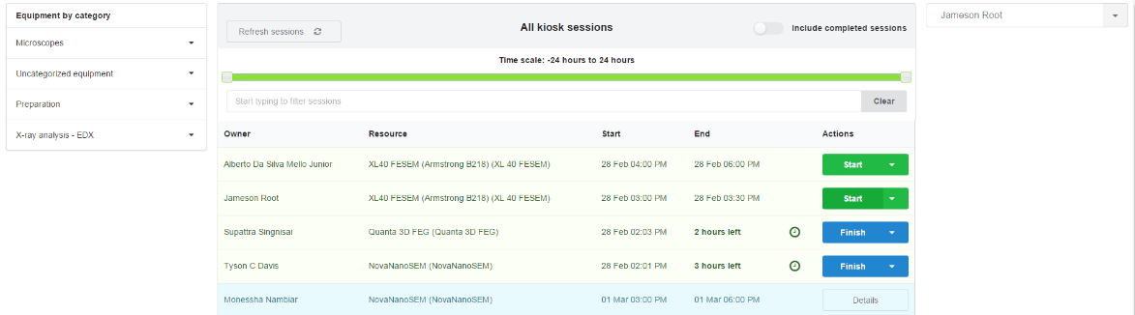
iLab Kiosk
Lab ECN computers have/will have the appropriate Core scheduling and kiosk pages linked to the Start menu under 'All Programs'
Suggested: bookmark your appropriate kiosk page(s)
Find your reservation and select Start

Slide 12
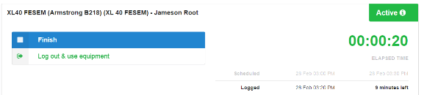
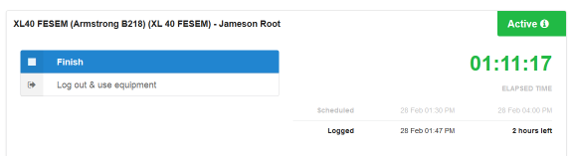
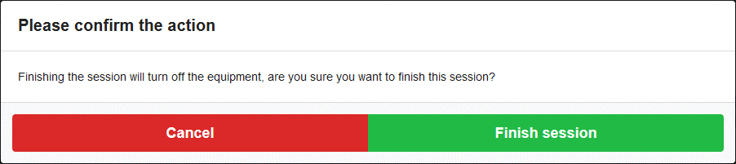
iLab Kiosk
Log out & use equipment
or
Finish to disable the instrument
and Confirm:

