Slide 1
Mike Sherwood PEARL Lab Manager
Responsibilities
Card Access for Pearl Areas
Safety Review of all Projects and Work Areas
Assign Project work areas
Help with Questions on Design and Materials
Welding of Projects with a 4 hour max per group
Some Rapid Prototyping of Parts
Checkout of hand tools
My Background
M.E. Research Machinist and Welder for 30 Plus Years

Slide 2
Safety
Safety Reviews :
There will be 3 safety reviews on your project. All reviews will be e-mailed to myself msherwoo@purdue.edu, Professor Greg Jensen Jensen23@purdue.edu and your instructor. Accepted formats are Word or PDF documents only. Approval to proceed will come directly from me.
SR3 is only due when your project is completed and ready for testing! I must see your project before you can start testing.
Work Room Safety:
Safety glasses are to be worn by you and others around you while working with power tools or hand tools that generate air borne debris in Rooms 1202, 1203 and 1178.
No open toe shoes are to be worn in the work rooms (1202, 1203, 1178)
A Safety Data Sheet (SDS) is required for any chemical brought into this lab. Please Give a copy to the Lab Manager.

Slide 3
Access
Test that Must be Taken:
M.E. Building Emergency Plan Quiz (BEP) https://engineering.purdue.edu/ME/AboutUs/Safety/BuildingSafety Test must be passed in order to get access to PEARL Breakout Rooms 24/7, Work Rooms 7:00am – 11:50pm and After hours Building Access.
Optional Tests if you plan on using these facilities.
M.E. Project Machine Shop Quiz https://engineering.purdue.edu/MECL/projectshop/ This must be passed before you can gain access to the Machine shop.
M.E. 3D Print Lab Quiz for after hours access. https://engineering.purdue.edu/MECL/3dprint/

Slide 4
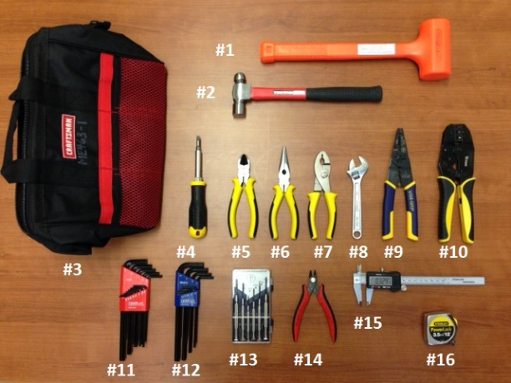
Available Resources For checkout from my office
Basic Tool Bags
Large Tool Kits

Slide 5
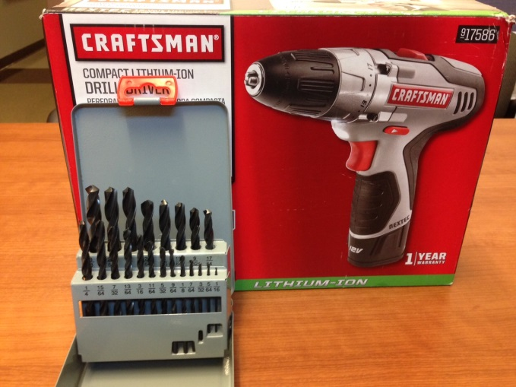
Available Resources For checkout from my office
Cordless Drills
Small Drill Bit Set
Batteries : Various Types
Radio control units & Misc. components
Desktop 3D Scanner

Slide 6
Resources In The Labs Rooms 1202 & 1203
Motors of all types AC, DC & Stepper
Bulk wire
Switches, buttons, Relays
Sprockets, Gears & Pulleys
Bearings Various types
Wheels & Castors
Other misc. Materials Hardware & Electrical
Fume Hood for Lite gluing, Fiber glassing & Painting

Slide 7
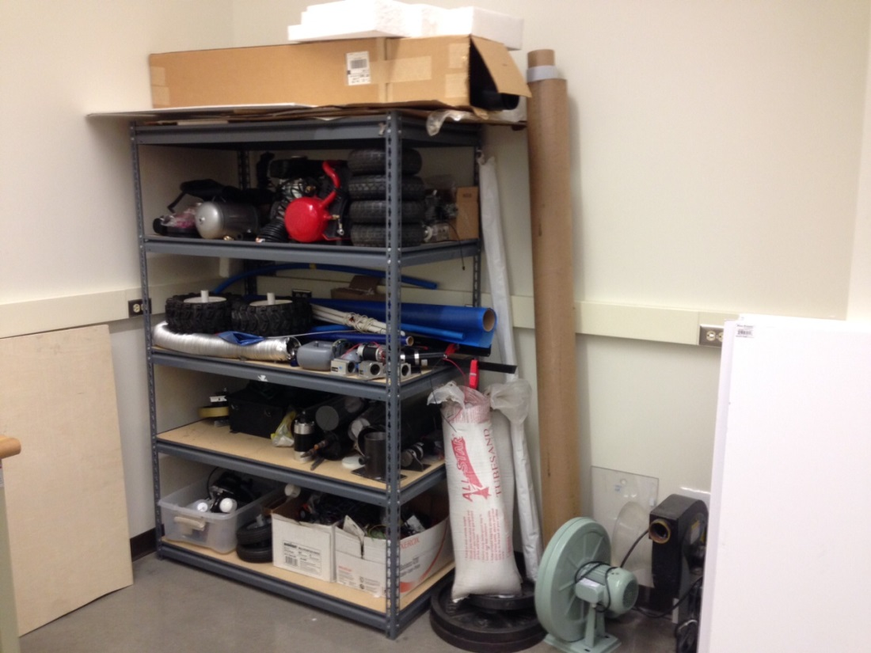
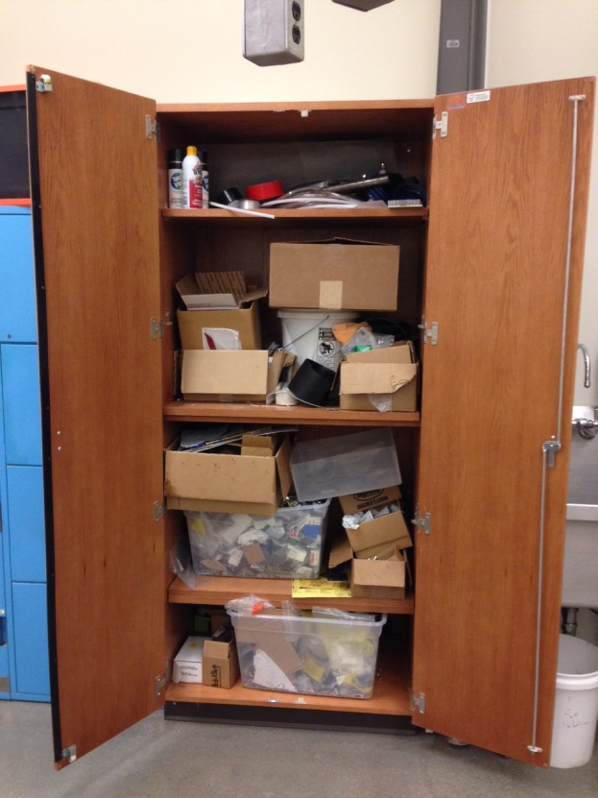
These are the Only Storage Areas where Components are available Free for the taking
Room 1202

Slide 8
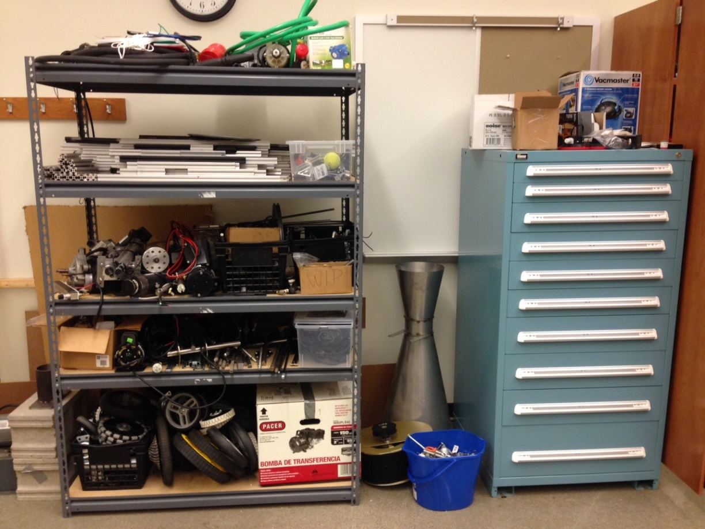
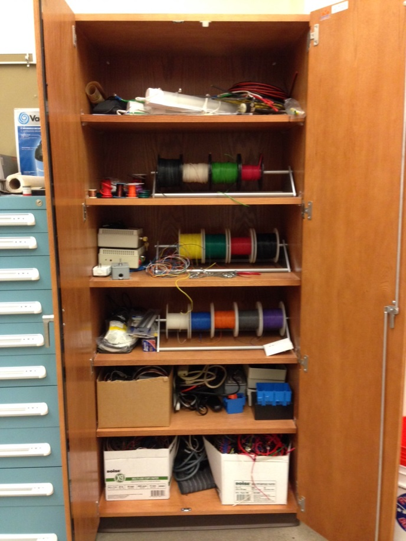
These are the Only Storage Areas where Components are available Free for the taking
Room 1203

Slide 9
Do Not Take Parts From Benches Or Storage Cubbies In Rooms 1202 & 1203 they belong to other 463 Groups!

Slide 10
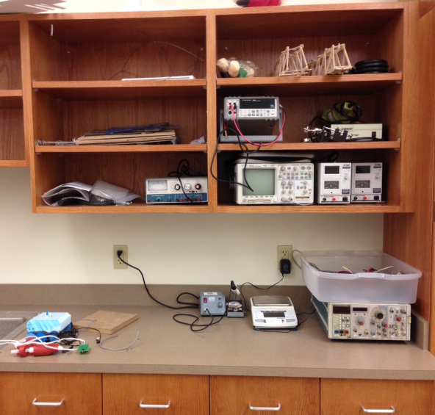
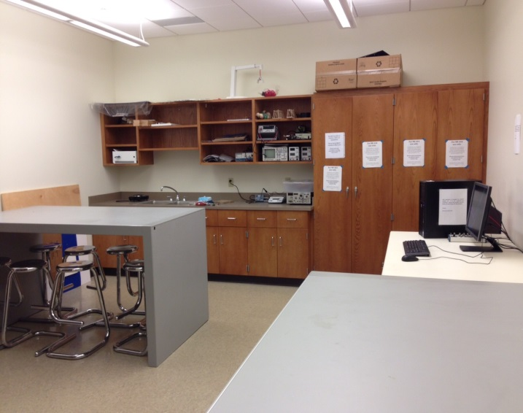
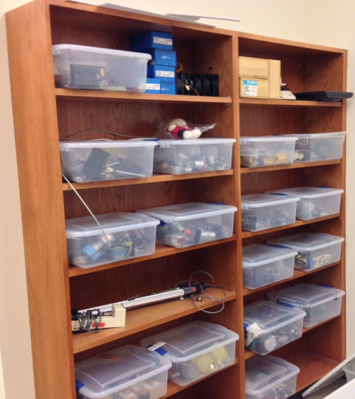
Additional Work Area For All M.E. Students Room 2130
Soldering Station
Test Equipment
Work Station for Programing Arduino's
Additional Electrical Component's

Slide 11
Rules For Painting Projects Here At Mechanical Engineering
No Spray Painting Is Allowed In The Building Except In One Of Two Fume Hoods!
These hoods are to be used on small projects. Heavy spray painting needs to be done outside in the designated area only.
If you have any Questions Please Contact:
Mike Sherwood room 1180
Or
Rick DuVall room G044

Slide 12
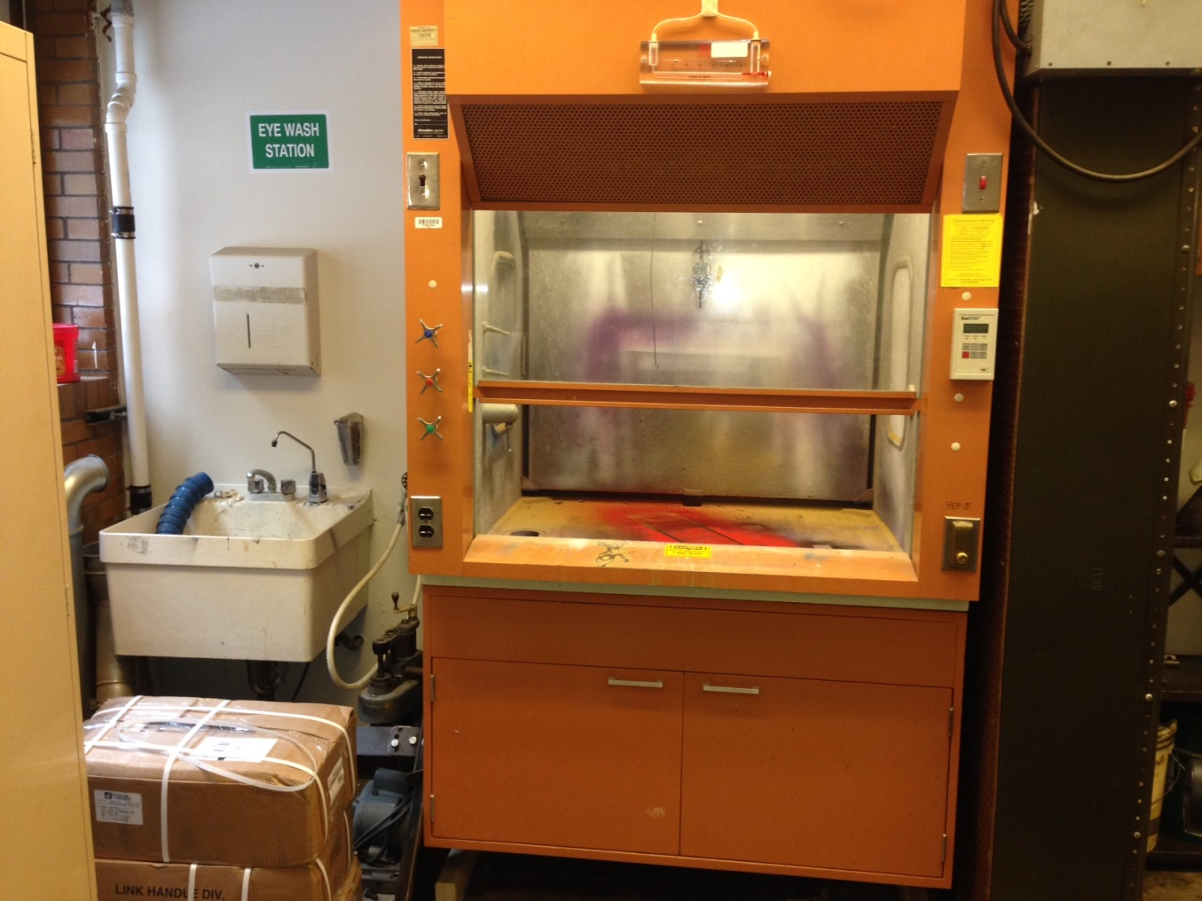
The First Hood Is In Room G039 Student Shop
This Hood Can Be Used By All M.E. Students.
Talk To Shop Staff Before Use.

Slide 13
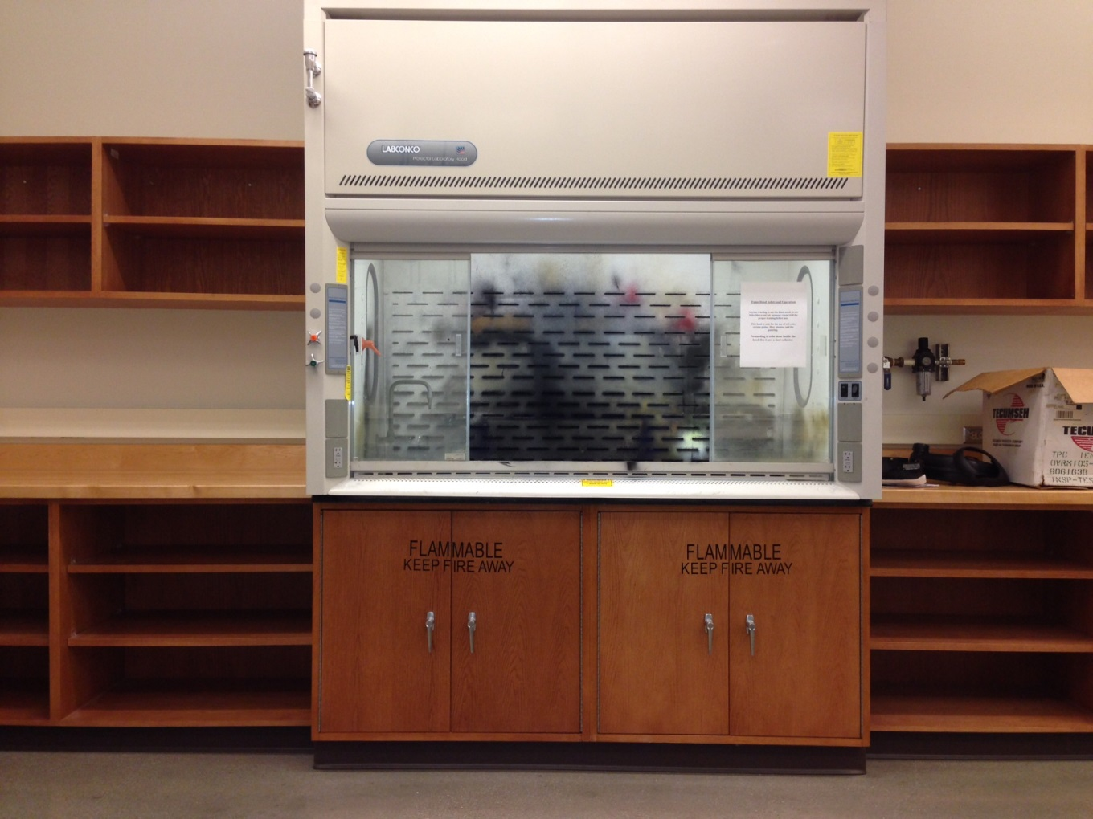
The Second Hood Is In Room 1202 PEARL Labs
This Hood Is For Senior design Use Only.
Contact: Mike Sherwood Before Use.

Slide 14
Brush Painting Is Allowed In The Building As Long As Proper Procedures Are Followed
Only Low Oder paints should be used. Read the label first if it says use in adequate ventilation then it needs to be used in a fume hood or outside in the designated area.
To protect tables and floors where you will be painting, use either Cardboard a Drop cloth or News Paper to protect the surfaces.
Large projects need to be painted outside in the designated area. If it is larger than a microwave oven then it needs to be painted outside.

Slide 15
Outside Designated Painting Area Location

Slide 16
Back Entrance M.E. Building Next To Loading Dock
Paint Here On Gravel

Slide 17
Painting Is Allowed On The Gravel Area Just Past The Green High Voltage Box On The Left
Paint Here On Gravel
Please Paint in the middle of the rocks and away from the sides of the building.

Slide 18
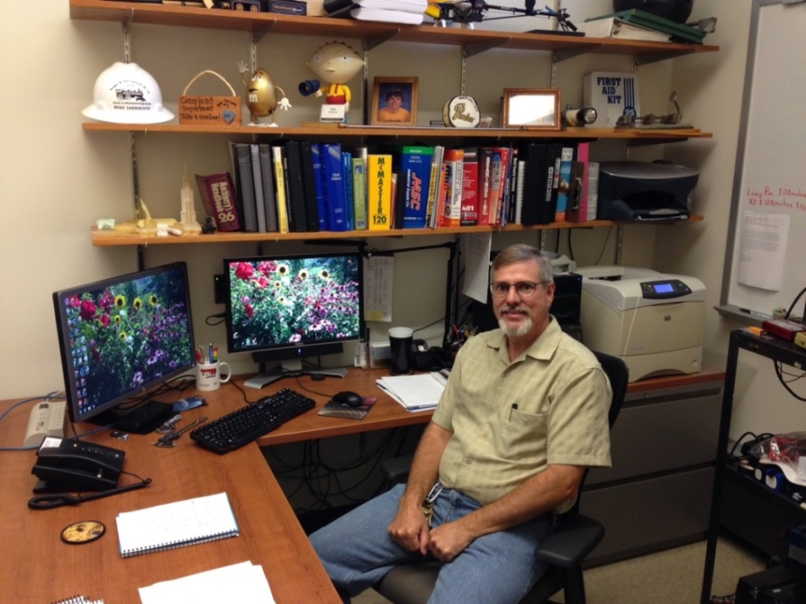
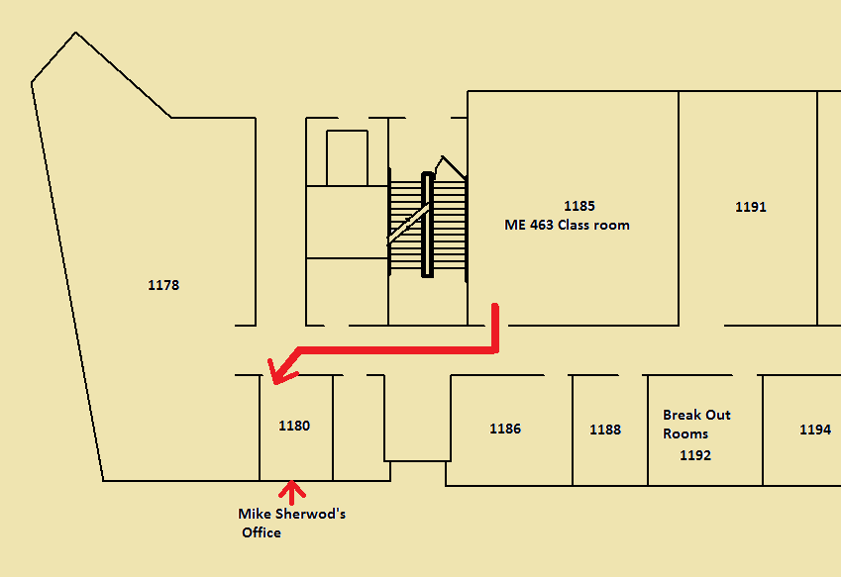
I am here as a resource so please ask Questions !
Contact
Mike Sherwood
Room 1180
msherwoo@purdue.edu

