Slide 1

Official Mechanical Engineering Graduate Association (OMEGA)
Spring Orientation 2026
Eugenio "Henny" Frias-Miranda
Vice-president
OMEGA

Slide 2
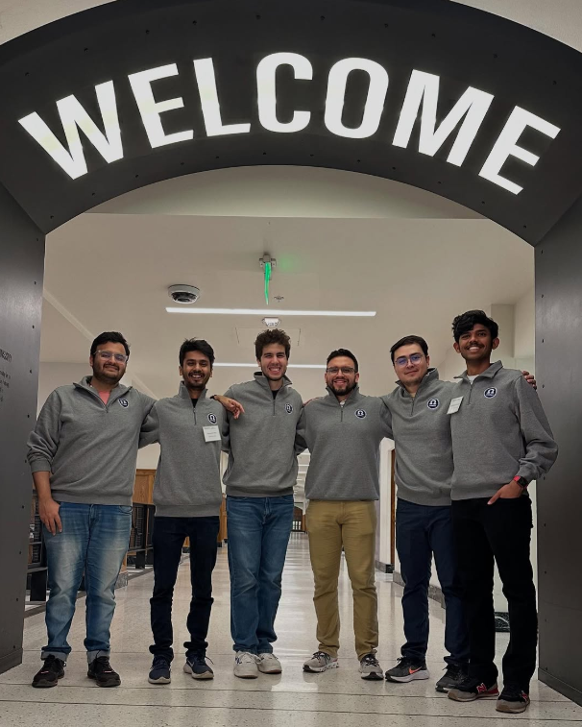
What is OMEGA?
The Official Mechanical Engineering Graduate Association, is a student organization that supports ME grad students through social, academic, and professional events
All ME grad students are automatically members of OMEGA (accept our Boilerlink request!).
We represent your interests in university leadership settings
24-25 Officers at ME grad student visitation day
24-25 Officers at ME grad student visitation day

Slide 3
Committees
Academic - Aims to enhance the academic experience of ME grad students through educational events and resources
ME290 research tours, Prof/grad student panels to ugrads, speaker series, mentoring programs, reverse career fair, industry tours
Social - Focuses on building a sense of community and connection among ME grad students through social events and activities
Socials/watch parties, hikes, IM teams, cookouts

Slide 4
What does OMEGA do?
Building Social Connections: We organize social events, often in collaboration with other departments, to help ME grad students connect
Academic Enhancement: We support your academic success by hosting study groups and facilitating academic seminars
Mentoring Opportunities: We run mentoring activities that pair experienced grad students with newcomers to help them transition smoothly
Resource Guides: We provide useful links and resources on our website to assist with academic and personal challenges (purdueomega.com/resources/useful-links-contacts)
Representing Students: We ensure your feedback is communicated to ME department and university leadership by actively representing you in leadership settings

Slide 5
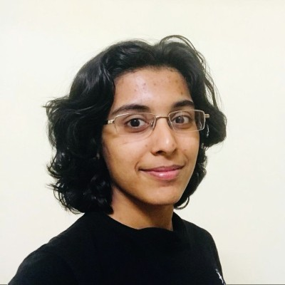
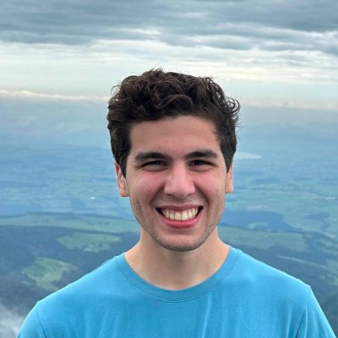
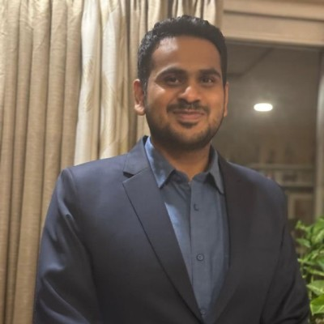
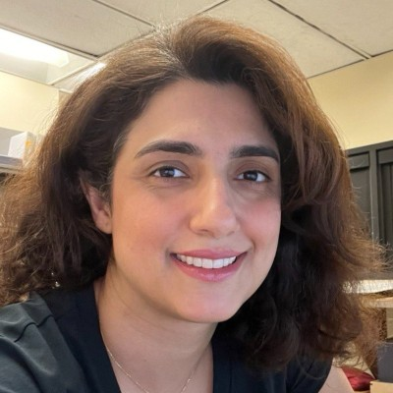
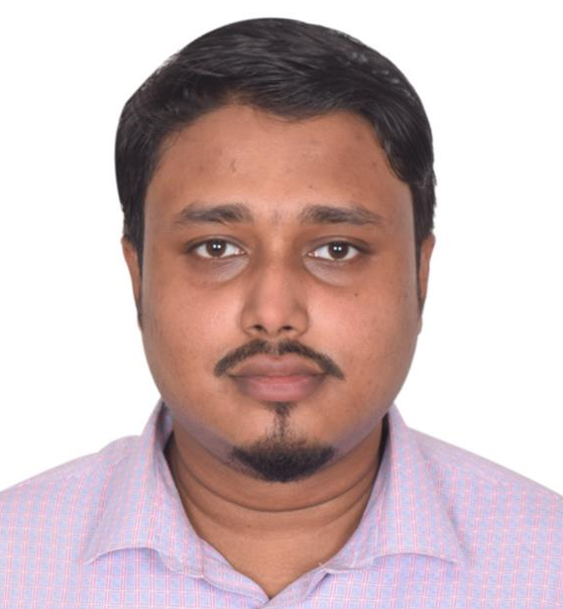
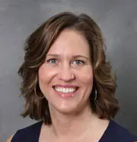
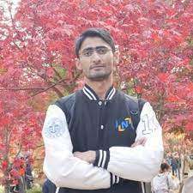
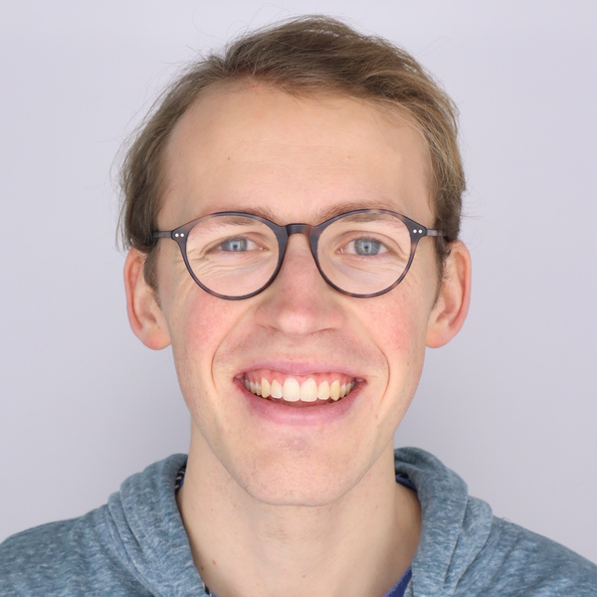
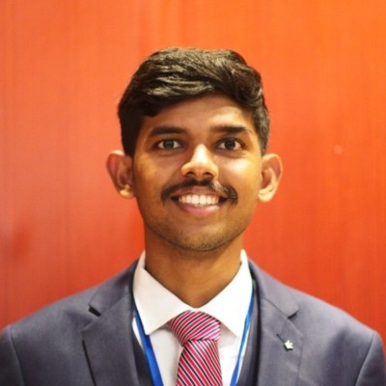
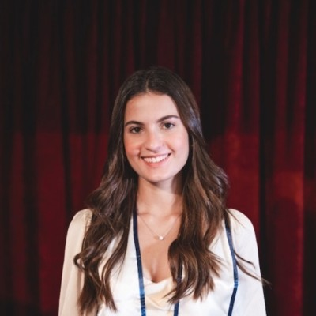
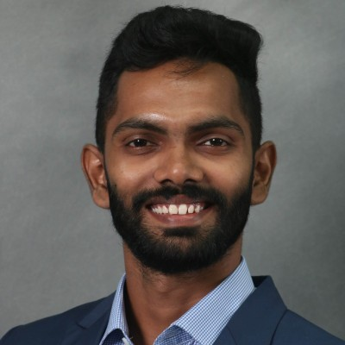
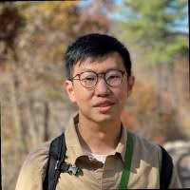
Our team
Nicole Key
Faculty Advisor
Sneha Srikanth
President
Eugenio Frias-Miranda
Vice-President
Shrihari Pande
Treasurer
Shahrzad Ghadiri
Secretary
Mhd. Abir Mahdi
Academic Chair
Sadaf Mehdi
Social Chair
Eric Williamson
Herrick Labs Representative
Athul C.
Dharmarajan
Outreach Chair
Juanita Latorre
Jaramillo
Social Media Chair
Chathusha Punchi Wedikkara
PGSG Senator
Sicheng Wang
Photographer

Slide 6
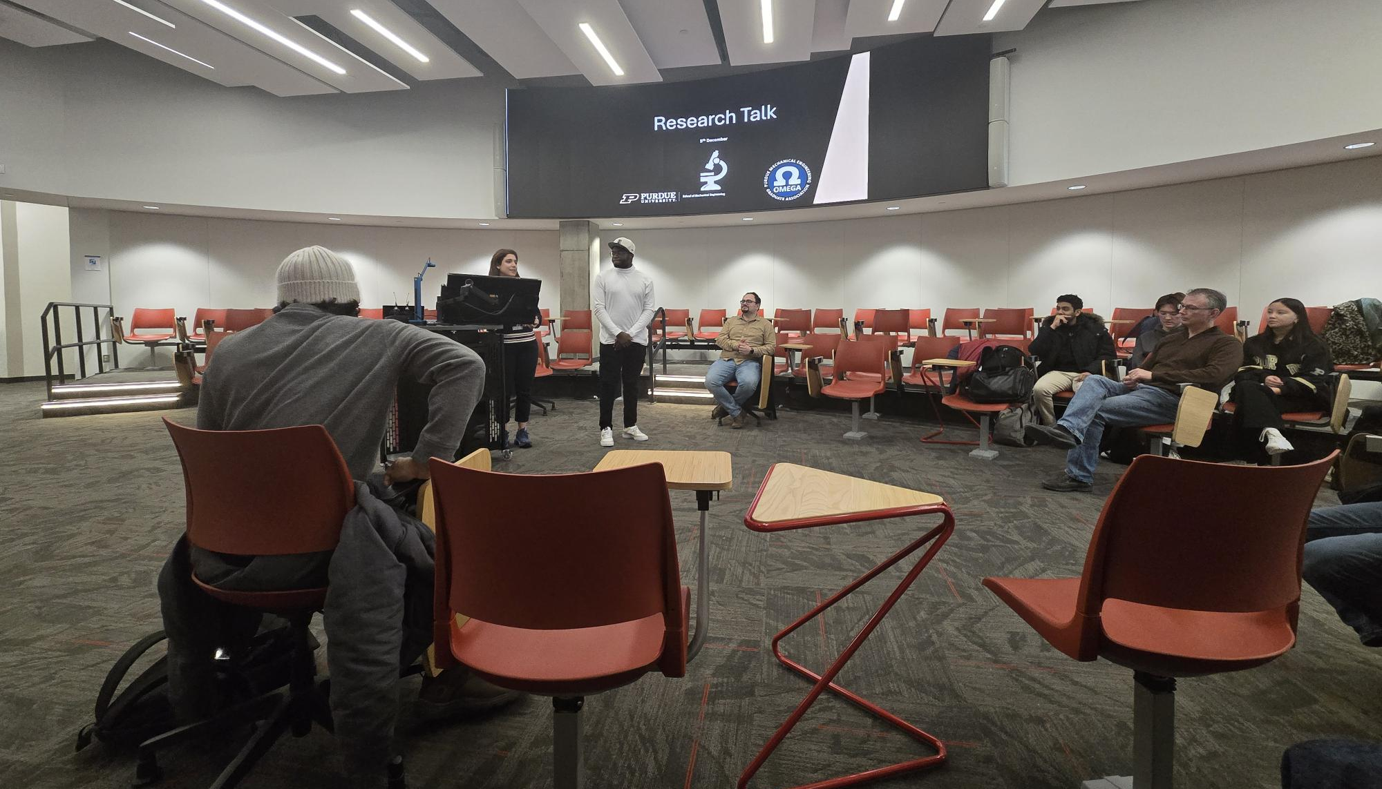
Events in November & December
OMEGA coffee hours (Nov 18, Dec 1): Casual space for early-stage grad students to socialize, and seek guidance from senior grad students.
Students & professors meetup @ Indy (Dec 5): Networking event at Indy for ME grad students and professors.

Slide 7
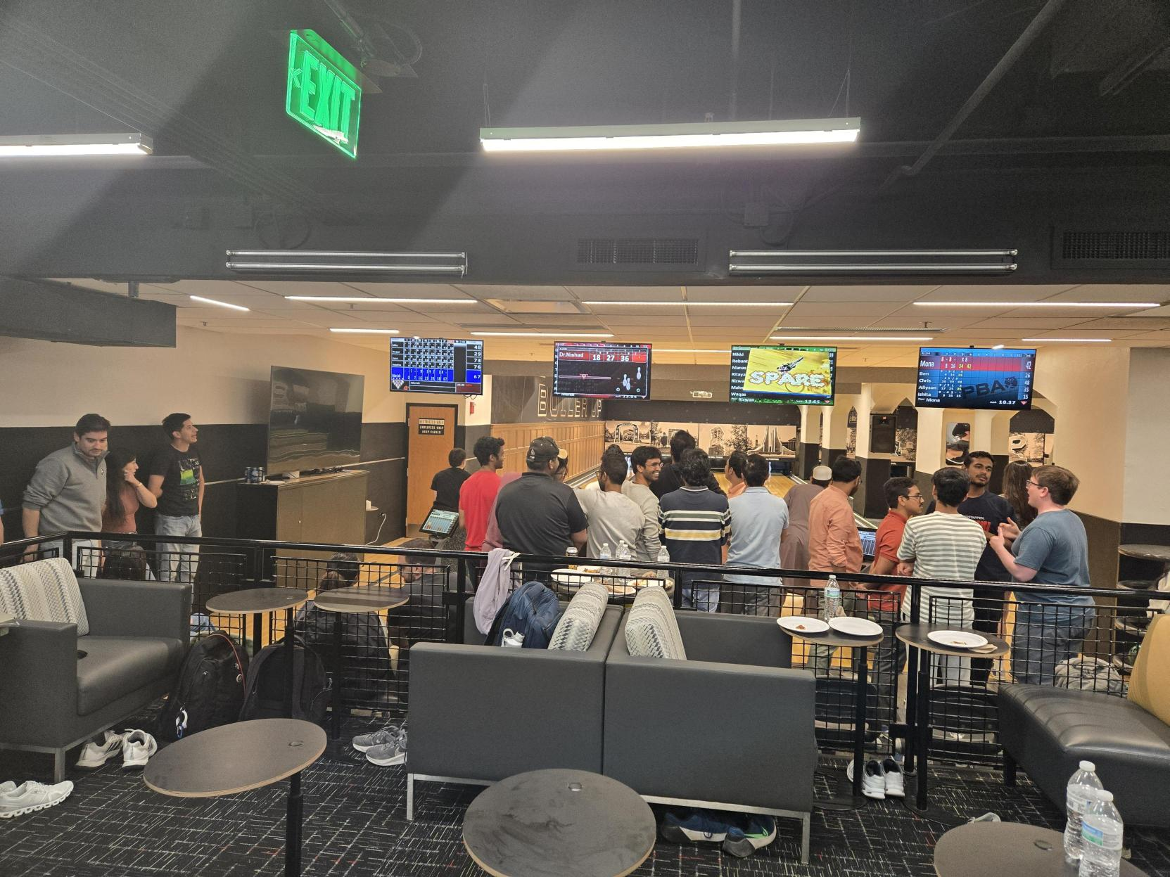
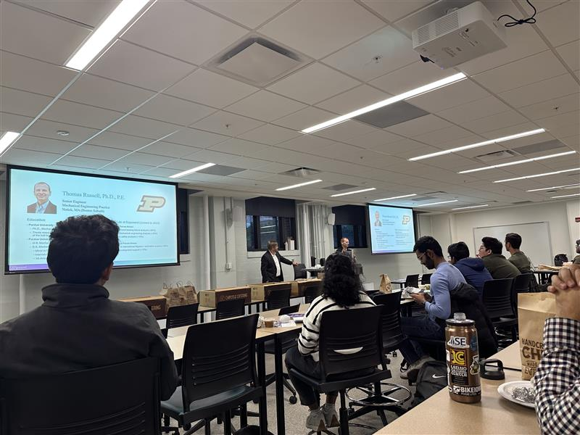
Events in October
Research Forum (along with PMEA) (Oct 6): Forum to discuss undergrad research with a panel of grad students and professors. ~40 undergrads participated in this event
Bowling night (Oct 17): Casual evening to socialize over bowling and pizza.
Exponent Recruiting Session (Oct 23): Representatives from Exponent Inc. talked about consulting careers.
Poster show at WiME symposium (along with GradSWE) (Oct 27)

Slide 8
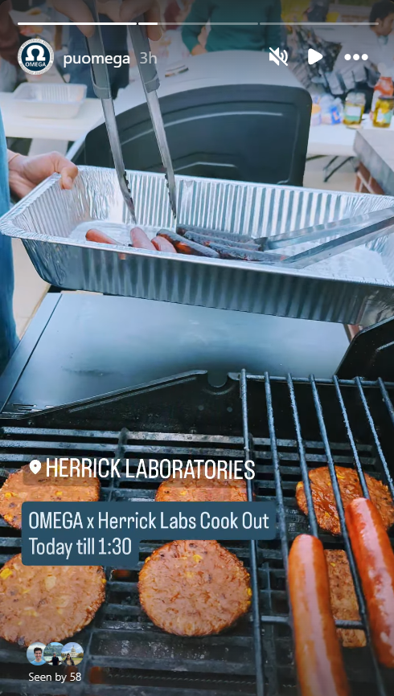
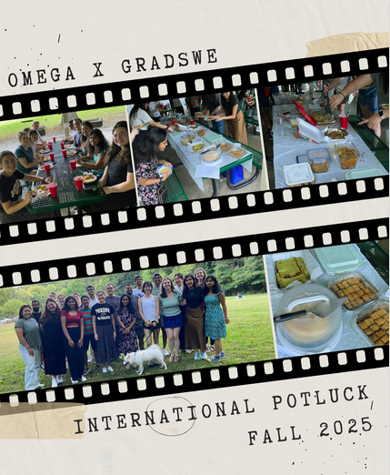
September : Collab social events
Welcome Cookout (OMEGA & HSRC): To welcome grad students to the new academic year.
International Potluck (OMEGA & GradSWE): A potluck to share food from different cultures at Happy Hollow park
Other initiatives:
Area exam prep discord server
Compilation of resumes for Industry Roundtable

Slide 9
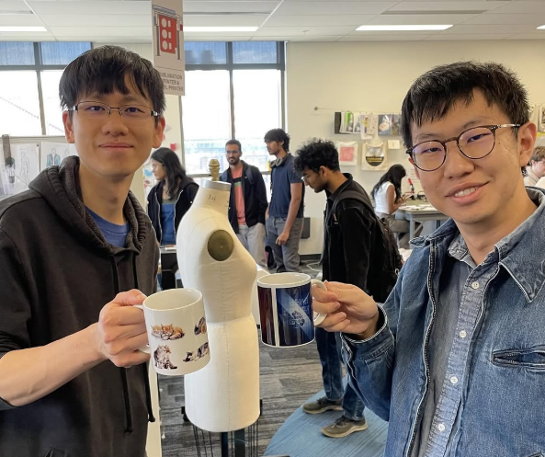
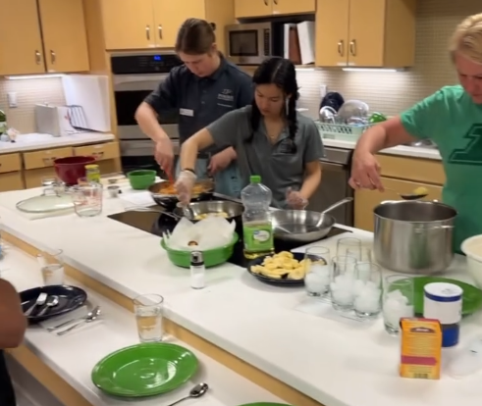
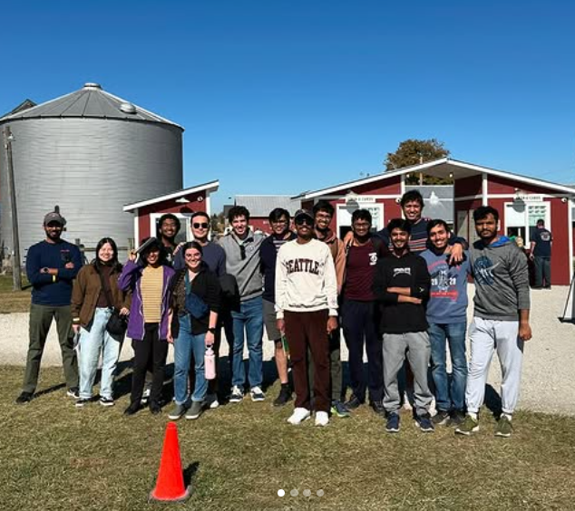
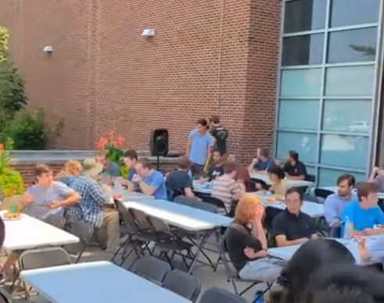
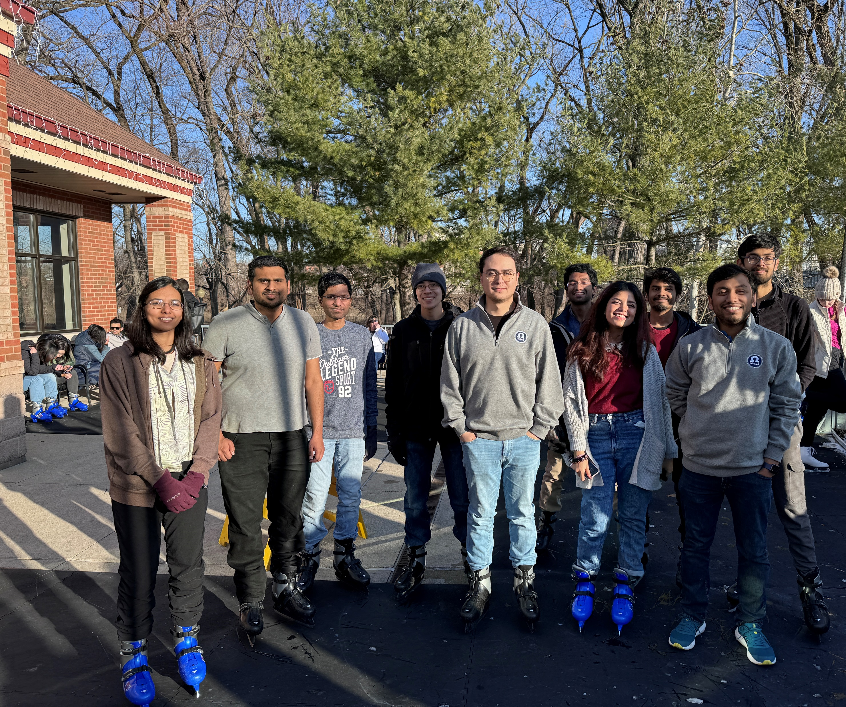
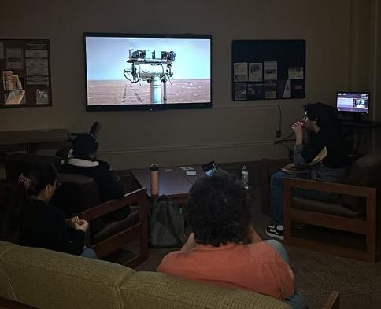
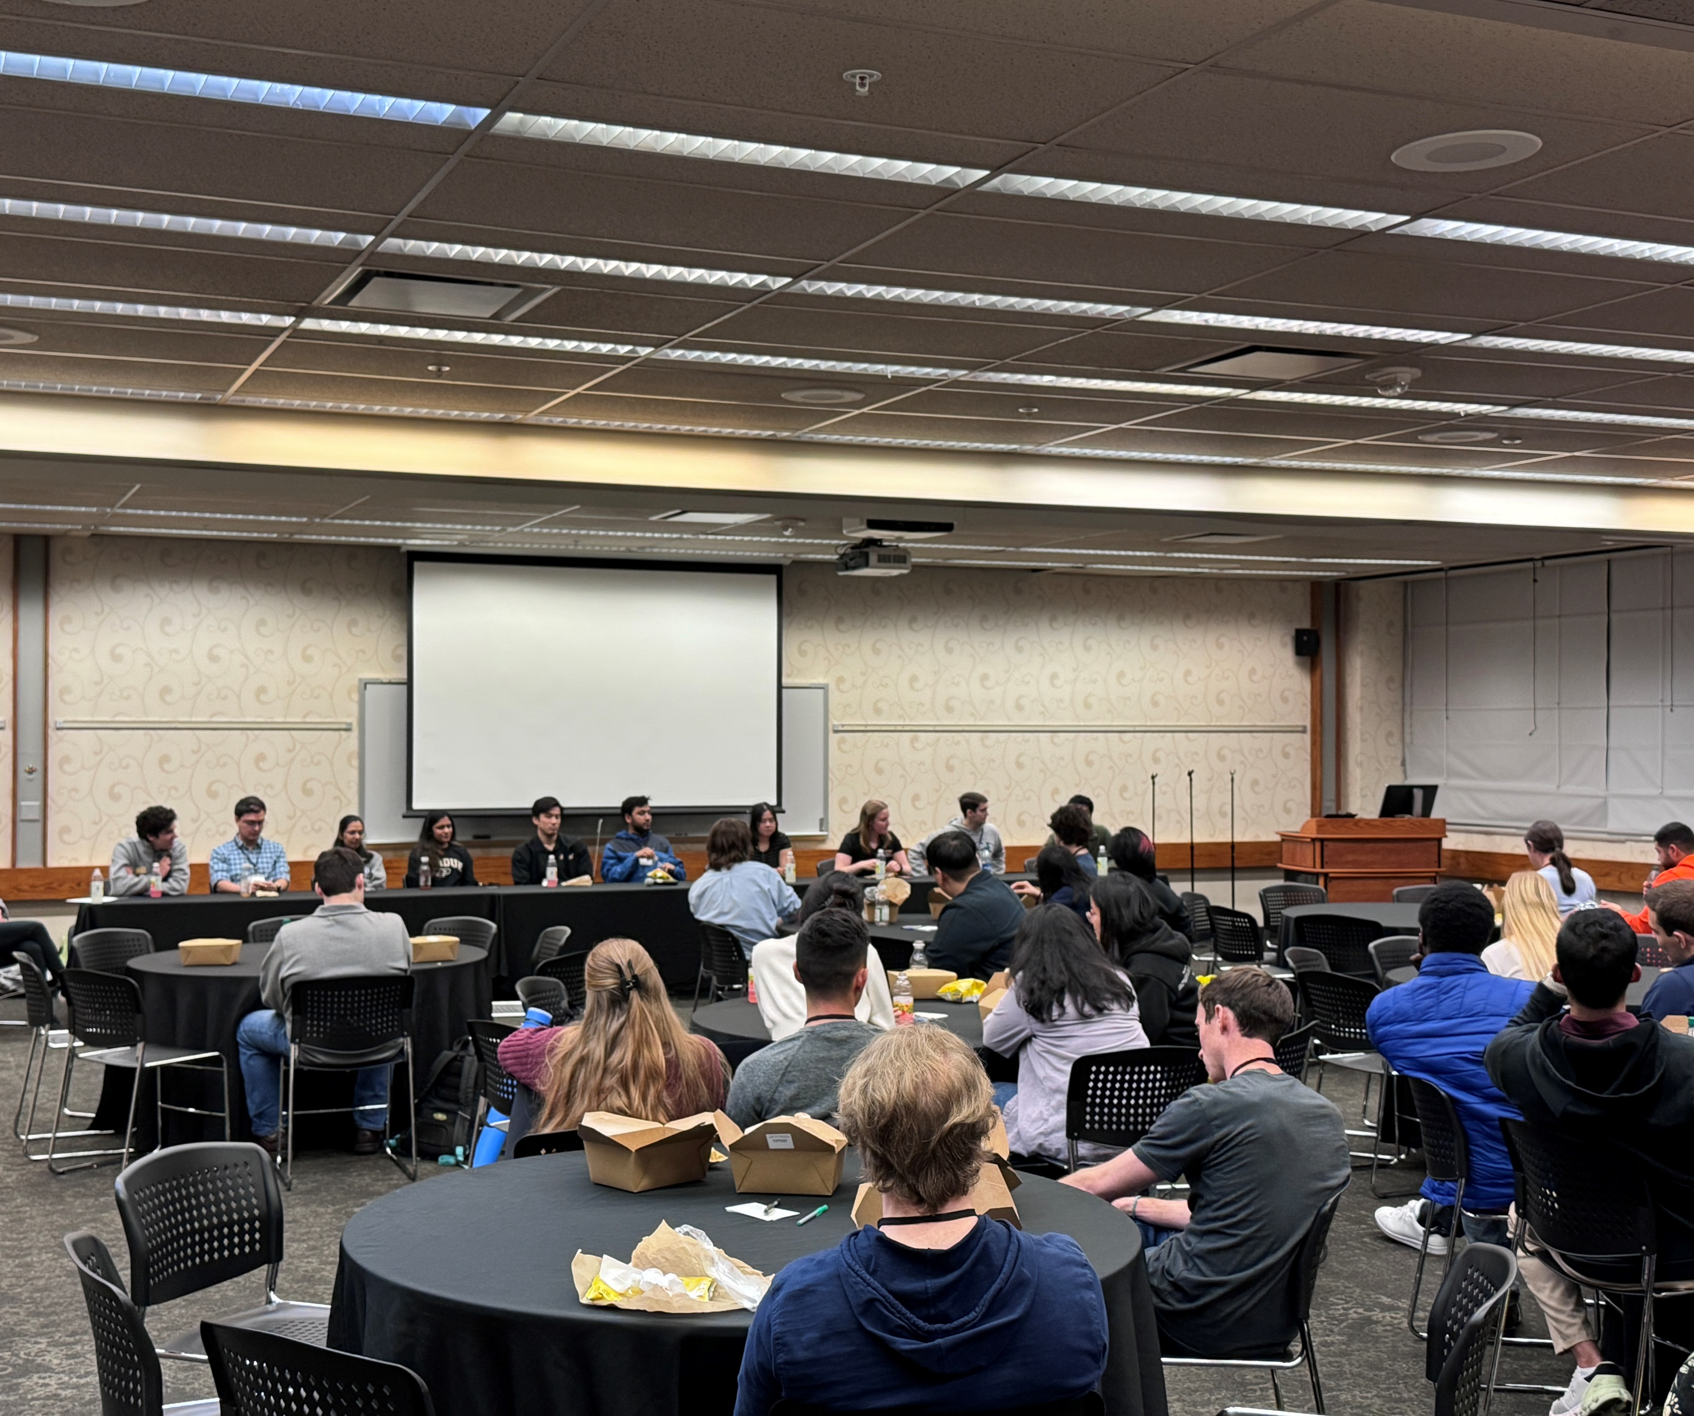
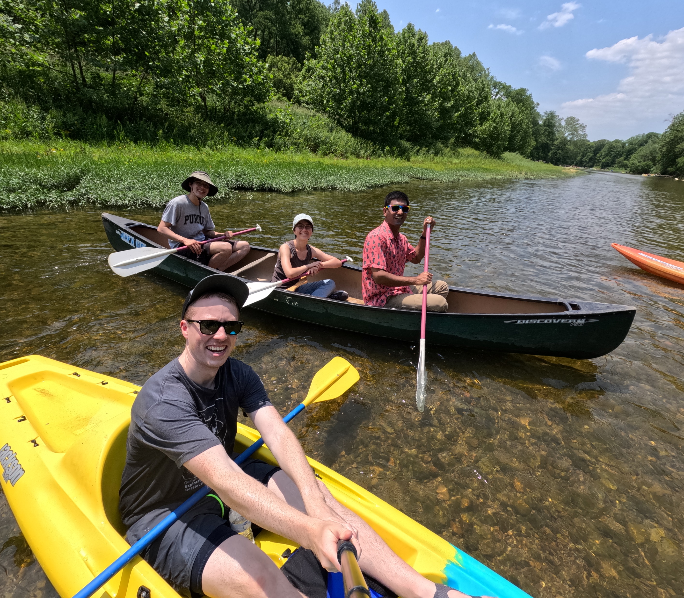
Mug Printing
Apr 2025
Cooking Demo
May 2025
Corn Maze
Oct 2024
Summer Cookout
Jul 2024
Ice skating social
Jan 2024
Movie Night
Nov 2024
Grad Visitation Day
Feb 2024
Canoe Trip
Jun 2023

Slide 10
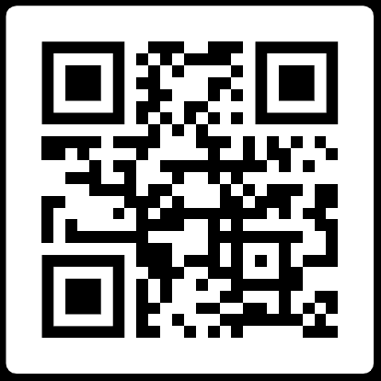
How to get involved?
Attend our events (advertised on OMEGA newsletter and our Instagram channel)
Don’t forget to accept our boilerlink request!
Follow us on Instagram, LinkedIn. Join the Discord server (especially for Area Exam prep)
Officer elections – end of Spring term
Our Socials
Website: purdueomega.com
Email: puomega@purdue.edu
Insta: puomega
Discord: https://discord.gg/gyyGmftsx8

