Slide 1
Official Mechanical Engineering Graduate Association (OMEGA)
Glynn Gallaway – OMEGA Vice President
puomega@purdue.edu

Slide 2
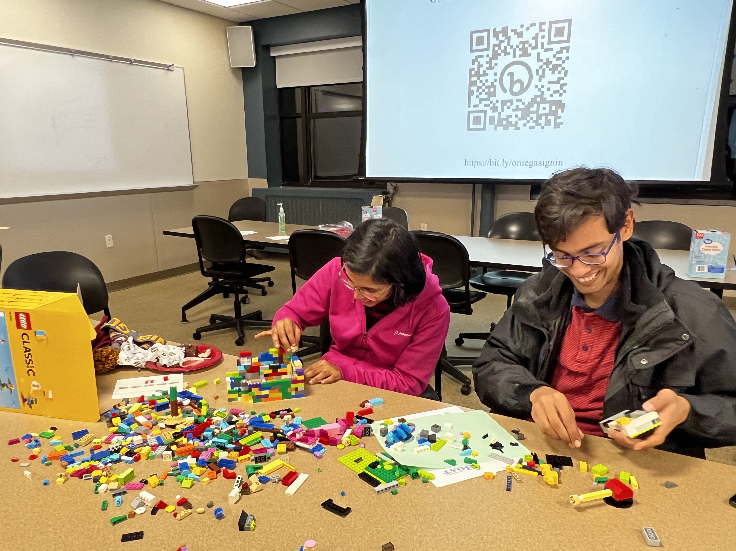
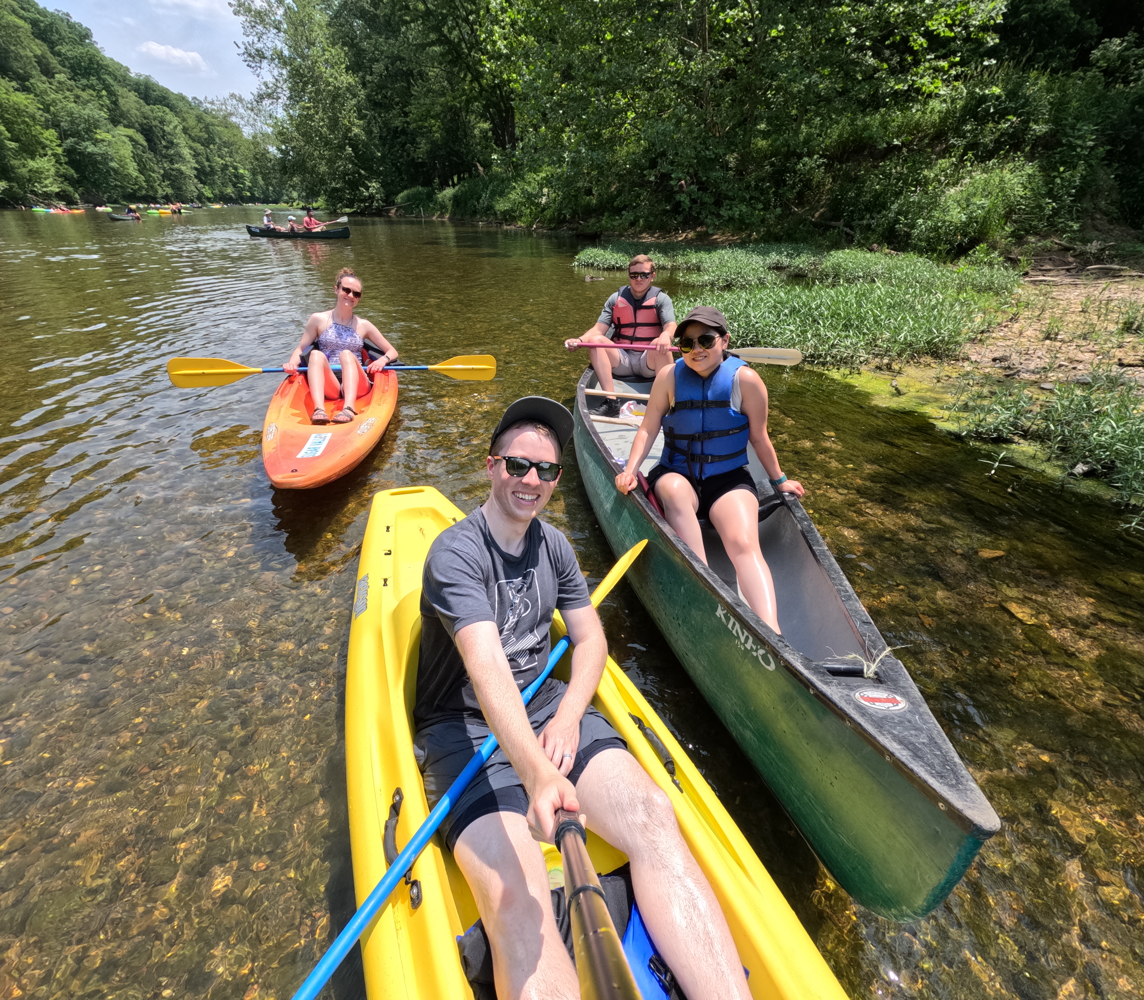
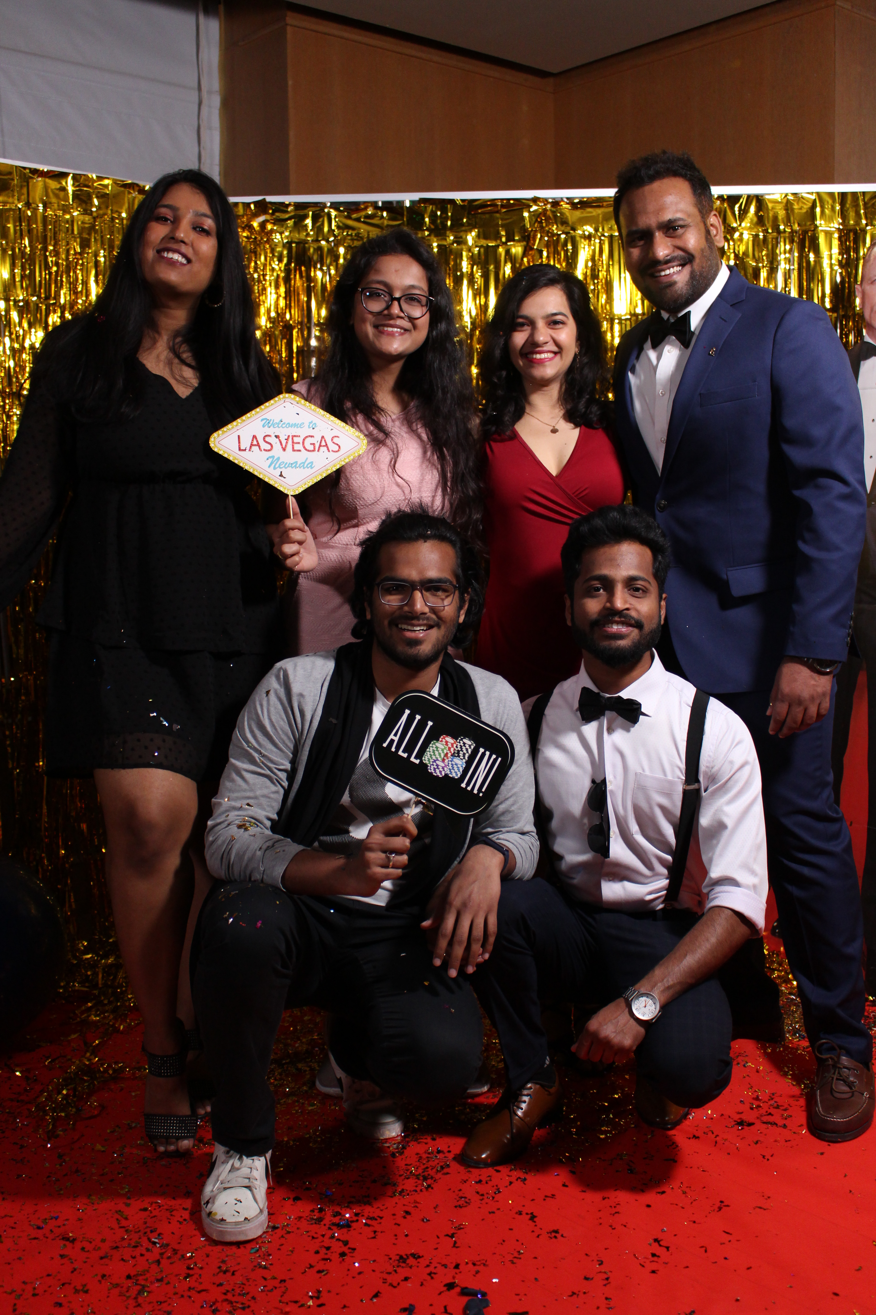
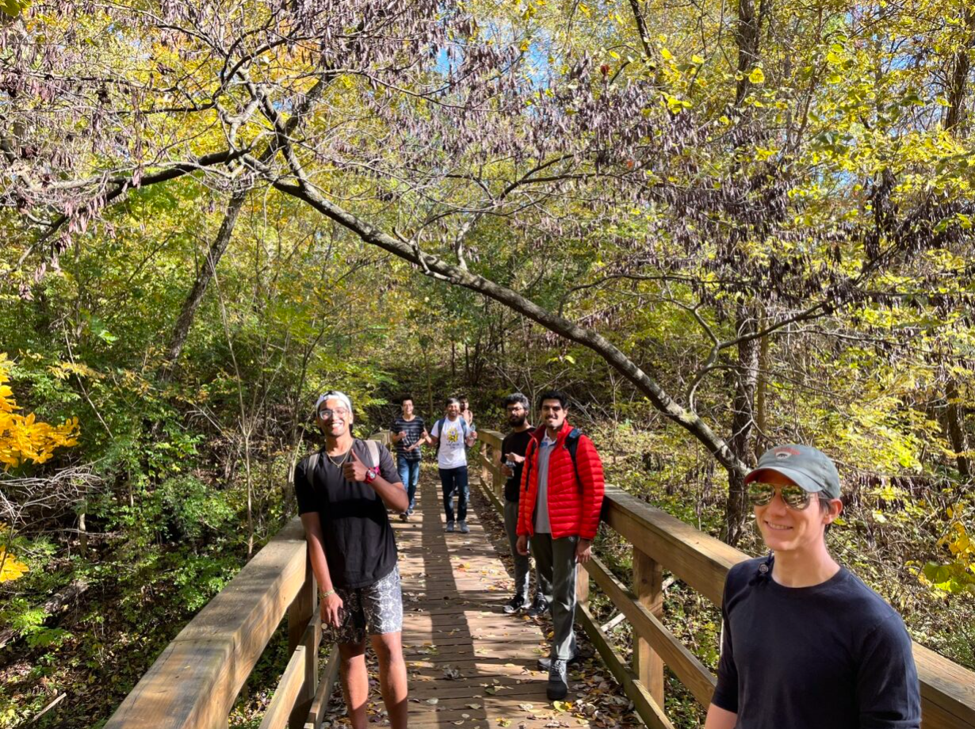
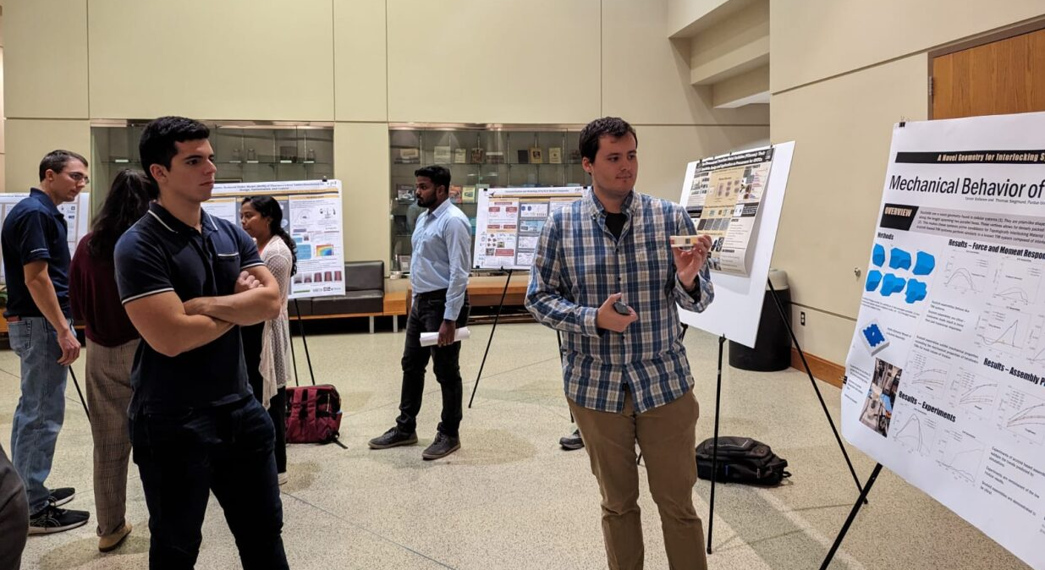
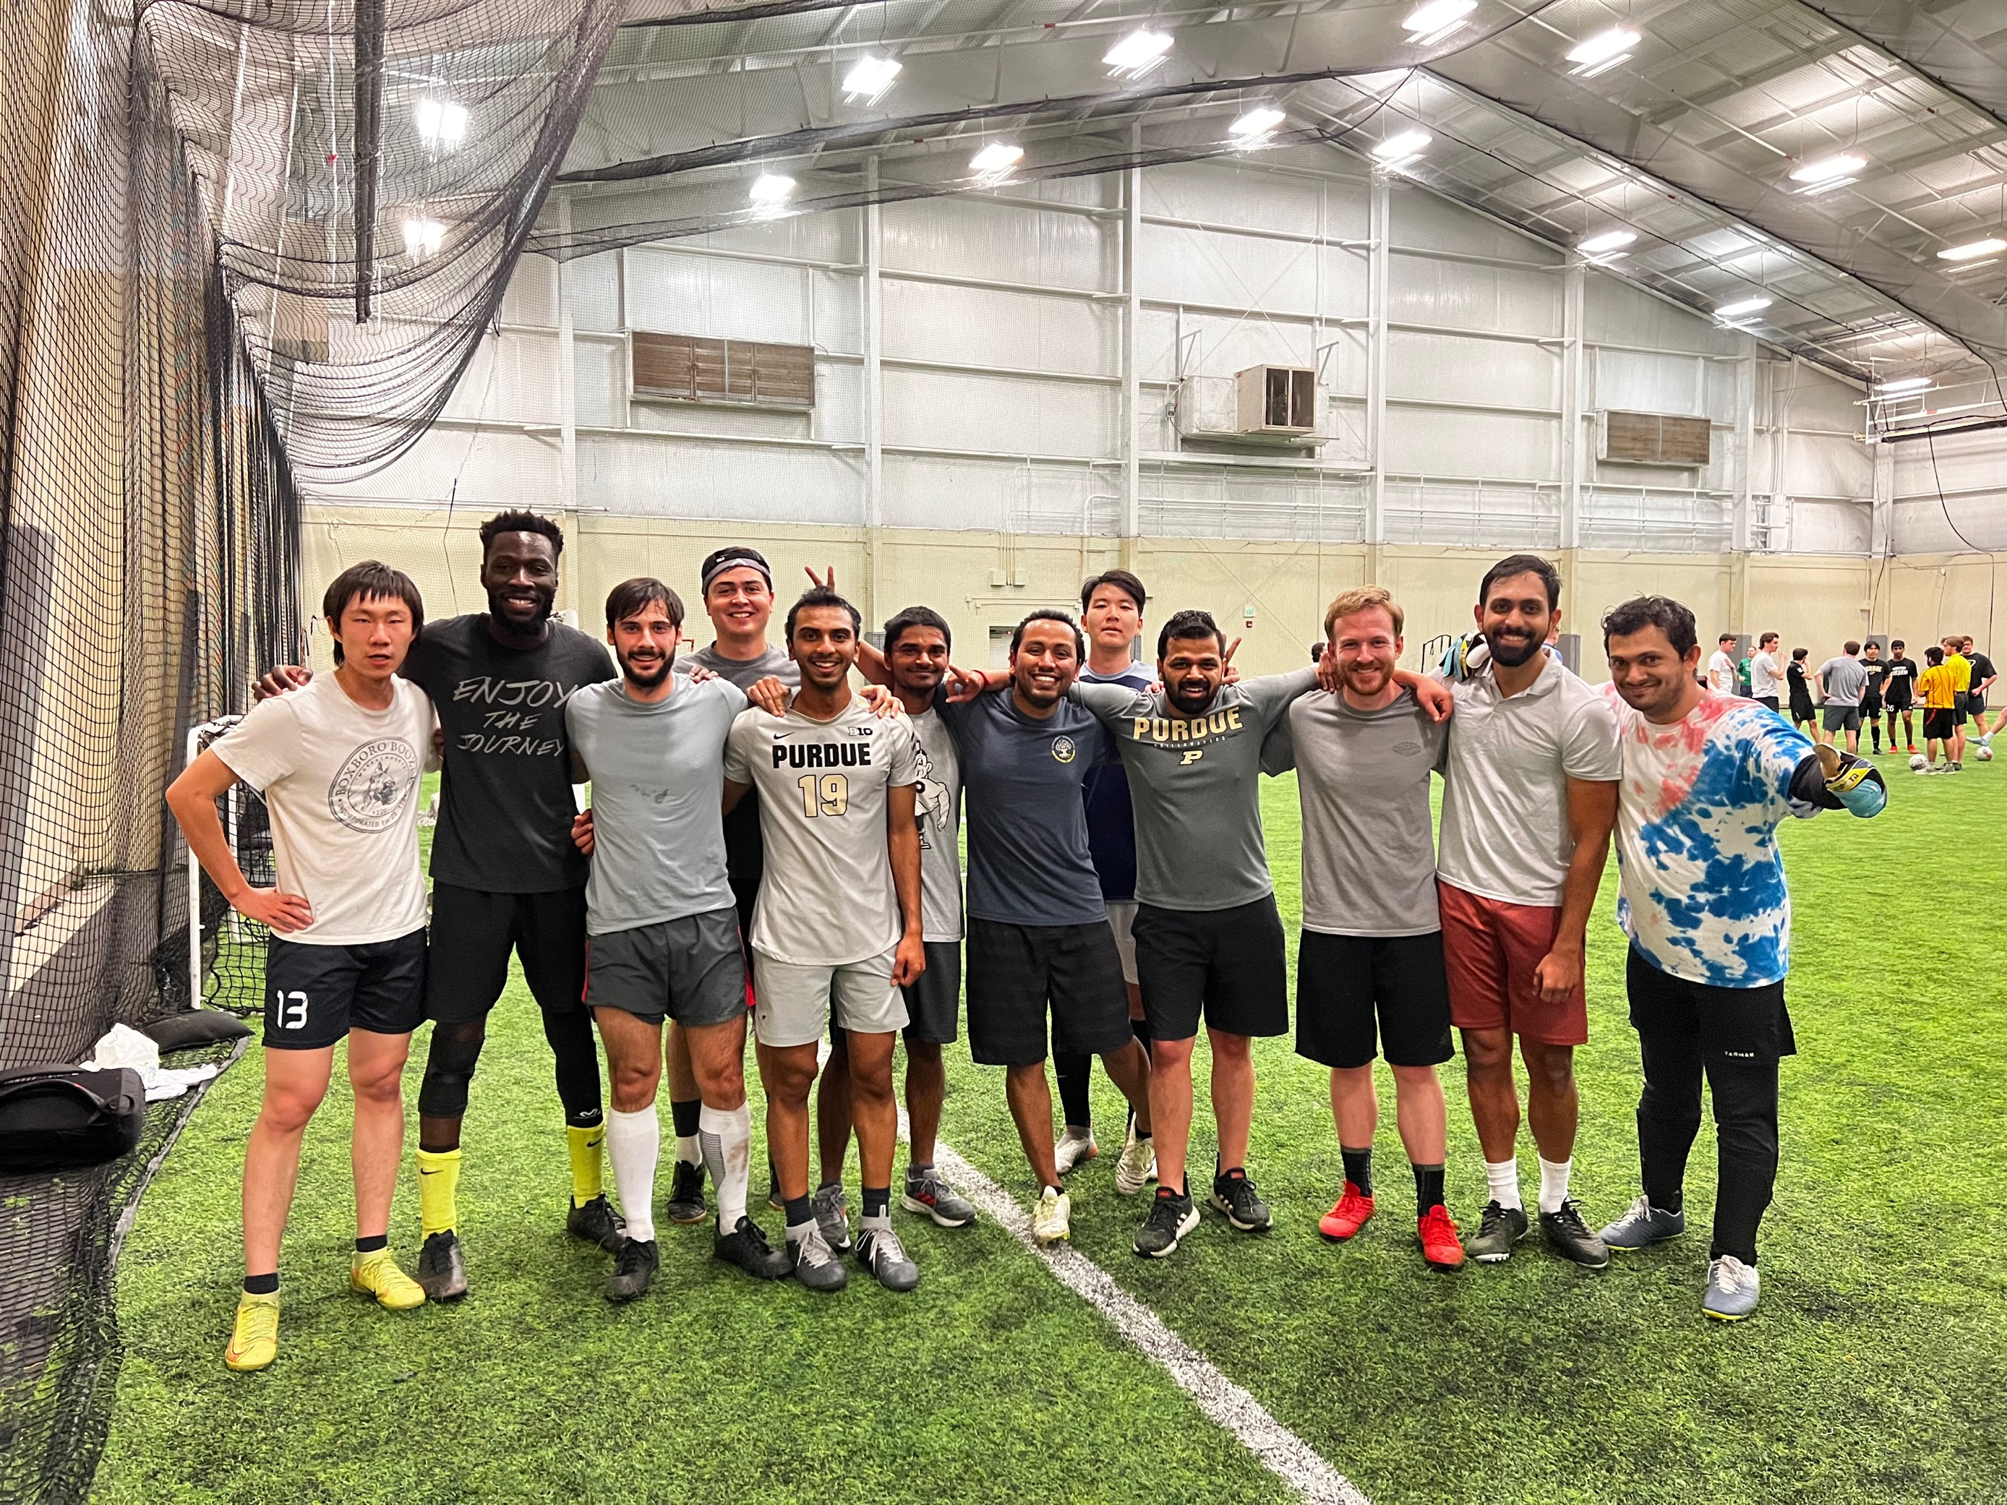
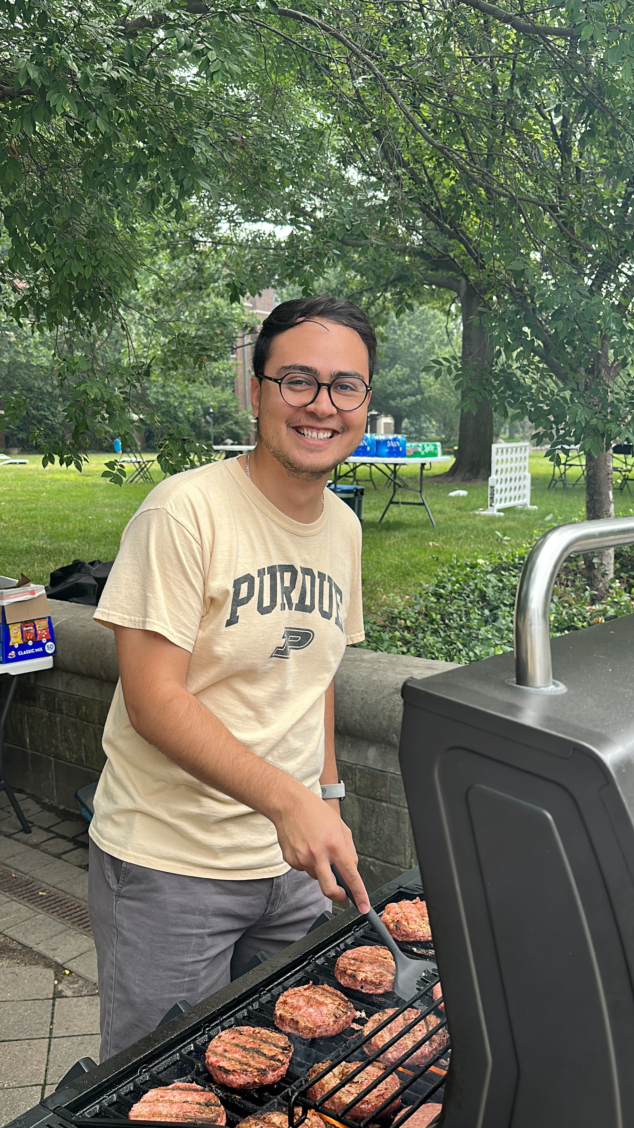
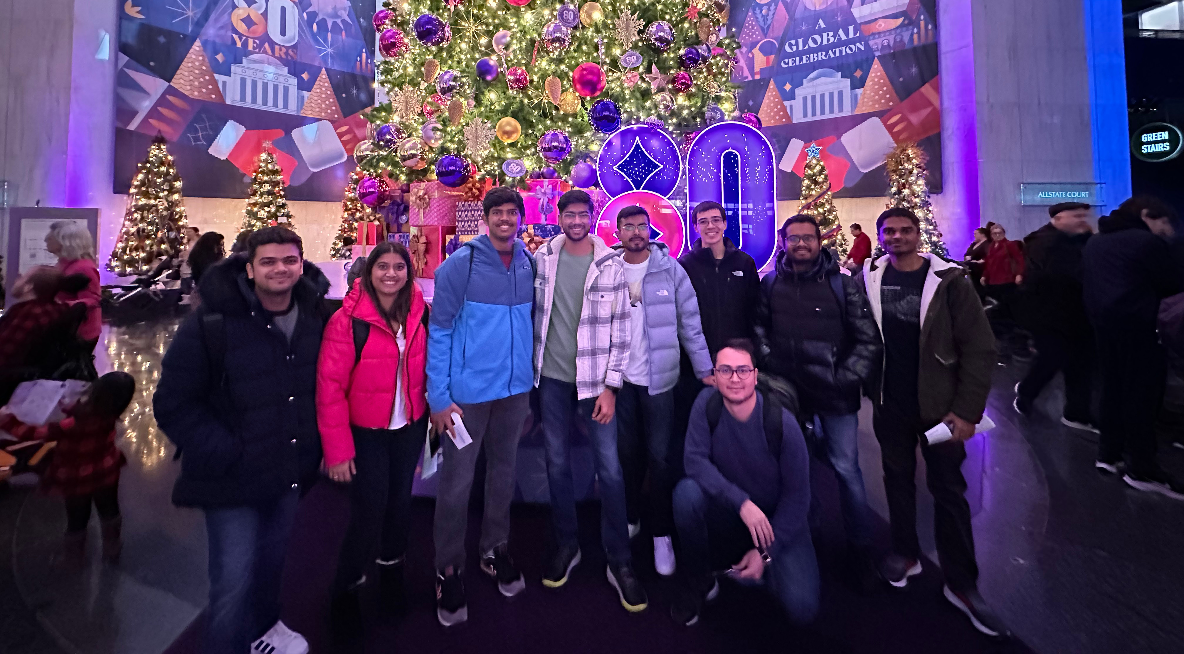
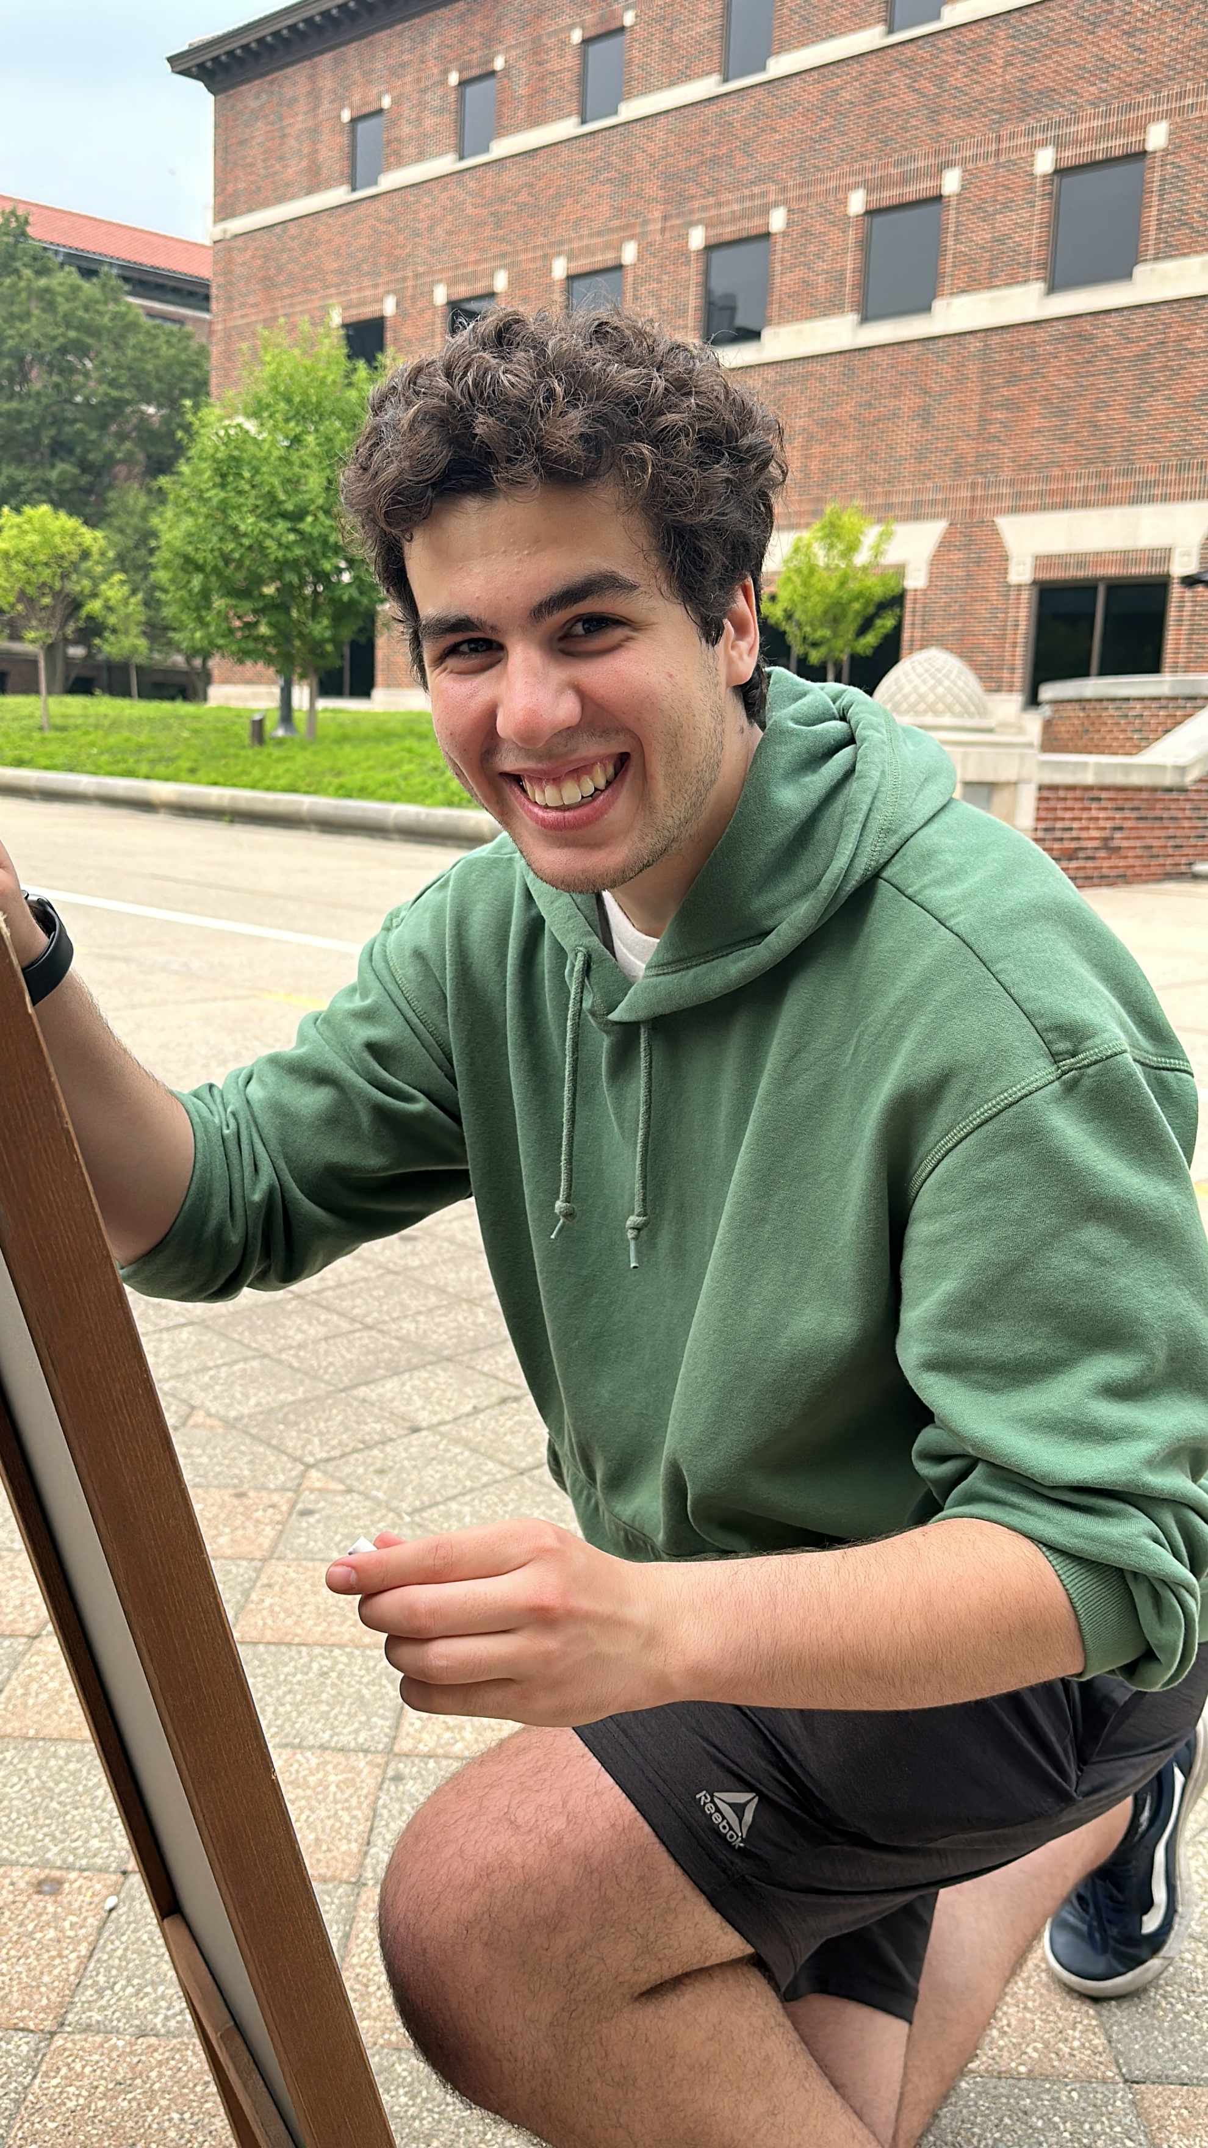
What is OMEGA?
Notes:
Academic, Professional, and Social Opportunities

Slide 3
Website
purdueomega.com

Slide 4
Course Feedback
purdueomega.com > Resources

Slide 5
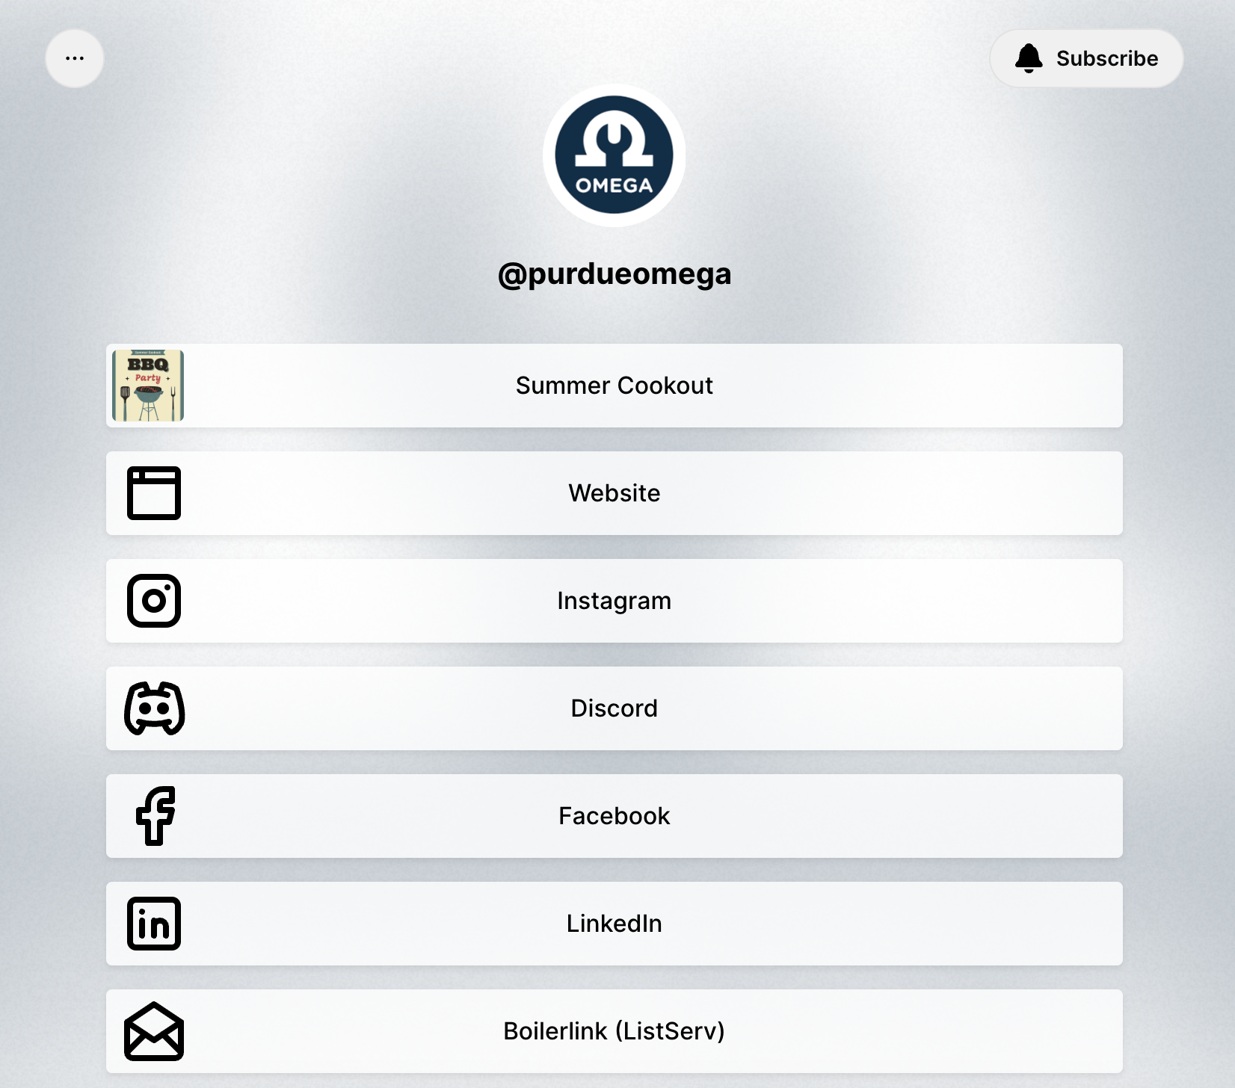
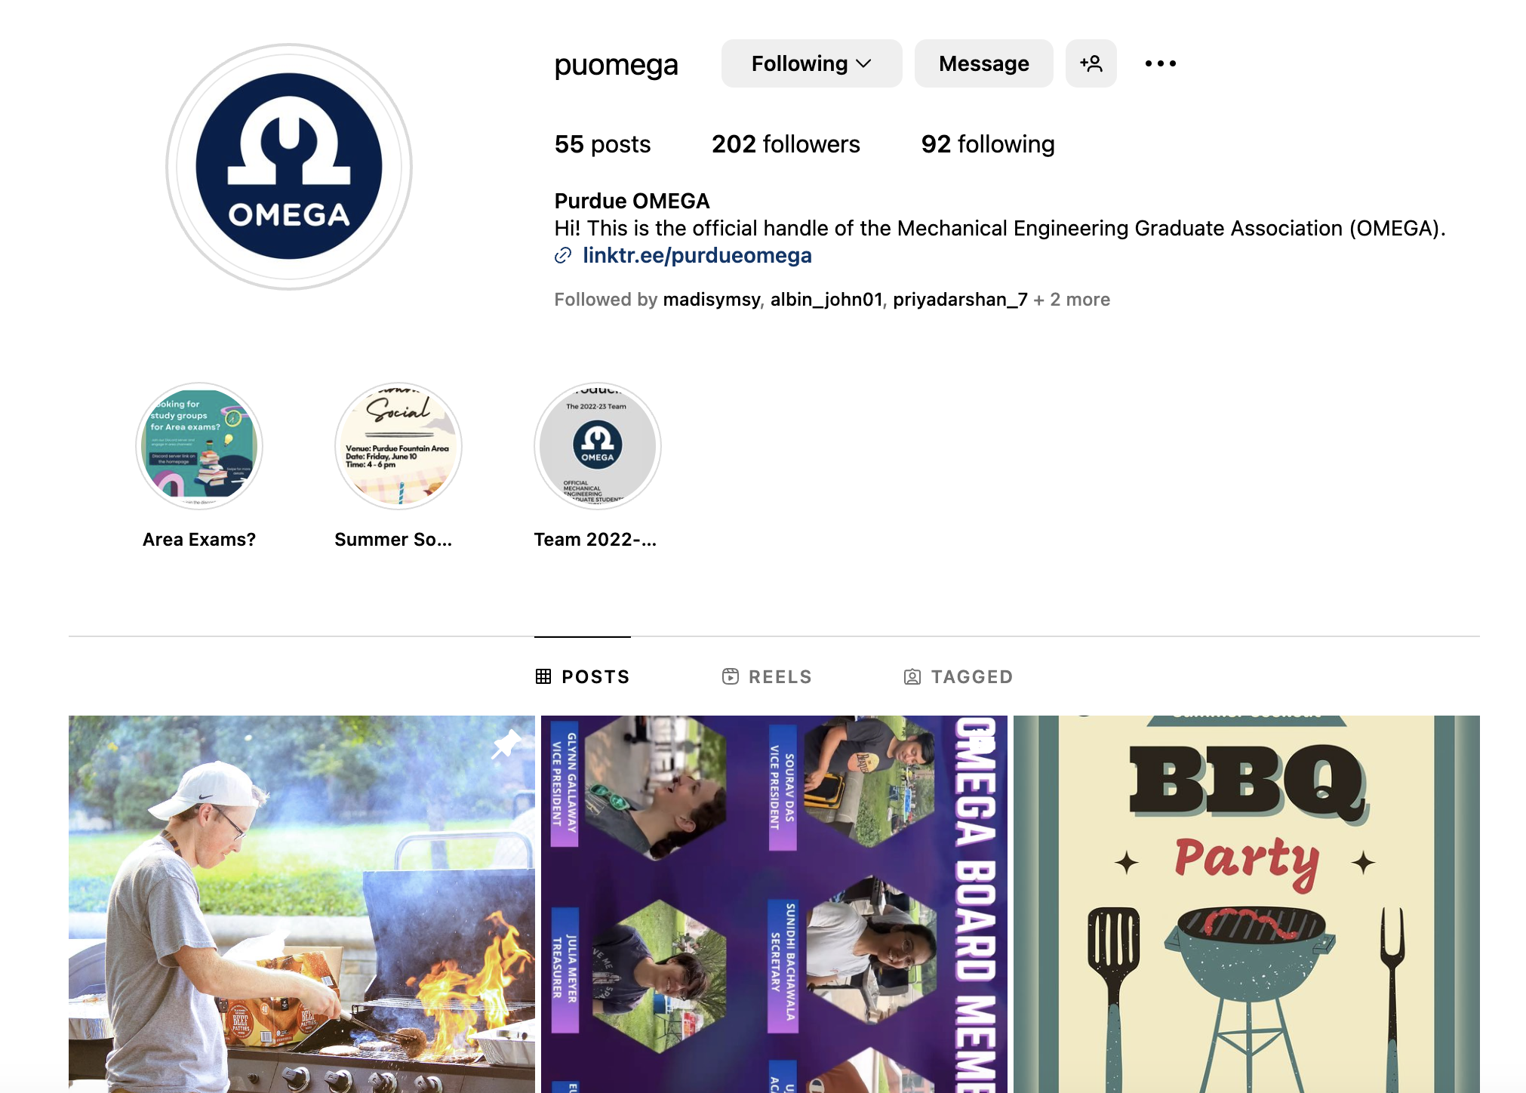
Instagram and Social Media
https://www.instagram.com/puomega/

Slide 6
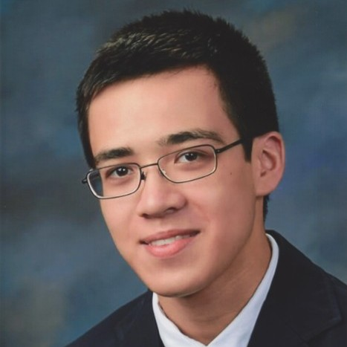
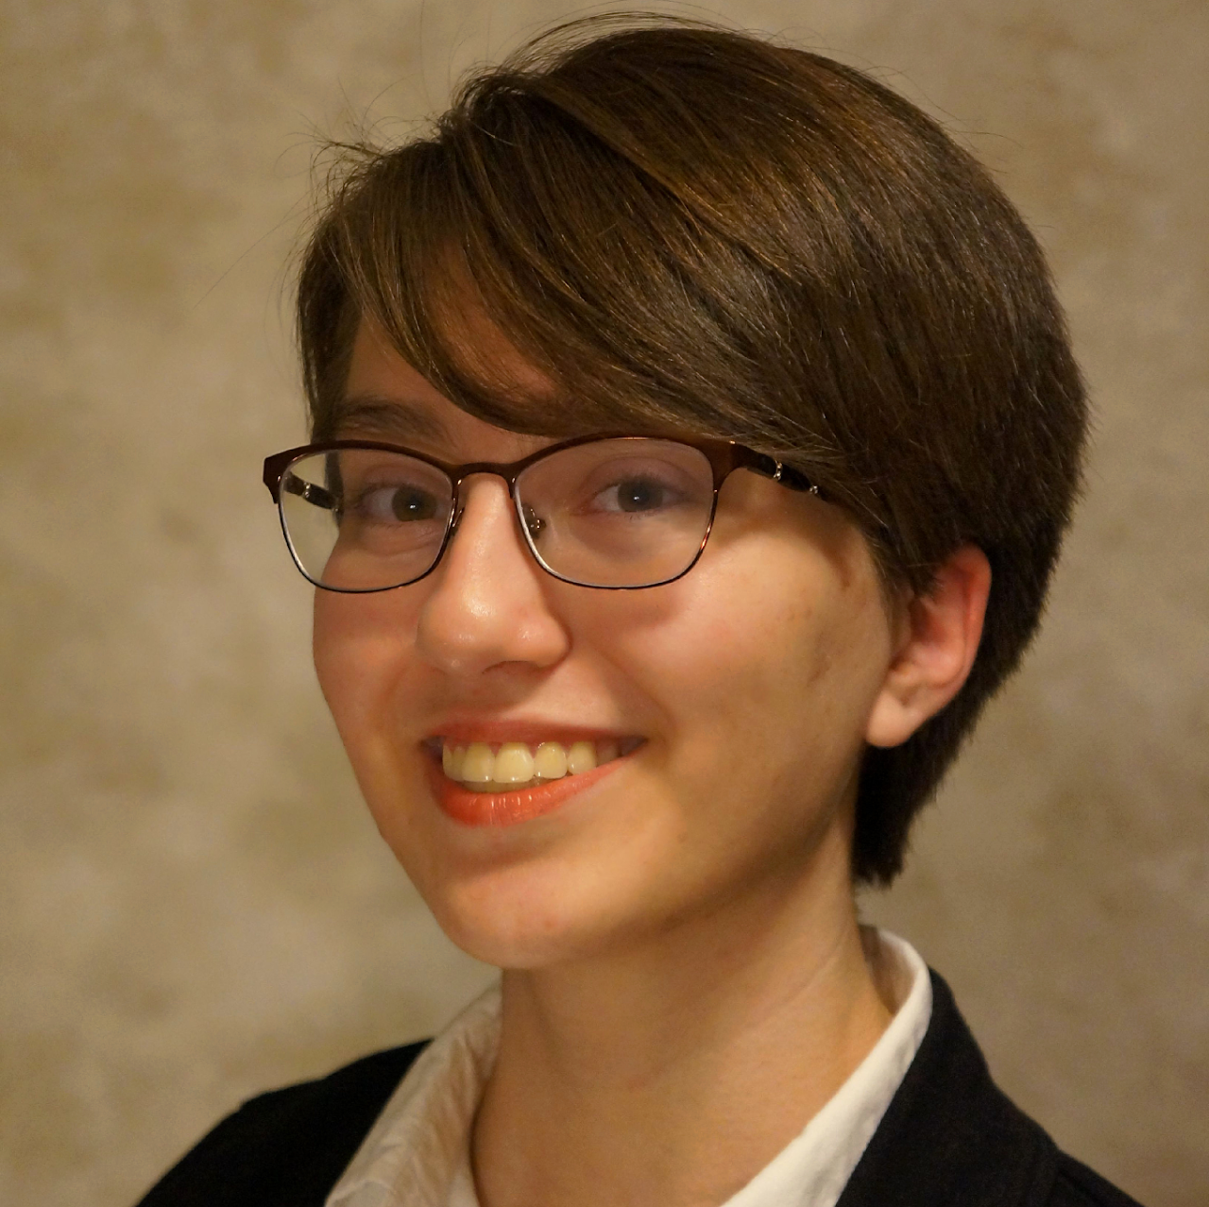
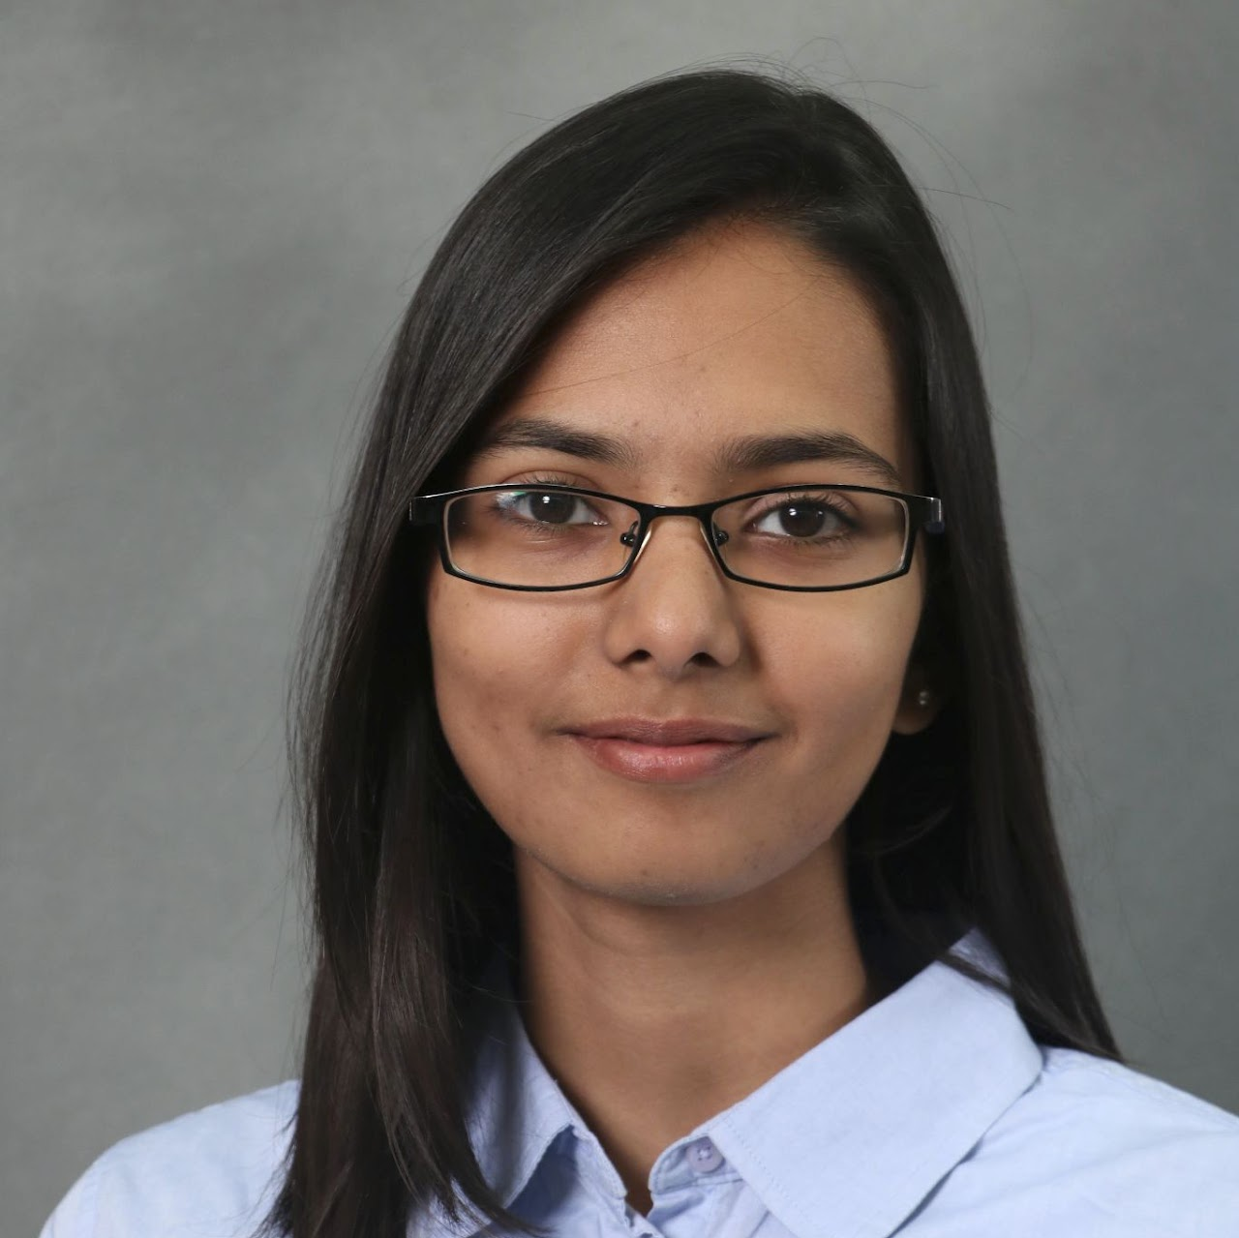
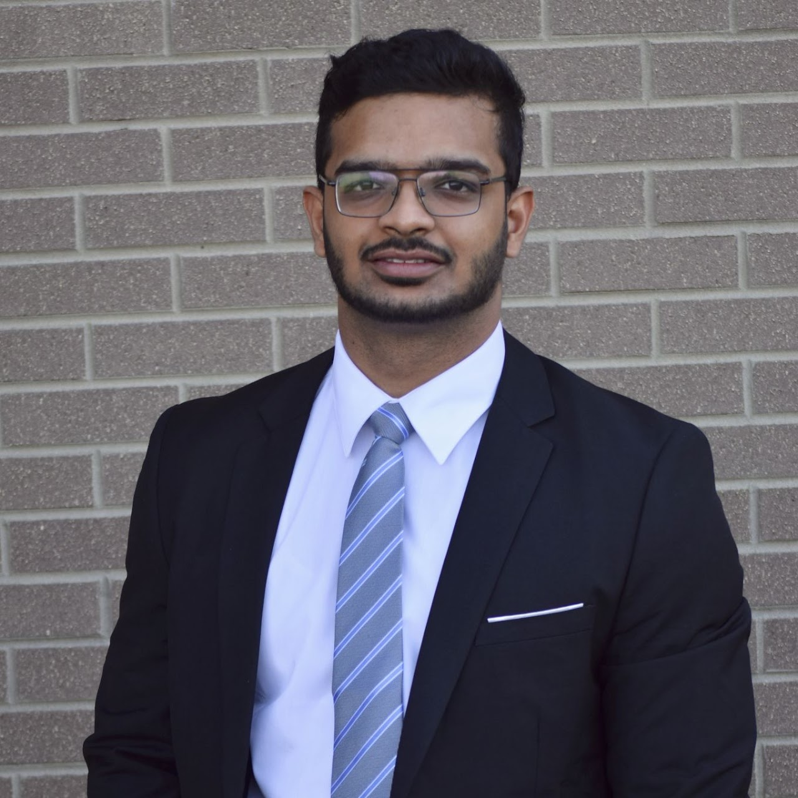
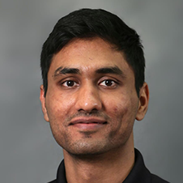
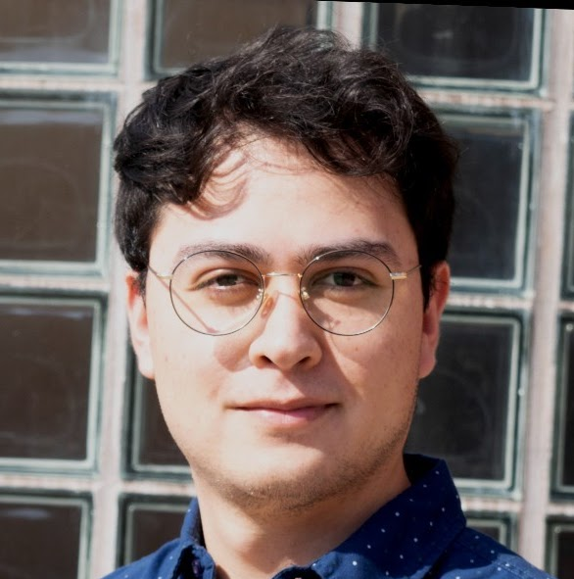
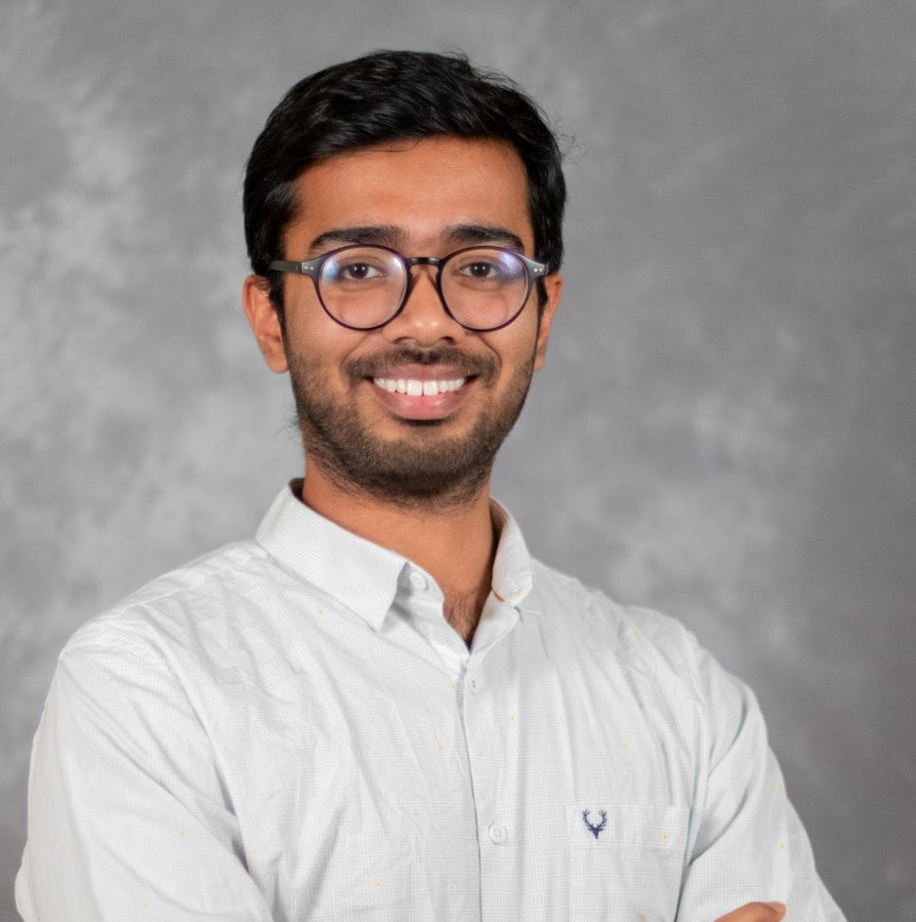
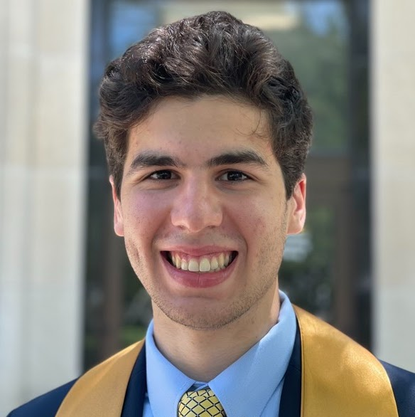
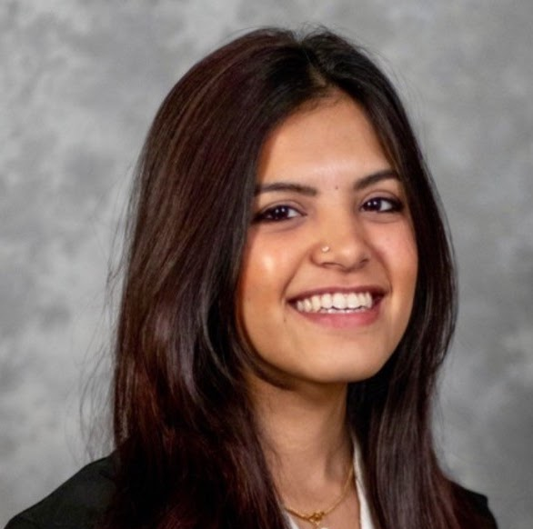
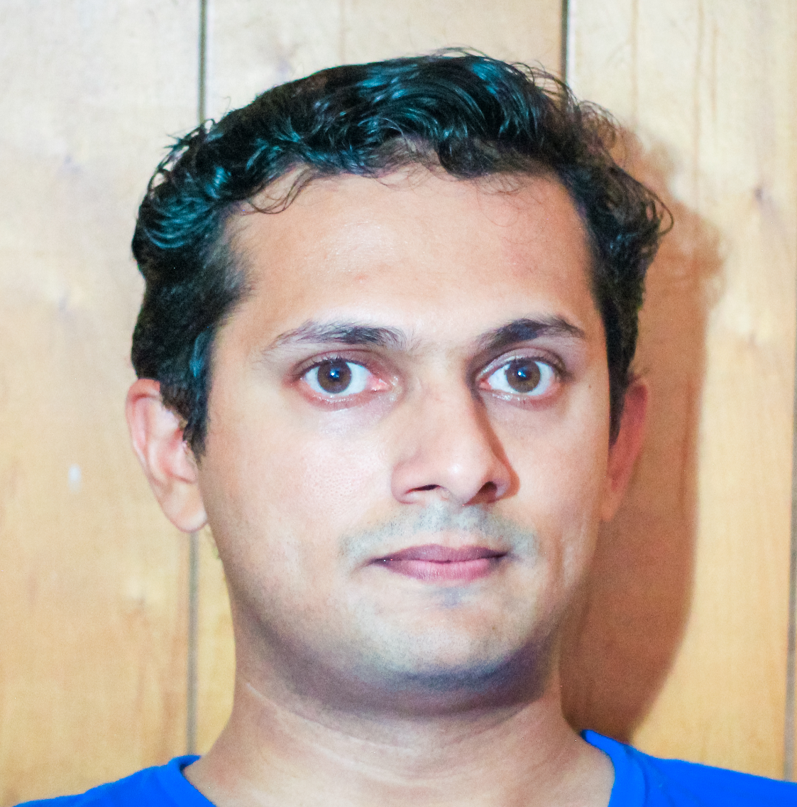
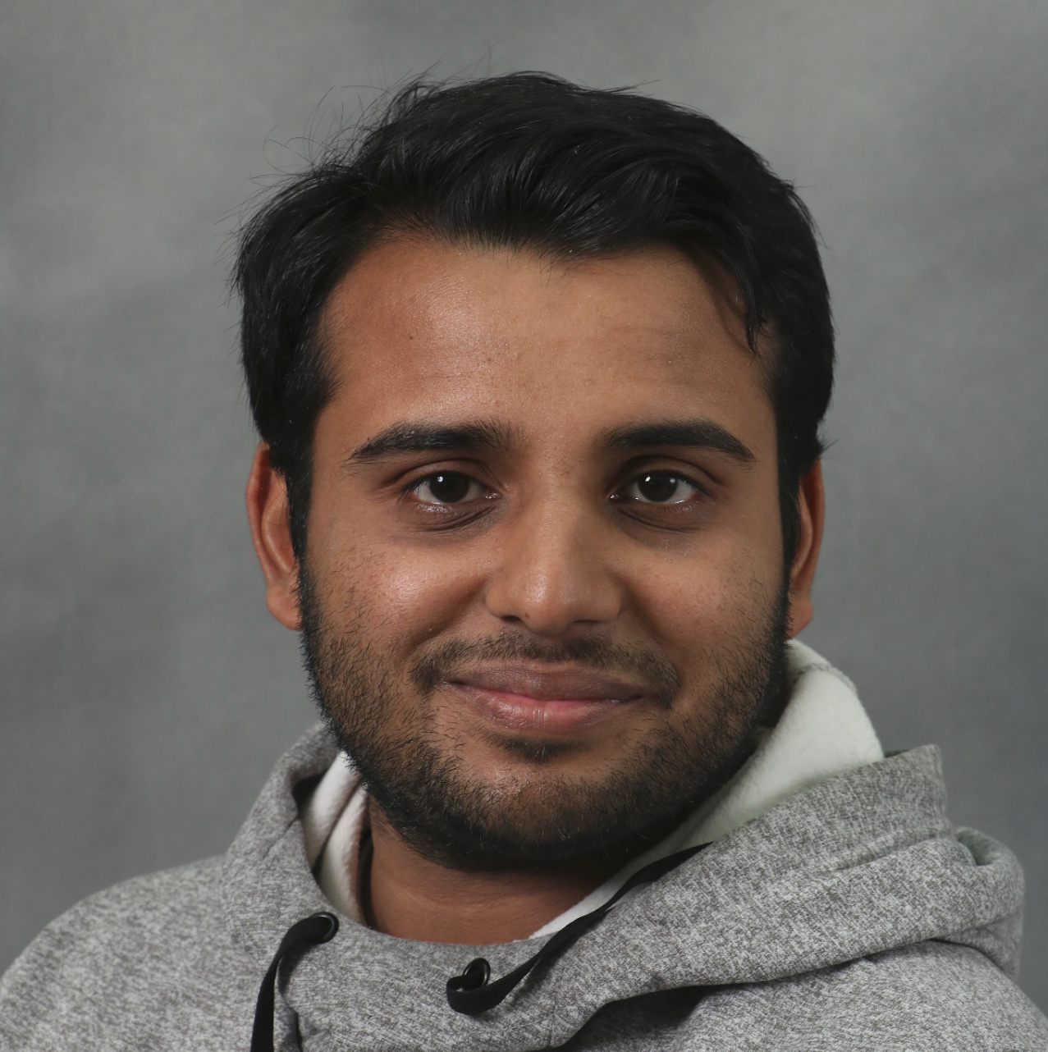
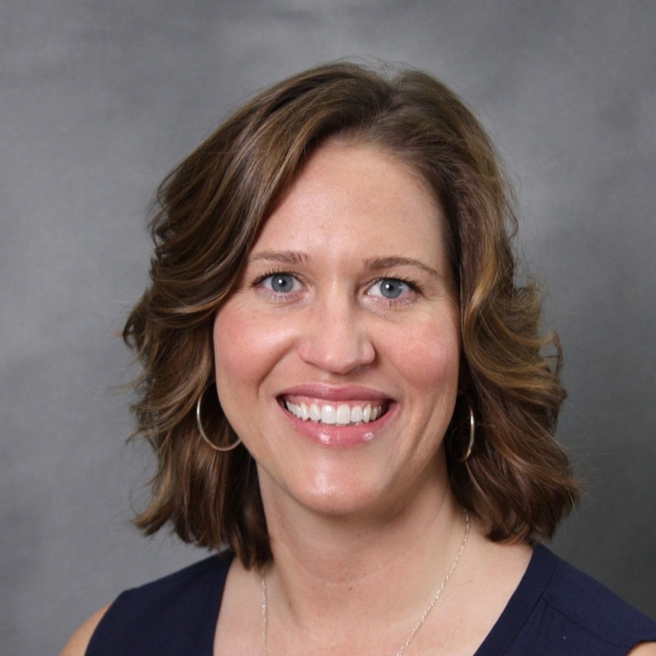
OMEGA Team
Nathan
Dept. Liaison
Julia
Treasurer
Sunidhi
Secretary
Ujjawal
Academics
Jake
President
Sourav
Vice President
Glynn
Vice President
Meghavin
PGSG Senator
Antonio
Diversity
Tanner
Diversity
Priyadarshan
Social Media
Eugenio
Social
Meenakshi
Outreach
Albin
Sports
Rohan
Industry
Abhi
Mentoring
Shanmukhi
Women in ME
Dr. Key
Advisor

Slide 7
Questions
purdueomega.com
puomega@purdue.edu

