Slide 1

OMEGA @
ME Grad Orientation
Website: purdueomega.com
Email: puomega@purdue.edu
Insta: puomega
Linkedin: purdueomega
Discord: https://discord.gg/gyyGmftsx8

Slide 2
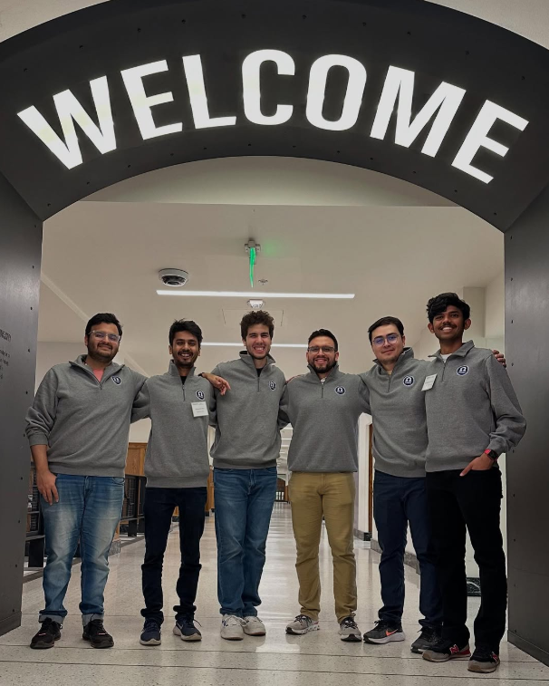
What is OMEGA?
The Official Mechanical Engineering Graduate Association, is a student organization that supports ME grad students through social, academic, and professional events
All ME grad students are automatically members of OMEGA.
We represent your interests in university leadership settings
24-25 Officers at ME grad student visitation day

Slide 3
What does OMEGA do?
Building Social Connections: We organize social events, often in collaboration with other departments, to help ME grad students connect
Academic Enhancement: We support your academic success by hosting study groups and facilitating academic seminars
Mentoring Opportunities: We run mentoring activities that pair experienced grad students with newcomers to help them transition smoothly
Resource Guides: We provide useful links and resources on our website to assist with academic and personal challenges (purdueomega.com/resources/useful-links-contacts)
Representing Students: We ensure your feedback is communicated to ME department and university leadership by actively representing you in leadership settings
Notes:
Lab cookouts
Area exam study sessions
Mentorship circles

Slide 4
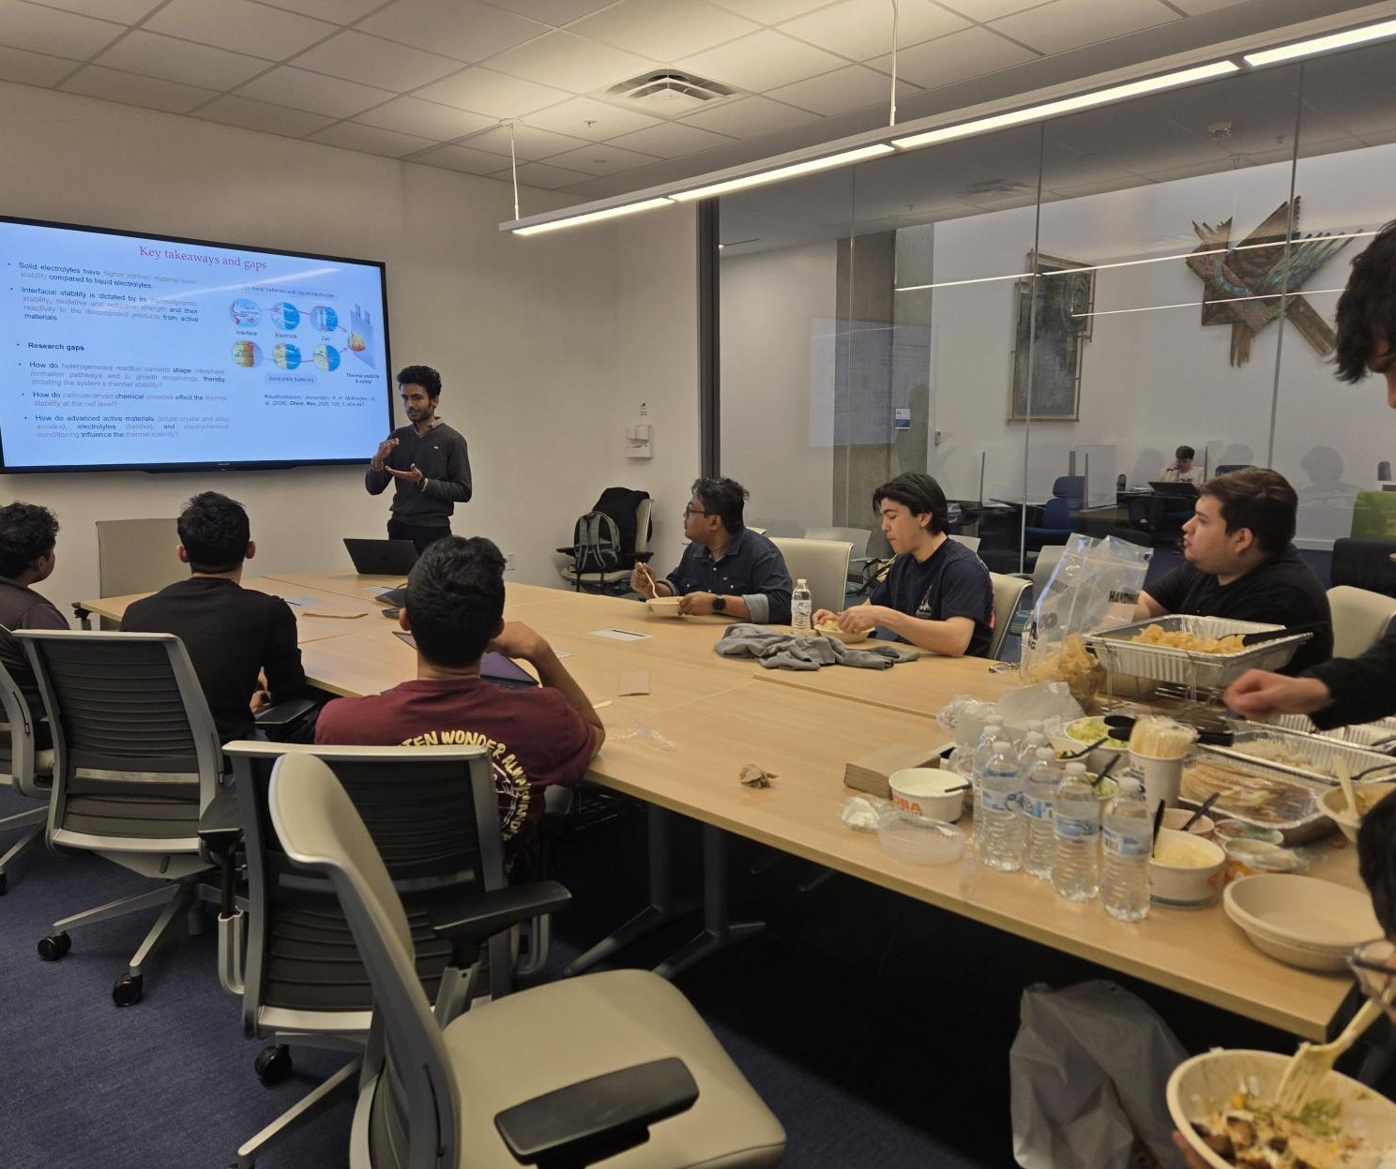
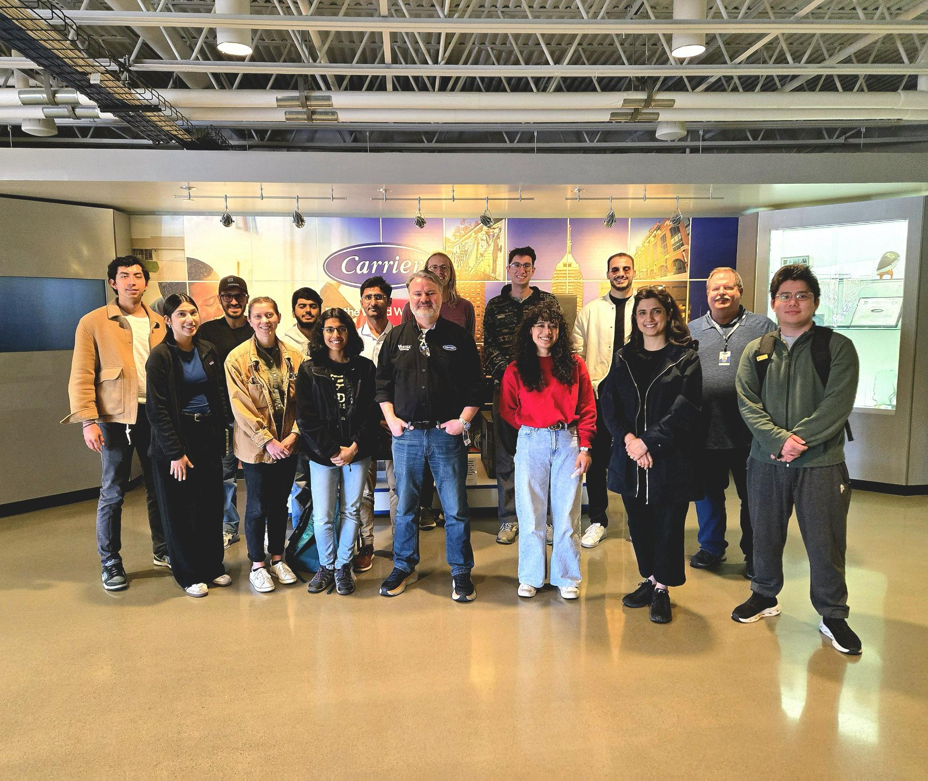
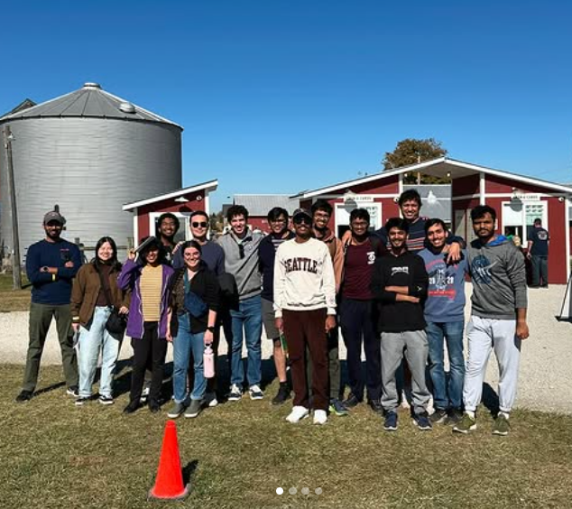
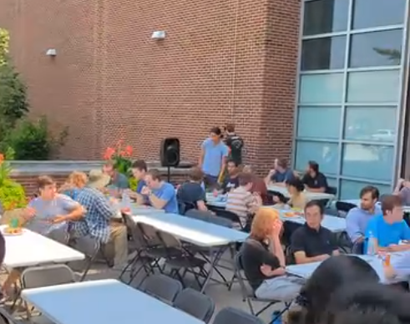
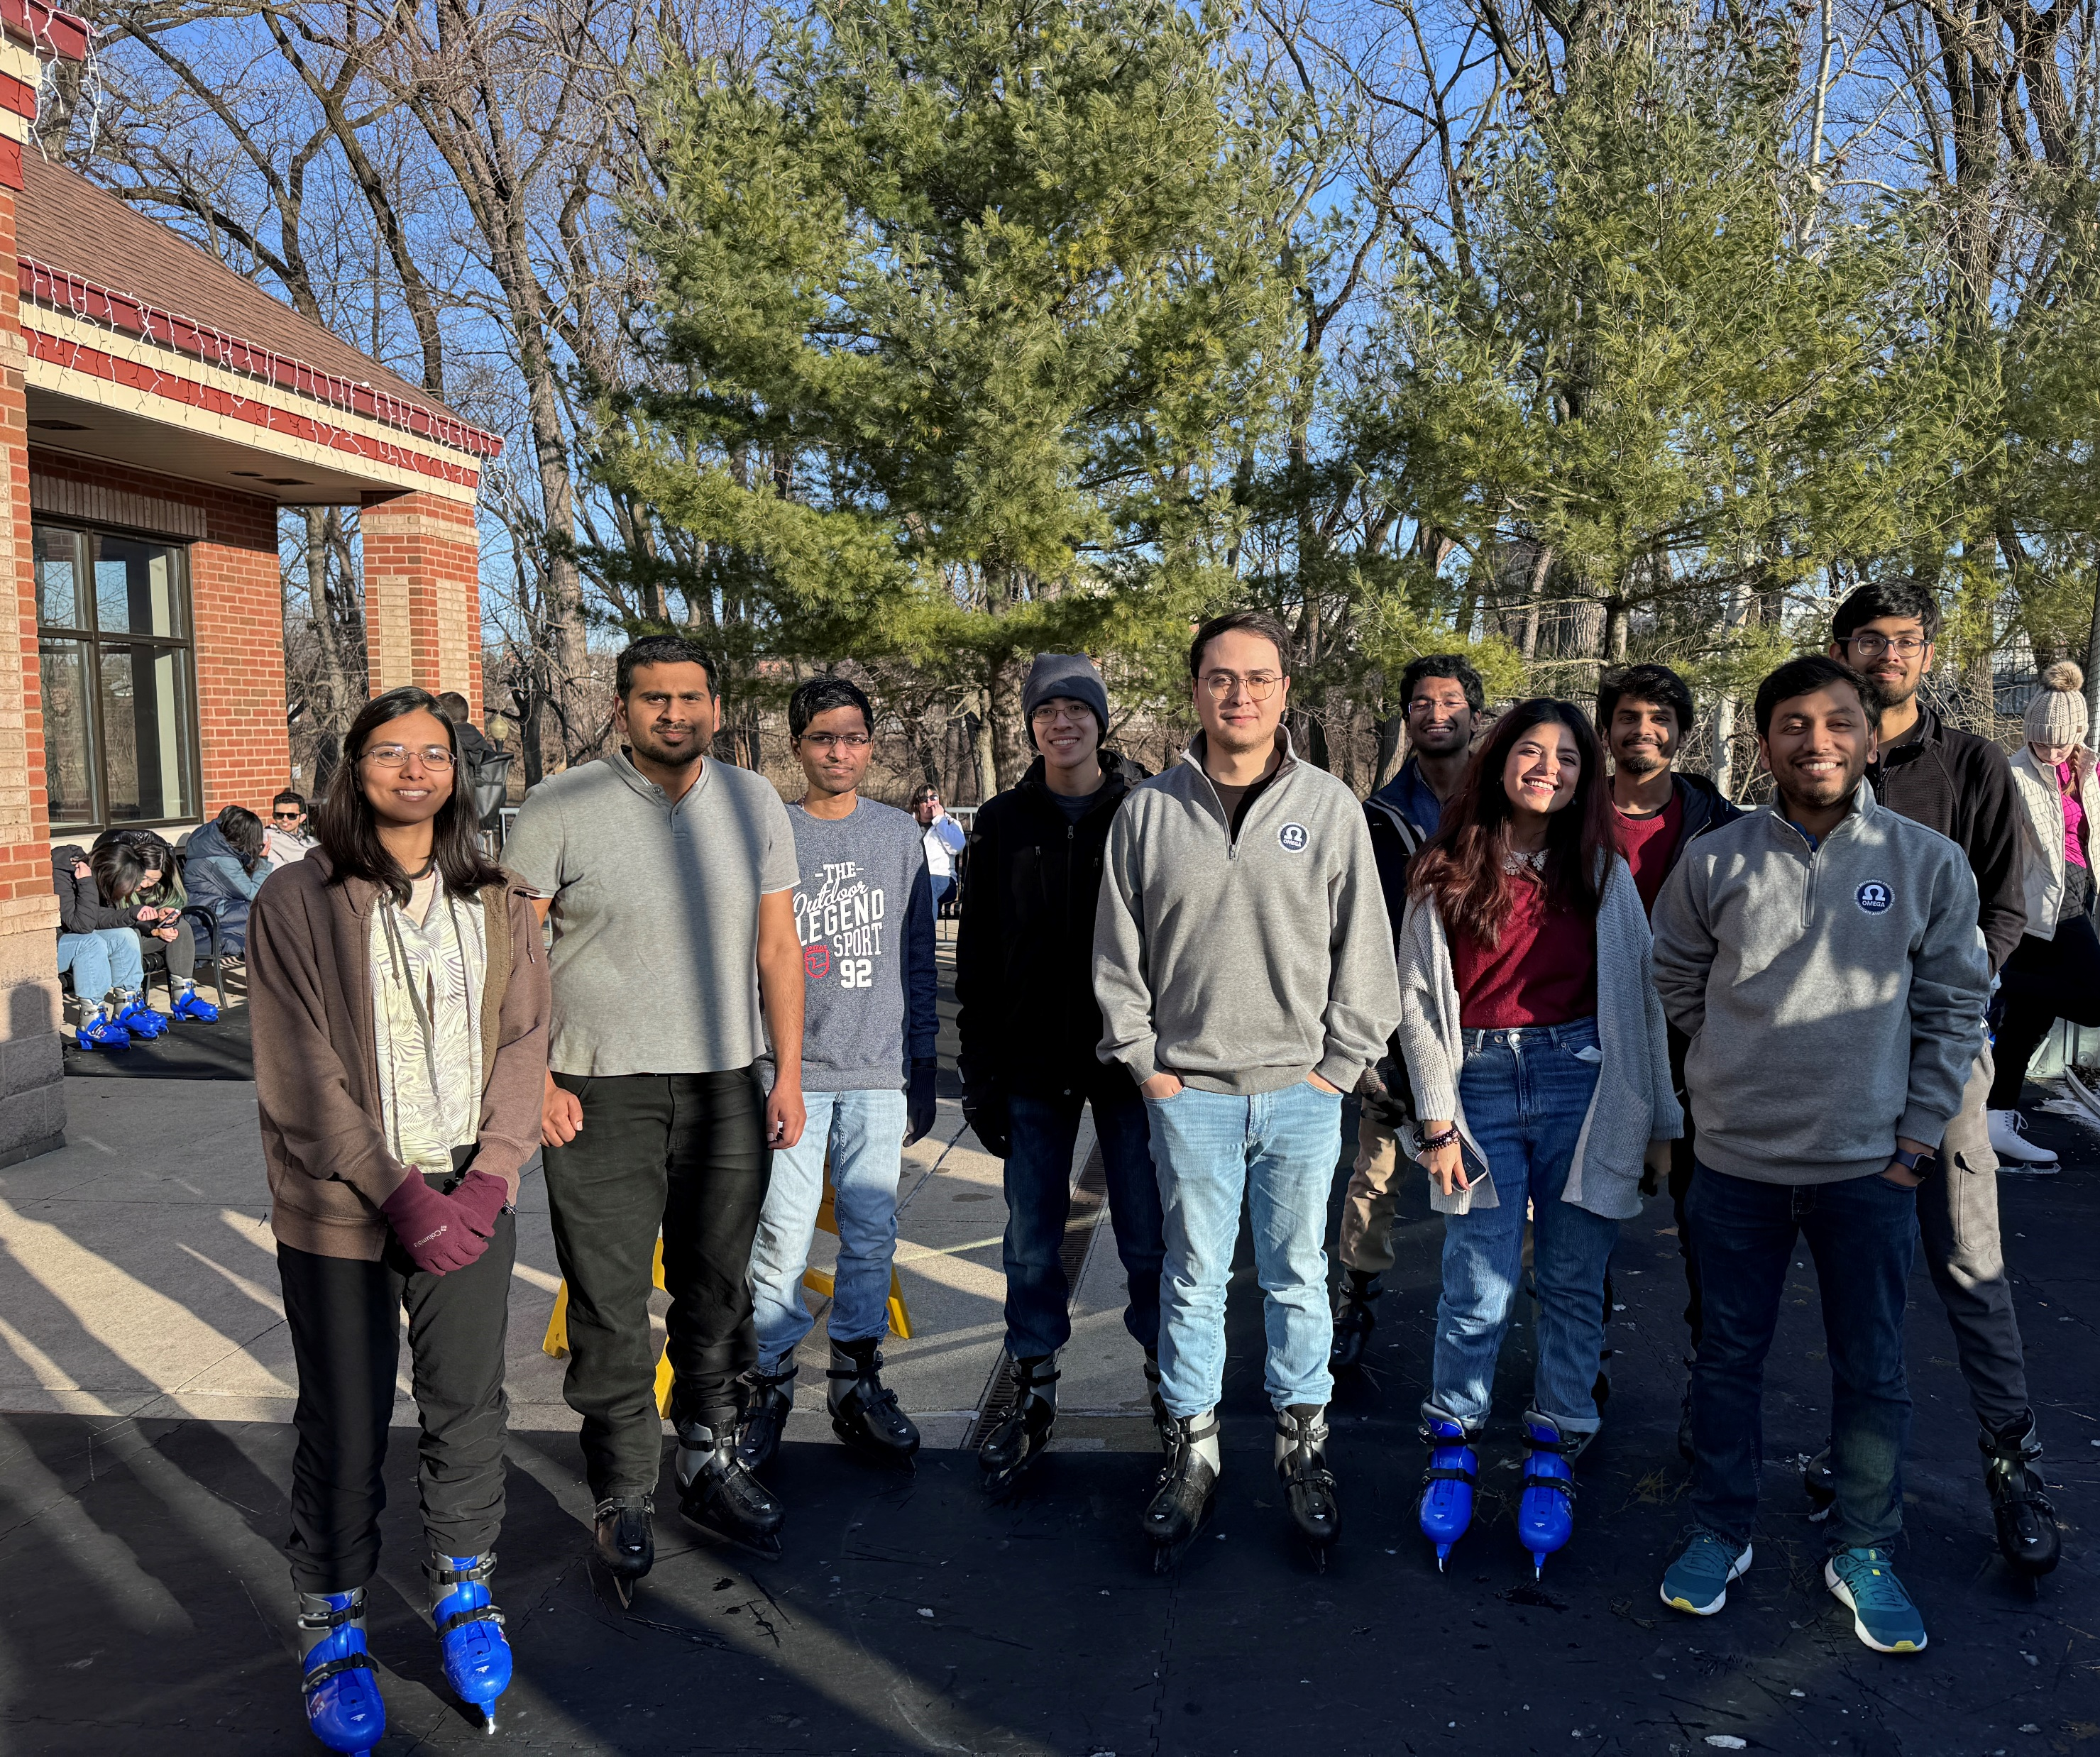
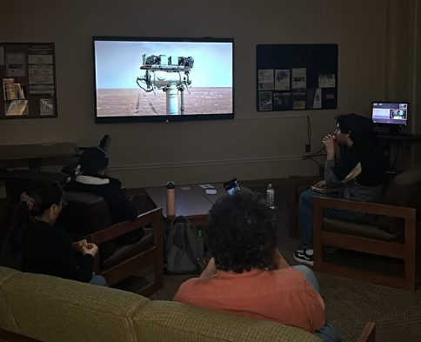
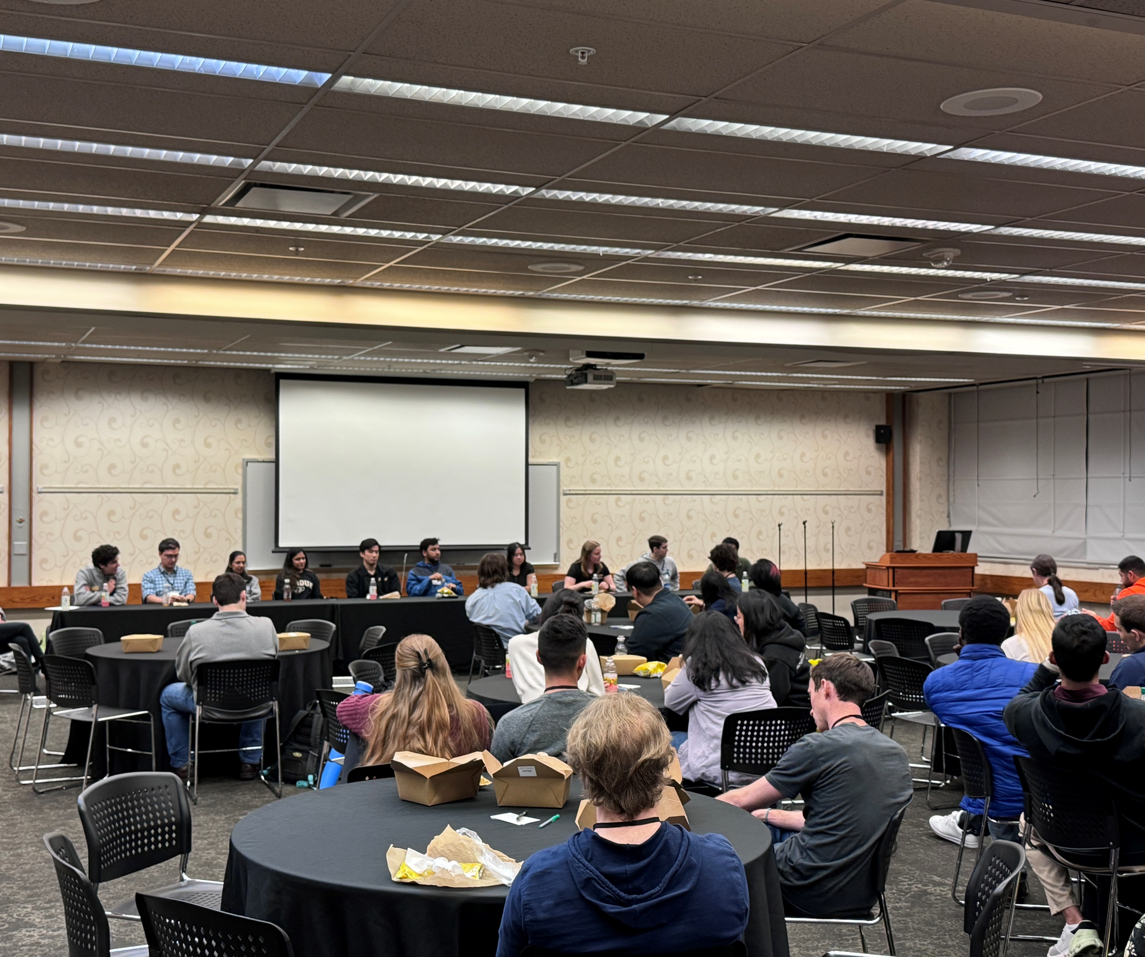
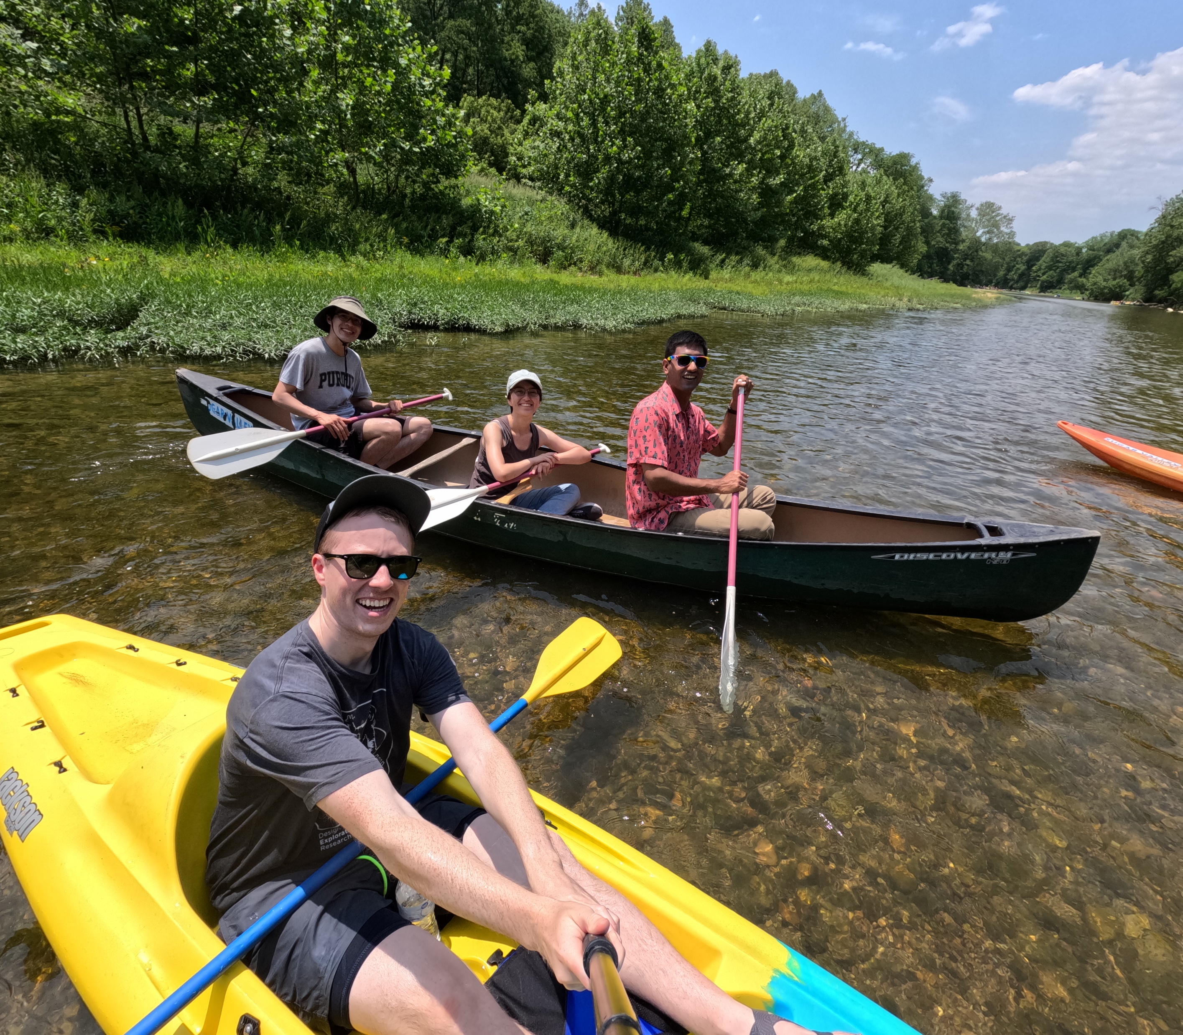
Seminar Series
March 2026
Industry Tour
April 2026
Corn Maze
Oct 2024
Summer Cookout
Jul 2024
Ice skating social
Jan 2024
Movie Night
Nov 2024
Grad Visitation Day
Feb 2024
Canoe Trip
Jun 2023

Slide 5
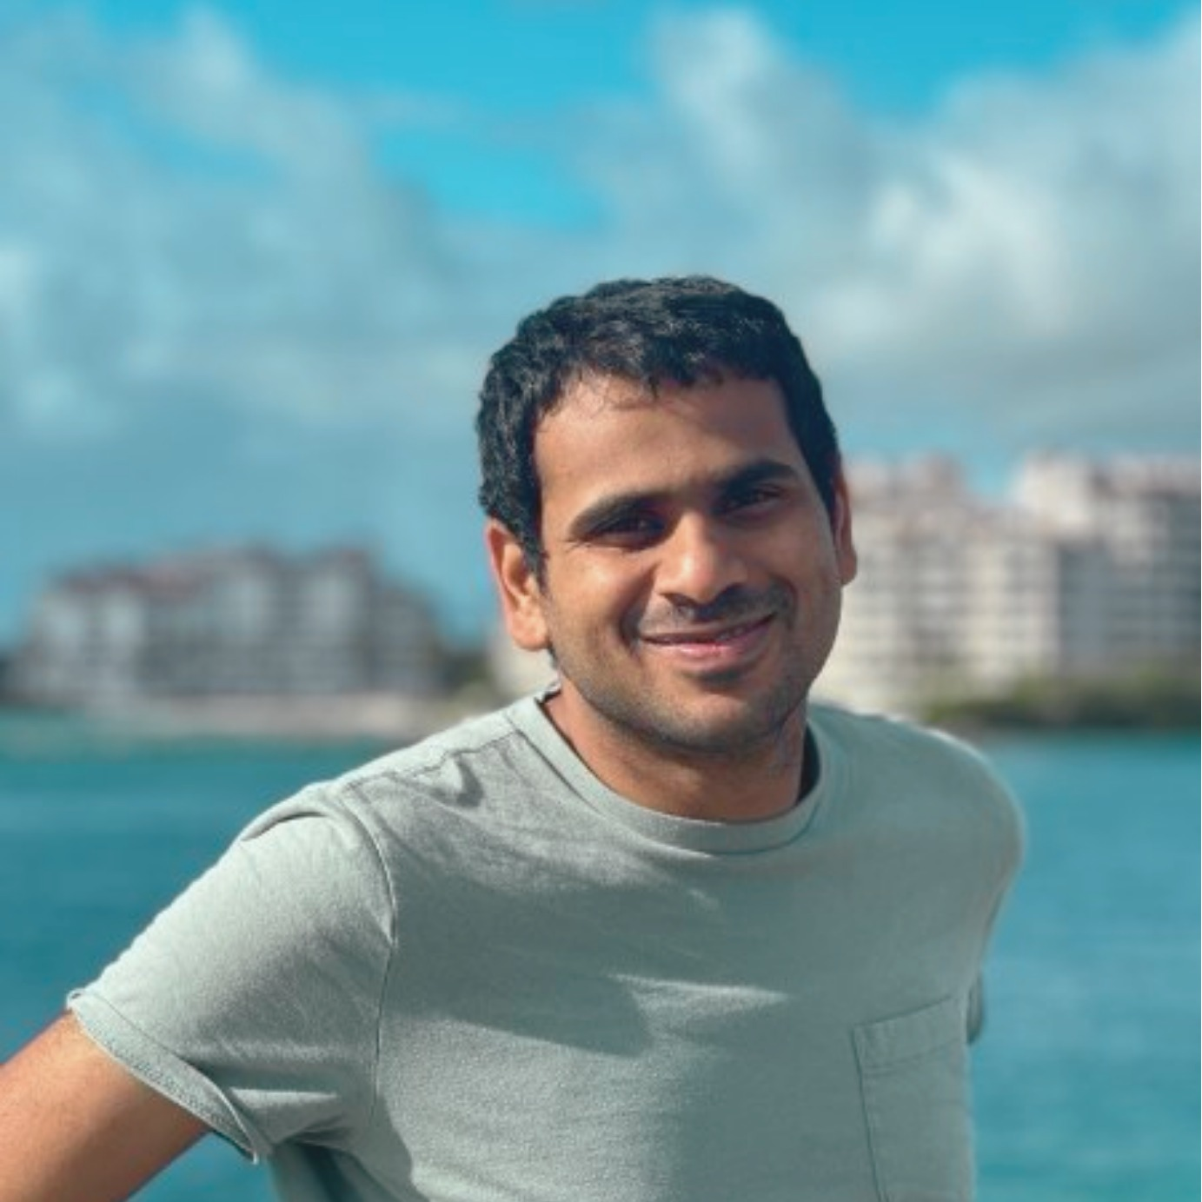
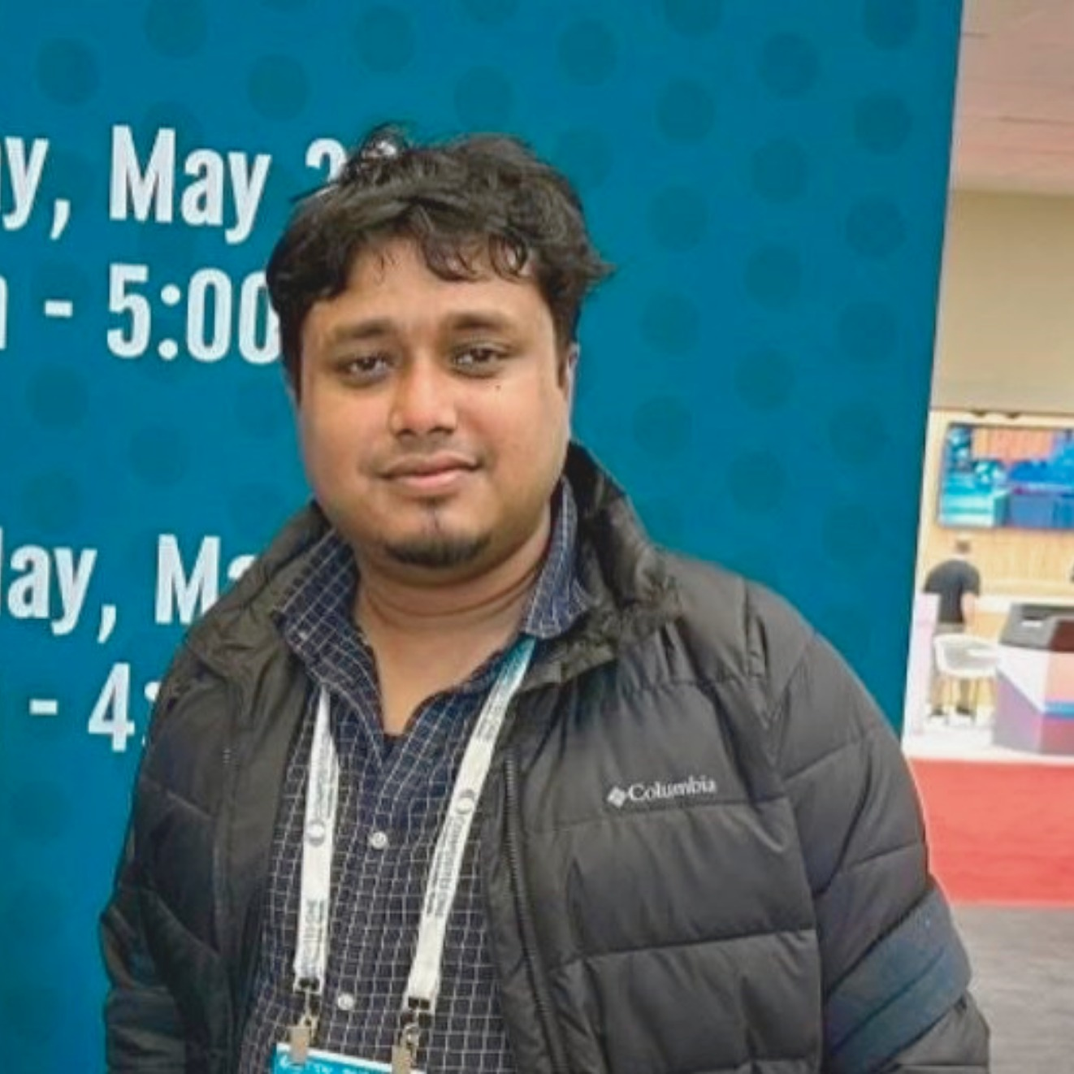
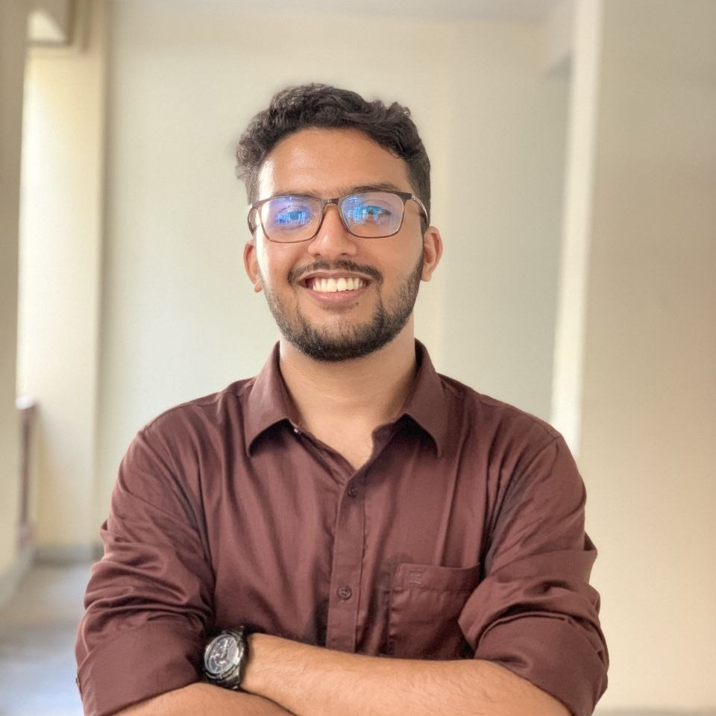

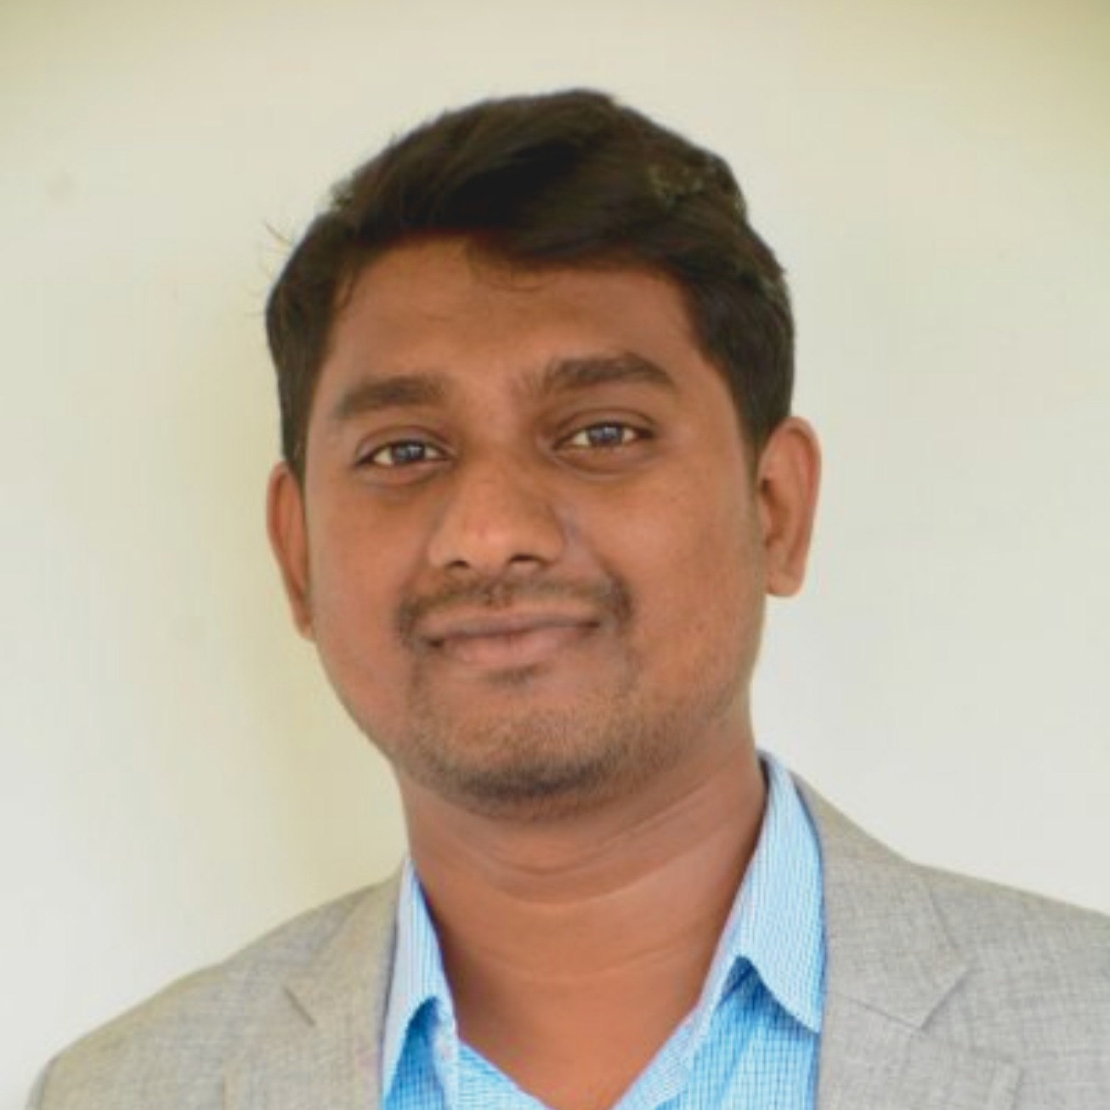
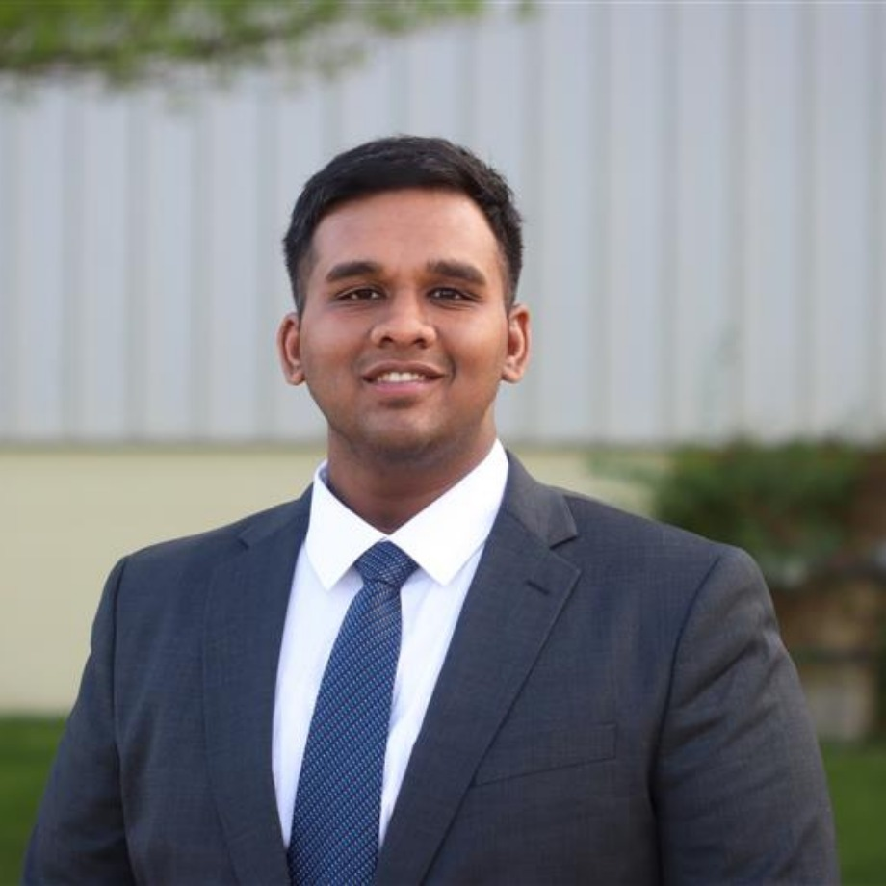


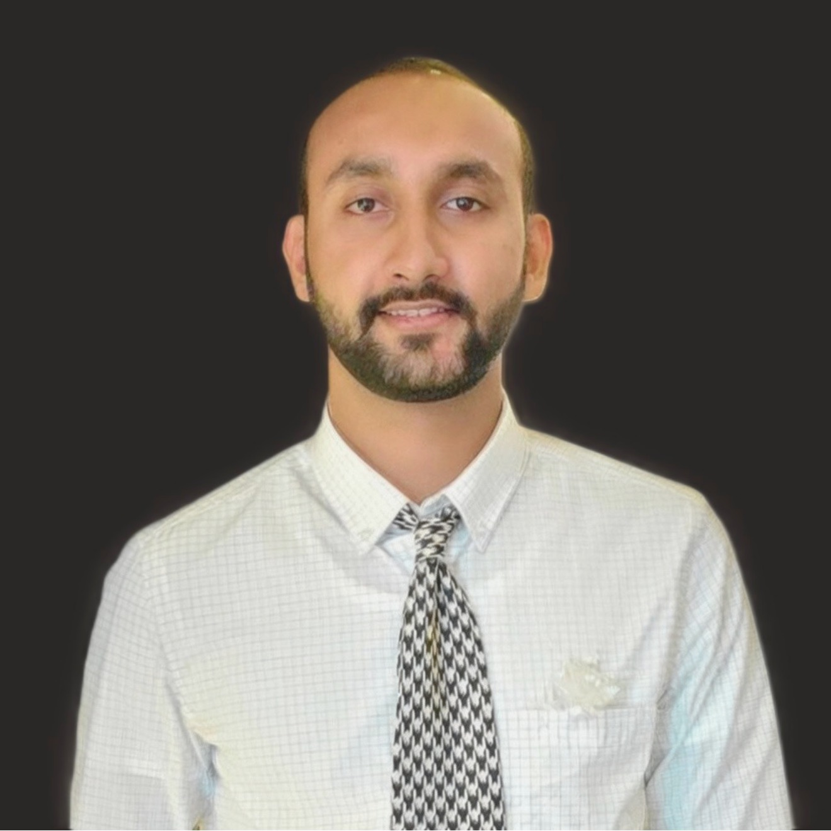
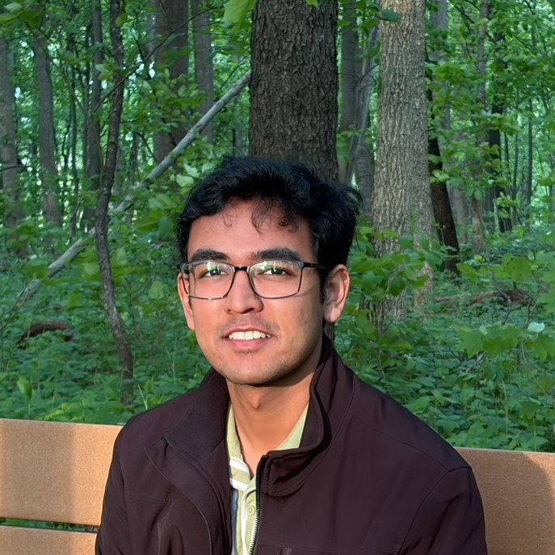
OMEGA Board 26-27
Shrihari Pande
President
Mohammed Abir Mahdi
Vice-President
Sheikh Sabbir Hossain Tuhin
Treasurer
Soumya Bhattacharjee
Secretary
Raju Ahammad
Academic Chair
Jonathan Aralikatti
Outreach Chair
Ramakrishnan Jayasekaran
PGSG Senator
Md Wasi Uddin
Industry Chair
Vardhan Mittal
Social Media Chair
Sadaf Mehdi
Social Chair

Slide 6
Committees
Academic - Aims to enhance the academic experience of ME grad students through educational events and resources
  ME290 research tours, Prof/grad student panels to ugrads, Speaker series, mentoring programs, reverse career fair, industry tours
Social - Focuses on building a sense of community and connection among ME grad students through social events and activities
  Socials/watch parties, hikes, IM teams, Cookouts

Slide 7
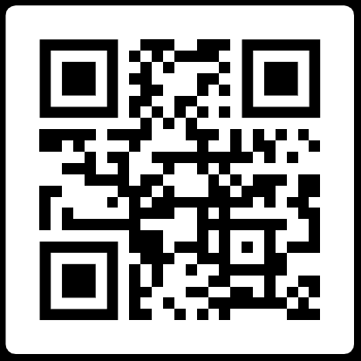
OMEGA Board - How to join?
Officer elections – end of spring term
Contact me (pandes@purdue.edu)!
Follow us on Instagram, LinkedIn
Attend events
We are actively looking to expand the team!
Our Socials
Website: purdueomega.com
Email: puomega@purdue.edu
Insta: puomega
Discord: https://discord.gg/gyyGmftsx8

Slide 8
Thank you!
Website: purdueomega.com
Email: puomega@purdue.edu
Insta: puomega
Discord: https://discord.gg/gyyGmftsx8

