Slide 1
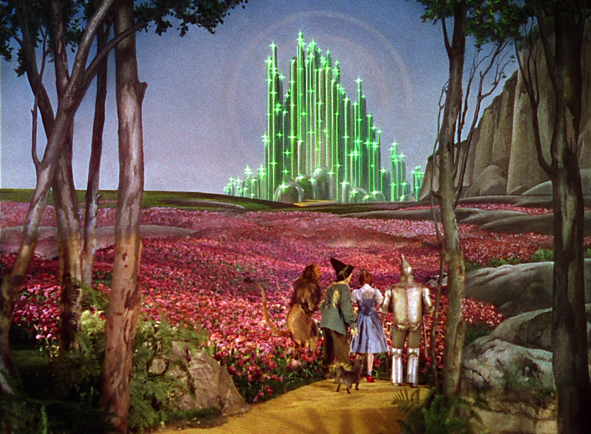
The XX’s
Felicia Anderson
Dana Beck
Cheryl Brier
Sarah Hook
Sarah Vaughn
OLS 388 - May 2012

Slide 2
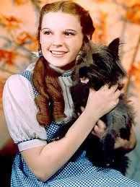
DOROTHY GALE
Style of Influence – Peace maker
Power Base
Role
Feelings

Slide 3
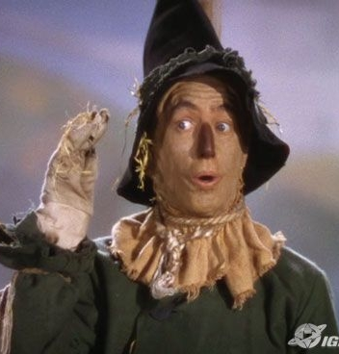
The Scare crow
Style of Influence – Peace maker
Power Base
Role
Feelings

Slide 4
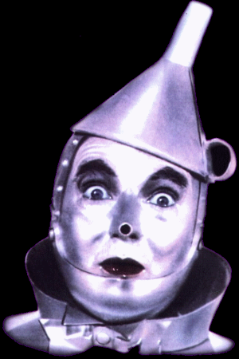
The tin man
Style of Influence – Peace maker
Power Base
Role
Feelings

Slide 5
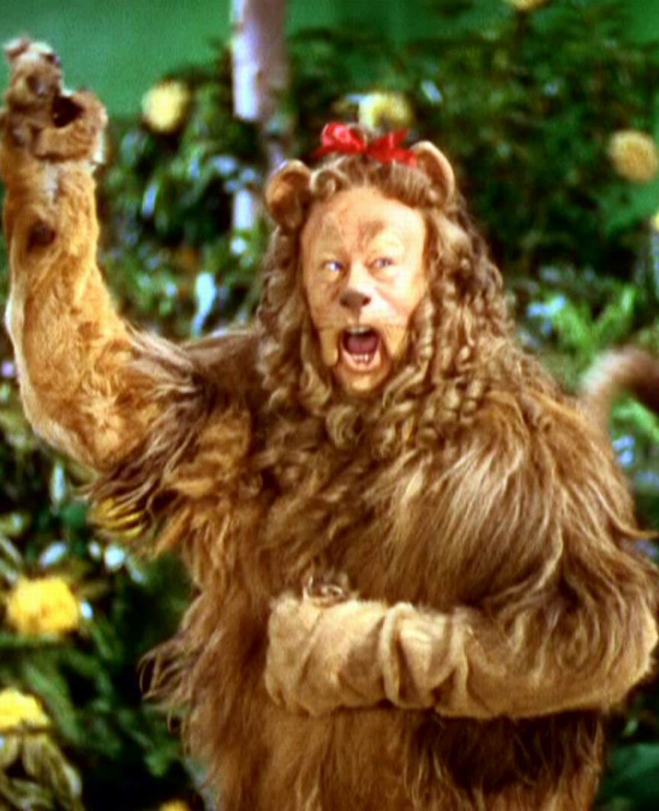
The cowardly lion
Style of Influence – Peace maker
Power Base -
Role -
Feelings -

Slide 6
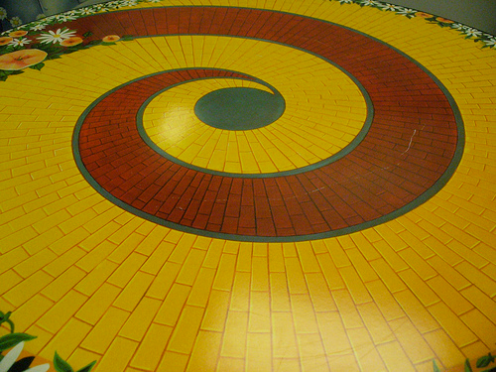
Team review
Decision Making Procedure – Done with the team , they have no self authorized decision makers
Task & Maintenance Functions – this team is constantly looking for ideas and feelings from their team mates.

Slide 7
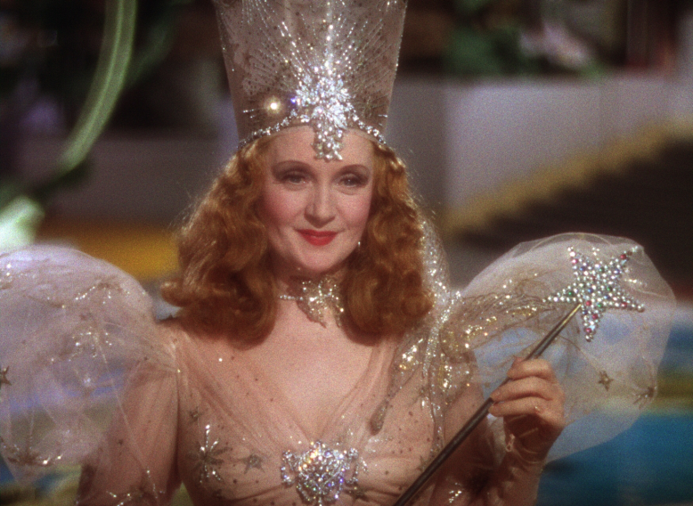
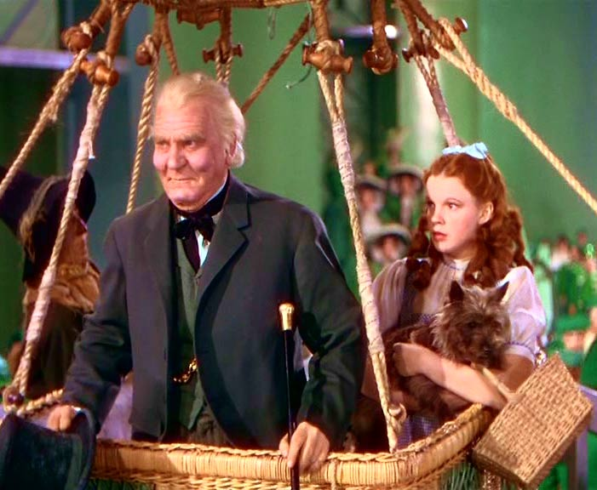
LOW PARTICIPANT MEMBERS
GLINDA
Style of Influence – Autocratic
Power Base
Role
Feelings – Anger & Irritation
THE WIZARD
Style of Influence – Autocratic
Power Base
Role
Feelings – Anger & Irritation

Slide 8
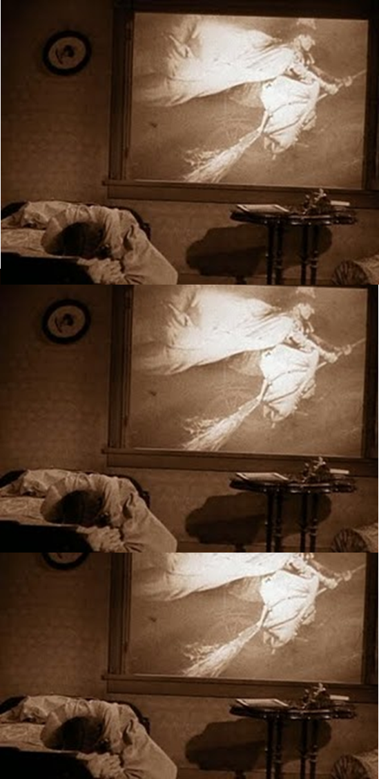
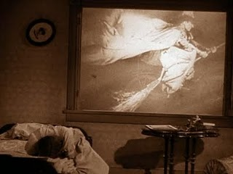
Introduction of the Antagonist.
The need for a goal…ruby slippers

Slide 9
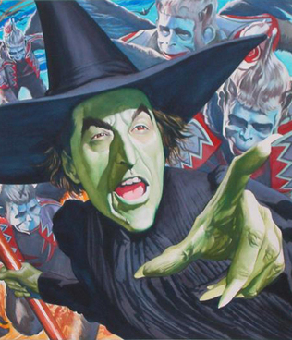
Wicked witch of the west
Style of Influence – Autocratic
Power Base
Role
Feelings – Anger & Irritation

Slide 10
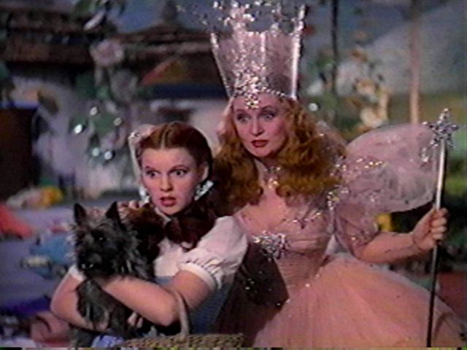
DOROTHY MEETS GLINDA … THE TEAM IS FORMED

Slide 11
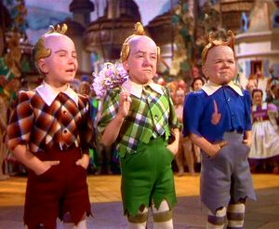
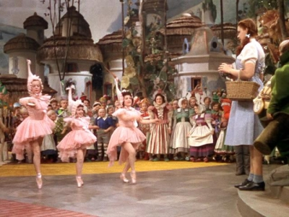
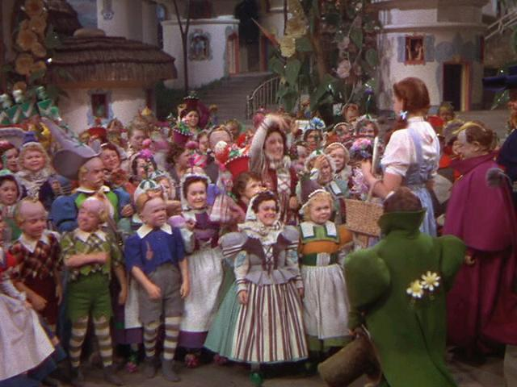
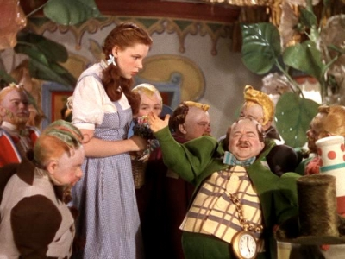
Dorothy is treated like a
hero for killing the
wicked witch of the east

Slide 12
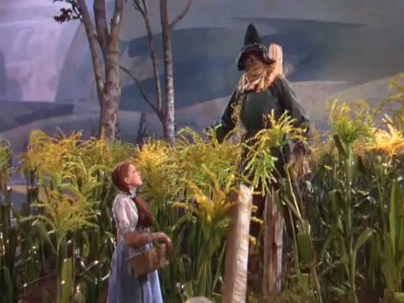
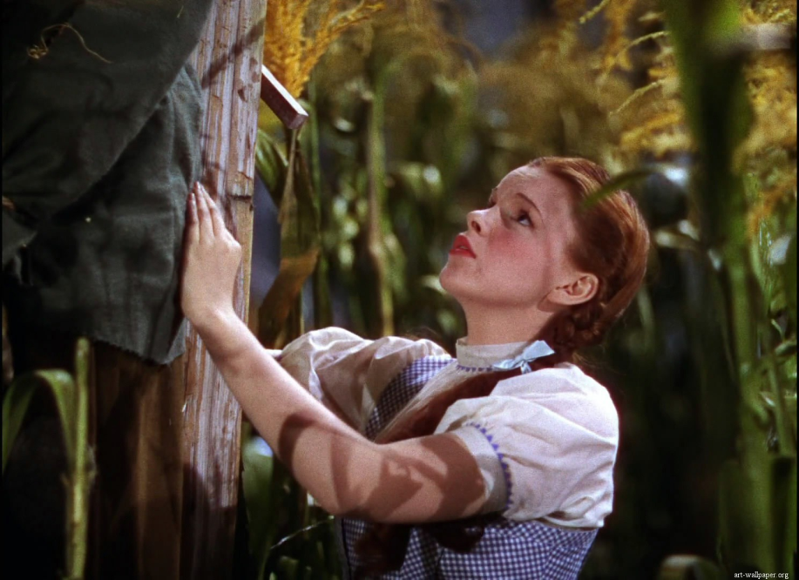
DOROTHY MEETS THE SCARE CROW

Slide 13
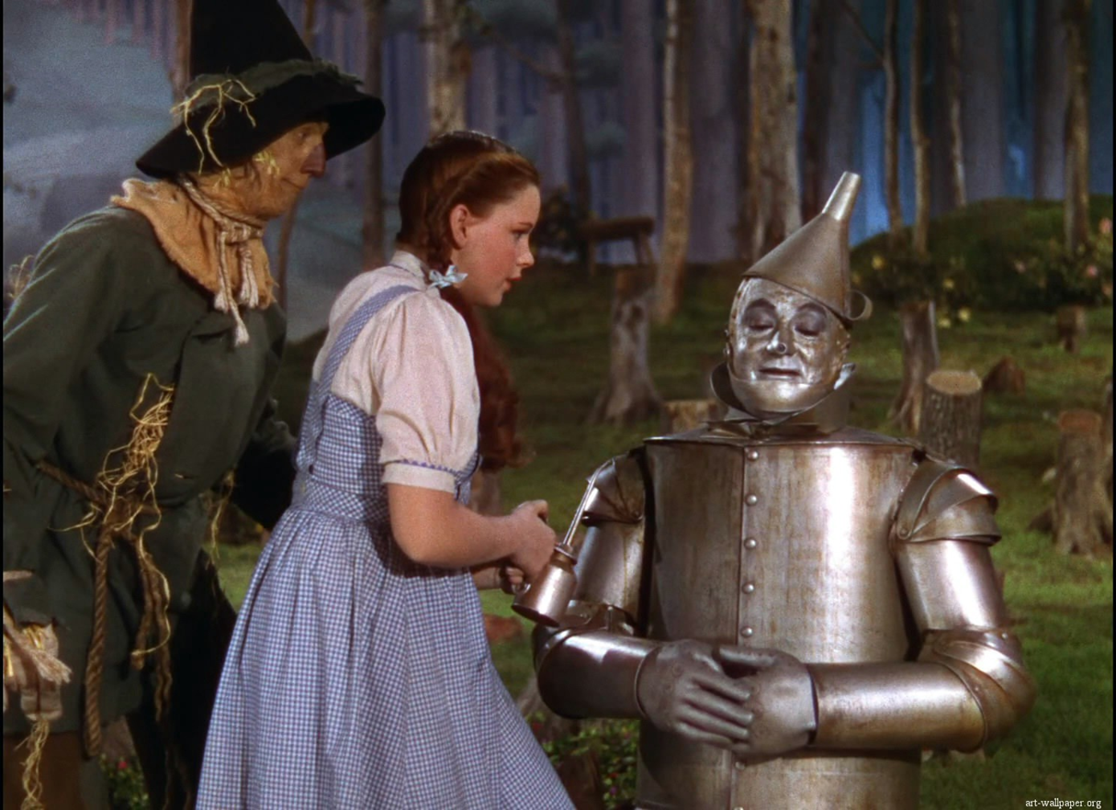
Dorothy Meets the tin man

Slide 14
THIS TEAM BEGINS TO PERFORM…
Lions and Tigers, and Bears…Oh MY!

Slide 15
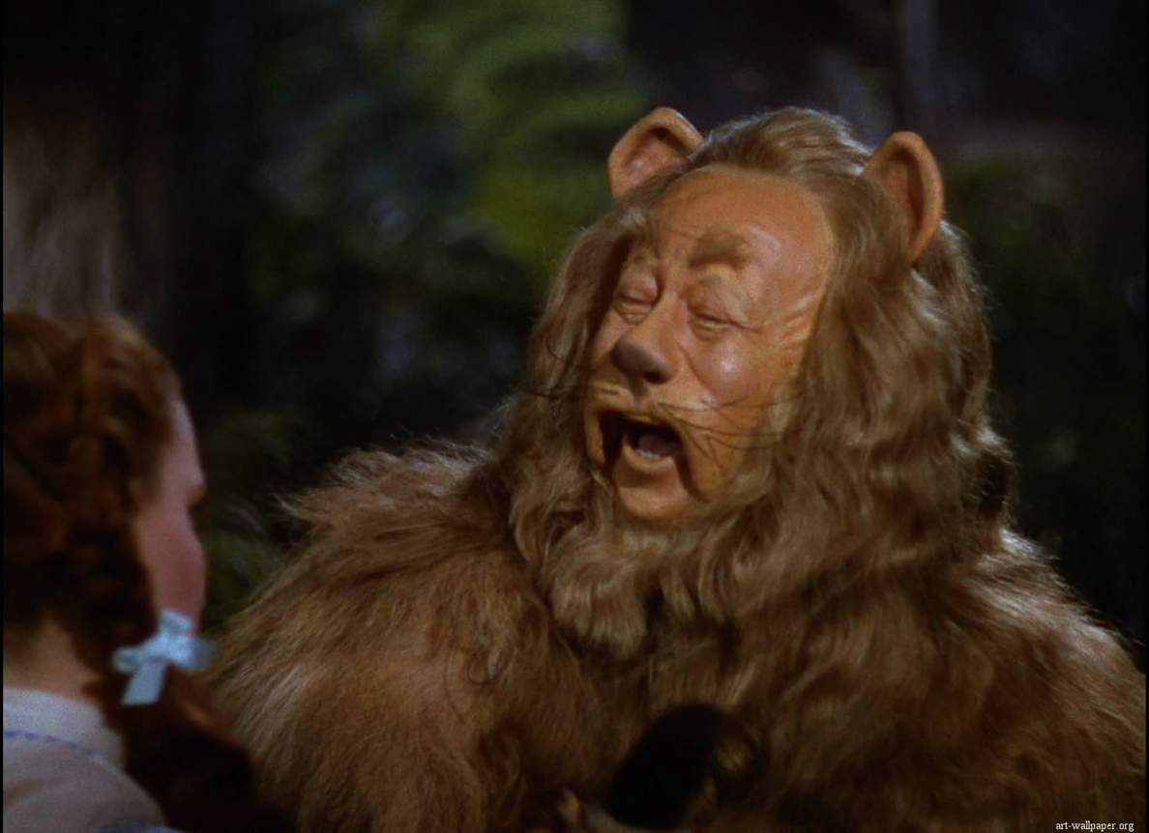
STORMING
The team meets their last member
*Major Storming*

Slide 16
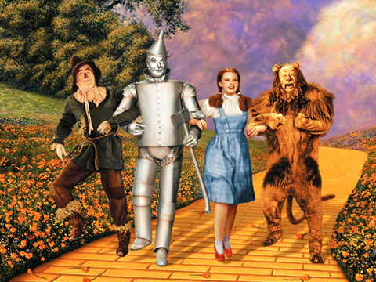
Performing
Off to see the wizard

Slide 17
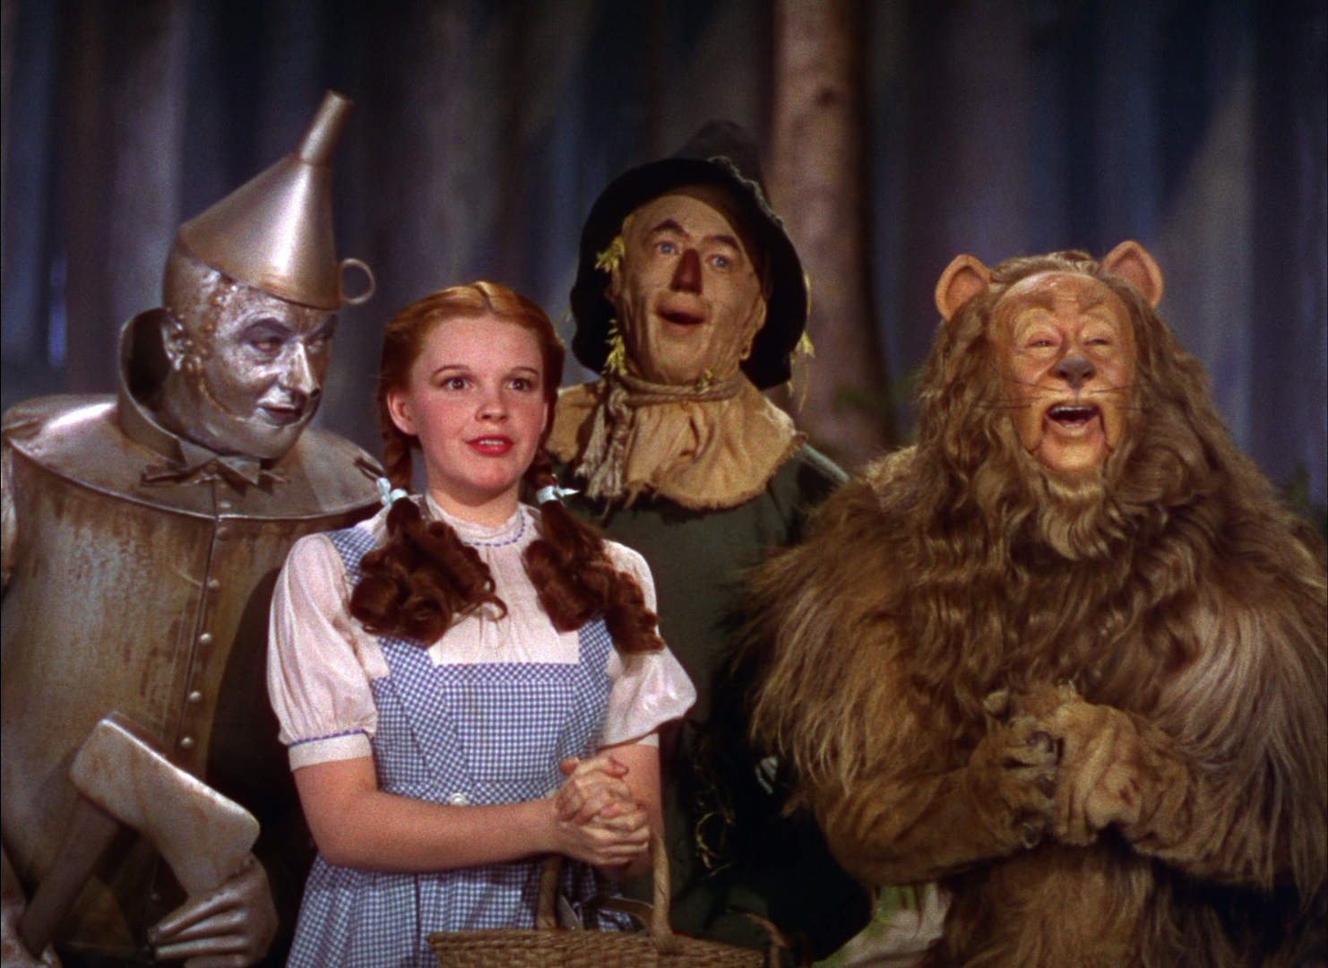

Slide 18
poppies

Slide 19
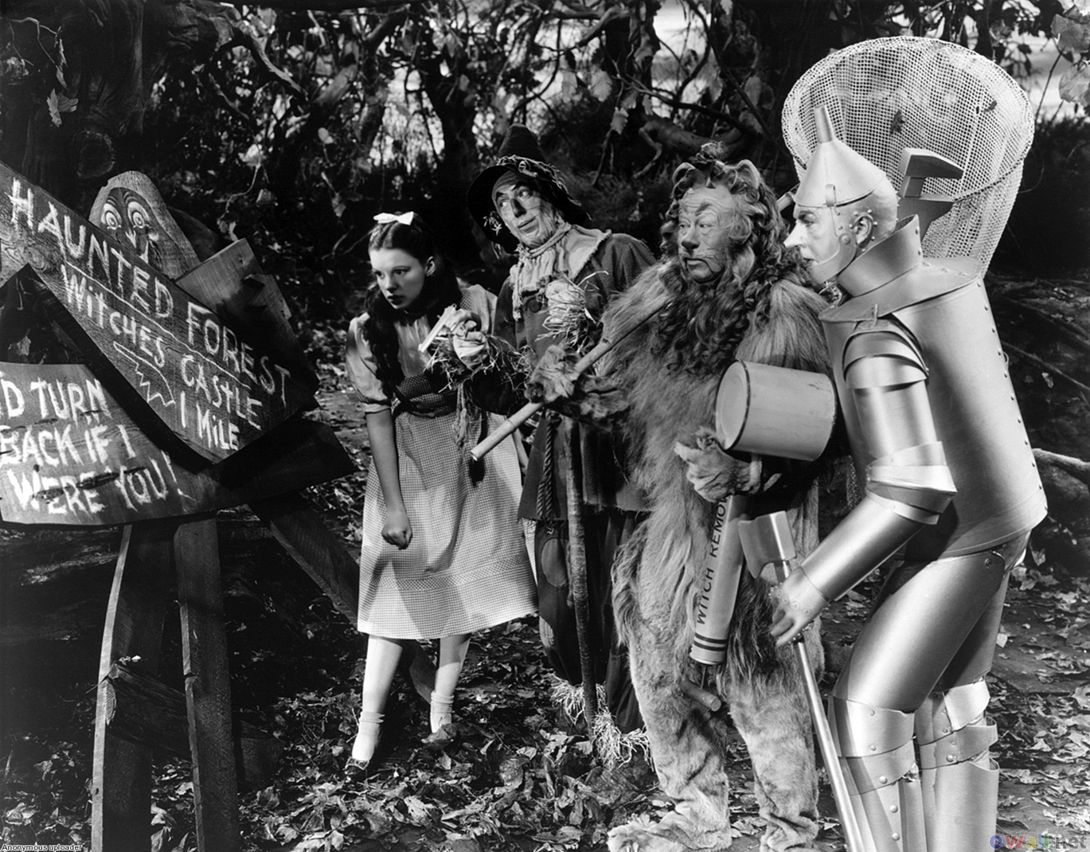
teamwork

Slide 20
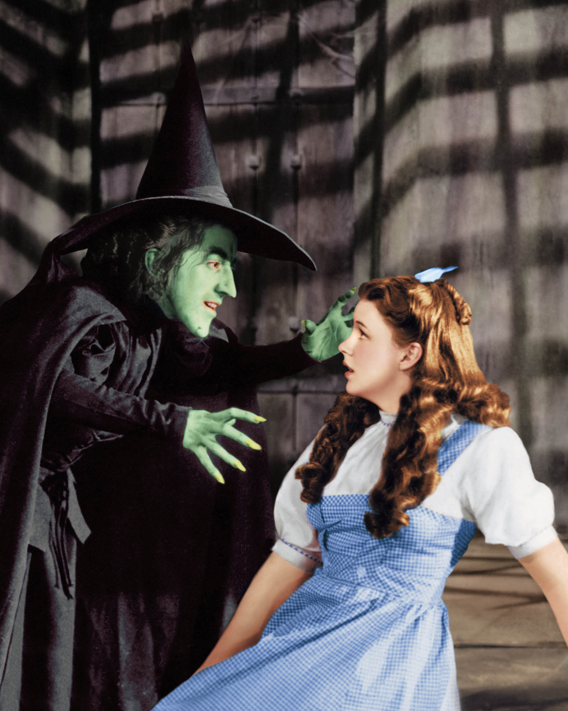
Power play

Slide 21
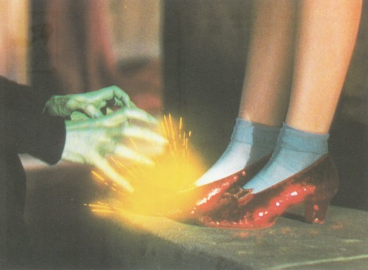
Ding Dong the
wicked witch is dead

Slide 22
What have you learned

Slide 23
