Slide 1
The XX’s
Felicia Anderson
Dana Beck
Cheryl Brier
Sarah Hook
Sarah Vaughn
OLS 388 - May 2012

Slide 2
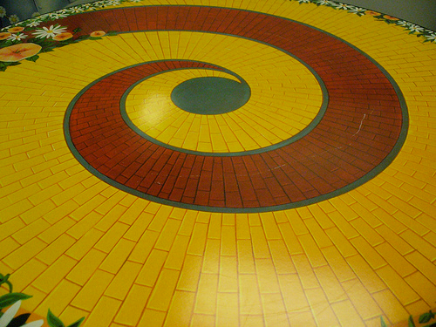
Introduction
of the
team

Slide 3
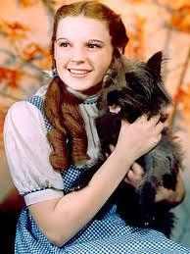
DOROTHY GALE
CAPS
Promoter
Supporter
Team Player Style
Collaborator
Participation
High Participation
Influence
Democratic
Task Roles
Initiator
Info. Seeker
Maintenance Roles
Encourager
Self-Oriented Roles
Help-Seeker
Membership
Insider

Slide 4
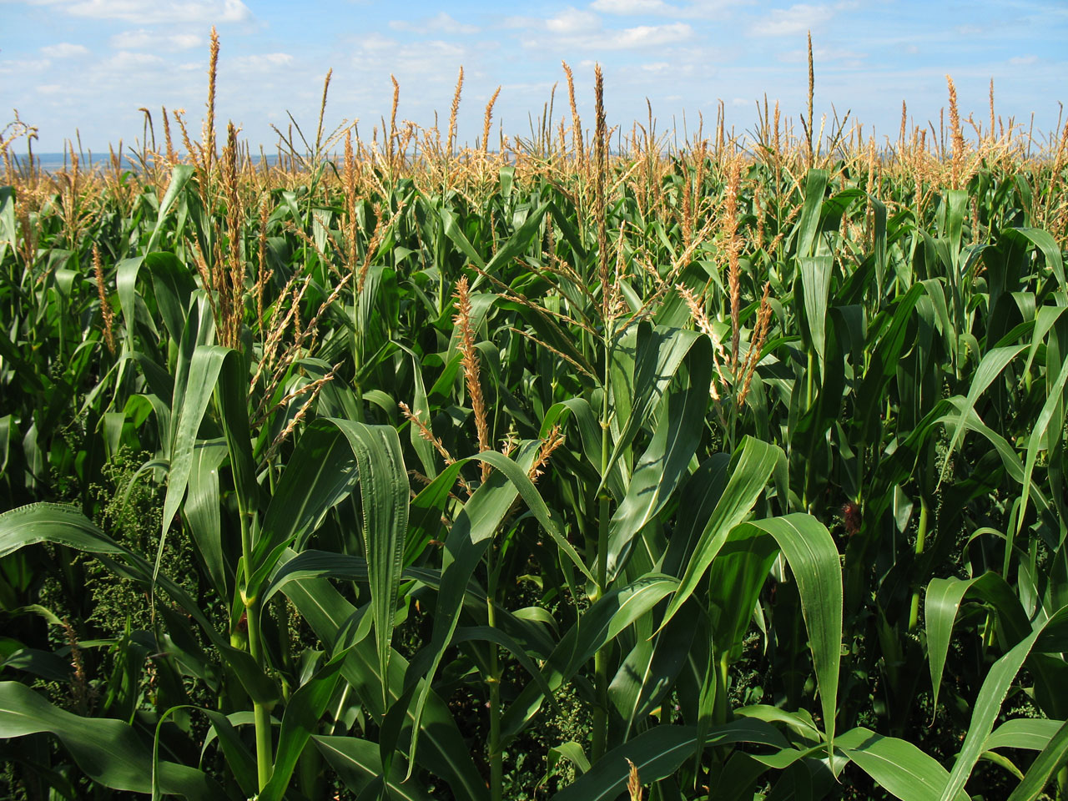
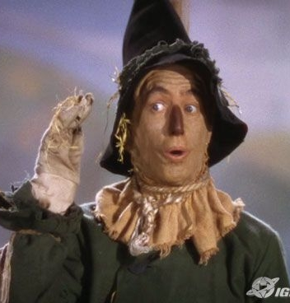
The Scare crow
CAPS
controller
Team Player Style
Collaborator
Participation
High Participation
Influence
peacemaker
Democratic
Task Roles
Info. Seeker
Energizer
Maintenance Roles
Encourager
harmonizer
Self-Oriented Roles
Help-Seeker
Membership
Insider

Slide 5
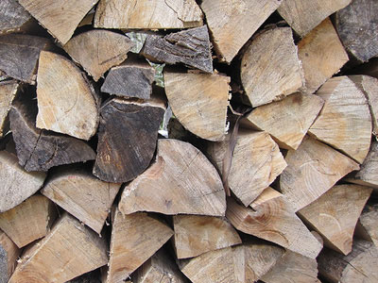
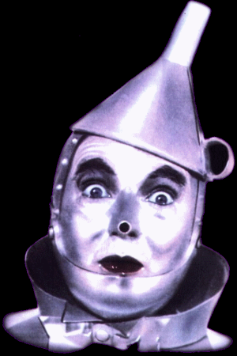
The tin man
CAPS
promoter
Team Player Style
Collaborator
Participation
low Participation
Task Roles
Info. Seeker
Maintenance Roles
harmonizer
Self-Oriented Roles
Help-Seeker
Membership
Insider

Slide 6
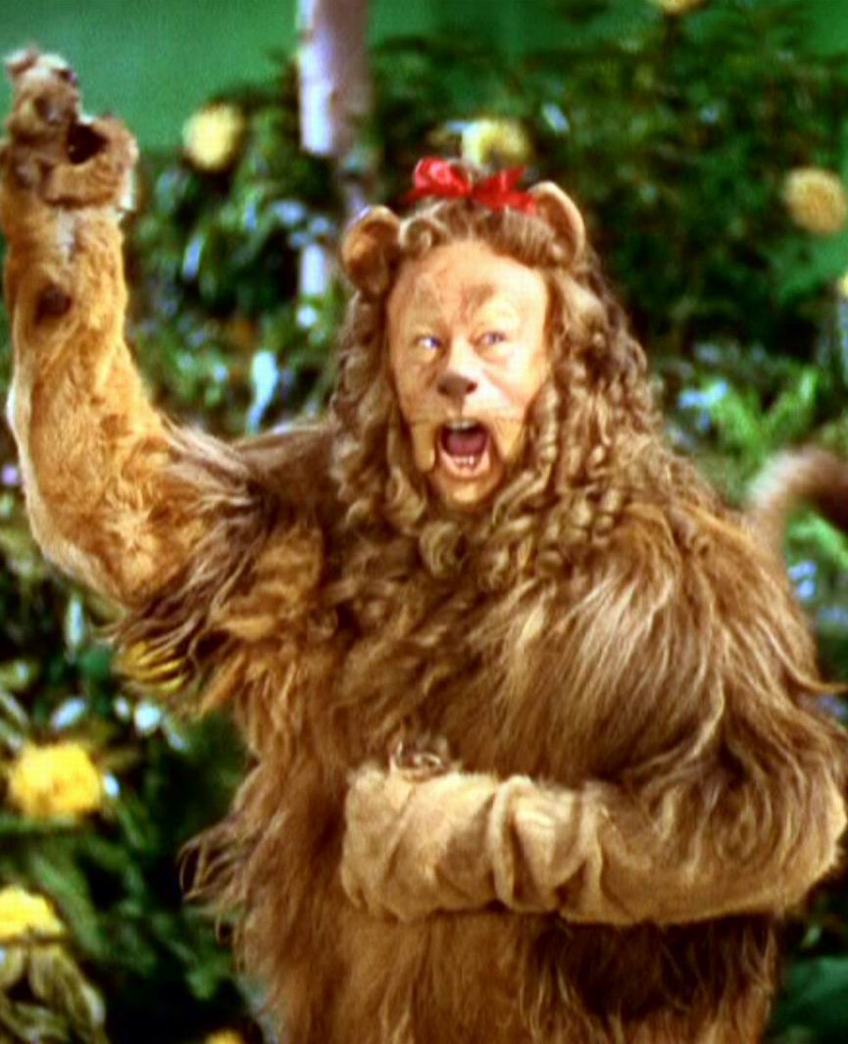
The cowardly lion
CAPS
promoter
Team Player Style
communicator
Participation
low Participation
Task Roles
Info. Seeker
Maintenance Roles
follower
Self-Oriented Roles
Aggressor
Blocker
Dominator
Avoider
Help-Seeker
Membership
Insider

Slide 7
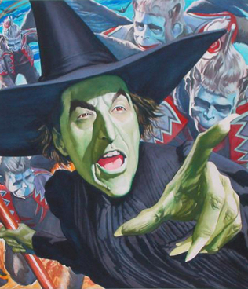
Wicked witch of the west
CAPS
controller
Team Player Style
challenger
Participation
high Participation
Task Roles
Opinion giver
Self-Oriented Roles
Aggressor
Blocker
Dominator
Membership
outsider

Slide 8
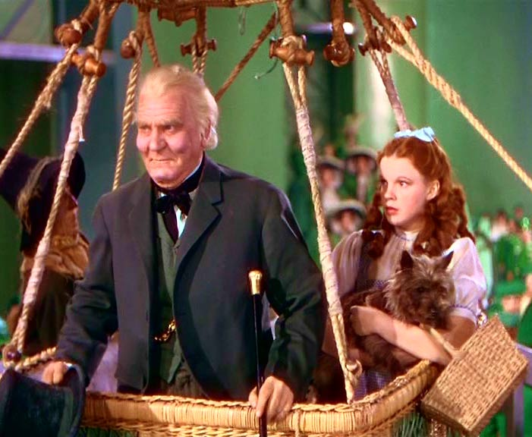
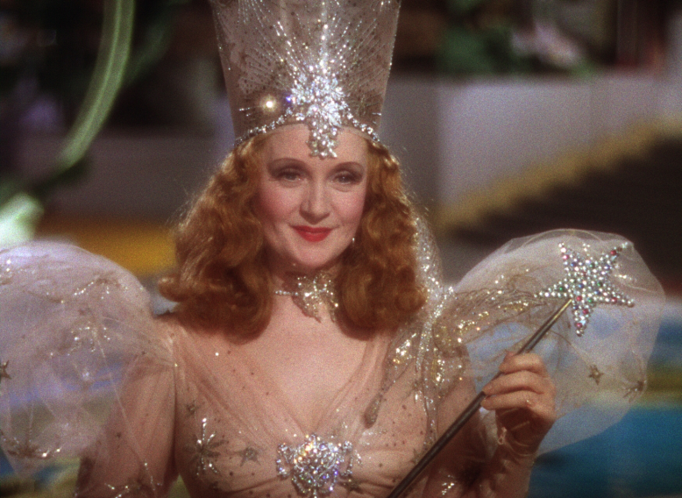
LOW PARTICIPANT MEMBERS
THE WIZARD
GLINDA
Style of Influence – laissez faire
Participation – low
Task role – evaluator
Maintenance role – group observer
Membership - subgroup
Style of Influence – Autocratic
Participation – low
Task role – energizer
Maintenance role – group observer
Membership - subgroup

Slide 9
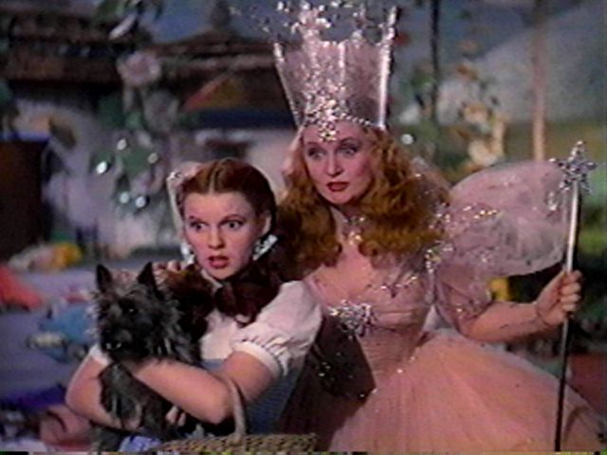
DOROTHY MEETS GLINDA … THE TEAM IS FORMED

Slide 10
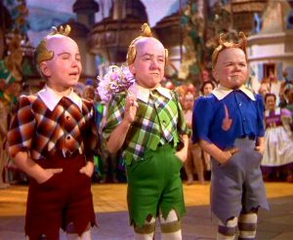
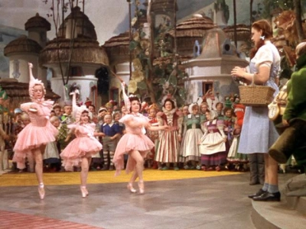
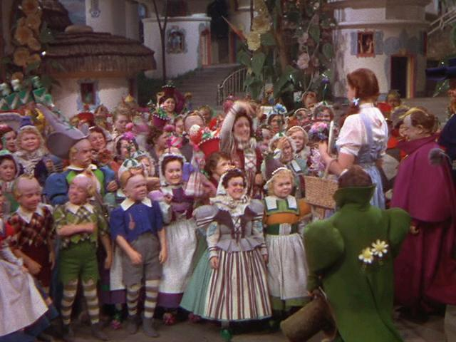
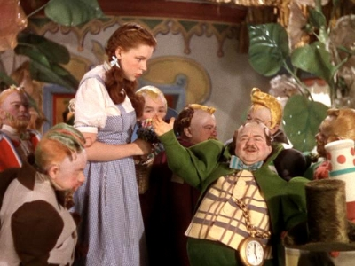
Dorothy is treated like a
hero for killing the
wicked witch of the east

Slide 11
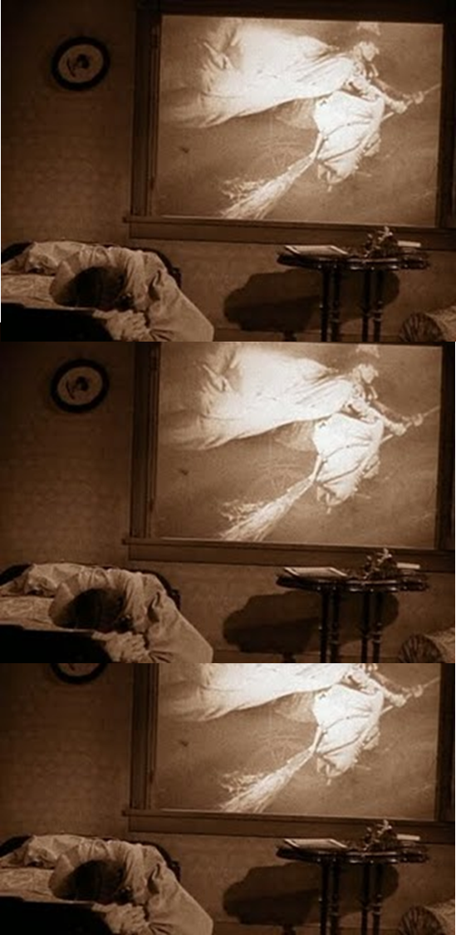
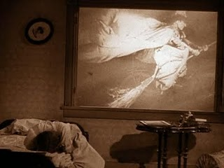
Introduction of the Antagonist.
The need for a goal…ruby slippers

Slide 12
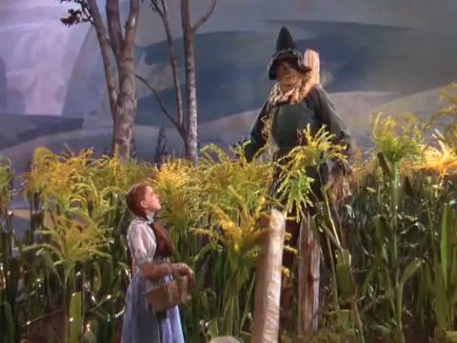
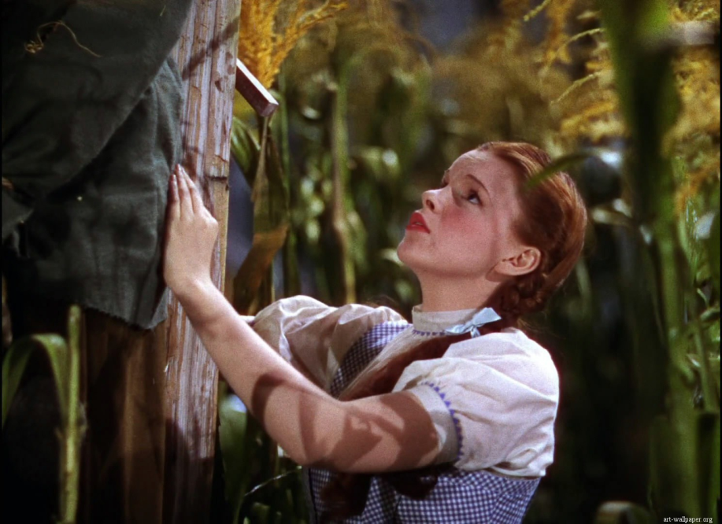
DOROTHY MEETS THE SCARE CROW

Slide 13
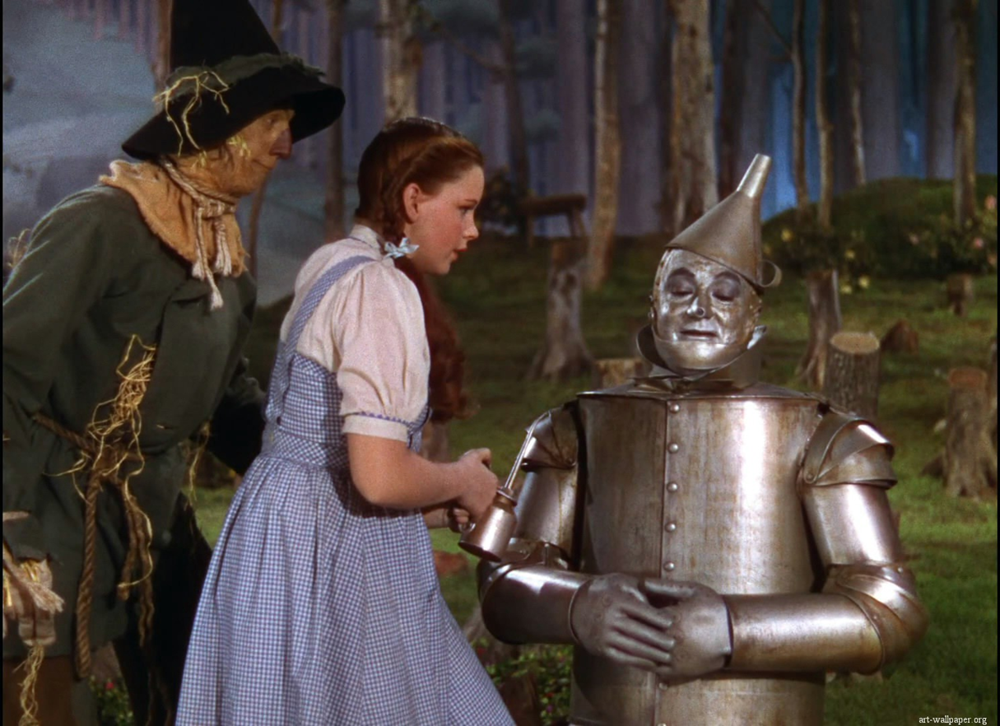
Dorothy Meets the tin man

Slide 14
THIS TEAM BEGINS TO PERFORM…
Lions and Tigers, and Bears…Oh MY!

Slide 15
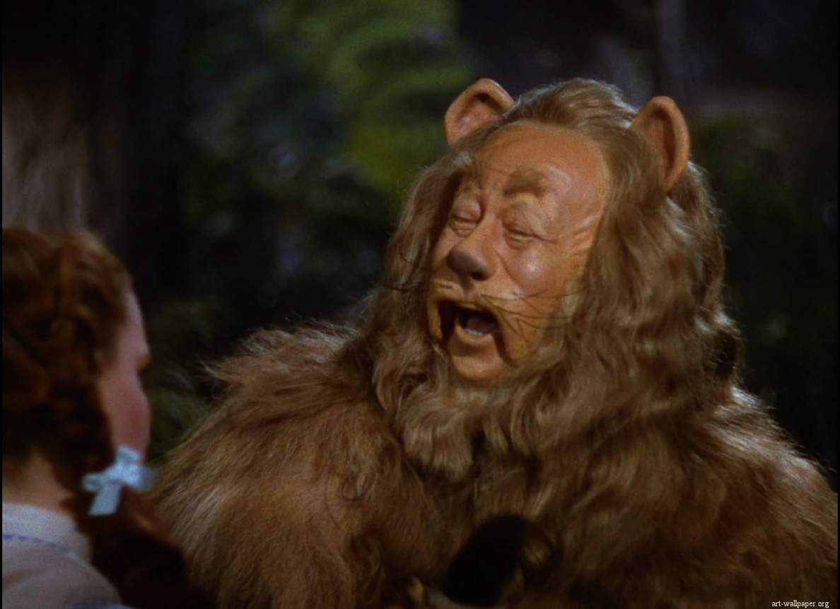
The team meets their last member
*Major Storming*

Slide 16
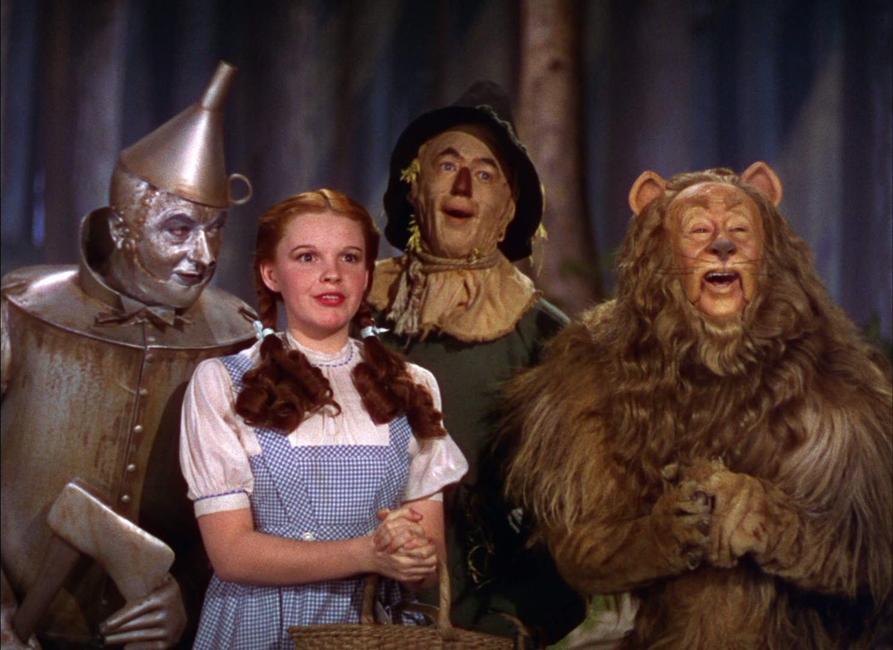
Our team is fully formed

Slide 17
Off to see the wizard
Performing

Slide 18
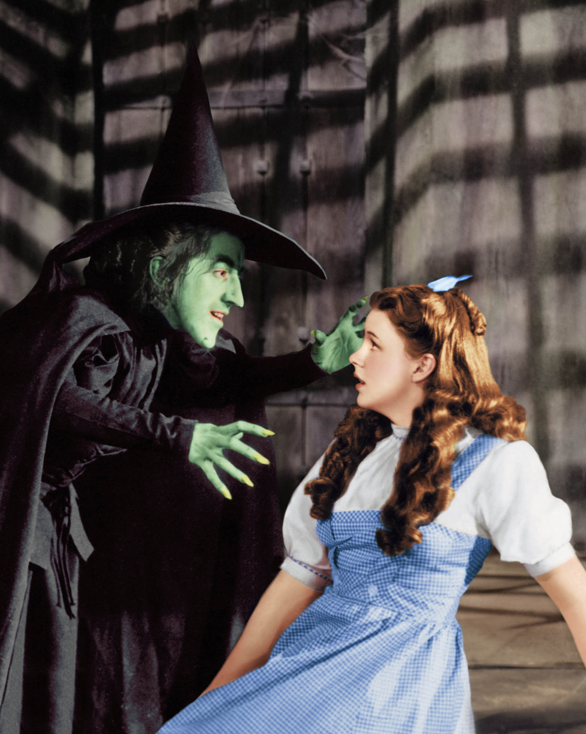
Power play

Slide 19
poppies

Slide 20
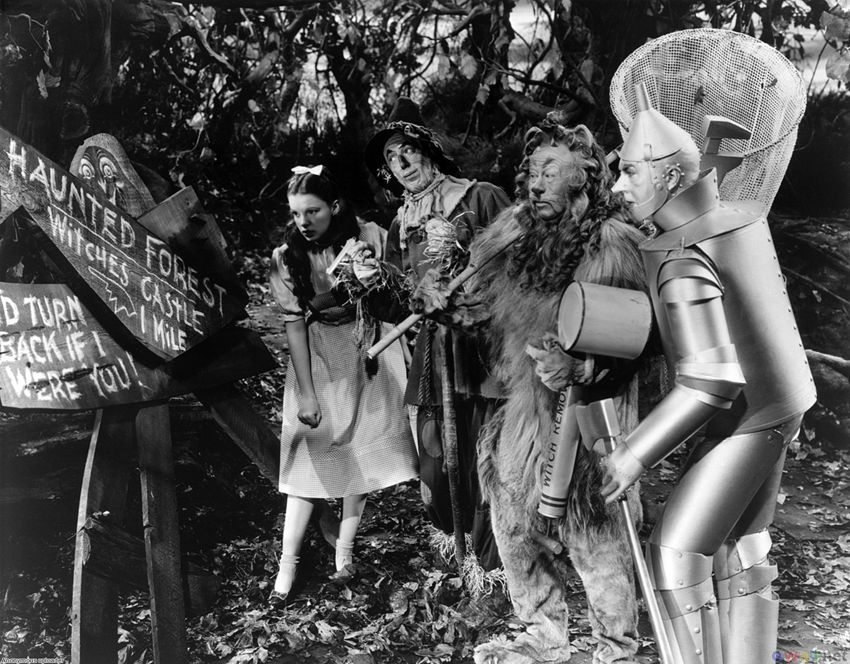
teamwork

Slide 21
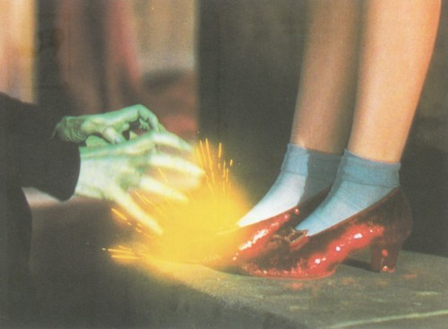
Ding Dong the
wicked witch is dead

Slide 22
What have you learned

Slide 23
100
100
100
100
200
200
200
200
300
300
300
300
400
400
400
400

Slide 24
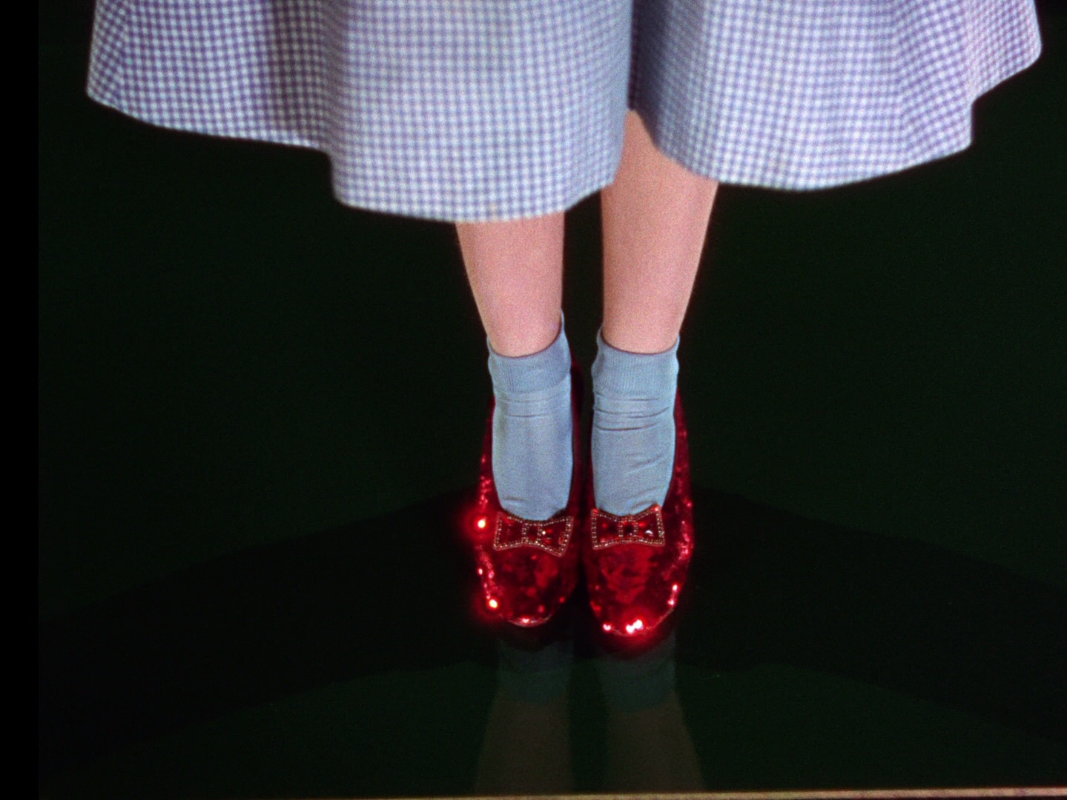
The end

