Slide 1
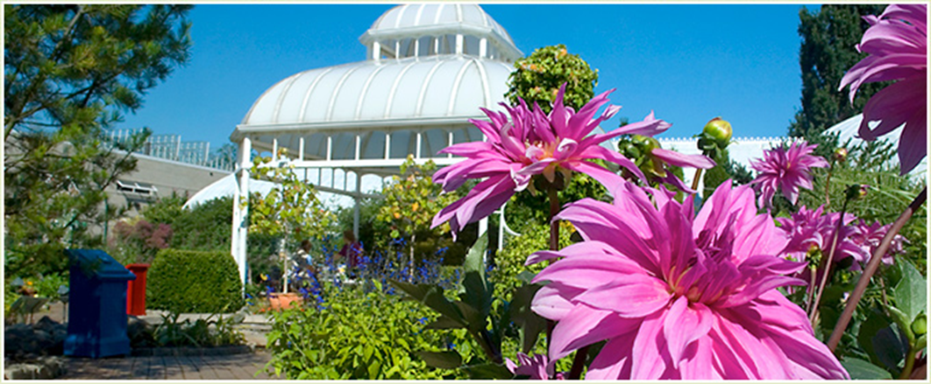
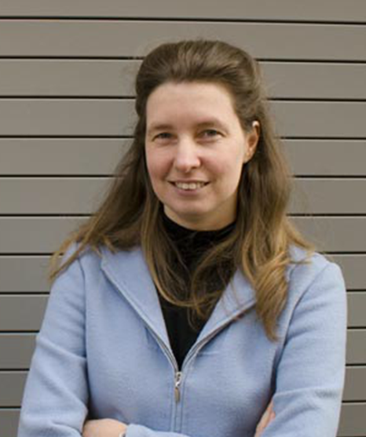

Building as Organism:
An Approach to the
Living Building Challenge
Friday, April 27, 2012
1:30 – 3:00pm
Pfendler Hall, Dean’s Auditorium
Christine Mondor
AIA, LEED AP
Adjunct Associate Professor of Architecture and Landscape Design
at Carnegie Mellon University and Chatham College
Come learn about the Living Building Challenge: a philosophy, advocacy tool, and certification program that promotes the most advanced measurement of sustainability in the built environment possible today. It can be applied to development at all scales, from buildings – both new construction and renovation, to infrastructure, landscapes and neighborhoods.
Christine Mondor is a LEED Accredited Professional whose diverse experience enables her to note trends and technologies and bring benefit across project types. In over a decade of experience, Christine has worked with builders to create award winning historic housing and has explored the use of new technologies for more efficient affordable urban housing. Christine was project architect for one of the first Leadership in Energy and Environmental Design (LEED) rated buildings in the country and has provided green building consulting for clients including the Carnegie Libraries of Pittsburgh, ALCOA Corporation, and Carnegie Mellon University. Most recently, Christine has designed residential and commercial landscapes to create beautiful settings that reconnect people to the outdoors and improve environmental conditions such as storm water and habitat quality.

