Slide 1
College of Engineering Communications
Christine Babick, Director of Communications

Slide 2
October 7, 2014
Communications Plan for a Global Brand

Slide 3
Inside-out Approach
Embrace Mission, Mirror Strategic Plan
Advance learning, discovery, engagement
Grads, research for 21st century
Leadership culture where people collaborate
Empower our people
Iterative
Flexible, organic

Slide 4
January 5, 2015

Slide 5
Vision
We Need Everything!
Operation
  Well-oiled machine, collaborate, share
  Resources
  Expertise
  Amazing photos, stories, video
Outcomes
  Cohesive brand
  Multiple vocalizations but one voice
  Website
  Publicity

Slide 6
Challenges
Engineering is gigantic

Slide 7
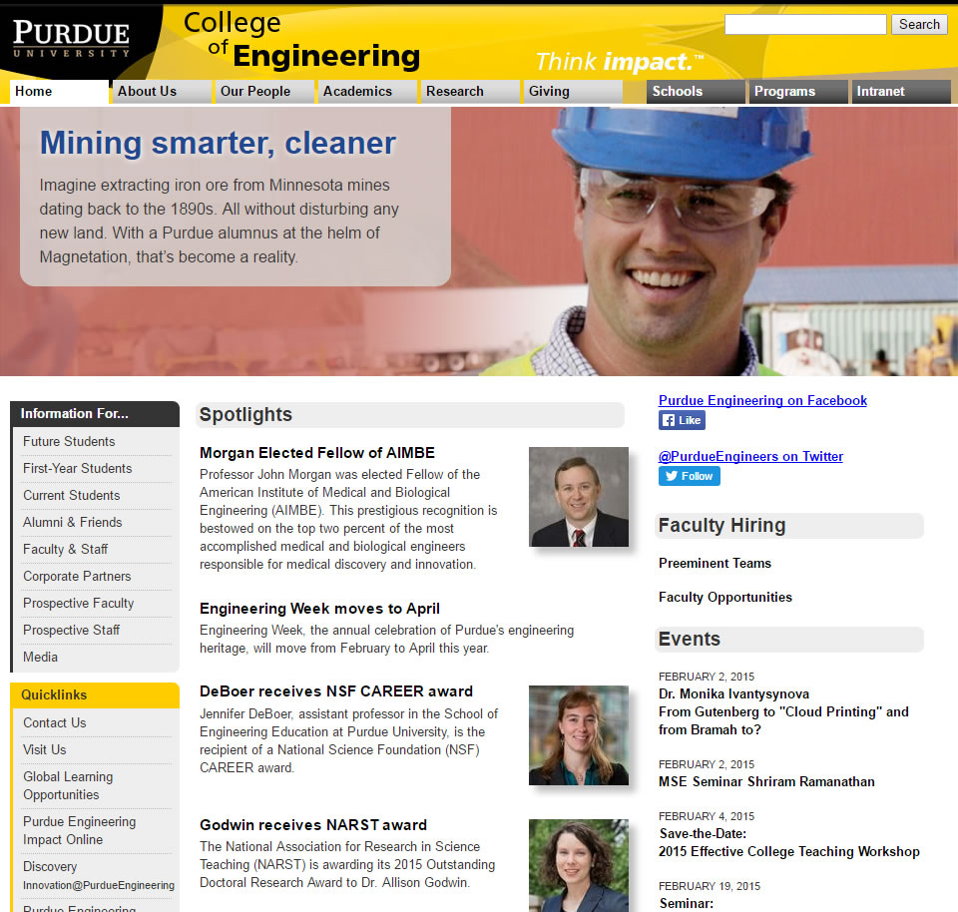
Challenges

Slide 8
Challenges
Infrastructure
  New people, new processes, new products
Relationships

Slide 9
Challenges
“Change is not the same as it used to be.”
Social media
Websites
Publicity
Four generations

Slide 10
January 2015 to early 2016

Slide 11
Mirror Strategic Plan
#Empower
Empower our people
  Designated Communicators
  Monthly meetings, daily interaction
  Official word, unofficial cohesion
  Listening tour: uncover issues, challenges
  Survey

Slide 12
Mirror Strategic Plan
#Learn
Learning, discovery
  Professional development
    Training for expertise
  Resources
  Organic sharing

Slide 13
Mirror Strategic Plan
#Collaborate
Leadership culture of collaboration/Engagement
  A house is not a collection of beams, concrete, tiles, siding, etc.
  How to collaborate/share (photo library, procedures, coordination)
  Strategic planning
  Fold in old, reach for new
  One voice (templates, policy, updates)

Slide 14
Mirror Strategic Plan
#Creative #Flexible #Iterative
Grads, research for 21st century
  Social media, policy
  Storytelling: photography, video
  Iterative, flexible, creative approach

Slide 15
April 19, 2016

Slide 16
Current
#BeatTheCompetition
Website overhaul
  Education process
  Particular and unique challenges
Social media
  New, revamped, revitalized
Publicity
  University-College-School partnership
  Folds in video, photography
  PBS
Promotion: General Handout
  A handout to show what Purdue Engineering is/does
  “wow”
More news, better video

Slide 17
At some point, 2016

Slide 18
Future
#EngineeringCommunicationsUtopia
Organizing Ourselves
  Communications Plan
  Templates for branded collateral
  Education about communications
    How to Talk to an Engineer, How to Talk to a nonEngineer
Promoting Ourselves
  Publicity (lists, “supplemented journalism”)
  Extraordinary People
  Blog
  Websites
    Analytics
    Photography and video
    Better writing
    Promotion, persuasion

