Slide 1
Web Accessibility and Inclusion
College of Engineering
June 28, 2016
Dean Brusnighan, ITaP Teaching and Learning Technologies

Slide 2
Why is this important?
Notes:
Ask the attendees

Slide 3
We will talk about
Inclusion
Breaking the accessibility rules
Accessibility priorities
Websites
Documents
Video captioning

Slide 4
Why is this important?
Notes:
Ask the attendees

Slide 5
Include people with disabilities
Inclusion – right thing to do
Everyone benefits from better design
Purdue Web Accessibility Policy
Federal laws – non-discrimination
Notes:
What if you couldn’t access the internet because you had red hair? Or brown eyes?
PWD just happen to have characteristics that interfere with using some technology when it isn’t designed with inclusion in mind
“Improving diversity and inclusion at Purdue is one of my highest priorities. It’s a cause that will enhance the academic and research experience for everyone on campus and is worthy of our very best efforts.” -Provost Deba Dutta

Slide 6
I’m afraid I’m breaking the accessibility rules
Notes:
Ask the attendees

Slide 7
Am I breaking the rules?
Yes, you are – almost everyone is
Throw that thought away
Progress not perfection
Start somewhere and make progress
Notes:
I’m not making fun, I want you to understand that we’re all in the same boat so you don’t feel overwhelmed
So throw that thought away – get rid of it because it isn’t helpful to moving forward. Instead ask, what’s the next thing I can do to get better?
How many of you have learned a foreign language?
Did you speak in complete sentences and correct grammar to start with? No, of course not.
We can think of accessibility as a foreign language that we all need to learn, but we’re not going to be experts to start with.
So let’s set our own expectation of ourselves for progress not perfection
To me, that means start somewhere and make progress
Can’t fix your entire website – OK, work on the pages with the highest traffic
Can’t put captions on all your videos – fine, do the most important 10 this semester, and each semester do 10 more

Slide 8
Accessibility priorities
Critical – barriers that make someone unable to complete a task
Frustrating – problems that make it difficult to complete a task
Annoying – things that make the task less pleasant to complete
Notes:
Examples:
Critical – unable to read a PDf, unable to complete an online form
Frustrating – no headings on a long web page or in a long document
May be that some get frustrated enough that they are unable
Annoying – text and image alt text repeating itself over the entire page

Slide 9
Website priorities
Headings
Image alt text
Keyboard access and visual focus
Labels that are explicitly associated with edit fields for online fillable forms
Anything that makes one unable to …
Notes:
Policies and guidelines are good at saying “all these things” are important to address, but aren’t so good about identifying priorities
So, these are my ideas, with help from the W3C Web Accessibility Initiative
Keyboard access examples:
Before: https://www.washington.edu/accesscomputing/AU/before.html
After: https://www.washington.edu/accesscomputing/AU/after.html
Unable to … complete a task, read the document content, comprehend the video

Slide 10
Make documents accessible
Word
PDF
Training sessions available
Adobe Acrobat Pro
  accessibility checker
  “make accessible” wizard
Notes:
Anyone using InDesign? No training available but I’m happy to meet with you to go over techniques
Yes the accessibility checker in Acrobat Pro is worth using
Acrobat Pro 11 and up has a “Make Accessible” wizard – not perfect but a good place to start if new

Slide 11
Provide video captions
Harvard and MIT were sued
Captioning vendor contracts with Purdue
  Cielo24 integration with Kaltura
Automatic captions on YouTube
Captioning tools on YouTube
Notes:
Harvard and MIT were sued in 2015 over missing or inaccurate captions on free educational content
Quote from the complaints: “Just as buildings without ramps bar people who use wheelchairs, online content without captions excludes individuals who are deaf or hard of hearing.”
Captioning contracts
Cielo24 ($1.60/minute, 99% accuracy, 48 hours)
3Play Media ($2.10/min, 98+% accuracy, 4 business days)

Slide 12
Resources
Web Accessibility in Mind (WebAIM)
  http://webaim.org
Web Accessibility Initiative Easy Checks
  http://www.w3.org/WAI/eval/preliminary
Web Accessibility Initiative Tips for Getting Started
  https://www.w3.org/WAI/gettingstarted/tips/index.html

Slide 13
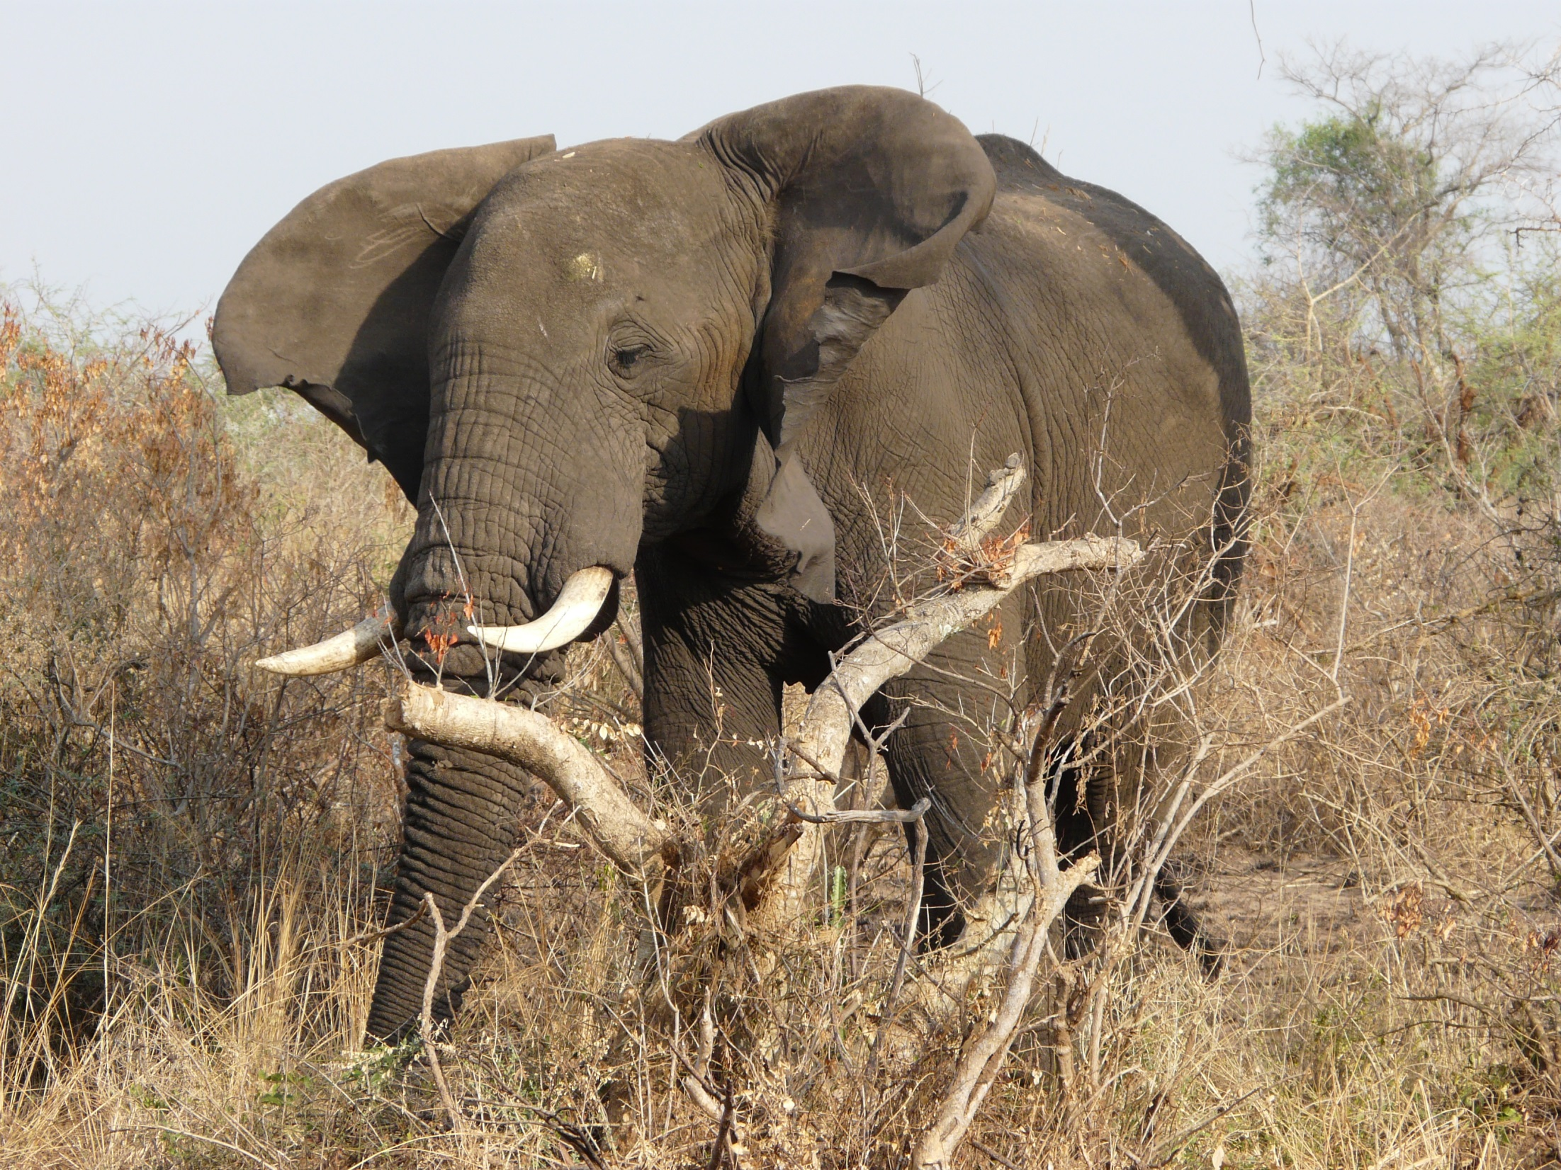
So Much to Do!
Notes:
So much to do.
Don’t try to eat the elephant all at once!

Slide 14
Moving forward
  Make a collective decision to improve accessibility
  Determine priorities
  Set goals
  Make progress
Notes:
We’ve talked about a wide range of things. There’s a lot to do here – don’t try to eat the elephant all at once!
Make a decision that improving accessibility is important, and let folks internal and external know that
With input across staff and administrators, gather information so priorities can be determined
What is most critical that needs improvement?
Set realistic goals for timelines
Just start somewhere and make progress

