Slide 1
WHAT IN THE WORLD IS
SEO…
OR, DO WE REALLY CARE WHAT
GOOGLE IS SAYING ABOUT US?

Slide 2

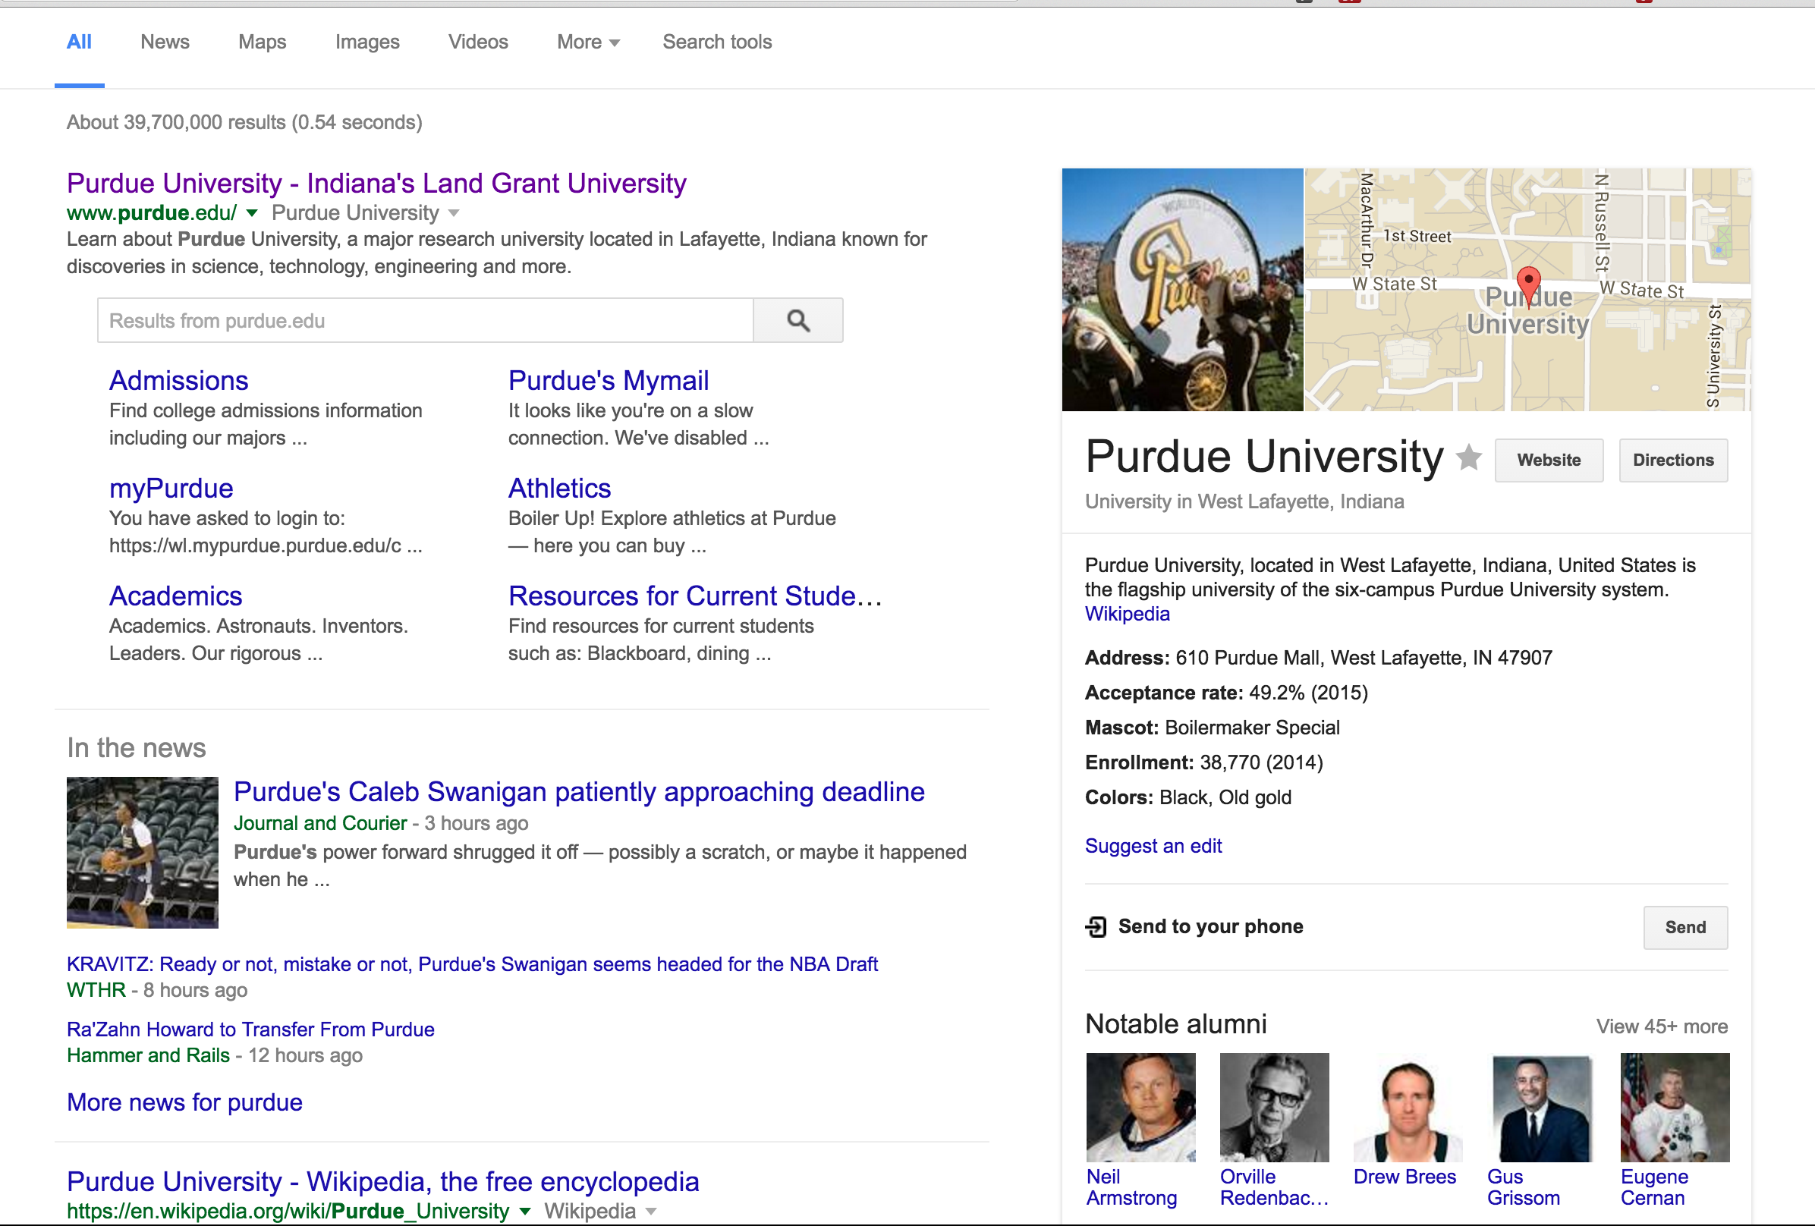

SEARCH ENGINE OPTIMIZATION
TERMS
SEO – A marketing discipline focused on growing visibility in organic
(non-paid) search engine results. SEO encompasses both the technical and creative elements required to improve rankings, drive traffic, and increase awareness in search engines.
There are many aspects to SEO, from the words on your page to the way other sites link to you on the web. Sometimes SEO is simply a matter
of making sure your site is structured in a way that search engines understand.

Slide 3
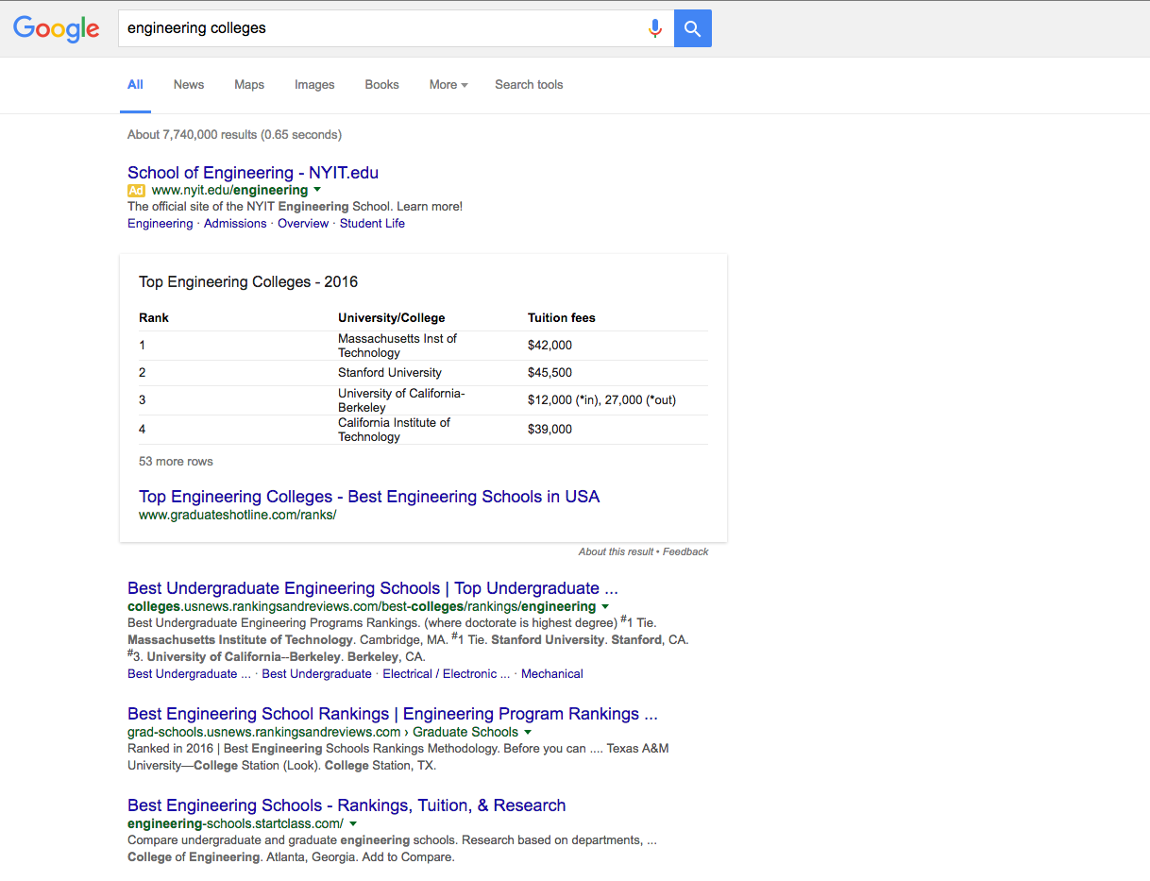
SEARCH ENGINE OPTIMIZATION
TERMS
SERP – Stands for Search Engine Results Page

Slide 4
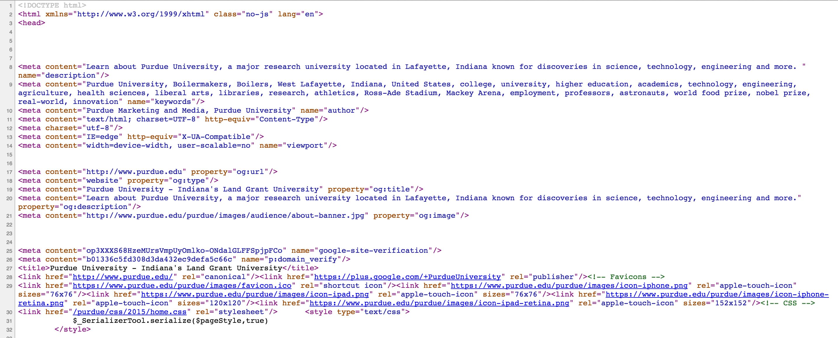
SEARCH ENGINE OPTIMIZATION
TERMS
Meta Description – The meta description is a ~160 character snippet, a tag in HTML, that summarizes a page's content.
Search engines show the meta description in search results mostly when the searched for phrase is contained in the description.
Optimizing the meta description is a very important aspect of on-page SEO.

Slide 5
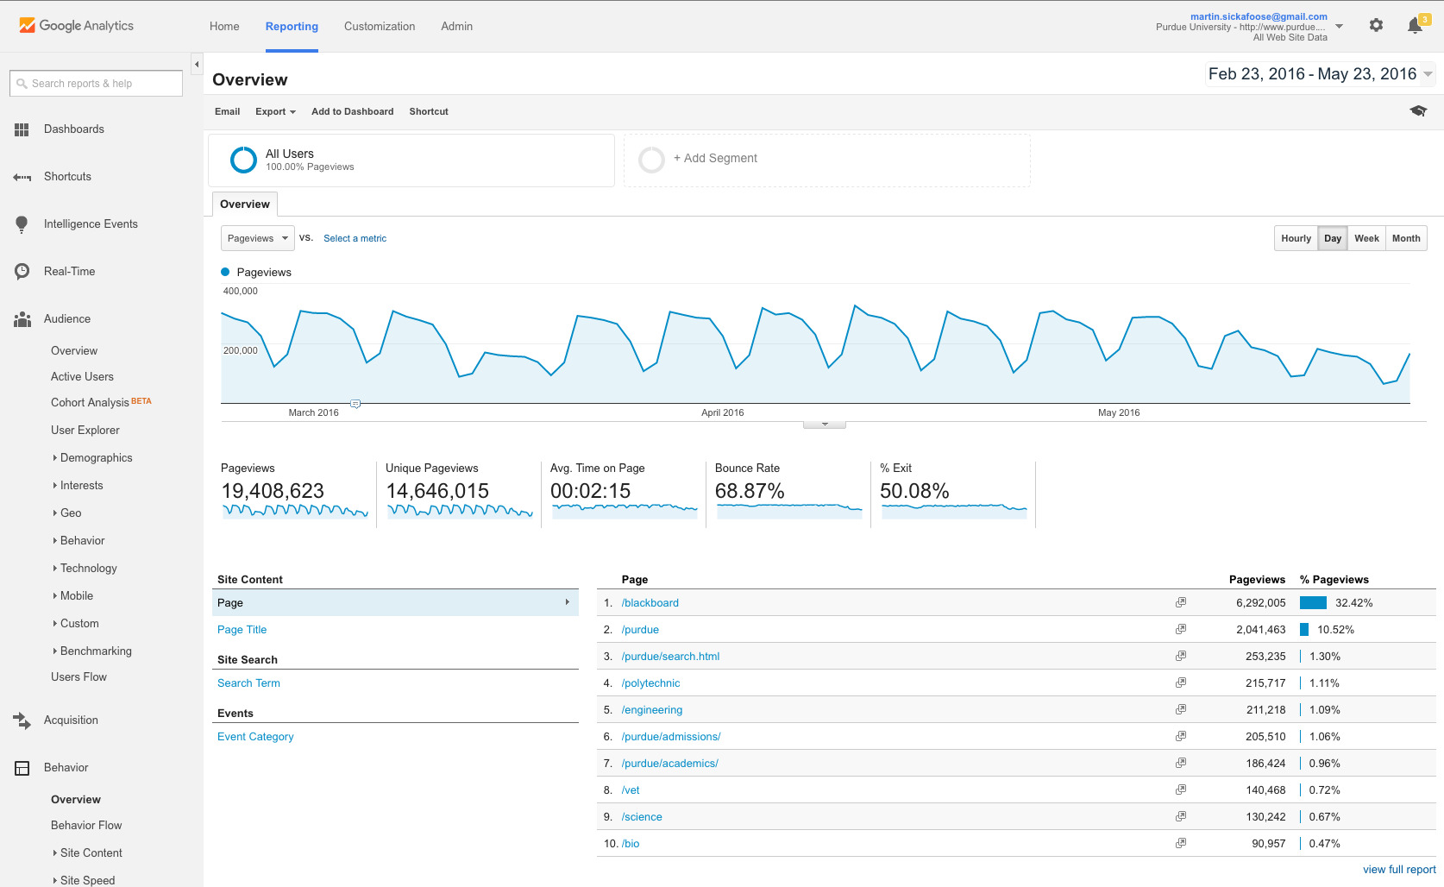
GOOGLE ANALYTICS

Slide 6
WHAT IN THE WORLD IS
SEO…
OR, DO WE REALLY CARE WHAT
GOOGLE IS SAYING ABOUT US?

