Slide 1
Undergraduate Program Update
August 16, 2023

Slide 2
Update on Organizational Structure
Who to ask instead of e-mailing Jim
Jitesh Panchal, Associate Head of Undergraduate Studies
  Undergraduate curriculum
  Course development and updates
  Assessment
  Teaching plan and assignments
  Academic integrity
Beth Hess, Assistant Head for Undergraduate Student Wellbeing
  Undergraduate student success
  Academic advising
  Course registration
If in doubt, e-mail both of us!

Slide 3
Undergraduate Program Philosophy
Data-driven decision making
  Impact of programmatic changes on student outcomes
  Transparency
  Opportunity for innovation
A multi-level strategy for continuous improvement
  Program level
  Course level
  Module level
Reminder of ABET timeline

Slide 4
Continuous Improvement
Program Level

Slide 5
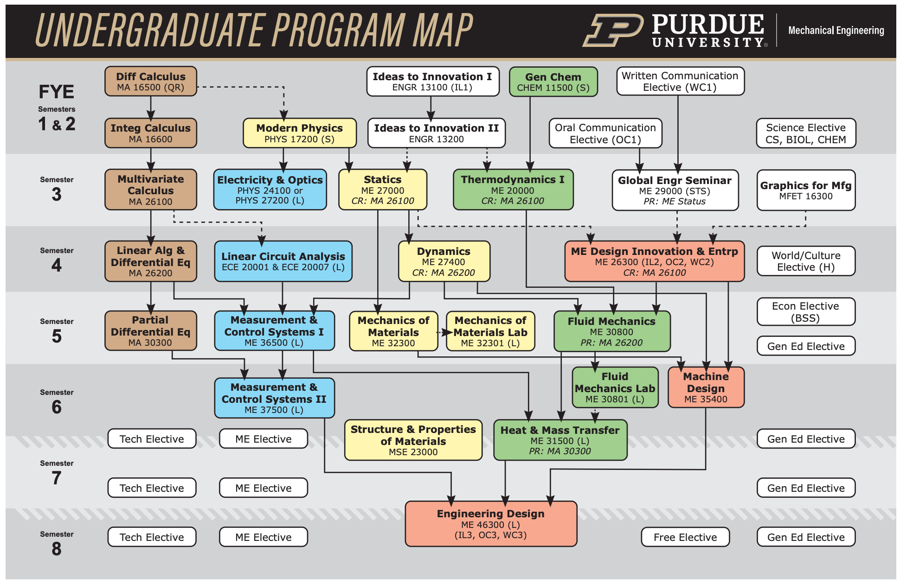
Continuous Improvement: Program Level

Slide 6
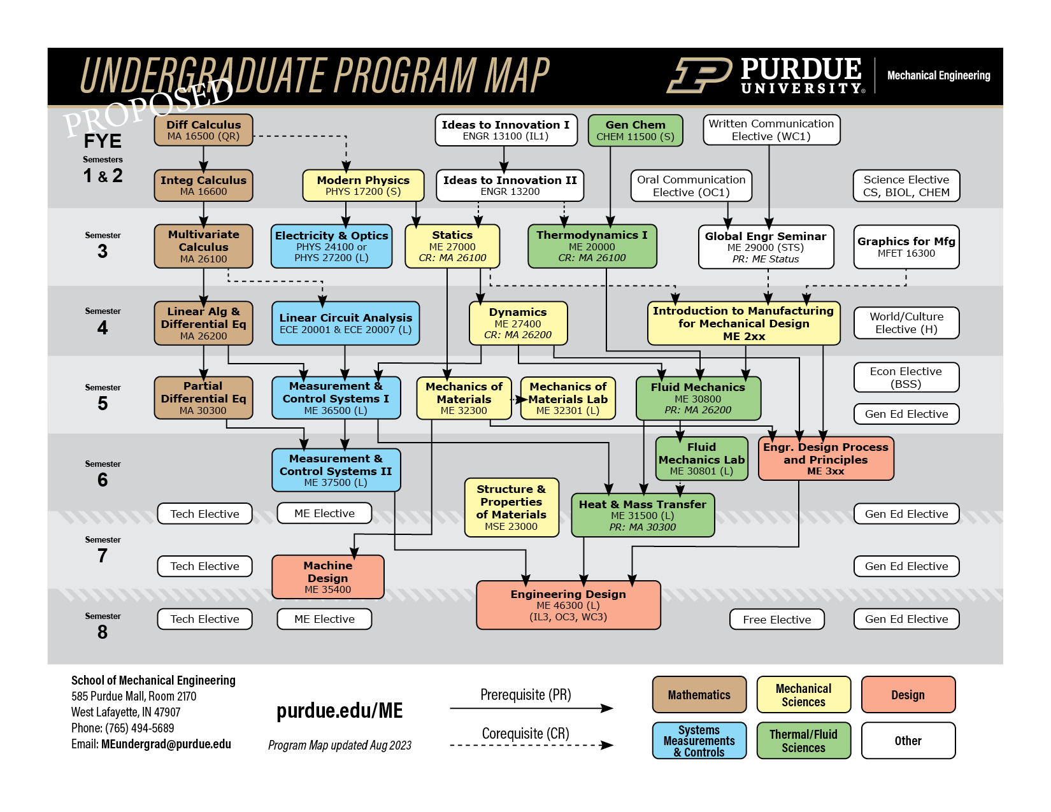
Continuous Improvement: Program Level
Updated Program Map [starting Fall 2024]

Slide 7
Continuous Improvement: Program Level
New ME Electives and Concentrations
Minor: supplemental academic program of at least 15 and no more than 21 credit hours from a single or closely related subject areas
  Engineering and Public Policy
  Intellectual Property Law for Engineers
  Sustainable Engineering
Certificate
  A supplemental academic program of at least 15 and no more than 21 credit hours that is by design multidisciplinary.
Concentration
  A specialization tied to a specific major of at least 9 hours.
  New: Concentration in Microelectronics and Semiconductors for Mechanical Engineering

Slide 8
Continuous Improvement
Course Level

Slide 9
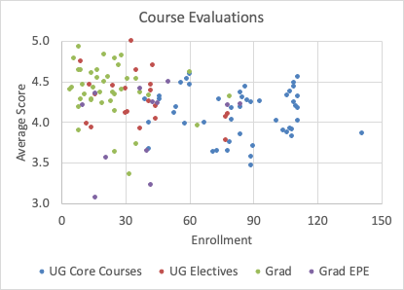
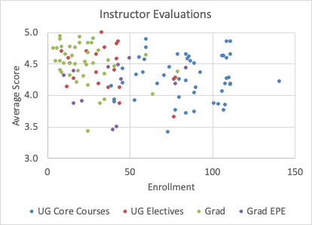
Greater transparency of aggregate results from course and instructor evaluations
Avg: 4.4
Avg: 4.2

Slide 10
Continuous Improvement: Course Level
Transparency of Course and Instructor Evaluations
Academic Year 2022-23

Slide 11
Continuous Improvement
Module Level

Slide 12
Continuous Improvement: Module Level
Example: Data-Science Modules by Ilias Bilionis
Topic | Semester 3 | Semester 4 | Semester 5 | Semester 6 | Semester 7 | Semester 8
Programming | Variables, numerical arrays, basic linear algebra, conditional statements | Classes | Python scripts | Super-computing
Data | Excel, comma-separated value files | Data frames, data cleaning, extracting subsets of data satisfying certain properties | Binary files (HDF5, NetCDF) | Databases
Visualization | Scatter plots, line plots, parity plots | Histograms | Contours, surface plots | credible intervals
Probability | Basic probability rules, probability mass function, Bernoulli | Binomial, probability density function, cumulative distribution function, expectation, variance standard deviation, Normal | Covariance, correlation | quantiles, credible intervals, Bayes’ rule | Central limit theorem
Statistics | Empirical statistics, method of moments | Principle of maximum likelihood | Empirical quantiles | Bayesian inference | Markov chain Monte Carlo | Variational inference
UQ | Aleatory uncertainty vs epistemic uncertainty | Monte Carlo simulations | Uncertainty propagation through physical models | Physical model calibration | Inverse problems | Decision-making
Machine learning | Linear regression | Polynomial regression, multivariate linear regression | Logistic regression, k-means clustering | Principal component analysis, neural network regression | Image classification | Recursive neural networks
ME 200
ME 274
ME 308
ME 354
ME 270
ME 323

Slide 13
Discussion

Slide 14
We suggest you use Think-Pair-Share within each area
Please take notes and summarize for the larger group at the end of the discussion period
Continuous improvement of core courses
New ME electives
New ME concentrations
Classroom and teaching innovations

Slide 15
Thank You

