Slide 1
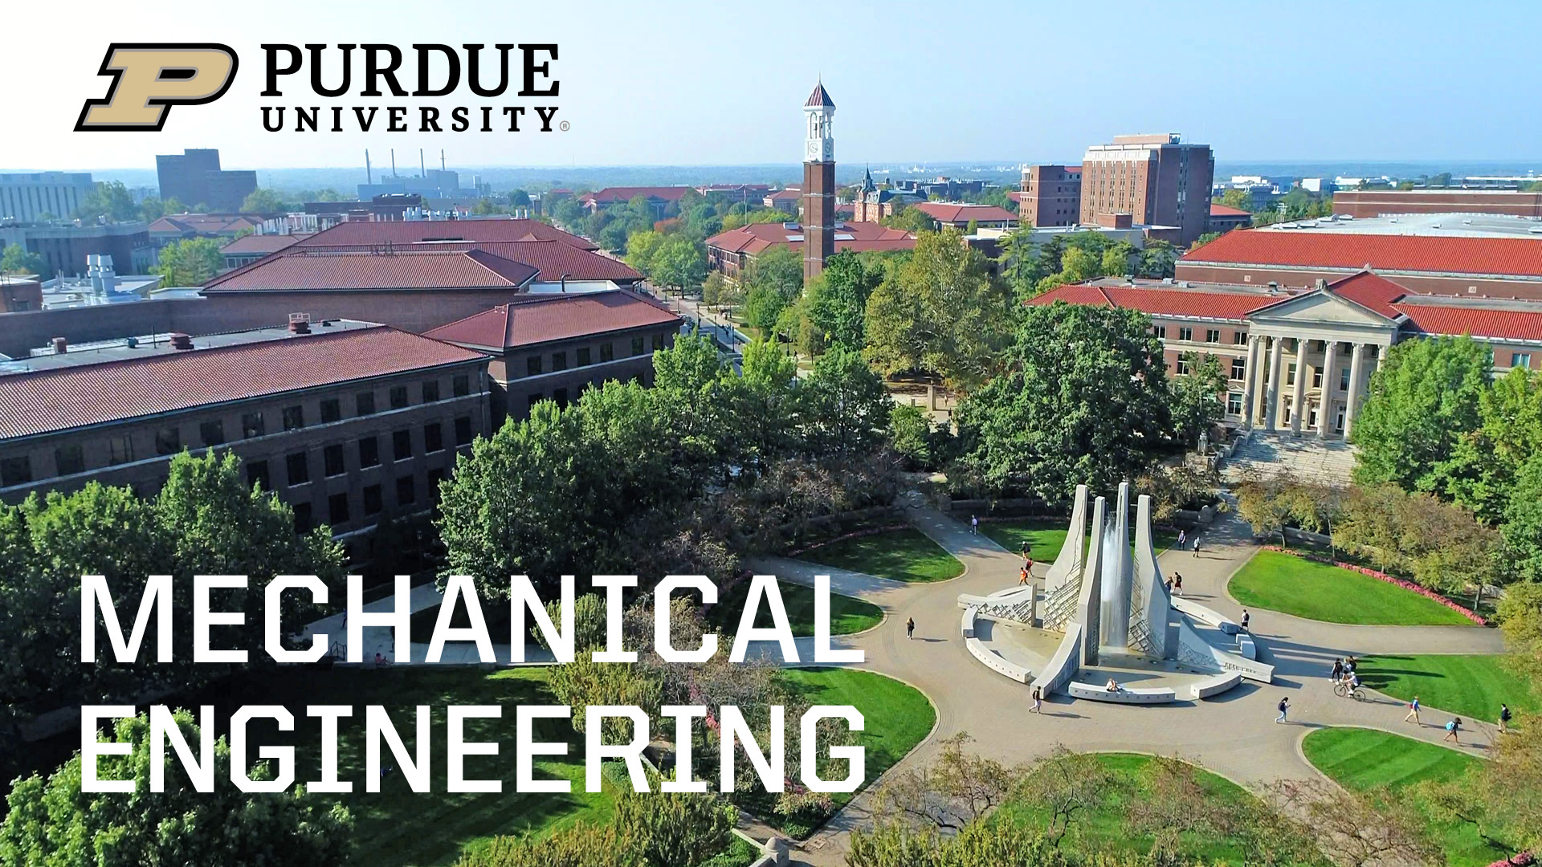
2023 Faculty/Staff Retreat

Slide 2
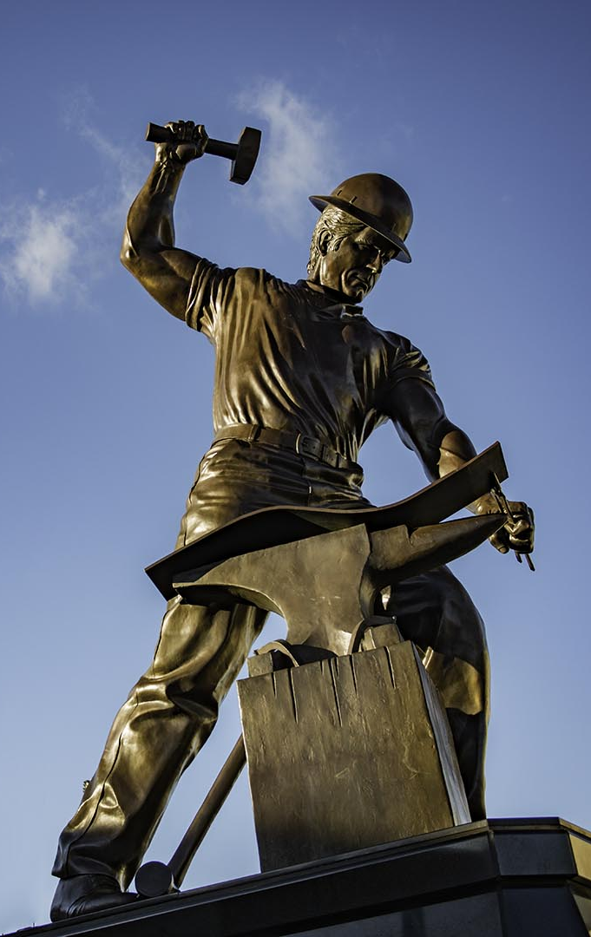

Here’s our plan for this morning
Welcome & discuss our goals
Introduce new faculty & staff
Message from Dean Arvind Raman and Q&A
State of the School (renovation, Indy, and more)
Well-being discussion
Breakouts:
  Faculty: Curriculum improvement
  Staff: Professional development
Discuss results, lunch, and you’re free!

Slide 3
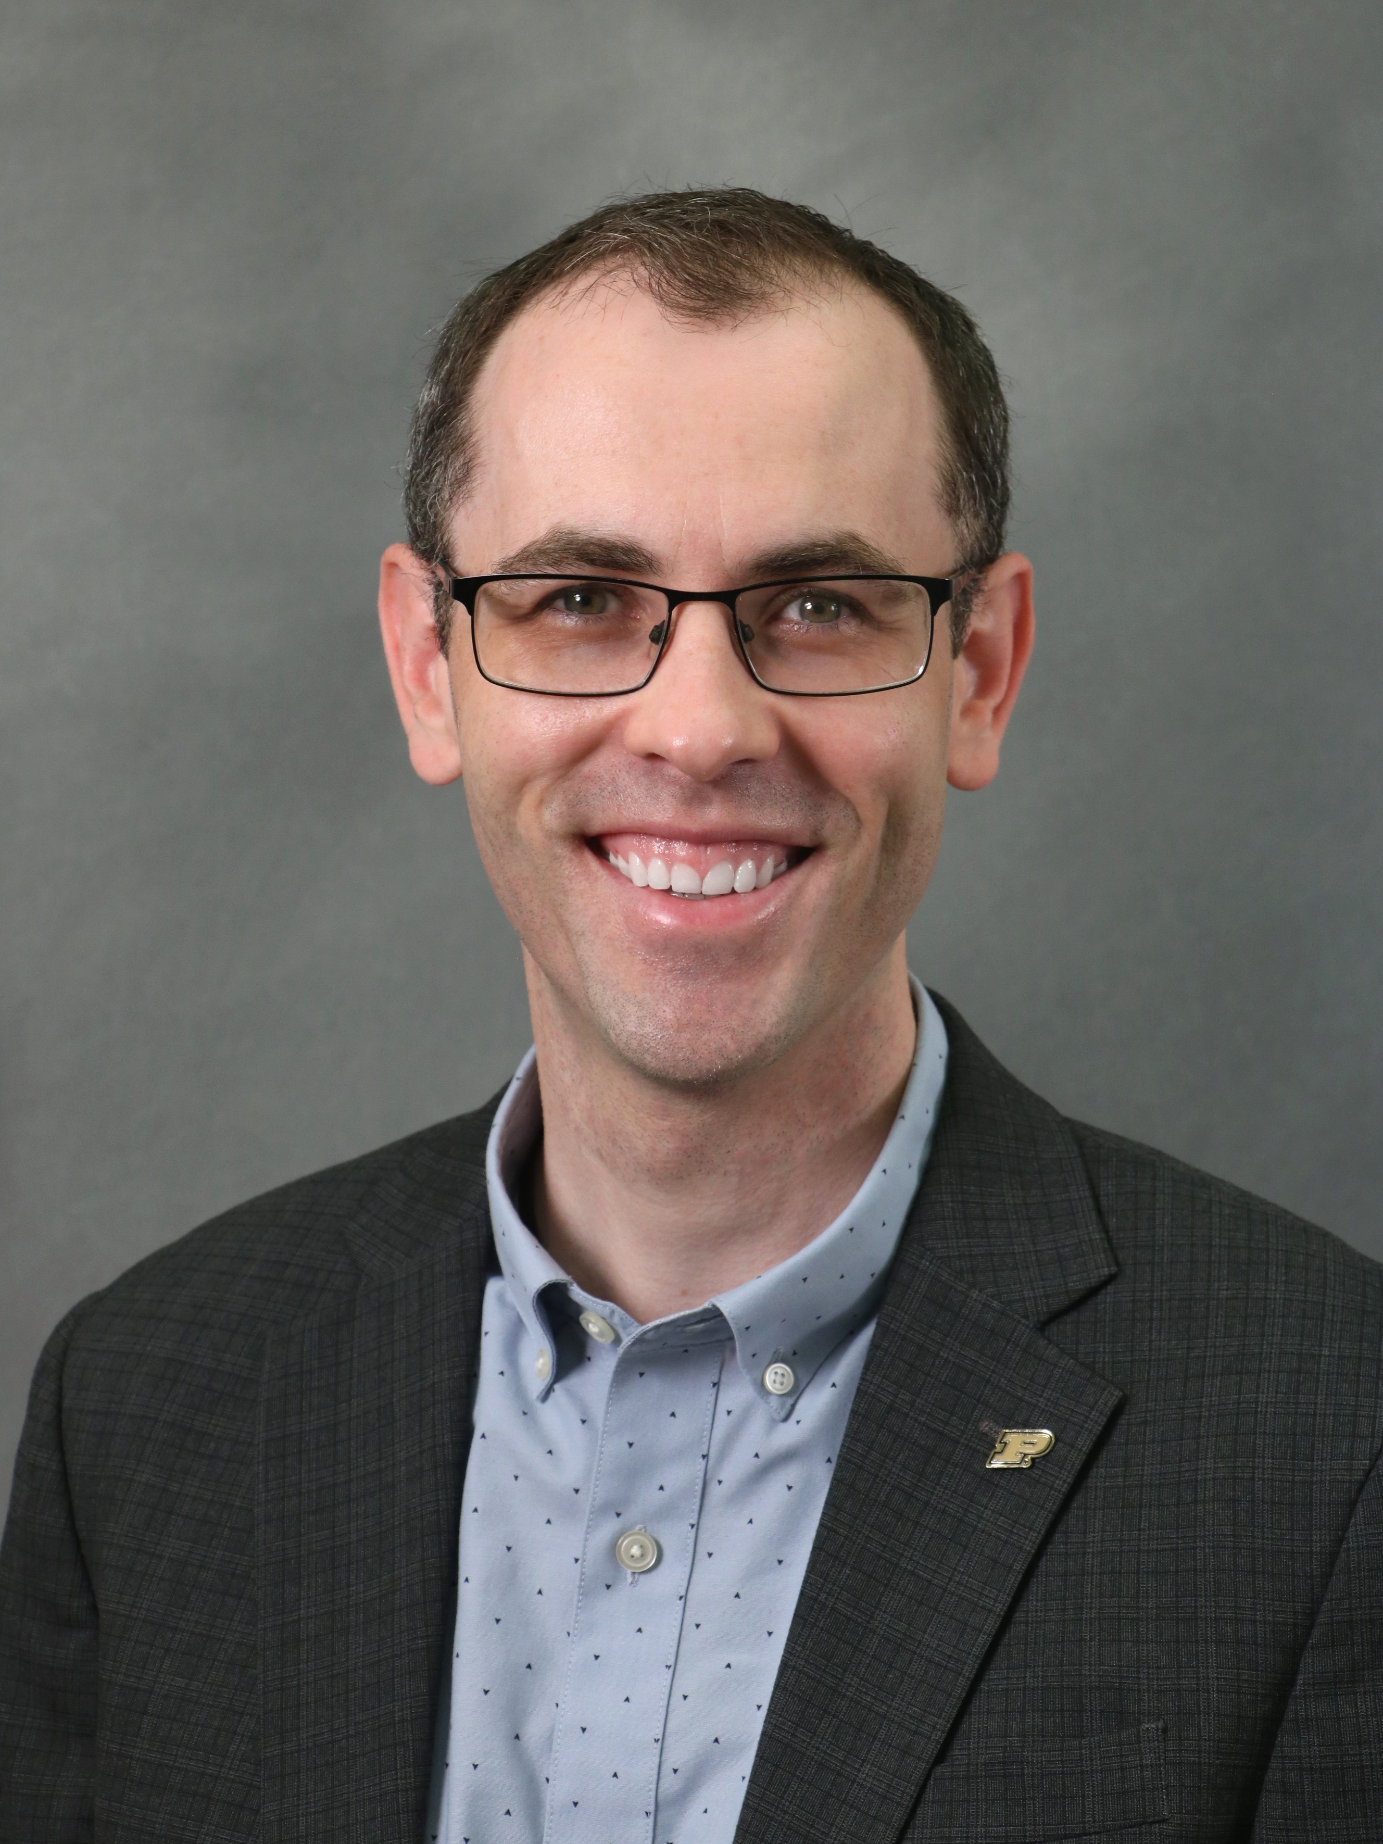
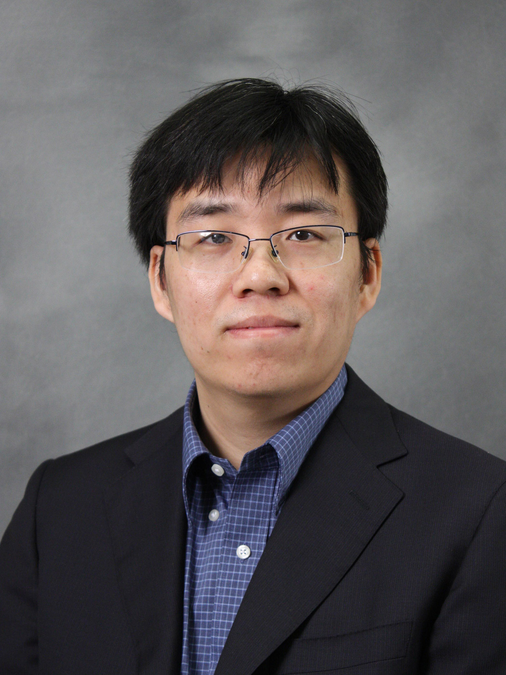
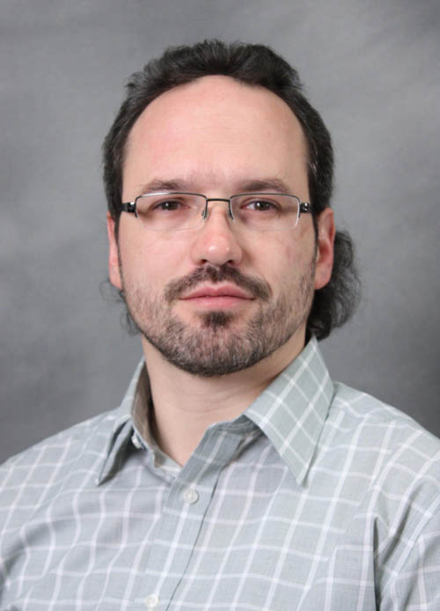
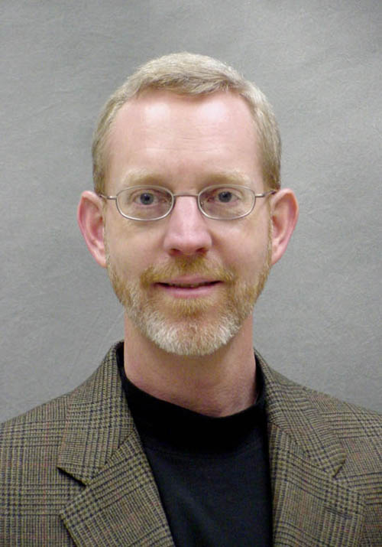
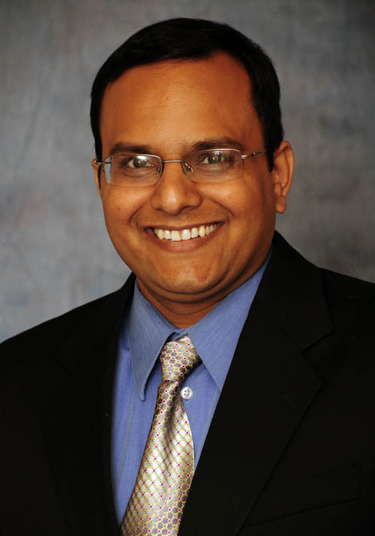
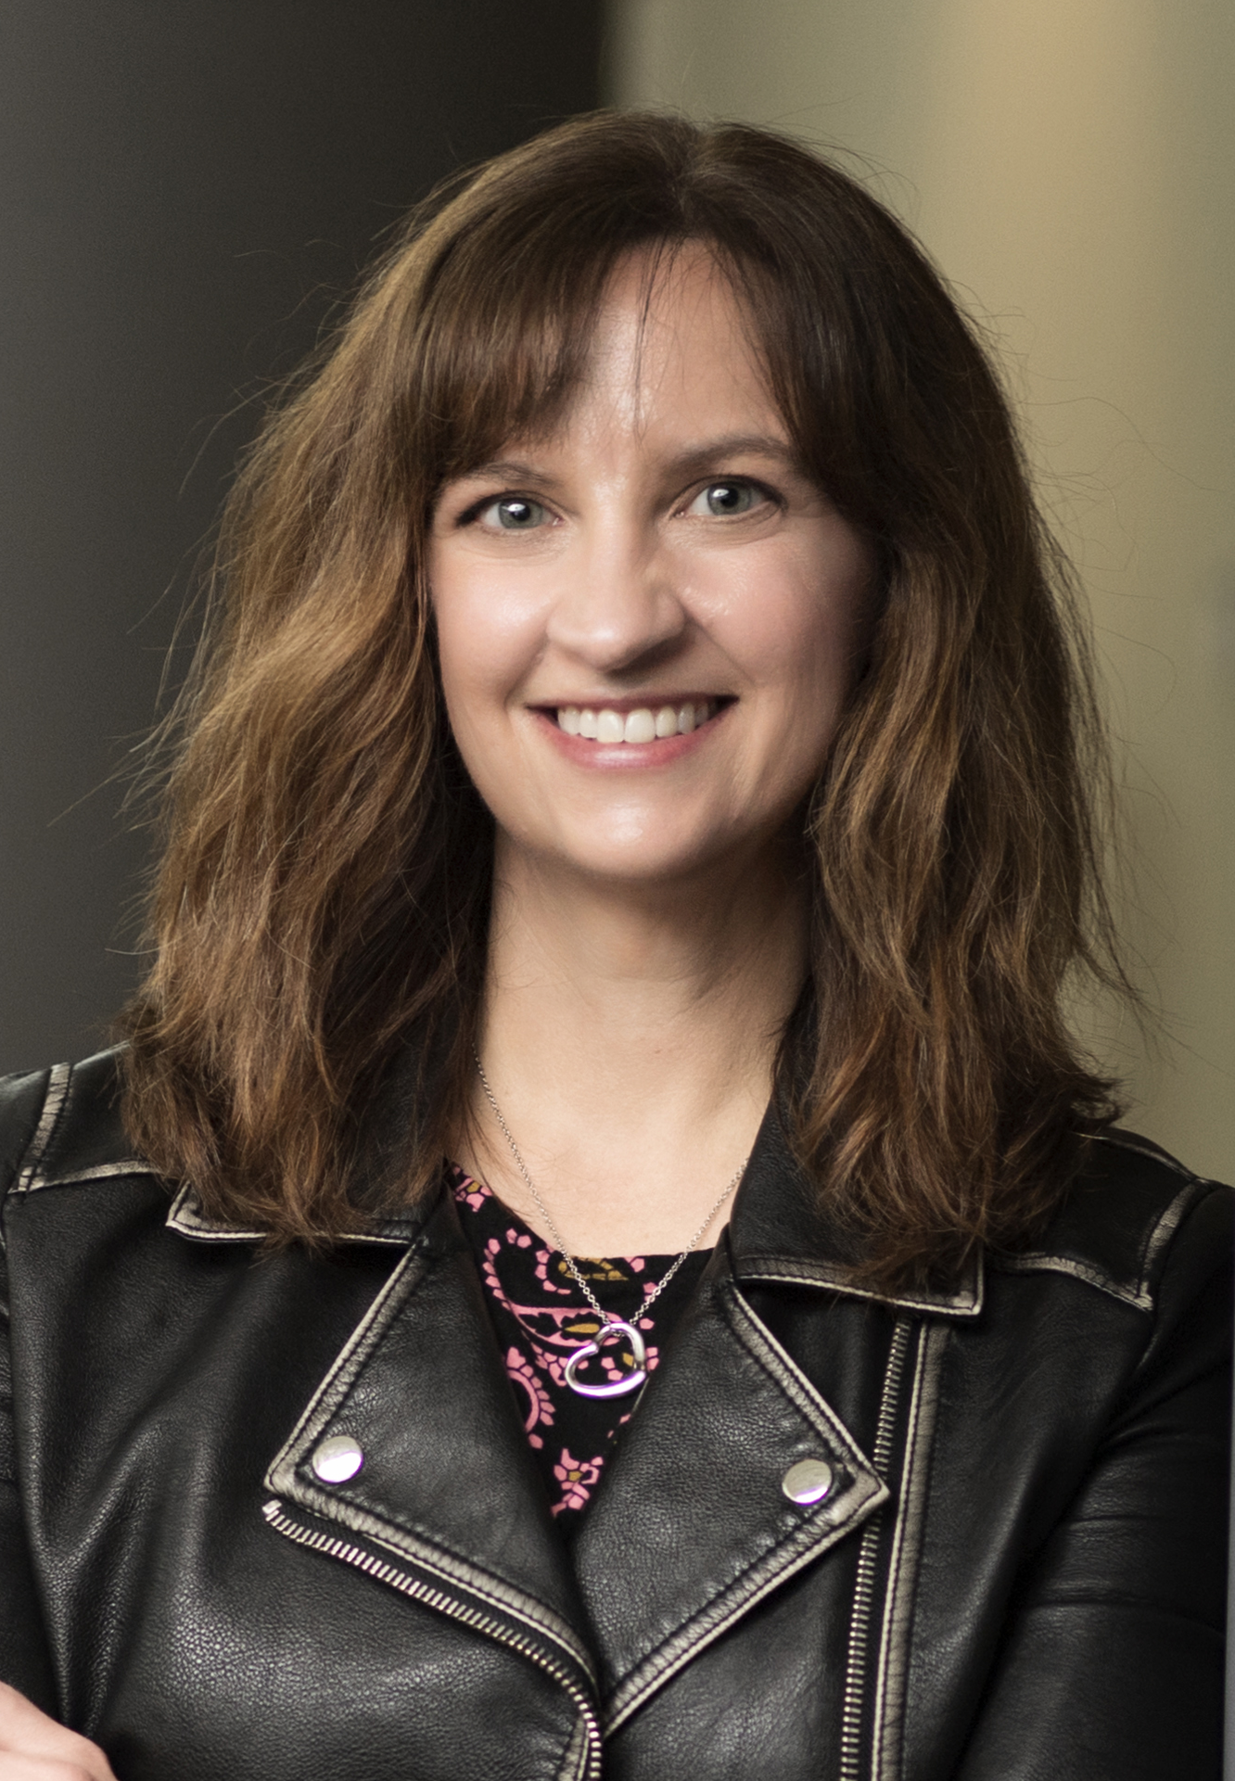
Faculty promotions / leadership positions
Promoted to Professor
  Justin Weibel, Kejie Zhao
Promoted to Research Professor
  Mikhail Slipchenko
Jim Jones steps down as Associate Head for Undergraduate Studies
  Jitesh Panchal: Associate Head of Undergraduate Programs
  (curricular activities, teaching plans, and ABET accreditation)
  Beth Hess: Assistant Head of Undergraduate Student Well-Being
  (advising and student success activities)

Slide 4
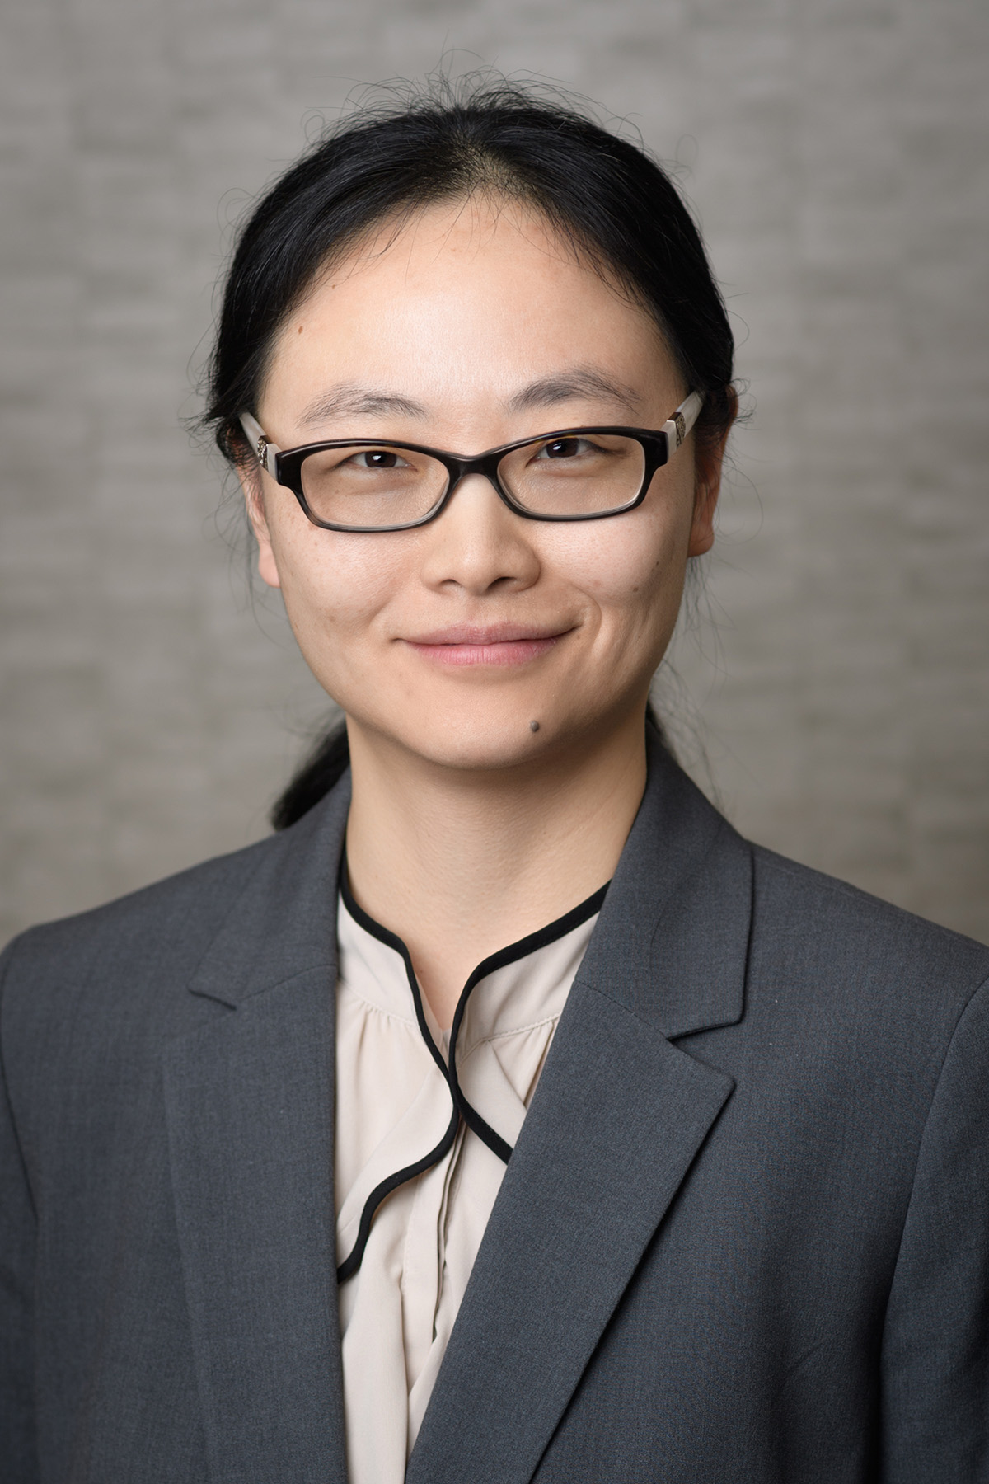
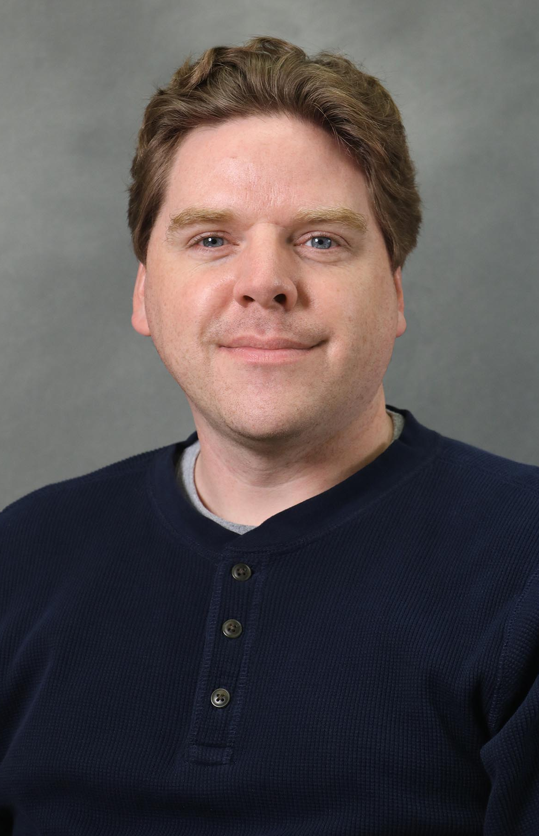
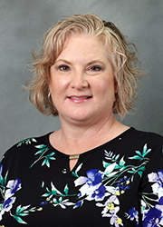
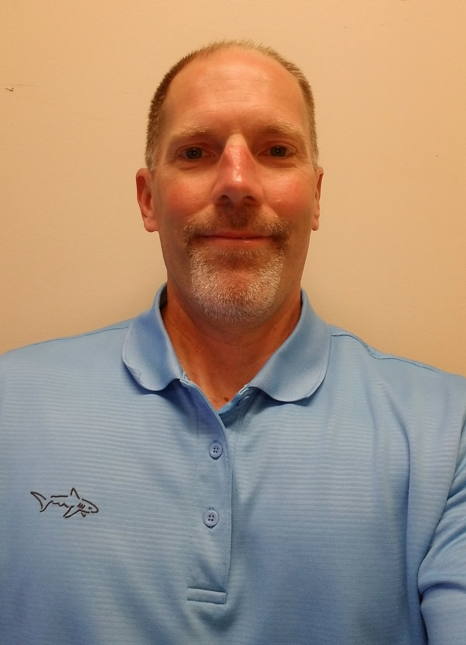
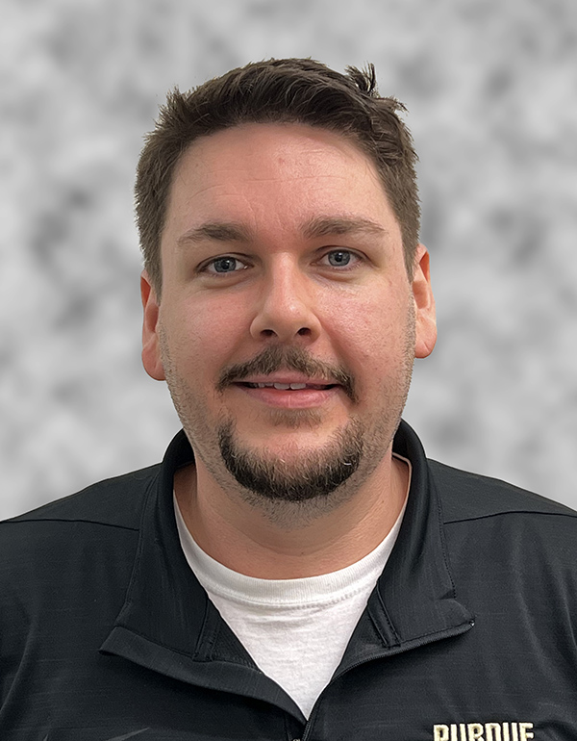
Staff promotions / new titles
Xiaomin Qian, Lead Program Administrative Specialist, Graduate Office
Jared Pike, Senior Communications Director
Stephanie Winder, Program Coordinator and Administrative Assistant Supervisor
Darren Wilcoxson, Senior Manager, Student Maker Spaces
Alex Van Allen, Research Facility Development & Operations Manager, Herrick Labs

Slide 5
Let’s meet our new faculty & staff!
Luz Sotelo – Assistant Professor in Convergent Manufacturing
Shubhra Bansal – Associate Professor in Semiconductor Manufacturing & Electronics Packaging
Riley Barta – Assistant Professor in Thermal Systems
Junfei Li – Assistant Professor in Fluid Dynamics
Heather Liddell – Assistant Professor of Mechanical Engineering and Environmental & Ecological Engineering
Dan Guildenbecher – Associate Professor in Thermodynamics and Fluid Mechanics (starts October 1, 2023)
Christopher Baer – Instructional Support Engineer (machine shop)
Carey Dilley – Operations Engineer (Zucrow Labs)
Munty Alfadel – Instructional Support Engineer (E-shop)
Monica Embry – Senior Administrative Assistant
Jessie Nesbitt – Account Clerk (Business Office)
Ben Prickel – Marketing and Communications Specialist (Herrick Labs)
Vivian Scott – Senior Administrative Assistant (Herrick Labs)
Yashoda Patil – Web Developer and Content Specialist
Ashlyn Butzen – Engineering Technician (Zucrow Labs)
Cody Bahler – Senior Engineering Technician (Herrick Labs)
Julie Goens – Research Account Specialist
Research scientists: Yingnan Shen (Bumsoo Han); Jie Ma (Jim Braun); Sayantan Bhattacharya (Pavlos Vlachos); Bairav Vishnugopi (Partha Mukherjee); Anne Meyer (Nicole Key)

Slide 6
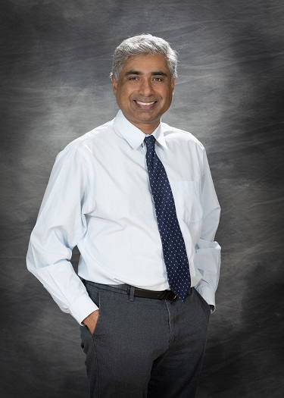
Dean’s Message
Arvind Raman
Dean of the College of Engineering, Robert V. Adams Professor in Mechanical Engineering, Professor of Materials Engineering (by Courtesy)

Slide 7
State of the School

Slide 8
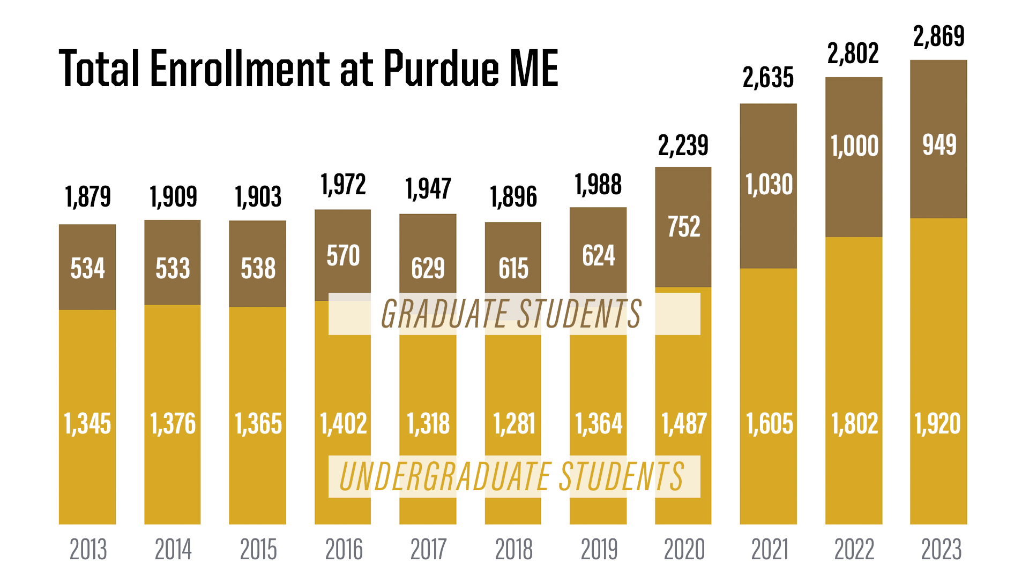

Slide 9
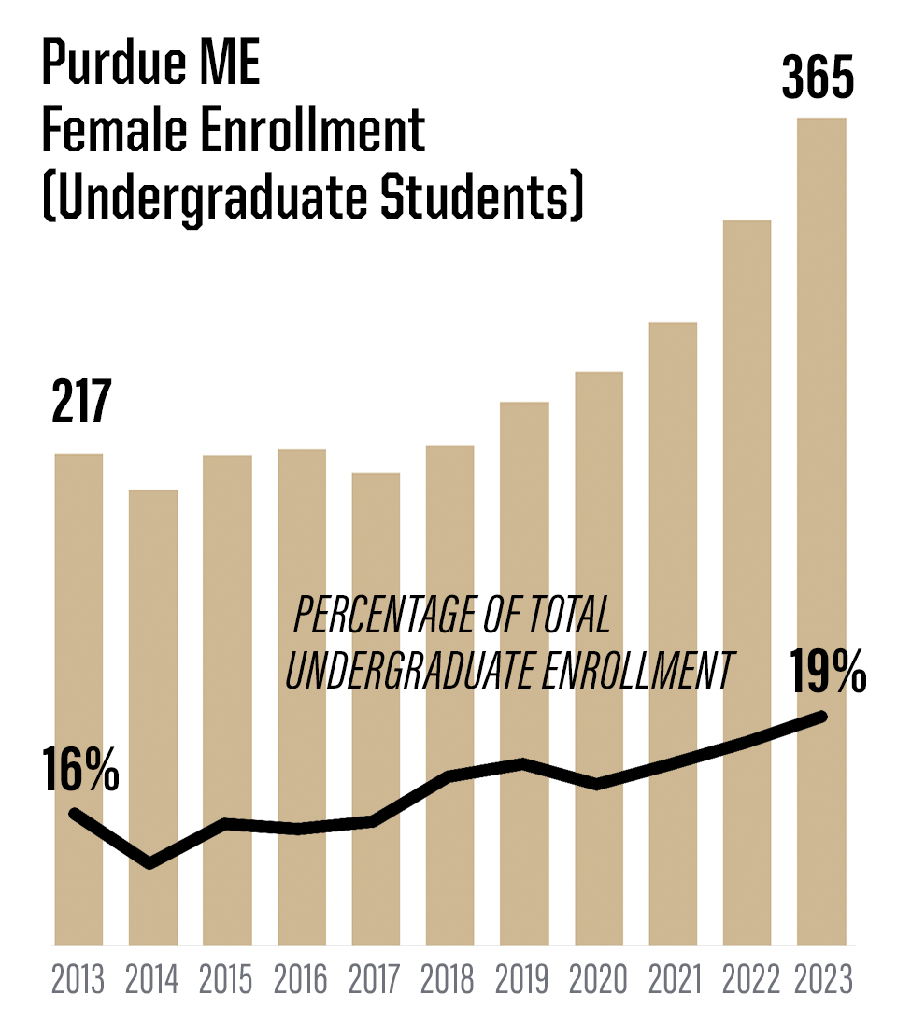
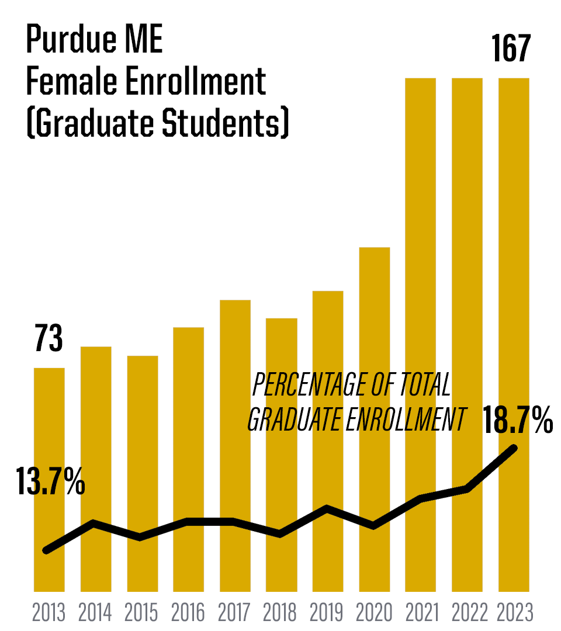

Slide 10
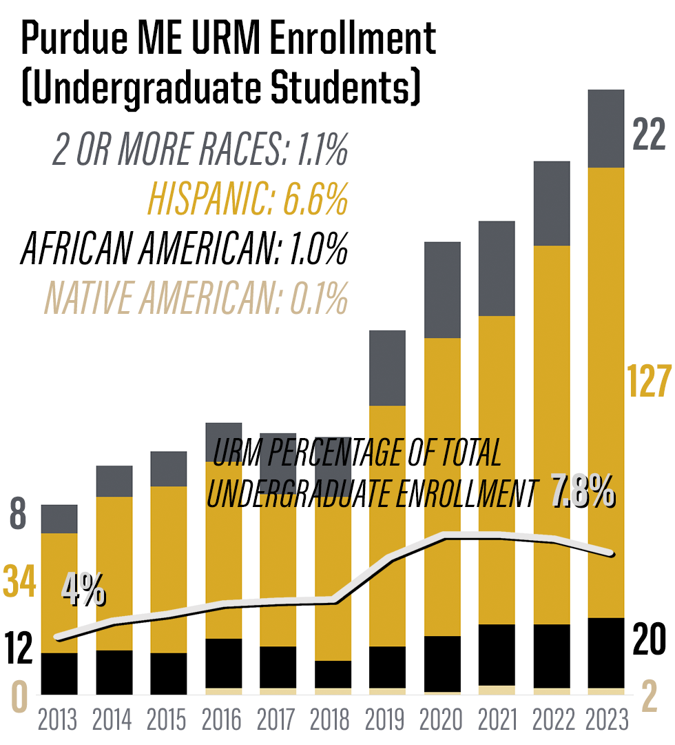
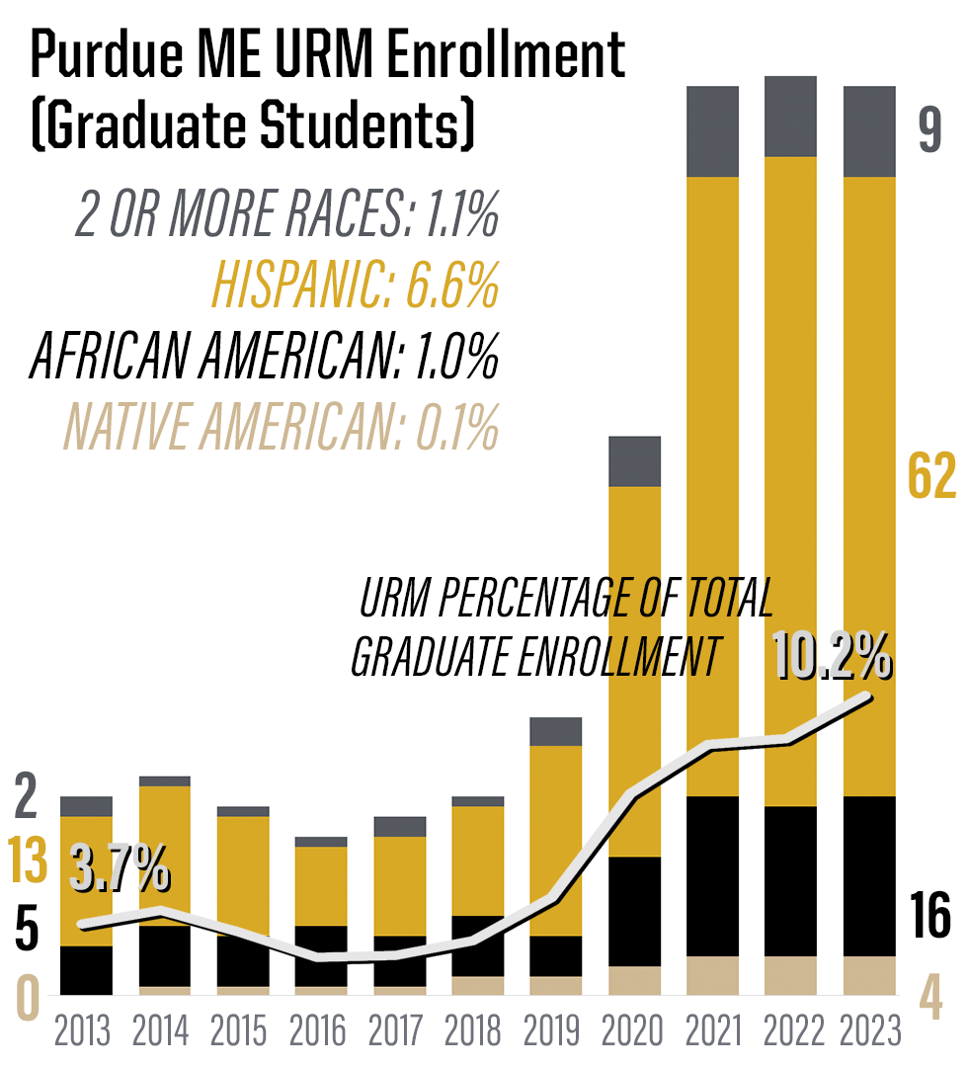

Slide 11
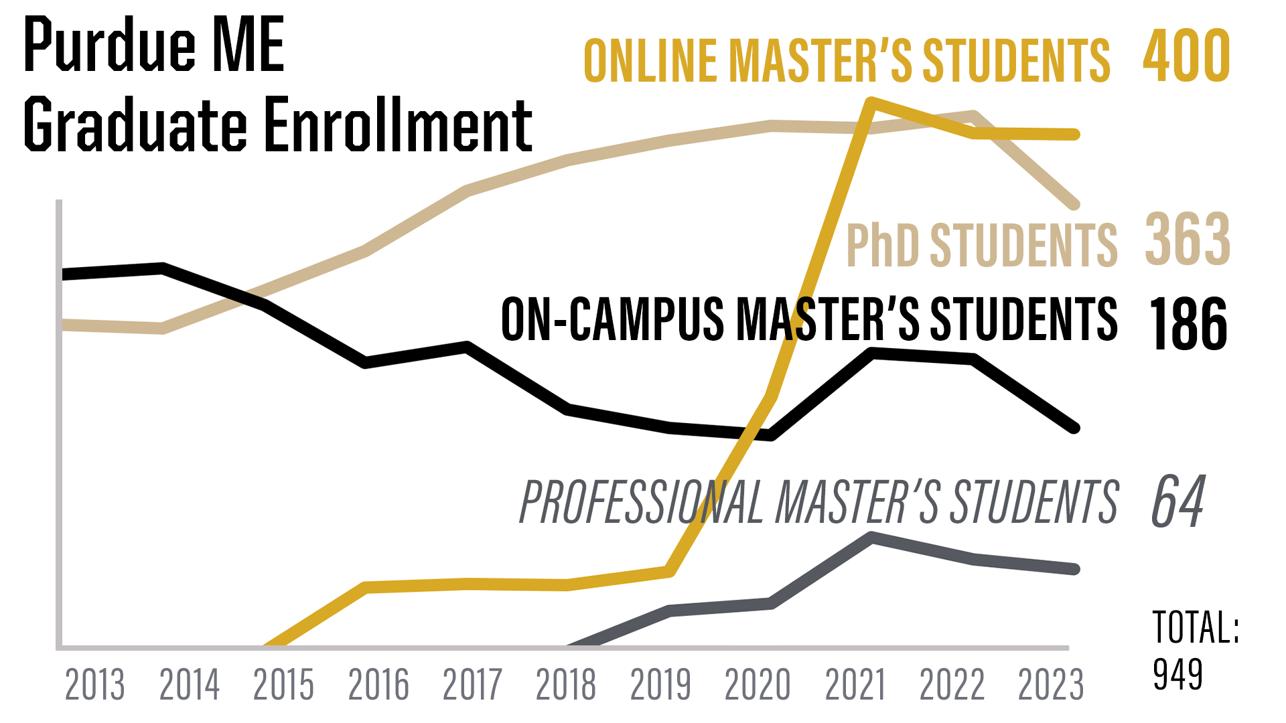

Slide 12
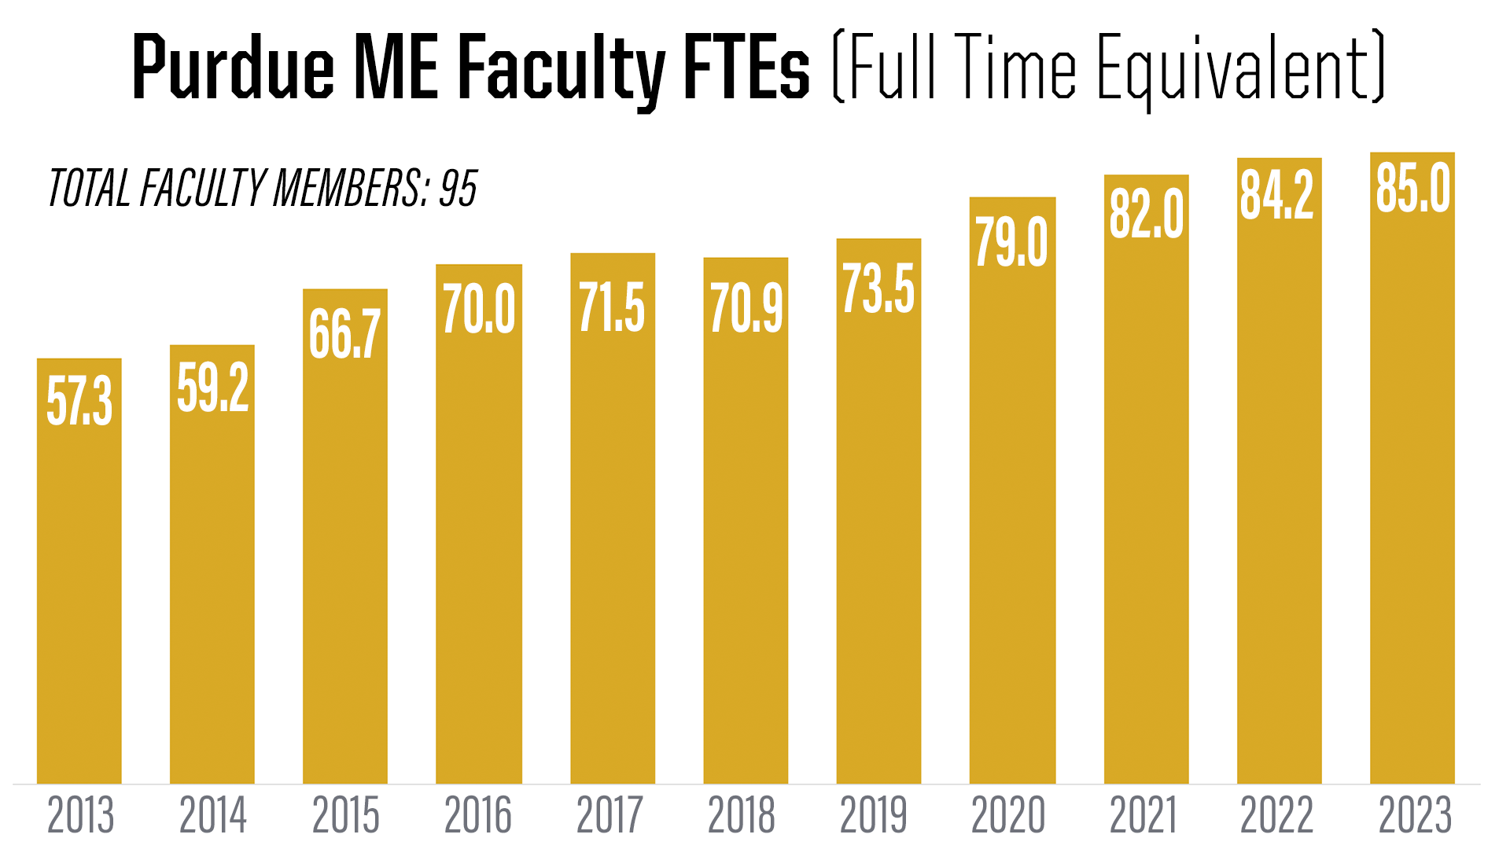

Slide 13
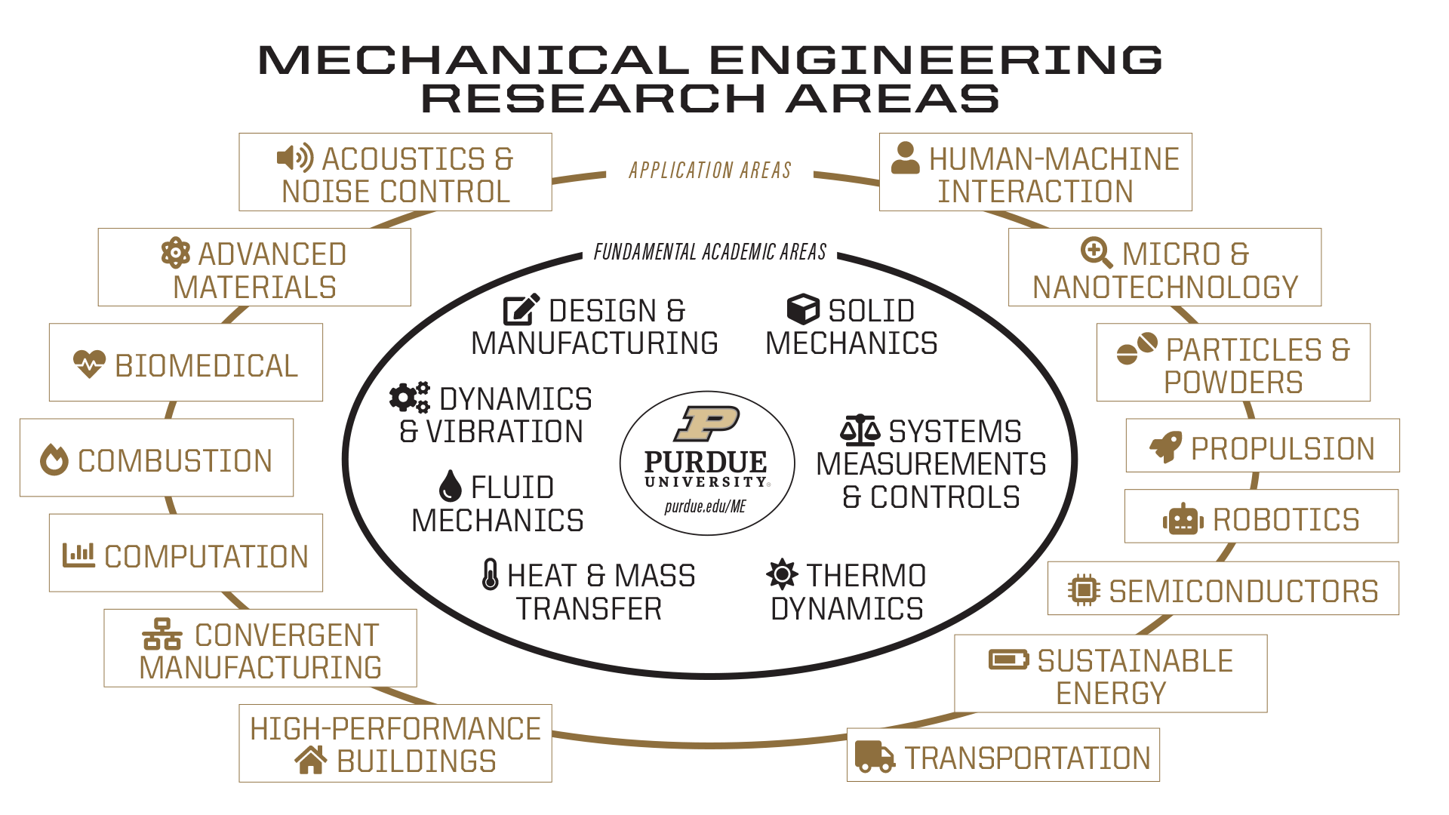

Slide 14
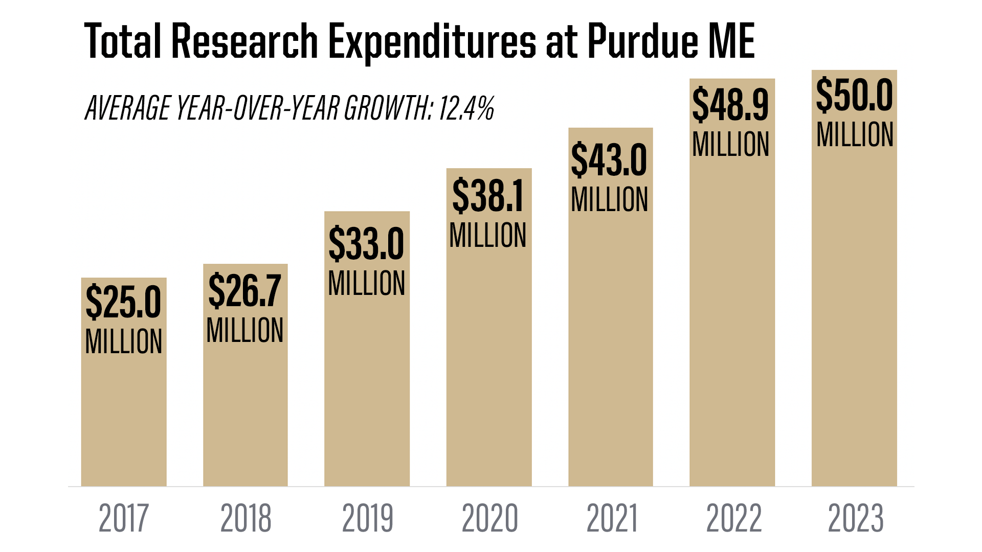

Slide 15
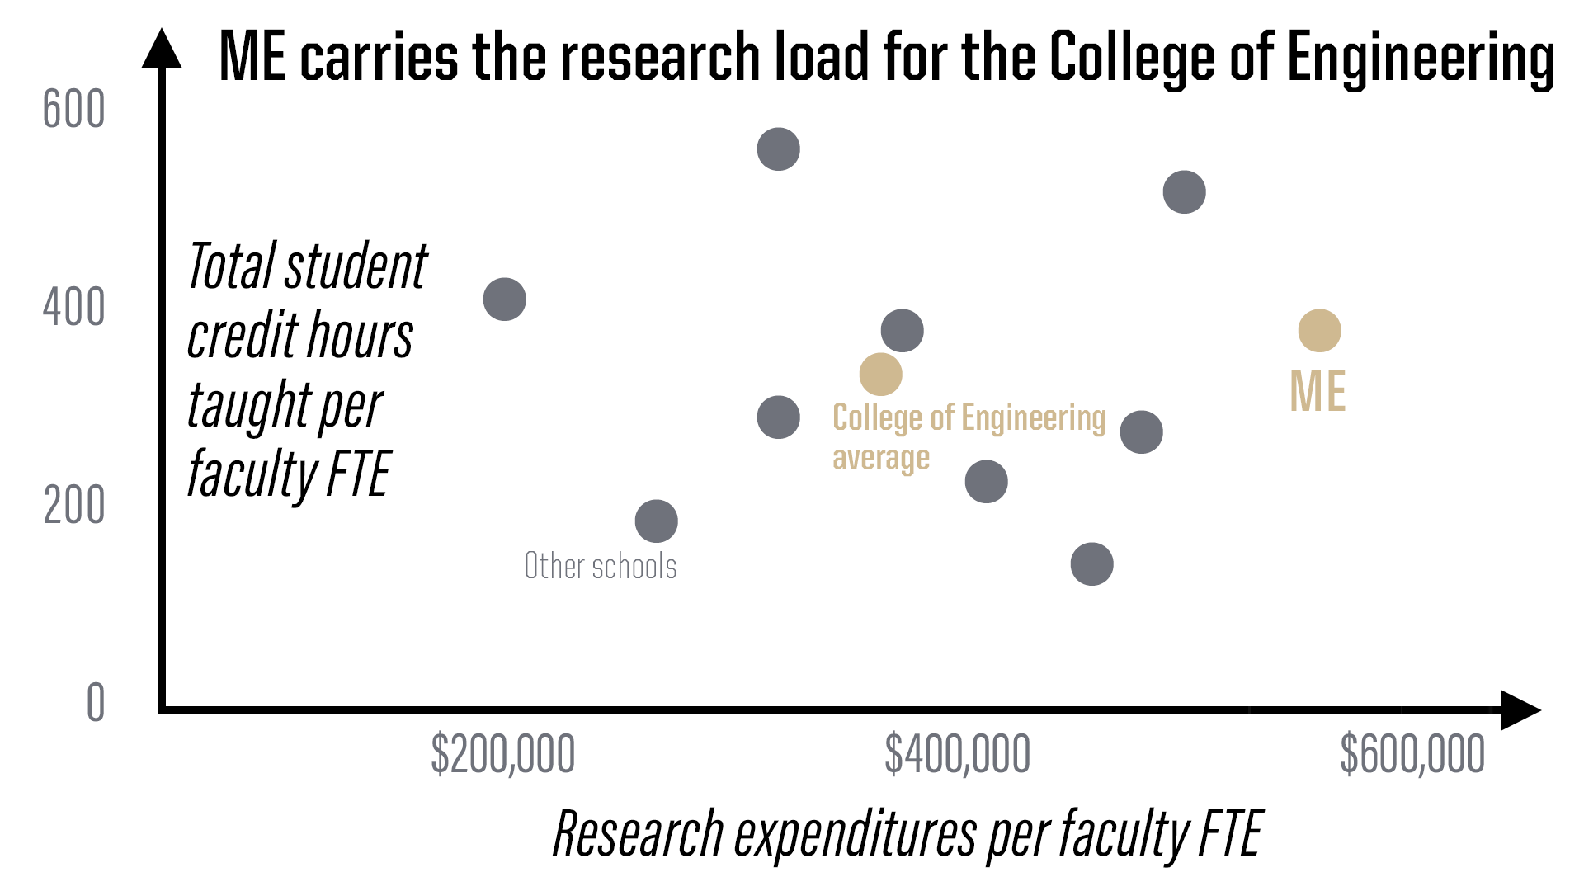

Slide 16
How does Purdue ME stand up against
peer institutions?
(Public universities)

Slide 17
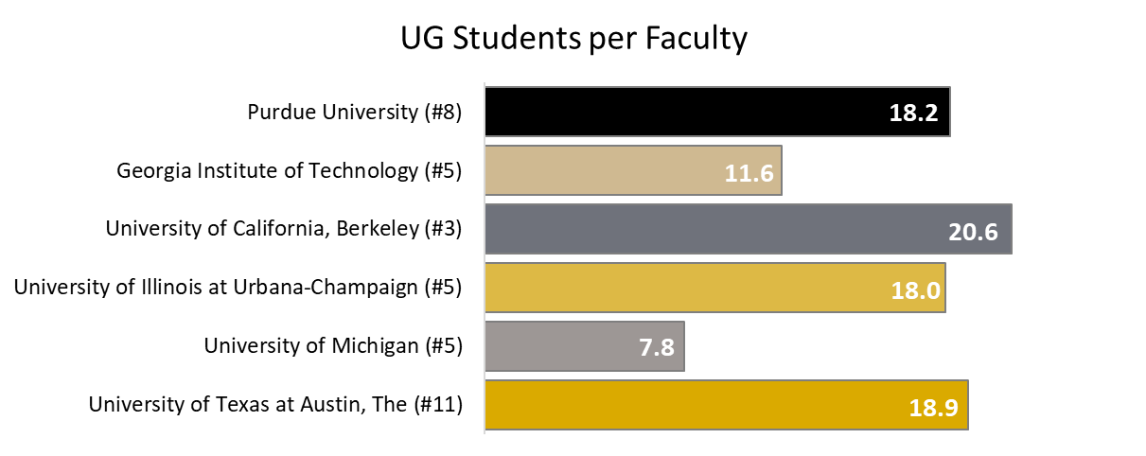
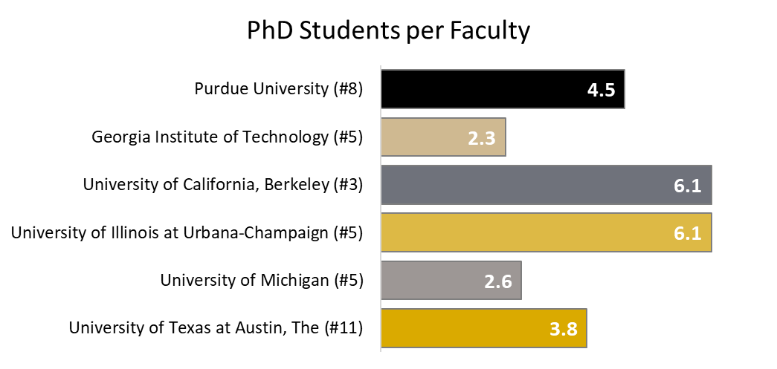
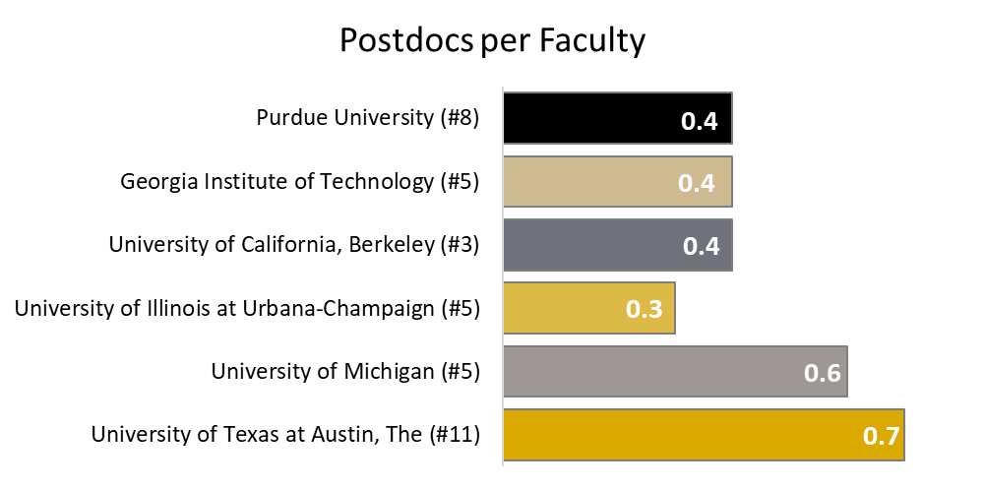
Students & Post Docs per Faculty

Slide 18
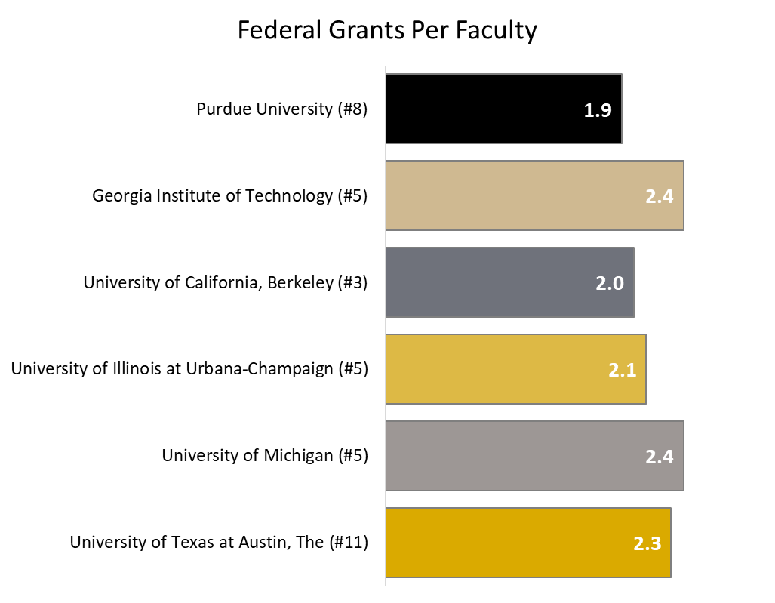
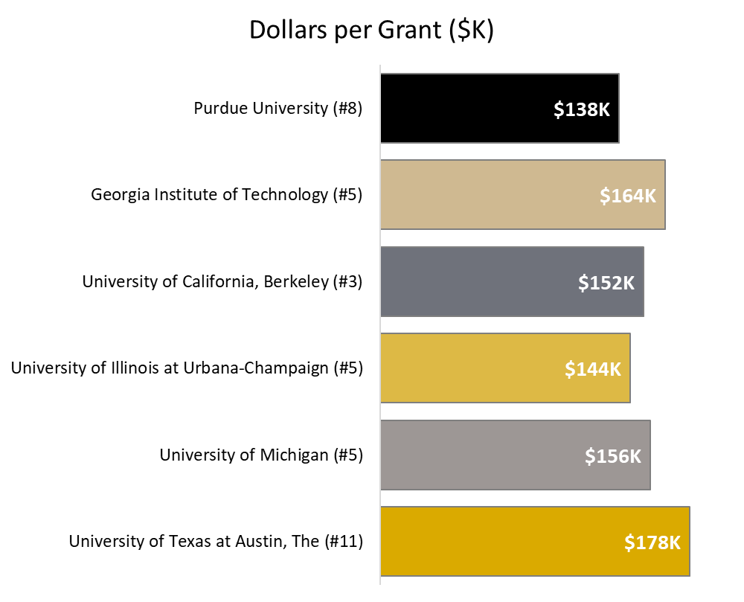
Federal Research Grants

Slide 19
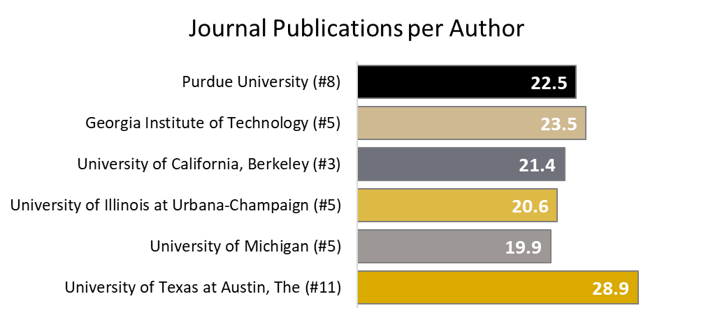
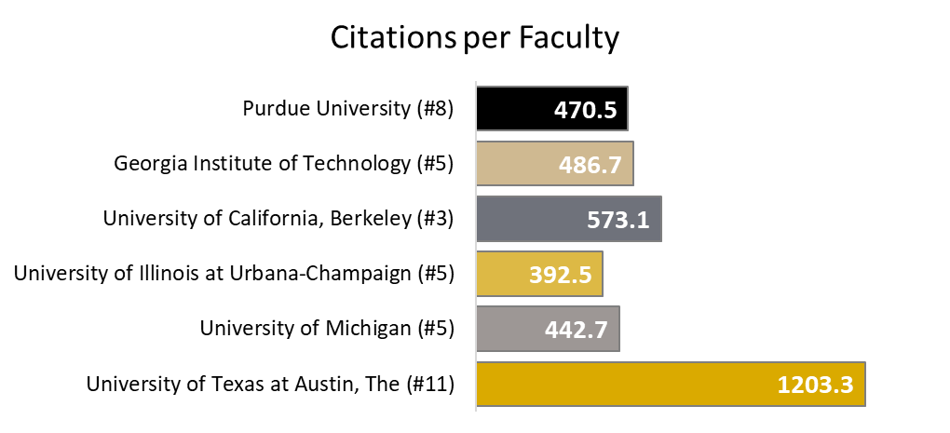
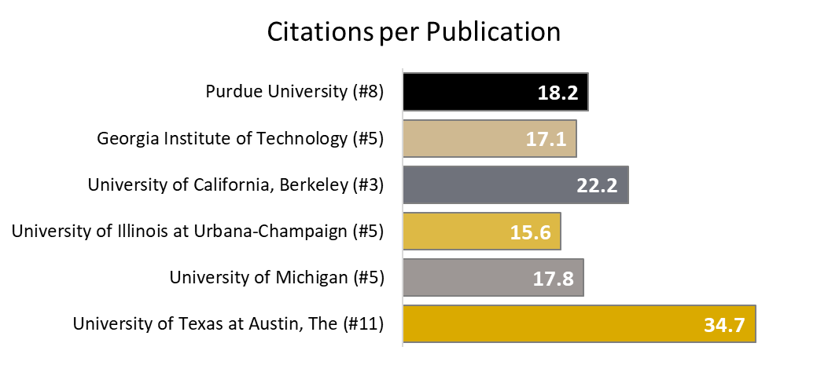
Journal Publications & Citations

Slide 20
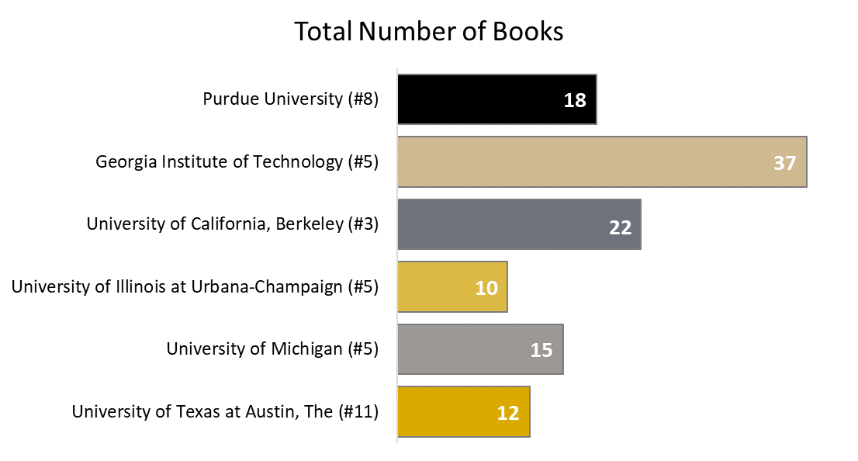
Books

Slide 21
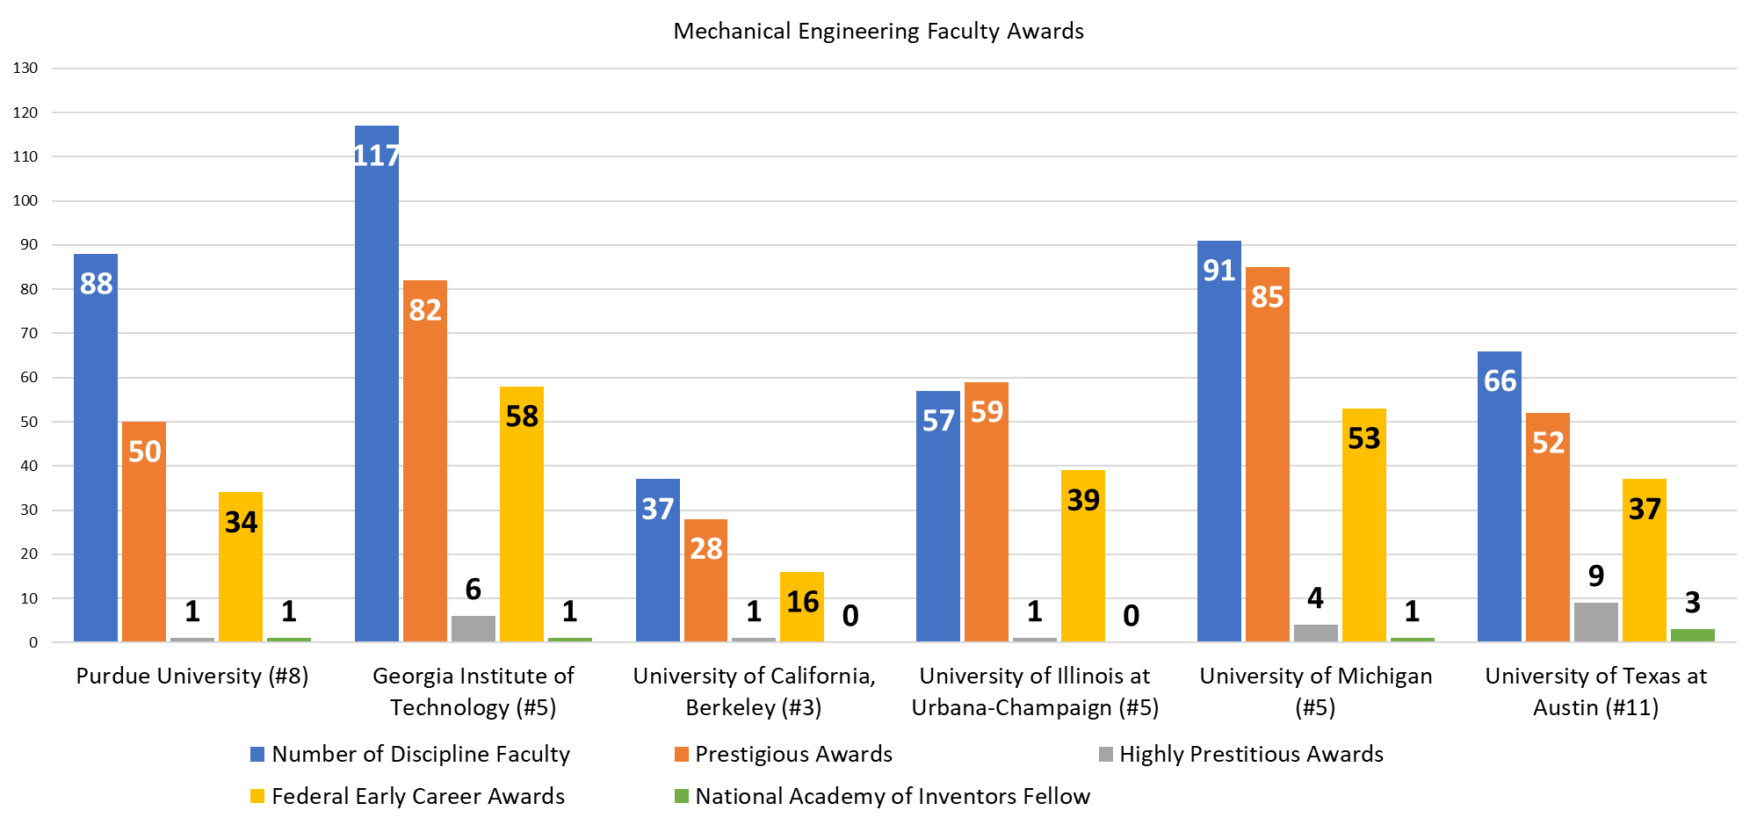
Honorific Awards

Slide 22
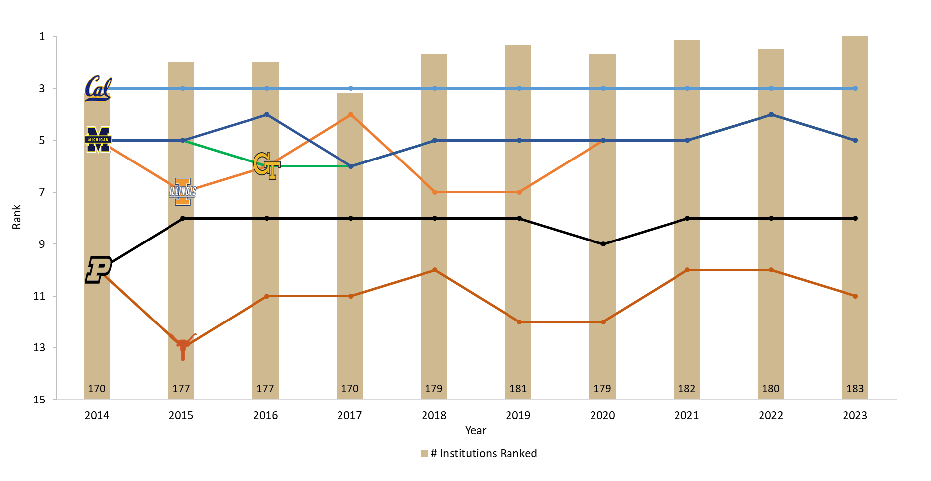
U.S. News Graduate Rank (ME Peers)

Slide 23
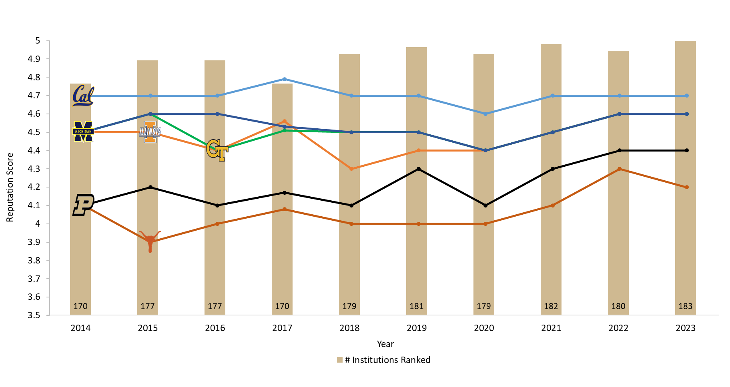
U.S. News Graduate Reputation Score (ME Peers)

Slide 24
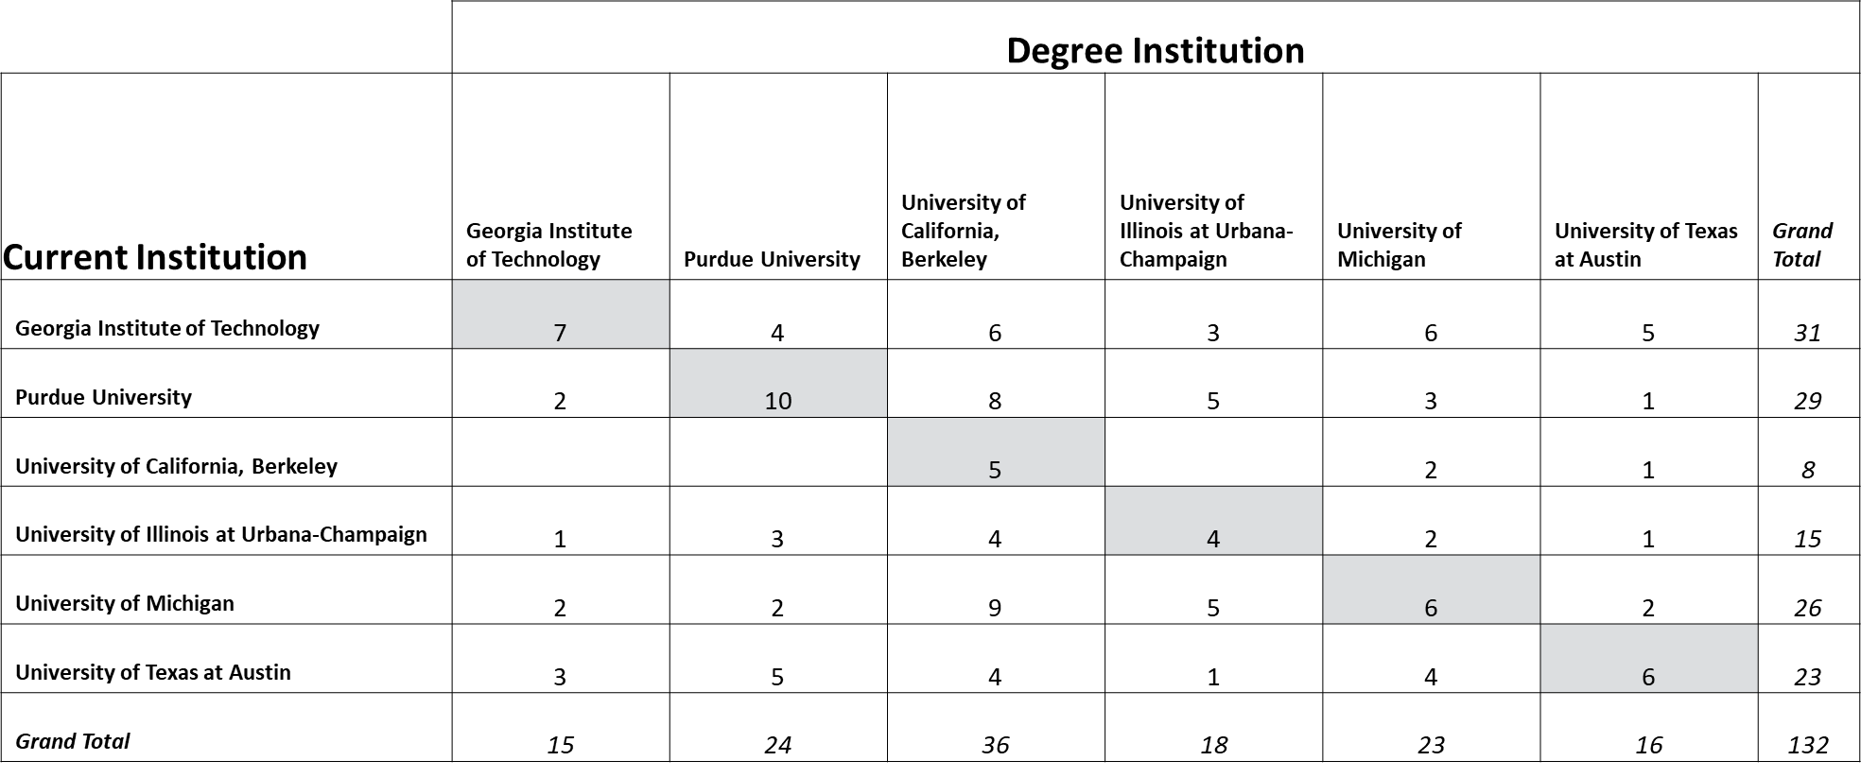
Peer Alumni in Engineering Faculty Positions at Peer Institutions
Mechanical Engineering
Notes:
The intersections on this table are showing how many alumni (PhD) from the Degree Institution are currently Engineering faculty at the Current (peer) institution shown.
For example: For the cell where Purdue (Current Institution) and Berkeley (Degree Institution) intersect with a value of 8: There are 8 T/TT or Research-focused faculty in Purdue Engineering that earned their PhD in Mechanical Engineering from UC-Berkeley
*Based on the 2021-22 academic year faculty snapshot

Slide 25
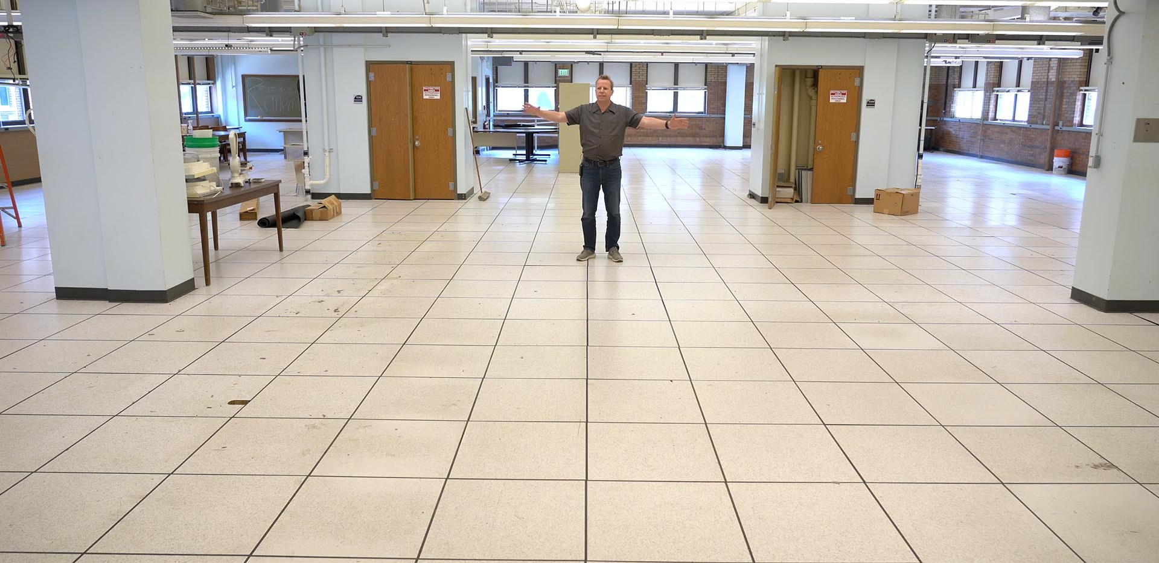
ME Building Renovation

Slide 26
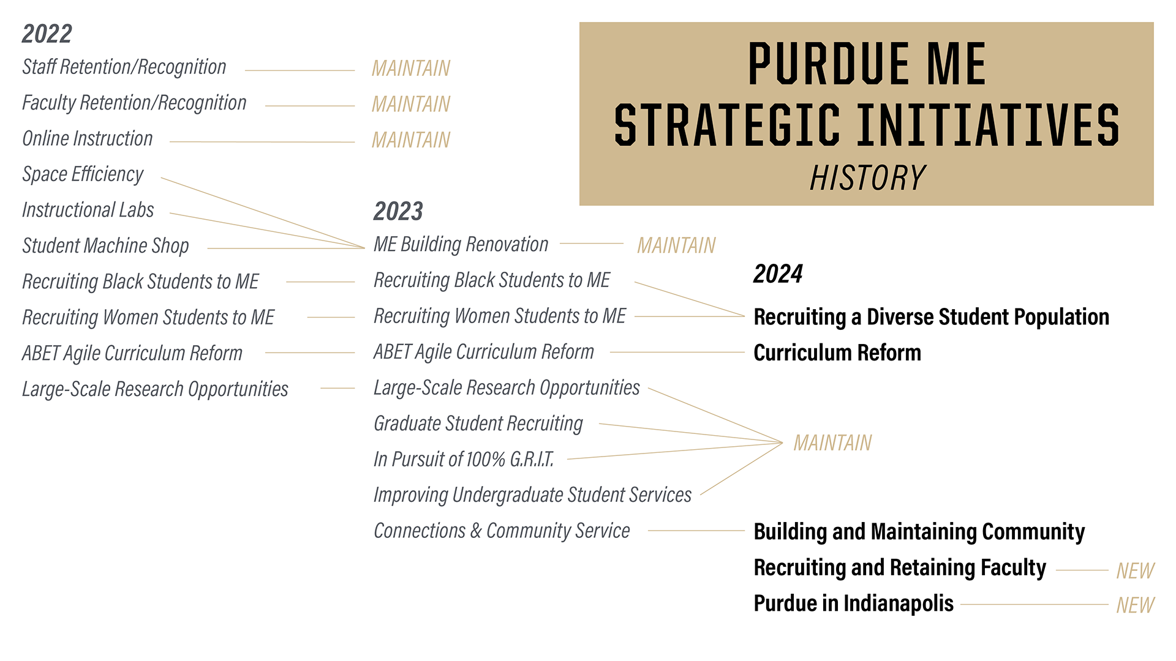

Slide 27
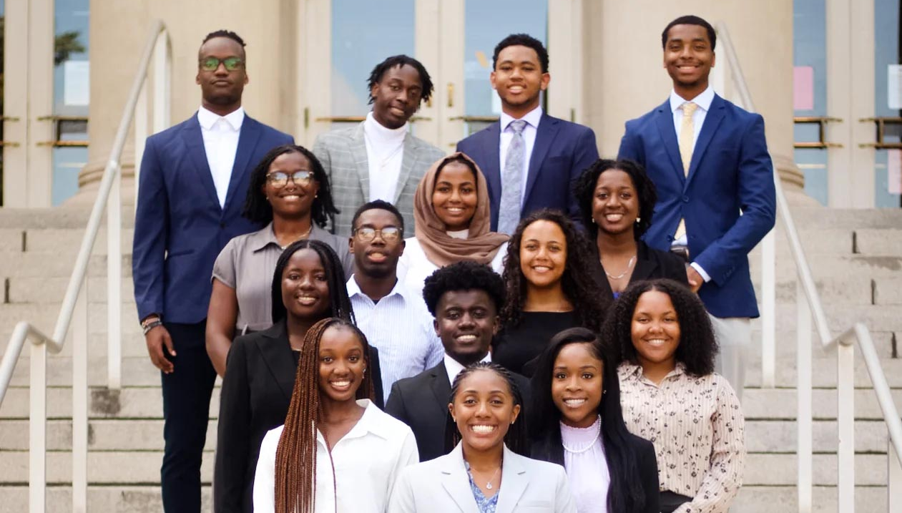
Recruiting a Diverse Student Population

Slide 28

Curriculum Reform

Slide 29
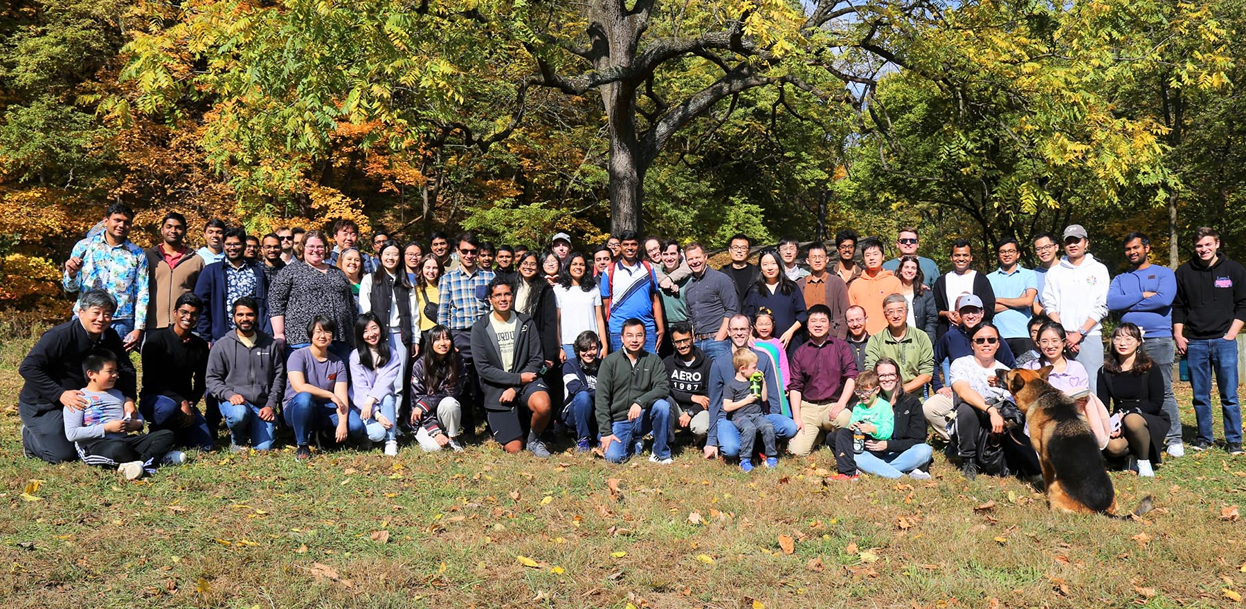
Building and Maintaining Community
Example Activities:
Free Food Fridays
10 Minutes of Talent
Monthly newsletters
Summer lab tours
Community service:
  FIRST Robotics
  High School EV
  Grand Prix
Faculty/staff recognition events each semester

Slide 30
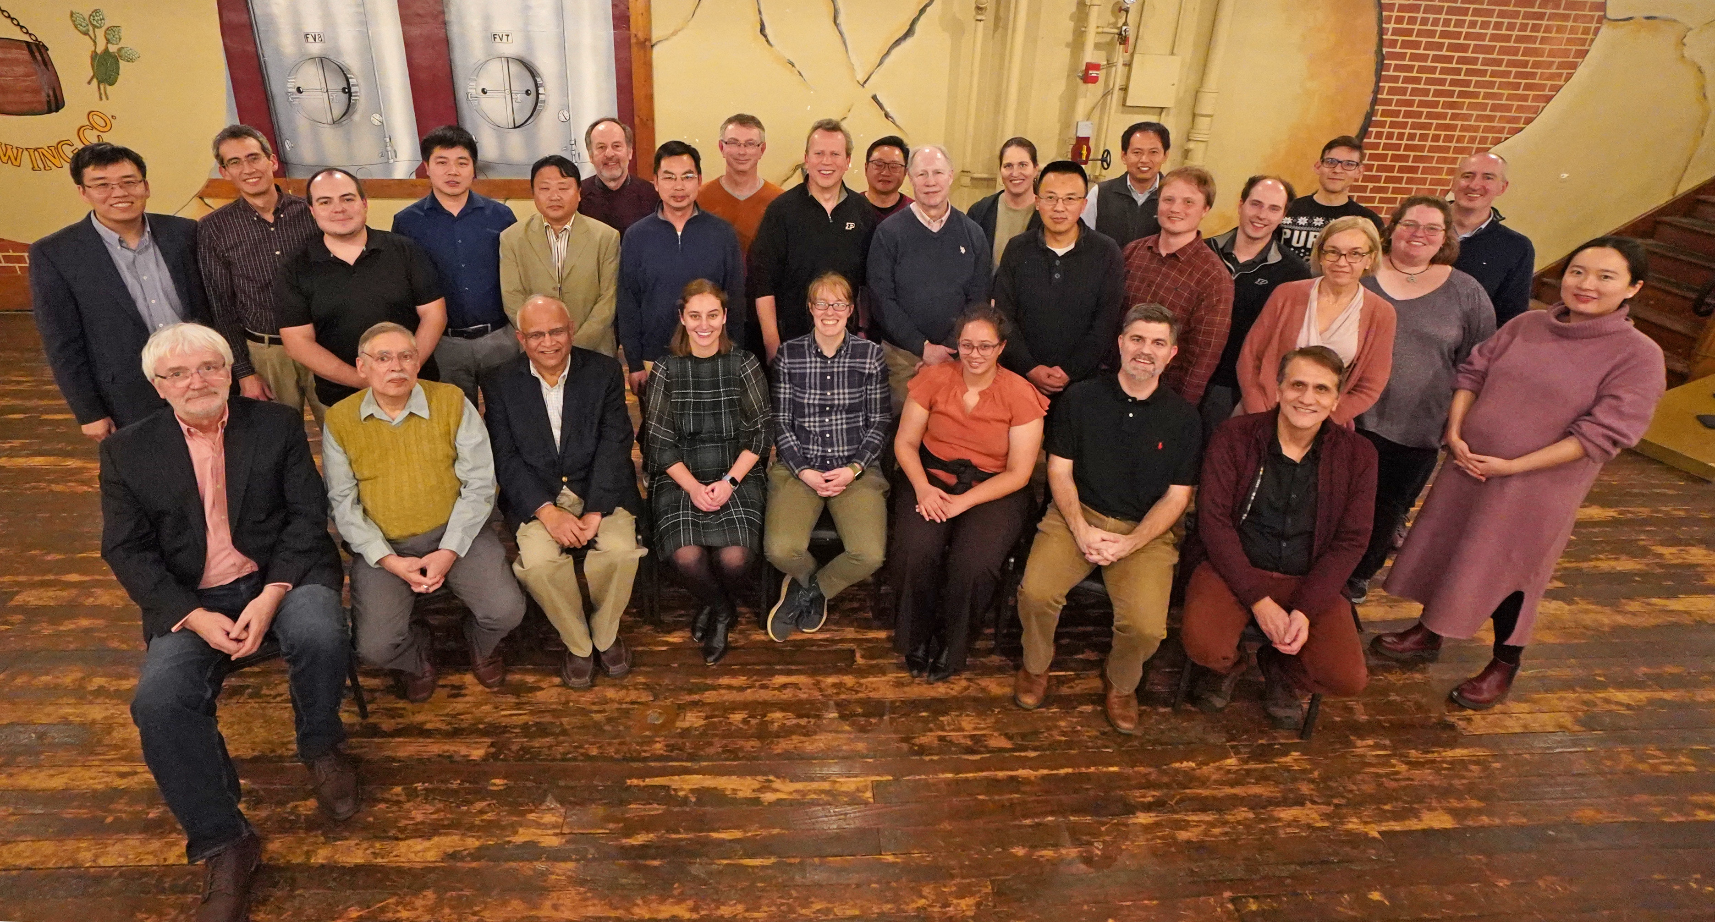
Recruiting and Retaining Faculty

Slide 31
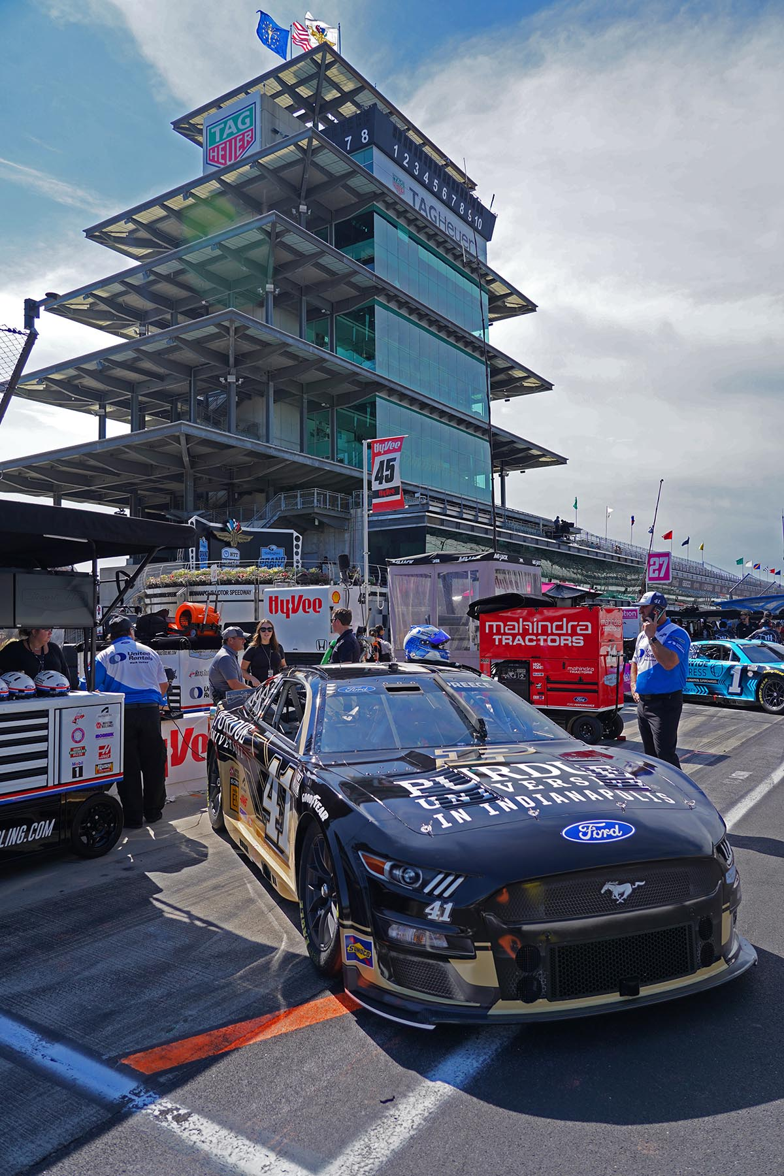

Purdue University in Indianapolis

Slide 32
Purdue University in Indianapolis
Faculty Realignment (e-mail by Dean Raman)
I know each of your schools [BME, ECE, and ME] is thinking about appointing an Assoc/Asst Head or PoC to prepare for and organize for the teaching needs in Indy come fall 2024. However, I request holding off on making those appointments until a few weeks later. Purdue would like to finalize who accepts the Purdue in Indy tenure home option before these discussions begin.
Once we know which IUPUI faculty will be on the Purdue in Indy tenure home vs Purdue WL tenure home, then you can make these Assoc/Asst Head appointments.
Current grad students in the programs in Indy will become full fledged Purdue WL grad students in your programs come fall 2024.
Those faculty who have Purdue in Indy tenure home appointment must be granted a “super” courtesy appointment in your units - i.e., they should have rights to be sole PhD advisors, have access to recruit PhD students, etc., i.e., our grad db system is common. If they do not have this appointment in your units then they will not be allowed to teach classes in your Indy program either.
Once you assign an Assoc/Asst head for your Indy program they will not directly make assignments, rather will coordinate with a person in David’s [Umulis] office to make those assignments (since the faculty have a different tenure home, this layer is needed but will be seamless).

Slide 33
2023 Faculty/Staff Retreat

