Slide 1

Making Organizations More Inclusive
Jesus Romero
Associate Director
Roger C. Stewart Leadership & Professional Development
Notes:
What’s good what games (loud & proud, mafia), Who Am I: immersive experiences for students to learn about social change (plus one strength: connectedness, “mindblown”)
Inclusive Leadership, we’ve all tried to solve a problem and noticed that the solution didn’t work for everyone, that’s where this comes in
Leaders You’re Gonna Meet Today
Point of Expectation - All Might Feel Really New, So Feel Free to Ask Questions
Leadership is Collaborative, because that’s true we want you all to engage with this material (let it in, let it challenge you a little bit)
10 minutes
Context about who I am and workshop expectations
After lunch they’ll go through exhibit that gives a breakdown of the pillars

Slide 2

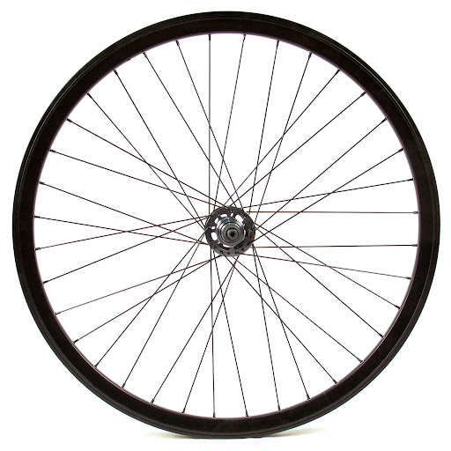
Identity Wheel
Notes:
16 minutes (6 personal +10 social), includes sharing with partner, (Total 18)
Ethnicity v. Race: desi identity or mediterranean (ex. adopted ppl)
Ability: neurotypical
Ex: if someone’s a chinese student adopted by white parents, their nationality might be American, ethnicity is chinese but their race is asian
Race: phenotypic presentation
Ethnicity: nationality, cultural background
Give example of yourself

Slide 3
Reflection Questions
What were your initial thoughts after completing this exercise?
Which identity do you think about most often? Why?
How do your social identities impact the way you experience Purdue?
Notes:
As a whole group
8 minutes (Total 26)
Biggest difference b/w social identity wheel vs personal identity wheel: social are assigned by social structures, can change lived experiences,

Slide 4
“We’re all put ahead and behind by the circumstances of our birth. We all have a combination of both. And it changes minute by minute, depending on where we are, who we’re seeing, or what we’re required to do.”
- Peggy McIntosh
Notes:
2 mins (total 28)
So how is power connected to privilege? Some things that give us power are outside of our control.

Slide 5
Understanding Privilege
operates on personal, interpersonal, cultural, and institutional levels and gives advantages, favors, and benefits to members of dominant groups at the expense of members of target groups
neither common nor universal
is granted, not earned or brought into being by one’s individual effort or talent
is a right or entitlement that is related to preferred status or rank
is exercised for the benefit of the recipient and to the exclusion or detriment of others
is often outside of the awareness of the person possessing it
Notes:
4 mins (Total 32)
Power and Privilege show up at the party together most visibly in our language. “Needy” and Food Insecurity (we all experience need but the fixation here is naming and shaming low-income people for not having access to the things we all need). We call that stigma and its prevents us from working together on a level playing field
Tie to service

Slide 6
Inclusive Leadership
Inclusive leadership is the purposeful integration of people’s experiences, knowledge, and perspectives in all aspects of the leadership process with the intent of minimizing hierarchy, sharing power and collectively working towards positive impactful change.
*Inclusive practice is not only embedded in the process but it is also an intended outcome
Notes:
2 mins (total 34)
What would it look like if we were always thinking about each other, thinking about power dynamics so that everyone could contribute and enjoy (re-imagine approach)
Definition of inclusive leadership
Say the pillars, but don’t have to explain

Slide 7





Inclusive Leadership
Notes:
The 5 Pillars of Inclusive Leadership: SHARE
S – Self-Awareness
H – Honor Others
A – Acquire Competencies
R – Reimagine Leadership
E – Educate and Advocate

Slide 8
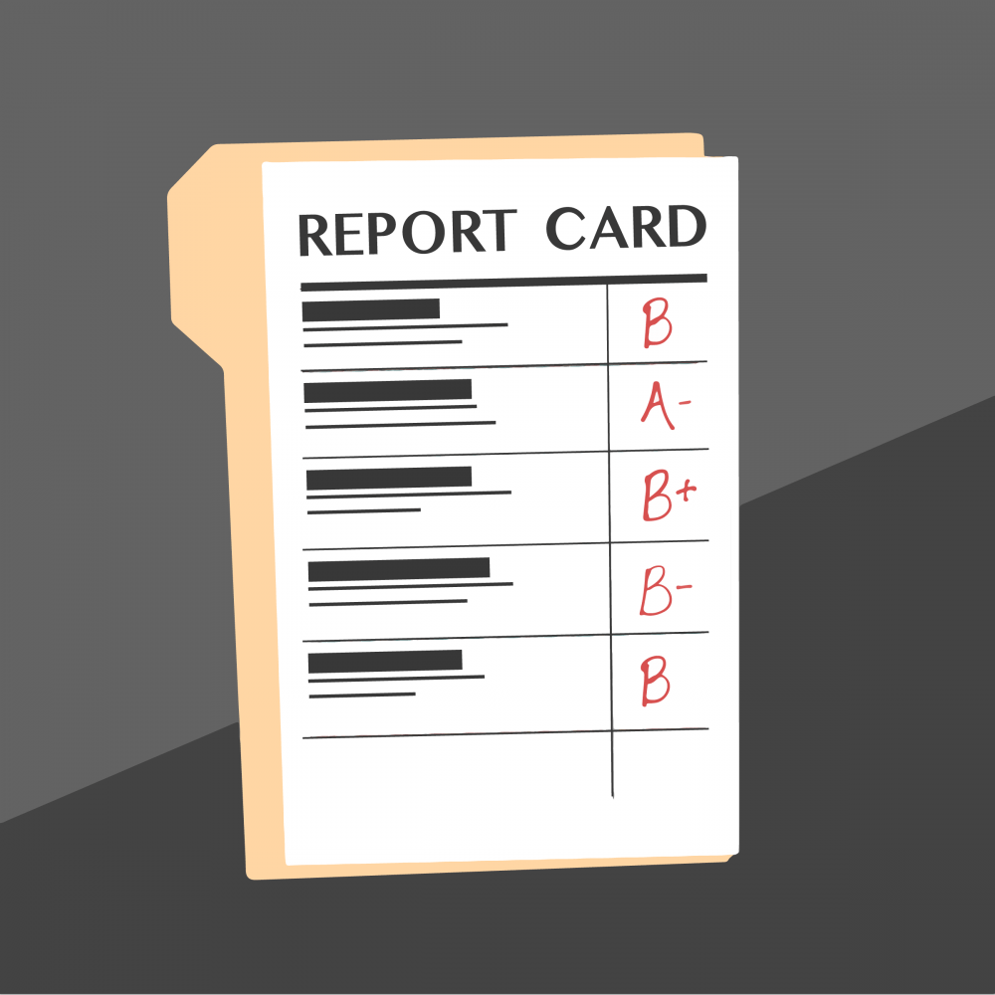
Inclusive Leadership Organization Report Card
Notes:
10 minutes (Total 44)
https://youtu.be/MIeOH351oi8

Slide 9
Sharing Experiences
In what ways does your organization demonstrate inclusive leadership practice (favorable grades)?
Groups of 3
What positive outcomes have you noticed from this practice? Have there been any unexpected surprises?
How might you and your organization continue to build on these things?
Notes:
5 minutes (Total 49)
Get into groups of three, and share:
What you see – literally
What meaning does it have
What do your partners see

Slide 10
Sharing Experiences
In what ways is your organization limiting inclusive leadership practice (least favorable grades)?
Groups of 3
What might you do to personally address this?
What can the organization do as a whole?
Are there policies, requirements or spoken/unspoken expectations that are perpetuating exclusive behaviors?
Notes:
5 minutes (total 54)
+ 4 minutes (total 58) to share with entire group

Slide 11
Questions? leadership@purdue.edu
765-496-2450
Notes:
2 minutes (total 60)

