Slide 1
REALISTIC WELLNESS
For When Work Gets Chaotic
Notes:
Introduction

Slide 2


Meet Our Trainers
Vanessa S. Pacheco Will Evans
Assistant Director, Health & Wellness Programs
Sr. Asst. Dir. Wellness

Slide 3
The Road Map for Today
Boundaries
Expectations
Deciding what is worth protecting
Choosing what and who to please
4
Wrap Up & Questions
Stress
2
Self-Compassion
Coping & Reframing
What do you when it goes wrong
5
1
3
Notes:
Will

Slide 4
Stress:
The physiological experience of your body in response to any perceived threat
Notes:
Vanessa
For the purposes of our talk today this is how we will think about stress. We are going to talk about ways to cope with mental and physical stress. First we will begin with mental stress. ​
And it's largely the same, no matter what the threat is. A more familiar way to understand this physiological experience is thinking about your fight, flight, freeze response to threat. You use all this energy stored in the body to help with this escape from this perceived threat, including our cognition. This is different than a stressor, because a stressor is anything that causes us to feel this way, but stress is the physical experience.

Slide 5
Stress as Helpful
too little
optimal
extra
too much
performance
stress
Notes:
First, lets consider the way we think about stress.
What tone do you hear yourself using in your head when you think about being stressed out? What words come to mind? How do you feel about the idea of being stressed?
Maybe you relate to the red zone on the graph. Stress is an enemy and hinders performance. Remember, 34% of students surveyed said stress had hindered they academic performance.
But look at the other sections. Stress can have different influences depending on how much of it we have. At its best, stress is a good motivator. Acting more like the Chinese duality Yin and Yang, stress can help push you into action and help keep you active. Too little stress and you can be thrown off and become apathetic. Too much, however, and you can be burnt out. It’s a delicate balance, but once you find it, stress can become more of a friend than an enemy.
So don’t always view stress as bad. It has its good sides. Be aware of how you are viewing stress and the amount of stress that you have at varying points in the year.

Slide 6
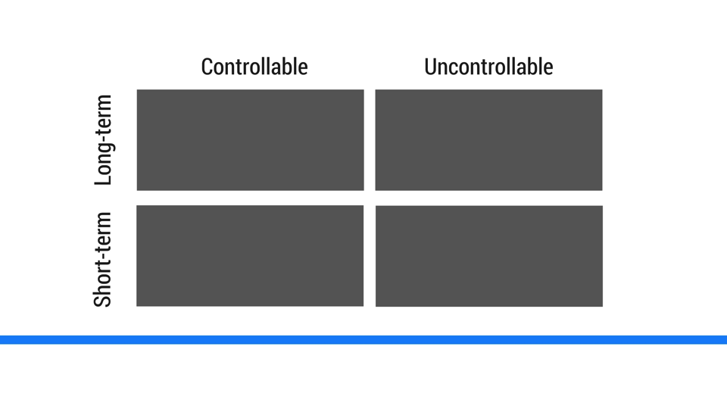
Labeling Common Stressors
Notes:
Now that we’ve talked about rethinking our attitude towards stress, let’s begin with just listing some of your common stressors. They can be anything—homework, partners, family, money, simply graduating. Whatever stresses you out.
Now that we have our list of common stressors. Let’s learn the second way to rethink mental stress.
You can create a similar table on your sheet of paper by drawing a cross to make four quadrants. I want you to label your stressors into the four categories. Really think about if the stressor is completely out of your control or not. Is it a short-term stressor or a long-term one?
(If necessary, give examples of what might fall into these categories.)
Why might this help us when wanting to reduce mental stress?
•We can’t change or control uncontrollable stressors. The more we fight them the more stress they cause. The best way to handle these is with acceptance and healthy coping. We will touch more on that later.
•“Worrying is the most effective way to expend a large amount of energy without accomplishing anything.” Worry about the things you can make a difference in—the controllable stressors.
•Short-term and long-term stressors help you prioritize where you spend your energy. Stress can make us feel overwhelmed so its important to prioritize and handle stress systematically.

Slide 7
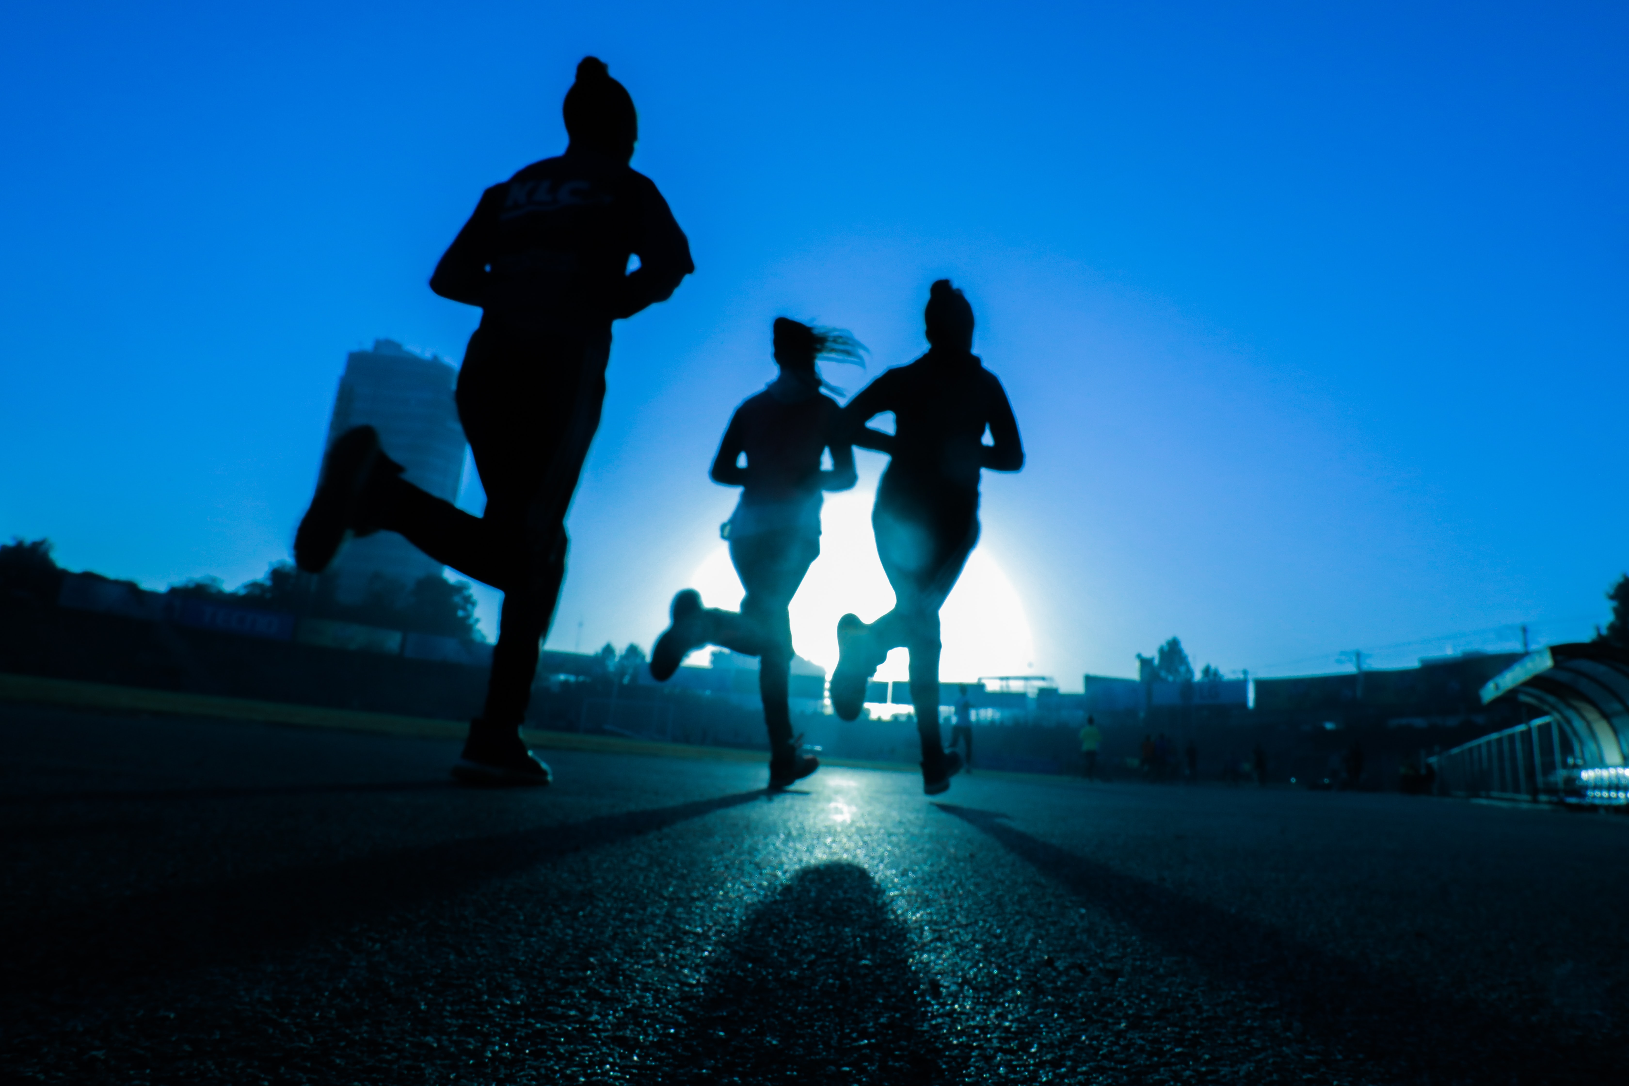



Body Movement
Coping Methods
Breathing
Moderates cortisol
Strengthens stress response
Calms you down
Clears the mind
Social Support
Mindfulness
Oxytocin release
Isolation thinking
Emotional Regulation
Acceptance
Notes:
-Explain that physical activity helps fight off stress in two main ways.
First, it helps rid your body of stress hormones like cortisol while replacing them with endorphins.
Second, it trains your body on how to deal with stress better because it causes your entire body to work together under a time of tension. Remember, stress is anything that cause mental or physical tension. Your body’s sympathetic, and parasympathetic systems (the forces that excite and calm the body under stress) get to operate under controlled conditions which helps you better deal with stress when it arises in real situations.
-Breathing exercises can seem really simple, but we will discuss their effectiveness after we practice. Have them sit in a comfortable position. Breath in through the nose for three seconds, hold briefly, and then exhale through the mouth for three seconds. Practice once, and then do this three times. ​
After breathing, ask the audience how they feel.
Vagus nerve to breathing
-Social support releases a hormone called oxytocin, which has been nicknamed the cuddle hormone. It promotes social bonding between people and encourages relationships. Another thing it does is help heal damaged cells because it’s also a natural anti-inflammatory.
Social support also minimizes isolation thinking. When we experience something bad or feel inadequate under the pressure of stress we can begin to think that normal people don’t have these problems. When we reach out to others, we experience a sense of common humanity that reassures us that there is nothing odd about what we are feeling and that in fact, isolating ourselves only makes us feel worse.
-Emotional regulation is important for stress because as we get better at recognizing and labeling the emotions we are feeling, we can get better at recognizing harmful stress and determining how stressed we actually are. ​
Acceptance helps us lessen the need to be in control over everything. When we think we have to control and make everything perfect we get stressed because things don’t meet our unrealistic expectations. Just like with the controllable and uncontrollable stressors, some things are outside of our control.

Slide 8
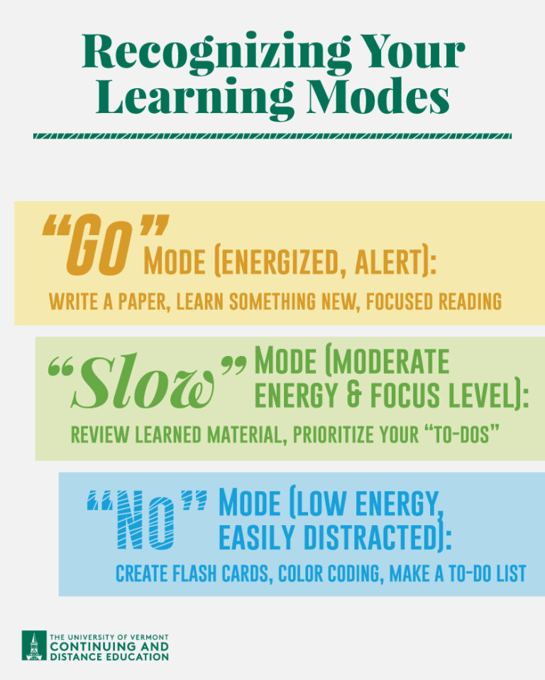
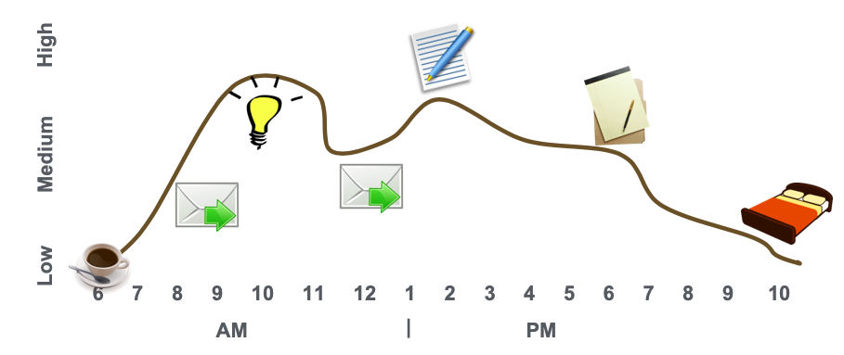
Track Your Energy Curve
Notes:
When designing our schedules, it can be helpful to track when you are mentally and physically tired in the day. For example, someone that hits their highest energy spike in the evening likely isn’t going to do well with and 8 am class.
“Go” Mode (energized, alert): write a paper, learn something new, focused reading, create a diagram, etc.
“Slow” Mode (moderate energy and focus level): review learned material, draft an outline for a paper, create a study guide, prioritize your “to-dos”
“No” Mode (low energy, easily distracted): create flash cards, organize notes, color coding, highlighting materials, make a to-do list
What are some things that influence these modes for you?
In the example above, we see that in the morning this person is tired so they grab some Starbucks. As they begin to wake up, they do some simple tasks like clearing out their inbox. They high a real high point of energy around 10 am, so they do more creative tasks like designing programs, writing reports—anything that requires lots of mental energy. Then they have a dip in energy around lunch, so they go back to checking email, they write some papers around 3, work on some homework around 7, and then wind down for the rest of the night.
Everyone’s schedule is going to be different, but take a moment to think about your energy curve and how you could structure your day around it. When do you feel your most productive? Take advantage of these peak hours.

Slide 9
Managing Expectations
1
2
3
SELF-IMPOSED
OTHER-IMPOSED
SOCIALLY-IMPOSED

Slide 10
Self-Compassion
What can I learn…
Next time I can…
This taught me…
Should have…
Could have…
Would have …

Slide 11
Mental Self-Care – Workplace Connection
Stress in the workplace
Workplace burnout can dampen productivity
Help staff members grow with appropriate challenges and development opportunities
Have regular check-ins with your team about workplace stress
Self-compassion in the workplace
How you respond to yourself can influence how you respond to others.
Is work performance driven by outputs alone or is professional development woven in?
How are you teaching those around you to have grit and overcome failure?
Expectations in the workplace
Are your goals, KPIs, outputs, etc. realistic?
What subliminal expectations are you telling your co-workers?
Do you take the time to understand your team’s expectations?

Slide 12
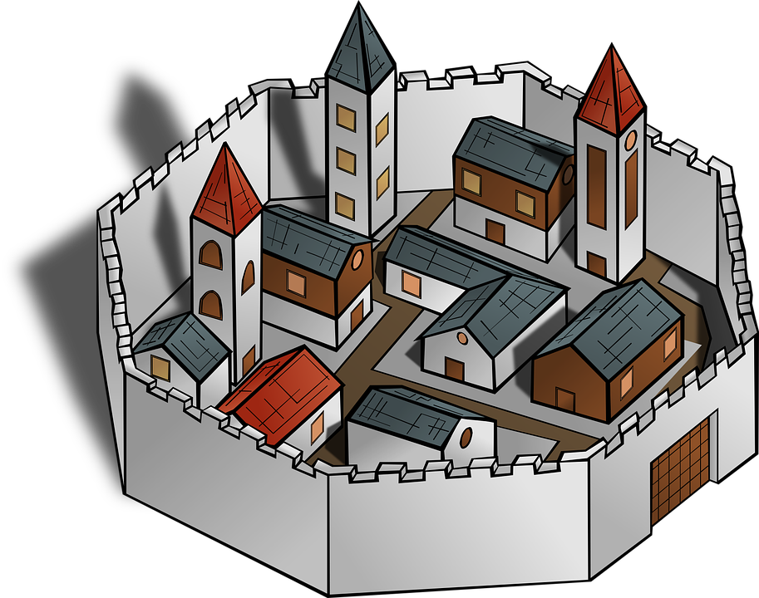

Deciding Boundaries
Boundaries
Like walls around yourself to keep you safe from burnout or unrealistic expectations
The walls should be expanded slowly, after you test their strength
Expanding the wall too fast can open you up to exploitation

Slide 13
What are we protecting?
Boundaries protect values
Integrity
Organization
Quality > Quantity

Slide 14
Boundaries vs Confinements
Boundaries are not…
1
A way of policing others
2
A means to avoid anything uncomfortable
3
Meant to manipulate
4
A way to be selfish

Slide 15
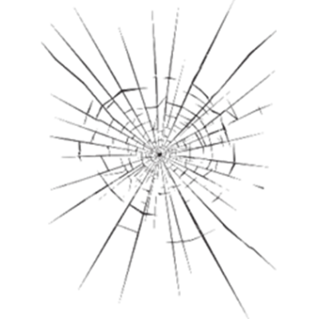
Barriers to Boundaries
Be sure to remember the value of what you’re protecting, or else cracks might form in your boundaries.
Over pleasing others
Boredom
Over-acheiver

Slide 16
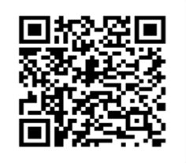
THANK YOU
Notes:
Also copy and paste the below link into the chat box.
Tinyurl.com/boilereval

