Slide 1
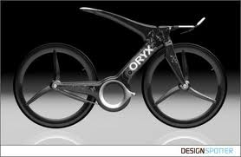
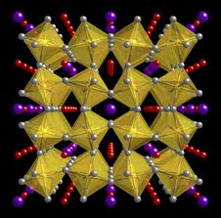
Materials Engineering
Present Your Major
Joseph Muth
Amanda Cooper

Slide 2
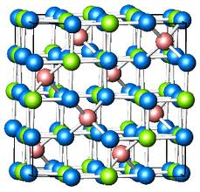
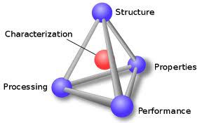
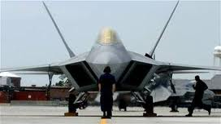
What is Materials Engineering?
“properties and phenomena associated with a material are intimately related to its composition and structure at all levels. This structure is a direct result of synthesis and processing. The final materials must perform a given task in an economical and socially acceptable manner.”
Materials Engineers analyze and exploit diverse scientific phenomena in order to develop new materials to address society’s needs

Slide 3
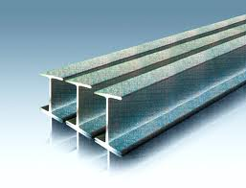
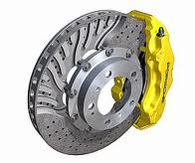
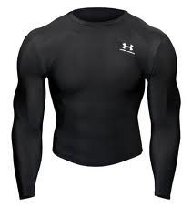
Traditional Disciplines
Metals – materials characterized by atomistic, delocalized, metallic bonding
Ceramics – materials characterized by atomistic ionic and covalent bonding
Polymers – materials characterized by macromolecular van der Waals bonds and atomistic covalent bonding

Slide 4
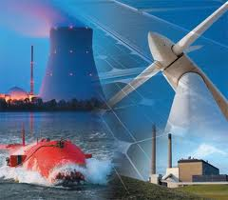
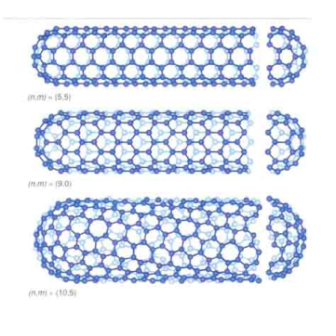
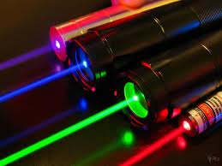
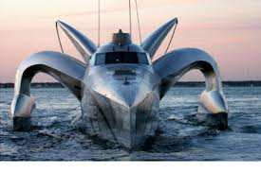
New Disciplines
Energy
Nanotechnology
Electronic
Structural
Interdisciplinary, problem focused approach

Slide 5
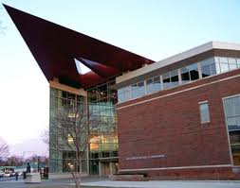
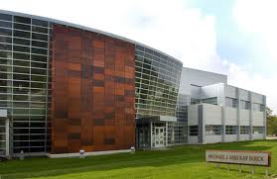
Materials at Purdue
Students: 120 -150 undergraduate, 80 graduate
22 faculty – 3 new faculty arriving in the spring
US News and World Report: Ugrad: 14th , Grad = 16th
Heavy metals and ceramics emphasis – growing in polymers and nanotechnology
ARMS, MSEE, PHYS, Birck – some of the best facilities in the country

Slide 6
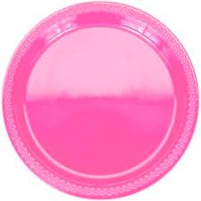
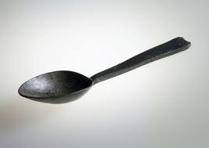
Coursework
Class size ~ 40 – all fundamental courses taken together
General courses focus on overall principles (thermo, quantum, heat transfer)
Tech electives (18 hrs) – specialization
Extensive hands-on labs every year (235, 335, 367, 430/440)
Extremely writing intensive
Widespread availability of research from day 1

Slide 7
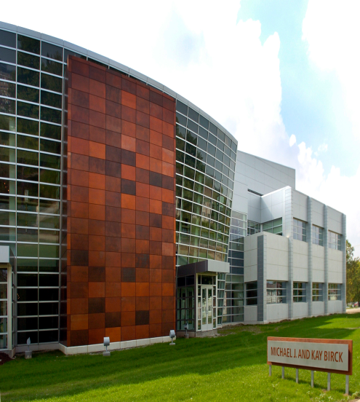
Careers: Education and Research
Education
Many practicing materials engineers were educated in different fields (chemistry, physics, Chem E, ME, BME)
Usually if a graduate degree is pursued it is a PhD due to the specialty of materials work
Grad schools have extremely specific programs within the 3 main types of materials
Research
National labs
Universities
Corporate R and D

Slide 8
Industry
Automotive/Equipment
Electronics
Aerospace
And many more…..

Slide 9
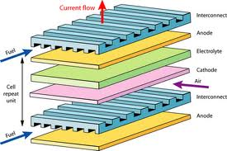
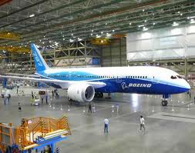
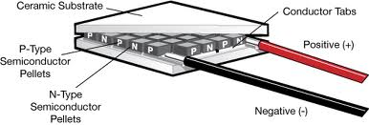
What I have done so far

Slide 10
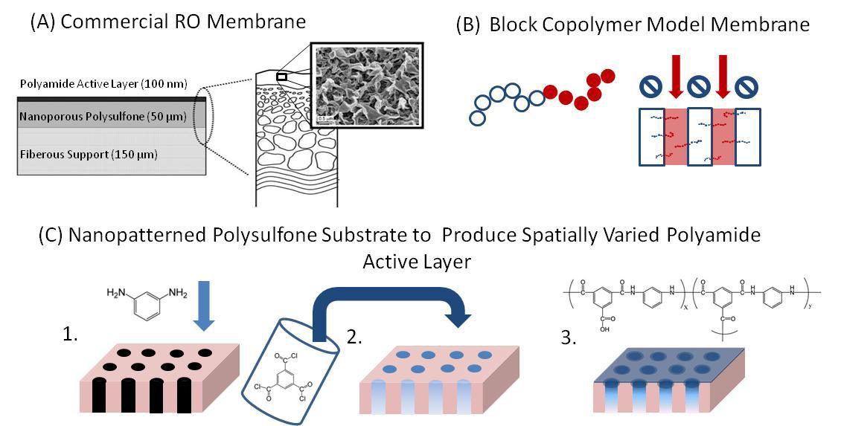
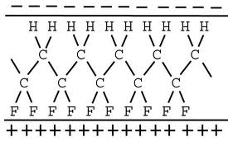
My Plans
Grad school
Water filtration
Sustainable modular energy
Start-up my own company/join a start-up
Dream is to open a business with my Dad doing humanitarian oriented engineering

Slide 11
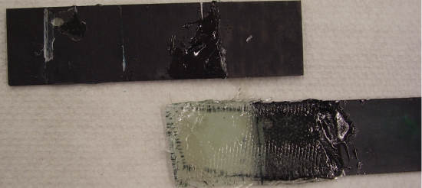
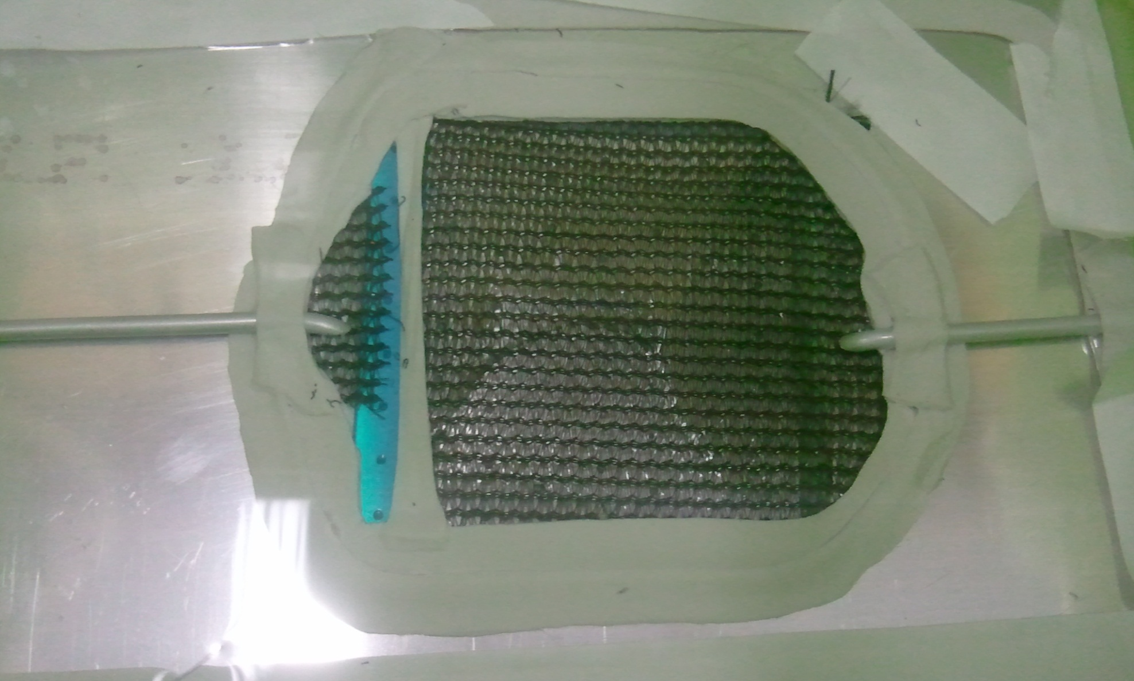
What I have done so far
Composites Research
UV-curable Adhesives
VARTM
Air Products Internship
Corrosion & Failure Analysis
Co-op
Molding & Casting
Solid Works
Rapid Proto-typing

Slide 12
My Plans
Now: Graduate School
PhD
University of Illinois-Urbana Champaign
Northwestern
University of Florida
Composites or Biomaterials
Future: Government
Light years ahead:
Liberia
Independent “Engineers Without Borders”

