Slide 1
Mechanical Engineering
Melissa Carosiello & Pete Leenheers

Slide 2
What is Mechanical Engineering?
Mechanical engineering is the broadest of all engineering disciplines and involves activities in research and development, design and manufacturing, operations and maintenance, and marketing and sales, among others.

Slide 3
Basic Stats
Ranked in top 7 ME Programs in the Country
Roger B. Gatewood Wing ($33 million state-of-the-art Wing) & First LEED Certified Building on Campus
1001 Undergrads (largest Program in the CoE)
39 Underrepresented Minority Students
134 Female Students
169 International Students
90% have Intern/Co-op Exp. (70/20 split)
30% have International Experience

Slide 4
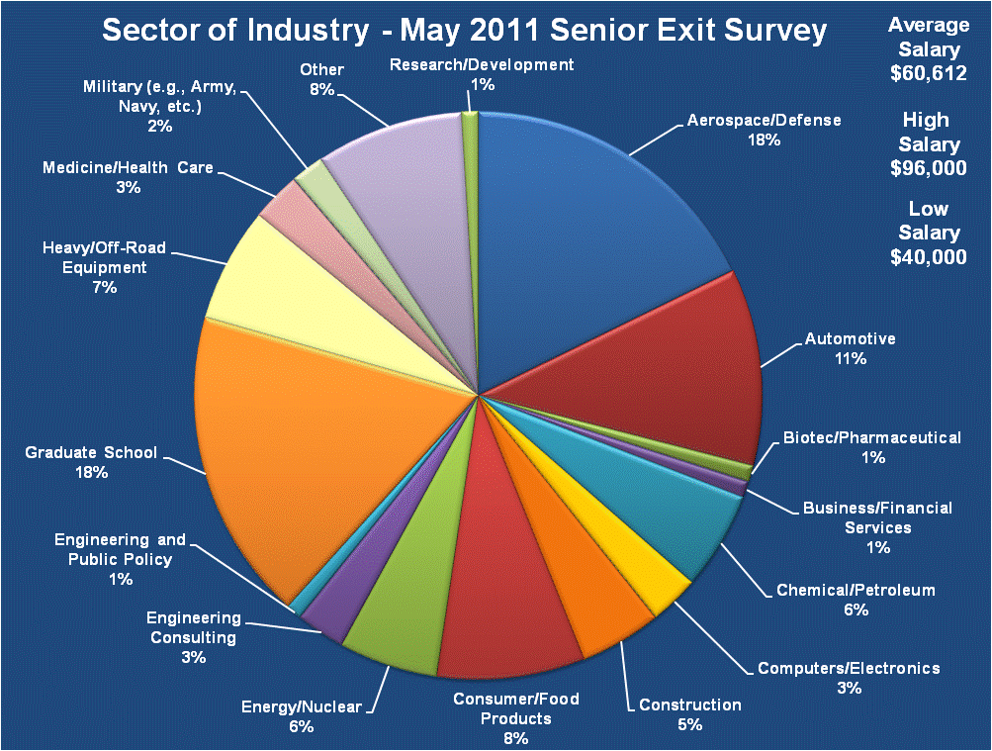

Slide 5
High Profile Employers
Aerospace/Defense – Boeing, GD, Lockheed-Martin, Northrup Grumman, Pratt & Whitney, Rockwell, Rolls-Royce, SpaceX, The Aerospace Corp., Wright Patt.
Automotive – Allison Trans., Bosch, Chrysler, Ford, Honda, GM, Toyota, Tesla
Biotech/Pharmaceutical – BioMet, DePuy/J&J, Zimmer, Eli Lilly, Merck
Chemical /Petroleum – 3M, Air Products, BP, ConocoPhillips, Dow, DuPont, Chevron, Exxon/Mobil, Marathon Oil, Shell
Computers/Electronics – Eaton, Honeywell, Lexmark, Motorola, Tyco, ZebraTech
Construction – ArcelorMittal, Bechtel, Babcock/Wilcox, KJWW Engr Consulting
Consumer/Food Products – Anheuser-Busch, P&G, Kimberly-Clark, GE, Frito-Lay, Gen. Mills, L’Oreal, Mars/Wrigley, Nestle, PepsiCo, Starbucks, Whirlpool,
Consulting – Accenture, PricewaterhouseCoopers, Tricad Engineering
Energy/Nuclear – Amer Elect Pwr (AEP), Duke Energy, GE, Indy Pwr & Light, Schneider Electric, Westinghouse Electric
Heavy Off Road Equip – Caterpillar, John Deere
Health Care – Abbott, Boston Scientific, Paragon Medical, Stryker

Slide 6
Available Opportunities
5 Year BSME/MSME (GPA>3.2)
Honors Certificate (Top 10%)
Undergrad Research
Technical Minors
ME Concentrations
Double Majors are also possible, but typically require and extra year.
BSME
4 PEs
6 GEs
Free El.
5Yr BSME/MBA (GPA>3.5)
Entrepreneurship Certif. MGMT Minor
ECON Minor
Gen. Ed. Minors
Global Engineering Minor
Engrng. & Public Policy
Intell Prop. Minor
Health Care Minor (In Process)

Slide 7
Available Global Opportunities
GEARE – 7 months abroad
Int’l and dom. internships; 2-sem global design proj.
Engr Term Abroad (ETA) – 1 sem. abroad
1 sem. study abroad, time to graduation unchanged
Summer Research Abroad (Hannover; Clausthal)
Traditional Study Abroad (Anywhere)
For more information go to: http://www.studyabroad.purdue.edu/
G-PAL – Int’l internship with host country student
International Project Course - (ME 463)
International Co-op – One co-op session abroad.
Maymester Abroad – 3 weeks abroad.
IAESTE – Int’l Assn. for the Exch of Stud for Tech Exp
For more information go to: http://www.iaesteunitedstates.org/

Slide 8
Target Goals for Int’l Programs School of Mechanical Engineering
2010 – 30% Participation in International Programs (Current)
19 (China), 7 (Germany), 1 (India), 30 (China Maymester), plus others
40 students committed to going to China next spring
Three new sites coming on line in 2011 – Singapore, Turkey, Spain)
2013 – 50% Participation in Int’l Programs (next ABET visit)
New ETA sites under consideration (Greece, Australia, New Zealand, United Kingdom, France, Japan, etc.)
2020 – 80% Participation in Int’l Programs (Engr of 2020 target)
International Experience should become as common place as Professional Work Experience (Intern/Co-ops)

Slide 9
Concluding Thoughts
ME is the Broadest of all of the Engineering Disciplines
ME offers the Broadest Array of Career Opportunities (both traditional & non-traditional)
ME offers the Broadest Array of Educational Options
ME is the most Progressive School with respect to International Experiences

Slide 10
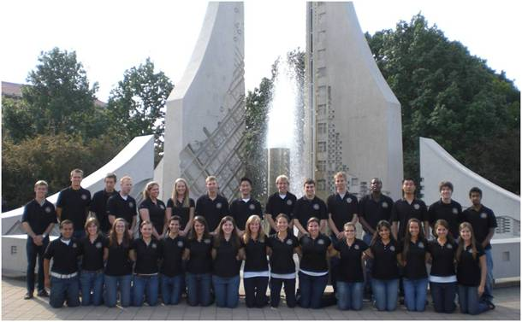
Melissa’s Journey
Academics
Minor in Environmental & Ecological Engineering
Activities
Purdue Mechanical Engineering Ambassadors

Slide 11
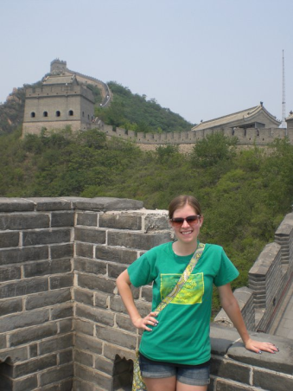
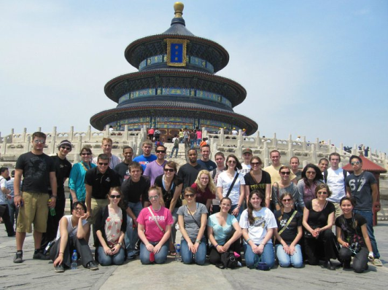
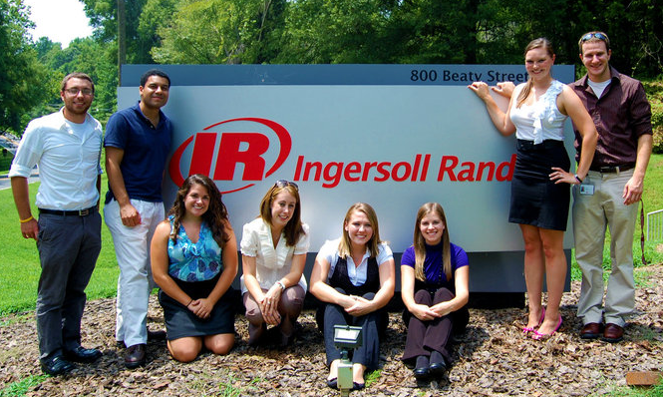
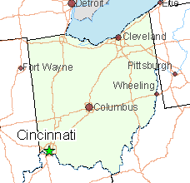
Melissa’s Journey
Study Abroad
2011 China Maymester
Internship Experiences
Ingersoll Rand
General Mills
Future Plans
General Mills – Cincinnati, OH

Slide 12
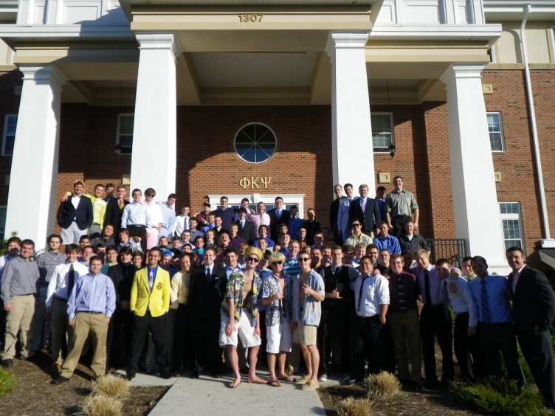
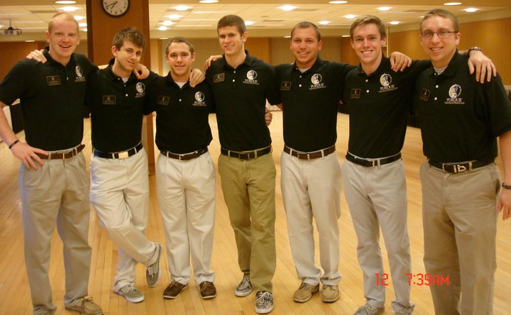
Pete’s Journey
Academics
Fourth Generation Purdue Engineer
Activities
Phi Kappa Psi Fraternity
Interfraternity Council
Old Masters
Mechanical Engineering Ambassadors

Slide 13
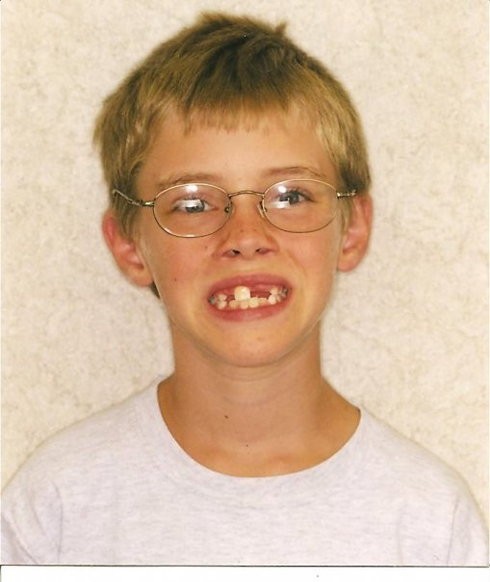
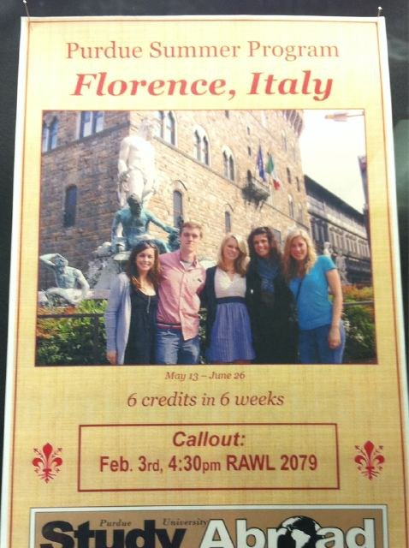
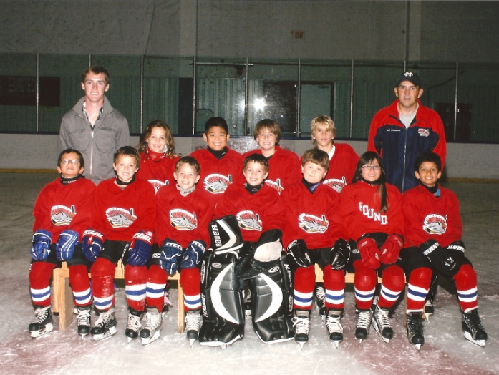
Pete’s Journey
Study Abroad
Summer in Florence, Italy
Work Experience
ExxonMobil Co-op
Argonne National Laboratory

