Slide 1
Environmental and ecological engineering
Engineering Ambassadors
November 1, 2011

Slide 2
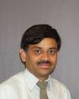
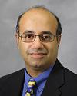
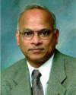
Introduction to EEE
Three engineering problems
What do EEE’s do?
What jobs are available?
What are the degree options?
What is it like to be an EEE student?

Slide 3
An engineering problem: energy
International Energy Agency,
“World Energy Outlook 2006”
What will be the sources of this energy?
What are the environmental implications of this energy use pattern?
What is the role of engineers?

Slide 4
An engineering problem: water
Colorado R. supplies: Los Angeles, Las Vegas, Phoenix, irrigation
Often does not reach Gulf of California.
What is the role of engineers?

Slide 5
An engineering problem: copper
Gordon, Bertram, and Graedel (2006)
Proc. Nat. Acad. Sci., 103(5)
“Today’s developed country level of services for copper worldwide… would appear to require conversion of essentially all of the ore…plus near-complete recycling of the metals from that point forward”
What is the role of engineers?

Slide 6
Grand challenges of engineering
Make solar energy economical.
Provide energy from fusion.
Develop carbon sequestration methods.
Manage the nitrogen cycle.
Provide access to clean water.
Restore and improve urban infrastructure.
Advance health informatics.
Engineer better medicines.
Reverse-engineer the brain.
Prevent nuclear terror.
Secure cyberspace.
Enhance virtual reality.
Advance personalized learning.
Engineer the tools of scientific discovery.

Slide 7
Grand challenges of engineering
Make solar energy economical.
Provide energy from fusion.
Develop carbon sequestration methods.
Manage the nitrogen cycle.
Provide access to clean water.
Restore and improve urban infrastructure.
Advance health informatics.
Engineer better medicines.
Reverse-engineer the brain.
Prevent nuclear terror.
Secure cyberspace.
Enhance virtual reality.
Advance personalized learning.
Engineer the tools of scientific discovery.

Slide 8
So what is EEE anyway? “Designing solutions at the boundary of the engineered and the natural.”
Multidisciplinary
Notes:
— EEE is about engineering while protecting these resources
— “Save the Planet”: The best solutions will require technology/engineering components

Slide 9
So what is EEE anyway? “Designing solutions at the boundary of the engineered and the natural.”
Multidisciplinary
System-wide problem-solving and analysis: complex and complete system thinking
Notes:
— EEE is about engineering while protecting these resources
— “Save the Planet”: The best solutions will require technology/engineering components

Slide 10
So what is EEE anyway? “Designing solutions at the boundary of the engineered and the natural.”
Multidisciplinary
System-wide problem-solving and analysis: complex and complete system thinking
Consideration of ecosystem resources:
materials
space / land
air and water availability and purity
waste assimilation capacity
Notes:
— EEE is about engineering while protecting these resources
— “Save the Planet”: The best solutions will require technology/engineering components

Slide 11
What EEEs Do
NATURAL RESOURCES ENGINEERING
Provide clean water and sanitation. Manage food production. Ensure that engineered systems and environmental and ecological systems interact sustainably.

Slide 12
What EEEs Do
POLLUTION CONTROL, MONITORING, ABATEMENT, AND REMEDIATION
Contaminated soil and sediment, water and wastewater treatment, air pollution control, brownfield remediation, industrial waste control, ecotoxicology.

Slide 13
What EEEs Do
INDUSTRIAL ECOLOGY
Optimize industrial resource use, analyze and control complete life-cycle of materials, industrial system redesign, energy efficiency maximization.

Slide 14
What EEEs Do
ENERGY TECHNOLOGY
Develop alternative energy, reduce greenhouse emissions, increase efficiency, seek energy sustainability.

Slide 15
What EEEs Do
SUSTAINABILITY
Provide for current needs without sacrificing future ability to meet needs. Consider equity over time. Design for consumption at biospheric regeneration rates. Consider the whole system.

Slide 16
What EEEs Do
From Labor Dept. O*NET:
Collaborate with environmental scientists, planners, hazardous waste technicians, engineers, and other specialists, and experts in law and business to address environmental problems.
Inspect industrial and municipal facilities and programs to evaluate operational effectiveness and ensure compliance with environmental regulations.
Prepare, review, and update environmental investigation and recommendation reports.
Design and supervise the development of systems processes or equipment for control, management, or remediation of water, air, or soil quality.
Provide environmental engineering assistance in network analysis, regulatory analysis, and planning or reviewing database development.
Obtain, update, and maintain plans, permits, and standard operating procedures.
Provide technical-level support for environmental remediation and litigation projects, including remediation system design and determination of regulatory applicability.
Monitor progress of environmental improvement programs.
Advise corporations and government agencies of procedures to follow in cleaning up contaminated sites to protect people and the environment.
Inform company employees and other interested parties of environmental issues.

Slide 17
Career opportunities
“Environmental Engineers should experience the fastest growth” of all engineering fields (2010 BLS Job Outlook Report for Engineers)
Bureau of Labor Statistics data:
in 2008, there were 54,000 Environmental and Ecological Engineering jobs in the US – more than ChE, NE, BME, MSE.
Predicted 30% increase in the next decade.
Shift in job emphasis to pollution and problem prevention, and public health

Slide 18
Career opportunities
public: 28%
federal – 7%
state – 13%
local – 8%
private: 72%
about half and half between
environmental firms and
other industry.

Slide 19
Career opportunities
Private sector EEE employment:
Consulting
environmental impact
remediation design
regulation compliance
energy planning / audits
Construction/Civil Engineering
Energy production/delivery
Mineral and resource extraction
Manufacturing
Non-profit / Global / NGOs

Slide 20
Career opportunities
Public sector EEE employment:
Federal
Environmental Protection Agency
Dept. of Energy
Army Corps of Engineers
Dept. of Interior
State
IDEM (Indiana Dept of Environ. Mgmt.)
Purdue University
Local
water/wastewater districts
city departments of engineering/planning

Slide 21
Career opportunities
Bureau of Labor Statistics data:
in 2009, the median salary was $77K for EEE jobs in the US.
EEE →
$60K
$70K
$80K
$90K
$100K
CE →
CHE →
BME →
AAE →
ABE →
EE →
NE →
IE →
ME →
MSE →

Slide 22
Electives (5)
Technical Electives (5)
Required (15-16): EEE 250, EEE 300, EEE 430, CE 350/ABE 325, CE 355
EEE Selective (18)
Ecology (6)
Statics and dynamics (3)
Thermodynamics (3)
Fluid Mechanics (4)
Senior Design (3)
Statistics (3)
Professional Preparation (1)
Calculus I and II (8-10)
Multivariable Calculus (4)
Linear Algebra / Diff. Eqns. (4)
Chemistry I and II (8)
Organic Chemistry (4)
Physics (3)
Biology (2)
English Composition: ENGL 106 (4)
Speech Communication: COM 114 (3)
General Education Electives (18)
Environmental and
Ecological Engineering
area focus courses (39-40)
Engineering
Fundamentals (17)
Math and Science
Tools (37-39)
Society and Humanity
Core (Gen Ed) (25)

Slide 23
Electives (5)
THESE ARE THE COURSES THAT HELP MAKE PURDUE EEE UNIQUE:
Environmental and
Ecological Engineering
area focus courses (39-40)
Engineering
Fundamentals (17)
Traditional Environmental Engineering Skills: CE 350/ABE 325, EEE 300
Complex Systems and Sustainability: EEE 250, CE 355, EEE 430
Flexibility to Study across Environment and Engineering: 18 credits of EEE Selectives
Ecology Focus: BIOL 286, BIOL 585
Math and Science
Tools (37-39)
Society and Humanity
Core (Gen Ed) (25)

Slide 25
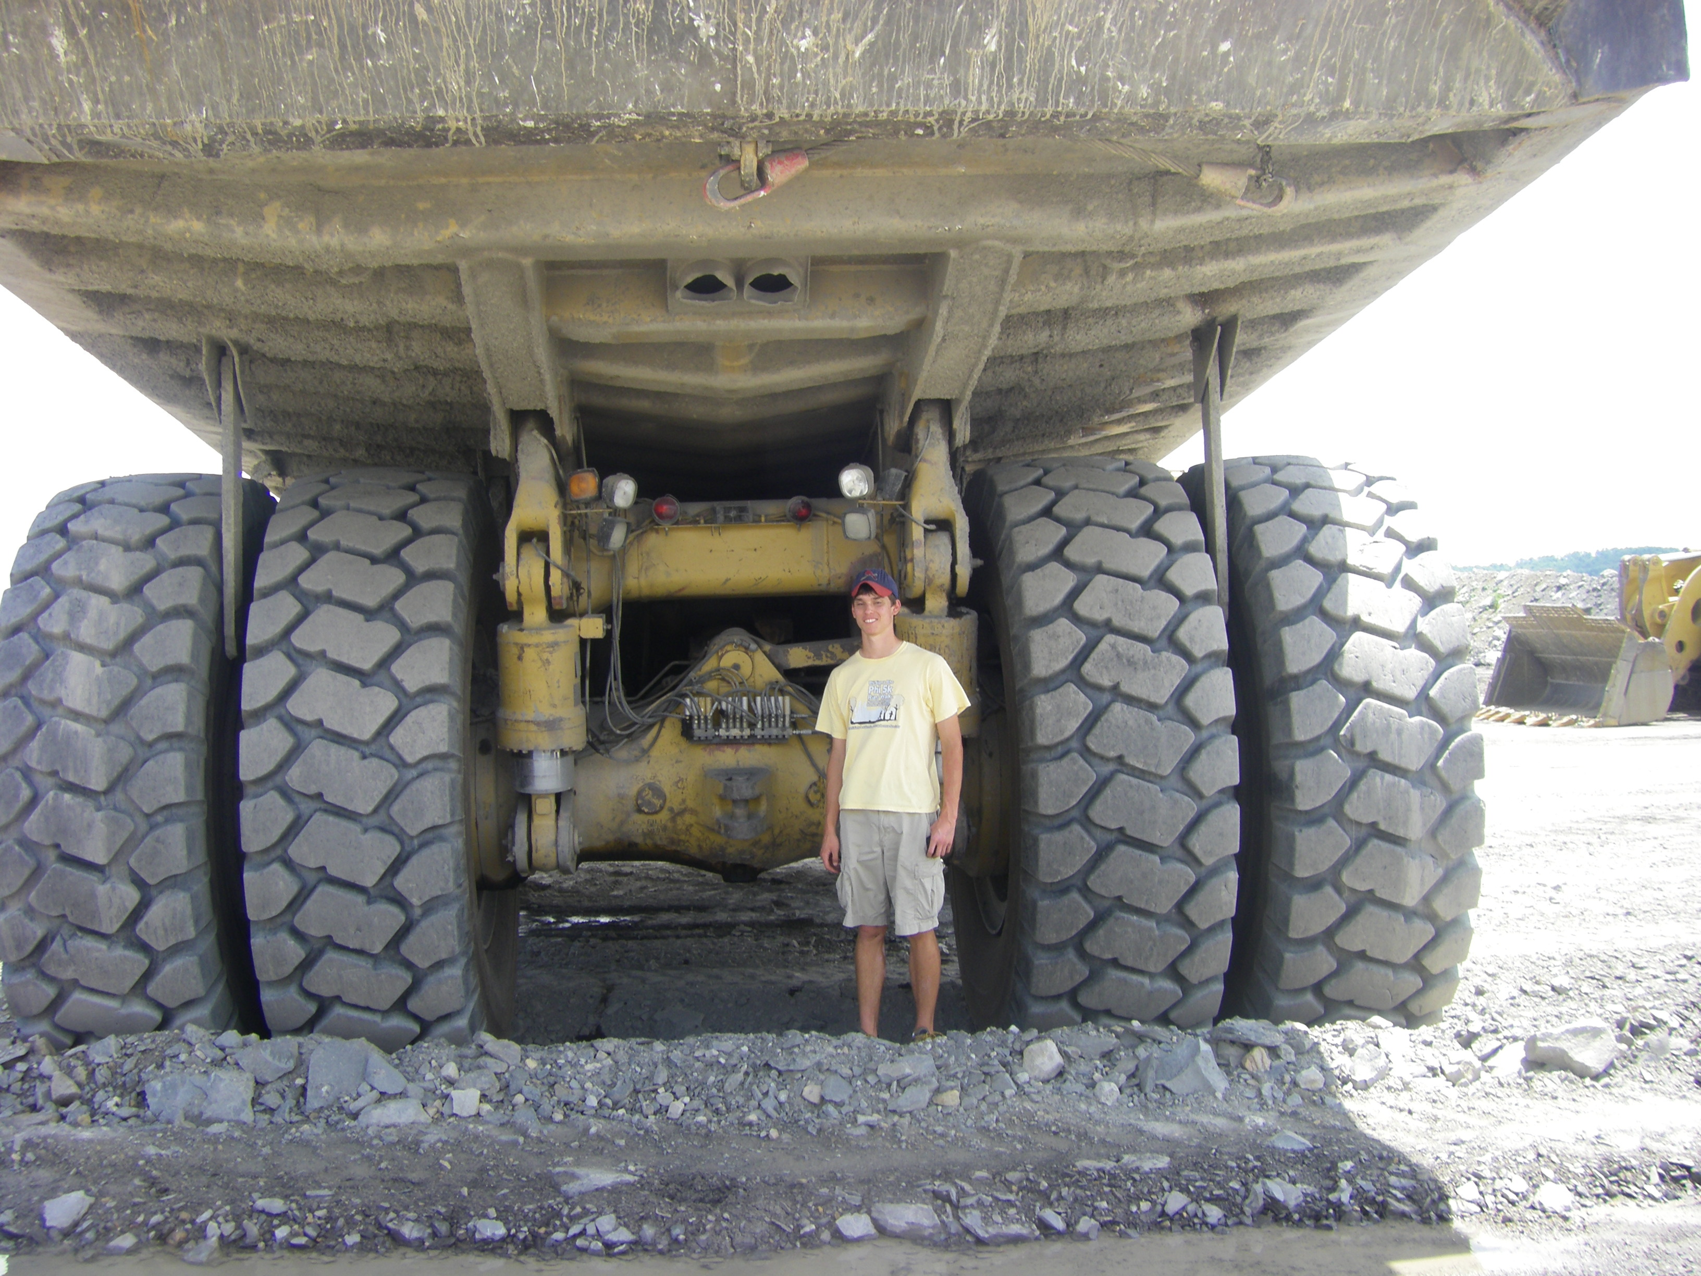
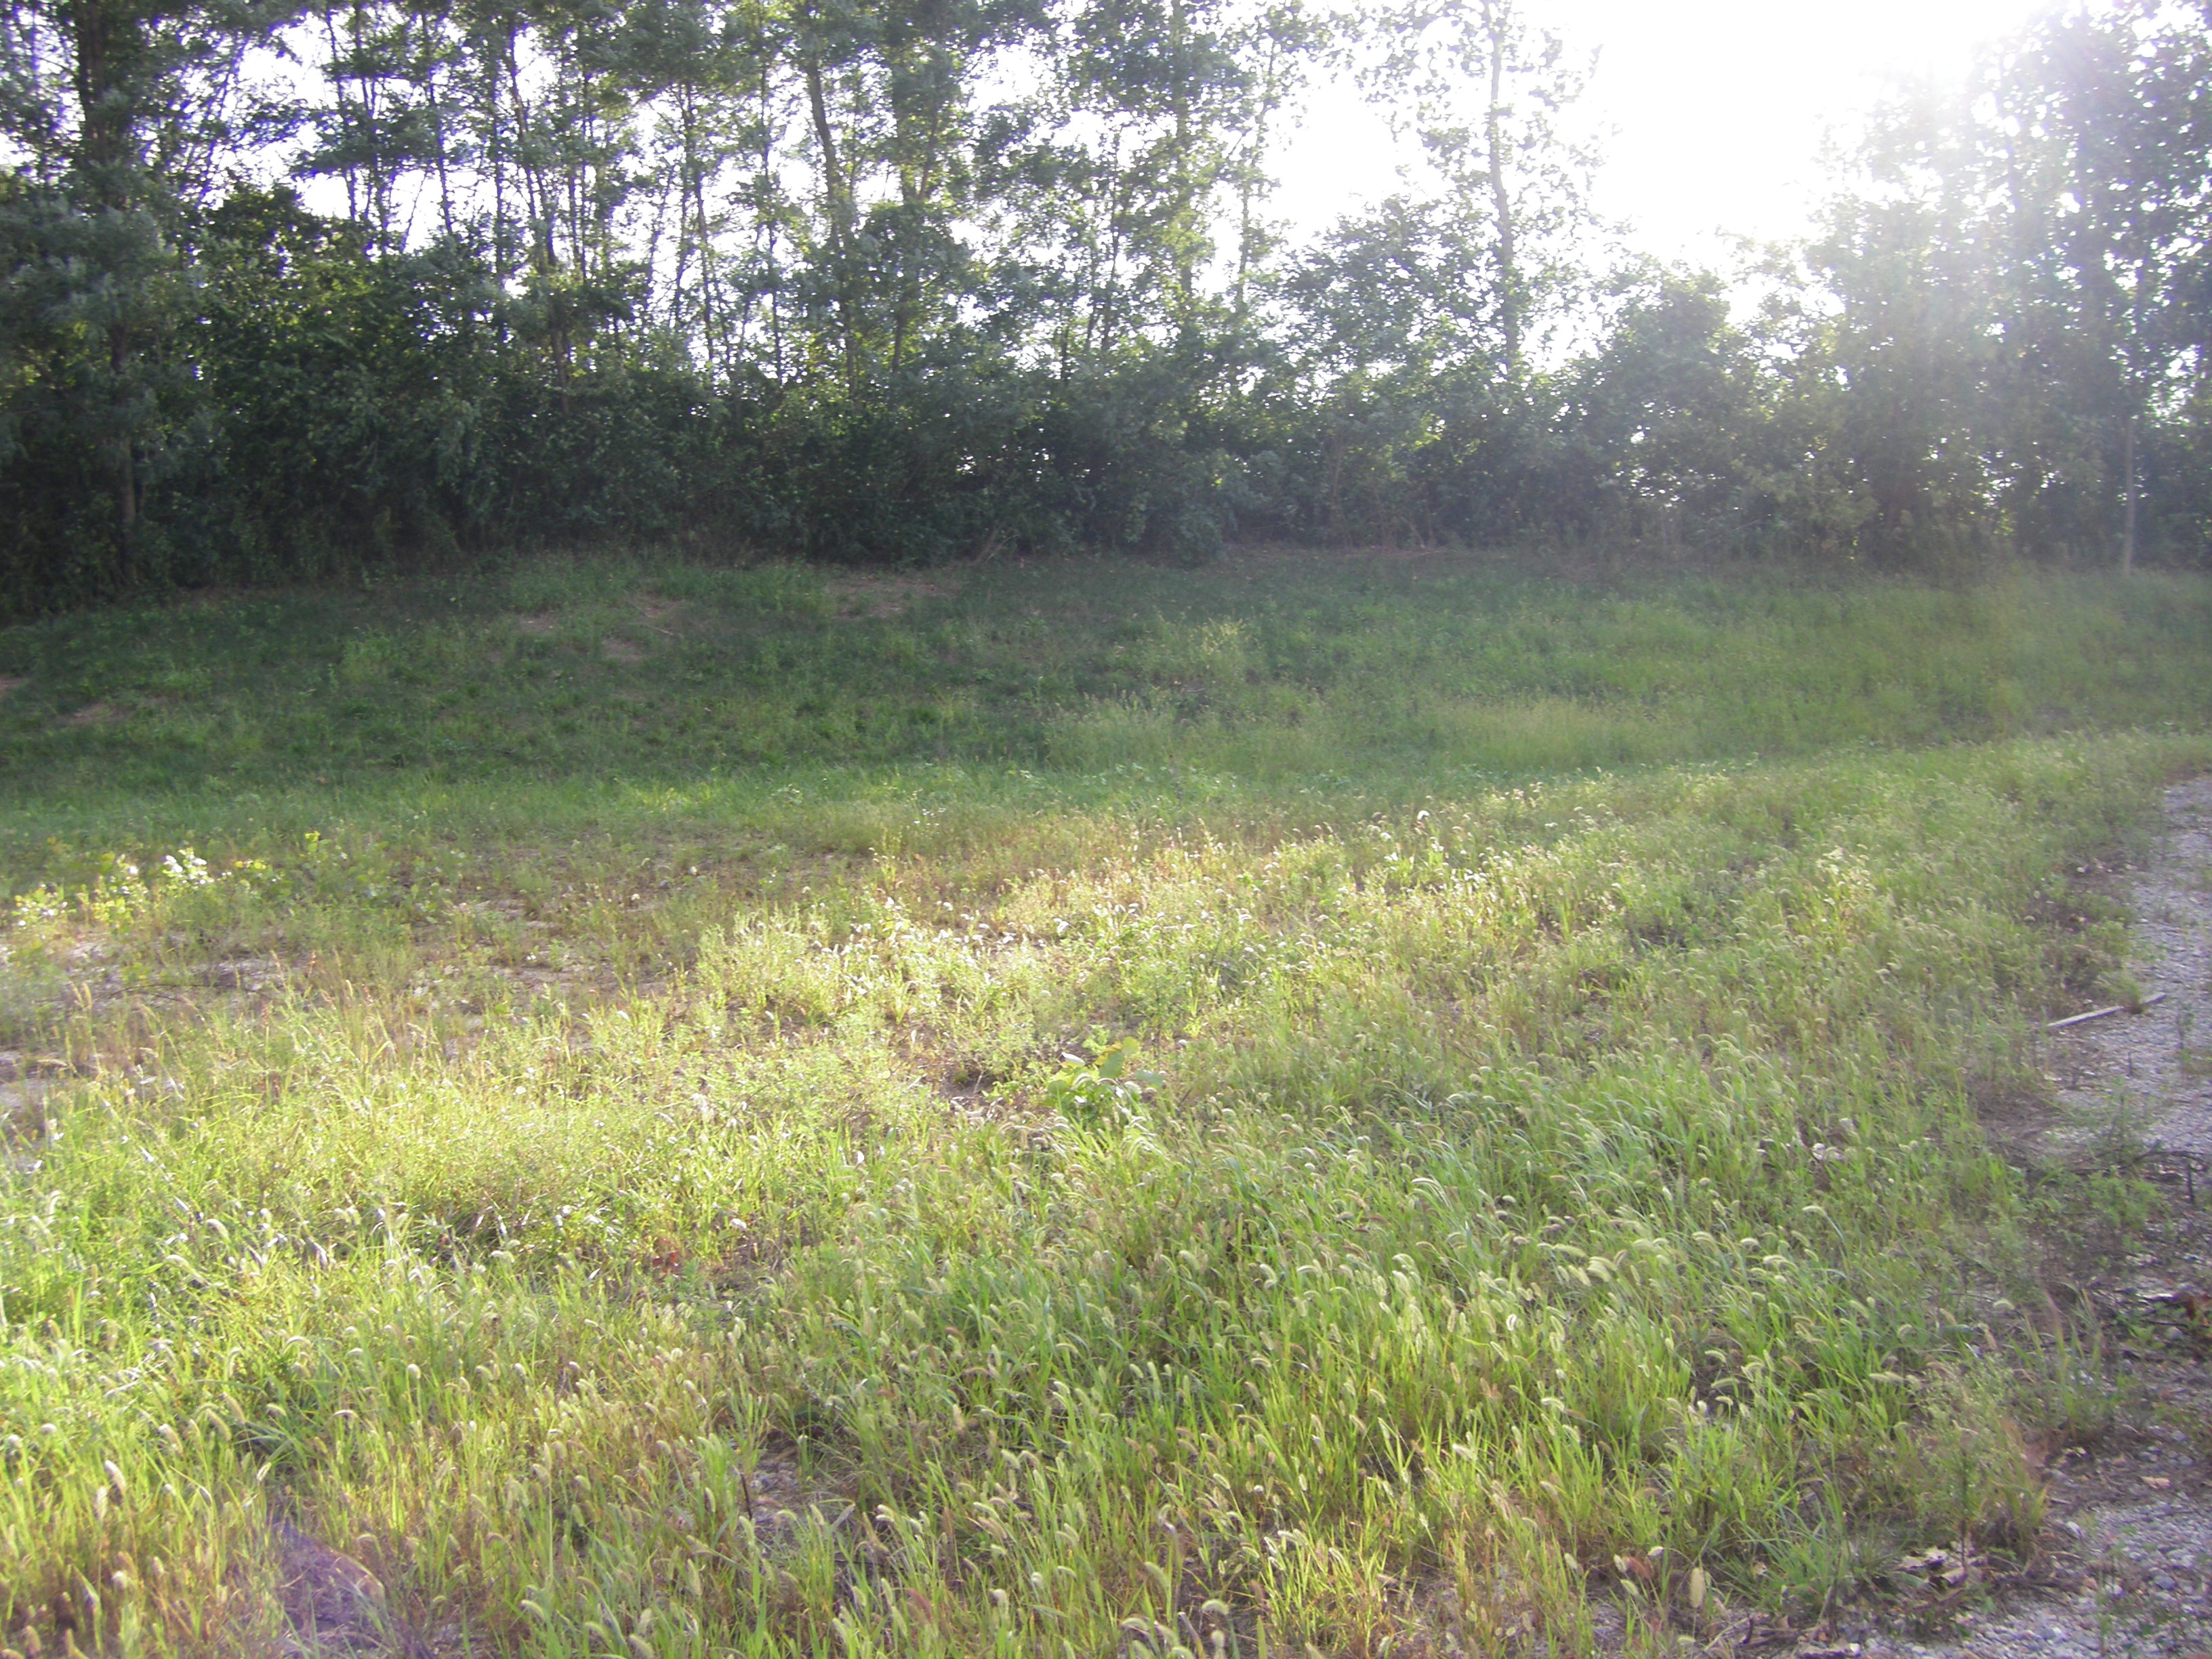
About me:
Study Abroad
REU – NSF
EPICS project
Boiler Green
Grad level courses
Next year?

Slide 26
Questions?

Slide 27
Contact information
Stephen Hoffmann srh@purdue.edu 6-7578
Stephen Kelly
kellysa@purdue.edu
Potter Engineering Center, room 322
http://engineering.
purdue.edu/EEE

