Slide 1
Chemical Engineering
Alyssa DeVries, Andrew Nguyen, Victoria Liem
November 15, 2011

Slide 2
What Do Chemical Engineers Do?
Chemical engineering is a very broad field
Affects the energy, pharmaceutical, foods, and consumer products industries
Roles in process, R&D, project development, and safety

Slide 3
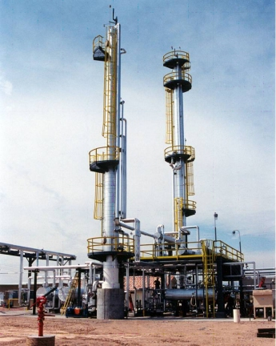
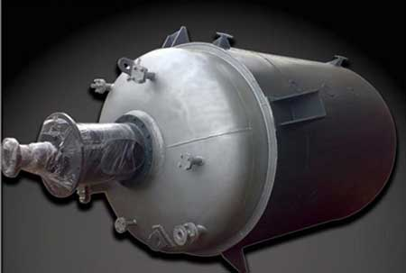
Role: Process Engineering
Design and optimization of chemical/biological process systems
Design of separation/purification systems, heat exchangers, reactors
Quality assurance

Slide 4
Role: R&D
Research and development of new process systems and technologies
Scale-up of novel chemical reactions to an industrial scale
Development of chemical synthesis and materials

Slide 5
Role: Safety
Evaluate risks and hazards of current industrial processes
Recommend safety and other preventative measures
Role: Project Management
Managing projects
Ensuring budget constraints and schedule milestones are met

Slide 6
Concentrations in ChE
Concentration Requirements
9 credit hours of coursework from an approved list
At least 3 credits of CHE coursework
At least 3 credits of ENGR coursework

Slide 7
Energy and Environment
Advanced Solar Energy Conversion
Energy Storage Systems
Biological Principles of Environmental Engineering
Engineering Environmental Sustainability
Air Pollution Control and Design
Fuel Cell Engineering
Radioactive Waste Management
Power Engineering

Slide 8
Biological Engineering
Engineering Applications of Biological Molecules
Tissue Engineering
Biochemical Engineering
Biomolecular Engineering
Introduction to Computational Biology
Biosensors: Fundamentals and Applications
Bio-energy and Biofuels
Biochemistry

Slide 9
Pharmaceutical Engineering
Particulate Systems
Intelligent Systems in Process Engineering
Pharmaceutical Process Development and Design
Principles of Pharmaceutical Engineering
Basic Pharmaceutics
Pharmaceutical Manufacturing Processes
Food and Drug Law Administration

Slide 10
Materials and Polymers
Micro/Nanoscale Physical Processes
Particulate Systems
Polymerization Reaction Engineering
Structure and Physical Behavior
Electrical, Optical and Magnetic Properties of Materials
Powder Processing
Fracture of Materials
Manufacturing Advanced Composites

Slide 11
Career Paths in Chemical Engineering
Gases
Pharmaceuticals
Chemicals

Slide 12
Career Paths in Chemical Engineering
Fuel/Energy
Consumer Products

