Slide 1
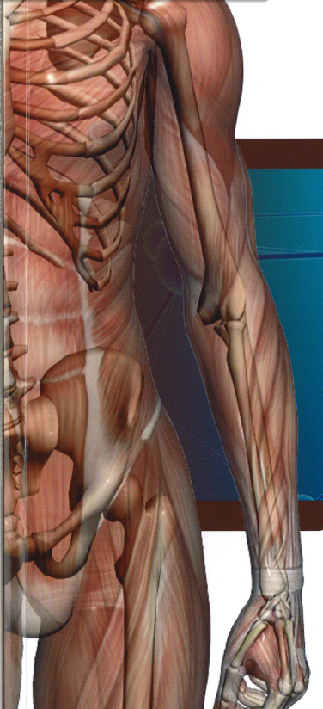
Introduction to
Biomedical Engineering
at Purdue
Notes:
Biomedical Engineering is an interdisciplinary science

Slide 2
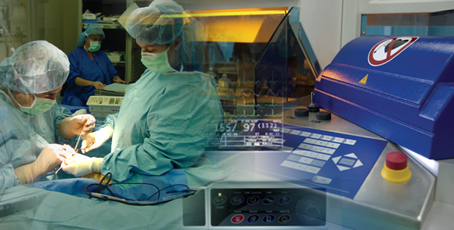
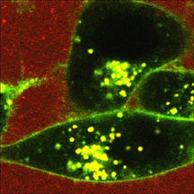
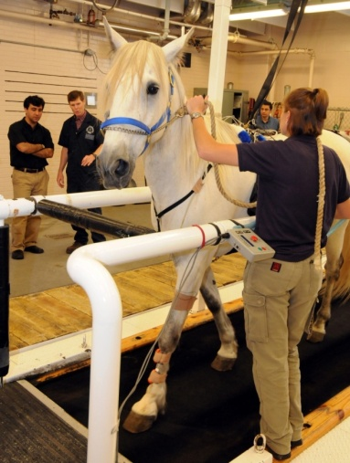
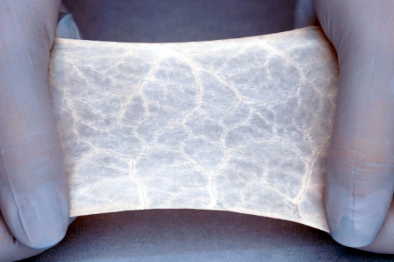
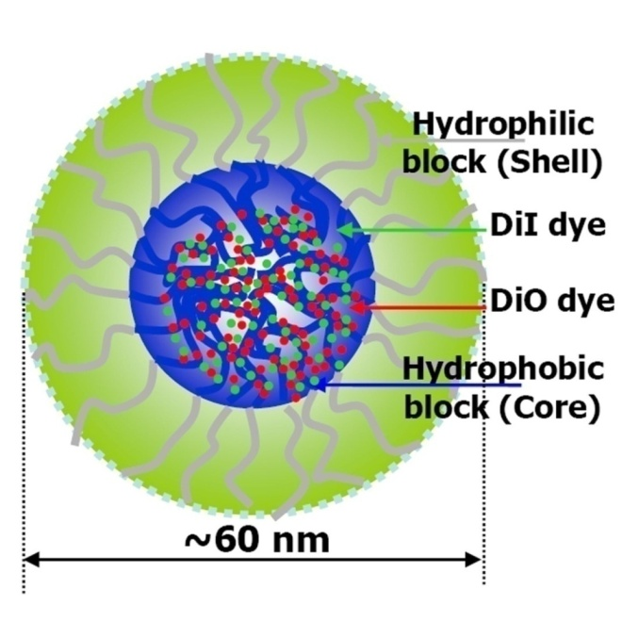
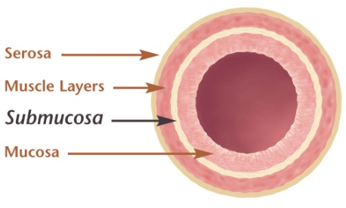
Areas of Excellence
Biomaterials & Tissue Engineering
Biomechanics and Orthopaedics
Biophotonics & Medical Imaging
Neural Engineering
Systems Science and Engineering

Slide 3
Where will a BME degree lead you?
Graduate School
5th Year BS/MS
Medical School
MBA
Law School
Industry
Rotational programs (Abbot: QDP, GE Healthcare: Financial management program; Edwards Life Sciences: TDP; Catalent: MDP Associate)
MED Institute (Engineer for non-clinical testing)
Cook Medical (Prod Engr-Aortic Intervention Unit)
Biomet (Microfixation: Product Development Engineer)
Roche Diagnostics (Research Scientist)
Integra Life Sciences (Collagen Sales Specialist)
Smith and Nephew (Product Development Engr)
St. Jude Medical (Clinical Systems Engineer)
Zimmer (Sales Academy—technical consultant)
Notes:
Ask Ambassadors to talk about summer experiences and career plans

Slide 4
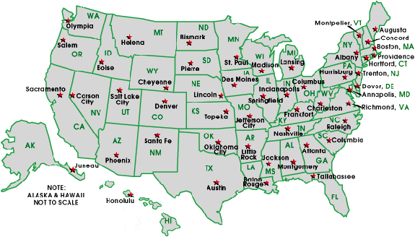
BME Internship/COOP
In Indiana
Maine Standards,
Lewiston, ME
MEDinstitute,
West Lafayette
Orthocare Innovations,
Seattle, WA
Medtronic,
Minneapolis, MN
Eli Lilly,
Indianapolis
Athena GTX,
Des Moines, IA
GE Healthcare, Waukesha, WI
Bard EP,
Lowell, MA
DePuy,
Warsaw
Abbott Vascular,
Redwood City, CA
Ethicon Endo-surgery,
Cincinnati, OH
Biomet,
Warsaw
Allosource,
Centennial, CO
St. Jude Medical,
Sylmar, CA
Cook Medical,
Bloomington
In Illinois
Rehabilitation Institute of Chicago
SonarMed,
Indianapolis
Cyberonics,
Houston, TX
Hollister, Inc., Libertyville
Hill-Rom,
Batesville
Siemens Medical, Hoffman Estates
Cook Biotech,
West Lafayette
Summer internships are most popular but we have a growing COOP program - these are in yellow.
COOP is typically three sessions starting during the summer after the sophomore year.
ZOLL Medical,
Hoffman Estates
Cook Urological,
Bloomington
Notes:
Two-thirds of our graduates have worked in industry.
Summer internships are most popular but we have a growing COOP program—these are in yellow. COOP is typically three sessions starting during the summer after the sophomore year.

Slide 5
BME Circles of Influence
IE
Electives Can Be Taken In:
AAE
ABE
BME
CHE
ECE
IE
ME
MSE
NUCL
ECE
ME
BME
PHIL
MSE
BIO

Slide 6
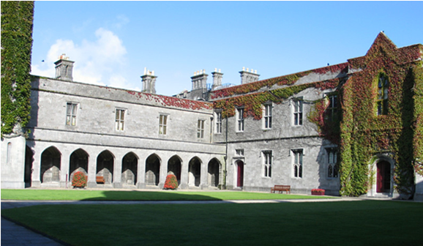
New Developments… Study Abroad
BME Exchange with Galway, Ireland,
Other options coming on-line in Madrid and Copenhagen
BME students spent Summer of 2011 doing research in Germany and China
Notes:
Expanding study abroad options will feature BME specific courses at universities in other countries so students can graduate on time with global experience.

Slide 7
Our Stories
James – Medical School
Michael - Industry
Morgan – Industry (Abbott Laboratories)
Sachin – Medical School
Notes:
12/10/2009 1:57 A.M. Purdue University's Biomedical Engineering Building Note that this was posted by Seij Larsen, a BME student who graduated in May 2009.
Seij; “This video was taken the morning of our final senior design demonstration. Our final prototype includes a carbon fiber foot, aluminum ankle joint, titanium pyramid connectors, pressure sensors along the length of the aluminum shaft, a pneumatic actuator (latex bladder constrained by 2" expandable nylon sleeving), a microcontroller, a battery regeneration circuit and electropneumatic solenoids that allow for air intake and exhaust based on EMG signals recorded from the calf muscle. The demonstration piece was designed to allow an observer to clearly visualize the pneumatic muscle's response to electrical activity that occurs during calf muscle contractions. During our final demonstration, the compressed air lines will be replaced by a high pressure air (HPA) tank that fits easily in a backpack.”
Seij now works as a Clinical Systems Engineer with St. Jude Medical in Los Angeles, CA. Brian Bigler is a PhD student at Duke, DJ Kennedy is a PhD student at Northwestern. Paul Cunningham is employed at GE Healthcare.

