Slide 1
Community, Assistance and Resources for Engineering Students (CARES)
Dr. Kristy Eaton, Director
April 2025

Slide 2
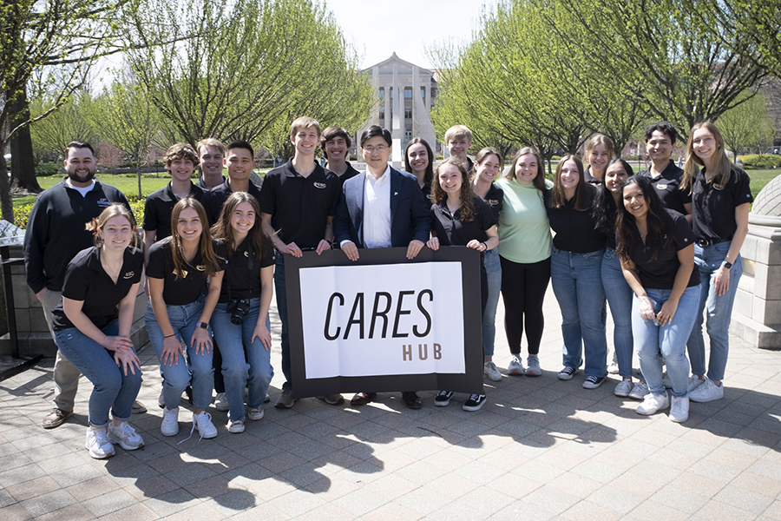
We Started with a Desire for Well-Being and a Gift from the Purdue Engineering Student Council (PESC)

Slide 3
Vision: To promote and sustain a culture of well-being for all Purdue engineers

Slide 4
WHY is this Work Important?
Students demanded it!
Engineering can be hard. Life can be hard. Balancing engineering and life can be hard. We want to help make it easier!
And then there is the data:
The number two leading cause of death in persons ages 10-34 is suicide - Centers for Disease Control and Prevention (CDC)
One in five students sitting in a classroom has a diagnosable mental health challenge
- US Department of Health and Human Services
- National Association of School Psychologists (NASP)
- Substance Abuse and Mental Health Services Administration (SAMHSA)
Ongoing stress can alter the neuroanatomy of the brain, causing difficulties with cognition and executive functioning
- “The Body Keeps the Score” -Bessel van der Kolk
- “What Happened to You?” -Dr. Bruce Perry
- “The Deepest Well” -Dr. Nadine Burke-Harris

Slide 5
Our Focus – Five Dimensions of Well-Being
Physical Wellness
Spiritual Wellness
School & Life Balance
Social Wellness
Mental Wellness

Slide 6
Our Multi-Tiered System of Supports Approach
Utilize an evidence-based multi-tiered system
of service delivery and data analysis
Physical space to study, relax and connect
Social events for well-being, connection & fun!
Well-being workshops
QPR suicide prevention training
Staff/faculty education and support
Nationally certified peer educators/mentors
Therapist on-site with daily walk-in hours
Tier I 5%
Therapy
IOP
Hospitalization
Tier II 10-15%
Peer Mentoring
(ENGR 49600)
Skills Groups
Walk-In Sessions
Tier III 80-85%
Study & Relaxation Space
Events for Connection & Well-Being
Prevention Education
Mental Health Minute

Slide 7

Jennie Beutler, MSW, LCSW CARES Therapist
Over a decade of clinical experience
Daily “Let’s Talk” walk-in hours
Monday through Friday
1 – 2 p.m. ARMS 1251
Scheduled appointments here.
Call CAPS (765)494-6995
Provides mental health and well-being workshops for classes and other groups

Slide 8

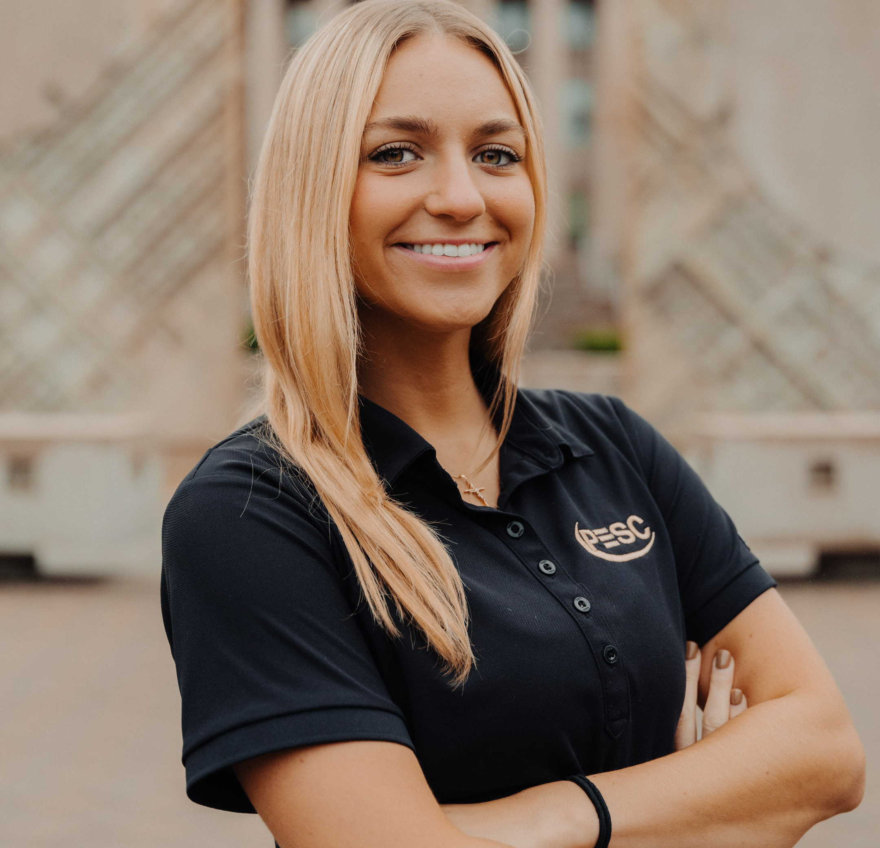
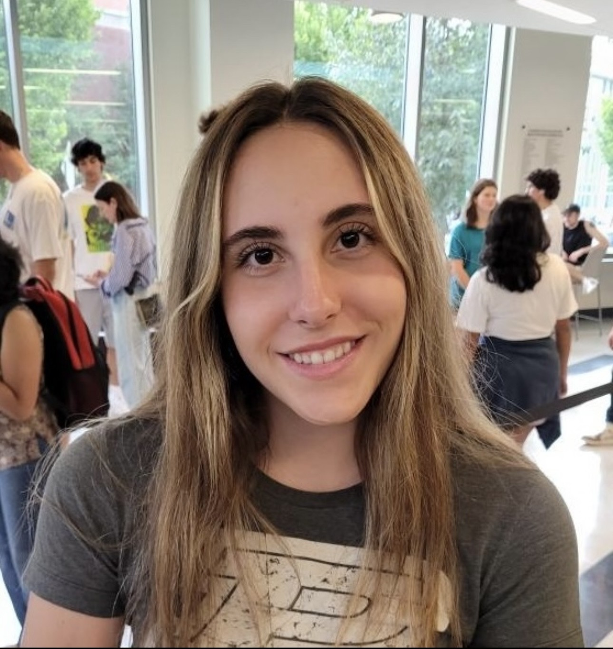
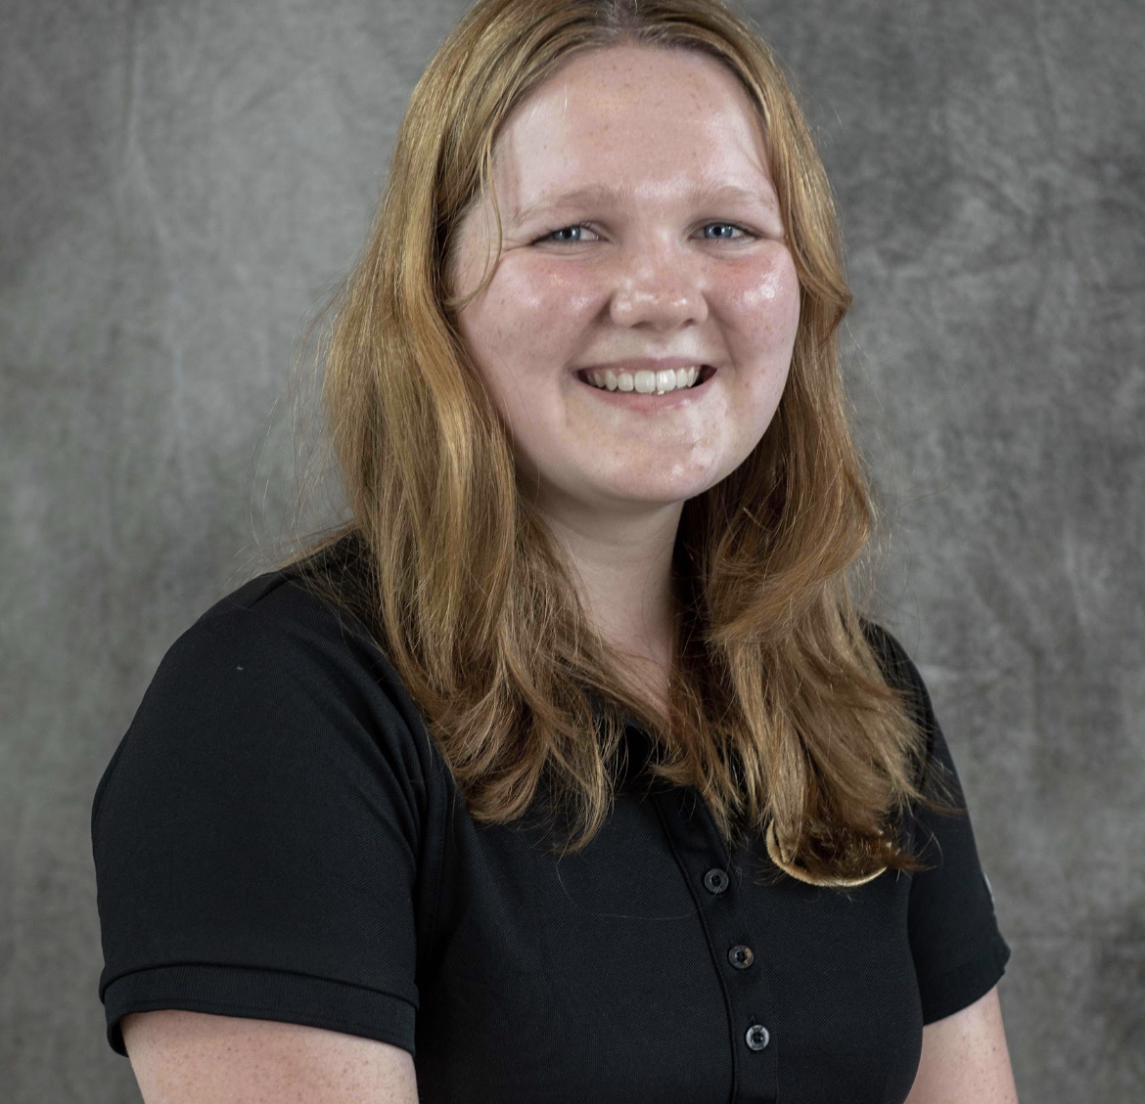
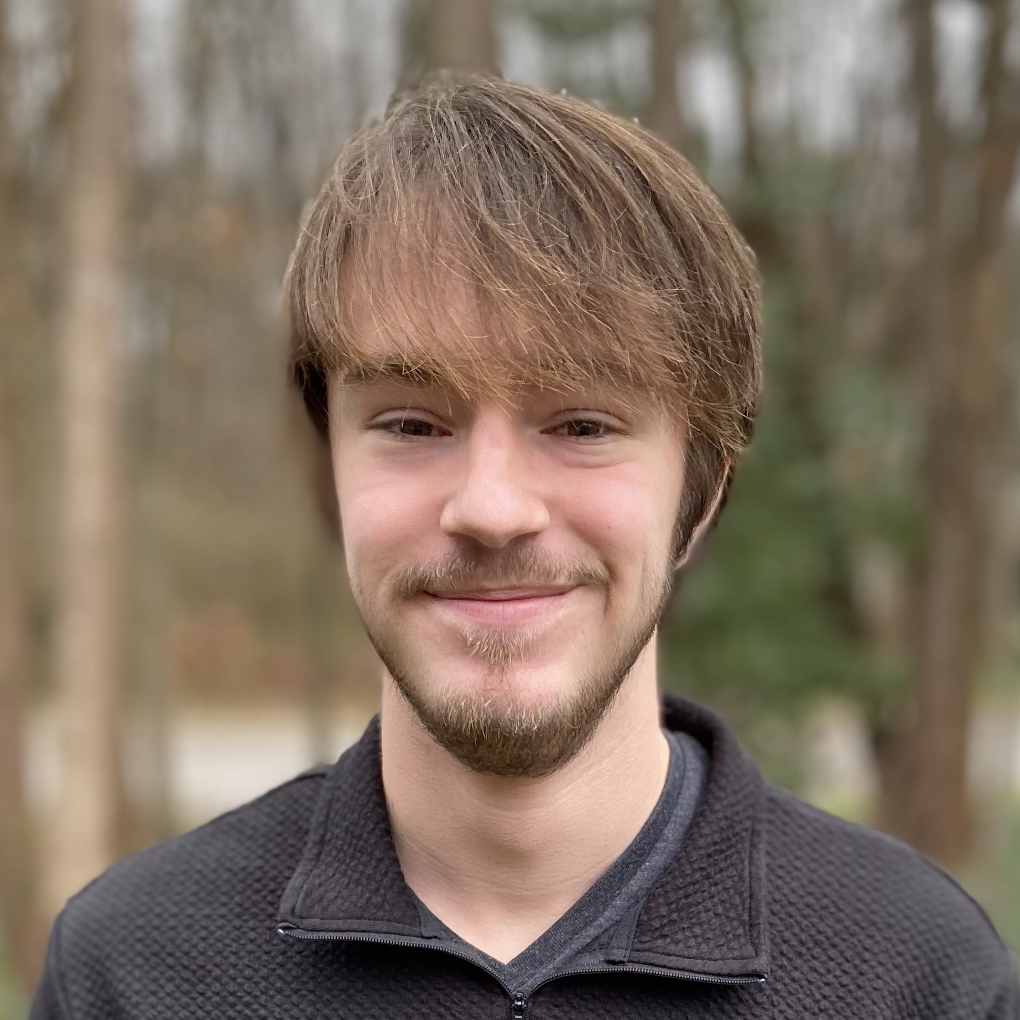
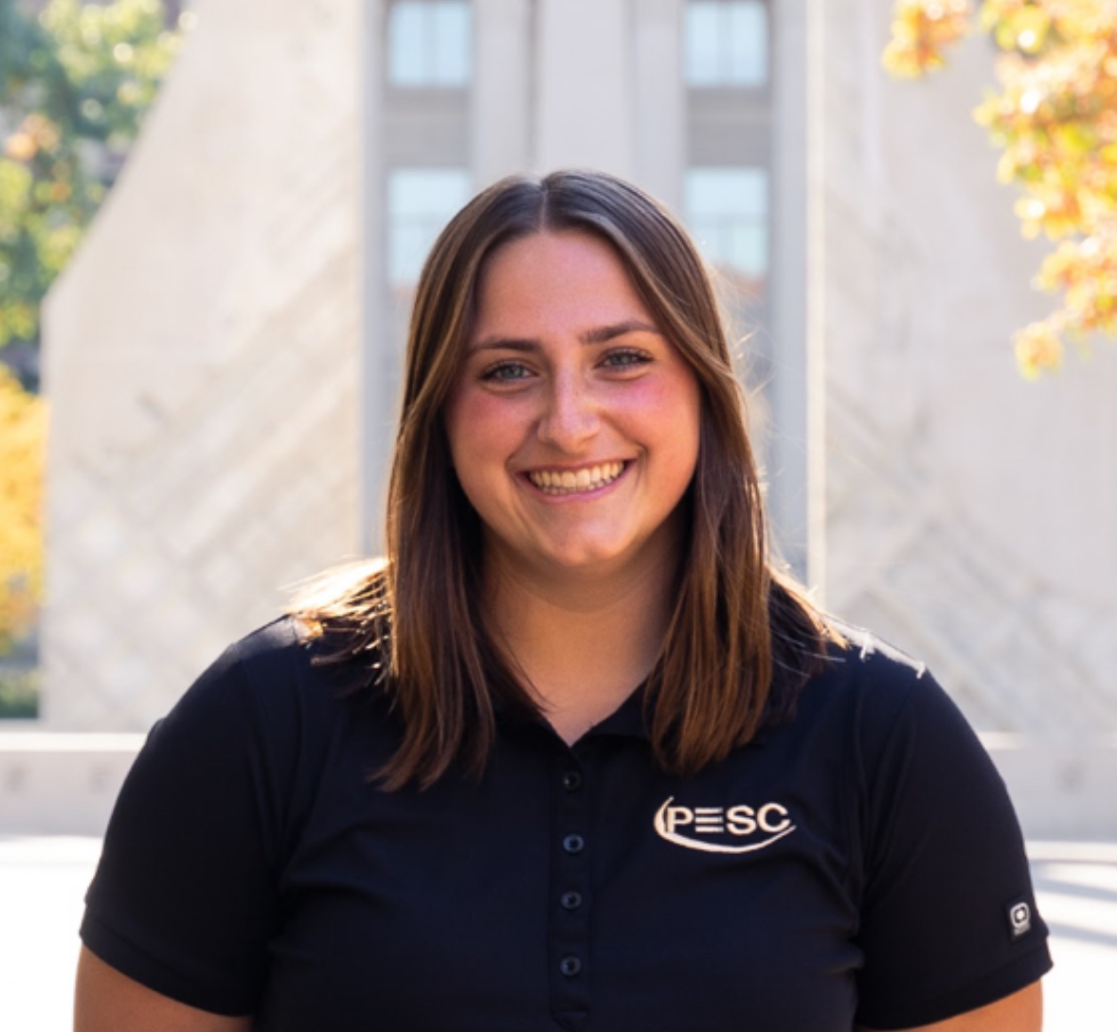
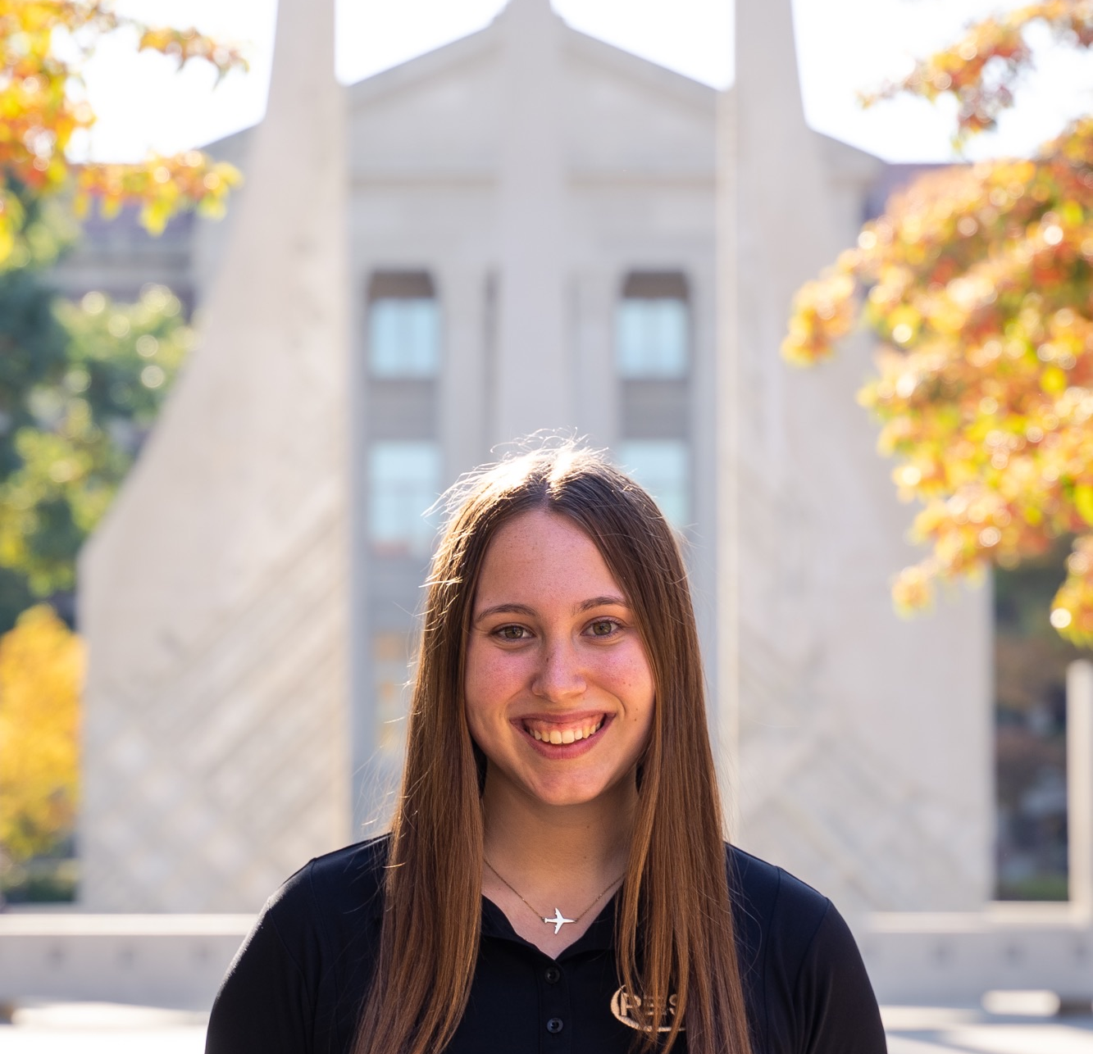
CARES Student Staff
Victoria
Karishma
Maddie
Kathleen
Zach
Sydney
Devon

Slide 9
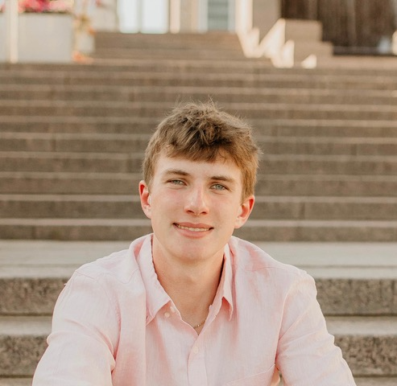
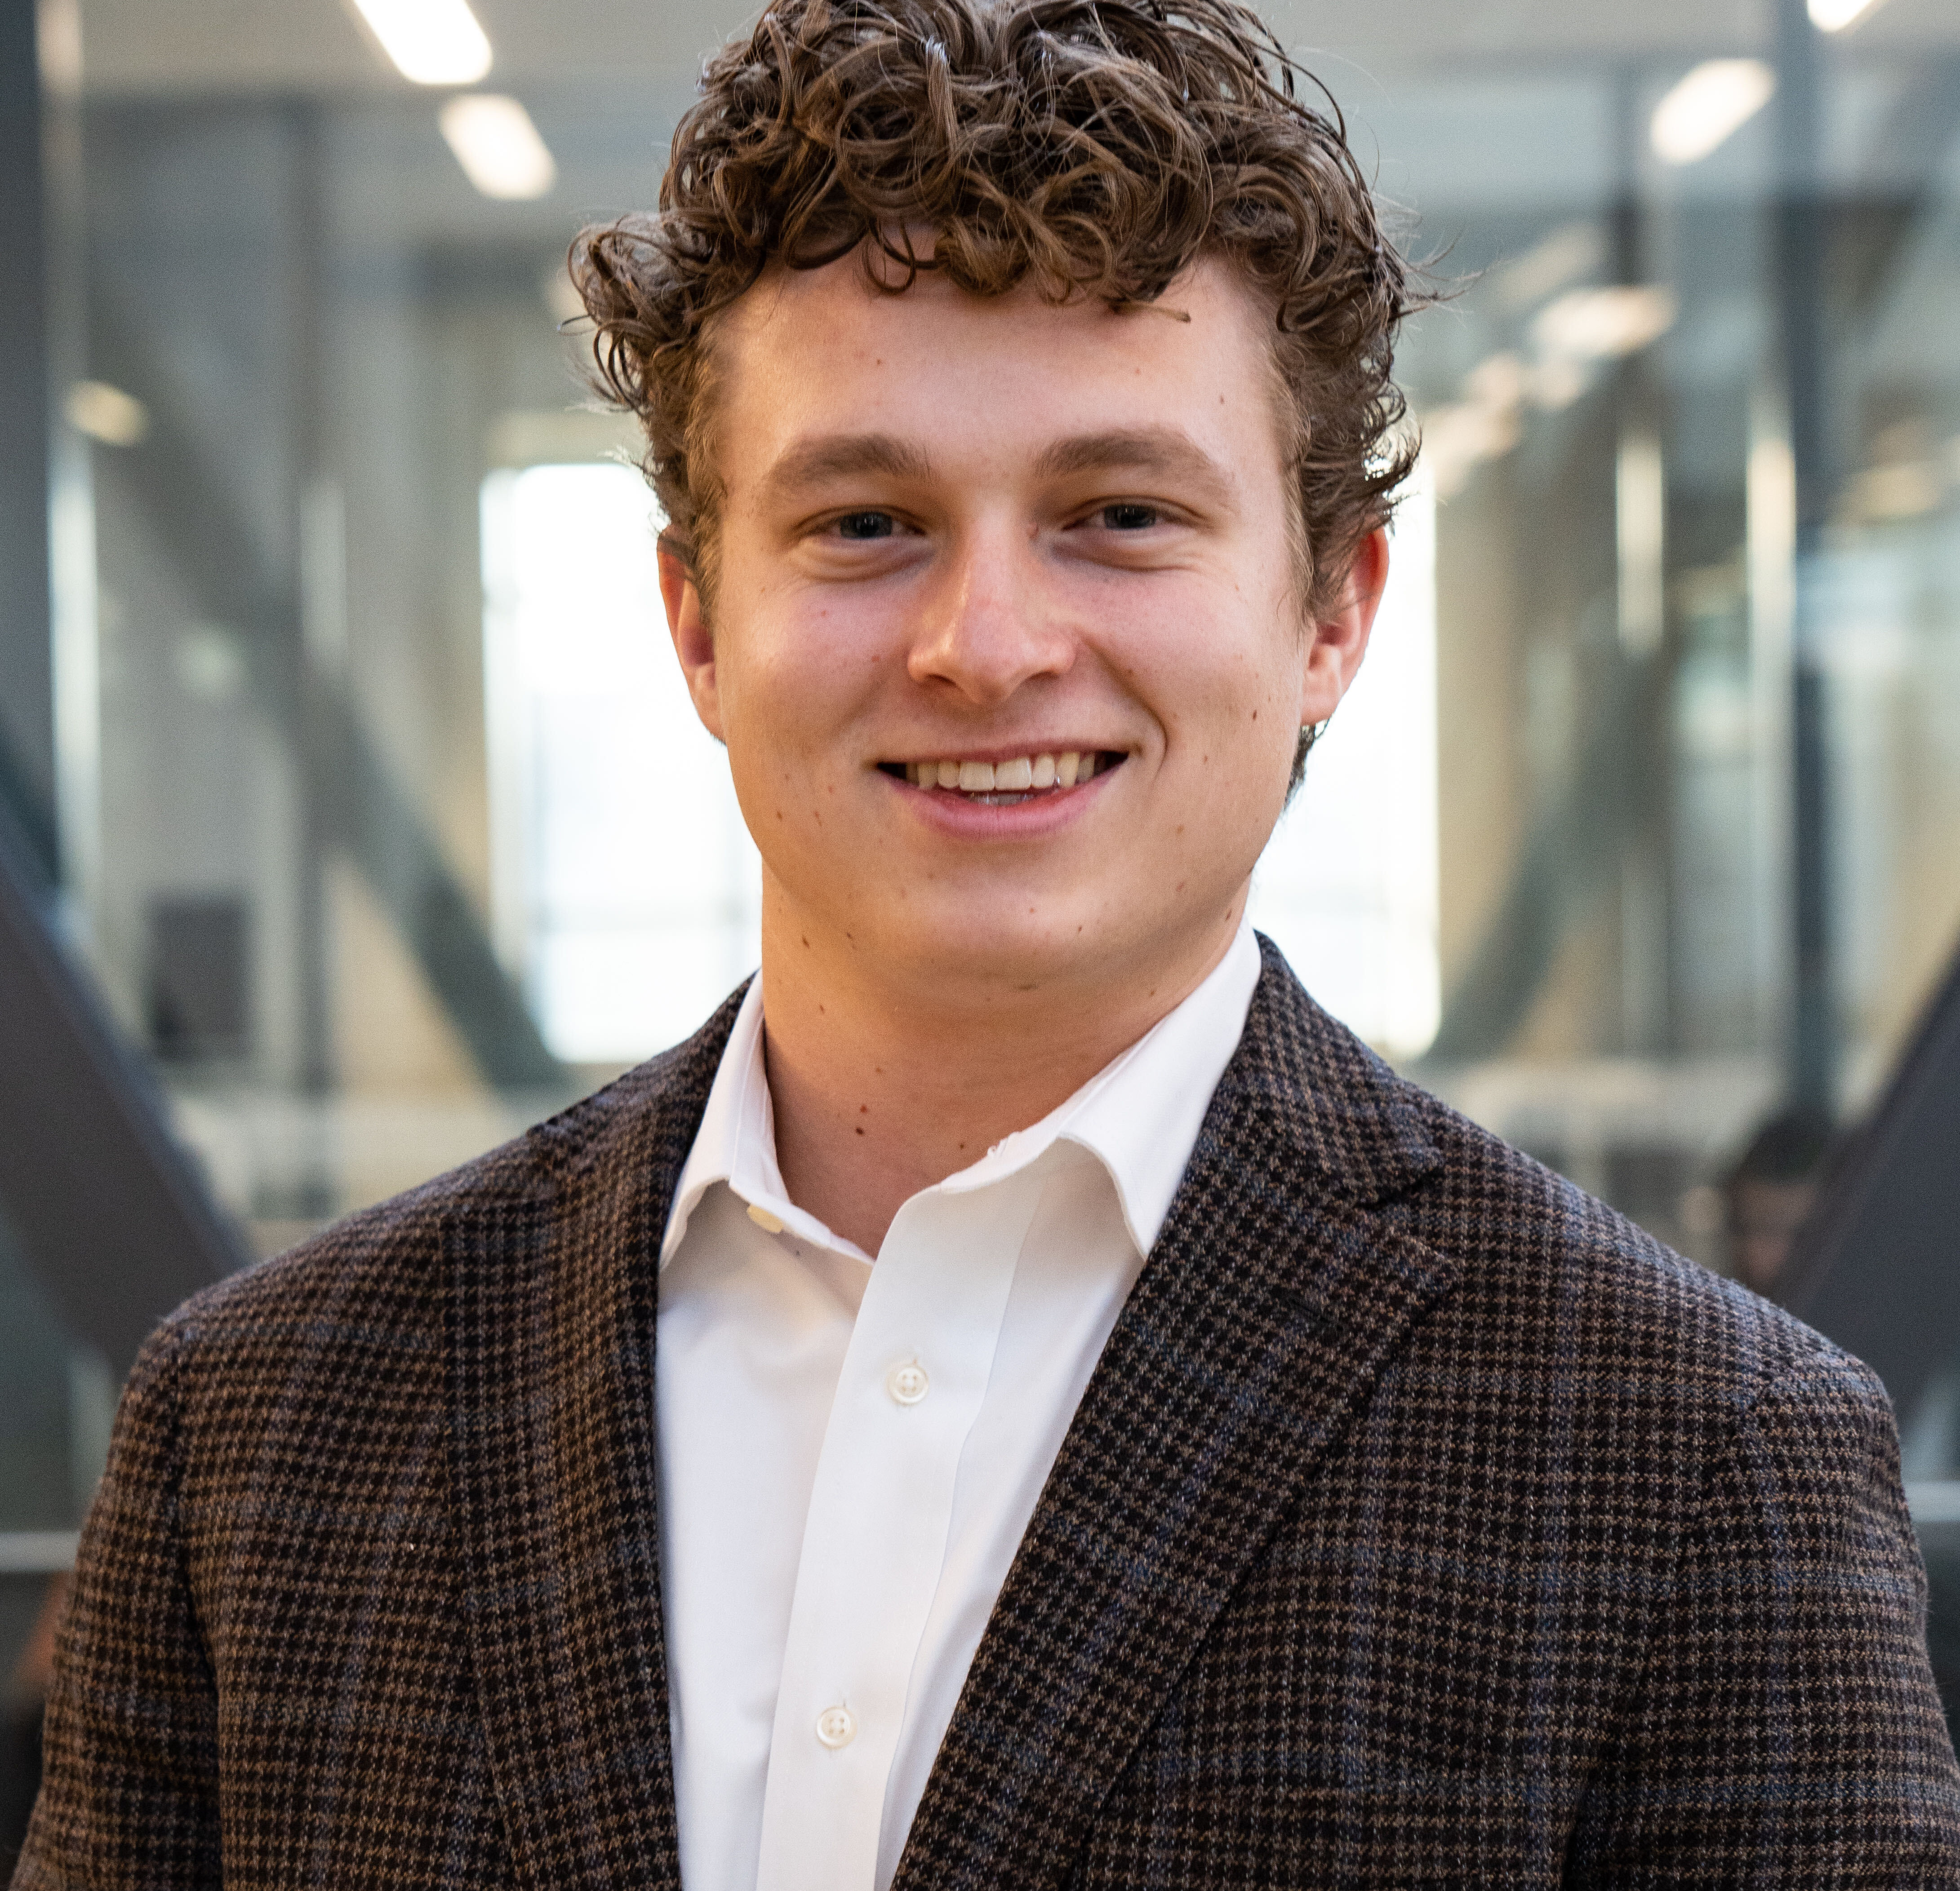
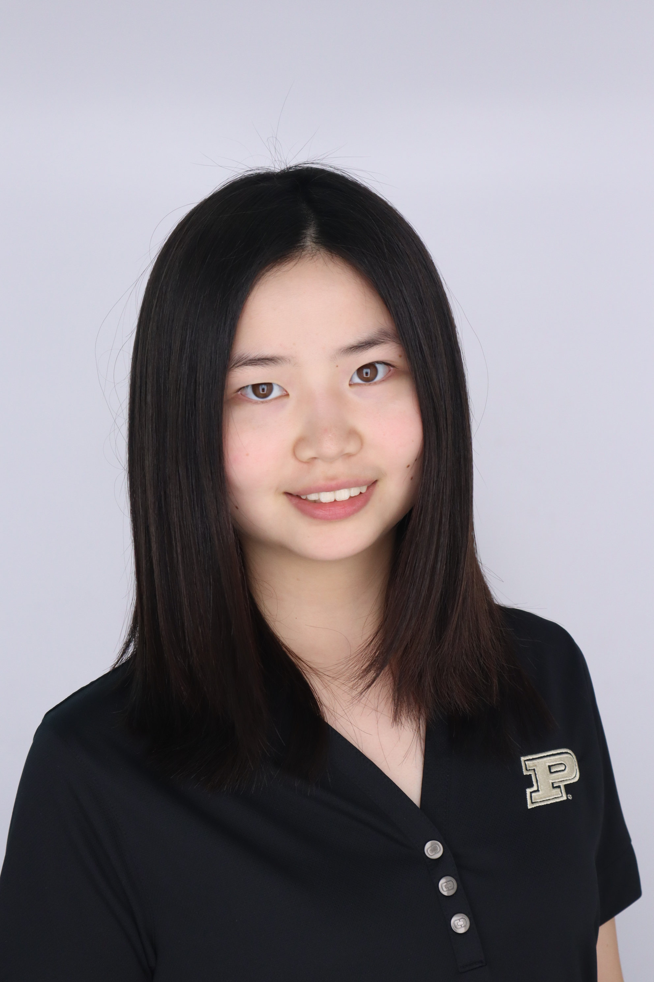
CARES Certified Peer Educators/Mentors
11 more in training!
Victoria
Luke
Parker
Karishma
Kathleen
Zach
Sydney
Devon
Haseung

Slide 10
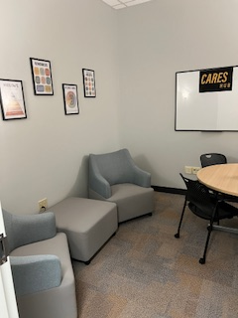
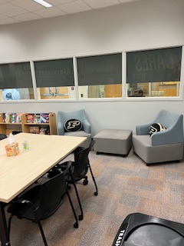
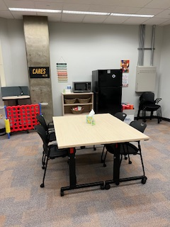
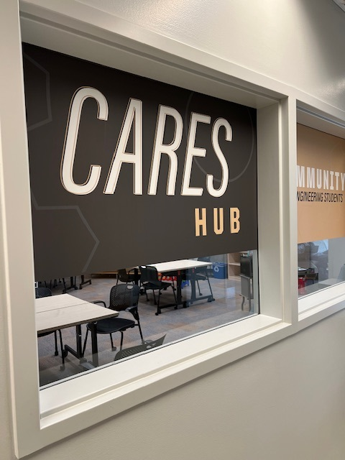
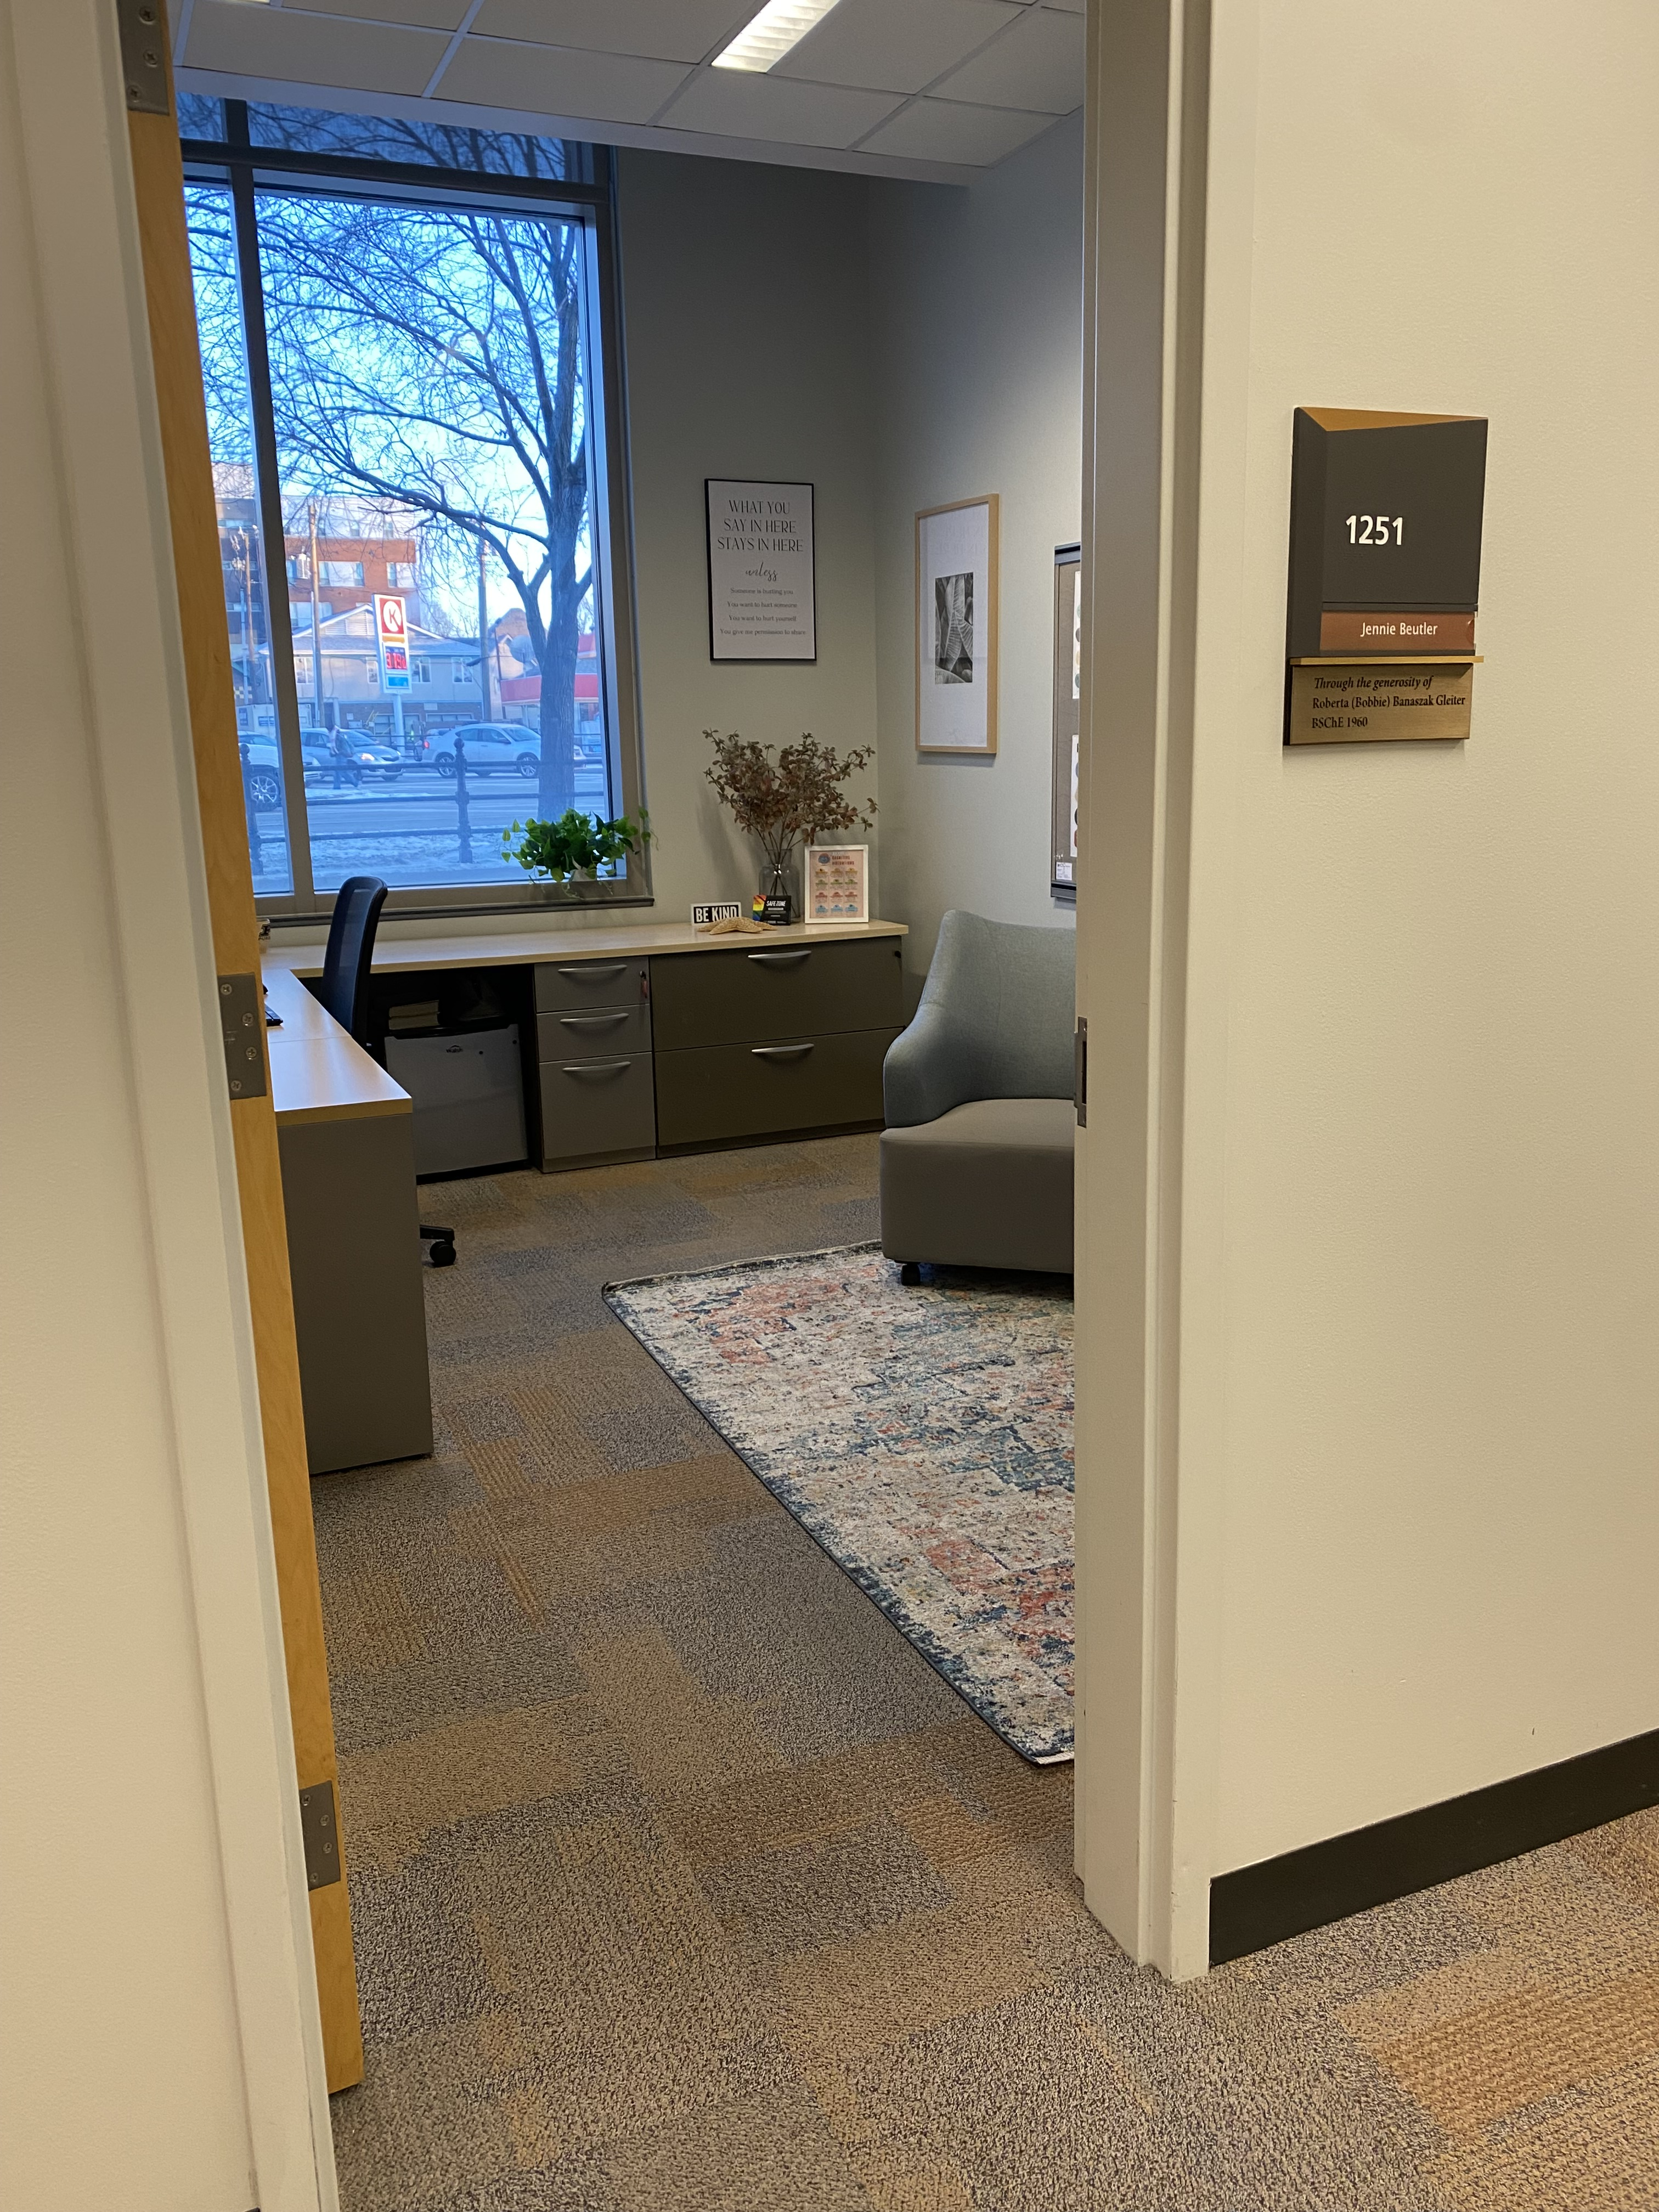
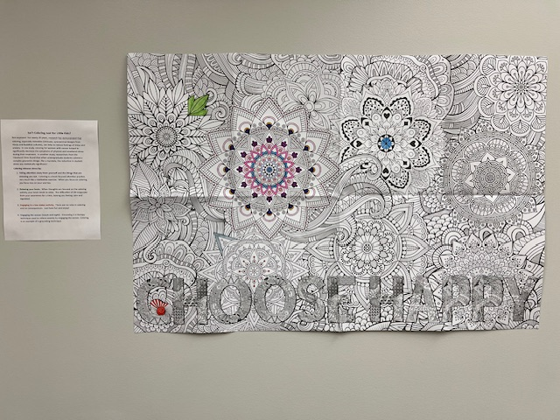
Our Space in Armstrong (1261 & 1264)
Find us on the 1st floor of ARMS! Small group meeting space
Come to study, relax, connect
Decompress at our coloring wall Therapist’s Office ARMS 1251
Printer, fridge, microwave & snacks

Slide 11

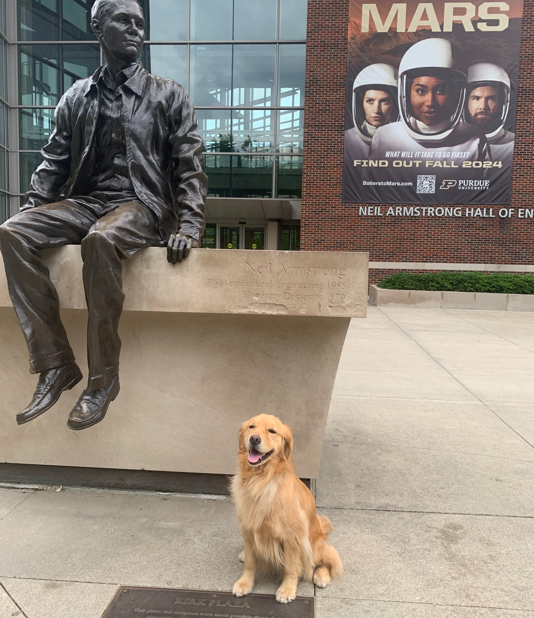
Coming Soon…
Notes:
Marketing – robust webpage, Instagram, CARES registered on Google Maps, tag lines, signature event. Sharing our work with publications and conference presentations.
Student led – CARES Hub Advisory Council, Purdue THINK, PESC Survey

Slide 12
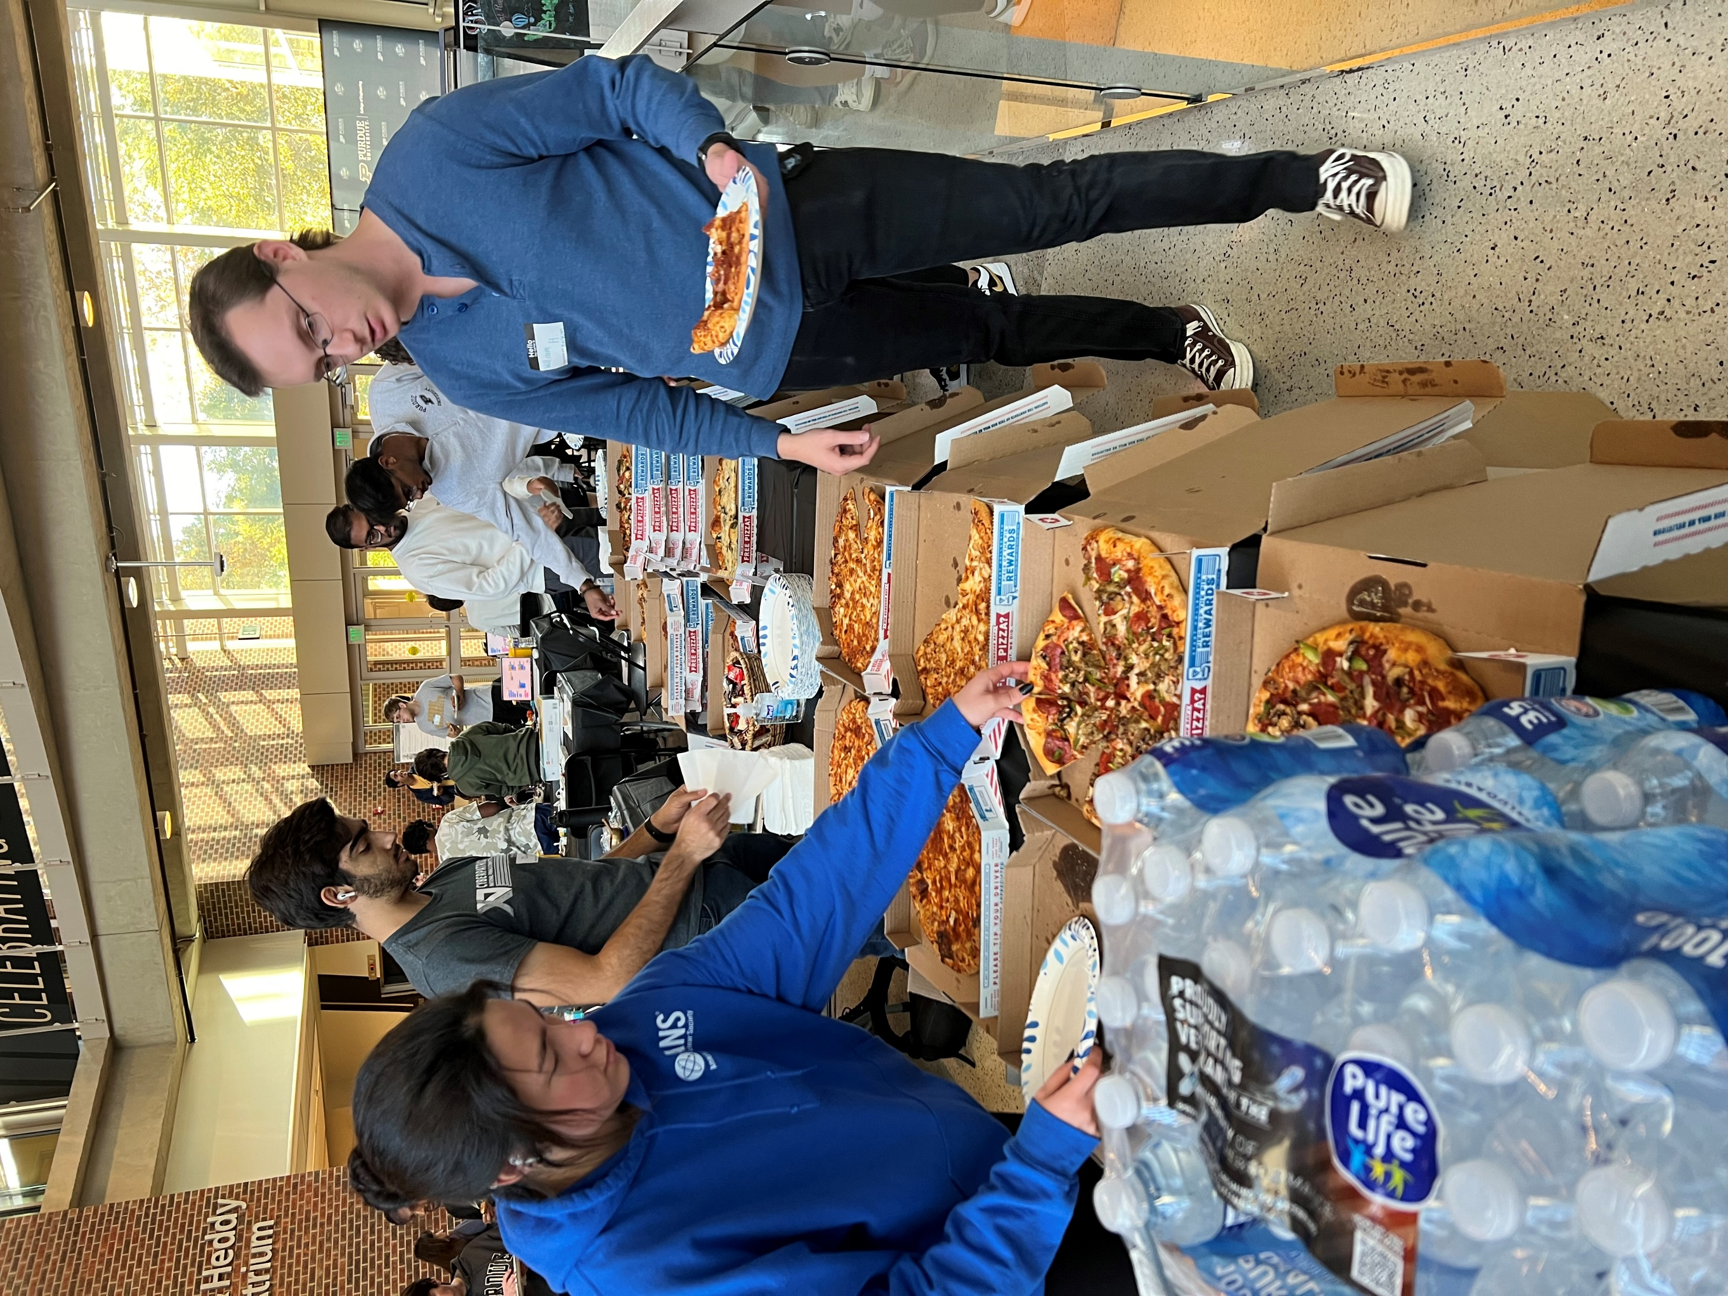
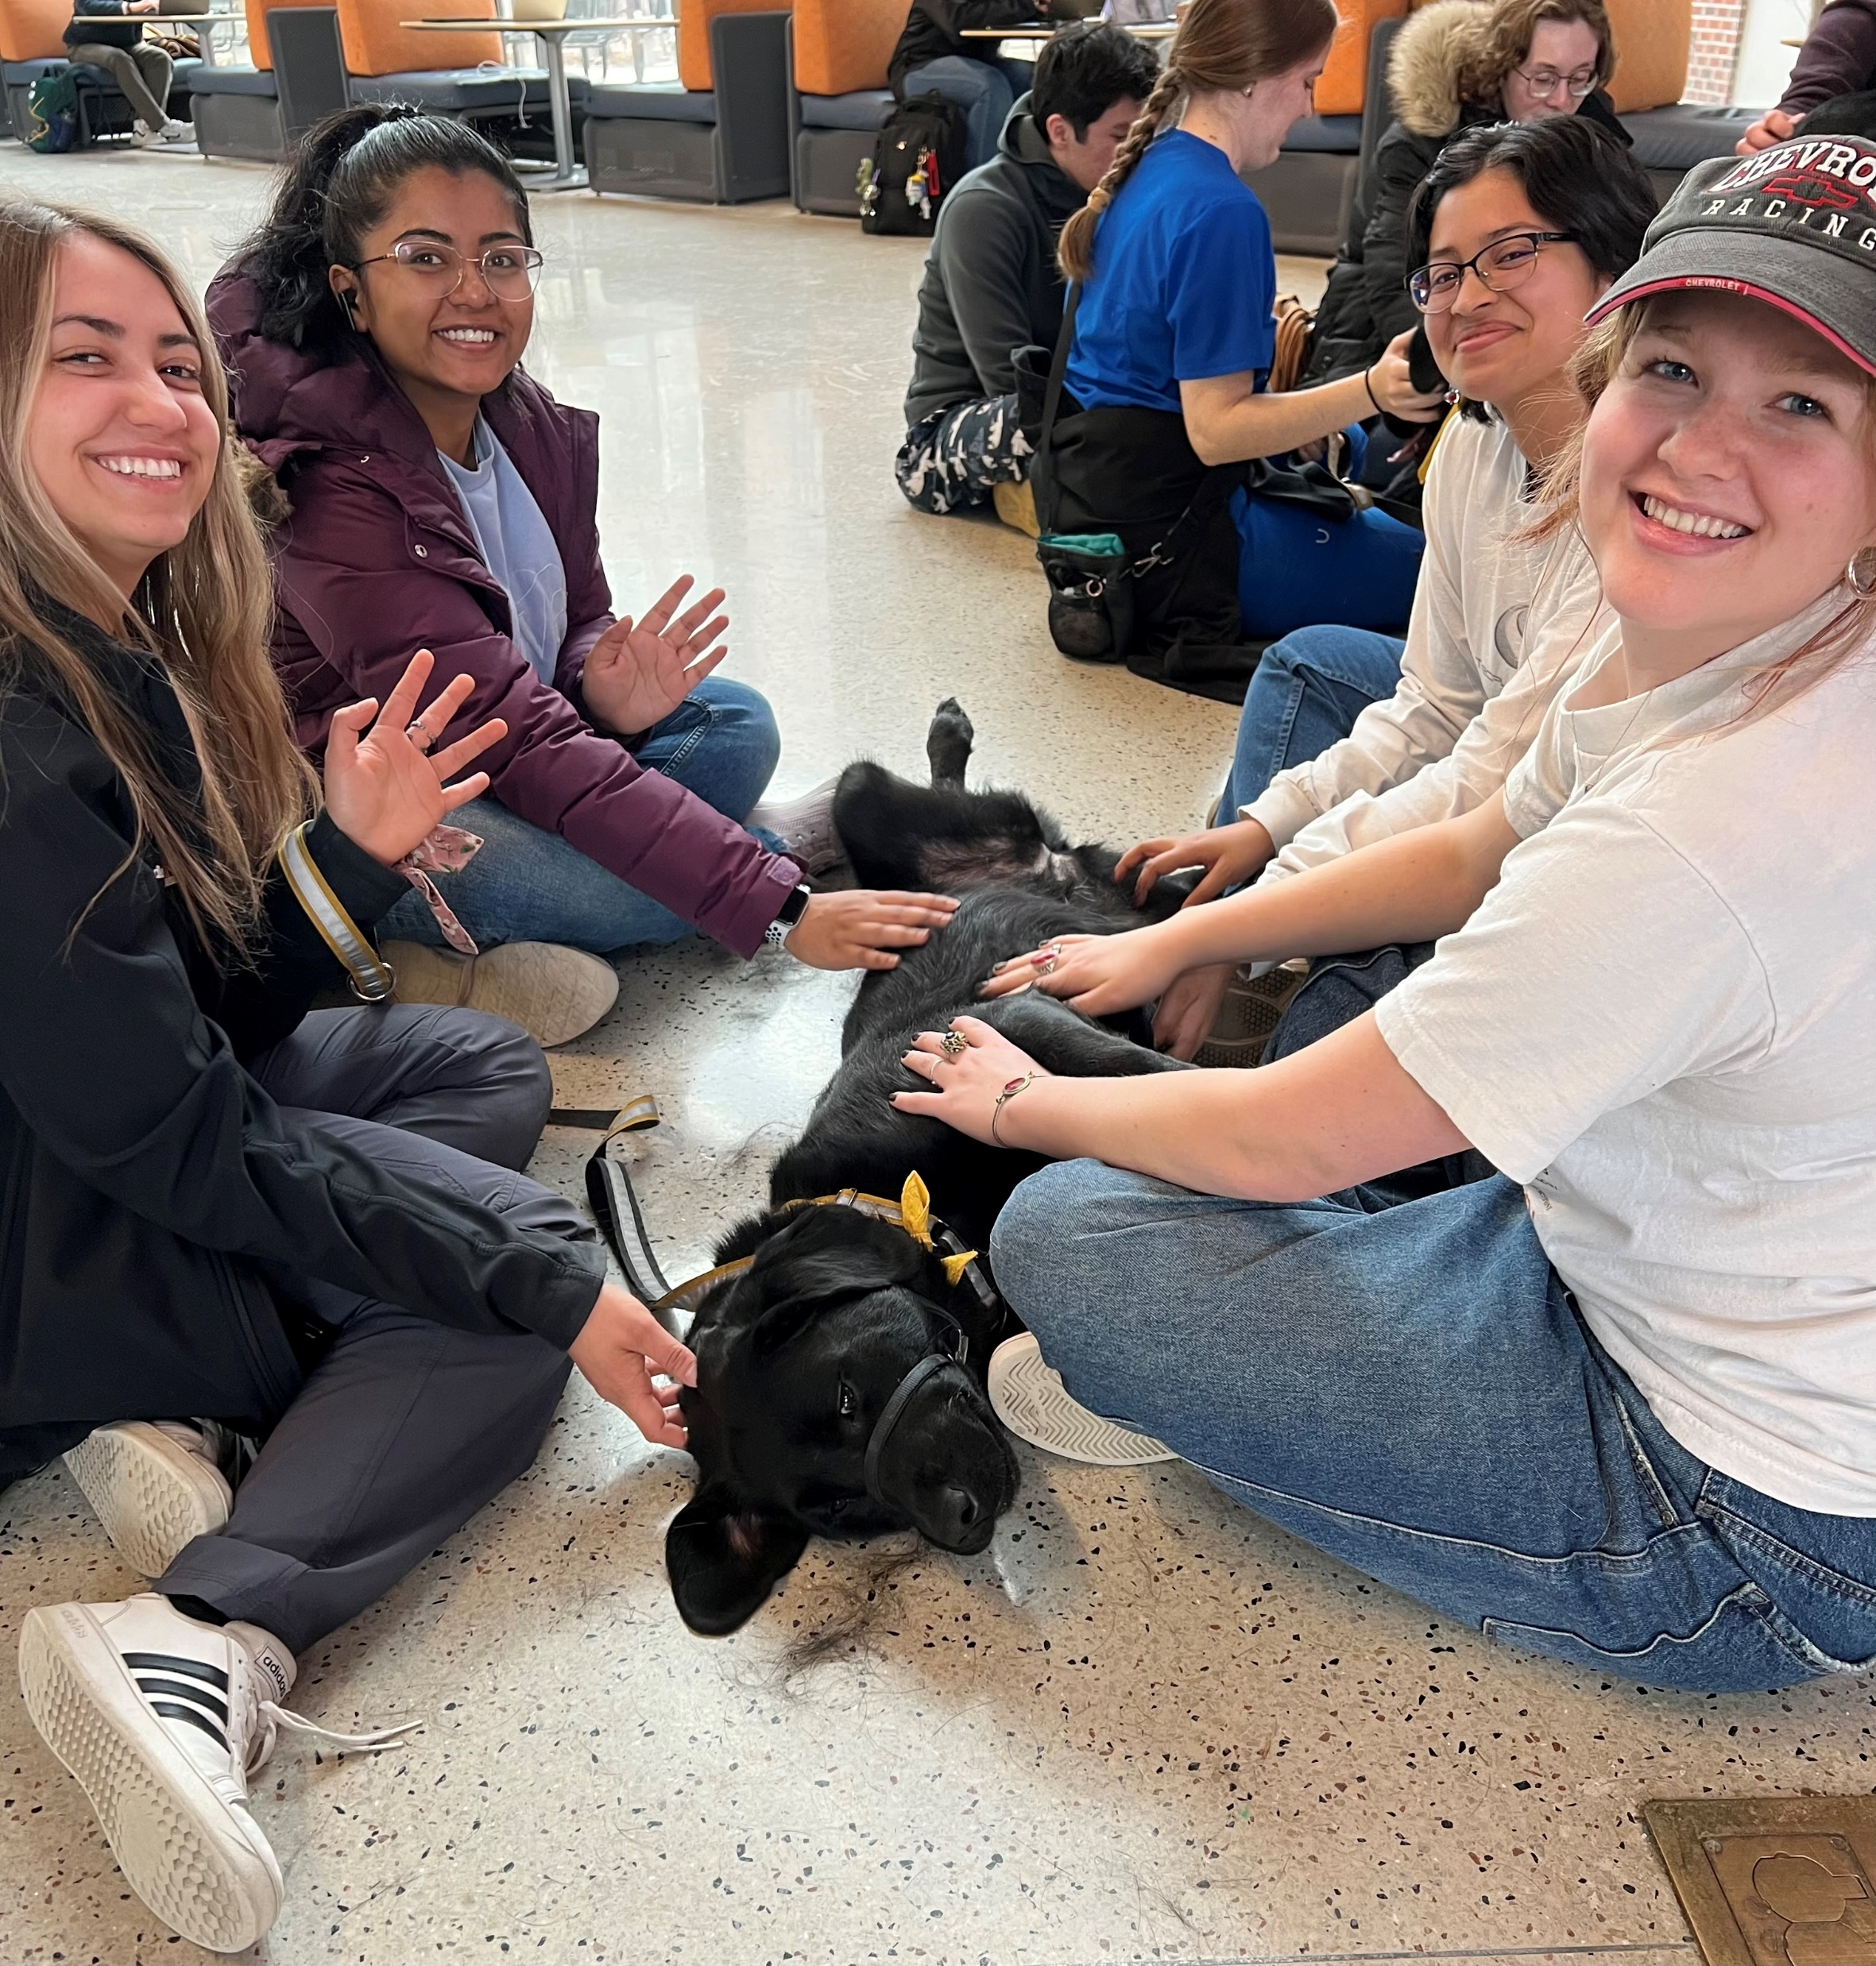
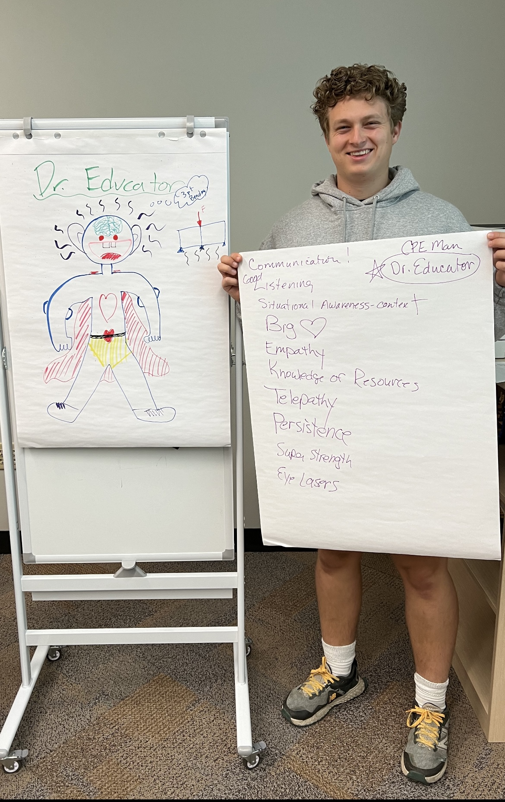
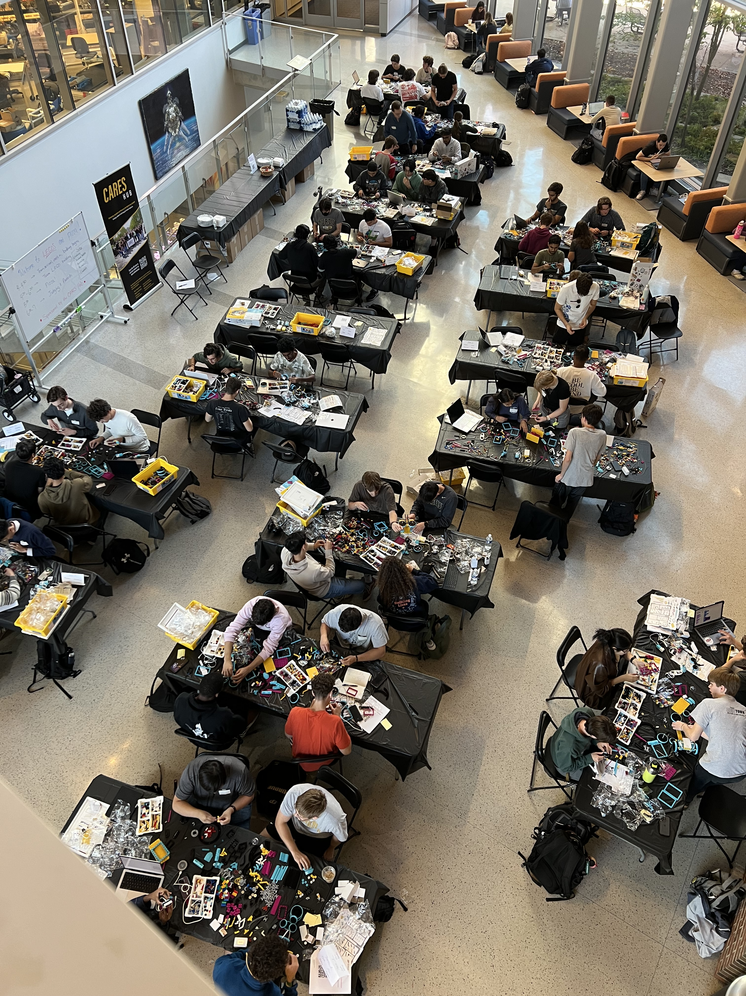
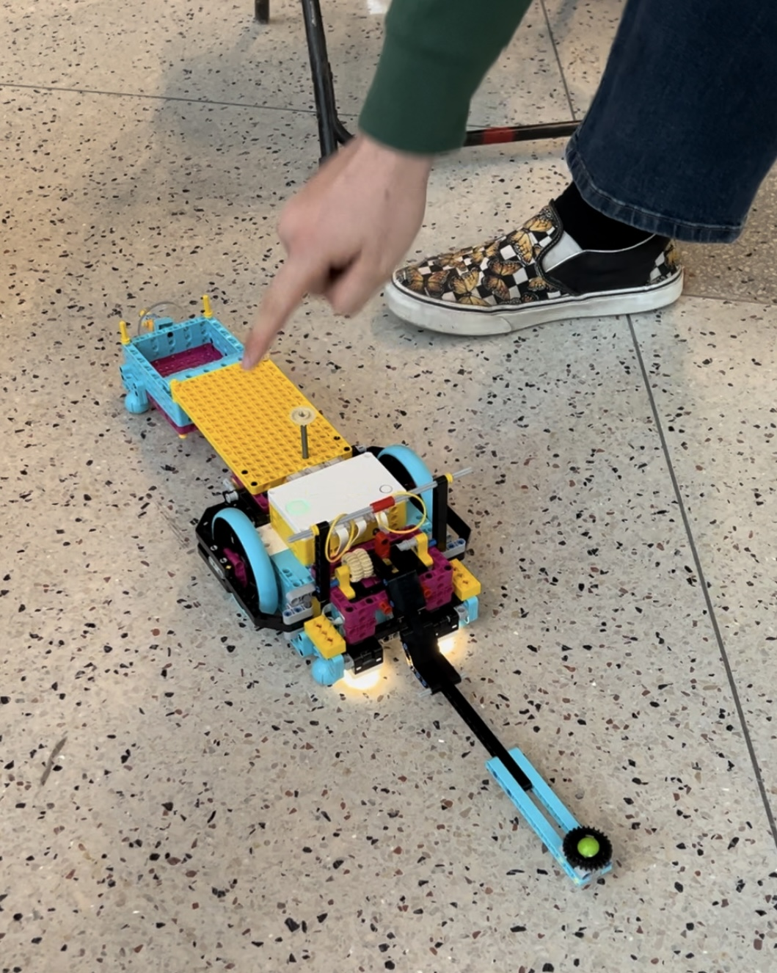
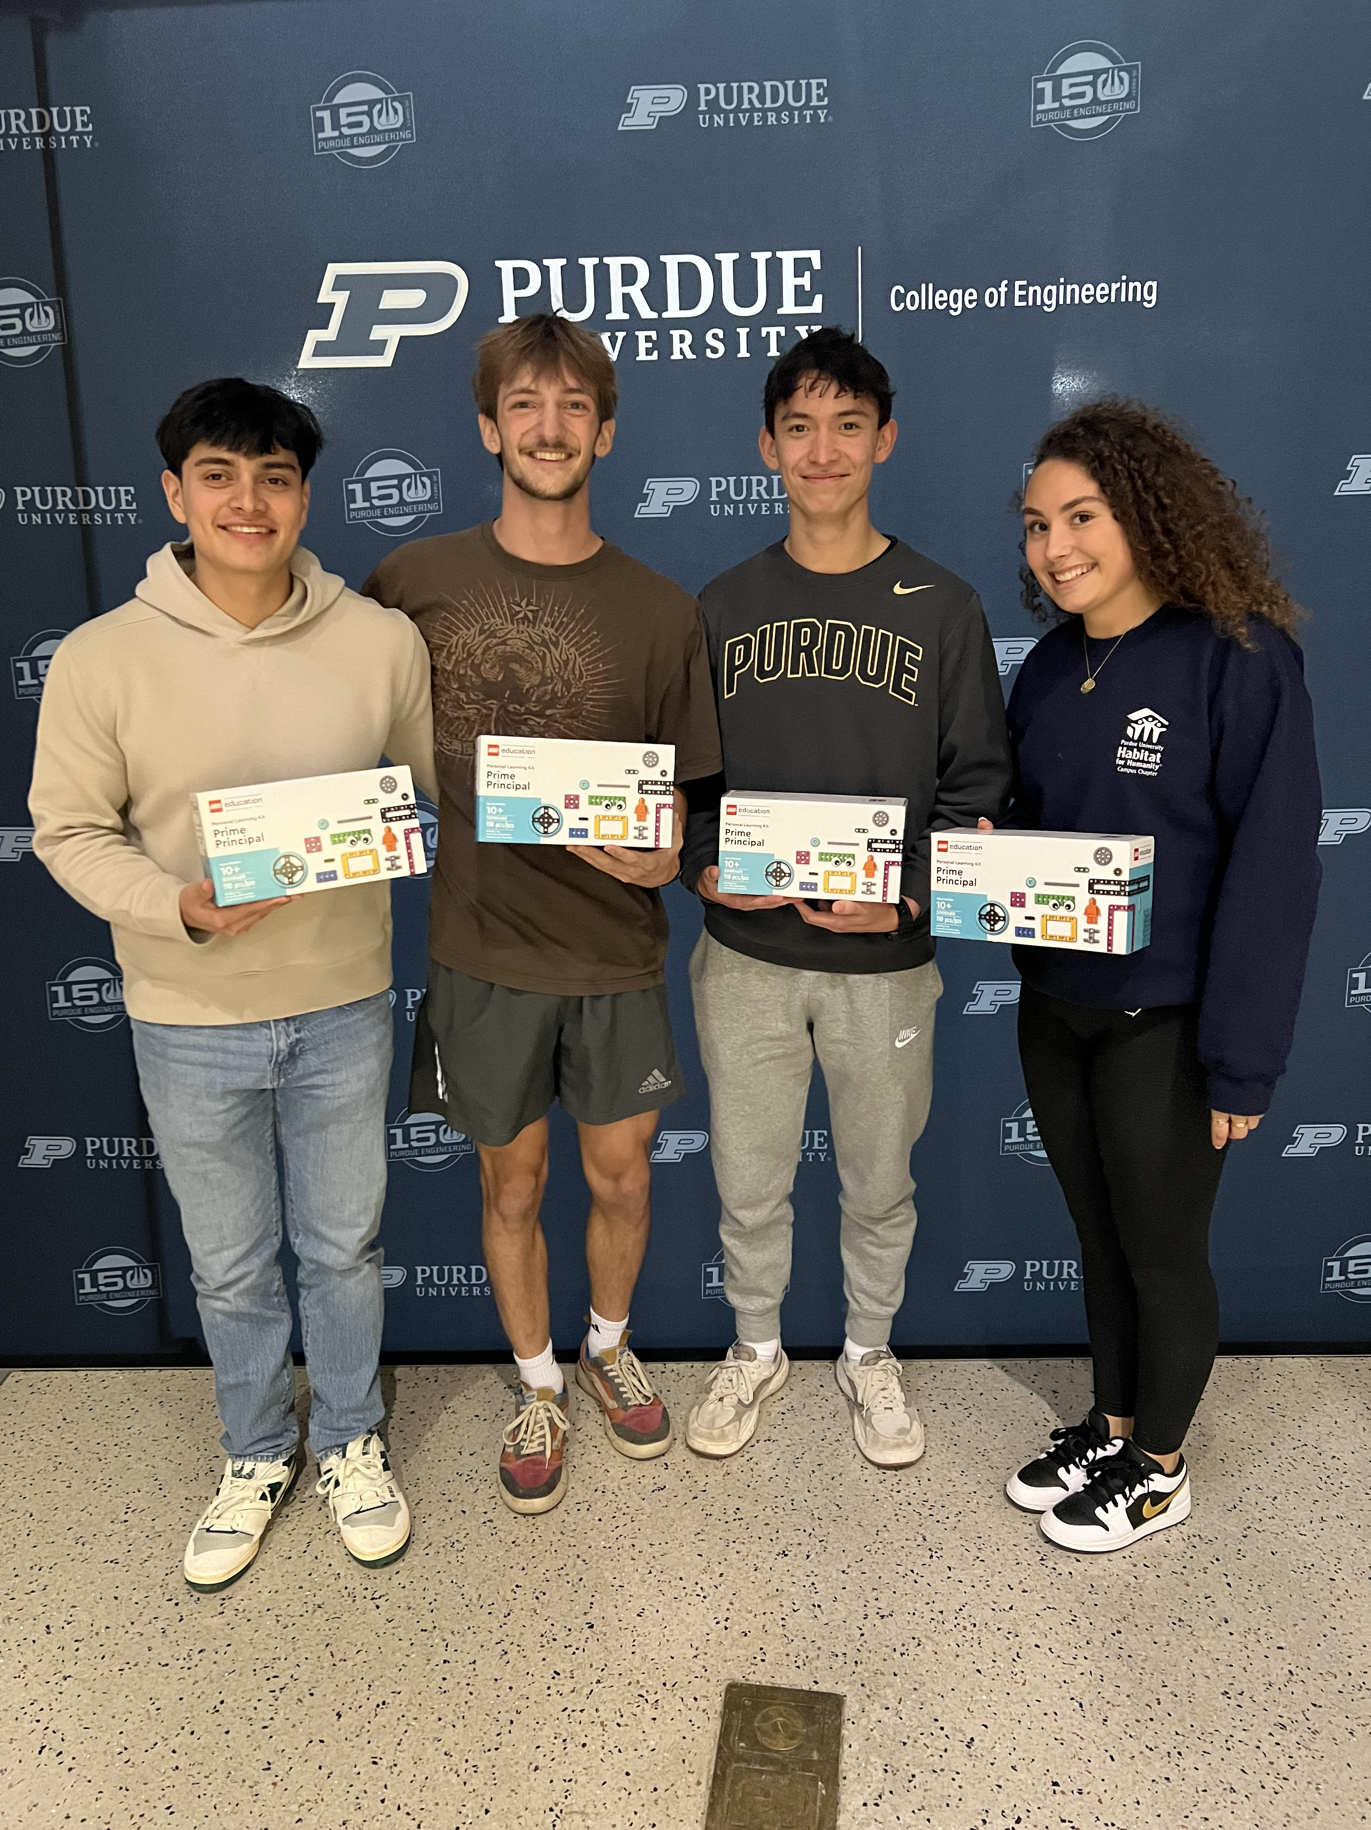
Initial Data
Students seen for counseling: 792
After 2-5 sessions students report:
an 82% reduction in stress
a 64% reduction in depressive symptoms
CARES Hub Study Lounge: 5,236 students
98% Feel relaxed
94% Feel welcome
99% Plan to return
78 workshops presented: 4,216 students
94% learned at least one new strategy to use
86% want to learn more about well-being
Formal Social Connection Activities
100% had fun
76% talked to a least one new person
Notes:
Data from 8/19 – 10/31/24 – 11 weeks.
Jennie 36 per week. CAPS therapists see 26 students per week. Daily walk-ins from 12:30 – 1:30 with Jennie. 80% decrease in stress. 62% decrease in depressive symptoms.
LEGO Event – 19 teams, completely full event. Individual registrations and team table visits. Fun, thank yous, requests for a repeat event. One Indy engineering student joined us too!

Slide 13
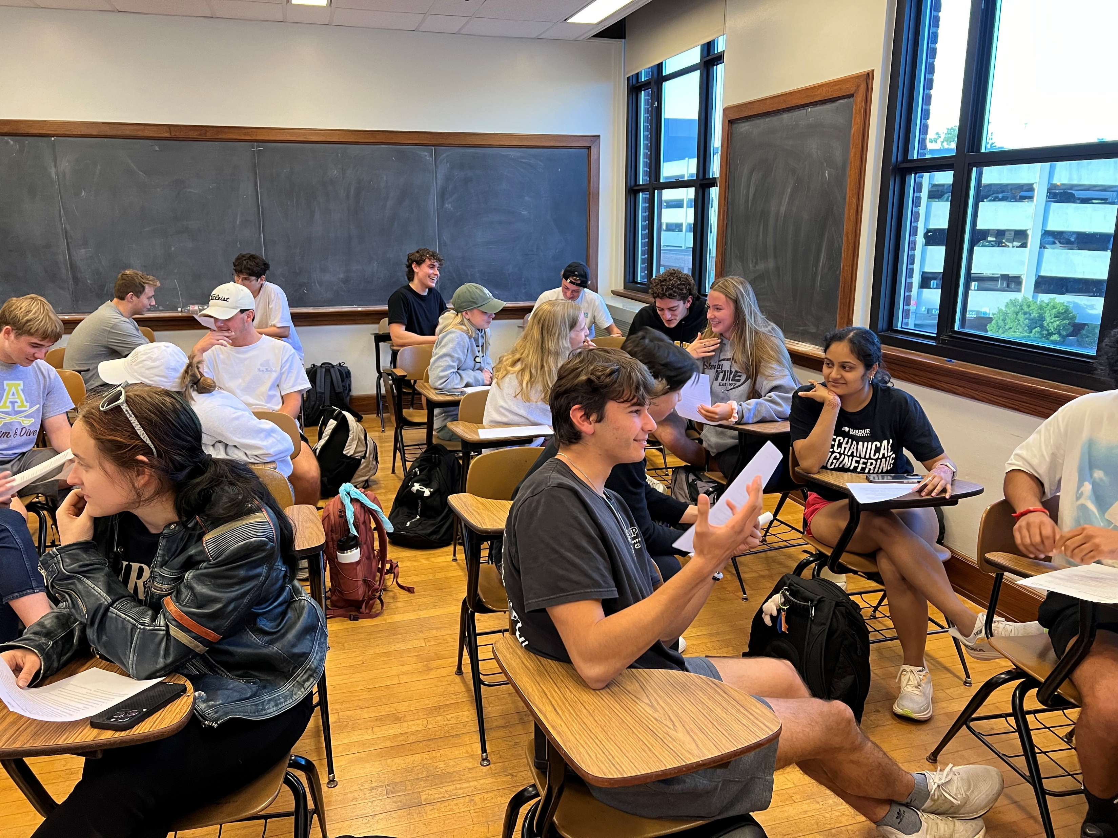
How Can We Help You?
Drop-in, call, or schedule some time to chat with me
* ARMS 1259
* Office (765)494-3716
* Mobile (317)509-5590
Schedule QPR (suicide prevention training) with your class, group, team, org
Copy and paste our info into your syllabi
Invite us to teach your class! We can talk about anything related to well-being. Popular topics are tools for managing stress, creating school-life balance, healthy boundaries, healthy relationships, and much more!
5. Tell your students about Jennie’s walk-in hours, Monday through Friday from 1 – 2 p.m. in ARMS 1251

Slide 14
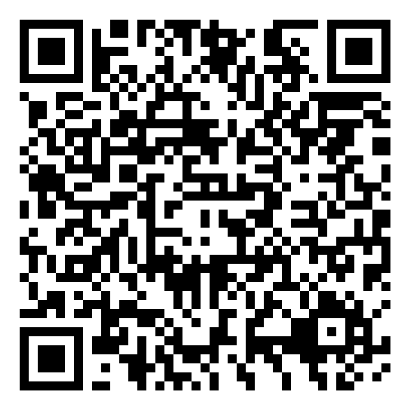

Come see us! ARMS 1261 & 1264
Use the QR Code to visit our webpage!
Follow us on @purduecares
For more info contact Dr. Kristy Eaton kmeaton@purdue.edu

Slide 15

An Optimistic Closure: Gratitude and the Science of Happiness
Two psychologists, Dr. Robert A. Emmons of the University of California, and Dr. Michael E. McCullough of the University of Miami
In one study, they asked participants to write a few sentences each week for 10 weeks, divided into 3 groups.
Group 1: gratitudes – 3
Group 2: aggravations – 3
Group 3: events of impact – 3
After 10 weeks, those who wrote about gratitude were more optimistic and felt better about their lives. They also exercised more and had fewer visits to physicians than those who focused on sources of aggravation or events of impact.

