Slide 1
COE Faculty Mentoring Survey
March 2019
Faculty Affairs Committee

Slide 2
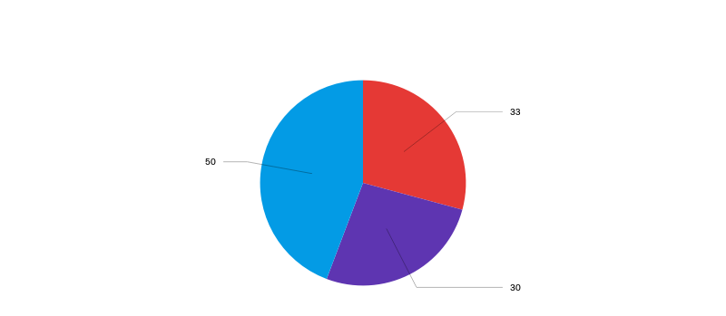
Distributed the survey in December 2018, and kept it open for 6 weeks. We got 113 responses:
33 Assistant Professors
50 Full Professors
30 Associate Professors

Slide 3
How many of us are mentoring?
39% of assistant professors,
58% of associate professors, and
87% of full professors have mentored colleagues
How many of us have been mentored?
88% of assistant professors,
90% of associate professors,
And only 76% of full professors, have been mentored by a Purdue colleague

Slide 4
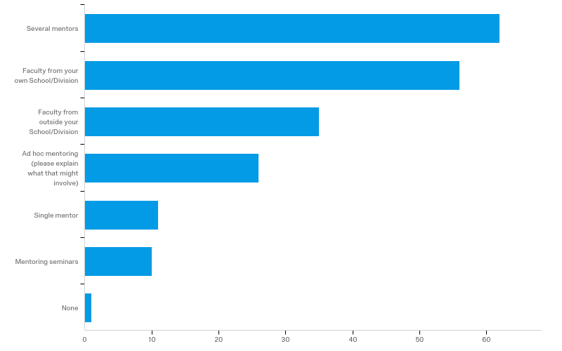
Most faculty would prefer to be mentored by several mentors, from their own department.

Slide 5
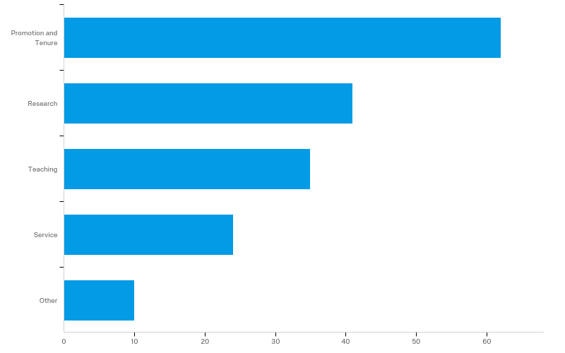
Not surprisingly, respondents most wanted help with promotion and tenure.

Slide 6
We’re not comfortable requesting needed support from our mentors:
  Only 54% of assistant professors,
  74% of associate professors, and
  53% of full professors felt comfortable requesting needed support
Overall, 79% of respondents think a formal mentoring system is necessary.
  80% of assistant professors,
  92% of associate professors,
  But only 74% of full professors!

Slide 7
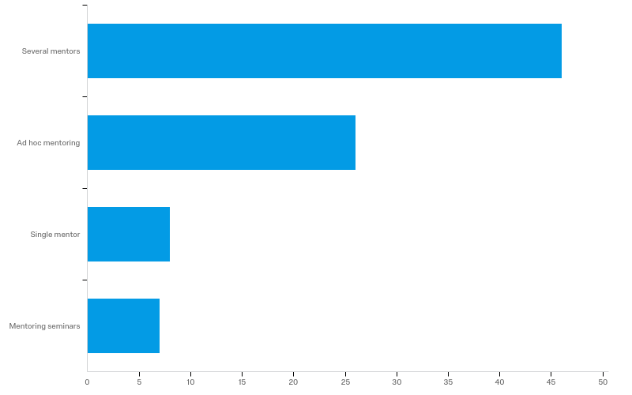
Most faculty thought that their departments should provide several mentors, supplemented with ad hoc mentoring. They were about evenly split as to whether there should be separate mentors for teaching and research.
How does that compare to departments’ formal mentoring plans?

Slide 8
Only ~66% of respondents found mentoring helpful or very helpful, with remarkable consistency between ranks:
  62% of assistant professors
  68% of associate professors
  65% of full professors
Only 43% of respondents think their school’s mentoring system is effective or very effective.
  Only 29% of assistant professors,
  60% of associate professors,
  And 44% of full professors

Slide 9
70% of respondents found mentoring satisfying or very satisfying.
  57% of assistant professors
  87% of associate professors
  70% of full professors
But only 15% of respondents felt sure that they get credit and recognition for mentoring.
  0% of assistant professors
  23% of associate professors
  16% of full professors

Slide 10
Respondents found mentoring on P&T, teaching, research, and just general support and encouragement valuable.
Some respondents highlighted negative experiences even when asked about what they found valuable.
Respondents wished mentors had shared advice on time management, how funding works, P&T logistics, department politics, and general support.

Slide 11
Summary
Faculty at all levels want to be mentored.
  They seek multiple mentors and at different levels (e.g., senior and peer mentors).
  Full professors also need mentoring, but can be hard to find mentors.
Junior mentees seek advice on P&T most, but also seek guidance on issues ranging from highly specific (e.g., which journal to submit to) to more general support and encouragement.
Mentors enjoy mentoring, but feel that there is little recognition at department or higher level.
Most agree on the need for a formal mentoring system, but it’s also clear that such systems do not guarantee that mentoring will occur.
ACTION: How well does each school’s mentoring plan match what faculty actually want/need?

