Slide 1
Engineering/Polytech Finance Presentation
Purchasing Operations Center
11/06/2024

Slide 2
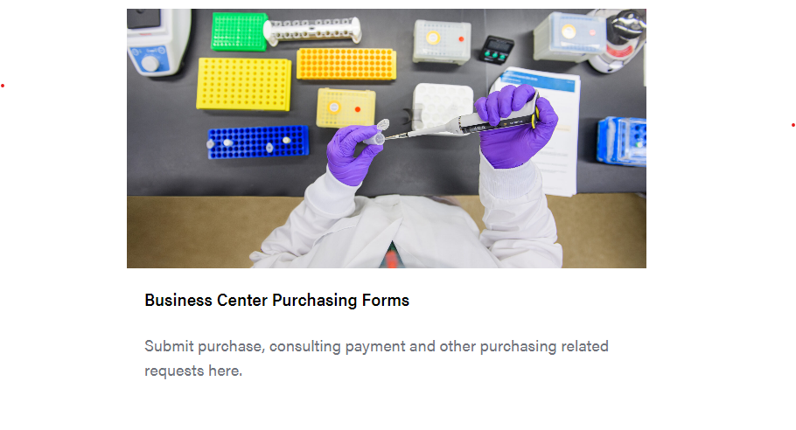
College of Engineering and Polytechnic Purchasing Operations Center
Our Webpage
Actions
Location
Contact Us
https://engineering.purdue.edu/Engr/AboutUs/Administration/BusinessOffice/procurement
Place Order
Invoice Payment
Reimbursement/Personal Payment
Packing Slips-Receipt of Goods
General Purchasing Inquiry
Reconcilers of Purchasing Cards (Pcards)
A.A. Potter Engineering Center (POTR)
500 Central Drive - Room 127
West Lafayette, Indiana 47907
Hours
8:30am to 12:00pm
1:00pm to 4:30pm
Monday - Friday
Closed weekends and University Holidays

Slide 3
Procurement vs. Purchasing
Central Procurement reviews and approves vendor contracts, agreements, and special purchases $10k & over.
Purdue has a list of preferred vendors; it is best practice to check our vendors first to see if they have something to fit your needs.
Purdue Procurement Webpage
https://www.purdue.edu/procurement/purchasing/catalog-orders/index.php
This webpage does break down a list of our main vendors/categories
We can use vendors outside this list, but our vendors should be reviewed first
Pricing found online may not reflect Purdue pricing.
If there is a discount on the items, the center will be able to obtain this when ordering thru ARIBA
Technology/IT Equipment Purchases
All computer, electronic devices such as iPads, and IT peripheral devices should start with a request to IT to place your order.
Please do not include the purchasing center when sending your request to IT.
Software purchases must be reviewed by IT as Purdue may have discounts or software available for use.
You may reach IT by using the service portal or the ECN Trouble Report
https://service.purdue.edu/TDClient/32/Purdue/Home/
Quotes for Large Purchases
Quotes are recommended for purchases over $1,500. Contact the vendor directly to request a quote for a high-value purchase.
International Vendors
These orders can take significant time to place, there will likely be a delay.
If possible, please try to use a domestic vendor.
Some sponsored funds do not allow international vendors to be used
There are restrictions on ordering from certain countries
Orders over $10k
There is a set of special requirements before order is sent to the purchasing center.
https://www.purdue.edu/procurement/purchasing/special-purchases/index.php

Slide 4
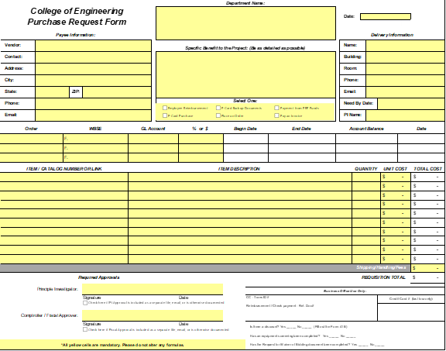
Engineering Purchasing Center Email
engrprocure@purdue.edu
Sending Orders to the Purchasing Center – One per Vendor/One per Submission
Once the end user has the pricing, benefit to project, and needed approvals, they may submit to our office using one of the below methods.
Email Submissions
Complete a purchase request form and submit to engrprocure@purdue.edu or knoy-purchasing@purdue.edu
Purchase Request Form
General Notes
Only one vendor order per submission
Please do not send multiple orders or list multiple vendors on a purchase request.
Please do not use multiple tabs within the same excel document.
engrprocure@purdue.edu and KNOY-Purchasing@purdue.edu are internal email addresses.
Please do not share with anyone outside of Purdue (including vendors).
Please do not ‘CC’ engrprocure@purdue.edu or KNOY-Purchasing@purdue.edu in your emails.
The email will be sent to an unassigned folder and may not be received.

Slide 5
Purdue Center Service Portal
TeamDynamix
Sending Orders to the Purchasing Center – One per Vendor/One per Submission
Once the end user has the pricing, benefit to project, and needed approvals, they may submit to our office using one of the below methods.
Service Portal
Go to Purdue One Campus - https://one.purdue.edu/
Click Business Center Purchasing Forms
Once in Portal – Click “Place order”
Fill out purchase request form and submit
Purdue Service Portal
Purchasing and Employment Center customers can submit service requests using online forms. The forms are designed to capture all information needed to start work but center staff will follow up with customers if additional information is needed. Current live forms can be accessed through the appropriate Purchasing or Employment Services link below.
https://www.purdue.edu/treasurer/finance/operations/business-operations-and-centers/tdx-resources/

Slide 6
Thank You
College of Engineering and Polytechnic Purchasing Center

