Slide 1
College of Engineering
Developing a Thriving Community through Celebrating Creative Talents
Staff Input Survey Summary

Slide 2

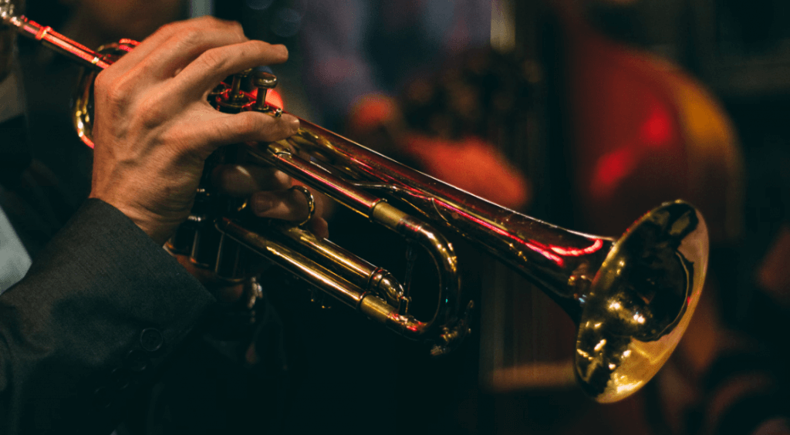
Creating a Positive Environment with Music & Art
Bell Works – formerly Bell Labs – “Music and art are not just decorative elements in an organization; they serve as the foundation of positive workplace culture.”
Benefits of music & art in the workplace:
  Connects with employees on a personal & emotional level
  Increases productivity
  Improves engagement
  Promotes collaboration
  Boosts morale
  Build mutual respect & trust
  Boosts appreciation for various cultures, traditions, and values
  Builds inclusivity

Slide 3

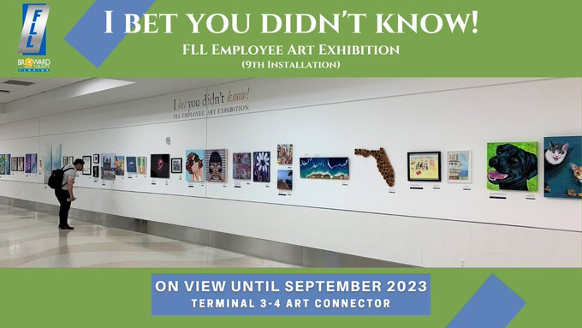
Survey Summary
Survey was sent to all CoE faculty & staff – June 2024
Received responses from 39 participants
Examples shared in survey:
  Ten Minutes of Talent – ME
  Ft. Lauderdale Airport- I bet you didn’t know…

Slide 4
1 - If your CoE colleagues performed or showcased their talents, what types of creative-focused events would you be interested in attending? (Select all that apply)
Answer | % | Count
Art exhibitions | 80% | 31
Talent Showcases | 56% | 22
Music performances | 64% | 25
Poetry readings | 26% | 10

Slide 5
2 - How likely are you to perform in or attend an event similar to Ten Minutes of Talent where you can showcase your talents?
Answer | % | Count
Yes, I would like to either perform or attend as a viewer/supporter. | 73% | 29

Slide 6
3 - Would you be interested in contributing to or attending a faculty and staff art exhibition similar to I Bet You Didn’t Know! at Fort Lauderdale-Hollywood International Airport?
Answer | % | Count
Yes, I would like to either contribute or attend as a viewer/supporter. | 82% | 32

Slide 7
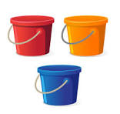
Categorizing Feedback
Music
  Short performances within the day
  Multiple locations – including Indy
  Determine frequency – monthly, weekly
Art
  Locations for art display
  Different mediums
  Occur over specified period of time

Slide 8
Next Steps…
Two Areas of Focus
1. Music & Performance
- Musical showcases in multiple schools
- Open to faculty, staff and student participants
- Occurs throughout the year
- First events planned by later this semester
- Assistance with getting started…
2. Art
-Requires more preparation
-Art displays in various locations throughout CoE buildings
-Group of faculty, staff to look at governance
-Partner with ADFP, AO, and others
-Indy included
-Engage students
-Organized group of faculty/staff this semester- planning for displays in spring semester

