Slide 1
Research Productivity
Key Areas of Focus
April 21, 2022

Slide 2
Research Enterprise Current Landscape
Significant Growth – Proposals, Awards & Expenditures
Increasing Complexity – Sponsor Mix, Purdue as project lead, new programs, new entities
Staffing -Turnover/Retention Efforts, Enhanced Skill Sets and the New Dynamics of Remote Work
Regulatory and Compliance Changes – Enhanced Focus on Reporting, Disclosure and Controls (Foreign Influence)
Audit and Risk Exposure - Financial, Reputational and Partnerships

Slide 3
Research Productivity Activities Completed (last 2 years)
Personnel & Organizational
Workload and Resource Monitoring (+2 FTE in each of Pre-Award, Post-Award, and Contracting)
Post Award Reorganization (Functional Areas)
PI Assignment (Same Pre-Award Specialist for 5 or More Proposal Submitters)
Business Processes
PARI Phase I
Travel/Procurement Improvements – travel card, cost compare and airport parking
Contract templates and NDA processing
Systems & Tools
Budget Spreadsheet Tool
AIMS Enhancements
SEEMLESS Enhancements
Training & Communication
Life-Cycle of Account Training
Internal Controls Reference Document
Continuous Feedback Surveys (CoE Business Office Staff & SPS Staff)
Compliance
Current & Pending & Other Support Reporting
Foreign Gifts and Contracts (Federal Compliance)
Export Controls Fischer Review
Competitiveness
Growth of Proposals, Awards, and Expenditures
HERD - Incorporated BPR Enhancements
Partnerships (Master Agreements, National Security, New Programs)

Slide 4
Research Productivity Activities Work In-Progress (recent/active/future)
Personnel & Organizational
ISS – SME network
Addressing Turnover through Job Family Structure Project and Market Salary Adjustments
Load balancing through the Job Family Structure and internally within CoE finance staff
Business Processes
PARI Phase II
Salary Encumbrances
Procurement Changes (Preferred Vendors, Faculty Advisory Committee, Guidance)
Develop Risk Matrix for Evaluating Research Opportunities and Partners
Systems & Tools
eRA System Solution (RFP)
Disc. Park, Centers, Institutes, Cores Credit Reporting
Improved Intake Tools for Proposals and Contracts
Training & Communication
Enhanced Training Effort and Focus
Improved Communication Methods and Channels
  MS Teams Chat/Call links in all CoE Finance Staff email signature blocks
  Active phone numbers for all CoE Finance Staff
Targeted Faculty Oriented Training/Information Exchange
Compliance
NSPM–33 Implementation – agency harmonization or reporting requirements
Foreign Gifts and Contracts (New State Guidelines)
Export Control Process Changes (based on Fischer Report)
Competitiveness
Improve AAU Metrics
HERD Roll-up categories and AAU alignment Review
Partnership and Opportunity Evaluation

Slide 5

Faculty Productivity Areas of Progress - Travel
    Cost comparison no longer required for travel
    booked outside of Concur, Anthony Travel
  December 2021
  T-Card Limits
  Card limits increased for faculty, grads, post docs and regular staff travelers

Slide 6
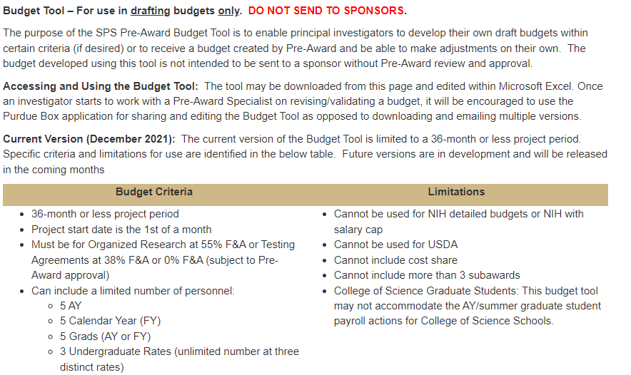

Faculty Productivity Areas of Progress - Research
Pre-Award Budget Spreadsheet Tool
SPS successfully piloted 1-year project budget spreadsheet (iterative updates)
Finalized 3-year version of budget spreadsheet
Available at: https://www.purdue.edu/business/sps/preaward/budget_tool.html

Slide 7

CoE Finance Staff Communication Methods/Channels + Feedback Mechanism
Improved Communication Methods and Channels
Active phone numbers in CoE Finance Staff signature blocks
  Teams Chat links in CoE Finance Staff signature blocks
Feedback Survey links in CoE Finance Staff signature blocks
Notes:
When we consider any process improvement or any new demand on our time, energy and efforts we address them through consideration of the following factors:
Will it open up new doors of opportunity or address our growth targets – our partnership focus. The implementation of PARI (which you will hear about soon from Crystal) is one factor
Will it affect our institutional profile, will it move the needle on our AAU metrics/placement or count towards our HERD rankings
How will it affect staff; how will we improve our knowledge, skills and abilities to meet the challenge, what impact will it have on our workload and how can we scale to the growth?
We always have in our minds to approach a task as efficient, effective and compliant – as possible - learning along the way
And we must consider our facilities, equipment and systems and if they are capable of addressing the demand and the need.
These are the challenges and the concerns and considerations affecting research productivity.

Slide 8
Ongoing Landscape and Considerations
New Targets & Opportunities (Targeted Growth, PARI, Partnerships)
Staffing/Resources (KSAs, Workload Metrics/Scale to Growth)
Efficient, Effective, Compliant
Infrastructure/Capabilities (Facilities, Equipment, Systems)
Notes:
When we consider any process improvement or any new demand on our time, energy and efforts we address them through consideration of the following factors:
Will it open up new doors of opportunity or address our growth targets – our partnership focus. The implementation of PARI (which you will hear about soon from Crystal) is one factor
Will it affect our institutional profile, will it move the needle on our AAU metrics/placement or count towards our HERD rankings
How will it affect staff; how will we improve our knowledge, skills and abilities to meet the challenge, what impact will it have on our workload and how can we scale to the growth?
We always have in our minds to approach a task as efficient, effective and compliant – as possible - learning along the way
And we must consider our facilities, equipment and systems and if they are capable of addressing the demand and the need.
These are the challenges and the concerns and considerations affecting research productivity.

Slide 9
Discussion and Questions
Notes:
Let me pause here to address any questions.

