Slide 1
Integrating Prevention through Design (PtD) into Capstone Engineering Design Projects
Derrick Tate
d.tate@ttu.edu
Assistant Professor of Mechanical Engineering
Texas Tech University
September 20, 2011
2011 Educating the Engineer of 2020 Workshop: Prevention through Design: Designing a Safer Tomorrow through Engineering Today

Slide 2
Design and Innovation
“Design may be characterized “as the epitome of the goal of engineering [that] facilitates the creation of new products, processes, software, systems, and organizations through which engineering contributes to society by satisfying its needs and aspirations.”
Suh, N.P., The Principles of Design. 1990, New York: Oxford University Press.
“‘[I]nnovation’ in its broadest sense...refer[s] to the entire process by which technological change is deployed in commercial products.”
“A technology may be invented, but it will not be an innovation until it is widely applied.”
Chesbrough H., Vanhaverbeke W., West J. (eds.), 2006, Open Innovation: Researching a New Paradigm. Oxford, UK: Oxford University Press.
Bainbridge W.S., Roco M.C. (eds.), 2006, Managing Nano-Bio-Info-Cogno Innovations. Dordrecht, The Netherlands: Springer.

Slide 3
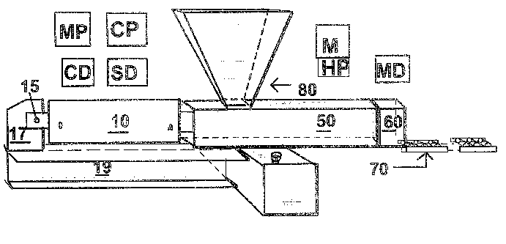
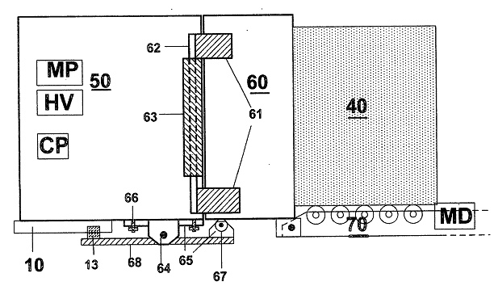
US Patent 7,311,865 B2
The patent for the large-block technology was issued Dec. 2007.
Williamson, L.D., Block-ramming machine. 2007: US. 7,311,865.

Slide 4
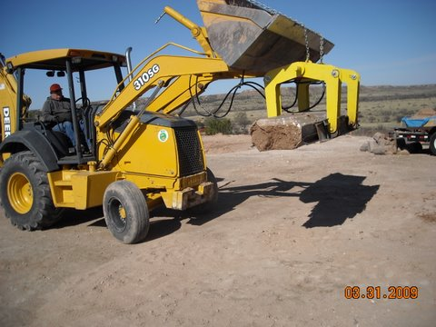
Photo by Larry Williamson.

Slide 5
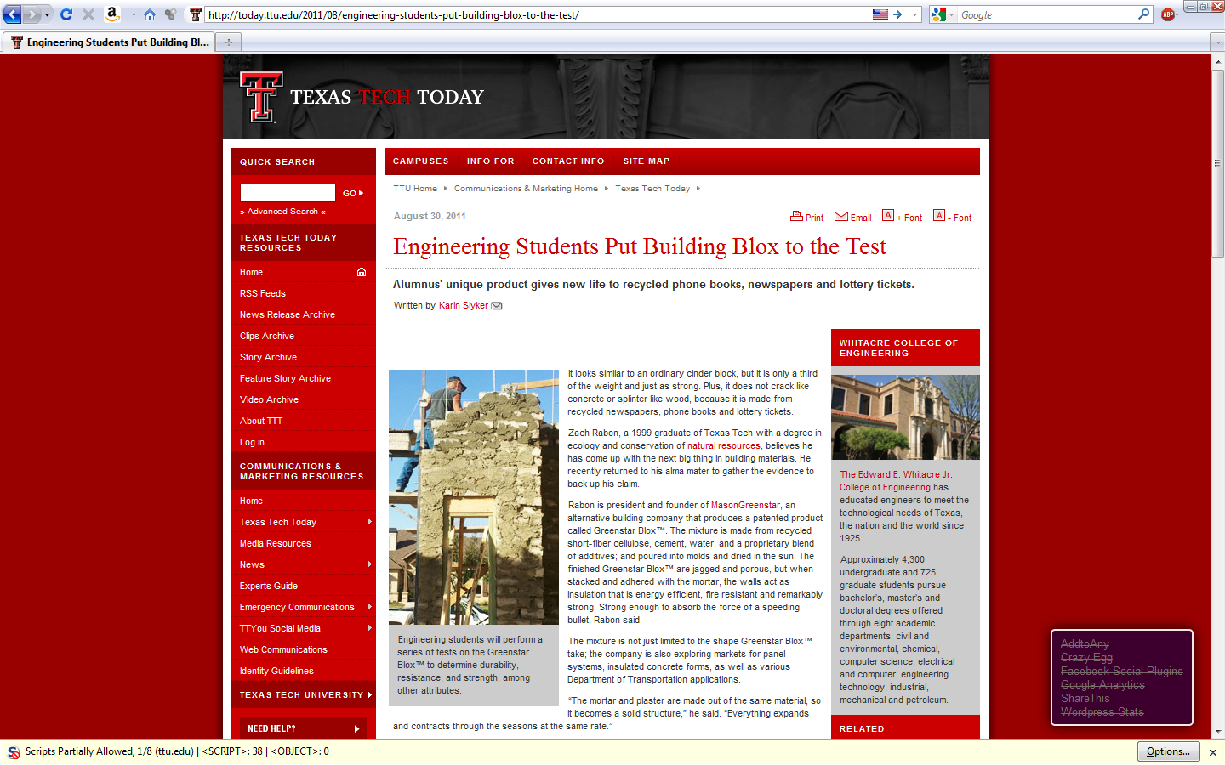
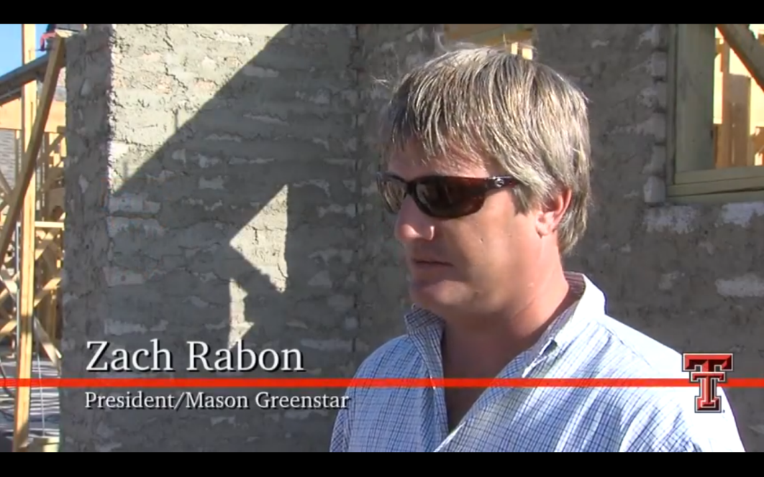

Slide 6
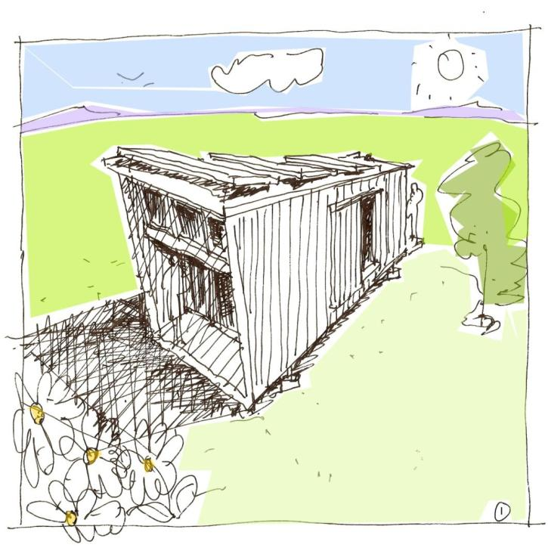
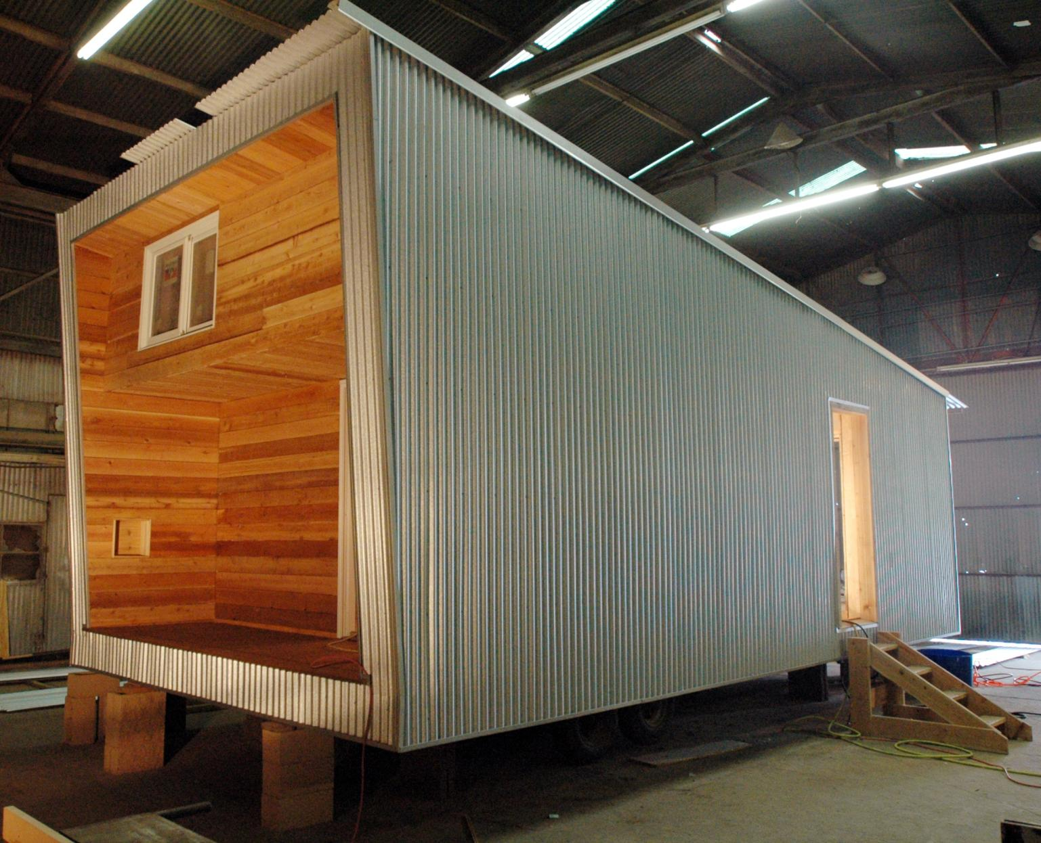
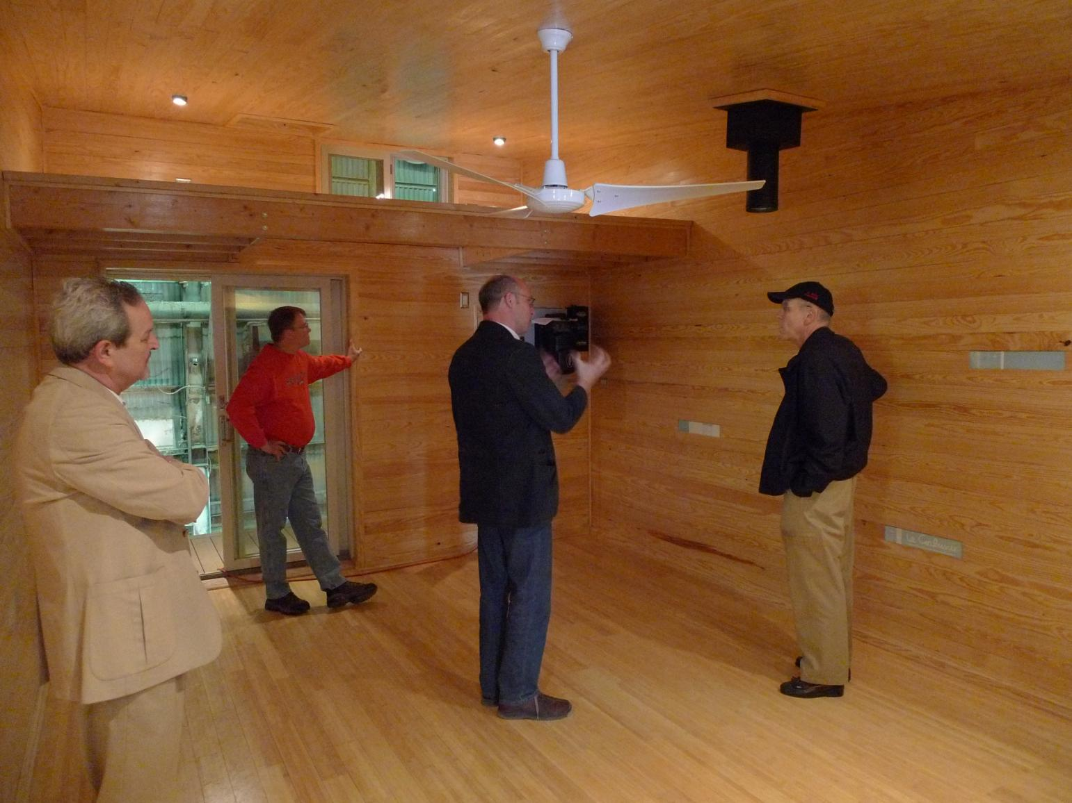
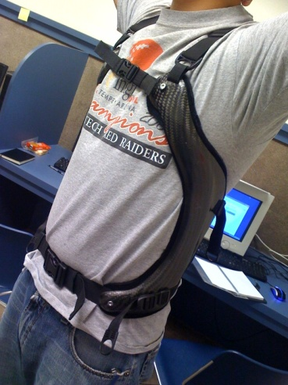
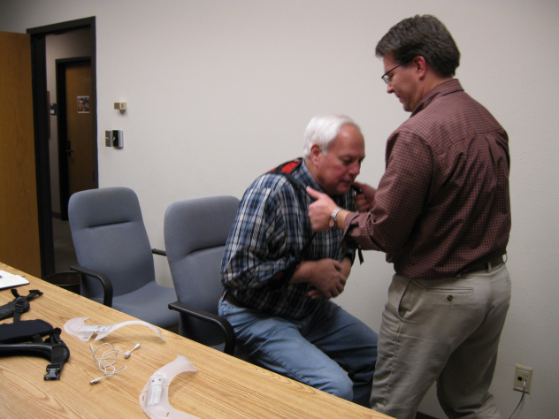
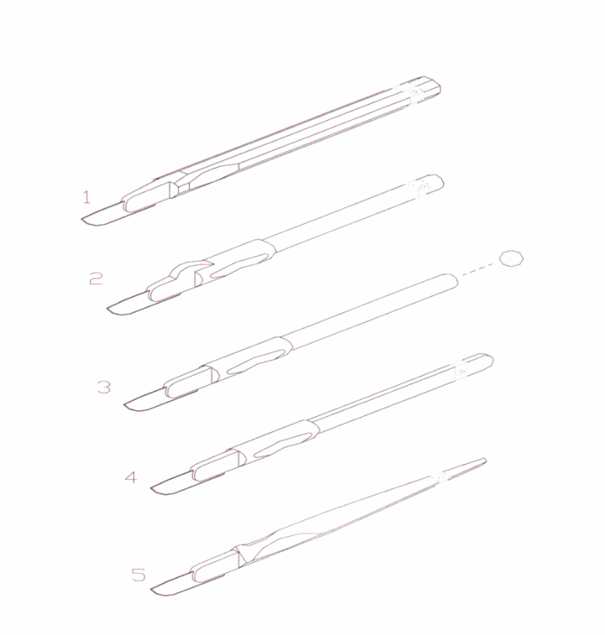
Entrepreneurs can interact with the university in a variety of ways.

Slide 7
Goal: Broadening Participation in Innovation Activities
The goal of this research is expanding and diffusing innovation activities to the general population through connecting individual inventors and entrepreneurs with the engineering tools and services needed to assess and realize their novel design concepts.
This goal may be considered as making innovators into better engineers.
Notes:
story bill gates, mit lunch
q add what value
benefit to university
other story

Slide 8
Dr. Ertas and PtD Books

Slide 9
Inclusion of PtD into Engineering Textbooks
Prevention through Design: Transdisciplinary Process
Engineering Mechanics and Design Applications: Transdisciplinary Engineering Fundamentals
Transdisciplinarity: Bridging Natural Science, Social Science, Humanities and Engineering
Transdisciplinary Design Process for Engineers
Introduction to Engineering

Slide 10
Inclusion of PtD into Engineering Textbooks
Prevention through Design: Transdisciplinary Process
(download from www.theatlas.org)
Published by TheATLAS Publishing, 2010
PtD concepts
[source: Ertas (2010)]

Slide 11
Inclusion of PtD into Engineering Textbooks
Engineering Mechanics and Design Applications: Transdisciplinary Engineering Fundamentals Published by CRC Press, 2011
Chapter 1... PtD concepts
Chapter 6… PtD Design applications
[source: Ertas (2011)]

Slide 12
Inclusion of PtD into Engineering Textbooks
Transdisciplinarity: Bridging Natural Science, Social Science, Humanities and Engineering Published by TheATLAS Publishing, 2011
Chapter 4... PtD concepts
[source: Ertas (2011)]

Slide 13
Inclusion of PtD into Engineering Textbooks Transdisciplinary Design Process for Engineers
Will be published by Wiley
Chapter 6... Transdisciplinary Sustainable Design &Development
6.11 Prevention through Design (PtD)
6.11.1 Introduction to PtD
6.11.2 The Business Value of Prevention
through Design
6.11.3 Prevention through Design and
Sustainability
6.11.4 The Safety Engineer
6.11.5 Prevention and Safety
6.11.6 Safety and Loss Prevention
6.11.7 Accident Prevention
6.11.8 Case Studies
[source: Ertas (TBD)]

Slide 14
Courses: Project Examples

Slide 15
PtD considerations in Design Process
PtD must be fully integrated in the early design process in the project.
The main objective of PtD at the conceptual design phase is to evaluate alternative design concepts, to plan to protect workers safety and health from hazards and to provide a conservative safety design basis for a chosen concept to carry on into preliminary design.
The conceptual design phase offers a key prospect for the safety and health hazard analysis to influence the product design.
^{Generic Design Process}
[source: Ertas (2011)]

Slide 16
ME 4370 Design I (& ME 4370 Design II)
Description:
Design problems characteristic of engineering are used to introduce students to the engineering design process. Topics covered and design exercises include problem formulation, design requirements and specifications, project management, concept synthesis, decision making approaches, analytical considerations of cost, design optimization, codes and standards, engineering communication, ethics, environmental considerations, and sustainability. (Writing Intensive.)
Number of sections
5 for Fall 2011
Number of students
Typically 25, as few as 12, as many as 40.
Recent projects

Slide 17
Implementation of PtD in Design Courses ME 4370 Fall 2010
CEB Ballistics Testing
PtD considerations: create a device that saves lives, doesn’t affect the environment, meet regulations for block production and wall assembly, risk of silica dust
Hall Pump
PtD considerations: high pressure, rotating components, protective guards, unloading valve, thermal protector for motor
TxDOT Roll-up Sign
PtD considerations: purpose safety and accident prevention, prevent “serviceability” failures, crash testing, handling of sign (weight and folding operations)
Percutaneous Annuloplasty for Mitral Valve Repair
PtD considerations: length of time device can remain within human body, material selection (shape-memory, nickel-titanium alloy)
CEB Moisture Absorption Apparatus
PtD considerations: use of non-toxic coatings, damper on door, covering exposed wiring
Lazarus Pump
PtD considerations: ???

Slide 18
Implementation of PtD in Design Courses ME 4371 Spring 2011
Hall Pump Design Compact reciprocating piston pump used for pressurizing water in fan misting system for evaporative cooling system.
PtD considerations: high pressure up to 1000 psi was consideration
Horizontal Shaker Table
PtD considerations: Design project “shaker table” was very heavy, needed to be handled with extreme care and accuracy…
Hip Rehabilitation: Abdominal Muscles
PtD considerations: sharp edges and corners were grinded; Open ends of the aluminum box tubing, square caps were manufactured by wrapping plastic in excess vinyl etc.
Hip Rehabilitation: Hip Muscles
PtD considerations: sharp edges and corners were grinded; Open ends of the aluminum box tubing, square caps were manufactured by wrapping plastic in excess vinyl etc.
Percutaneous Annuloplasty for Mitral Valve Repair
PtD considerations: ???

Slide 19
Implementation of PtD in Design Courses ME 4370 Spring 2011
Magnetic Endoscopy Device
PtD considerations: preventing lost parts, use of non-toxic materials
Pulse Power AL Foil Feeder
PtD considerations: material choice, easy maintenance, used only in position, ear protection, minimize sharp edges
Subsea Thermostat Valve
PtD considerations: training of personnel, minimize impact on environment
Wind Belt
PtD considerations: material choice
Fixed-wheel Bicycle Clutch
PtD considerations: careful planning for manufacture
Medical Staple Gun for Biodegradable Staples
PtD considerations: material choice, reducing sharpness of parts
Tribology Tester
PtD considerations: on-off switch, plastic shields, locking mechanism
RC Model Aircraft Pulse Jet
PtD considerations: remote start, kill switch
Mariposa EcoVillage Lifetrac Attachment
PtD considerations: ???

Slide 20
Transdisciplinary Systems for Safety, Health, and Resilience (ME 6331)
(September 10-12, 2010) at Texas Tech University, Mechanical Engineering Department.
Generic design process and an understanding of transdisciplinary (TD) research process and activities are presented. TD requirements, analysis, synthesis, evaluation, identification and management of complexity, conceptual framework development and the net-centric research process model are discussed. This course will also discuss mathematical tools and methods (uncertainty, reliability, statistical decisions, etc.) shared by diverse disciplines. This course will provide tools for a new generation of transdisciplinary engineers. The topics covered will facilitate collaborative research across traditional academic fields, analyze TD systems, and validate research results.

Slide 21
Interdisciplinarity/Transdisciplinarity
Today the need is for a “transdisciplinary” education and research model that can transcend traditional disciplinary or organizational boundaries to enable the solution of large problems by teams of people from diverse backgrounds.
PhD Track in Transdisciplinary Design, Process, and Systems, example dissertation research topics:
Biomimetic Design for Intrusion Tolerance of Software
Complexity of COTS Deployment (with Civil Engineering)
Effects of Schedule Compression on Systems Engineering Cost Estimation (with Industrial Engineering)
Use of Concept Maps for Curriculum Development (with Computer Science)
Hyperspectral Imaging for Bacterial Detection (with Computer Science)

Slide 22
In-Class Assignments
Assignment: Explain in two paragraphs why PtD is Transdisciplinary Process
Assignment: Justify why PtD should be integrated into engineering curriculum.

Slide 23
Courses: Teaching Suggestions

Slide 25
Customers and Stakeholders
Goals
Identifying Stakeholders
Communicating with Customers
Organizing Customer Needs
Characterizing their Importance

Slide 26
Grouping and abstracting CNs: An Image KJ
[source: 2.870 report]

Slide 27
Kano Analysis
Categories of Needs
Attractive
One-dimensional
Must-be
Indifferent
Reverse & Questionable
Positive question: How do you feel if <CN is met>?
like it
must be
neutral
live with it
dislike
Negative question: How do you feel if <CN is not met>?

Slide 28
Domains, Mapping, and Hierarchies
Customer Environment
Functional Domain
Physical Domain
Process Domain
What
How
What
How
What
How
Why
Why
Why
constraints
constraints
Customer Needs
Functional Requirements
Design Parameters
Process Variables

Slide 29
Coke Can
What are the design parameters?
What are the functional requirements for a Coke can?
What are the constraints?

Slide 30
Functional Domain: Functional Requirements | Physical Domain: Design Parameters | Constraints
Contain pressure | Concave bottom | Minimize material
Withstand dropping from 3 ft | Shape - diameter
Easy to hold in hand | cylinder
Allow access to beverage | Tab – size and shape location | Prevent litter - tab not fall off
 | Opening geometry | Safety – prevent injury to user
 | liner | Minimize cost
 | strength | recycleable
Can stack | Crease on top - ring | Fit drink machine, koozie,
Save material | Top and bottom tapers | Non corrosive
Rigid when opened | material | Chemically stable
 | Opening notch | Non -toxic
 | Wall thickness | Prevent change of liquid
Contain beverage until opened | Top thickness | lightweight
 | Joint geometry
 | Coating/paint

Slide 31
Refinement of Constraints
Definition
Bounds on acceptable solutions
Types
Performance constraints
Interface constraints
Project constraints

Slide 32
Summary
Talk with customers and stakeholders.
Don’t just assume requirements are “given.”
Consider what the design needs to do.
Don’t jump to the solution first.
Recognize that system-level constraints may lead to lower-level functions (and solutions).
Make guidelines and regulations in terms of functional performance to be achieved.
Don’t impose particular solutions. (Technology will change.)

Slide 33
Conclusions
PtD should be introduced to students at the throughout their engineering education, starting at the freshman level.
PtD must be fully integrated in the early design process in the project. PtD enables the students to consider a more complete set of stakeholders.
Work-related injuries are real, devastating, and common.
Can we help to other countries in developing similar, common PtD concepts?

