Slide 1





Educating the Engineer of
2020 Workshop
Prevention through Design Innovation Competition
Packaging Line Ergonomic Improvement for Trane Commercial Systems
PURDUE University
Gaurav nanda
Bryan Carpenter
Akshat Dhawan
Ronald Klein
Heather Reeves
Wendy Ross
September 20, 2011

Slide 2
Project Description
This project was to improve ergonomics and safetyof workers through process improvement !
Trane’s manufacturing location in Rushville, Indiana has a packaging line where crates are manually assembled around the units to prepare them for shipment.
Due to the fact that there are many different sizes of units packaged on the line, there is little automatic work.
Bending and lifting caused an above acceptable ergonomic score of 24 for the assembly line workers.
Challenge: Examine this crating process and offer a solution to improve the ergonomic score !

Slide 3
Project Objectives
The objectives of this project were:
Finding solutions for improving the ergonomic score of the workers.
Maintaining or improving Takt time.
Staying within the $100,000 client budget.

Slide 4
Project Deliverables
The deliverables of this project were:
  A yardstick tool which would dictate the height the lift should be at for any height of person and both the top and bottom staples on the crate.
  A manual to use the tool.
  Create a guideline for each employee, perform the new method.
  Cost analysis.
  Implementation plan.

Slide 5
Integration of PtD
PtD was integrated in this project through:
  “Yardstick” Lift Location Tool - allows the operator to raise or lower the lift to the optimal height quickly
  Yardstick Manual - allows the employee a quick reference guideline to assemble the crate in the most optimal position.
  Crating Process Improvement

Slide 6
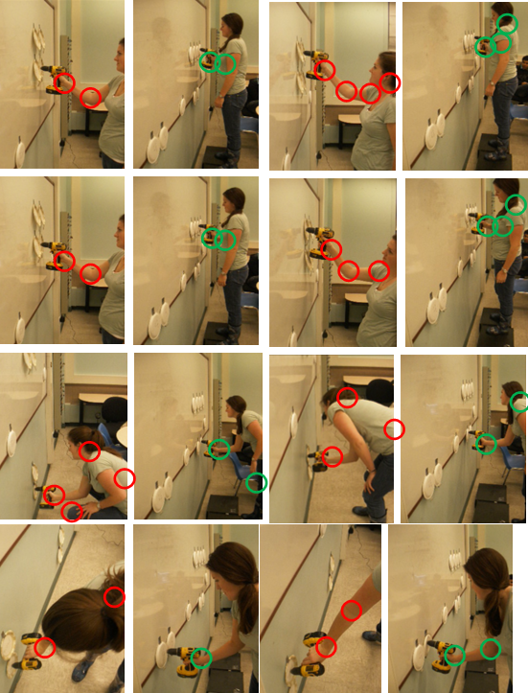
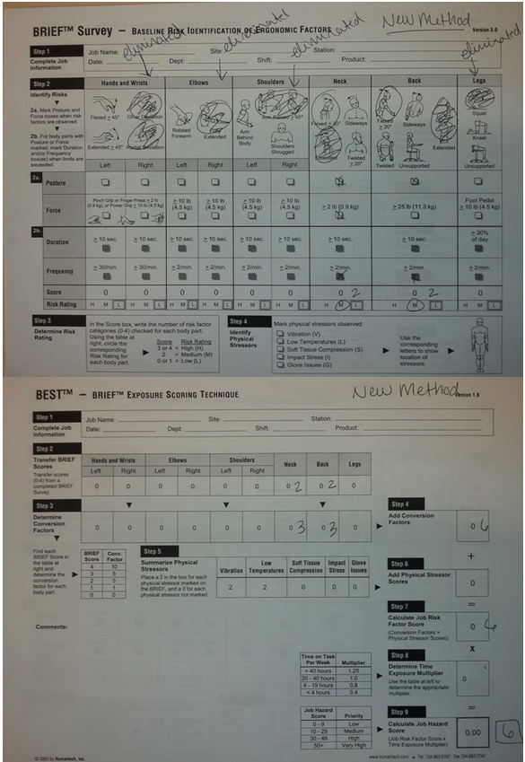
Experimental Analysis

Slide 7
Lessons Learned
The lessons learned through the implementation of this project were:
  The team approached this project in four stages:
    Visitation: Learned about the crating process and solutions which have previously failed
    Research: Devised 5 different approaches and got client feedback. Client feedback is important for judging feasibility.
    Proposition of solution ideas: Realizing that the stapling procedure of the crating process posed the biggest threat to a high ergonomic score; solutions were then focused on improving that particular part of the process
    Experimentation: Results from the experimental analysis led the team to create a set of deliverables for the client including an implementation plan.

Slide 8
Next Steps
Suggested next steps of this project and the integration of PtD in your project are:
  Have a comprehensive experiment with larger sample and create more generic guidelines for improving ergonomic score and safety of processes like this.
  Since the team’s experiment only simulated the actual crating process, it is recommended that after the training is complete, the crating process is assessed according to the ergonomic worksheets in order to get accurate data with the new process.

Slide 9
Conclusions
The conclusions drawn from this project are:
  Ergonomic Score improved from 24 to 6 !!
  The total cost to implement all of the recommendations results in a first year cost of $15,065 and $5,977 each year following. Relative to the average costs of work place injuries which are $38,000 for musculoskeletal injuries and $34,000 for occupational hazard cost for work place injury, the implementation cost is significantly less than the potential value of risk reduction.

Slide 10
Questions?
Are there questions about this project and the integration of PtD in it?

