Slide 1





Educating the Engineer of
2020 Workshop
Prevention through Design Innovation Competition
Ergonomic Design and Evaluation of a Clinical Teaching Laboratory for People with Disabilities of the Lower Limbs
Purdue University
Wei-Chun Chen, B.S
James D. McGlothlin, M.P.H., Ph.D., C.P.E.
September 20, 2011

Slide 2
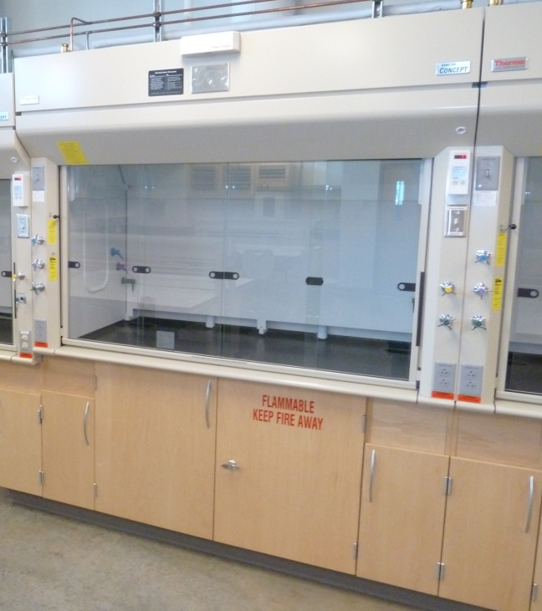
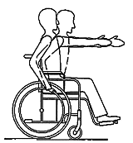
Project Description
The design of clinical laboratory environments can be challenging for people with lower limb disabilities. Redesigning these environments will allow them to better compete for these well-paying technical jobs.
?
How can he/she access?
http://www.un.org/esa/socdev/enable/designm/AD5-02.htm

Slide 3
Project Objectives
  Specific aim 1: Conduct an ergonomic evaluation of clinical laboratory workers to determine common “value added” laboratory practices.
  Specific aim 2: Use PtD principles to design a clinical laboratory for students/workers with lower limb disabilities.
  Specific aim 3: Develop common laboratory skills for students/workers with lower limb disabilities. Specifically: user skills for microscope, pipetting, and slide preparation tasks.
  Specific aim 4: Evaluate and compare students/workers with lower limbs disabilities to those without disabilities in clinical laboratories.
  Specific aim 5: Achieve PtD design goals that enable students/workers with lower limbs disabilities to fully function and prosper as clinical clinicians in such laboratories.

Slide 4
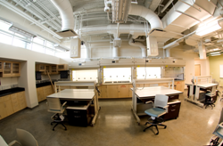
Project Deliverables
Teaching Clinical Laboratory located at the Discovery Learning Research Center, Purdue’s West Lafayette campus, has been built with development of the reasonable accommodations in workstation design for people with disabilities of the lower limbs.
https://iashub.org/

Slide 5
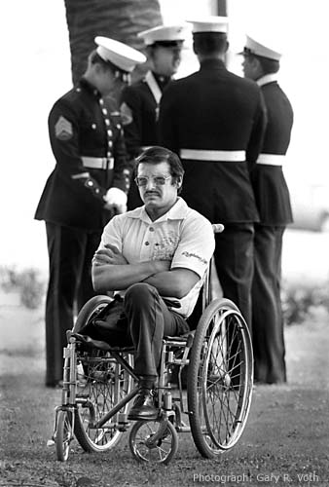
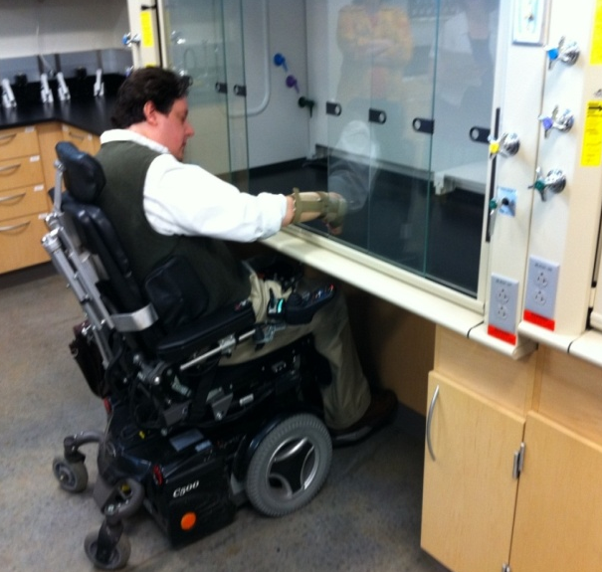

Integration of PtD
For a person in a wheelchair, e.g. veterans returning from war with lower limb disabilities
  A modified workstation (ventilated hood as shown here) with adequate knee clearance.
  A redesigned sink area with ADA-compliant faucets and adequate knee clearance.
Pictures from http://vothphoto.com/gallery/ ; http://www.darkdaily.com/

Slide 6
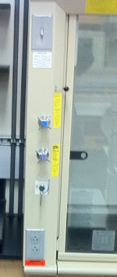

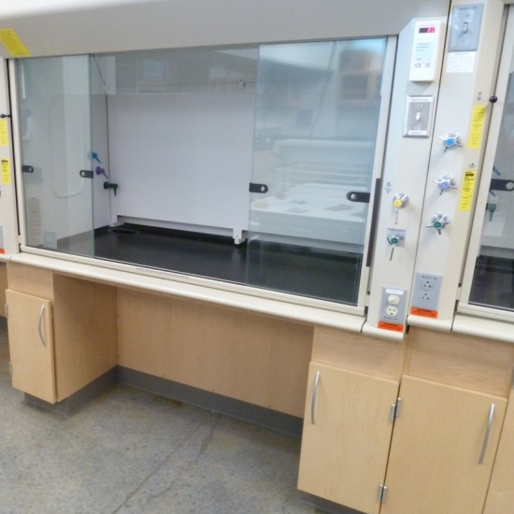
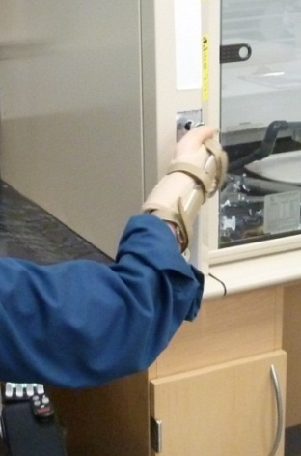
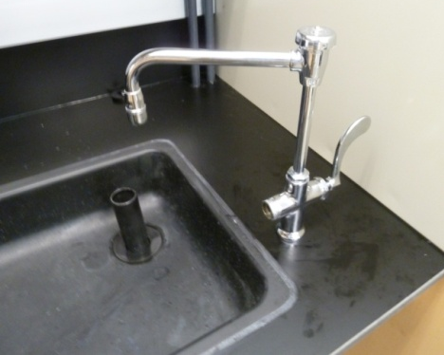
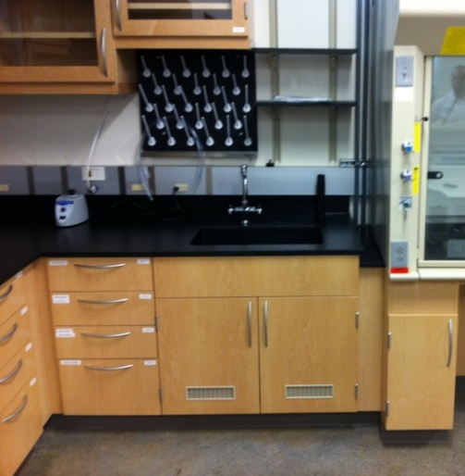
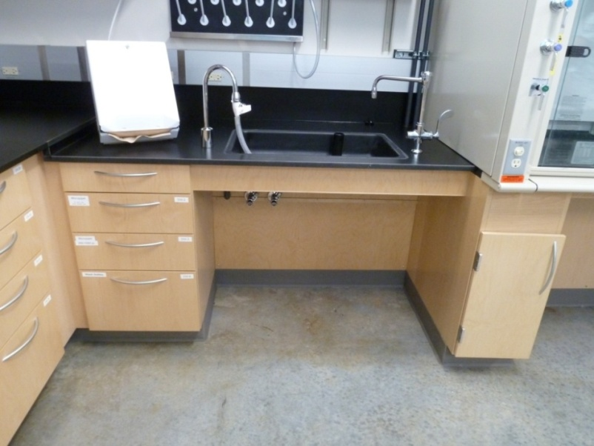
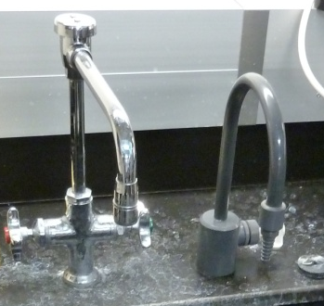
The Clinical Teaching Laboratory
Before
After

Slide 7

Lessons Learned
The challenge to redesigning a laboratory for people with lower limb disabilities is having adequate knee clearance, yet have good work bench height for a person who works from a wheelchair.
Solution a sink area that is redesigned that is ADA-compliant including:
  removing cabinets below the sink
  lower the sink work surface
  making the sink functional more shallow and easy-to-reach
  using toggle hot and cold water handles
4.25 “
Shallow sink
to allow knee
and leg
clearance

Slide 8
Next Steps
Validate PtD of clinical laboratories for use by students/workers with lower limb disabilities.
Expend the development of the clinical laboratories program to attract and educate veteran's with lower limb disabilities.
Promote and share findings with other institutions of higher learning to use PtD in the development of clinical laboratories for the veteran’s with lower limb disabilities.

Slide 9
Conclusions
A clinical laboratory environment proved to be useful for helping to design a working environment for a person with lower limb disabilities, such as having to work in a wheelchair.
It is possible to do the accommodations without significant labor and cost (about 2,000 dollars for refitting the sink, water supply, counter top, and removal of floor cabinets).
Consideration of PtD with ergonomic features should reduce and prevent musculoskeletal disorders and enable students/workers/veterans with lower limb disabilities to have successful careers in clinical laboratories.

Slide 10
Questions?
What are the interaction and functionality of people in wheelchairs at these workstations over time?
How do we optimize work practices using pipettes, microscopes, and slide preparation to decrease risk of musculoskeletal disorders among our veterans with lower extremity disabilities who want careers in clinical laboratories?
Answer: With a coordinated effort Purdue and other universities can and should develop such degree programs as they are good for our students and veterans, and our society.

