Slide 1
Prevention through Design in Construction Engineering Education
Deborah Young-Corbett, PhD CIH CSP CHMM
Assistant Professor, Virginia Tech
The Engineer of 2020
Purdue University, 2011

Slide 2
Presentation Outline
Design for Hazard Control – Course Overview
Course Composition
Course Goals
Structure of Course
Topics Covered

Slide 3
Design for Hazard Control
Virginia Tech CEE 4064/5064
Created Fall 2007
Offered Annually
COURSE DESCRIPTION: Design of construction projects, materials, equipment and systems to control inherent hazards to the health and safety of construction workers, inhabitants of the built environment, and the general public. The emphasis of this course is on Prevention through Design (PtD). The course will provide students with in-depth knowledge of the regulatory and legal drivers pertinent to construction, the chemical and physical health hazards, the major classes of safety hazards, the design processes to control safety and health hazards. Format of the course will involve lecture and participatory activities.

Slide 4
PtD Definition
The optimal method of preventing occupational illnesses, injuries, and fatalities is to “design out” the hazards and risks; thereby, eliminating the need to control them during work operations. This approach involves the design of tools, equipment, systems, work processes, and facilities in order to reduce, or eliminate, hazards associated with work.

Slide 5
Course Composition
Graduate Students (MS and PhD)
Advanced Undergraduate Students
Civil Engineering
Building Construction
Architecture
Design teams: mix of all of the above!

Slide 6
Course Goals
EDUCATIONAL OBJECTIVES: Having successfully completed this course, the student will demonstrate the ability to:
identify risks to the health and safety of construction workers and the general public
analyze exposure situations to quantify safety and health hazards
design noise and vibration control systems, excavations, fall protection, fire control and ventilation systems
develop conceptual design solutions for tools, materials, equipment, cranes, and processes to mitigate hazards
synthesize the existing scientific literature on PtD innovations for construction safety and health

Slide 7
Structure of Course
Lecture and Participation
Participation:
Design Innovation Groups
Researcher Presentations
Student-led Discussions of Literature
Lectures organized by hazard
Student design projects
Field project

Slide 8
Topics Covered
History
Regulations
Hazard Recognition
PtD Solutions
Chemical Health Hazards
Physical Health Hazards
Excavation
Falls
Heavy Equipment
Cranes
Fire

Slide 9
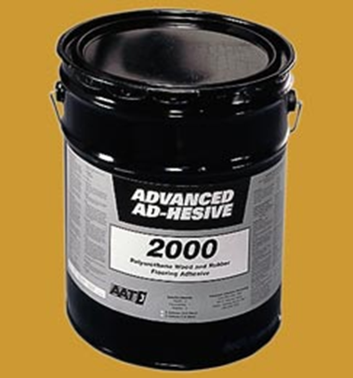
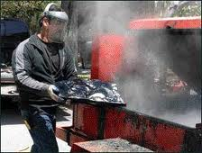
Topics Covered
Hazard Recognition: Chemical Health Hazards
Particulates
Dusts, Mists, Fumes, Smoke
Vapors
Gases

Slide 10
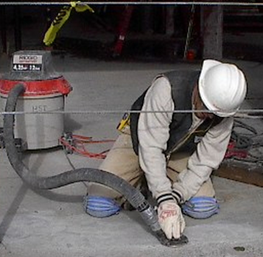
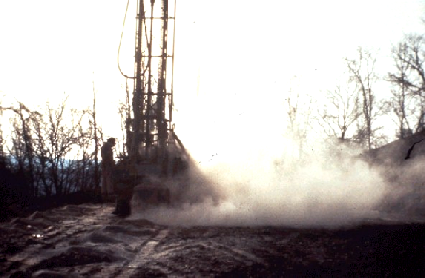
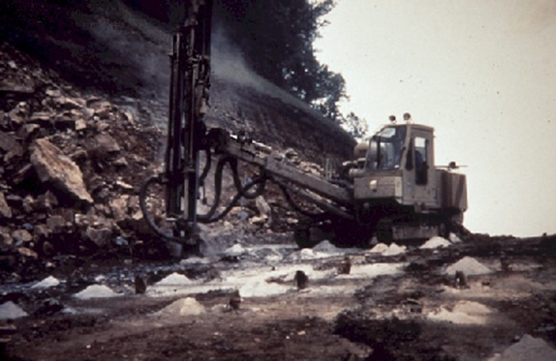
Topics Covered
PtD Solutions: Chemical Health Hazards
1) Materials Substitution
2) Process Design
Wet Methods
Ventilation
Tool Design
3) Material/Worker Isolation
4) Alarm systems

Slide 11
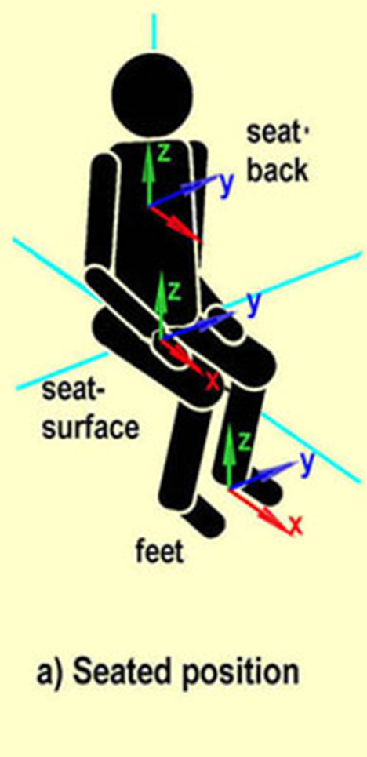
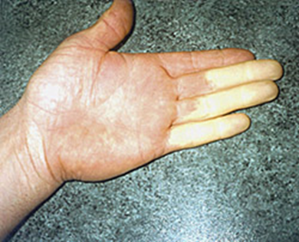
Topics Covered
Hazard Recognition: Physical Health Hazards
Noise
Vibration:
Hand/Arm
Whole Body
Thermal Extremes
Non-ionizing Radiation
Ergonomic Stresses
Pressure
Ionizing Radiation

Slide 12
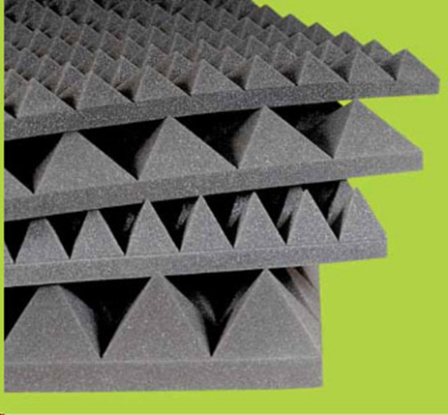
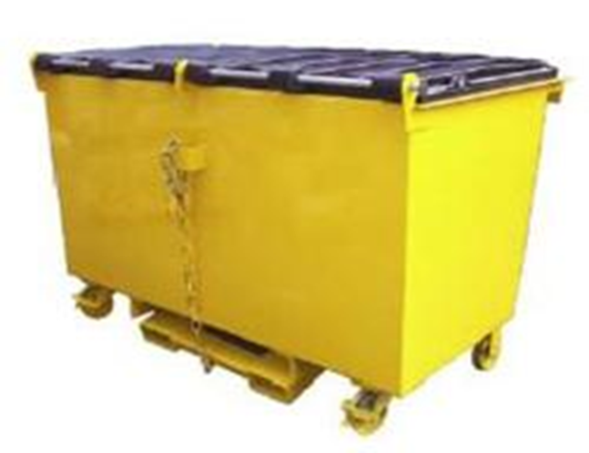
Topics Covered
PtD Solutions: Physical Health Hazards
Noise
Solid Vibration Control
Control of driving force vibration
Control of responsiveness of surface to driving force
Control of radiation efficiency of surfaces
Air Turbulence Control
Absorptive materials
Enclosure of equipment
Enclosure of personnel
Barriers or shielding
Lagging (wrapping with damping material)
Mufflers
Distance Attenuation

Slide 13
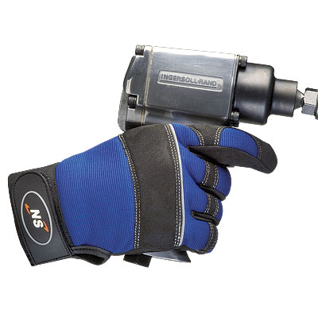
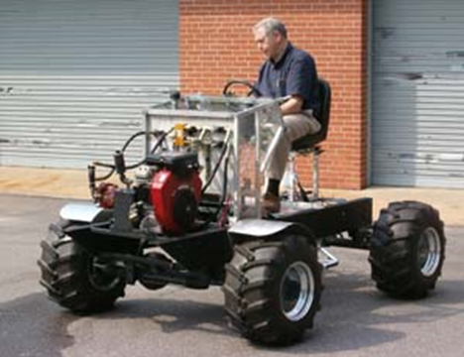
Topics Covered
PtD Solutions: Physical Health Hazards
Vibration
Vehicle/Equipment seat design
Low-vibe tools
Anti-vibe gloves
Vibration damping
Driving force reduction
Isolation
Resonant frequency interference/isolation
Notes:
Images: anti-vibe gloves and active seat suspension design

Slide 14
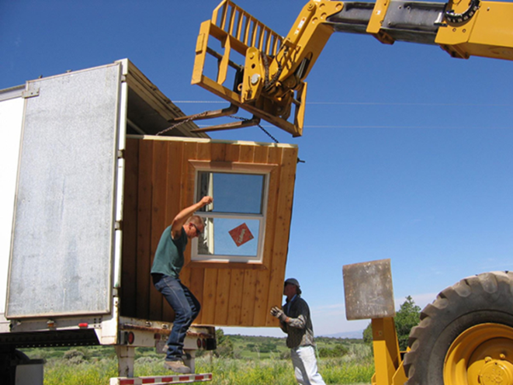
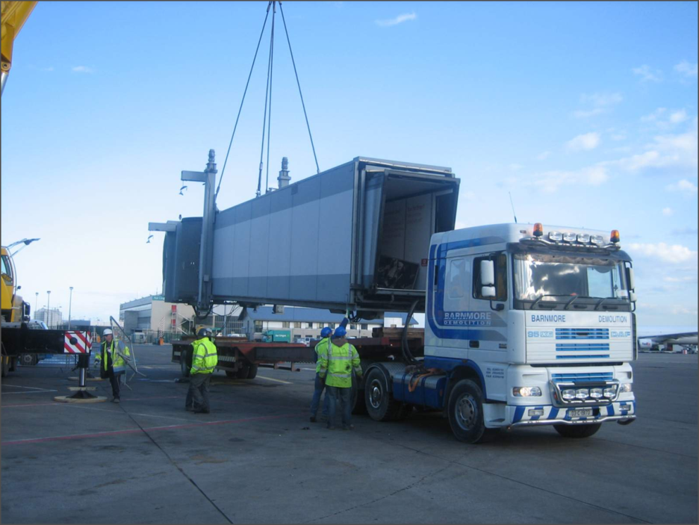
Topics Covered
PtD Solutions: Physical Health Hazards
Ergonomic Hazards
Work re-design
Panelization
Prefabrication
Tool re-design
Automation

Slide 15
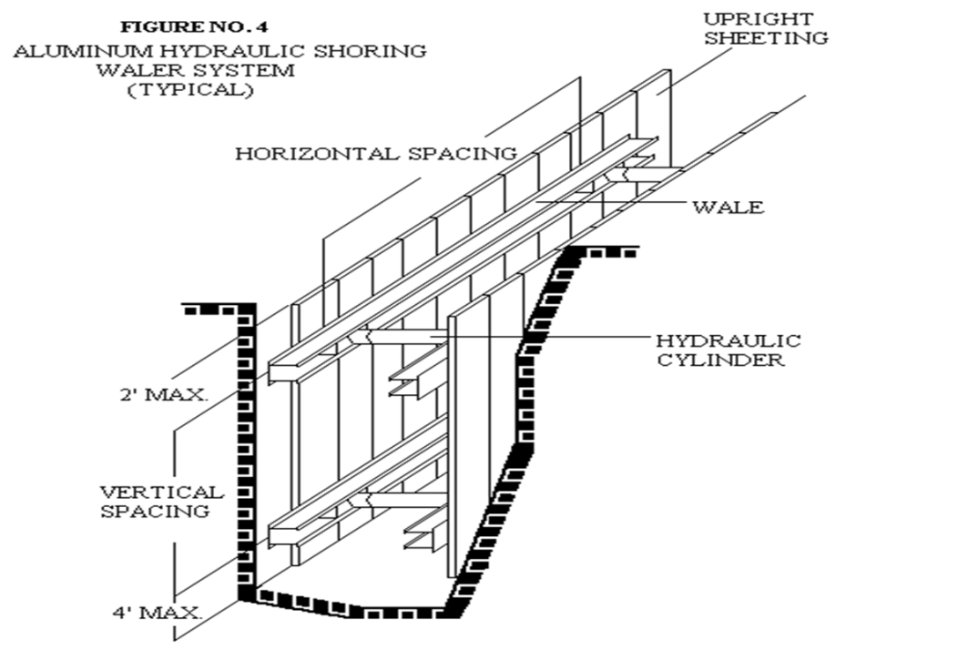
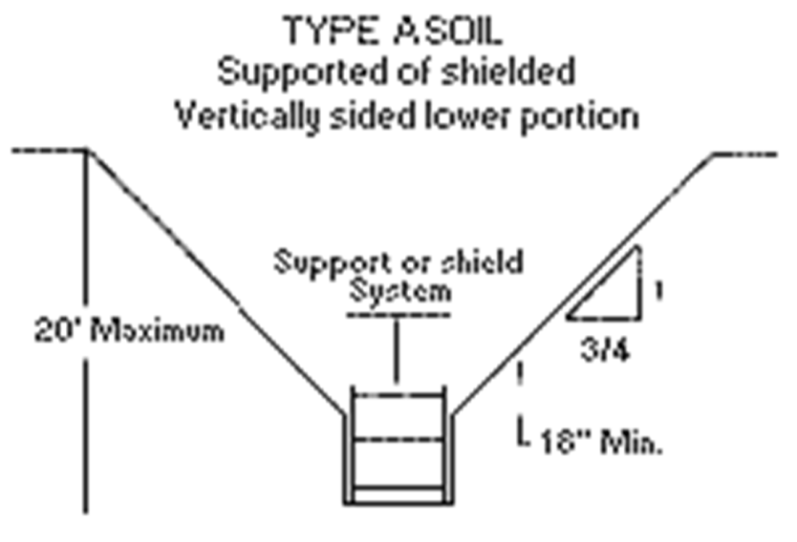
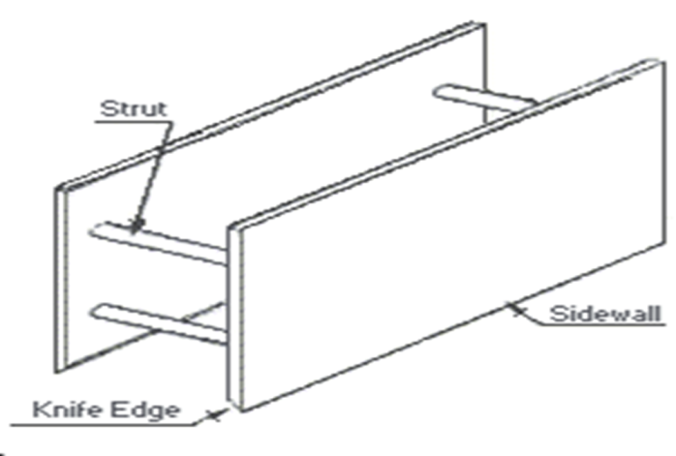
Topics Covered
PtD Solutions: Excavations
Sloping
Benching
Support Systems
Trench boxes
Shielding
Shoring (hydraulic, whaler)

Slide 16
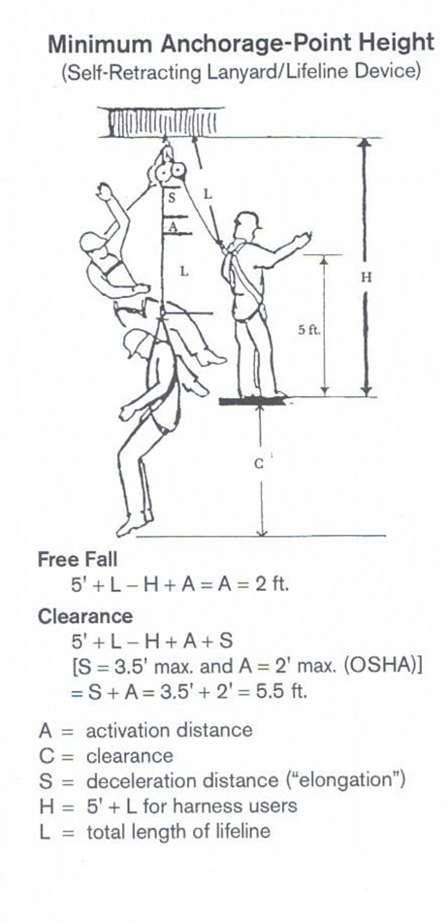
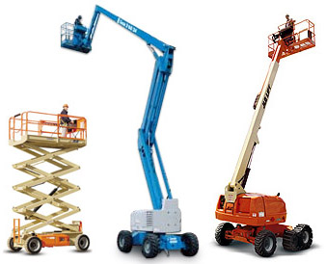
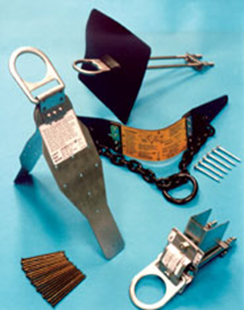
Topics Covered
PtD Solutions: Falls
Passive Systems
Aerial Lifts
Powered Platforms
Nets
Guardrails
New Designs
Active Systems
Body support equipment
Belts
Harnesses
Anchorage points
Connecting hardware
Shock absorbing lanyards
Self retracting lanyards
Body positioning systems

Slide 17
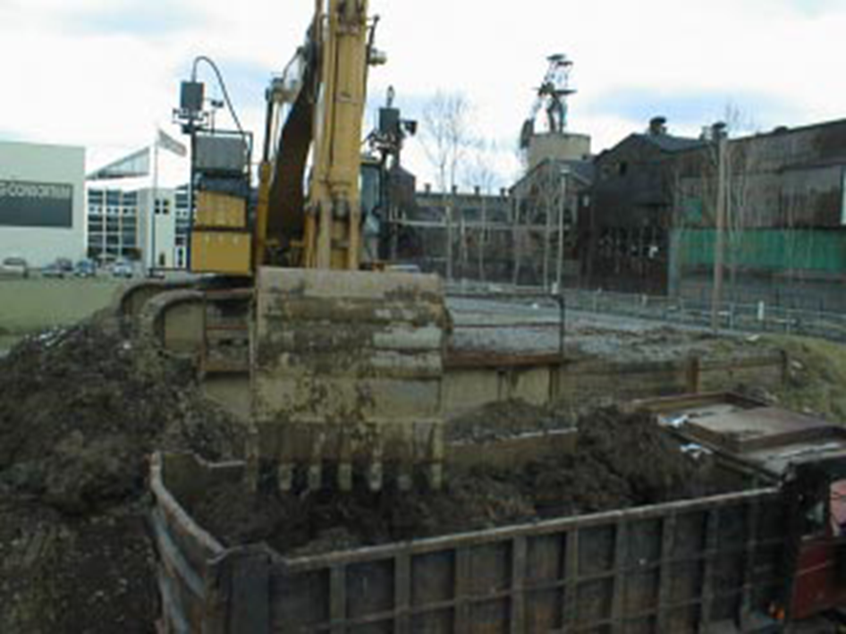
Topics Covered
PtD Solutions: Heavy Equipment
Carnegie Mellon University Robotic Excavator
Autonomous Vehicles
Proximity Monitoring and Alert Systems
On-Guard Vehicle Warning System

Slide 18
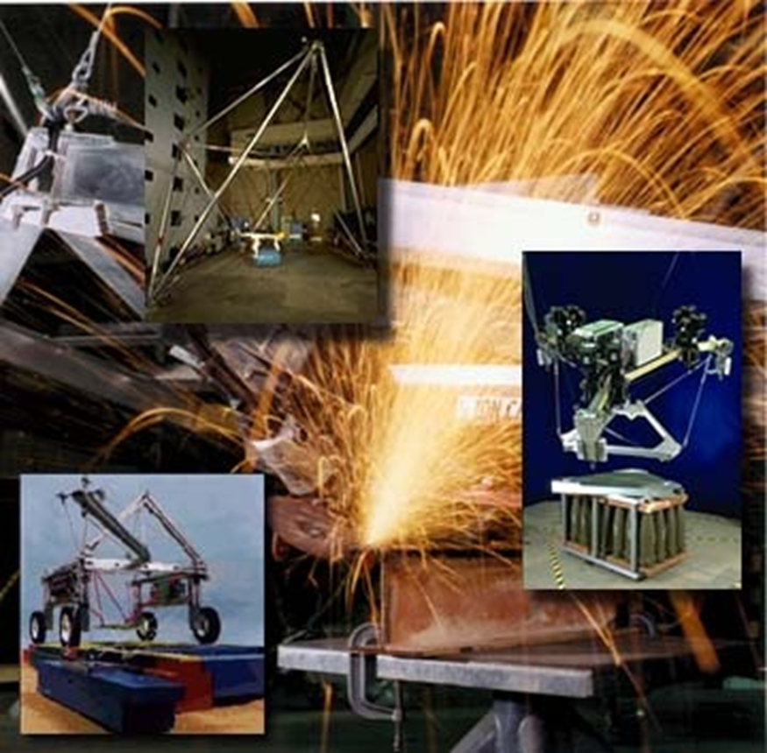
Topics Covered
PtD Solutions: Cranes
Power-line Avoidance (Proximity Alarms)
Boom angle control
Operator Visualization
Robotics (NIST Robocrane)
Rigging
Leveling/Stability

Slide 19
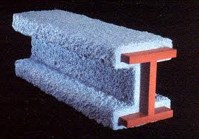
Topics Covered
PtD Solutions: Fire
Fire resistance of structural elements
Control of movement through structural design
Containment
Venting
Design for structural stability in event of fire damage
Active Fire Protection:
Detection
Signaling
Suppression

