Slide 1
The Certificate in Entrepreneurship and Innovation Program
Engineer 2020 Workshop
September 2010
Nathalie Duval-Couetil, MBA, PhD
Director, Certificate in Entrepreneurship and Innovation Program
Associate Director, Burton Morgan Center for Entrepreneurship
natduval@purdue.edu
765-494-7068

Slide 2
Some history…
Launched in Fall 2005
Multidisciplinary entrepreneurship education was novel at the time
Typically the domain of management schools
Universities had tried it with limited success
Today, over 2500 students have taken program’s introductory course
ENTR 20000 voted one of Purdue’s top five courses in 2010

Slide 3
Overarching goals
Provide students with the tools and knowledge required to assess new venture opportunities
Develop leadership and communication skills necessary to advocate for these enterprises
Make entrepreneurship an “accessible” career option -- now or in the future

Slide 4
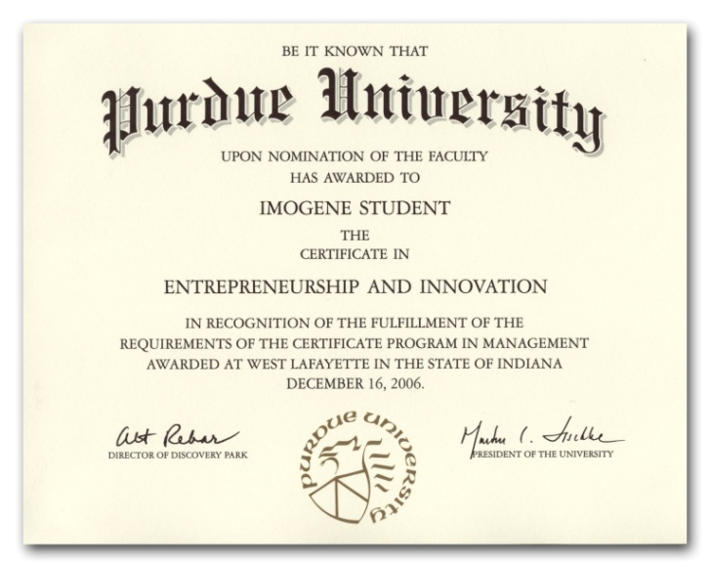
Academic Requirements
2 Core Courses (6 credits) | Theory and practice ENTR 20000 Intro to Entrepreneurship and Innovation ENTR 20100 Marketing and Management for New Ventures
2 Option Courses (6 credits) | Discipline- or industry-specific Offered throughout colleges
1 Capstone (3 credits) | Application of “core” and “option” Via courses or experiential learning programs
Certificate at graduation and noted on transcript

Slide 5
Enrollment by College in ENTR 20000
 | Cumulative |  | Fall 2010
College | Number | Percent | Number | Percent
Technology | 558 | 22% | 59 | 20%
Management | 507 | 20% | 46 | 16%
Liberal Arts | 349 | 14% | 45 | 15%
Engineering | 320 | 13% | 52 | 18%
CFS | 227 | 9% | 22 | 7%
Undecided | 183 | 7% | 7 | 2%
Agriculture | 193 | 8% | 36 | 12%
Science | 124 | 5% | 18 | 6%
Pre-Pharmacy | 48 | 2% | 10 | 3%
Other | 31 | 1% | 2 | 1%
TOTAL | 2539 | 100% | 296 | 100%
Cumulative since launch in Fall 2005

Slide 6
Engineering Participation by Area

Slide 7
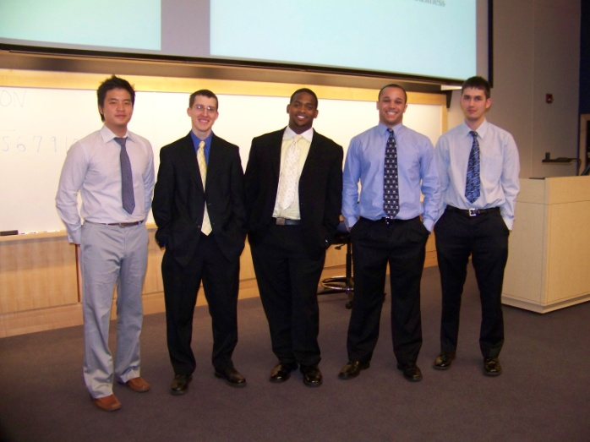
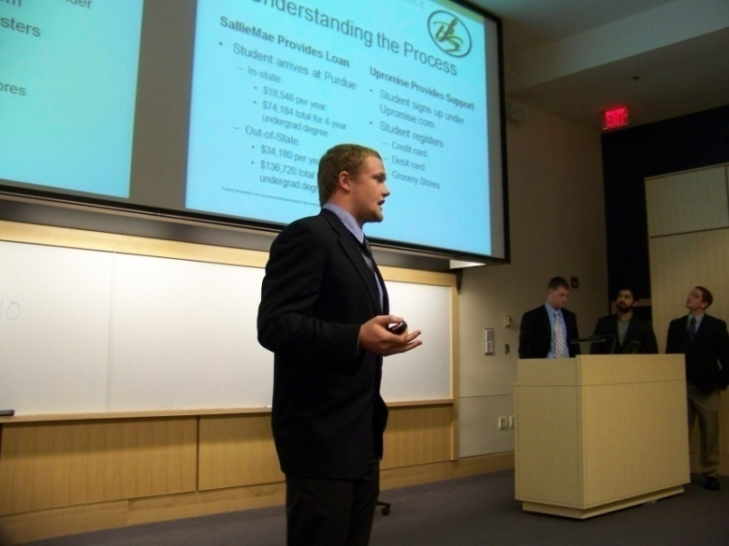
Real-world focus: Capstones
ENTR Capstone: Led by practicing entrepreneur or venture capitalist
Scott Jones, Boston Technology, Gracenote, ChaCha
Don Aquilano, Blue Chip Venture Company
Eric Davis, Kylin Therapeutics, In-vivo Ventures
Chad Barden, Quadraspec, In-vivo Ventures
Dennis Barket, Griffin Analytical/Icx
Chris Beltran and Paroon Chadha, Passageways
Experiential learning
Interns for Indiana
Global entrepreneurship

Slide 8
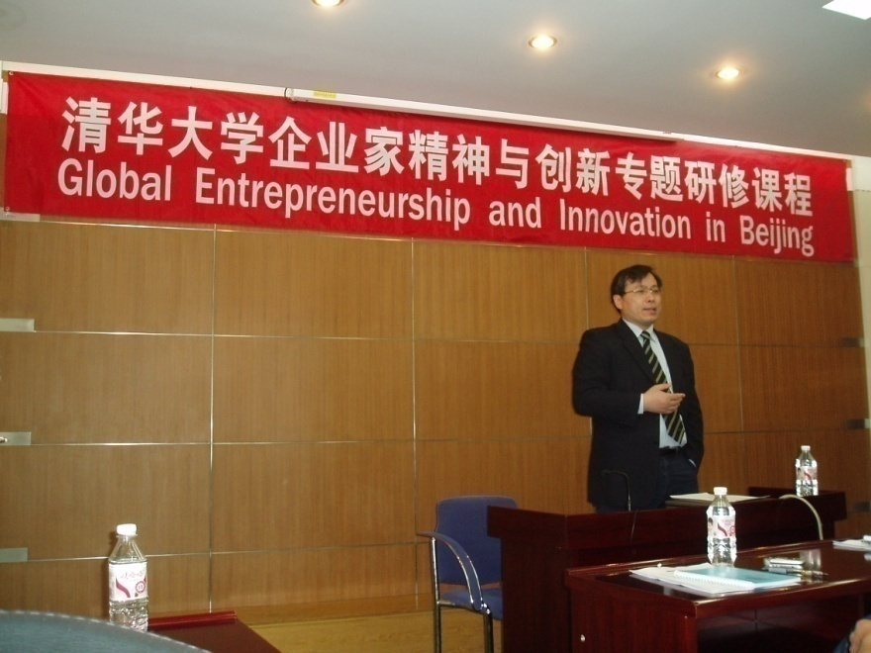
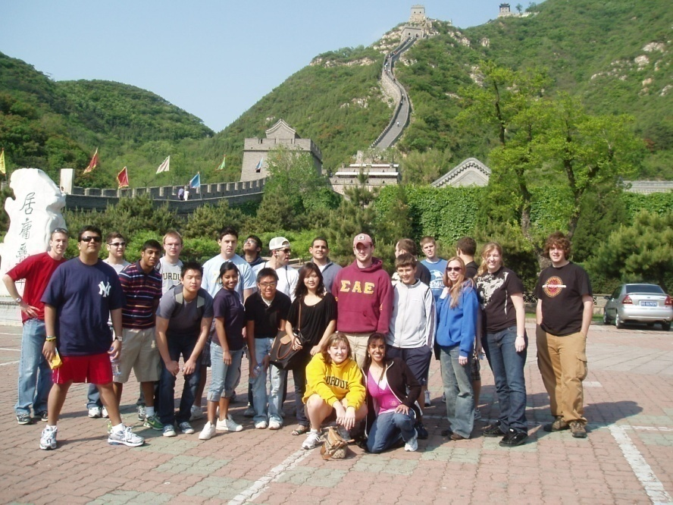
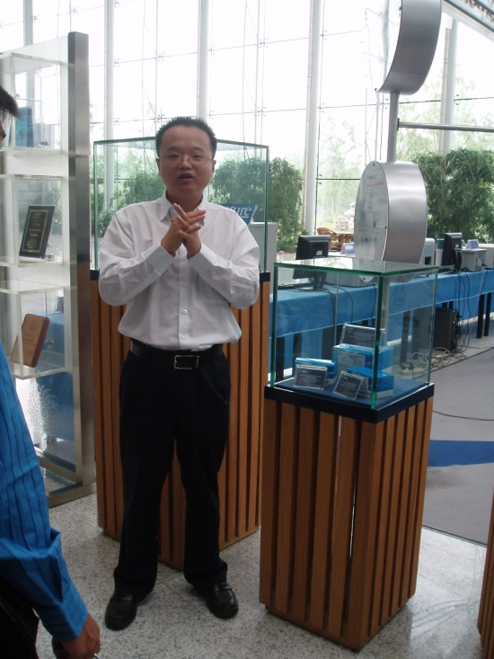
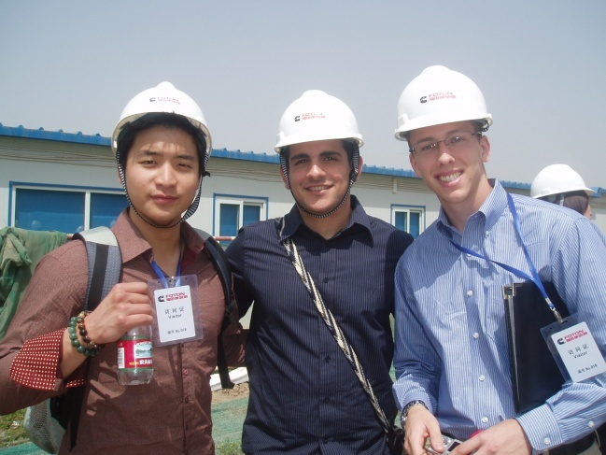
Global Entrepreneurship and Innovation
Beijing and Hong Kong – May 2011
Beijing and Shanghai – May 2010
Beijing and Shanghai – May 2009
Beijing – May 2008
South Korea – May 2007

Slide 9



Women and Leadership Course
Majors represented:
Management
Communications
Nuclear Engineering
Photo & Related Media
Selling & Sales
Public Relations & Rhetorical Advocacy
Computer Science
Agricultural Economics
Elementary Education
Chemical Engineering
Political Science
Retail Management
Industrial Engineering
Behavioral Neuroscience Psychology
Thru Spring 2008 | ENTR 200 Enrollment since launch | Purdue Students 2007
Male | 76% | 57%
Female | 24% | 43%
Increase to 34% female in Spring 2009 !
Now housed in Department of Communication

Slide 10
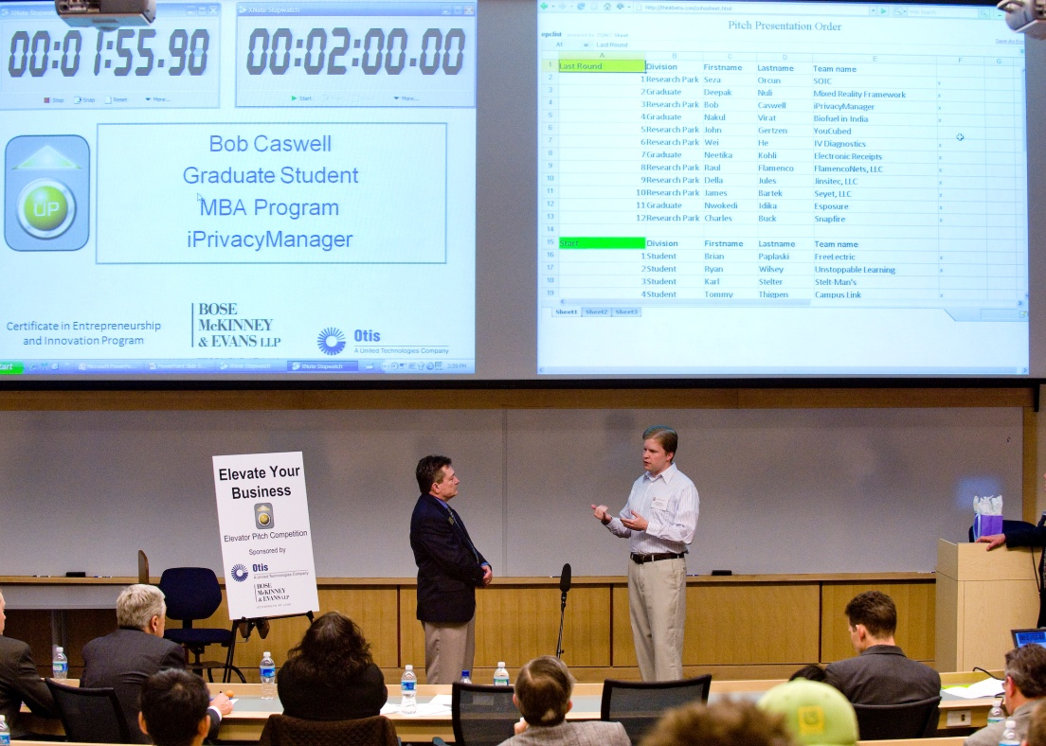
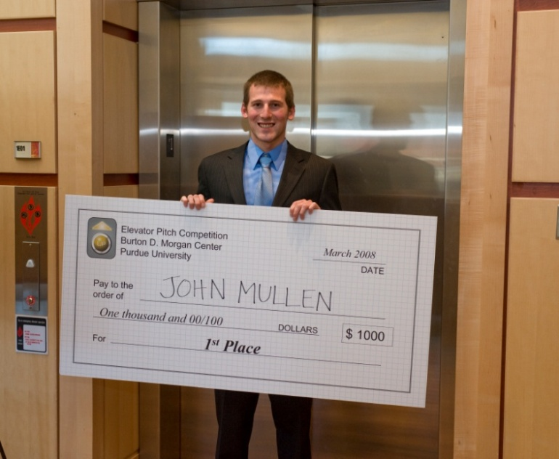
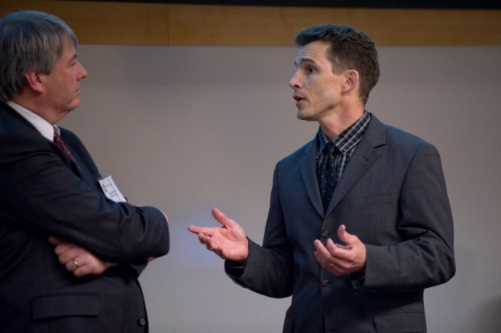
Elevator Pitch Competition
Launched in 2007 as part of the Certificate Program
2 divisions - students and Purdue Research Park/DP/or faculty entrepreneurs
30 teams competed in 2009

Slide 11
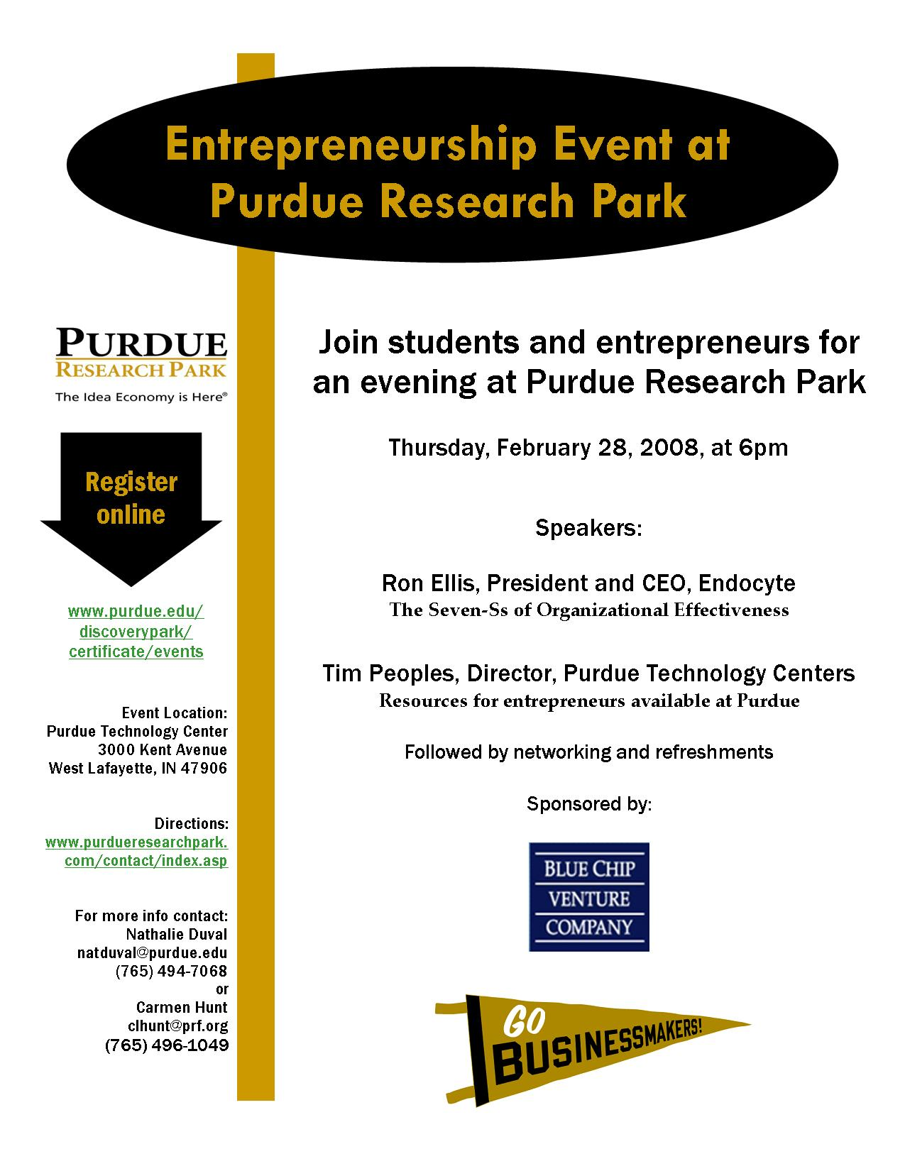
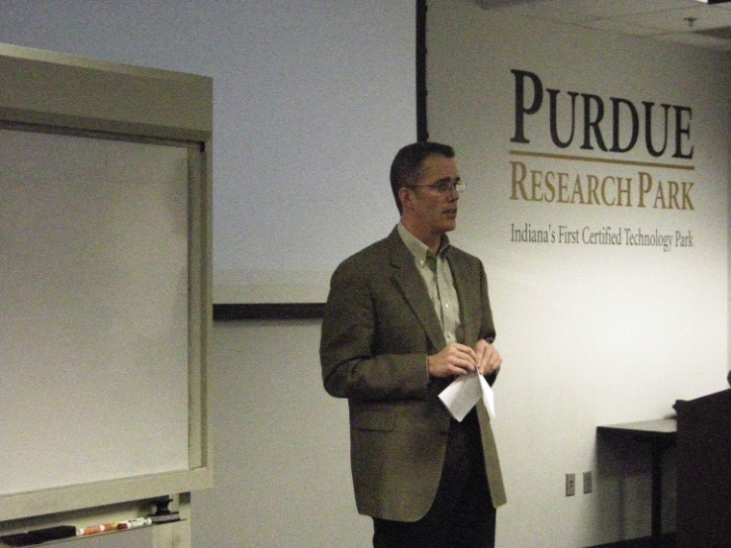
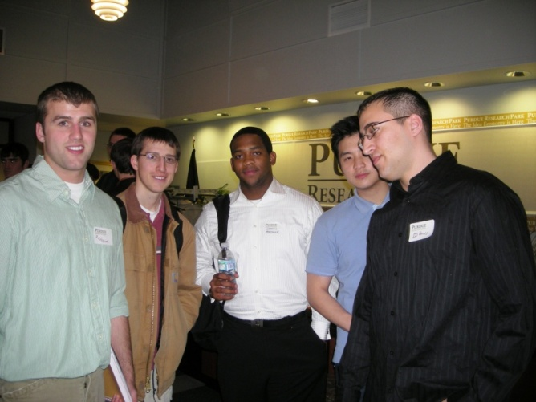
Awareness of Purdue Resources

Slide 12
Perceived Skills at Certificate Entry and Exit
Below average
Average
Above Average
Excellent
Source: ENTR 200 survey n=1672, Exit survey n=158 (Spring 2006 – Spring 2009)

Slide 13
ENTR courses improved my…
 | Disagree or Unsure | Agree | Strongly Agree
Analytical skills | 15% | 61% | 24%
Communication skills | 15% | 57% | 27%
Presentation skills | 13% | 54% | 33%
Ability to evaluate ideas | 6% | 45% | 48%
Confidence that I can be an entrepreneur | 11% | 40% | 49%
~ 85-95% Agree
Exit survey Spring 2007-09, n=158

Slide 14
Career Plans
 | Somewhat useful | Very useful
To what degree do you feel that the skills and knowledge gained in the Certificate Program will be useful in your future career? | 28% | 66%
 | Yes
Are you currently involved in a start-up venture of any kind? | 25%
 | Likely | Very likely
How likely are you to be involved in an entrepreneurial venture in the future? | 32% | 54%
Source: Program exit survey n=158 (Spring 2007 – Spring 2009)

Slide 15
Course Evaluations
5 = Strongly Agree
4 = Agree
3 = Undecided
2 = Disagree
1 = Strongly Disagree
Mean ratings – Spring 2009

Slide 16
What did you like most?
“Being able to gain knowledge outside of my major.”
“I loved sitting in a multidisciplinary classroom with a diverse group of students.”
“The Capstone Course - Level of interaction with very successful entrepreneurs.”
“The most beneficial fact to me is coming out of the program with a business plan in hand.”
“The wide variety of outside speakers that shared different ideas.”
“All of the extra resources and events.”
ENTR 200 Exit Survey Spring 2007-08

Slide 17
Research Collaboration with Engineering
NSF funded: Entrepreneurship Education and Its Impact on Engineering Student Outcomes: The Role of Program Characteristics and Faculty Beliefs*
Institutions |  | Study Components |  | Goal
Purdue Penn State North Carolina State NCIIA |  | Student characteristics and outcomes Program characteristics Faculty beliefs |  | Explore relationships to help inform program development, improve educational experiences, and evaluate their success
* with Teri Reed-Rhoads & Shiva Haghighi

Slide 18
Research Questions - Purdue
To what degree are engineering students participating in entrepreneurship education?
How familiar are they with entrepreneurship terms and concepts?
What are their perceptions of their entrepreneurship-related abilities?
What are their attitudes toward entrepreneurship as a career?
To what degree is entrepreneurship being addressed in their engineering courses?

Slide 19
NSF Study: Preliminary Results
Relatively high rates of participation among:
  International students
  Students whose parents are entrepreneurs
  Mechanical and electrical engineering
Students who have taken at least one course had significantly higher perceptions of their:
  Self-efficacy in technology entrepreneurship
  Knowledge of entrepreneurial terms and concepts
  Ability to evaluate business ideas, to deal with uncertainty, and tolerate risk

Slide 20
NSF Study: Preliminary Results
Students who had take one course were 2-3 times more likely to have experience with:
  market analysis
  technology commercialization
  business presentations
  internships in startups
Less than 30% felt that entrepreneurship was being addressed by engineering faculty or in their engineering programs

Slide 21
Model: Work in partnership with colleges
ENTREPRENEURSHIP
(turbo)
Lens through which to see opportunities
Tools to evaluate
Understanding of what it takes to execute
OUTCOMES
Marketable experiences to employers
Expanded career options
MAJOR
Discipline- specific expertise

Slide 22

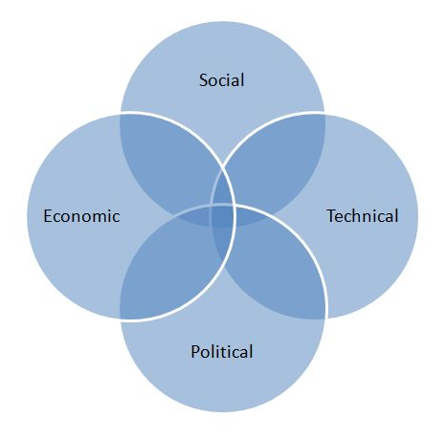



Engineers + Entrepreneurship = Possibilities
Customer focused, innovative & value-driven Certificate Program
Hank Feeser, PhD

Slide 23
Engineers & Entrepreneurship @ Purdue
Ideas ≠ Opportunity
Opportunity ≠ Successful Business
Solve a problem = 10X better
Be disruptive
Team > ∑ Individuals
Make meaning
Have fun

Slide 24
Learn
From - Successes & Failures
About - Business Models
By doing - Competitive Analysis
Why - IP is not an end all
Doing - What Matters.....

Slide 25
Thank you
For more information or to get involved, Please contact:
Nathalie Duval-Couetil, MBA, PhD
Director, Certificate in Entrepreneurship and Innovation Program
Associate Director, Burton Morgan Center for Entrepreneurship natduval@purdue.edu
765-494-7068

Slide 26
EXTRA SLIDES

Slide 27
ENTREPRENEURIAL STUDENTS

Slide 28
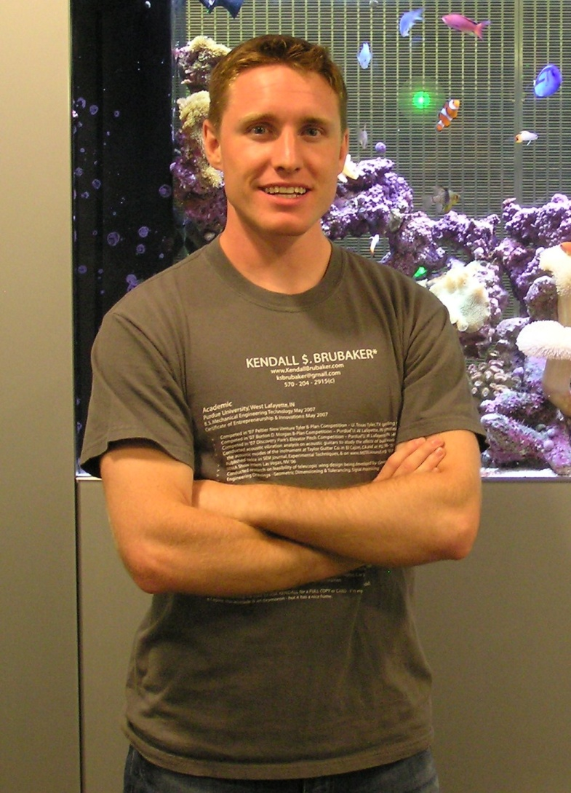
Kendall Brubaker
Mechanical Engineering Technology, May 2007
Elevator Pitch Participant
Attended Berkshire Hathaway shareholders meeting
Branch Manager, Superfund Asset Management, Inc., Chicago
“There are three core characteristics of success that my ENTR classes taught me: passion, commitment, and ownership. Rather than having to climb the corporate stairs, with the experience in the entrepreneurship program, students may well find themselves riding the elevator to the top.”

Slide 29
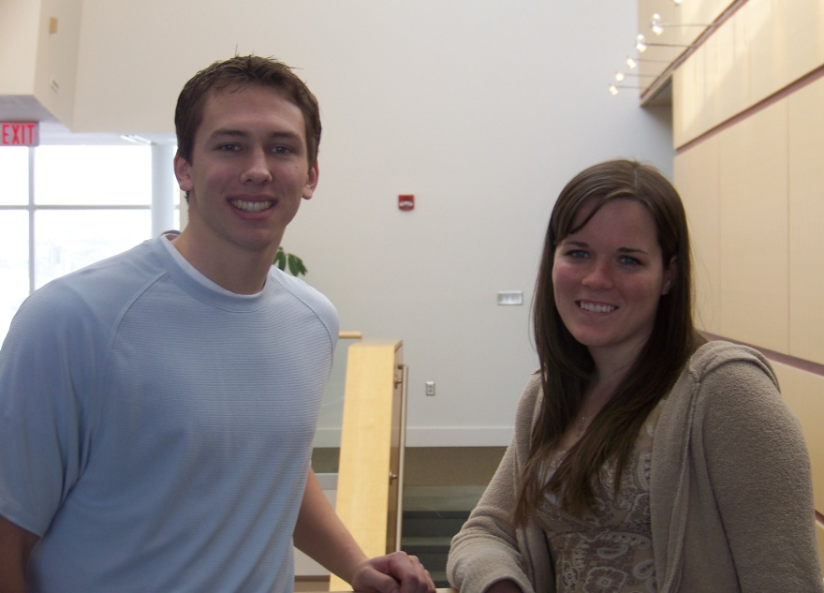
Kristeen Hudson and Brian Paplaski
Graduates, May 2009
  Kristeen, Computer Graphic Technology
  Employed by Exact Target in Indianapolis
  Brian, Accounting and Finance
  Employed by Morningstar in Chicago
Launched MissionMixUp in 2008
Social networking and fundraising site for people interested in mission trips
Participated in the 2009 Certificate Program Elevator Pitch Competition
2009 Winners of the Burton D. Morgan Business Plan Competition
“ Without the Certificate Program, MissionMatchUp would have never gotten off the ground. The program gave our team the fundamental knowledge and confidence needed to start the company, which has been one of the most rewarding things we have done while in college. We would have never pursued this avenue without the encouragement of the Certificate Program faculty.”
www.missionmixup.com

Slide 30
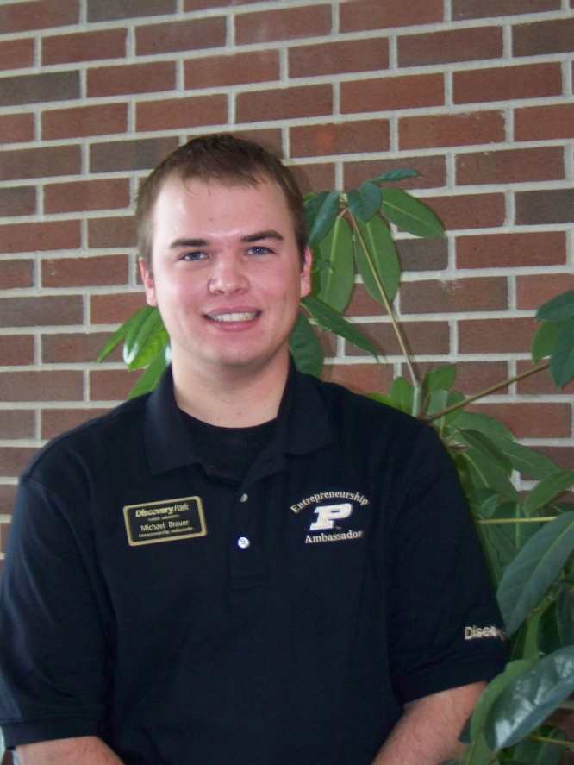

Michael Brauer
Management and Accounting, Minor in Marketing, May 2009
Launched Write to College in 2009
Founded to help students earn higher scores on the SAT and ACT's toughest new section: Writing
Participated in the 2008 Global Entrepreneurship Study Abroad Program in China
“The Entrepreneurship Program encouraged me to constantly look for opportunities, express my creativity, enhance my leadership and collaborative skills, and gave me the confidence I needed to launch my own venture.”
www.writetocollege.com

Slide 31
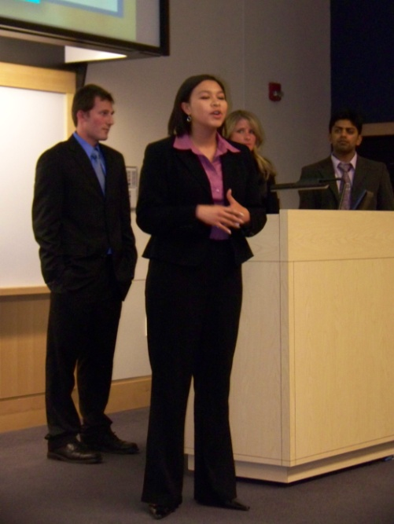
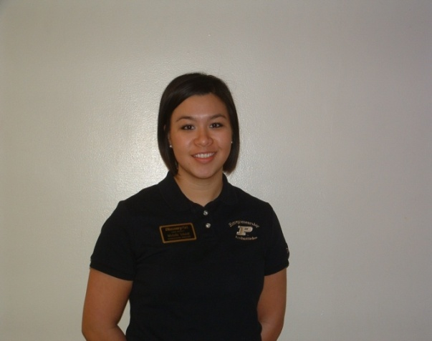
Michelle Scheidt
Biomedical Engineering, May 2008 graduate
Management Minor
Entrepreneurship Ambassador
Intern with Axogen, Alachua, Florida
Regulatory Affairs Specialist for Clinical Systems, GE Healthcare
“I was able to obtain a fabulous marketing internship with a small start up company which specializes in peripheral nerve regeneration. My internship culminated my biomedical engineering, management, and entrepreneurship interests into one neat experience.”

Slide 32
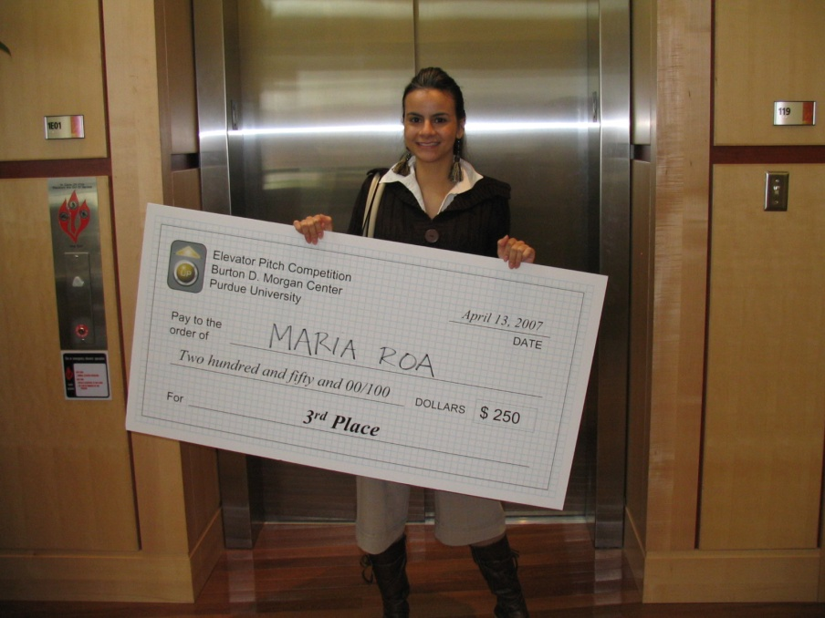
Maria Roa
Management major, Senior
Minors in international business, economics, art and design
Entrepreneurial Learning Community
Certificate Program Ambassador
Peterson scholarship recipient
Elevator Pitch award winner
Finalist in Ball State’s Nascent 500
Summer intern with Versace in NYC
Is currently starting company - Qvit
“I gained a lot of confidence because classes were very interactive and focused on real startups… I had a big idea but it was not until I start competing and meeting actual VCs that I really start giving shape to Qvit.”

Slide 33

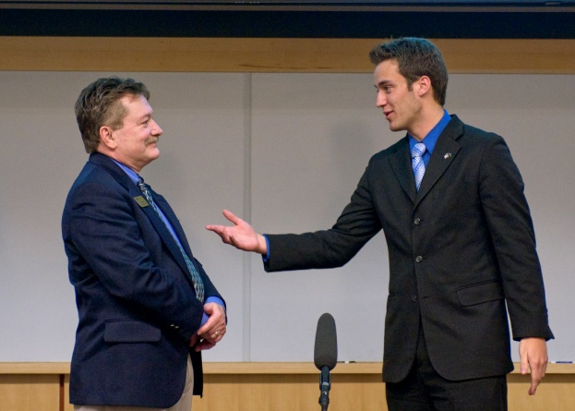
Vince PeGan
Management major
Interns for Indiana, Summer 2008
  Scott A. Jones Enterprises (SAJE)
Award winner Elevator Pitch Competition
Peterson Scholarship Recipient, 2007-08
Cultural, Technological, Environmental Exchange (CTEE)
Employed by Exact Target in Indianapolis
"The Program allows you to gain a firm grasp on all aspects that go into a startup. With the skills and knowledge I've gained, I'm confident that with the right idea, someday I will succeed in my own business endeavor."

Slide 34


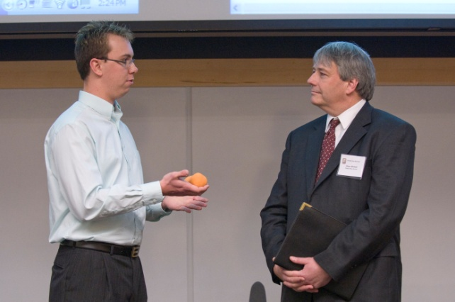
Sawyer Sparks
Agricultural Economics, Junior
Minor, Political Science
Launched Greene BioFuels in 2005
Launched Soy-Yer Dough in 2007
Elevator Pitch Competition, IEDC Collegiate Bootcamp
Appeared on ABC’s entrepreneurship show Shark Tank in September 2009
“The Certificate Program has given me the opportunity to hone my entrepreneurial skills. There’s always someone offering great advice.”

Slide 35









Links to student ventures …
Proemus

Slide 36
Going Forward
Continue to refine and develop curriculum
“Package” what we have accomplished
Develop alumni program
Target the right students
Expand global and experiential learning
Attract funding
  Near term: curriculum development and scholarships
  Longer term: endow/name program

Slide 37
Satisfaction with Program
Below Average
Average
Above Average
Excellent
Exit survey Spring 2009 n=158

Slide 38
Diverse Entrepreneurial Interests
Electric vehicle drive systems Wireless technology Nanotechnology product manufacturing Web-based entertainment Publishing company or magazine Brand identity advertising firm Biotech Aquaculture operation Graphic design firm Fuel and aircraft charter/rental services Orthopedic implant design and mfg Recording studio Commercial photography Adventure travel company | Bakery/deli Wine and wine industry Coffee shop Boarding stable or dude ranch Chain of spas Motorcycle sales and service Clothing and accessories boutique Law firm Non-profit community center Real estate developer Hip hop radio station Accounting firm Speech therapy clinic Pumpkin farm
ENTR 200 survey Spring 2006 to Spring 2008

Slide 39
Overview
10-12 ENTR core sections per semester
40-50 students each
Encourage start in first or second year
Mix of faculty and lecturers
Integration with complementary programs
  Entrepreneurial Learning Community
  Interns for Indiana
  Discovery Park Undergraduate Research Internship

Slide 40
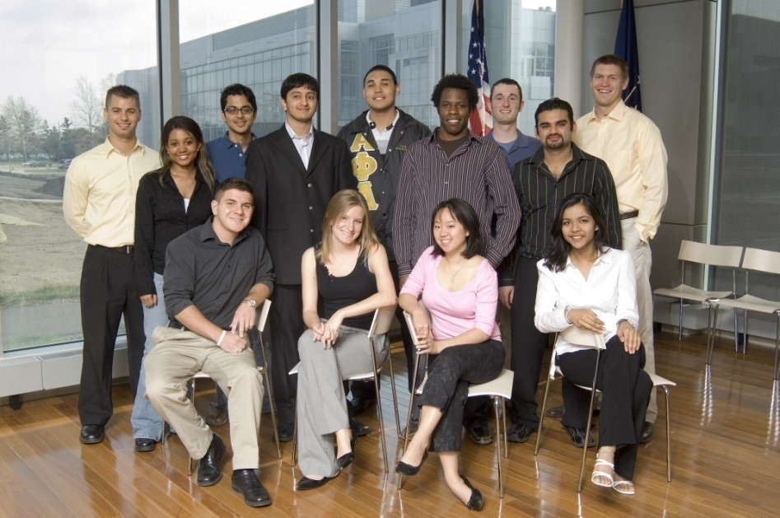
Other Activities
Student Ambassadors
Scholarships
Grants/Research
Student organization: Purdue Innovations
Purdue recruitment events
K-12 engagement
Breakfasts, speakers
Discovery Park Recognition Dinner
Notable presence at state-wide events & competitions
Networking
Facebook & LinkedIn groups
First cohort of Certificate Program graduates (May 2007)

Slide 41
Rate your entrepreneurial ability
Source: ENTR 200 survey n=1672, Exit survey n=158 (Spring 2006 – Spring 2009)

