Slide 1
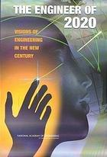
Educating the Engineer of 2020 Workshop
Stewart Center
Purdue University
September 21, 2010
Steven P. Nichols, Ph.D, J.D., P.E.
Professor of Mechanical Engineering
Director, Chair of Free Enterprise
Director, Advanced Manufacturing Center
Cockrell School of Engineering
University of Texas

Slide 2
Educating the Engineer of 2020 Workshop:
Embedding Elements of Entrepreneurship into Engineering Courses

Slide 3
Partially Funded by NSF Grant #0650249 Partnerships for Innovation Program

Slide 4
Chair of Free Enterprise
… to create and nurture a culture of technology innovation, creativity, and leadership at The University of Texas and the global community that we serve.
Notes:
etc

Slide 5
Outline
Part 1:
Entrepreneurship and Technology Innovation
Part 2:
Universities and Technology Commercialization
Part 3:
Entrepreneurship and Engineering Education

Slide 6
Operating Premise
Adopt
Adapt
Create

Slide 7
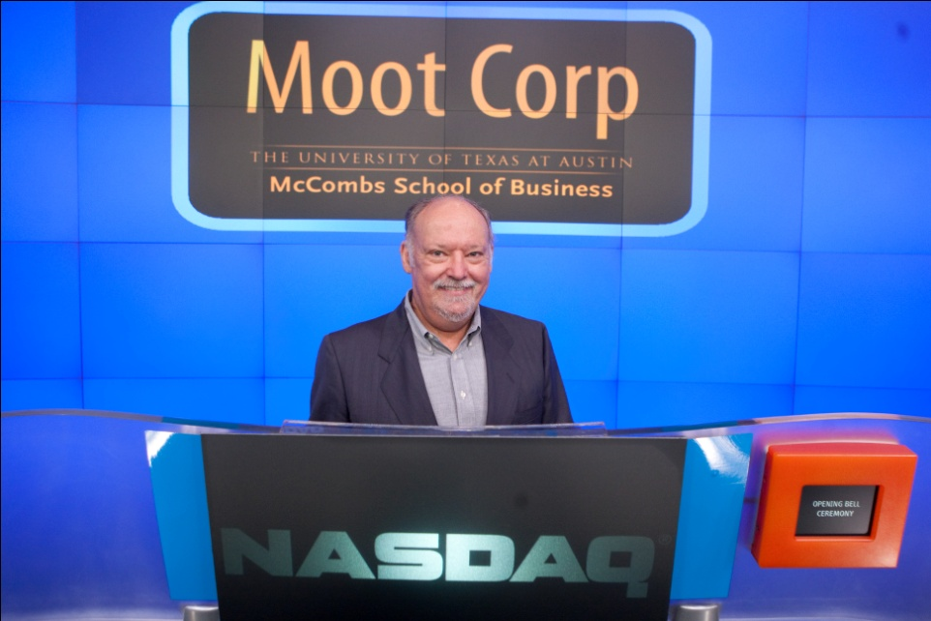
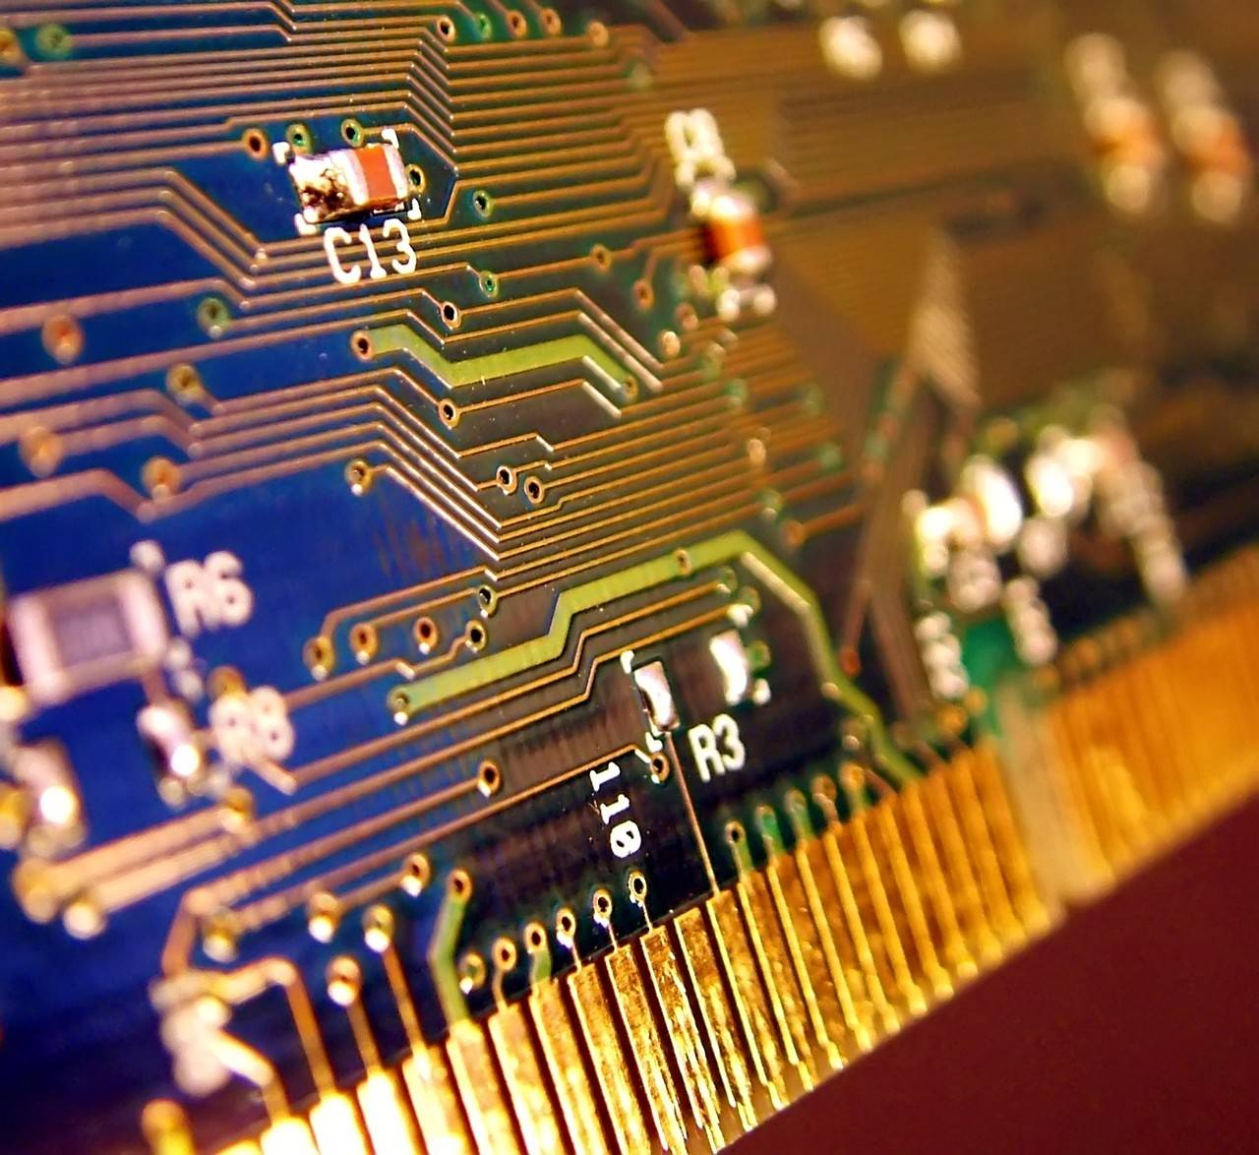
Part 1: Entrepreneurship and Technology Innovation

Slide 8
Regional Advantage
Seattle
Minneapolis
Boston
Portland
Salt Lake City
Troy-Albany
Colorado Springs
Silicon Valley
New York
Los Angeles
Raleigh-Durham
Phoenix
Dallas
Austin
San Antonio
Orlando
Annalee Saxenian, “Regional Advantage”,
Harvard University Press, 1994, 1996.
The University of Texas at Austin

Slide 9
“Top Inventive Towns in America”, (Wall Street Journal 22-23 July 2006, pg. P6)
No | Town | # Patents (2005)
1 | San Jose, CA | 3,867
2 | Sunnyvale, CA | 1,881
3 | Austin, TX | 1,705
4 | Palo Alto, CA | 1,601
5 | Fremont, CA | 1,440
6 | San Diego, CA | 1,382
7 | Cupertino, CA | 1,360
8 | Boise, Idaho | 1,213
9 | Mountain View, CA | 1,128
10 | Santa Clara, CA | 1,096

Slide 10
Almost Universal Statement
“Its easier to be successful at technology commercialization somewhere else!”
Note: Statement vs. Fact

Slide 11
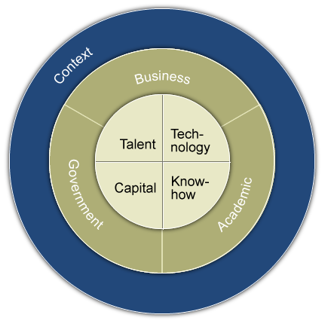
Entrepreneurial Infrastructure

Slide 12
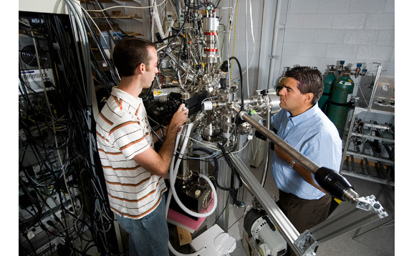
Does Technology Have Inherent Application?
Intellectual value?
Academic value?
Societal value?
Notes:
Step 1: Idea Stage: Commercialization starts here
An imagination of a breakthrough idea links a technology with a market need,
At this stage, prospects for a technical breakthrough get combined with a potentially attractive market opportunity.
Most ideas are also killed at this stage.
Why do you think so many ideas are killed here?
Competition begins here -- competition of ideas for resources.
The attrition of ideas is due to subjective idea judgement.
Investment at this stage usually low: Example: Small Business Innovation Research (SBIR) grants:
$50,000 in a small- company idea or technology -- “Phase I” grant
Phase II-- requires significant advancement of the technology, a prototype for example, with a larger investment, up to $500,000
Quicklook technology assessment useful at this stage.
Limited information constrains the analysis
Useful to determine whether to proceed and invest more
Idea stage is most closely associated with basic research
Next stage, Imagine, most closely associated with applied research
But research can occur at every stage in the commercialization process.
Often each stage requires a different type of research.
What are special challenges at this stage?
There are many ideas competing for resources.
The determination of whether an idea is worth pursuing is a very subjective action.

Slide 13
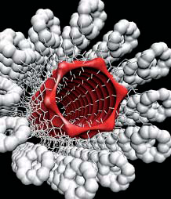
Does Technology Have Inherent Application?
Intellectual value?
Academic value?
Societal value?
Technology has no additional social value until one creates a link between the technology and social need
Notes:
Step 1: Idea Stage: Commercialization starts here
An imagination of a breakthrough idea links a technology with a market need,
At this stage, prospects for a technical breakthrough get combined with a potentially attractive market opportunity.
Most ideas are also killed at this stage.
Why do you think so many ideas are killed here?
Competition begins here -- competition of ideas for resources.
The attrition of ideas is due to subjective idea judgement.
Investment at this stage usually low: Example: Small Business Innovation Research (SBIR) grants:
$50,000 in a small- company idea or technology -- “Phase I” grant
Phase II-- requires significant advancement of the technology, a prototype for example, with a larger investment, up to $500,000
Quicklook technology assessment useful at this stage.
Limited information constrains the analysis
Useful to determine whether to proceed and invest more
Idea stage is most closely associated with basic research
Next stage, Imagine, most closely associated with applied research
But research can occur at every stage in the commercialization process.
Often each stage requires a different type of research.
What are special challenges at this stage?
There are many ideas competing for resources.
The determination of whether an idea is worth pursuing is a very subjective action.

Slide 14
Does Technical Knowledge Have An Inherent Application? Inherent Social Value?
Don’t confuse intended application with an inherent application
Intended application may not even be a valid application (See Post-Its® and Viagra ®)

Slide 15
Market opportunity?
High density digital storage
Compact and mobile
Input/output device
Audio capabilities

Slide 16
Source: www.apple.com/ipod/

Slide 17
Source: www.apple.com/ipod/

Slide 18
Source: www.apple.com/ipod/

Slide 19
Source: www.apple.com/ipod/

Slide 20
Technology Commercialization
No inherent application
It is an intellectual challenging and rewarding experience involving creativity similar to the research that makes it possible.
It is a value creating activity
… is it engineering?

Slide 21
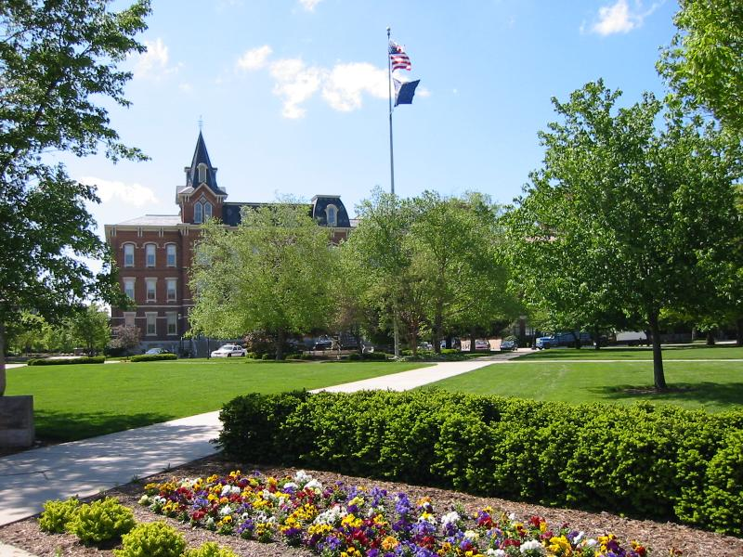
Part 2: Universities and Technology Commercialization

Slide 22
UT SYSTEM
15 component institutions
9 general academic universities
4 medical schools
9 nursing schools
Student Population
202,240 students
Approx. 41,779 degrees awarded
UT System employees:
61,800 personnel
The University of Texas at Austin
Notes:
Source 2010 Quick Facts

Slide 23
$12 billion operating budget
18% from state general revenue
>$2.25 billion in research spending
Consider the Flagship Institution---

Slide 24
UT Austin
annual enrollment of about 50,000 students
awards the greatest number of doctorate degrees of any university in the nation
students from all 50 states and about 120 foreign countries

Slide 25
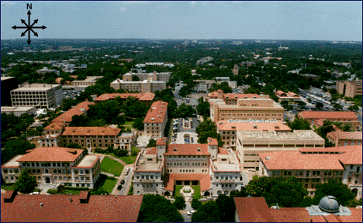
Sponsored research (2009)
> $535 M/yr. (approx)
Note that data on following slides are not for the same AY
Notes:
Quick Facts 2010

Slide 26
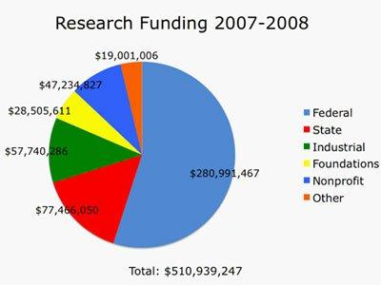
Funding by Source

Slide 27
FACULTY RECOGNITION
Nobel Prizes 2
(Chemistry, Physics)
National Academy of Sciences 18
National Academy of Engineering 29

Slide 28
Active NAE Faculty Members

Slide 30
Who Cares?

Slide 31
The University of Texas at Austin
Logo 1: “Were Texas”

Slide 32
University of Texas at Austin
Logo #2:

Slide 33
Entrepreneurial Infrastructure

Slide 38
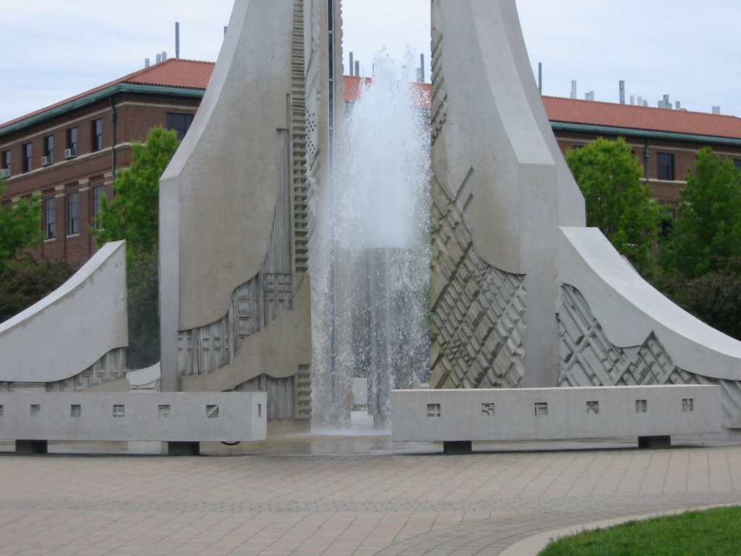
Missions of University
Universities create and disseminate knowledge
Education
Research
Service

Slide 39
Universities in the Marketplace
What did Derek Bok have to say about technology commercialization from universities?
Bok, Derek, Universities in the Marketplace: The Commercialization of Higher Education, Princeton University Press, 2003.

Slide 40
Bok
“Entrepreneurship is no longer the exclusive province of athletic departments and development offices; it has taken hold in science faculties, business schools, continuing education divisions, and other academic unites across the campus.”
Bok, pg. 4

Slide 41
Bok
“…to commercialize a university is to engage in a practice widely regarded in the academy as suspect of not downright disreputable.”
Bok, pg. 18

Slide 42
Bok
Concerns
Accuracy
Secrecy
Publications
Promotion
Conflicts of Interest
Corporate efforts to influence results

Slide 43
Conflicting Values – Common Interest
UNIVERSITY
INDUSTRY
Knowledge for Knowledge’s Sake
Management of Knowledge for Profit
Teaching
Research
Profits
Commercialization of New and Useful Technologies
Service
R&D
Development
Confidentiality Limited Public Disclosure
Academic Freedom Open Discourse
Louis P. Berneman, 1999

Slide 44
“A reputation for integrity is the second most important asset of a university.” S. Nichols

Slide 45
Problems?
Why would a university add technology commercialization to the mix of already complex issues?
Is it in their Missions?
Should it be in their Missions?

Slide 46
Missions of University
Universities create and disseminate knowledge
Education
Research
Service

Slide 47
Clarification
Knowledge encompasses both content and process

Slide 48
Proposition
Universities have obligations to support positive social change

Slide 49
Sources of Obligation
University obligations as corporate citizen
“Professional” obligation as corporate citizen
Personal obligation as citizen

Slide 50
Value Added: Three Categories
Intellectual and Academic
Social
Economic
Note: Overlaps

Slide 51
Hypothesis:
One of the most important mechanisms for universities to add social value is by adding economic value

Slide 52
Knowledge Transfer Process
Social & Economic
Knowledge Generation
Transfer Functions
Value Added

Slide 53
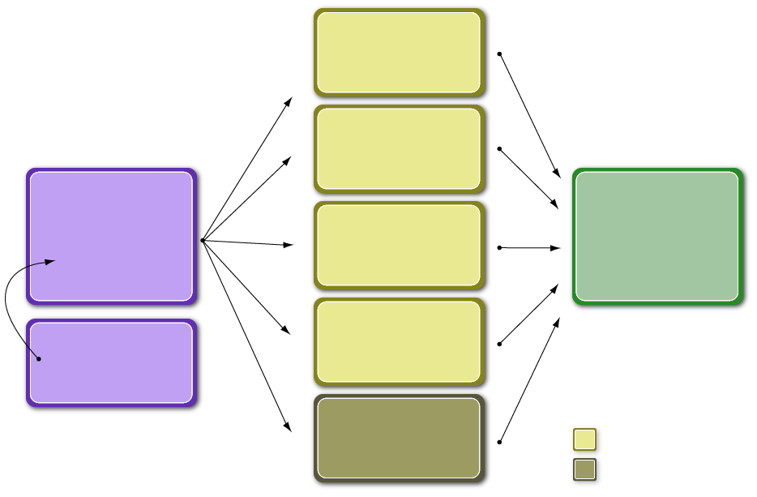
Graduates
Faculty Consulting
University
Social
Value Added
(Knowledge Generation)
Faculty / Staff Departures
Economic
Value Added
Publications
Funding Sources
Non-traditional Transfer Functions
Mechanisms:
Natural
Non-traditional

Slide 54
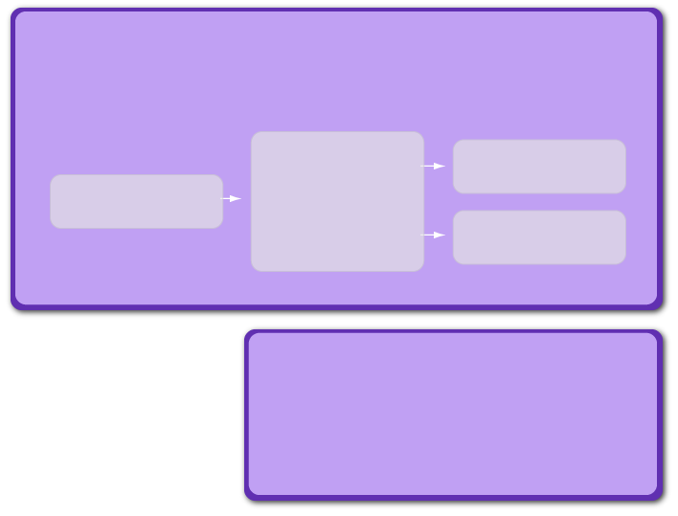
University
(Knowledge Generation: Intellectual Value Added)
Research Results
Faculty Driven
Research
Graduates
Government (various levels)
Universities
Industrial
Commercial
Foundations and Not-for-Profits
Individuals
Gifts
Etc.
Funding Sources

Slide 55
Graduates
Faculty Consulting
University
Social
Value Added
(Knowledge Generation)
Faculty / Staff Departures
Economic
Value Added
Publications
Funding Sources
Non-traditional Transfer Functions
Mechanisms:
Natural
Non-traditional

Slide 56
Examples of Economic Value Added from University of Texas (Based on fundamental research)
Tracor
National Instruments
Nanotechnologies Inc.

Slide 57
Examples of Economic Value Added from University of Texas (Based on fundamental research)
LabNow (AIDS detection—UT/Harvard)
Molecular Imprints
Therasense (FreeStyle)

Slide 58
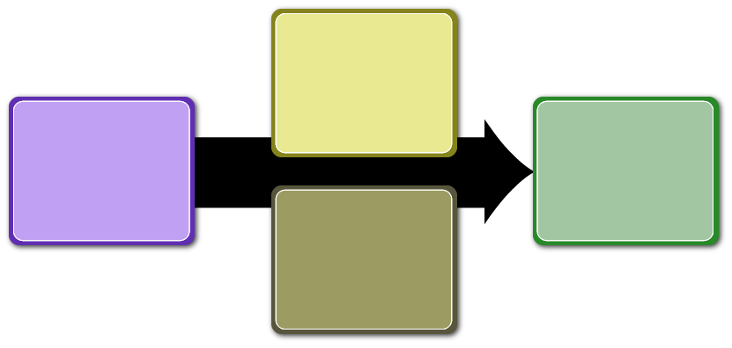
Natural
Transfer Functions
Social & Economic
Knowledge Generation
Value Added
Non-traditional
Transfer Functions

Slide 59
UT Internal Partners in Technology Commercialization
Office of
Sponsored Projects
Office of
Technology Licensing
Office of the V. P. for Research
DEPARTMENT OF
BIOMEDICAL ENGINEERING
The College of Natural Sciences
Center for Nano- and Molecular
Science & Technology
Clint W. Murchison
Chair of
Free Enterprise
Herb Kelleher
Center for Entrepreneurship
The University of Texas at Austin

Slide 60
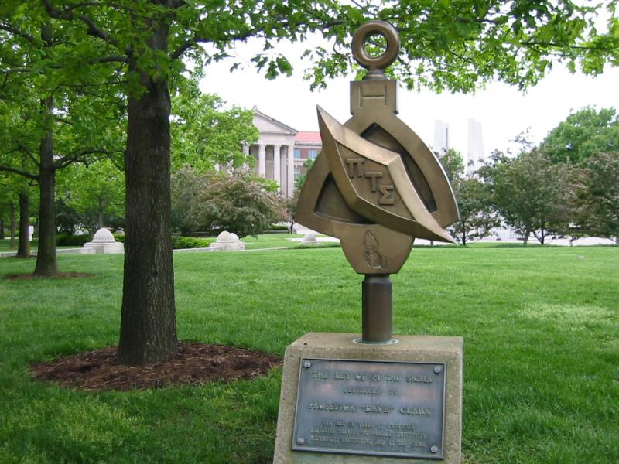
Part 3: Entrepreneurship and Engineering Education

Slide 61
“I am a man’s past.” Nicholas Nichols, age 5

Slide 62
EFAC/Faculty Task Force
What should the College do in Entrepreneurship?
For engineering students with special interests in entrepreneurship
For all engineering students
Students with interests in graduate study
Students with interest in small businesses
Students with interest in large corporations
Students who don’t know their interests

Slide 63
Entrepreneurship
What does “entrepreneurship” mean in the context of engineering?
Does “entrepreneurship” have a place in engineering education?

Slide 64
Entrepreneurship vs. Technology Entrepreneurship

Slide 65
EFAC Task Force: National Science Foundation
Entrepreneurship and Decision Making
Ability to manage complexity and uncertainty
Problem formulation as well as decision making
Ability to advocate and influence
Teamwork and sensitivity in interpersonal relations
Ability to realize products

Slide 66
EFAC Task Force: Boeing has recommended that engineering students (and engineers) have:
A realization of the context in which engineering is practiced including economics, business practice, history and societal needs
An ability to think critically and creatively as well as independently and cooperatively
An ability and the self-confidence to adapt to rapid and major change (flexibility).
(EFAC added: An ability to raise funds, and identify and manage risk)

Slide 67
ABET Criteria 2010
(a) an ability to apply knowledge of mathematics, science, and engineering
(b) an ability to design and conduct experiments, as well as to analyze and interpret data
(c) an ability to design a system, component, or process to meet desired needs within realistic constraints such as economic, environmental, social, political, ethical, health and safety, manufacturability, and sustainability
(d) an ability to function on multidisciplinary teams
(e) an ability to identify, formulate, and solve engineering problems
(f) an understanding of professional and ethical responsibility
(g) an ability to communicate effectively
(h) the broad education necessary to understand the impact of engineering solutions in a global, economic, environmental, and societal context
(i) a recognition of the need for, and an ability to engage in life-long learning
(j) a knowledge of contemporary issues
(k) an ability to use the techniques, skills, and modern engineering tools necessary for engineering practice.

Slide 68
EFAC/Faculty Task Force
What should the College do in Entrepreneurship?
For engineering students with special interests in entrepreneurship
For all engineering students
Students with interests in graduate study
Students with interest in small businesses
Students with interest in large corporations
Students who don’t know their interests

Slide 69
Identification of the Innovation Gap in Engineering Education
INNOVATION (Synthesis)
Univ. Research
Business Plans & Incubators
INNOVATION GAP
Knowledge Creation
Tech./Mkt.
Opportunity Creation
Specific Product Creation
Commercial Demonstration
Production & Marketing
Sustaining Operations
FEEDBACK
The Commercialization Process and Innovation Gap

Slide 70
Creation of the Idea to Product® Program (Education and Events)
INNOVATION (Synthesis)
Univ. Research
The Idea to Product® Program
(curricular and extra-curricular)
Business Plans & Incubators
Knowledge Creation
Tech./Mkt.
Opportunity Creation
Specific Product Creation
Commercial Demonstration
Production & Marketing
Sustaining Operations
Feedback
Crossing the Innovation Gap: The I2P® Program

Slide 71
Idea to Product Events
I2P UT Austin
European I2P (Imperial College/Aachen)
Asian I2P
Undergraduate Social I2P (Perdue)
Italian I2P
I2P Portugal
Egyptian I2P
Latin American I2P
Global I2P

Slide 72
Natural
Transfer Functions
Social & Economic
Knowledge Generation
Value Added
Non-traditional
Transfer Functions

Slide 74
