Slide 1
Stepping Outside the Engineering Mind
Educating the Purdue Engineer of 2020
Donna Riley
Smith College

Slide 2
Overview
What perspectives does the engineer of 2020 need with respect to society and the environment?
How can we structure curricula and classroom experiences to enable students to develop these perspectives?
What institutional structures and postures can support the effort?

Slide 3
Perspectives
Co-construction of technology and society (as opposed to “impacts”)
Epistemic frames
Critical thinking not only within but also about engineering
Social change orientation

Slide 4
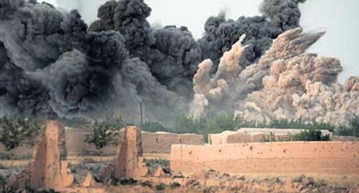
Perspectives: Co-construction
The problem of “impacts”
technological determinism
Myth of neutrality
Ethics simplified, individualized
Co-Construction of Technology and Society
Robust STS concept
Ethical responsibility shifts
Illumines contexts, assumptions underlying technology development and choice

Slide 5
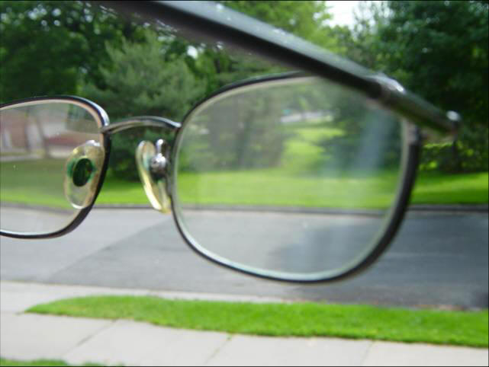
Perspectives: Epistemic Frames
Determining the height of a building
Engineering is positivist
Scientific method, problem solving, design process
Uncertainty: analyze, or live with?
Other ways of knowing
Acknowledging
Respecting
Incorporating (not co-opting)
Relational and transformational

Slide 6
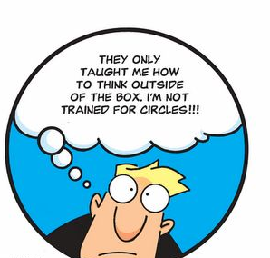
Perspectives: within and about
Critical thinking within engineering
Problem solving: Articulating assumptions
Ethics: Articulating facts, values multiple perspectives
Lab: Working with experimental data
Critical thinking about engineering
Macroethics
Discourse, thematic content
Problem framing, concept definitions
What’s not in the curriculum?
Who’s not in the profession, or not served by it?

Slide 7
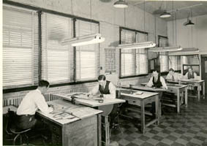
Perspectives: Social Change
No education is politically neutral
What are the current politics of engineering education?
Identify and examine structural problems
Neoliberalism in global and domestic economic policy
Institutional, cultural forms of racism, sexism, homophobia
National priorities and engineering opportunities
Attention to power relations
classroom, workplace, community
Praxis
Act our way to thinking differently?

Slide 8
What we do
Smith College – small, private, liberal arts college for women
Liberal arts, sustainability are defining characteristics
Study abroad
BS or BA options (“engineering and…”)
ABET outcomes balanced and integrated
Engineering science allowed for reinvention
My classrooms – transform content + pedagogy
Engineering & Global Development
Thermodynamics
Mass and Energy Balances
Course in macroethics

Slide 9
Mass and Energy Balances
Intro to ChemE redesigned
Mass and energy balances, problem solving, units
Problem sets AND problem set culture
Industrial Mass Balance AND “Cradle to Cradle”
LCA AND its critics
Green products, class, and consumerism
Anti-regulation posturing in green design
What engineering is AND gendered definitions
Engineering ethics
Micro AND macro ethics
Ethics as problem solving AND alternative framings
Bruntland sustainability AND Morally Deep AND ecofeminist
Critical thinking AND reflective judgment
Information literacy AND open-ended research
Student reflection assignments woven throughout
Reading and discussion in class
Very disciplinary content omitted
RE JECT?
RE FUSE?
RE PAIR?
RE ACT?

Slide 10
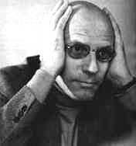
Thermodynamics
Power/Knowledge
Foucault on truth and power in science
Attention to power relations – pedagogies of liberation
Critique of textbook & syllabi
19th c. science applied to 20th c. fossil fuel tech
What do students need for 21st c. energy issues?
Textbook companion
Global energy needs
Technology choice and criteria
Macroethics (e.g., climate and development)
Non-western thermo conceptions and technologies
Student-driven explorations of current topics

Slide 11
Engineering and Global Development
Histories and Theories of Development
Neoliberalism and globalization – why now?
What constitutes development? Who decides?
Co-construction – limits of technology
Examining Assumptions
Critiques of current projects’ models and values
Expertise, action over inaction, individualism, capitalism
Power relations
Constructing participation and colonialism revisited
Past and Present Failures
Why projects fail; Mortgaging the Earth
Danger of engineering-specific development orgs
Transparent critique of our own projects

Slide 12
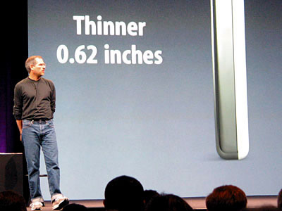
Macroethics
Themes
Technology and control
Science and social inequality
Consumption (domestic, global)
Engineering and social justice
Vehicles
Seminar – reading and student led discussion
Action essays
Self-directed learning proposal and reflections
Case study/term paper

Slide 13
Recommendations – course level
Work incrementally
Be transparent with students
Coverage is the enemy
Use outcomes not content to guide syllabus design
Problem sets and diminishing returns
Teach method and critique together
Creatively pursue development opportunities
Listen to students
Expand/challenge what counts as engineering
Assignments: Reflections, actions, reading/discussion
Pedagogies: authority of experience, holistic focus

Slide 14
Recommendations– institutional
Make it a priority
Coverage is the enemy – use ABET
Support faculty development and course development activities
Cross-disciplinary exchange
Resources – Funding, Time, etc.
Expand what counts as engineering, what counts as valued faculty contributions

