Slide 1
Energy for the 21st Century: A thermodynAmics textbook companion
Donna Riley
Smith College

Slide 2
Overview
What’s missing in thermodynamics education?
Why a textbook companion?
Pedagogical goals
Content goals
Structure of book
Sample modules
Discussion and Feedback

Slide 3
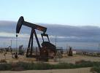
Thermo Education Today
Content: Energy vs. Thermodynamics
Pedagogy: Contradictions in Engineering Education

Slide 4
Energy vs. Thermodynamics
Energy
Thermodynamics
Basic human need
Critical choices amid global concerns for economic development, ecological sustainability
Strong role of policy
Macro-ethical issues
Lay people know about energy
19th century European canon
Theory centered on heat engines, fossil fuels
Minutiae of steam tables eclipses technology choice
Policy and Ethics absent
Thermodynamics is esoteric

Slide 5
Contradictions in Engineering Education
Cooperation vs. Competition
Creativity vs. Conformity
Relevance vs. Theory
Integrated vs. Detached
“the educator, generally, produces answers without having been asked anything.”
– Paulo Freire

Slide 6
What should engineering students learn about energy?
Current and emerging technologies
Heat engines, steam cycles (coal, nuclear)
Heat transfer, materials (solar, fuel cells, geothermal)
Fluid mechanics (wind, hydro)
Energy storage technologies
Openness to new
Policy analysis, social and ethical issues
Technology choice
Fuel/source choice
Co-construction of technology and society
Macroethics of energy policy

Slide 7
Strategy
Engineering education does not prepare graduates to address energy problems
Changing structure of engineering education?
Approach: help students recognize gaps, learn independently
Approach: empower students to demand better energy education

Slide 8
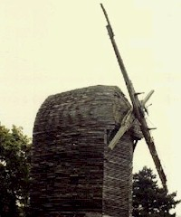
Vehicle: Textbook Companion
Sits alongside existing curricula and textbooks
Addresses non-technical ABET criteria
Modular approach for piece-wise adaptation
E-book format
easily updatable
free to students and faculty
Interactivity

Slide 9
Objectives
Organize around engineering knowledge and skills required for 21st century energy issues
relevance
Incorporate innovative pedagogies that foster intentional and independent learning, critical thinking and reflective action
Integrate accreditation criteria related to technology and society, communications skills, and professional ethics

Slide 10
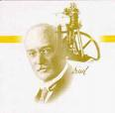
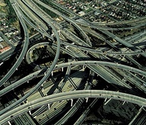
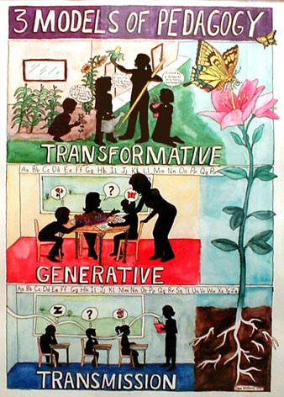
Features
History
Ethics
Sustainability
US Policy
Liberative
(feminist, critical, transformative)
pedagogies
Risk, reliability and safety
International Perspectives

Slide 11
Challenging Content
Challenging unconscious canon creates open questions
What is to be included/excluded?
History of thermo challenges assumptions
Thematic content of science, working with incomplete or incorrect knowledge
Teaching energy policy undermines canon
Why aren’t we learning about renewables?
This isn’t engineering! Assign more problems!

Slide 12
Challenging Pedagogy
Liberative pedagogies require power shifts
Real-world engagement is messy
Student-initiated questions, topics
Students as teachers
Student resistance to pedagogies
How to be relational in a book?

Slide 13
Example Material
Overall structure:
Foundations – pedagogy, energy studies basics
Making theory relevant
New applications
Foundations
Foucault
Theory
First Law: Hunger, Poverty, Obesity
Second Law: Thematic Content of Science
Applications
Overview of technology choice section
Overview of applications section

Slide 14
Foucault: reflexivity around content and pedagogy
Pedagogy
Shift in student awareness and intentionality
Relation between power/knowledge interwoven in what, how, and why students learn – motivates pedagogy
Content
Role of science in forming society’s truths
Epistemic frames
Engages engineering canon, ownership of course content
Syllabus
Fossil fuel emphasis
No education is politically neutral

Slide 15
Foucault (Power/Knowledge)
Free association on “power”, “knowledge”
Reading: Power/Knowledge excerpt on “regime of truth”
Role of science in forming our society’s truths (“’Truth’ is centered on the form of scientific discourse and the institutions that produce it”)
Political forces that influence production and transmission
Stimulates critical thinking about course content, classroom power relations
Helps with later discussions of co-construction of technology and society
Discussion questions
Reflective Essay
Revisits– ideal gas law, multiple statements of 2nd law, history of thermo, critical reading of textbook

Slide 16
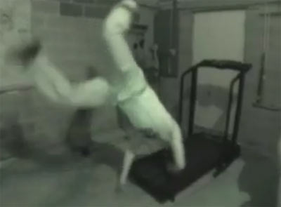
First Law: Hunger, Poverty, and Obesity
Thermo texts often include “biological thermo” unit
Çengel and Boles:
Burger King, Hardee’s, McDonalds
1 L ice cream in one sitting
Bloody Mary, Martini, Beers (and treadmills)
Weight loss rate near 1lb/day

Slide 17
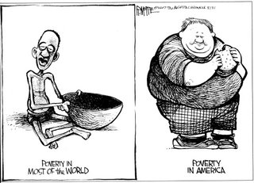
Hunger, Poverty, and Obesity

Slide 18
Impacts of Agricultural Policy
Notes:
http://www.acton.org/commentary/commentary418.php

Slide 20
First Law: Hunger, Poverty, and Obesity
Community-based project
Energy density vs cost of food
Store visits
“Hidden hunger”
Availability and affordability of healthy food across social location

Slide 21
2nd Law: History of Thermo
Thematic content of science
Concise
Balance
Clausius develops entropy in quest for invariants, parsimony, writing (in)equations…

Slide 22
2nd Law: History of Thermo
Multiple Understandings
Kelvin-Planck, Carnot, Clausius – about heat engines
Carnot assumed Caloric Theory of Heat
Microscopic: entropy as (molecular) disorder
Probabilistic understandings: entropy as number of digits in a probability
Time’s Arrow & improbability (not impossibility!) of reversal
Entropy as missing information
Colloquial: “the best you can do is break even”
Using context as framework to make sense of multiple statements
Problem of analogies (rooms, libraries, learners, armies)
Problem of transferring statements as absolutes from one context to another

Slide 23
A different level of systems analysis: technology choice
Selection criteria
Politics and national priorities
Cost
Entrenched economic interest vs. innovation
Efficiency
Scale
Sustainability
including how this is defined – LCA as one tool
Reliability
Safety
Human impacts – jobs, displacement, quality of life…
Co-construction of technology and society

Slide 24
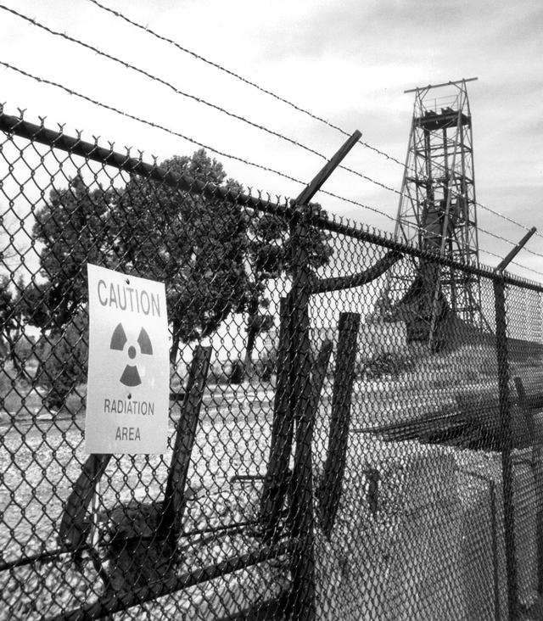
Technology Choice
Example explorations:
Nuclear power as a green alternative?
How the refrigerator got its hum
Hypothetical pump tax to cover war for oil costs
Fuel choices in transportation and/or power generation
Campus cogeneration retrofit

Slide 25
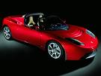
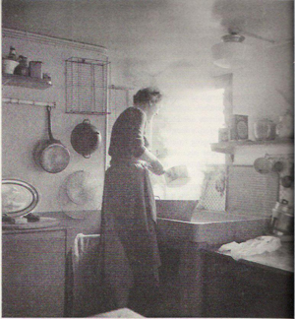
A different level of applications: from cycles to usage sectors
Power generation
Dean Kamen’s Stirling Engine
Transportation
LCAs of ethanol
Who killed the electric car?
Domestic (Refrigeration, Heating, Cooking)
Solar hot water heater design
Industrial (Chemical reactions and separations in manufacturing, environmental)
Fugacity in Superfund Site Cleanup
Processing of biodiesel
Fuel cells

