Slide 1
Sustainability in the First Year Engineering Curriculum
A collaborative effort of the FYE ENE Faculty
Alice L. Pawley
September 22, 2009
Purdue University

Slide 2
“Normalized sustainability” in ENGR 126, 195
Designing for sustainability is (or must be) a normal part of engineering practice
All engineers must become facile with environmental sustainability concepts
Therefore incorporate sustainability in multiple contexts in students’ first engineering course:
Cross-disciplinary
Intergenerational
Intra-curricular
Notes:
..Then, each of the four of you will give a quick description of the sustainability module and the course (or courses) you are fitting it into. This can be rather informal -- good things to include about the project/module would be the main ideas, the objectives and what you are hoping/expecting students to get out of it, how the module helps define sustainability for your field of engineering, what experiences you have had (if you have already had the chance to incorporate the module), etc. You could also include a description of the course students (and where the course fits into the overall curriculum), the course objectives and/or main topics, and how/why you chose to incorporate sustainability into this course. Try to prepare this description to be about five minutes -- Powerpoint projection will be available if you need to use it, but in such a short presentation, it is also fine if you would like to just talk.

Slide 3
Key ideas
Problem definition as initial process of design
Systems Design
Life Cycle Analysis: Cradle-to-grave vs. cradle-to-cradle
Ecological/Energy Footprints

Slide 4
“Normalized sustainability” in ENGR 126, 195
Sustainability:
In class discussions and mini-lectures
In exams, assignments through explicit and implicit questions
Project (F08): Assess the energy footprint of your living space
Project (S09): Design a process by which the energy footprint of campus could be estimated. (Client: ACUPCC, Purdue)
Notes:
..Then, each of the four of you will give a quick description of the sustainability module and the course (or courses) you are fitting it into. This can be rather informal -- good things to include about the project/module would be the main ideas, the objectives and what you are hoping/expecting students to get out of it, how the module helps define sustainability for your field of engineering, what experiences you have had (if you have already had the chance to incorporate the module), etc. You could also include a description of the course students (and where the course fits into the overall curriculum), the course objectives and/or main topics, and how/why you chose to incorporate sustainability into this course. Try to prepare this description to be about five minutes -- Powerpoint projection will be available if you need to use it, but in such a short presentation, it is also fine if you would like to just talk.

Slide 5
“Normalized sustainability” in ENGR 126, 195
Sustainability:
In class discussions and mini-lectures
In exams, assignments through explicit and implicit questions
Project (F08): Assess the energy footprint of your living space
Project (S09): Design a process by which the energy footprint of campus could be estimated. (Client: ACUPCC, Purdue)
www.oberlin.edu/dormenergy
Notes:
..Then, each of the four of you will give a quick description of the sustainability module and the course (or courses) you are fitting it into. This can be rather informal -- good things to include about the project/module would be the main ideas, the objectives and what you are hoping/expecting students to get out of it, how the module helps define sustainability for your field of engineering, what experiences you have had (if you have already had the chance to incorporate the module), etc. You could also include a description of the course students (and where the course fits into the overall curriculum), the course objectives and/or main topics, and how/why you chose to incorporate sustainability into this course. Try to prepare this description to be about five minutes -- Powerpoint projection will be available if you need to use it, but in such a short presentation, it is also fine if you would like to just talk.

Slide 6
“Normalized sustainability” in ENGR 126, 195
Sustainability:
In class discussions and mini-lectures
In exams, assignments through explicit and implicit questions
Project (F08): Assess the energy footprint of your living space
Project (S09): Design a process by which the energy footprint of campus could be estimated. (Client: ACUPCC, Purdue)
http://www.presidentsclimatecommitment.org
Notes:
..Then, each of the four of you will give a quick description of the sustainability module and the course (or courses) you are fitting it into. This can be rather informal -- good things to include about the project/module would be the main ideas, the objectives and what you are hoping/expecting students to get out of it, how the module helps define sustainability for your field of engineering, what experiences you have had (if you have already had the chance to incorporate the module), etc. You could also include a description of the course students (and where the course fits into the overall curriculum), the course objectives and/or main topics, and how/why you chose to incorporate sustainability into this course. Try to prepare this description to be about five minutes -- Powerpoint projection will be available if you need to use it, but in such a short presentation, it is also fine if you would like to just talk.

Slide 7
“Normalized sustainability” in ENGR 126, 195
Sustainability:
F09 195 Classroom studio, assignment, introduced through design & problem definition modules
Notes:
..Then, each of the four of you will give a quick description of the sustainability module and the course (or courses) you are fitting it into. This can be rather informal -- good things to include about the project/module would be the main ideas, the objectives and what you are hoping/expecting students to get out of it, how the module helps define sustainability for your field of engineering, what experiences you have had (if you have already had the chance to incorporate the module), etc. You could also include a description of the course students (and where the course fits into the overall curriculum), the course objectives and/or main topics, and how/why you chose to incorporate sustainability into this course. Try to prepare this description to be about five minutes -- Powerpoint projection will be available if you need to use it, but in such a short presentation, it is also fine if you would like to just talk.

Slide 8
IEECI: Assessing Sustainability Knowledge
NSF Award # 0935066, $150,000; Pawley, Hoffmann, Cardella, Ohland, Jahiel, Streveler, Radcliffe
Identify existing concepts and themes of sustainability currently applied across engineering design. Extensive compilation and analysis of existing literature, syllabi available on existing digital libraries, and curricular resources focused on engineering and sustainability.
Determine a set of engineering students’ understanding and misconceptions of key sustainability concepts in the context of engineering design. Semi-structured interviews with undergraduate students.

Slide 9
IEECI: Assessing Sustainability Knowledge
Create a synthesis of key sustainability concepts and their relationships through the development of a framework suitable for future adaptation to a sustainability concept inventory. Structured iterative feedback from content experts.
Interested in contributing/learning more about IEECI-ASK? Email me at apawley@purdue.edu

Slide 10
Publications
Mudd Design Workshop VII: “Sustaining Sustainable Design” May 28-30, 2009
Under review for subsequent International Journal of Engineering Education special issue publication.
Monica E. Cardella, Stephen R. Hoffmann, Matthew W. Ohland, and Alice L. Pawley, “Sustaining Sustainable Design through “Normalized Sustainability” in a First-Year Engineering Course.”

Slide 11
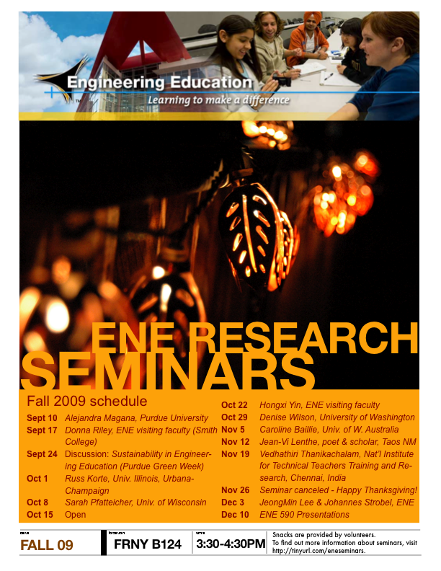
Learn more...
ENE Departmental Seminars, Thursdays 3:30-4:30 FRNY B124
Sept 24 (Green Week) “Sustainability in Engineering Education”

