Slide 1
Engineering 2020 Workshop Panel Vincent G. Duffy, Ph.D., CPE Associate Professor School of Industrial Engineering and Department of Agricultural & Biological Engineering Purdue University Tuesday, September 22, 2009 Incorporating Social & Environmental Issues

Slide 2
Introduction – in the past
1995 - Wrote a proposal and syllabus for ‘Engineering & Society’ (published in AEI 1996 proceedings, Istanbul, Turkey)
Read Technology Review, Samuel Florman (The Civilized Engineer), Hong Kong Ethics Development Council (Ford Pinto case), Harvard Business Cases- Safety Related, partnered with Historian
Sustainable development
1997 in Hong Kong Engineering Curriculum
Environment - considering unintended consequences
In research, environment – became environmental psychology
Ecological validity – impact of environmental variables on outcomes – field studies
Sustainable – how to help develop new markets for emerging capabilities to save lives (eg. Delphi Corp.)

Slide 3
Today – overview of initiatives
Assist in forming Systems Engineering
Considers multi-disciplinary perspectives
For Graduate & Undergrad in the form of Certificate, Concentration, Minor, Multi-disciplinary plans of study
Human factors & Ergonomics
Understanding capabilities & limitations
Digital Human Modeling
Human-Systems Integration
From Human-Machine Interface
7 Grad Level Courses at Purdue including: Safety Engineering, Applied Ergonomics, Job Design, Human Factors in Healthcare Engineering, Modeling Healthcare Systems, Healthcare Safety Systems, Digital Human Modeling
Reaching out to K-12
In areas of their interest to find commonality
Systems applications in manufacturing, healthcare, transportation and various other engineering academic units

Slide 4
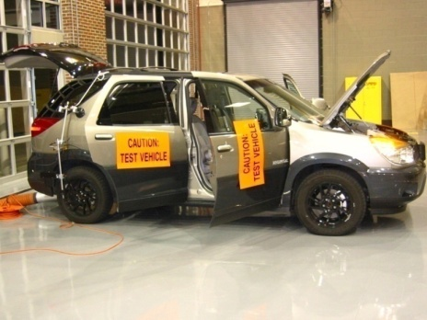
Medication Impairment & Driving Safety
PI: Vince Duffy IE/ABE. Motivation: Around 40,000 drivers die each year on US roads; 500,000 each year worldwide; younger & older drivers at highest risk; elderly take on average 7 medications; impairment due to medications is not well understood. Active safety systems can remediate impaired performance & could be prescribed.
Accurate driver models can enable Interactive Software that supports Vehicle-Vehicle (V-V) & Vehicle-Infrastructure (V-I) information system utilization. Together with In-vehicle sensor networks these can provide alternate control options, affect impaired driver performance, behavior & can extend quality-of-life.
Collaborators at Purdue include: graduate students & faculty in IE , faculty in ECE, Pharmacy, Psychology, CoE Sig. areas: ICPT, SoS, HE.
Strategic partners include: TASI-Transportation Active Safety Institute, NEXTRANS-DOT, Delphi Corp., IU Medical Center, Wishard Hospital, National Advanced Driving Simulator, U. of Wisconsin, MIT-Age Lab, Envision Center.
Builds on expertise in Digital Human Modeling – math, science & visualizations (from SAE-DHM, HCII-ICDHM ‘07, ’09, AHFE-ADHMI ’10) & Human Factors in Healthcare Eng. (RCHE ‘06-’09)
Funding opportunities with various agencies including NSF, NIH and Foundations.
Notes:
MSU Ranked 24th in research expenditures
Currently working with 8 graduate student research associates; 5 Ph.D. 3 M.S. (1 IE, 2 Ag&Bio – 2 graduating)
Virtual Layout – Award winning project 1997 – led to questions about the effectiveness of application

Slide 5
Computer Chess & Engineering Systems for K-4 – begins Friday, Oct. 2, 2009
Focusing on commonalities of chess and systems for coordinating man/people, machines, money, materials, methods
In cooperation with the Chess Clubs at Cumberland Elementary & Happy Hollow Schools in West Lafayette and parents including Nihayet Ersoy & Peri Gulen, Purdue Chess Team, Barnard Parham & Bernard Parham, Jr.
44 students signed up (level 1-21, level 2-8 and computer -15 students)

Slide 6
Computer Chess & Engineering Systems for K-4 – begins Friday, Oct. 2, 2009
Teaching Strategic Thinking & Systems Design
Chess shown to have benefits in later math & reading scores
The systems portion is intended to assist in fostering interest in engineering among K-12, especially in metropolitan areas that tend to be quite culturally diverse
Community service - students come to this region of the State of Indiana – previously considered to be the weakest/easiest path to State Championships in K-12
Systems Engineering modules can be available to K-4

