Slide 1
CEM 425: Construction Practice Project
Ebenezer Retreat & Camping Institute
2009 Educating the Engineer of 2020 Workshop: Environmental & Societal Impact of Engineering Practice

Slide 2
Course Objectives
To provide leadership opportunities to CEM Students Interns
To develop a Service Learning courses which are Multi-disciplinary
To demonstrate leadership and project management skills on a construction project.
To integrate industry and academic resources to address community needs (Engineer of 2020)

Slide 3
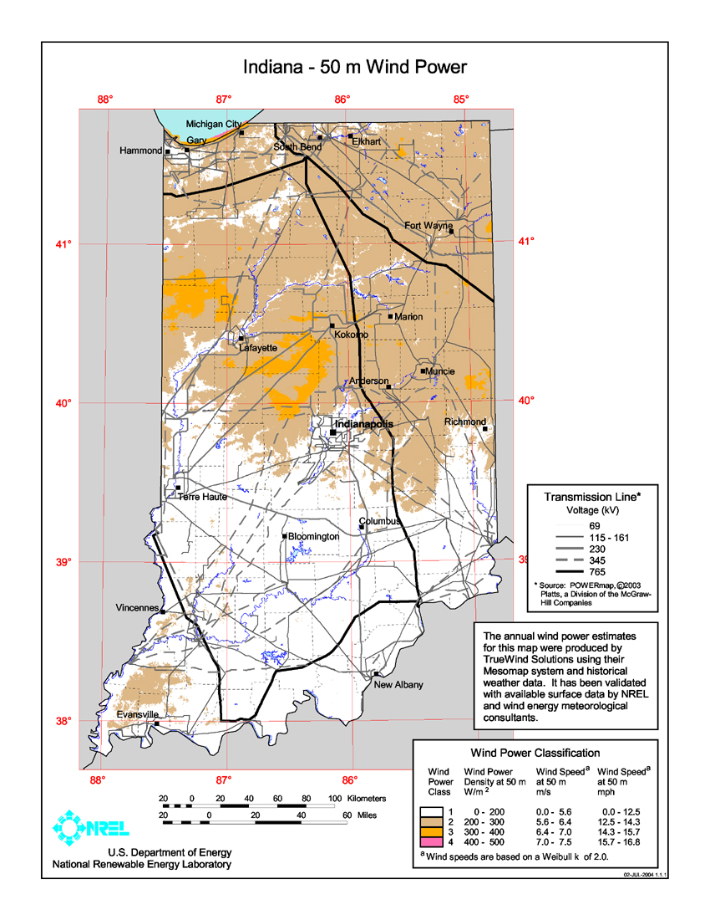

ERCI – Sustainable Energy Alternatives
Located in Roachdale, IN
46 Acres of Campground and related Facilities

Slide 4
Functional Teams
Infrastructure (Civil/Structure)
Utilities/Facilities (MEP)
Ergonomic (Architectural/Environmental)
Logistics (Site Access/Supply Chain)
Marketing (Programs/Income Potential)

